Slide 1
Making MAT Work
Darrin Mangiacarne, DO, MPH
Andrew Sonderman, MD

Slide 2
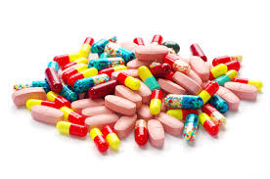
Prescription Drug Abuse
Newest problem in the field
Patients believe that they are “medications” and do not look at them as drugs
Pharmaceutical companies make a fortune selling a “pill for every ill”
Physicians need to be careful when prescribing controlled substances

Slide 3
Opioids and Pain
Opioid analgesia is effective for treating acute pain only
Drugs like Oxycontin and Fentanyl were designed to relieve suffering from cancer
Opioids do not improve function or lifestyle for chronic, benign back pain
Opioid narcotics are the 3rd most commonly prescribed drug class in the US, 244.3 million prescriptions annually

Slide 4
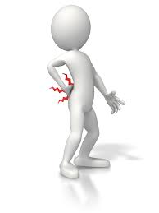
But I Have Pain
Long term opioid use lowers patients pain tolerance and actually causes pain
Opioid induced hyperalgesia
A month after being detoxed off opioids most patients are in less pain then they ever were on high doses of opioids
NSAIDS work

Slide 5
Pain Is Not a Vital Sign
The Joint commission added pain to be considered as a vital sign after intense lobbying
Purdue Pharma is responsible for producing Oxycontin
Marketed as being a “safe alternative” with “low abuse potential”
Notes:
Pain is not measurable

Slide 6
Medication numbers in prescriptions 2010 (in millions)
1. Hydrocodone/Acetaminophen Drug of abuse 131.2
2. Simvastatin 94.1
3. Lisinopril 87.4
4. Levothyroxine sodium 70.5
5. Amlodipine 57.2
6. Omeprazole 53.4
7. Azithromycin 52.6
8. Amoxicillin 52.3
9. Metformin 48.3
10. Hydrochlorothiazide 47.8
11. Alprazolam Drug of abuse 46.3
12. Lipitor 45.3
13. Furosemide 43.4
14. Metoprolol 38.9
15. Zolpidem Drug of abuse 38
21. Oxycodone/Acetaminophen Drug of abuse 31.9

Slide 7
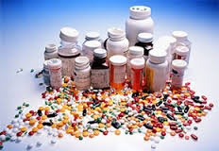
A Billion Dollar Industry (2012 Sales)
Oxycontin $2.695 billion
Suboxone $1.349 billion
Concerta $1.073 billion
Ambien $671 million
Ritalin $554 million
Lunesta $447 million
Adderall $429 million
Opana $299 million
Xanax $274 million
Vicodin $168 million
Fentanyl $161 million
Percocet $104 million

Slide 8
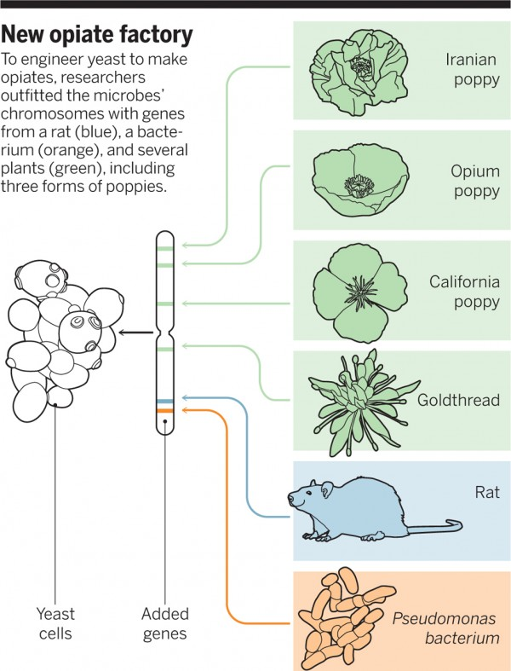
Modified Yeast Produce Opiates (Thebaine) from Sugar

Slide 9
MAT at Fairbanks
Antabuse
Campral
Naltrexone
Vivitrol
Suboxone

Slide 10
Naltrexone
Revia (oral)
Vivitrol (injection)
Mu opioid receptor antagonist
Indicated for alcohol and opioid dependence
Oral formulation 50 mg po q day
Depot formulation 380 mg IM q month

Slide 11
Naltrexone 2
Very effective therapy for cravings
Dampens dopamine release, which reduces euphoria associated with alcohol and drug use
There is a genetic component to its effectiveness with treating alcoholism

Slide 12
Naltrexone Side Effects
Hepatic impairment
Insomnia
N/V
Opioid withdrawal
Pregnancy Class C
Injection site reaction (Vivitrol)

Slide 13
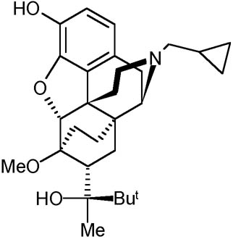
Buprenorphine

Slide 14
What is buprenorphine/naloxone?
Opioid mu receptor agonist with kappa receptor antagonist ability
Used for opioid maintenance
Schedule III controlled substance
Formulations:
Suboxone
Zubsolv
Bunavail

Slide 15
How does one prescribe?
Any licensed physician with a DEA number is eligible for the training program
Course takes approximately 8 hours and includes 12 courses
Can be taken online or live at a conference
Course registration costs $150

Slide 16
More on regulation
For the first year, a physician can only treat up to 30 patients in their practice at one time
After 1 year a physician may notify the DEA about intent to treat up to 100 patients
The limit is to encourage family practice physicians to use it to treat their own patients

Slide 17
Reasons Buprenorphine is preferable to Methadone
It has less potential for abuse
It is the first drug that can be used in a physician’s office to treat opioid addiction
Reduces stigma of drug addiction
It has a ceiling effect at higher doses
It has greater safety in overdose

Slide 18
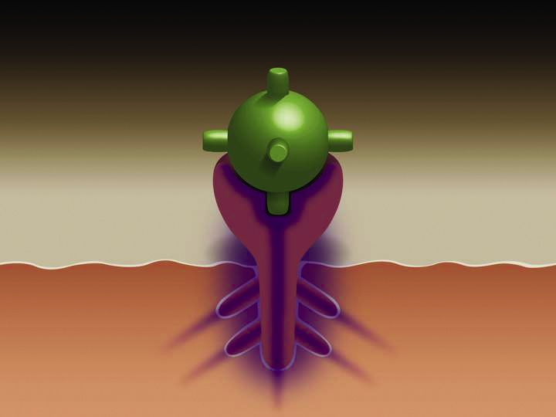
Perfect Fit - Maximum Opioid Effect
Empty Receptor
No Withdrawal Pain
Euphoric Opioid Effect
Neuro receptor satisfied with an opioid. The strong opioid effect from painkillers, or heroin, stops the withdrawal symptoms for a short time. (4-24 hours) The person is high. After prolonged use, the patient is no longer getting high as much as preventing the withdrawal symptoms.

Slide 19
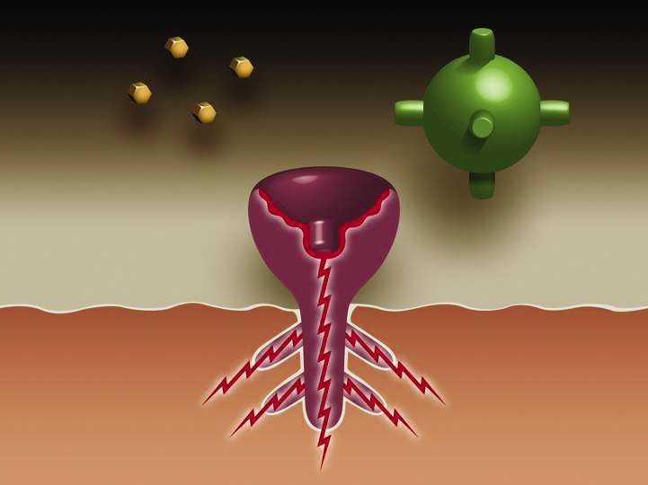
Opioid
Buprenorphine
Empty Receptor
Receptor Sends Pain Signal to the Brain
Withdrawal Pain
Neuro receptor in withdrawal and craving opioids. Once dependent the body cannot produce enough natural opioids to satisfy the many new receptors that were produced while taking large doses of opioids over time. The unsatisfied receptor sends pain signals to the brain. This is withdrawal.

Slide 20
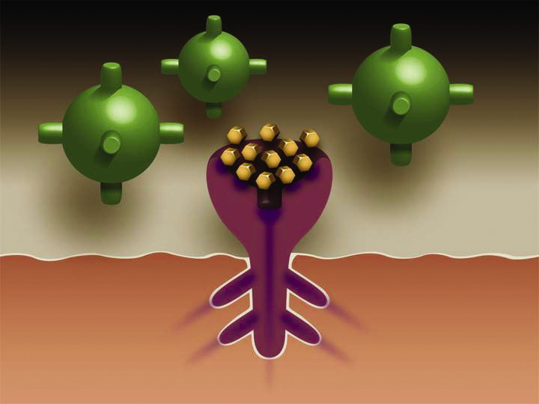
Imperfect Fit – Limited Euphoric Opioid Effect
Courtesy of NAABT, Inc. (naabt.org)
Opioids replaced and blocked by Buprenorphine. Opioids cannot get to the neuro receptor while occupied by Buprenorphine. The person no longer feels sick (in withdrawal) and is unable to get high even if he/she uses other opioids. Buprenorphine produces a limited opioid effect, and cravings are reduced or eliminated.

Slide 21
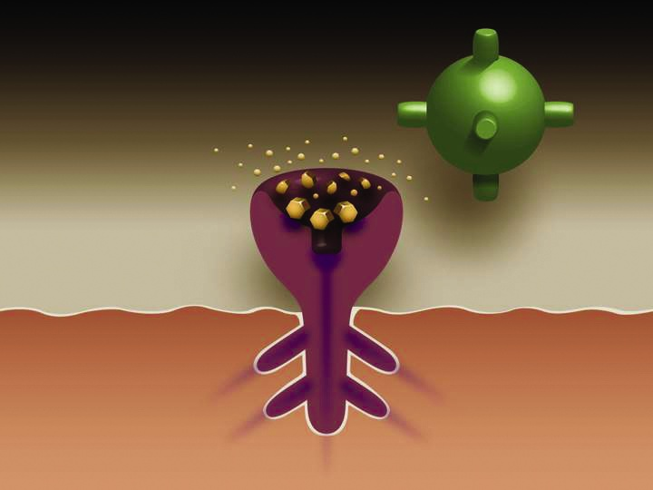
Buprenorphine Still Blocks Opioids as It Dissipates
Over time (24-72 hours) Buprenorphine dissipates, but still creates a small opioid effect (enough to prevent withdrawal) and still block opioids from attaching to the receptors. This means if someone were to take an opioid, they still would not get high.
Courtesy of NAABT, Inc. (naabt.org)

Slide 22
Ideal candidates
Diagnosis of opioid dependence
Have an appropriate understanding of Buprenorphine and are motivated
No active significant medical / psychiatric complications
Stable living environment
Participation in counseling

Slide 23
Maintenance Phase
Longest period of treatment (can last from 12 months to indefinitely)
Physician must still be aware of psycho social issues for patient
Success defined by goals set with patient
If patient desires to be chemical free in the future you can begin to decrease their dose by 2 mg/month and monitor

Slide 24
Buprenorphine Diversion
Patients may trade Suboxone on the street for heroin or other opioids
They will hold on to Suboxone and only use it when they are withdrawing
Naloxone component discourages IV use

Slide 25
Monitoring
Do not give more then a month’s supply at a time
Reasonable to give 1 week’s supply with 3 refills
Random, observed drug screens for compliance with treatment and to check for other drug use
Random pill counts (call patients back into office and check the number of pills left)

Slide 26
Buprenorphine Side effects
Pregnancy class C
Swelling
Headaches
Sweating
Nausea
Mood swings
Insomnia
Precipitated Withdrawal

Slide 27
Fairbanks programming
Supportive Living Program (SLP)
Therapeutic community housed in apartments near Fairbanks Hospital
25 apartments that house an average of 4 patients
Approximately 40% are opiate dependent
Patients must be enrolled in Fairbanks continuum of programming to live in the SLP Apartments.

Slide 28
Fairbanks programming
Outpatient programming
Partial hospitalization program (PHP)
Intensive outpatient program (IOP)
Recovery management

Slide 29
How we started
Suboxone was kept at SLP in a safe in an office and staff counted medications and attempted to manage
Issues involved controversy over the counts, inconsistent supervision, missing suboxone and burglaries
Process Improvement
Cameras installed
Added a nurse and tech staff to assist in monitoring and observation
Staff collaborated with multiple prescribing doctors

Slide 30
Desired Changes
Improve compliance
Decrease diversion
Increase retention in treatment
Improve treatment for our patients
How do we get there?

Slide 31
Existing Opioid Treatment Programs
US Methadone maintenance
Australia buprenorphine MAT

Slide 32
Australian MAT
Physician sees patient 2-3 days after initiating treatment, and every 2-3 days until a stable dose is reached
physician then sees patient every week for the following 4-6 weeks
then every 2-4 weeks until 6 months on treatment
Monthly to quarterly (every 3 months) thereafter for stable patients

Slide 33
Australian MAT
The patient goes to the pharmacy every day for daily dispensing of buprenorphine.
“No take away doses of buprenorphine should be considered until the patient has been in continuous treatment for a minimum of 6 months, has dosed regularly for 2-3 months, and has no contraindications present.”

Slide 34
Australian MAT
The dispensing pharmacist is required to assess whether a dose of Suboxone is appropriate and can withhold treatment when necessary (i.e. patient is intoxicated, there are concerns about diversion, patient has missed doses).
Pharmacist is required to notify prescribing M.D. about these concerns.

Slide 35
Fairbanks Opiate MAT
During medical stabilization period, patients review MAT options with physician
MAT plan is determined and mutually agreed upon.
If Buprenorhine is selected, contract outlining all expectations is reviewed and signed
Fairbanks physicians prescribe during outpatient care and assist in transferring to a primary care provider

Slide 36
Fairbanks MAT program
Clients reside in the Supportive Living Program
Clients must be involved in treatment programming and are prescribed medications by Fairbanks physician.
Clients do not have their medications in their possession
Pharmacy delivers each client one dose daily to staff
Staff observe each client taking their daily dose both a.m. and p.m.
Staff document and track missed doses
Staff report to physician any compliance concerns
Clients are drug screened

Slide 37
Naltrexone Supervision
Observe daily dosing of oral Naltrexone- crush pill to reduce incidents of non compliance
Coordinate and Monitor Vivitrol compliance
Add additional support during critical gap between last opiate use and Naltrexone initiation

Slide 38
Final Thoughts
Medications are not a cure for any addictive process
Please refer to appropriate counseling resources
Seeing patients come out of the fog of their addiction is very rewarding

