Slide 1
Pain Management and Opioid Safety Initiative at the Indianapolis VA
Nabiha Gill, MD
Chief, PMRS Pain
Indianapolis VA
Assistant Professor PM&R IUPUI

Slide 2
Objectives
Learning Final Indiana pain management prescribing rule and changes from the emergency rule
Learning about opioid safety initiative at the Indianapolis VA hospital
Learning Stepped care model and biopsychosocial model of pain management
Learning about PMRS chronic pain program at Indianapolis VA hospital
Learning non pharmacological pain management options

Slide 3
Chronic Pain
http://www.dvcipm.org/clinical-resources/joint-pain-education-project-jpep

Slide 4
Pain in Veterans
Pain is the most common physical problem affecting service members.
50% of male veterans report chronic pain.
>56% incoming veterans from present conflicts have musculoskeletal pain.
Over 40% of returning OEF/OIF veterans with TBI also have PTSD and pain.
Pain is among the most costly disorders treated in VHA setting.

Slide 6
Nonopioid Substance Use Disorders and Opioid Dose Predict Therapeutic Opioid Addiction
This article examines TOA in patients with chronic noncancer pain undergoing long-term opioid therapy. Results suggest that patients should be screened for nonopioid substance use disorders prior to prescribing. In the absence of improvement in pain or function, there is a low threshold (50 mg daily opioid dose) for addiction screening.
ª 2015 by the American Pain Society
Huffman et, al.

Slide 7
Risk of death from drug overdose increased with history of benzodiazepine prescription.
Design; Case-cohort study. Veterans Health Administration (VHA), 2004-09.
Participants: US veterans, primarily male, who received opioid analgesics in 2004-09. All veterans who died from a drug overdose (n=2400) while receiving opioid analgesics and a random sample of veterans (n=420 386) who received VHA medical services and opioid analgesics.
To study the association between benzodiazepine
prescribing patterns including dose, type, and dosing
schedule and the risk of death from drug overdose
among US veterans receiving opioid analgesics.
Main outcome measure
Death from drug overdose, defined as any intentional, unintentional, or indeterminate death from poisoning caused by any drug, determined by information on cause of death from the National Death Index.
Results
During the study period 27% (n=112 069) of veterans who received opioid analgesics also received benzodiazepines. About half of the deaths from drug overdose (n=1185) occurred when veterans were concurrently prescribed benzodiazepines and opioids. Risk of death from drug overdose increased with history of benzodiazepine prescription.
BMJ 2015;350:h2698

Slide 8
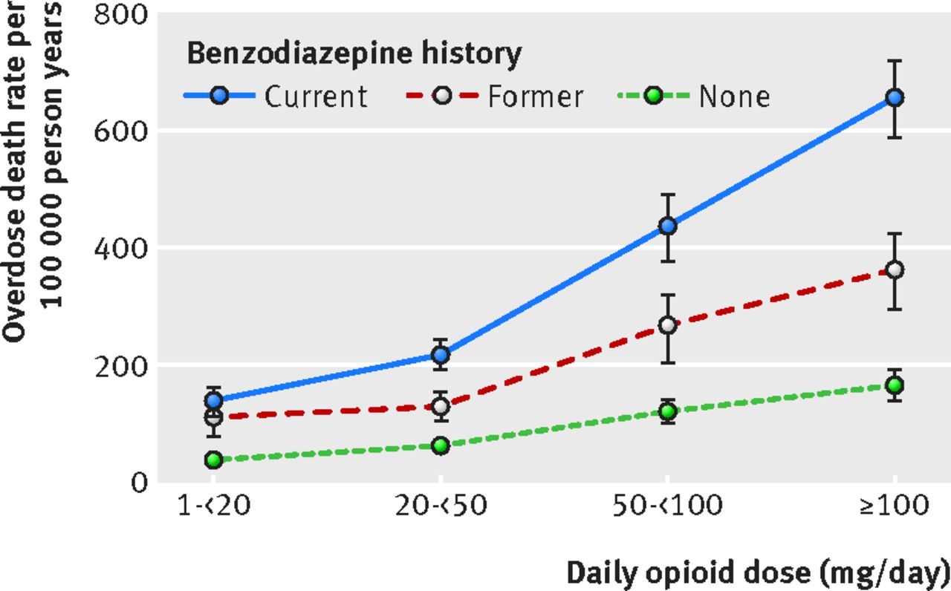

Slide 9
Methadone poisonings at 10 times the rate of other prescription opioid poisonings. Among nonmethadone opioid poisonings, 44% had chronic opioid use, 17% had prescribed doses in the week before the poisoning >120 mg/d morphine-equivalent dose (MED), 28% had doses <50mg/d MED, and 48% had concurrent sedative prescriptions.
Objectives: To examine changes in rates of methadone and other opioid poisonings after implementation of the WA State Opioid Guideline in 2007 and to examine the prescription history before poisonings.
Methods: The study sample consisted of individuals who had at least 1 paid claim for an opioid prescription in the Medicaid fee-for-service system between April 2006 and December 2010 and had an emergency department or inpatient hospital claim for an opioid poisoning.
Results: Conclusions: It may be prudent to revise guidelines to address opioid poisonings occurring at relatively low prescribed doses and with acute and intermittent opioid use. Research is needed to establish the best strategies to prevent opioid poisonings.
(Med Care 2015;53: 679–685)
Fulton-Kehoe et, al.

Slide 10
Significant variation in mean opioid conversions to MEQ doses within each profession type, particularly for fentanyl and methadone.
Conclusions:
“As evidenced by large standard deviations, there was significant variation in mean opioid conversions to MEQ doses within each profession type, particularly for fentanyl and methadone. The median MEQ doses provided for opioid conversions were the same among each profession. No universal method exists that allows each of the five studied opioids to be accurately and consistently converted to another opioid (i.e., morphine).”
Rennick et, al. Pain Medicine 2015

Slide 11
National Dissemination of Cognitive-Behavioral Therapy for Chronic Pain in Veterans Therapist and Patient-level Outcomes
Training in and implementation of CBT-CP in the VA health care system were associated with significant increases in therapist competencies to deliver CBT-CP and improvements in several domains for Veteran patients. Results support the feasibility and effectiveness of broad dissemination of CBT-CP in routine, nonpain specialty settings.
Stewart et, al. , (Clin J Pain 2015;31:722–729)

Slide 12
Medical Licensing Board Emergency Pain Management Prescribing Law went into effect 12/15/13

Slide 13
On October 6, 2014, the Drug Enforcement Agency (DEA) changed the status of hydrocodone containing products from Schedule III to Schedule II, making it more strictly controlled.

Slide 14
The Drug Enforcement Agency (DEA) has changed Tramadol to schedule IV

Slide 15
On Sept. 25 2014, the Medical Licensing Board of Indiana (MLB) adopted the final version of the opioid prescribing rule for chronic pain management, which became effective Nov. 2014.

Slide 16
Indiana Medical Licensing Board Emergency Pain Management Prescribing Rule
Any patient > 60 opioid pills x 3 months or 15 MED x 3 months
Exclusions include terminally ill, nursing home, palliative care & hospice care

Slide 17
Patient Visits
• No prescribing without periodic scheduled visits
• If medication and treatment plan are stable, face-to-face visits at least once every four months
• More frequent visits if still optimizing
• If changes are still being made to medication and treatment plan, visits at least every two months until stabilized
Informed consent for chronic opioid therapy
INSPECT
UDS
Opioid risk tool

Slide 18
Here are the changes from the prior emergency rule you will need to know.
Morphine-equivalent conversion
To eliminate the need for a morphine-equivalent conversion for one particular opiate, the final rule automatically applies to any patient who receives a transdermal opioid patch for more than three consecutive months. Due to safety concerns, it also applies to any patient who is prescribed a hydrocodone-only extended release medication that is not in an abuse deterrent form (first pill).
Additionally, at ISMA’s request pursuant to Resolution 14-45, tramadol is not included in the rule unless the patient receives a high dose - more than 60mg of morphine equivalent dose per day - for more than three consecutive months.

Slide 19
Here are the changes from the prior emergency rule you will need to know.
Informed consent
Informed consent has been expanded in three ways:
Discuss with the patient safe storage practices for prescribed opioids.
Require the patient to disclose if they are drinking alcohol while taking opioids.
Provide written warning to patients prescribed hydrocodone-only extended release medication that is not in an abuse deterrent form that discloses the risks associated with taking extended release medications.
Now, the physician is required to perform or order a drug monitoring test, including a confirmatory test any time the physician determines that it is medically necessary. Unlike before, the frequency is not specified.”
To determine medical necessity, physicians must consider 17 specific factors and an 18th catch-all provision. The MLB clarified that a confirmatory test must use a method selective enough to differentiate individual drugs within a drug class.

Slide 20
VA Pain Initiatives

Slide 21
PMRS Pain program is trying to change the pain management culture from a bio-medical model to bio-psych-social model at the Indianapolis VA.

Slide 22
There has been 33.8% drop in high dose opioid prescriptions at Indianapolis VA since August 2013.

Slide 23
Indianapolis VA Chronic Opioid Rx Data

Slide 24
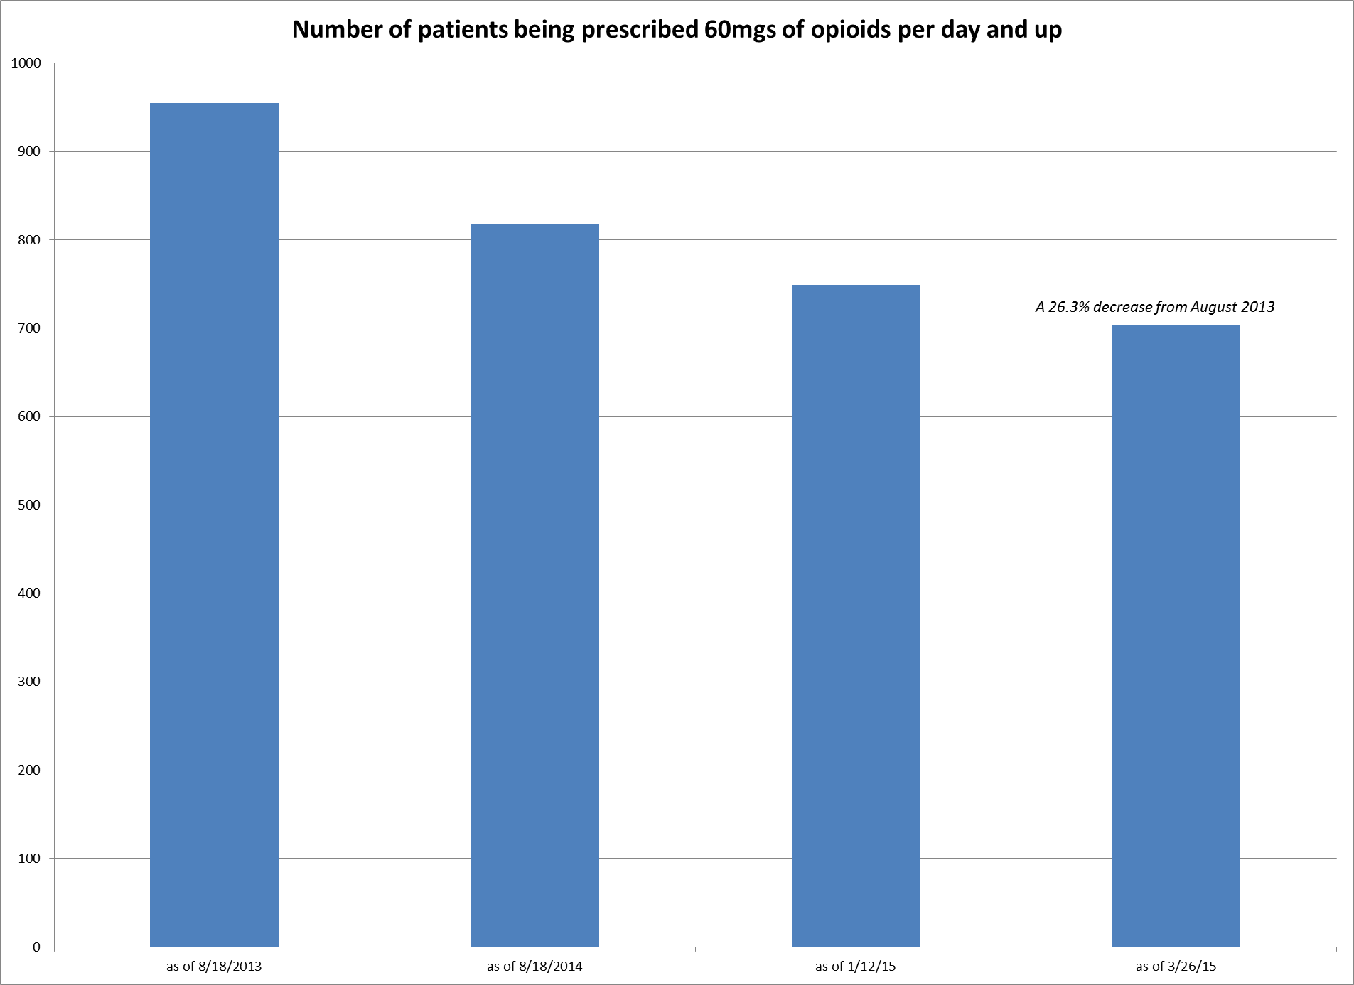

Slide 25
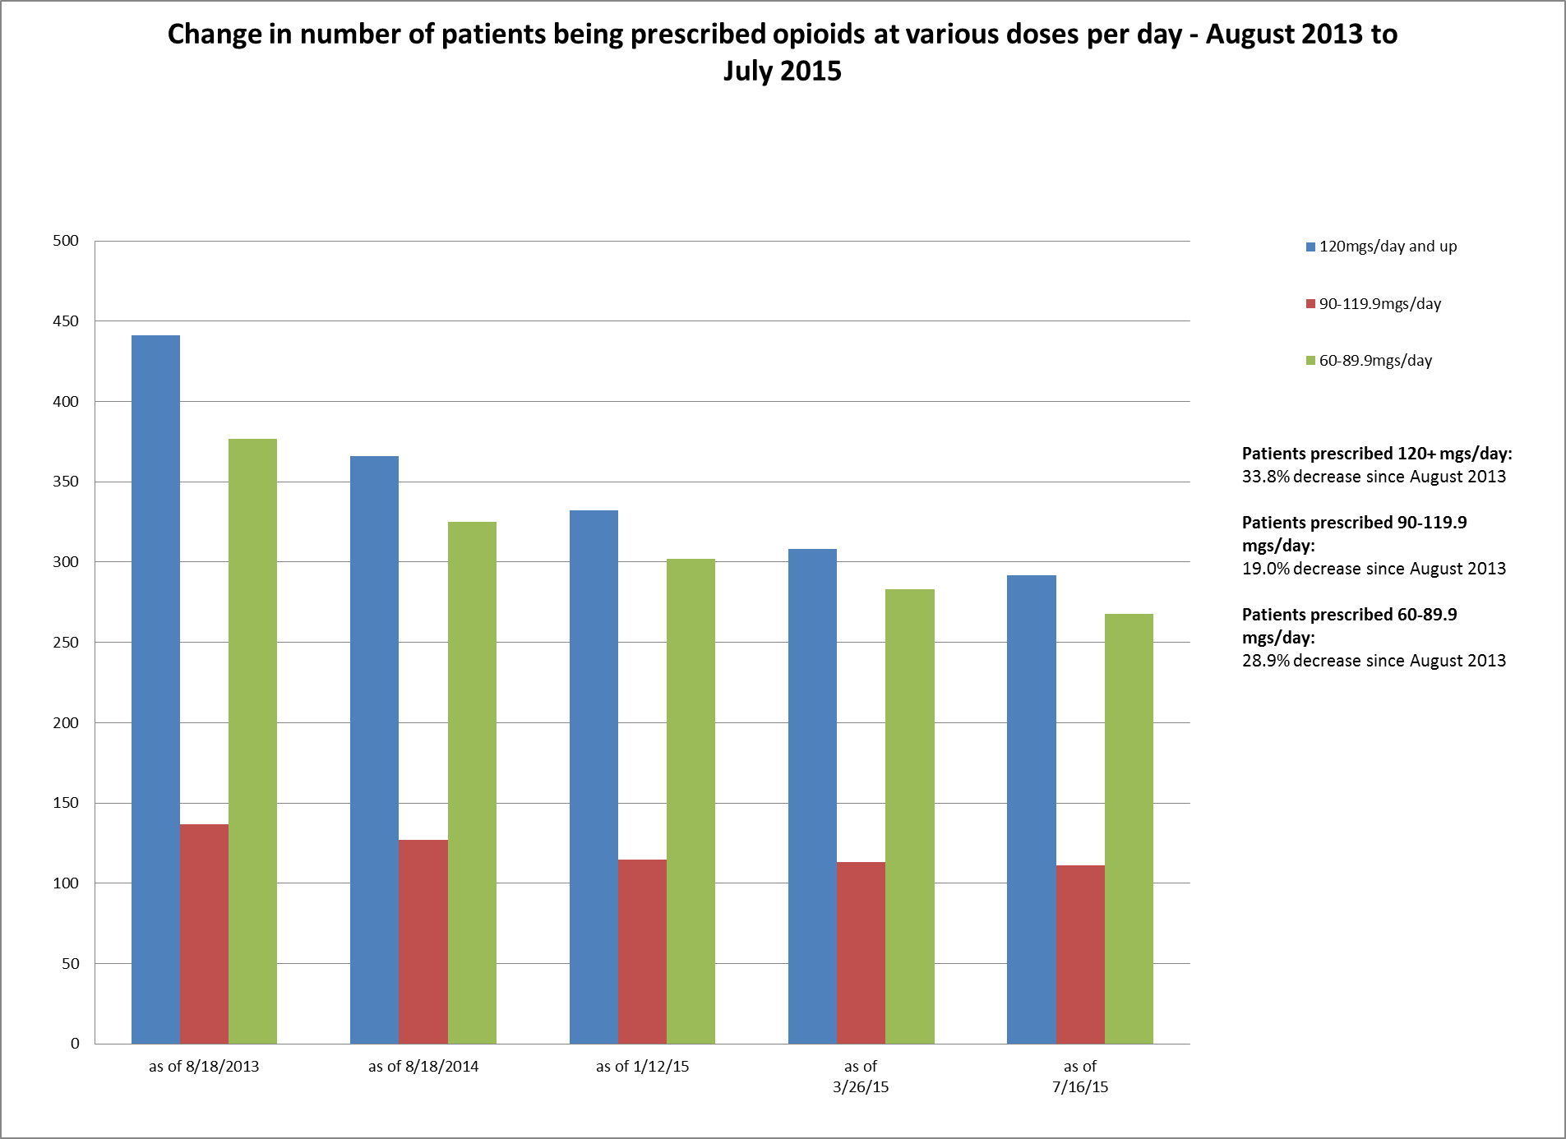

Slide 26
Stepped Care Model for Pain Management
Indianapolis VA
Tertiary Level
Secondary Level
Primary Level

Slide 27
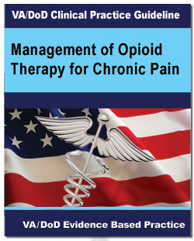
Management of Opioid Therapy (OT) for Chronic Pain (2010) http://www.healthquality.va.gov/guidelines/Pain/cot/

Slide 28
Opioid Safety Initiative (OSI)
Providing facilities with data on opioid and Benzo use at their facilities with guidance on how to help providers manage unsafe practices for pain management.
Ongoing monitoring of opioid use and safe practices.
OSI Toolkit to assist with practice transformation and support team in management of complex pain patients on high risk med combos.
IMED Consent Directive
Opioid therapy risk report

Slide 29
Opioid Safety Initiative (OSI)
The key clinical indicators measured by the OSI;
Percent of Veterans dispensed an opioid over time
Percent of Veterans dispensed an opioid and a Benzo over time
Percent of Veterans opioids long-term with a urine drug screen completed over time
Stratification of the percent of Veterans dispensed MED
Composite score

Slide 30
OEND Program
Opioid Overdose Education & Naloxone Distribution

Slide 31
To date, 100 reversal events using VA-prescribed Naloxone kits have been reported!
Veterans’ lives are being saved!

Slide 32
Opioid safety and chronic pain management efforts at Indianapolis VA
PMRS Pain program
Pain policy/opioid policy
OSRC members
OSRC meetings
OSI chart reviews
Pain clinical reminders (drug testing, INSPECT, EKG, ORT)
Opioid safety 101
ER SOP
Opioid agreement directive, facility MCM, standard national consent and "Opioid Safety" document.
Pain seminars, pain in-services, monthly PCP meetings, grand rounds
PCP invitation to OSRC
PCP invitation for presenting complex pain cases in weekly meetings
Weekly meeting IDTs with addiction psych/psych
Pain education class
EKG if Methadone
Pain school
Patient education
>120 mg per day
Tai chi
Yoga
CAM
Web based patient education
Art
Benzo and opioid
Take back envelopes
Leadership support
Huddle PDSA (Plan do study act)

Slide 33
PMRS (Physical Medicine Rehab Service) Chronic Pain Program
Gender: 85% males; 15% females
Age: 75% of clinic patients are ages 50-69 years of age

Slide 34
PMRS Chronic Pain Program, Indianapolis VA
Interdisciplinary pain rehab program
Bio-psycho-social model
Multi-modal model approach
Physician, nurse practitioners, pain psychologists, physical therapist, recreational therapist, pharmacist, social workers, support staff all working together to help these complex chronic non-cancer pain patients.
UDS with opiate confirmation, INSPECT , Opioid treatment agreement, previous pain related medical record, frequent face to face visits
We try to maximize non-opioid and non-pharmacological pain management strategies, multi modal approach like pain CBT, tai chi, yoga, acupuncture, chiropractic treatment, pain school, creative art therapy, relaxation strategies, mindfulness, guided imagery, physical therapy, aquatic therapy, weight loss program (for obesity), gradual walking program, back education classes, self-management strategies to just name a few.
Several opioid risk tools, functional assessment and mental health screening tools.
Functional goals
Weekly case conferences
Team approach
Collaboration with addiction treatment program
Medical, mental health and chemical dependency issues are initially assessed as a prerequisite to further treatment.
Naloxone rescue kits are issued by our program for high risk chronic pain patients. Patients are caregivers get scheduled with our pain pharmacist for education as well.

Slide 35
Risk assessment tools
Pain Outcome Questionnaire- short form (POQ-SF)
SOAPP version 1.0-SF Score
Mental Health Screening Tool (The Patient Health questionnaire-9) PHQ-9
Opioid Risk Tool (ORT)
Drug Abuse Screening Test (DAST-10)
Generalized Anxiety Disorder (GAD-7)
Risk index (assessment) for overdose or serious opioid-induced respiratory Depression (RIOSORD)
PCS (Pain catastrophizing scale)

Slide 36
PMRS Pain Program Compliance
100% compliant with opioid consents
100% compliant with drug testing
100% compliant with checking INSPECT

Slide 37
Tertiary level Self-Management Program
Evidence-based treatment program designed to empower participants to take an active role in their pain management plan. This program is aimed toward patients who are ready to change current behavior and engage in treatments geared toward the improvement of quality of life and daily function.
Providers (including licensed psychologist, recreational therapist, and physical therapist) use a biopsychosocial approach that will provide participants with skills and tools that can be used for lifelong self-management of persistent pain.
The program consists of twelve treatment sessions held on Tuesdays and Thursdays for six weeks. We focus on functional goals in PMRS Pain program.

Slide 38
Non-Pharmacological pain management resources

Slide 39
Non-Pharmacological pain management resources
Acupuncture
Alpha-Stim M device
Aquatic therapy
Chiropractor
Creative Arts
Equine therapy
Pain CBT groups
Pain ACT groups
Mindfulness-Based Stress Reduction (MBSR)
MOVE/TeleMOVE
PAIRS Warrior to Soul Mate Workshops
Pedometers

Slide 40
Non-Pharmacological pain management resources
Physical Therapy Recreational Therapy-Creative arts group sessions.
Reiki therapy
StressEraser Relaxation Training and Stress reduction device
Tai Chi Class
TeleHealth Chronic Care Pain School
TENS
Yoga Class

Slide 41
Thanks

