Slide 1
Handling Iatrogenic Disasters in Prescription Drug Abuse
Allen County Providers Respond
Prescription Drug Symposium
October, 2015

Slide 2
The Crisis
Deborah A. McMahan, MD

Slide 3
Agenda
Issue
Solutions
Why Worry?
Provider Perspective

Slide 4
Issue

Slide 5
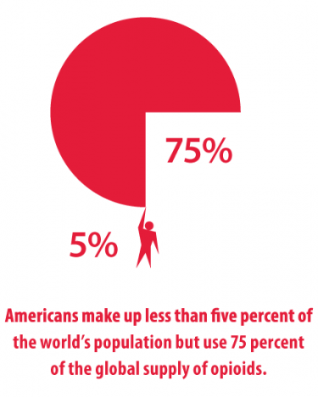
http://www.dmu.edu/wp-content/uploads/2014/11/american-opioid-usage-375x468.png

Slide 6
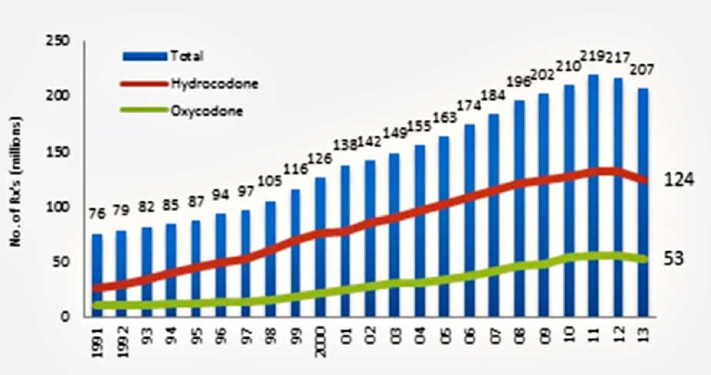
Opioid Prescriptions Dispensed by US Retail Pharmacies
https://d14rmgtrwzf5a.cloudfront.net/sites/default/files/4-2014-testimony-fig1.jpg

Slide 7
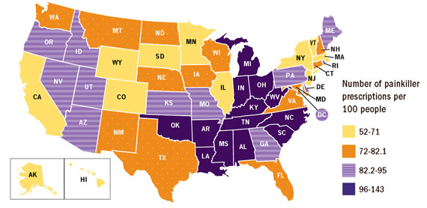
State Painkiller Prescriptions per Person
http://www.cdc.gov/media/releases/2014/p0701-opioid-painkiller.html

Slide 8
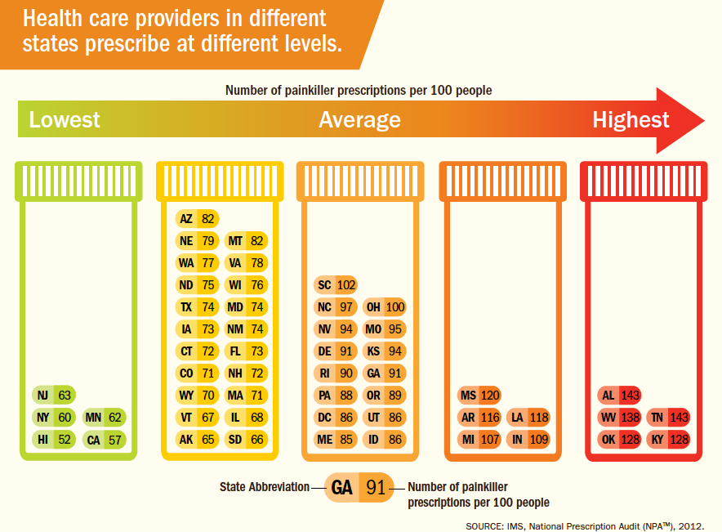

Slide 9
Issue
In October the Attorney General’s Office filed a petition seeking to immediately suspend one of our local pain docs medical license, alleging he had engaged in conduct that jeopardizes patient safety, including falsifying medical records, falsifying prescriptions, and utilizing dangerous prescribing practices.
He operated 11 clinics in NE Indiana

Slide 10
Issue
In early December our local medical society (and pain docs) began to receive calls from patients reporting that his clinics had closed suddenly.
We began to receive calls about what we the medical community was going to do about the situation.

Slide 11
Scope of the Problem
We invited providers from various areas to participate including
  Primary Care
  Pain Medicine
  ER docs
  Health Admin
  Mental Health and Addiction
  Law Enforcement
  Pharmacy

Slide 12
Scope of the Problem
Providers estimated that he served approximately 5,000 to 10,000 patients.
Dan will discuss the issues related to the patients.
Realized we were limited because we did not know how many patients he really had and who their primary care docs were

Slide 13
Scope of the Problem
Also, law enforcement is telling us that we are seeing unprecedented heroin use in our community
And by the way – did I mention we were in the middle of one of the worst flu seasons in a decade?

Slide 14
Painful Solutions
First, was to let folks vent
Understand the patients who would need care (Dan)
Realized that the primary care docs and pain docs would both have to shoulder this burden.
Mental Health and Addiction were right there and willing to see patients but providers did not know how to connect patients (Marcia, Connie and Kristina)

Slide 15
Good News
New Prescribing rules gave cover to physicians in that they could not simply continue the pain doc’s treatment plan, but rather had to perform their own assessment.
  We highlighted this in the news extensively

Slide 16
Good News
We felt that primary care could do the following:
  Assess patient and either:
    Continue existing plan
    Continue or reduce current meds and refer to pain for further evaluation and treatment
    Discontinue meds and begin detox or refer for opioid replacement therapy

Slide 17
Equip
Equip the providers to handle the situation
Created a short toolkit that provided quick info on:
  Appendix A: Opioid Withdrawal and Treatment Options
  Appendix B: Detoxification Medications
Crisis Pain Management Toolkit
for Allen County Healthcare
Providers
A Guide for Handling Pain Clinic Patient Overflow

Slide 18
Equip
Equip the providers to handle the situation
Created a short toolkit that provided quick info on:
Appendix C: Physical dependence, Dependence, and Addiction
  Appendix D Local Addictions and Mental Health Providers
  Appendix E: TITLE 844 MEDICAL LICENSING BOARD OF INDIANA
  Appendix F: Safely Discontinuing Opioid Analgesics

Slide 19
Educate and Inform the Media
Media Roundtable
Rather than a press conference we scheduled 30 min appointments with various media folks and gave them a synopsis of the situation, solution and important messages from local experts.
  Pain, Primary Care, Law enforcement and Pharmacy and Mental Health/Addictions
On camera interviews with local experts.

Slide 20
Feedback
Patients
Providers
Everybody was unhappy
We received a number of calls and emails for help for the next month
Some providers really stepped up to the plate

Slide 21
Why Worry?

Slide 22
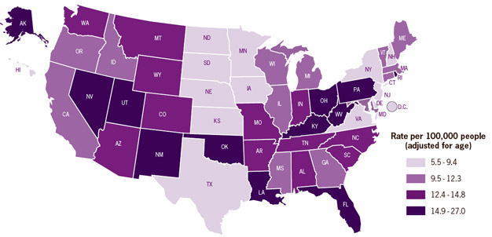
Drug Overdose Death Rates by State
http://www.cdc.gov/VitalSigns/PainkillerOverdoses/images/state-info-mapB_626px.jpg

Slide 23
Methodology
Collaborative Study
  Fort Wayne-Allen County Department of Health
  Allen County Coroner’s Office
  Fort Wayne Medical Education Program
Lutheran Hospital of Indiana IRB
Reviewed Death Certificate
Reviewed Coroner’s File
  Coroner’s Report
  Toxicology Report
  Police Report
  Other Documents
Notes:
This study was a retrospective descriptive study of deaths that occurred in Allen County, Indiana from 2008 to 2013 that resulted from drug overdose. It included anyone whose death was a direct result of drug overdose, regardless of whether it was intentional or accidental.

Slide 24
Overdose Rates
287 Overdose Deaths
2010 Allen County Overdose Death Rate 12.9 per 100,000
2013 Estimated Overdose Death Rate: 17.1 per 100,000
In 2013 Overdose deaths equal Motor Vehicle Deaths
  11% Increase in MVA deaths over study period versus 55% increase in OD deaths.
Notes:
Accidental may be falsely high due to the fact we did not consider a death intentional unless there was evidence at the scene of death/ determined by the police/ coroner’s investigation.
2008 Rate: (40 deaths/350,523 estimated population)*100,000=11.4
2010 Rate: (46 deaths/355,329 population)*100,000 = 12.9
2013 Rate: (62 deaths/363,014 estimated population)*100,000= 17.1

Slide 25
Age
Notes:
Average Age: 43 Median Age: 45 This graph uses the CDC age classifications.

Slide 26
Gender

Slide 27
Race
Notes:
12% AA
1% other
87% White

Slide 28
Demographics
Marital Status
  25% Married
  74% Single
    36% Never Married
    31% Divorced
    5% Widowed
    2% Married, Separated

Slide 29
Demographics
Employment
  64% Employed
  18% Unemployed
  4% Student
  9% Disabled
  5% Unknown

Slide 30
Education
Notes:
89% had some college or less
11% had completed college.

Slide 31
Manner of Death by Age
Intentional
Accidental
Notes:
Age distribution of intentional deaths by overdose is age dependent.

Slide 32
Notes:
We looked at if other people where present for Narcan kit would be helpful

Slide 33
Notes:
This is with methadone/ tramadol/ fentanyl in their own categories
OTC stimulates = caffeine
Opioids were found in over 70% of the study population (when methadone, fentanyl and tramadol are included in the opioid group as a whole).
Benzodiazepines were found in half of the study population

Slide 34
Why Worry?

Slide 35
Heroin
The only increases in past year heroin use were observed among persons who reported past year nonmedical use of opiates (not prescribed for them).
In a sample of heroin users in a treatment program, 75% of those who began opioid abuse after 2000 reported that their first regular opioid was a prescription drug.
http://www.cdc.gov/mmwr/preview/mmwrhtml/mm6339a1.htm

Slide 36
Heroin
It is estimated that about 23 percent of individuals who use heroin become dependent on it.
Heroin can be injected, inhaled by snorting or sniffing, or smoked.
Studies indicate an increasing problem with fatal overdoses from heroin from 2010 to 2012.
http://www.drugabuse.gov/publications/drugfacts/heroin

Slide 37
Heroin
This ain’t your Momma’s heroin
More potent
Laced with fentanyl
More overdoses
Officials in Chicago suspect heroin laced with fentanyl responsible for 74 overdoses in three days
http://www.drugabuse.gov/publications/drugfacts/heroin

Slide 38
Key Points
Iatrogenic problem – we need to help solve it
Collaboration is key
Great opportunity to re-assess these patients and offer a fresh new perspective and treatment plan that will lead to increased productivity and functionality.

Slide 39
Public Safety Consequences of the Opiate Crisis
Captain Kevin Hunter
Sgt. Mark Brooks

Slide 40
Heroin Update
Captain Kevin Hunter
Fort Wayne Police Department
Vice & Narcotics Division

Slide 41
Scope of Problem 2009-2014
Heroin Seizures 2009 – 2014
2009 43.23 grams
2010 96.10 grams
2011 108.10 grams
2012 123.92 grams
2013 150.10 grams
2014 157.50 grams (+ 8 Kilos DEA Case)
Price of Heroin = $15 - $20 per point (Point = .10 grams)
Oxycontin = $30 - $60 per pill (prior to reformulation)

Slide 42
Scope of Problem 2015
2015 Seizures (January – July) 284.8 grams
Fentanyl (June & July) 13.7 grams

Slide 43
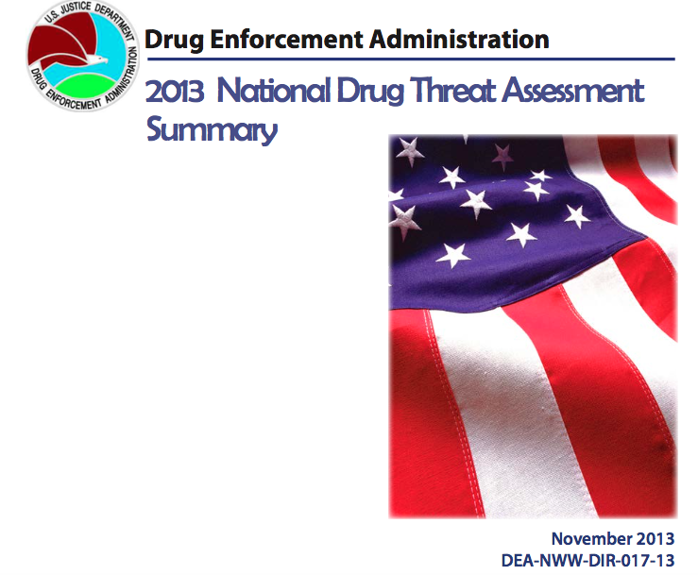

Slide 44
2013 NDTA-Heroin
The availability of heroin continued to increase in 2012, likely due to high levels of heroin production in Mexico and Mexican traffickers expanding into white powder heroin markets in the Eastern and Midwest United States.
Further, some metropolitan areas saw a recent increase in heroin overdose deaths. Law enforcement and treatment officials throughout the country are also reporting that many prescription opioid users have turned to heroin as a cheaper and/or more easily obtained alternative to prescription drugs.

Slide 45
2013 NDTA-Heroin Overdoses
Availability of High-Purity Heroin
  LEO’s reporting an increase of high purity heroin at the street level
People are switching from abusing prescription drugs to abusing heroin
  LEO’s & Treatment Officials report people first used heroin after having abused prescription opioids
  Turned to heroin because it was cheaper and easier to obtain than prescription drugs

Slide 46
2013 NDTA-Heroin Overdoses
More people are using heroin and at a younger age
  In 2011, the average age at first use among heroin abusers aged 12 to 49 was 22.1 years and in 2010 it was 21.4 years, significantly lower than the 2009 estimate of 25.5 years

Slide 47
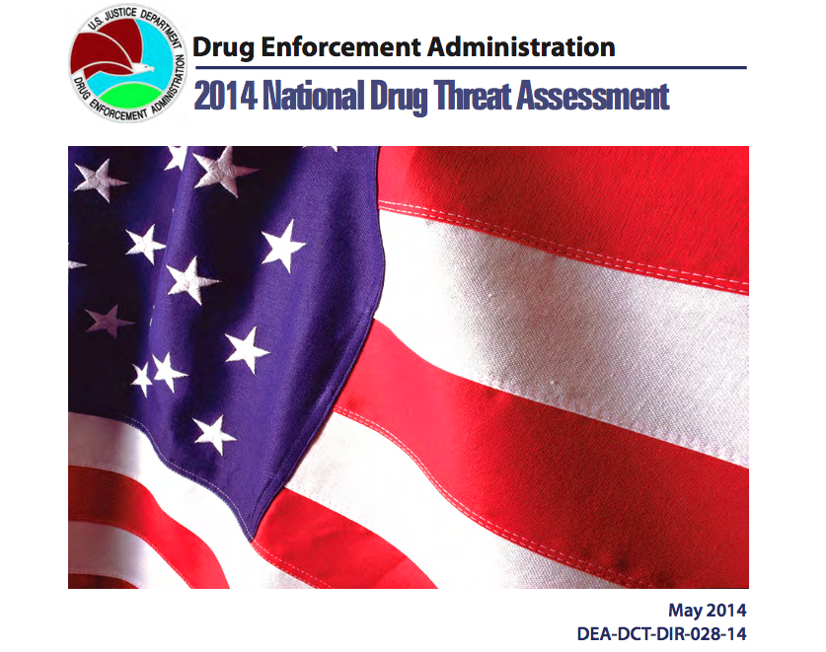

Slide 48
2014 NDTA
Heroin abuse and availability are increasing, particularly in the Eastern United States.
There was a 37 percent increase in new heroin initiates between 2008 and 2012.
Increased demand for heroin is largely being driven by prescription drug abusers switching to heroin because heroin is more available and less expensive.
Further, some OxyContin® abusers switched to heroin after the reformulation of that drug made it more difficult to abuse.

Slide 49
2014 NDTA
Many cities and counties across the United States, particularly in the Northeast and Midwest, are reporting increasing heroin overdose deaths.
Some areas are also reporting overdoses due to heroin tainted with fentanyl or fentanyl being sold as heroin. Fentanyl is much stronger than heroin and can cause even experienced abusers to overdose.

Slide 50








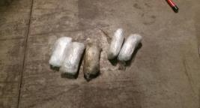
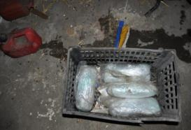
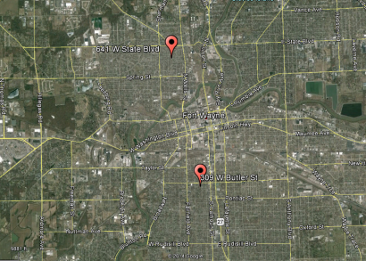


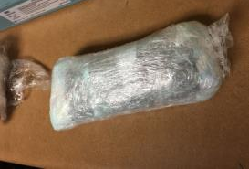


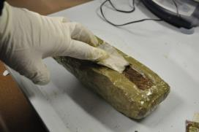

NOBLE
Operation Hoosier ICE
Arrests and Seizures 12/17/2014

Slide 51
Recent Developments
It would appear that we are in the midst of an opiate epidemic!
While synthetic cannabinoids and meth are still prevalent in Fort Wayne, the overwhelming abuse trend in the last year has been heroin
In the last few months, there have been 5 overdose deaths that we know of
  Three from the same dealer…

Slide 52
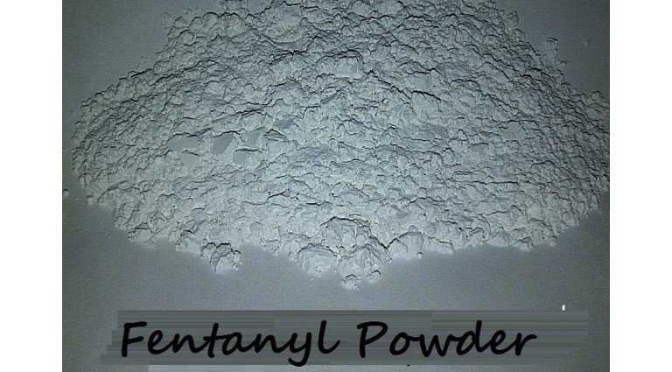
Recent Developments

Slide 53
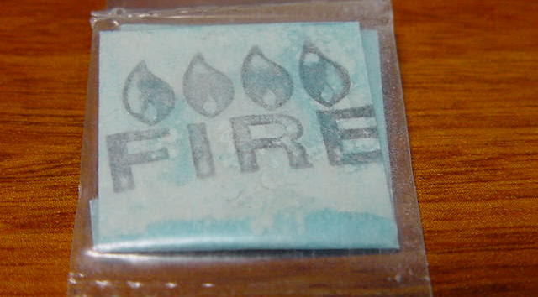
Recent Developments

Slide 54
Recent Developments
We have arrested one dealer who admitted to previously being a patient of Dr. Hedrick
We have been told that most people who use heroin start abusing through snorting
Most abusers end up using needles…
We have had six pharmacy robberies in the last six months (Two in the last two weeks…)
We are seeing all walks of life abusing this drug!

Slide 55
Recent Developments
Most recently, the product being sold as heroin in Fort Wayne has turned out to be Fentanyl
We are currently seeing Fentanyl as a fine white powder with an orange or pink tint
It looks very similar to powdered cocaine
In some cases Fentanyl has replaced heroin altogether
Dealers are even warning their buyers to “be careful and not use this alone…”

Slide 56
Recent Developments
FENTANYL
  Fentanyl is a potent, synthetic opioid analgesic that has been used as a pain reliever and anesthetic and is a schedule II substance under the Controlled Substances Act
  Fentanyl can be absorbed into the body via inhalation, oral exposure, ingestion, or skin contact.
  Due to its rapid rate of absorption into the human body, reports indicate that 100 to 150 micrograms (0.1 to 0.15mg) of pure fentanyl can be deadly
    Visibly, that amount is about the size of a few grains of table salt

Slide 57
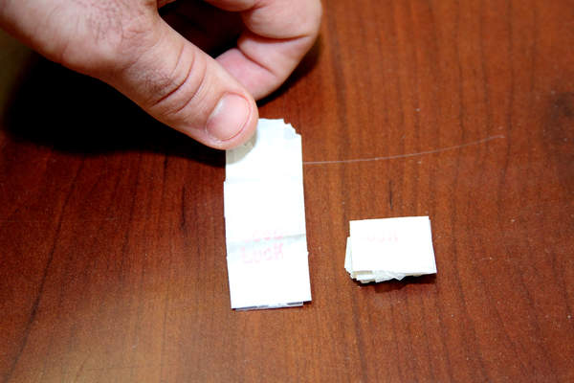
Recent Developments
We are seeing Fentanyl packaged in folded up pieces of paper

Slide 58
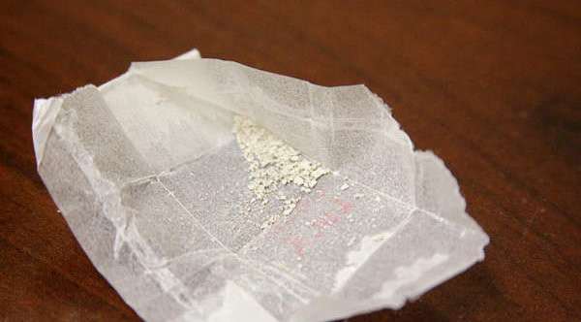
Recent Developments

Slide 59
Recent Developments
FWPD uses a new device called “TruNarc” that uses Ramen Spectrometry
Without this device it would take weeks, if not months to learn what drugs we are dealing with
We have been told that the current epidemic of Fentanyl is a national problem as well. Our drug testing company has been getting bombarded with drug scans that all have returned positive for some form of Fentanyl

Slide 63
Questions?

Slide 64
Thank You!
Captain Kevin Hunter
Office Telephone: 427-2081
E-Mail: kevin.hunter@cityoffortwayne.org

