Slide 1
Firefighters/EMT Begin to Carry Narcan
Mike Brown
Doug Call

Slide 2
Clinical Perspective
“Handling 5,000 patients,
one patient at a time”
Daniel C. Roth, DO, MBA, MS
Summit Pain Management
Fort Wayne, Indiana

Slide 3
The Problem
Over 5, 000 patients were being seen by clinicians/providers (MD/NP/PA/RN) who had very little to no advanced training or collaboration in pain medicine
Patients were not being appropriately assessed for risk, comorbid psychological diseases, and appropriate interventional care
Generic/Sham interventional procedures were being performed

Slide 4
The Problem (continued)
When the patient got no real benefit, the provider seeing the patient in follow-up would act to “try to alleviate” the patients pain. This resulted in a very clear and obvious trend of dose-escalation of opioid medications and other concomitant medications.
Patient would unknowingly become more and more “dependent and tolerant” of their opioid medications (not necessarily addicted)

Slide 5
The Problem (continued)
Many patients had no imaging (MRI/CT, etc) and no real plan of care for short, moderate and long term, safe and effective pain management.
Thus, when the practice was closed abruptly, thousands of opioid dependent/tolerant and some addicted patients were turned loose to “fend for themselves” (PCP, friends, the street)

Slide 6
The Solution
The team of the Allen County Health Department, community ERs, some PCPs, and (surprisingly) few Pain Management Practices……. All stepped up to try and care for these patients
Full assessment of these patients included their complete history and physical, current medications, proper pain generator diagnosis and closely working with a mental health professional.

Slide 7
The Solution
Once a full assessment had been completed, the patient was then started on an evidence-based treatment plan
Approximately 1/3 of all patients seen were weaned or immediately discontinued from opiate medication
Approximately 1/3 had drastic changes to dosages
Approximately 1/3 stayed at their current dosage while a functional treatment plan was established.

Slide 8
Outcomes
Most of the patients referred to us by PCP, ER, Allen County Department of Health, self-referral, stayed in our practice.
Many of them are on significantly lower or no opioid medications
Some of the patients who had severe aberrant behaviors or addictions got into appropriate mental health treatment, albeit with significant issue (insurance, etc)

Slide 9
Outcomes
Many patients were treated with the appropriate interventional procedures including;
Transforaminal Epidural Steroid Injections
Facet Joint Rhizotomies
Kyphoplasty
Spinal Cord Stimulation

Slide 10
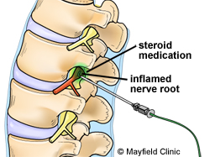
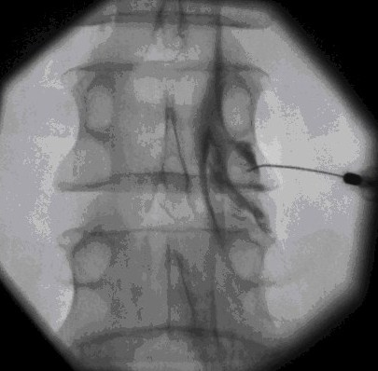
TFESI

Slide 11
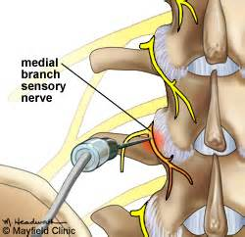
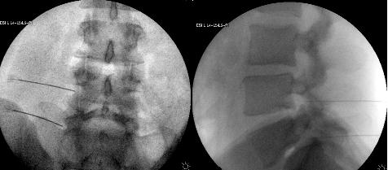
Facet Joint Rhizotomy

Slide 12
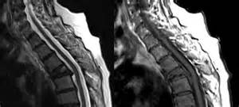
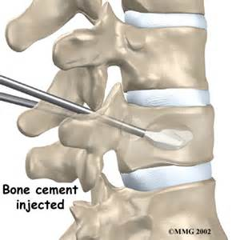
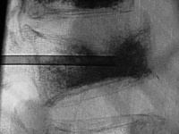
Kyphoplasty

Slide 13
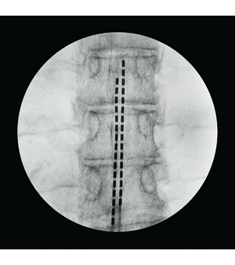
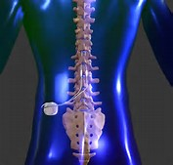
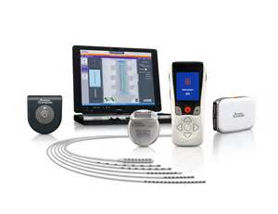
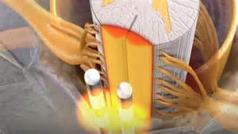
Spinal Cord Stimulator

Slide 14
Key Points
Crisis required collaboration
Careful assessment of these patients revealed many therapeutic opportunities that had not previously been utilized.

Slide 15
Mental Health Response – Facilitating Providers Referrals for Addiction
Kristian Johnson
Connie Kerrigan
Marcia Haaff

Slide 16
Clinical Response
Care Navigators
800 Number
Partial Hospitalization for Addiction
Faith Based Intensive Outpatient Program
Pain Management Program (Cleveland Clinic Model)
Partial Hospitalization for Pain Management (in development)

Slide 17
Mental and Behavioral Health Needs Assessment Recommendations
Address issues of access, including:
Improving resource and referral networks;
Sustaining care until positive therapeutic outcomes can be realized;
Balancing personal cost and investment with realities
Expanded and accessible services beyond case management and intake assessments in non-urban counties’

Slide 18
Mental and Behavioral Health Needs Assessment Recommendations
Address issues of access, including:
Address needs of families with mental illness amongst family members;
Seeding a systemic approach;
Supporting schools to become reliable referral resources;
Addressing stigmatization

Slide 21
Reducing the Risk of HIV and Hepatitis C Needle Exchange Program
Deborah A. McMahan, MD

Slide 22
Why Needle Exchange Program
Well if things weren’t bad enough …
In Scott County (pop 4,500) over 180 cases of HIV (most co-infected with Hepatitis C) identified
Largest IVDU related HIV outbreak in decades – IN THE COUNTRY
Now what?

Slide 23
Needle Exchange Program
A needle exchange program (NEP) is a harm reduction strategy that allows injecting drug users (IDUs) to obtain hypodermic needles and associated paraphernalia at little or no cost.

Slide 24
Principles of Harm Reduction
"Harm reduction” aims to keep people safe and minimize death, disease, and injury from high risk behavior.
Harm reduction involves a range of support services and strategies to enhance the knowledge, skills, resources, and supports for individuals, families and communities to be safer and healthier.

Slide 25
The Process to Open in Indiana
Senate Bill 461 outlines process
Outbreak established
County government approves
State Health Commissioner approves
Engage local law enforcement and public officials and community to ensure all on same page with respect to evidence.

Slide 26
Community Concerns
Do needle exchange programs encourage IVDU in a community?
No. According to Surgeon General Dr. David Satcher: "After reviewing all of the research to date, the senior scientists of the Department and I have unanimously agreed that there is conclusive scientific evidence that syringe exchange programs, as part of a comprehensive HIV prevention strategy, are an effective public health intervention that reduces the transmission of HIV and does not encourage the use of illegal drugs."

Slide 27
Community Concerns
Do needle exchange programs increase crime?
No. A study presented in the Journal of Public Health found a lack of association of overall and type-specific arrest data with NEP implementation and argues against the role of needle exchange programs in increasing crime rates.

Slide 28
Community Concerns
Do needle exchange programs encourage addicts to seek care?
Studies since 1997 have demonstrated that individuals in areas with needle exchange programs have an increased likelihood of entering drug treatment programs. -

Slide 29
Community Concerns
Are needle exchange programs effective?
According to the Centers for Disease Control, the one-time use of sterile syringes remains the most effective way to limit HIV transmission associated with injection drug use
Supported by AMA, Surgeon General, HHS, WHO, CDC, etc.)

Slide 30
Components of NEP
Provision of NEP Kits
Collection of used needles
Screening for HIV, Hepatitis B and C
Education about safe practices and HIV and Hepatitis
Provision of Immunizations for those with Hep C or B
Referrals for other services including
Mental health and addiction
HIP
Other services

Slide 31
Kits
30 syringes.
Filter needles- 1 cc 28 gauge ½ inch (http://catalog.bd.com/nexus-ecat/getProductDetail?productId=329410)
Alcohol swab-30
Tourniquets-3
Sterile water-2ml
Cookers-2
Condoms-5
Band-Aids-10
Anti Biotic Ointment-5

Slide 32
Kits
Include sharps box for used needle return
Entire kit costs about $5
Remember to educate that it is not just the needle that spreads HIV and Hep C

Slide 33
Key Points
Engage stakeholders and community to provide current evidence about NEPs
Provide screening and mental health and addiction services
Include both needle/syringe and other necessary materials to reduce risk of Hep C

Slide 34
Questions for Any of Us?

