Slide 1
Integration of Prescription Drug Monitoring Programs (PDMP) in Pharmacy Practice: Improving Clinical Decision-Making and Supporting a Pharmacist’s Professional Judgment
Connor W Norwood, MHA Assistant Director, Health Workforce Studies Program Visiting Research Associate, Department of Family Medicine
PhD Candidate, IU Richard M. Fairbanks School of Public Health,
Department of Health Policy and Management
Eric Wright, PhD
Professor of Sociology and Public Health, Georgia State University

Slide 2
Learning Objectives
Discuss the role of pharmacists in the dispensation of controlled substance prescriptions.
Assess how integration and consistent use of INSPECT in pharmacy practice impacts pharmacists’ dispensing practices for controlled substance prescriptions.
Examine the most common barriers to INSPECT use reported by pharmacists.

Slide 3
What’s the Issue?

Slide 4
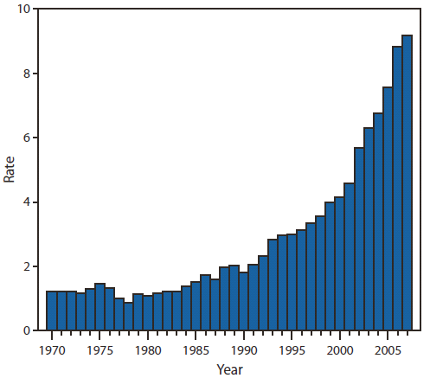
Rx Drug Abuse
Rx abuse has quickly become a top public health concern in the United States
Every day, 44 people in the U.S. die from overdose of prescription painkillers (CDC, 2015)
Indiana had 17th highest drug overdose mortality rate in the United States in 2013.
Figure 1: Rate* of unintentional drug overdose deaths — United States, 1970–2007

Slide 5
Prescribing Trends
Quality improvement initiatives served as catalyst to increased prescribing of opioids in late 1990s (Pletcher et al., 2008)
Exponential increase in the distribution and access to opioid analgesics
7x between 1997 and 2007 (CDC, 2012)

Slide 6
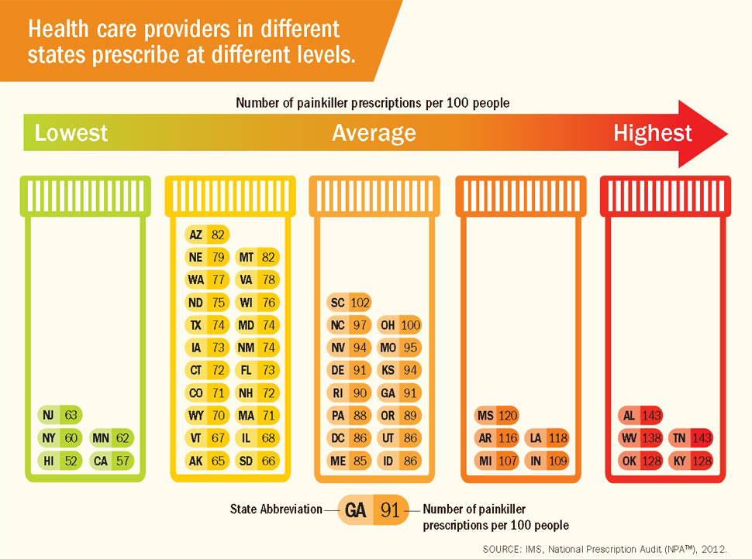

Slide 7
Drug Diversion
“Drug diversion is the illegal distribution or abuse of prescription drugs for purposes not intended by the prescriber (for example: recreation, addiction, or financial gain).”
Types of drug diversion:
Doctor shopping
Drug theft
Illegal internet pharmacies
Selling of Rx Drugs

Slide 8
DEA Regulation
21 C.F.R. § 1306
Controlled substance prescriptions (CSPs) must be “issued for legitimate medical purposes by individual practitioners acting in the usual course of their professional practice”
Drug diversion can occur at any point.
Notes:
Drug diversion can occur at any point from the time they are manufactured to the time they reach the point.

Slide 9
The Role of Pharmacists
21 C.F.R. § 1306
Responsibility on pharmacists.
They must
investigate the validity of CSPs that raise red flags
resolve these red flags
refuse to dispense a CSP if the validity of the prescription cannot be verified.
Pharmacist may refuse to fill a prescription if
filling it would be contrary to law,
be against the best interest of the patient,
aid or abet an addiction or habit,
be contrary to the health and safety of the patient.
Notes:
21 C.F.R. § 1306
Puts responsibility on pharmacists who fill the prescriptions.
They must investigate the validity of CSPs that raise red flags, resolve these red flags, and ultimately exercise their professional judgment to refuse to dispense a CSP if the validity of the prescription cannot be verified.

Slide 10
Corresponding Responsibility
Pharmacists are equally responsible under the law and may be prosecuted for the dispensation of a CSP that was not issued for a legitimate reason.
“Enforcement action against pharmacists is most likely to occur when pharmacists fail to exercise corresponding responsibility” (Cote, 2013)

Slide 11
Prescription Drug Monitoring Programs
Improve clinical decision-making (PDMP Center for Excellence, 2014)
Increase ability to detect prescription drug abuse and diversion (Fleming et al., 2014)
Notes:
PDMPs may improve clinical decision-making through increased access to detailed patient drug histories for both prescribers and dispensers (PDMP Center for Excellence, 2014)
Increased access to patient data facilitates pharmacists ability to detect prescription drug abuse and diversion (Fleming et al., 2014)

Slide 12
Our Research
Study 1:
Norwood, C. W., & Wright, E. R. (2015a). Integration of prescription drug monitoring programs (PDMP) in pharmacy practice: Improving clinical decision-making and supporting a pharmacist's professional judgment. Res Social Adm Pharm. doi:10.1016/j.sapharm.2015.05.008
Study 2:
Norwood, C. W., & Wright, E. R. (2015b). Promoting consistent use of prescription drug monitoring programs (PDMP) in outpatient pharmacies: Removing administrative barriers and increasing awareness of Rx drug abuse. Res Social Adm Pharm. doi:10.1016/j.sapharm.2015.07.008

Slide 13
Study One
Norwood, C. W., & Wright, E. R. (2015a). Integration of prescription drug monitoring programs (PDMP) in pharmacy practice: Improving clinical decision-making and supporting a pharmacist's professional judgment. Res Social Adm Pharm. doi:10.1016/j.sapharm.2015.05.008

Slide 14
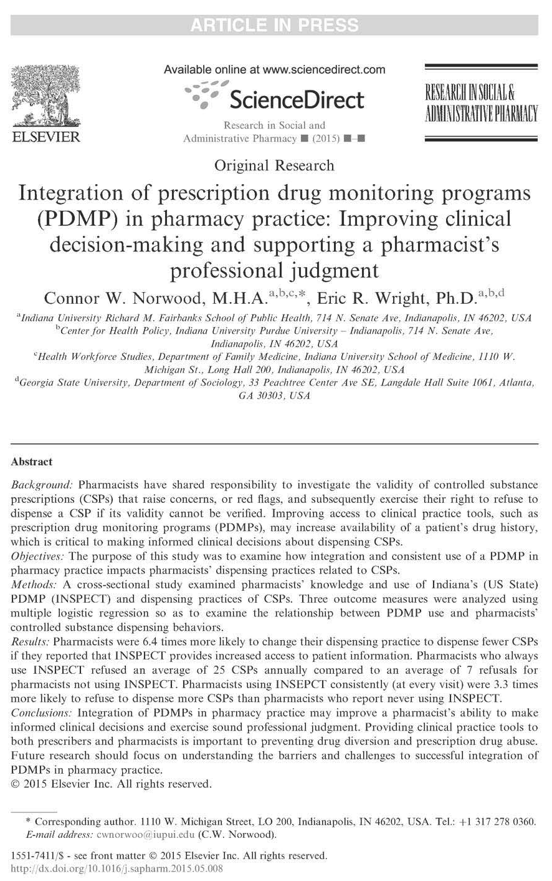
Objectives
To examine how use of INSPECT impacts:
Dispensing practices
Decisions to refuse a CSP
Annual refusals of CSPs

Slide 15
Data
Demographic Characteristic | N (%)
Age (years) | Mean ± SD, 46.9 ± 13.7
Years Practicing | Mean ± SD, 20.8 ± 14.0
Gender
Female | 833 (54)
Male | 699 (46)
Pharmacy Setting
Inpatient | 353 (26)
Outpatient | 1,000 (74)
Heard of INSPECT
Yes | 1,469 (94)
No | 88 (6)
Used INSPECT
Yes | 1,043 (72)
No | 410 (28)
Frequency of INSPECT
At every visit | 73 (8)
Periodically | 799 (78)
Never | 39 (4)
INSPECT Knowledge and use Survey
10,606 Pharmacists Surveyed
15% Response Rate (1,582 Pharmacists)

Slide 16
Sample Comparison
Sample exhibited similar characteristics to Indiana’s 2012 Pharmacist workforce in regards to age, years practicing, and gender.
 | IPLA INSPECT Survey Sample | 2012 Indiana Pharmacist Workforce Data
Demographic Characteristic | N (%) | N (%) | Statistic
Age (years) | Mean ± SD, 46.9 ± 13.7 | Mean ± SD, 46.3 ± 12.4 | P > .05
Years Practicing | Mean ± SD, 20.8 ± 14.0 | Mean ± SD, 20.3 ± 12.9 | P > .05
Gender |  |  | X² = .417, P > .05
Female | 833 (54) | 4963 (58)
Male | 699 (46) | 3645 (42)

Slide 17
Outcome Measures
Dispensation Change
Refused to Dispense
Annual Refusals

Slide 18
Training Period Variable
Degree type was not available in the data
Training period
3 level categorical variable (Cohort 1-3)
Calculated based on years practicing
Pharmacists practicing today were trained in one of three distinct cohorts, which are bound by events relating to the adoption of the Doctorate of Pharmacy as the sole entry degree for the profession.

Slide 19
Data Analysis
Descriptive Statistics
Independent variables
Practice and demographic characteristics
Other response variables
Analyzed using independent samples t tests or one-way analysis of variance (ANOVA)
Multiple Regression Models
Backward elimination
Conceptual relevant variables
Statistically significant variables

Slide 20
Measure 1: Dispensation Change
Top 3 factors leading to a change in dispensing practice of CSPs:
New professional practice standards and protocols (56%)
INSPECT providing greater access to patient prescription drug history (53%)
Increased professional awareness of risks, benefits, and other solutions. (50%)

Slide 21
Measure 1: Dispensation Change
Those reporting increased access to patient Rx drug history through INPSECT had 6.4 greater odds of changing their dispensing practice to dispense fewer CSPs (OR = 6.4, 95% CI, 3.437 – 11.862)

Slide 22
Measure 2: Refused to Dispense
Characteristic | Refused to Dispense | Did Not Refuse to Dispense | Total Responses | X² | P-Value
 | N (%) | N (%)
Pharmacy Type |  |  | 1,222 | 233.1 | < .0001
Inpatient | 217 (70) | 94 (30)
Outpatient | 896 (98) | 15 (2)
Gender |  |  | 1,305 | 12.6 | 0.0004
Female | 639 (88) | 85 (12)
Male | 546 (94) | 35 (6)
Training Period |  |  | 1,337 | 13.0 | 0.0015
Cohort 1 (after 2006) | 330 (88) | 46 (12)
Cohort 2 (transition) | 386 (90) | 45 (10)
Cohort 3 (before 1997) | 500 (94) | 30 (6)
Have you ever used INSPECT? |  |  | 1,254 | 57.2 | < .0001
Yes | 890 (95) | 51 (5)
No | 252 (81) | 61 (20)
Notes:
Cohort 1
Pharmacists trained after complete transition to the PharmD as the sole entry degree for the pharmacist profession and full implementation of ACPE’s1 new accreditation standards.
Cohort 2
Pharmacists trained during the transition to the Doctor of Pharmacy (PharmD) as the sole professional practice degree for pharmacy in the United States and after the adoption of ACPE’s new accreditation standards in 1997.
Cohort 3
Pharmacists trained prior to the adoption of ACPE’s1 Implementation Procedures for Accreditation Standards and Guidelines for the Professional Program in Pharmacy Leading to the Doctor of Pharmacy Education. New accreditation standards and guidelines were adopted in June of 1997.

Slide 23
Measure 2: Refused to Dispense
Using INSPECT increased the odds of pharmacists reporting a CSP refusal by 2.2
OR = 2.2, 95% CI, 1.339 – 3.693

Slide 24
Measure 3: Annual Refusals
Characteristic | Mean (SD) | Statistic | P Value
Pharmacy Type |  | -10.36 | < .0001
Inpatient | 2.6 (5.3)
Outpatient | 21.2 (25.6)
Gender |  | -2.01 | 0.045
Female | 15.7 (22.7)
Male | 18.6 (25.5)
Training Period |  | 3.21 | 0.041
Cohort 1 | 19.4 (26.2)
Cohort 2 | 18.4 (25.2)
Cohort 3 | 15.5 (22.3)
Frequency of INSPECT Use |  | 5.68 | 0.004
Never | 6.9 (13.1)
Periodically | 18.6 (23.9)
At Every Visit | 24.8 (27.3)

Slide 25
Measure 3: Annual Refusals
Practitioners who reported using INSPECT were statistically more likely to refuse to dispense more CSPs than pharmacists who reported never checking INSPECT
“Periodically”
OR_{periodically} = 3.0, 95% CI, 1.351 – 6.763
“At every visit”
OR_{everyvisit} = 3.3, 95% CI, 1.307 – 8.465

Slide 26
Conclusions
PDMPs may empower pharmacists to exercise corresponding responsibility through access to additional patient information.
Removing barriers to INSPECT should be a priority to facilitate full integration of PDMP in pharmacy practice.
Notes:
PDMPs are valuable clinical resources that may empower pharmacists to exercise corresponding responsibility through access to additional patient information.
Removing barriers to INSPECT should be a priority for policy makers and health professionals to facilitate full integration of PDMP in pharmacy practice

Slide 27
Study TWo
Norwood, C. W., & Wright, E. R. (2015b). Promoting consistent use of prescription drug monitoring programs (PDMP) in outpatient pharmacies: Removing administrative barriers and increasing awareness of Rx drug abuse. Res Social Adm Pharm. doi:10.1016/j.sapharm.2015.07.008

Slide 28
Study Objectives
To identify barriers to PDMP use in outpatient pharmacies
To determine the impact these barriers have on utilization of INSPECT.

Slide 29
Study Data
INSPECT Knowledge and use Survey
10,606 Pharmacists Surveyed
15% Response Rate (1,582 Pharmacists)
Outpatient Pharmacists

Slide 30
Study Sample
Sample Demographics (n=1,000)
 | N (%)
Age (years) | Mean ± SD, 46.4 ± 13.6
Years Practicing | Mean ± SD, 20.5 ± 14.0
Gender
Female | 521 (54)
Male | 445 (46)
Race/Ethnicity (n=1000)
White/non-Hispanic | 898 (93)
Asian American/ Pacific Islander | 28 (3)
Black/non-Hispanic | 17 (2)
American Indian/ Alaska Native | 3 (0)
Hispanic/Latino | 11 (1)

Slide 31
Study Sample Continued
Sample Demographics (n=1,000)
 | N (%)
Training Period
Cohort 1 (After 2006) | 272 (28)
Cohort 2 (Transition) | 302 (31)
Cohort 3 (Before 1997) | 393 (41)
Barriers to INSPECT
Insufficient Time | 532 (58)
Not Registered | 129 (14)
Lack of Reimbursement | 89 (10)
Other Barriers | 96 (10)
Afraid of Legal Ramifications | 26 (3)
No Barriers | 288 (31)

Slide 32
Key Measures
Used INSPECT
Binary variable (Yes=1, No=0)
Often Check INSPECT
3 level categorical variable (Never=1, Periodically=2, At Every Visit=3)
Pharmacist Level of Concern
4 level ordinal variable (Likert scale)
Extremely concerned
Moderately concerned
Slightly concerned
Not concerned at all

Slide 33
Data Analysis
Bivariate analyses
Utilization and perceived barriers
Multiple logistic regression
Pharmacists’ level of concern and reported utilization.
Notes:
Bivariate analyses on utilization and perceived barriers were conducted using cross-tabulations and X²
Multiple logistic regression examined the relationship between pharmacists’ level of concern with prescription drug abuse and reported utilization.

Slide 34
Measure 1: Used INSPECT
 | Total Respondents | Used Inspect
Outpatient Pharmacists |  | Yes | No | Relative Risk (95% Confidence Interval)
Barriers to INSPECT
No Barriers | 288 (31) | 268 (29) | 20 (2) | 3.112* (2.0381, 4.751)
At Least One Barrier | 638 (68) | 492 (52) | 146 (16) | .7960* (.7290, .8692)
Not Registered | 129 (14) | 38 (4) | 91 (10) | .0970* (.069, .1363)
Afraid of Legal Ramifications | 26 (3) | 17 (2) | 9 (1) | .4386* (.1989, .9673)
Lack of Reimbursement | 89 (10) | 71 (7) | 18 (2) | .9160 (.5611, 1.495)
Insufficient Time | 532 (58) | 444 (48) | 88 (10) | 1.172* (1.001, 1.3721)
Other Barriers | 96 (10) | 75 (8) | 21 (2) | .8293 (.5263, 1.3068)
* Statistically significant at the .05 level

Slide 35
Measure 2: Often Check INSPECT

Slide 36
Pharmacist Level of Concern
Those extremely concerned with Rx abuse in the community were approximately 10 times more likely to use INSPECT as compared to those who reported being not at all concerned
OR = 9.96, 95% CI, 1.724 – 57.536
They were also 18 times more likely to use INSPECT more frequently than those who were not at all concerned
OR = 17.89, 95% CI, 1.457 – 219.69

Slide 37
Conclusions
Strategies to
limit administrative barriers
build outpatient pharmacists’ awareness of prescription drug abuse and misuse within their community
Notes:
Strategies to improve outpatient pharmacists’ utilization of PDMPs should look for innovative ways to limit administrative barriers while simultaneously building outpatient pharmacists’ awareness of prescription drug abuse and misuse within their community.

Slide 38
Study Limitations
Limited to Indiana Pharmacists
May not be generalizable to other states
Response Rate
Comparison to IN pharmacists workforce
Response Bias
Anonymous survey
Degree type variable
Proxy variable constructed

Slide 39
Take Away
Pharmacists play a critical role
Last line of defense
Increased access to patient drug information may support pharmacists professional judgement
Removing barriers to INSPECT use and fully integrating INSPECT into pharmacy practice is a promising strategy to fight prescription drug abuse

Slide 40
Questions/Discussion
Connor W Norwood, MHA 1110 West Michigan Street, Room 200
Indianapolis, IN 46202
Ph: (317) 278-0360
Email: cwnorwoo@iupui.edu

