Slide 1
The Nose Knows Train-the-Trainer on Intra-Nasal Naloxone
Donna Purviance, DNP, FNP-BC
Goodman Campbell Brain & Spine
Indiana State University

Slide 2
Objectives
Understand
How the perception of naloxone administration by law enforcement changed before and after training
Different Learning Styles
How to train others on recognizing the signs of an overdose and administering naloxone

Slide 3
Senate Enrolled Act No. 227
Section &. IC 16-31-2-9. As amended by P.L. 77-2012, Section 18,…(5) Standard for distribution, administration, use, and training in the use of an overdose intervention drug.
Section 8, IC 16-31-3-23.5. The following may administer an OD intervention drug to an individual who is suffering from an OD: First responder (EMT, A-EMT, emergency medical responder, paramedic, firefighter, volunteer firefighter, or law enforcement…..
….Immune from civil liability….

Slide 4
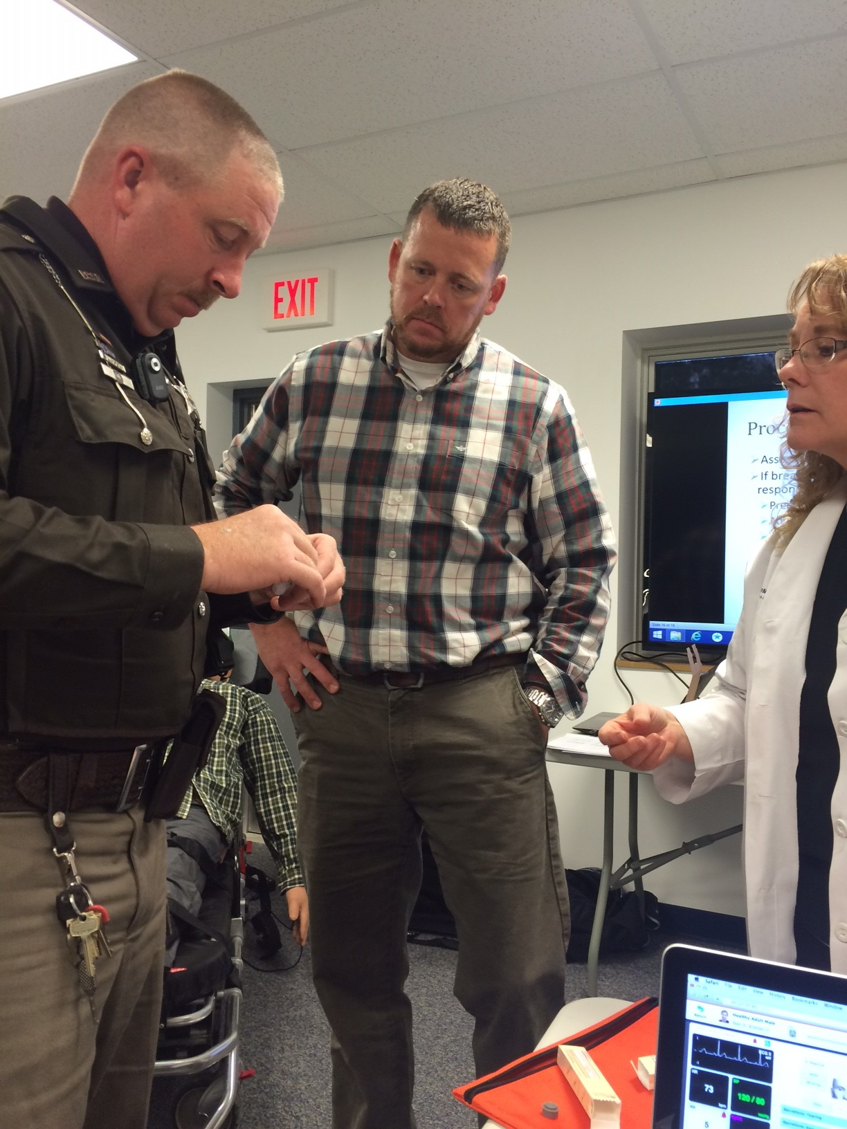
Law Enforcement

Slide 5
Analytical Tool
Development of opioid overdose knowledge (OOKA) and attitudes (OOAS) scales for take-home naloxone
training evaluation
Short Title: Development of OOKA & OOAS
Anna V. Williams, John Strang, & John Marsden
King’s College, London: Addictions Department, Institute of Psychiatry
London, United Kingdom

Slide 6
RESEARCH
Purpose: to teach and assess knowledge deficits & to decipher law enforcement attitudes associated with saving a life from an opiate OD, be it intentional or accidental, be it from legally prescribed medications or illicit use.
Hypothesis: Training would be associated with improved knowledge & have a POSITIVE impact on attitudes.

Slide 7
RESULTS
Domain | Significance (2-tailed)
Knowledge | .000
Competency | .000
Concerns | .000
Readiness | .000

Slide 8
Vigo County Attitudes
Table 4 Officers attitude responses to an opioid overdose situation
Pre and post scores
Agree, Unsure, Disagree
Competency, Concerns, Readiness

Slide 9
Outcomes from Indianapolis PD 1 year later*
From Indianapolis South District Current Stats:
129 uses of naloxone
3 deaths despite officers using naloxone appropriately
No legal issues
1 victim was combative
Overall, > 80% of the victims went to the hospital after resuscitation
All myths associated with LE using naloxone dispelled
*Personal Communication, B. Ray (IUPUI), October 9, 2015

Slide 10
Senate Enrolled Act No. 406
Indiana Code §16-42-27 et seq,
A prescriber may write a standing order to authorize an entity to receive naloxone & distribute it to those individuals that may be in a position to assist a person experiencing an opioid-related overdose.
The prescriber’s standing order must contain 3 things:
Instructions to summons emergency services immediately
Education & training on OD response & treatment, including administration of naloxone
Information & referrals to drug addiction treatment & programs, including medical assisted treatment

Slide 11
ASSESSMENT
Notes:
An important first step is to assess the audience. For example, in this audience, we have educated individuals. We know as medical personnel, and as law enforcement, we have our own language that not everyone comprehends. Going forward, assessing the audience of family and friends, I can assure you they have a street language that may elude some of us but their experience with overdose situations can be more real and carry an emotional charge different than the professional giving the antidote.
There are ALSO different learning styles also among a given group of people. Not all people learn by the same type of presentation. Some learning by reading the material, some by hearing the words, and some by practical application.
As an educator, how that information is presented will be pertinent to your audience.

Slide 12
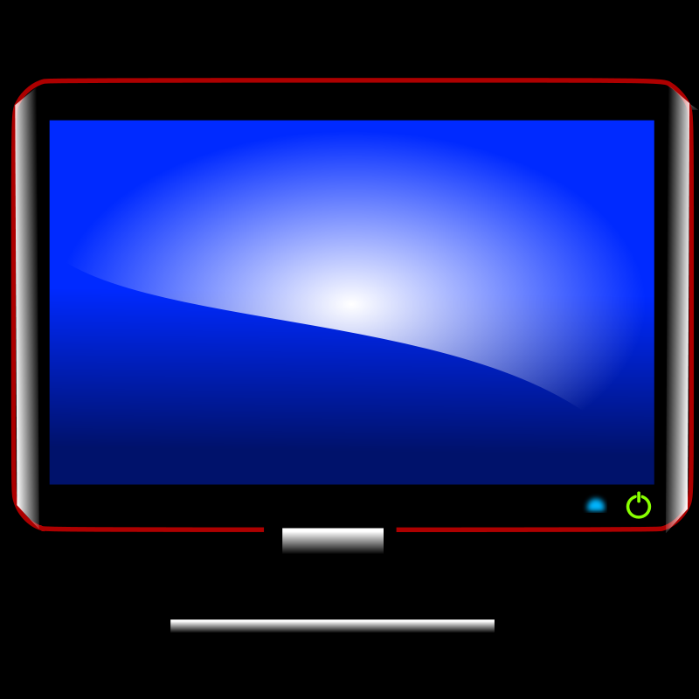
Learning Styles
Notes:
Will do an activity with 3 pieces of paper for each participant.
Will read the instructions to the audience: Listening
Will have the audience read the instructions for themselves.
Will have them watch the youtube video.

Slide 13
Educational Requirements
What is an opioid and how does it work?
What is naloxone and how does it work?
What does an opioid overdose look like?
How to resuscitate the patient.
How to administer the naloxone.
Recovery of the victim.
Reporting requirements.
Notes:
According to Senate Enrolled Act No. 406
The statute states: The Advanced EMT, emergency medical responder, the EMT, the fire department or volunteer fire department, the law enforcement agency, the paramedic AND the individual receiving an overdose intervention drug or prescription can give the antidote after receiving training on:
Overdose response and treatment including the administration of an opioid-related overdose.

Slide 14
How to conduct intra-nasal naloxone training
Training power point available
Composed by
Joan Duwve, MD, MPH
Indiana State Department
Of Health
http://www.in.gov/isdh/26689.htm
Notes:
According to SB 227, Section 7, IC 16-31-2-9, as amended by P.L. 77-2012, section 18, sec. 9: The EMS commission shall establish Standards for distribution, administration, use, and training in the use of an overdose intervention drug.
Therefore, Dr. Duwve from the Indiana State Department of Health has developed and composed a power point presentation for utilization in educating those listed in the Senate Bill including
An Advanced emergency medical technician
An emergency medical responder
An emergency medical technician
A firefighter or volunteer firefighter
A law enforcement officer
A paramedic.

Slide 15
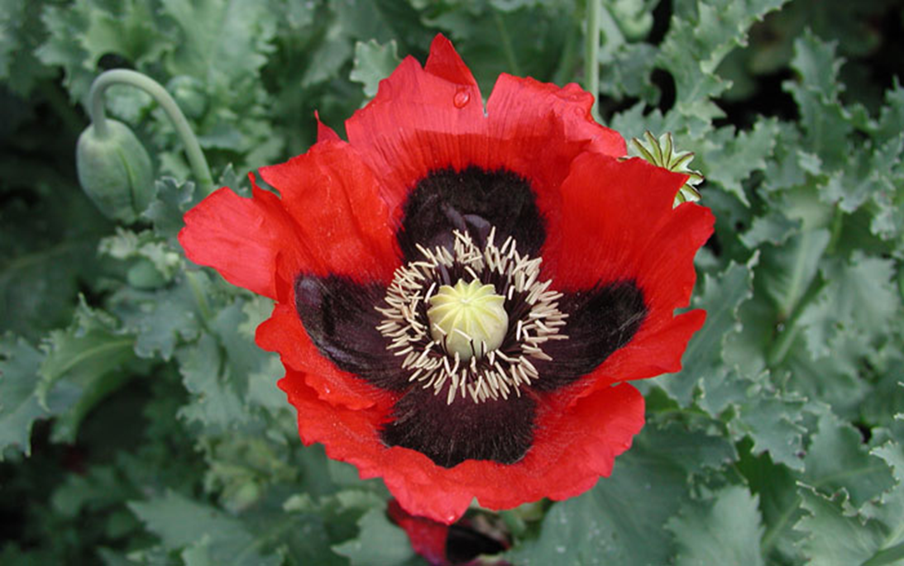
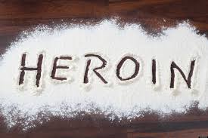
What is an opioid & how does it work?
Notes:
Definitions:
OPIOIDS are both natural and synthetic substances with morphine-lie activity.
OPIATES include a subclass of opioids consisting of compounds specifically extracted and purified from the opium (poppy) plant
Opiates and opioids act on the same receptors in the brain. Decrease the feeling of and reaction to pain
Depress the nervous system (which can depress breathing)
Provide comfort and may cause euphoria
Are used to treat acute and chronic pain and as anesthesia during surgeries or painful procedures
Medical and illicit opioid use can result in addiction, overdose, and death
Morphine is the prototypical opioid (HEROIN, when metabolized) becomes morphine.
1. Decreases the feeling of and reaction to pain
2. Acts as a nervous system depressant (which can depress breathing).
3. Provides comfort and may cause euphoria
Opioids are used as a treatment for acute and chronic pain and as anesthetic agents (during surgeries or painful procedures)
Opioid use (both medical and illicit) can result in significant health risk.
After prolonged use of these substances, tolerance develops
1. This means that the person needs increasing amounts to achieve the same effects
Common side effects include:
1. nausea and vomiting
2. drowsiness
3. lethargy
4 itching & flushing
5. dry mouth
6. small pupils
7. constipation or difficulty having bowel movements.
Opiates NAMES: heroin, suboxone, stadol, codeine, duragesic patch, hydrocodone (Vicodin, norco), hydromorphone (dilaudid), Demerol (meperidine), morphine, nubain, oxycodone (Percocet, Percodan), talwin, paregoric, Darvon (propoxyphene).
After prolonged use of these substances, TOLERANCE, develops -→This means that the person needs increasing amounts to achieve the same effects.

Slide 16
Opioid Names
Heroin Morphine
Buprenorphine (Suboxone) Butorphanol (Stadol)
Nalbuphine (Nubain) Oxycodone (Percocet/Percodan)
Codeine Oxymorphone (Opana)
Fentanyl (Duragesic Patch) Hydrocodone (Vicodin, Norco)
Hydromorphone (Dilaudid) Meperidine (Demerol)
Pentazocine (Talwin) Propoxyphene (Darvon)
Paregoric

Slide 17
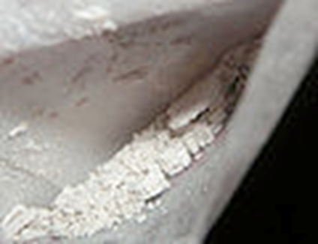
Heroin Street Names
Smack, H, Tar, Chiba
Junk, Brown Sugar, Skag, Mud
Dragon, Dope
White, China White, White Nurse/Lady/Horse/Girl/Stuff/Boy
Boy, He
Black, Black Tar, Black Pearl, Black Stuff, Black Eagle
Brown, Brown Crystal, Brown Tape, Brown Rhine
Mexican Brown, Mexican Mud, Mexican Horse
Snow, Snowball
Scat, Sack, Skunk
Number 3, Number 4, Number 8

Slide 18
Opiate Receptors
Notes:
4 types of opiate receptors: Delta, Kappa, Mu, Nociceptin.
Opiate receptors are a type of protein found in the brain, spinal cord and gastrointestinal tract. Opiates activate receptors once they reach the brain. They produce effects that directly correlate with the area of the brain involved. Opiates facilitate pain relief and stimulate the pleasure centers in the brain that signal reward. When a person injects, sniffs or orally ingests heroin or morphine, the drugs travel quickly through the bloodstream to the brain.
Once heroin gets to the brain, it converts rapidly to morphine, which activates the receptors. In the reward system, the drugs activate these areas of the brain: ventral tegmental area (VTA), cerebral cortex and nucleus accumbens. Research shows that stimulation of the opiate receptors by heroin, morphine and other opiates results in feelings of reward. It also activates pleasure circuits by causing a larger amount of dopamine to be released in the nucleus accumbens. This causes a rush, or intense feelings of euphoria, which subside quickly and are followed by relaxation and contentment. The calm typically lasts a few hours. Excessive release of dopamine and activation of the reward system can lead to addiction.
Types of Opiate Receptors
The four major subgroups of opiate receptors are delta, kappa, mu and Nociceptin, and each is involved in controlling different functions of the brain. As an example, opiates and endorphins block pain signals by binding to the mu receptor site. The delta receptor in the brain is involved in pain relief, antidepressant effects and physical dependence. Kappa receptors in the brain and spinal cord are linked with sedation, spinal analgesia and pupil constriction.
The functions of the mu receptors in the brain and spinal cord are physical dependence, respiratory depression, euphoria, pupil constriction and supraspinal analgesia. Nociceptin receptors in the brain and spinal cord are involved with appetite, depression, anxiety and the development of tolerance to mu agonists.

Slide 19
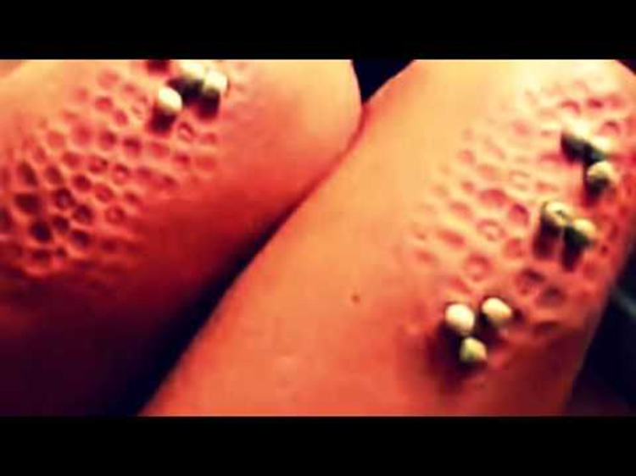
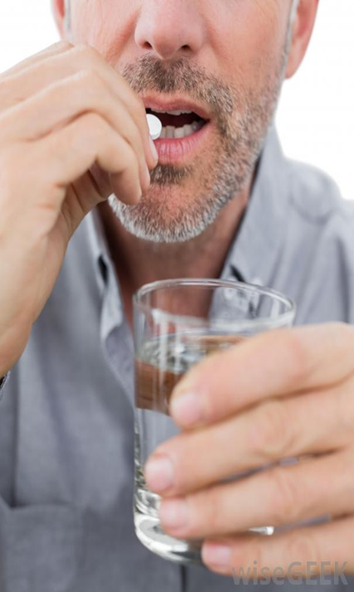
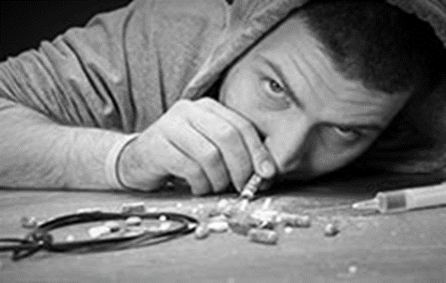
Portals of Entry
Notes:
Snorting
Sniffing
Shooting up
Mainlining
Skin-popping
Muscling

Slide 20
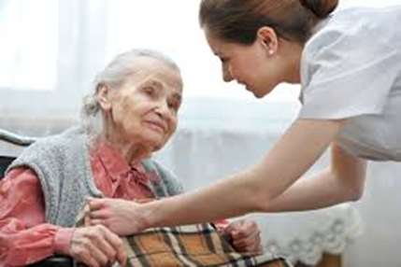
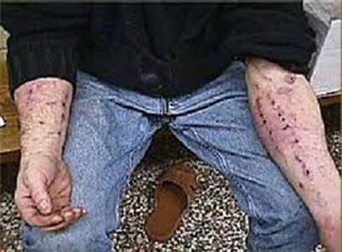
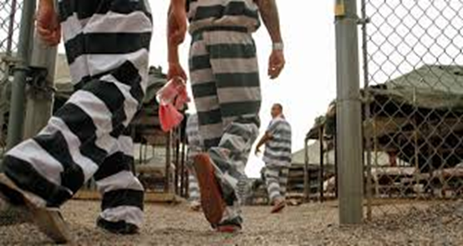
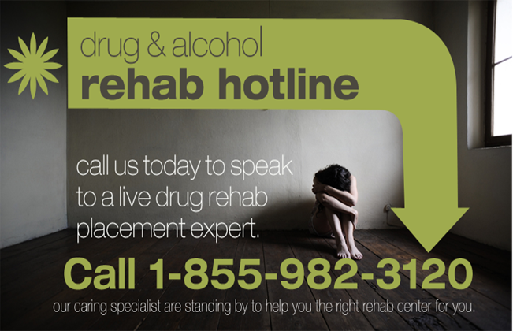
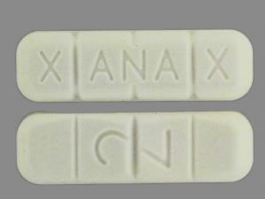
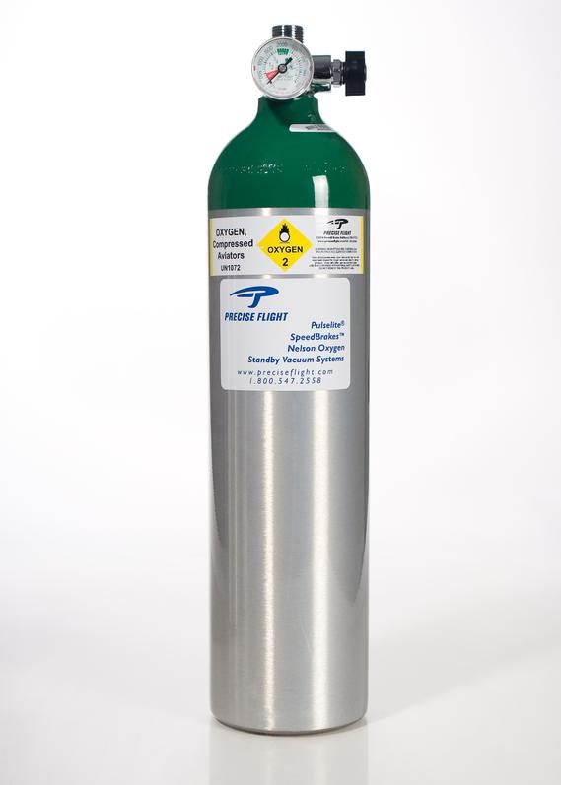
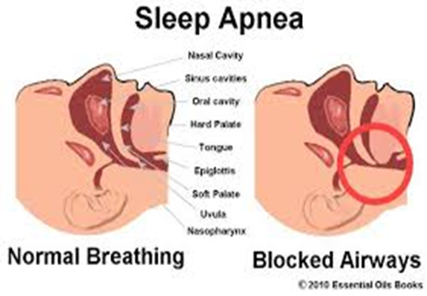
WHO is at risk for an Overdose?
Notes:
People who get opiate from multiple providers
People who use opioids for non medical reasons
People who use drugs prescribed for others
People who inject drugs
Former users recently released from prison or abstinence-based drug treatment programs
Elderly people using opiates for pain
Anyone on high doses of opioids, even if taking as prescribed
People using pain-relieving patches incorrectly.
People taking multiple respiratory depressants
People with chronic lung disease or with sleep apnea AND taking opioids
Children who accidentally take pain-killers

Slide 21
What is naloxone & how does it work?
Naloxone (Narcan) = Antidote
REVERSES the effects of an opiate overdose→ blocks opioid effects
NOT effective unless an opiate has been taken
Notes:
Naloxone (Narcan) is an antidote reverses the effects of opioid overdose
Naloxone is NOT effective against respiratory depression due to non-opioid drugs (or other causes)
Naloxone
Blocks opiate effects
Restores breathing
Increases oxygen to the brain
Reversing the overdose quickly saves life.
Wears off in 20-90 minutes
Some opioids (buprenorphine and methadone) can last for 24-36 hours
Wears off, may need to repeat the dose

Slide 22
How naloxone works
Graphics: Maya Doe-Simkins
http://harmreduction.org/wp-content/uploads/2012/02/naloxone-one.png

Slide 23
WHEN to use naloxone
IF a person is NOT responding to you AND
Bystanders report drug use
There are drug bottles, needles, cookers, paraphernalia at the scene
Signs & symptoms of injection of drugs (track marks)
History of opioid use, prescription or illicit
Symptoms of overdose

Slide 24
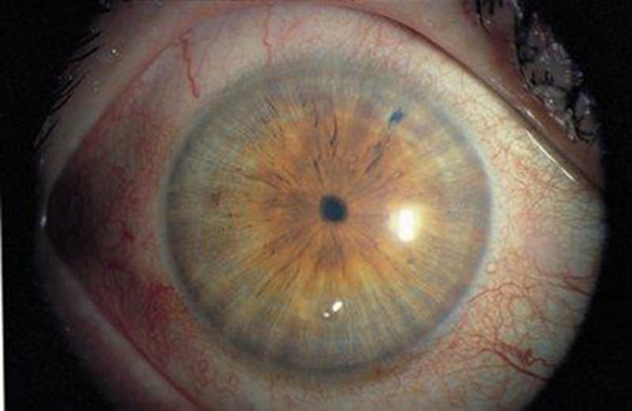
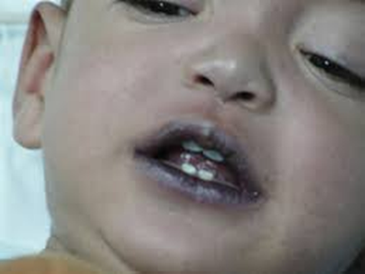
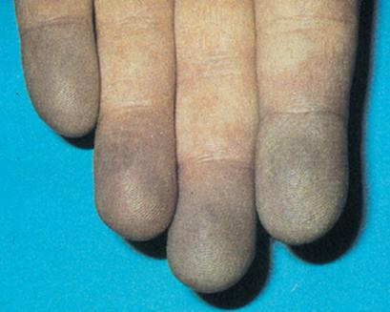
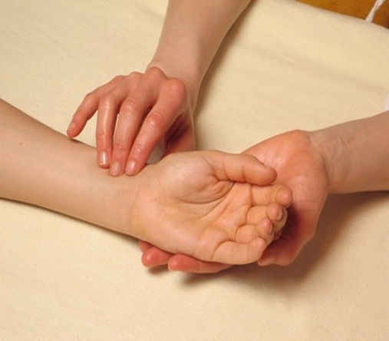
What does an overdose LOOK like?
Notes:
No response to stimuli (shaking, sternal rub)
Infrequent or NO breathing
Deep snoring or gurgling (death rattle)
Pale, clammy skin
Blue lips and/or fingertips
Small pupils
Slow pulse
UNTIMATELY, opioids kill by suppressing the drive to breath.
SLOWS EVERYTHING down…….breathing, pulse, blood pressure
Slowed breathing -→ decreased oxygen flow to the brain--→brain injury and death.

Slide 25
How to resuscitate the victim
Determine responsiveness
Contact EMS (Dial 911)
Provide rescue breathing to the limit of your skills/comfort level ➔ A, B, C
Administer Naloxone
Notes:
Assess if the people being treated know the steps of CPR.
Start with assessing the victim to determine responsiveness. May start CPR if you know it and are comfortable with doing so.
Assess the scene.
If unresponsive, blue, can’t find a pulse, can’t determine if breathing
Give the antidote.

Slide 26
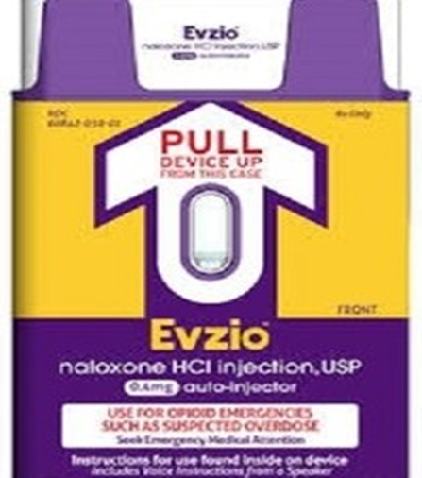
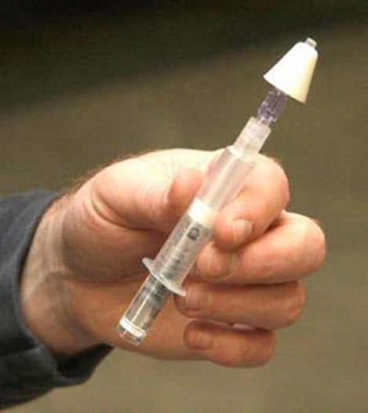
Naloxone Administration
Notes:
Intranasally
Auto-injector
IV injector
IM Injection
Ezvio is a take home auto-injector
FDA approved April 2014
Each dose contains 0.4 mg naloxone in 0.4 mL
Comes in a box of 2 single dose auto-injectors plus a training injector
Intranasal
Very low risk of exposure to blood (no exposed needle)
Can be administered quickly and with little training
Rapid onset of action
Very effective when used properly. The NOSE is lined with lots of tiny blood vessels which quickly absorb naloxone into the blood stream
Atomizer turns the liquid into a fine mist
Squirting the drug as mist covers more of the surface inside the nose
More surface= more blood vessels= more naloxone into the blood stream

Slide 27
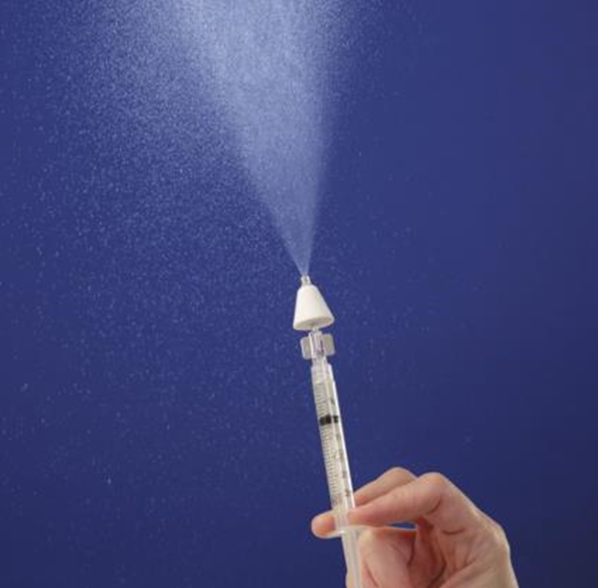
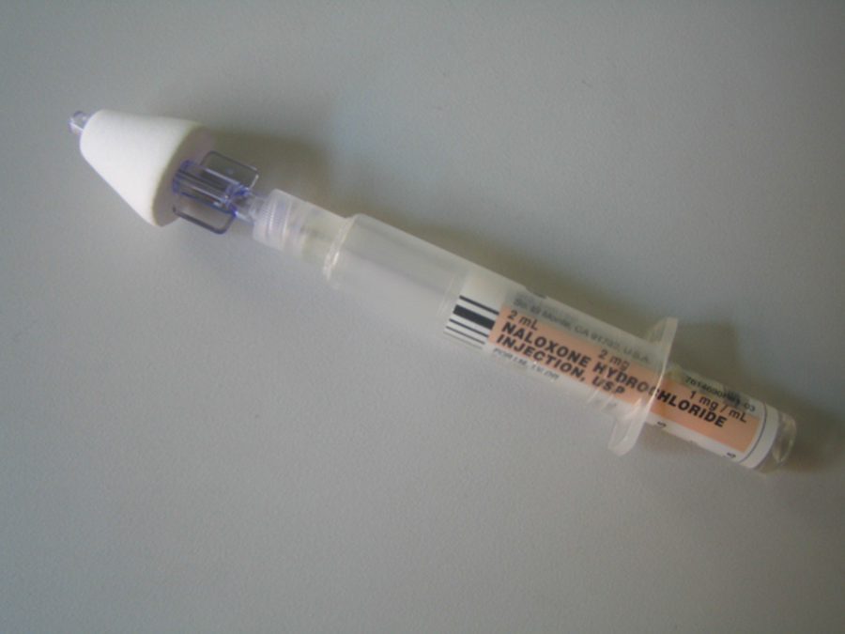
Administer Naloxone
Inspect the nose
Assemble the kit (video)
Gently, but firmly, place the atomizer in one nostril & spray ½ the medication
Repeat on the other side
Notes:
Demonstrate with the demo syringe…………….

Slide 28
AND………what next?
Respiratory rate increases
NO Breathing → Breathing
Color improves
BLUE → “NORMAL” Color
Victim wakes up

Slide 29
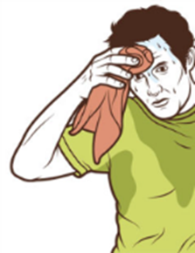
WITHDRAWAL
FEAR of causing withdrawal should NOT prevent use if victim is unresponsive.
Withdrawal is NOT life-threatening
Runny nose
Sweating, Goose Flesh
Nausea & vomiting
Fast heart rate
Shakes
Agitation, irritability, restlessness, confusion

Slide 30
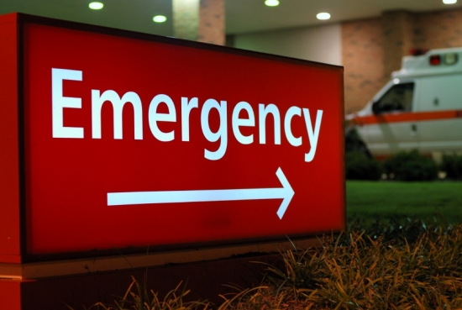
Recover the victim
May need to repeat the dose
Roll patient onto his/her side if not fully awake
Monitor until EMS arrives
Transport to hospital ED
per EMS

Slide 31
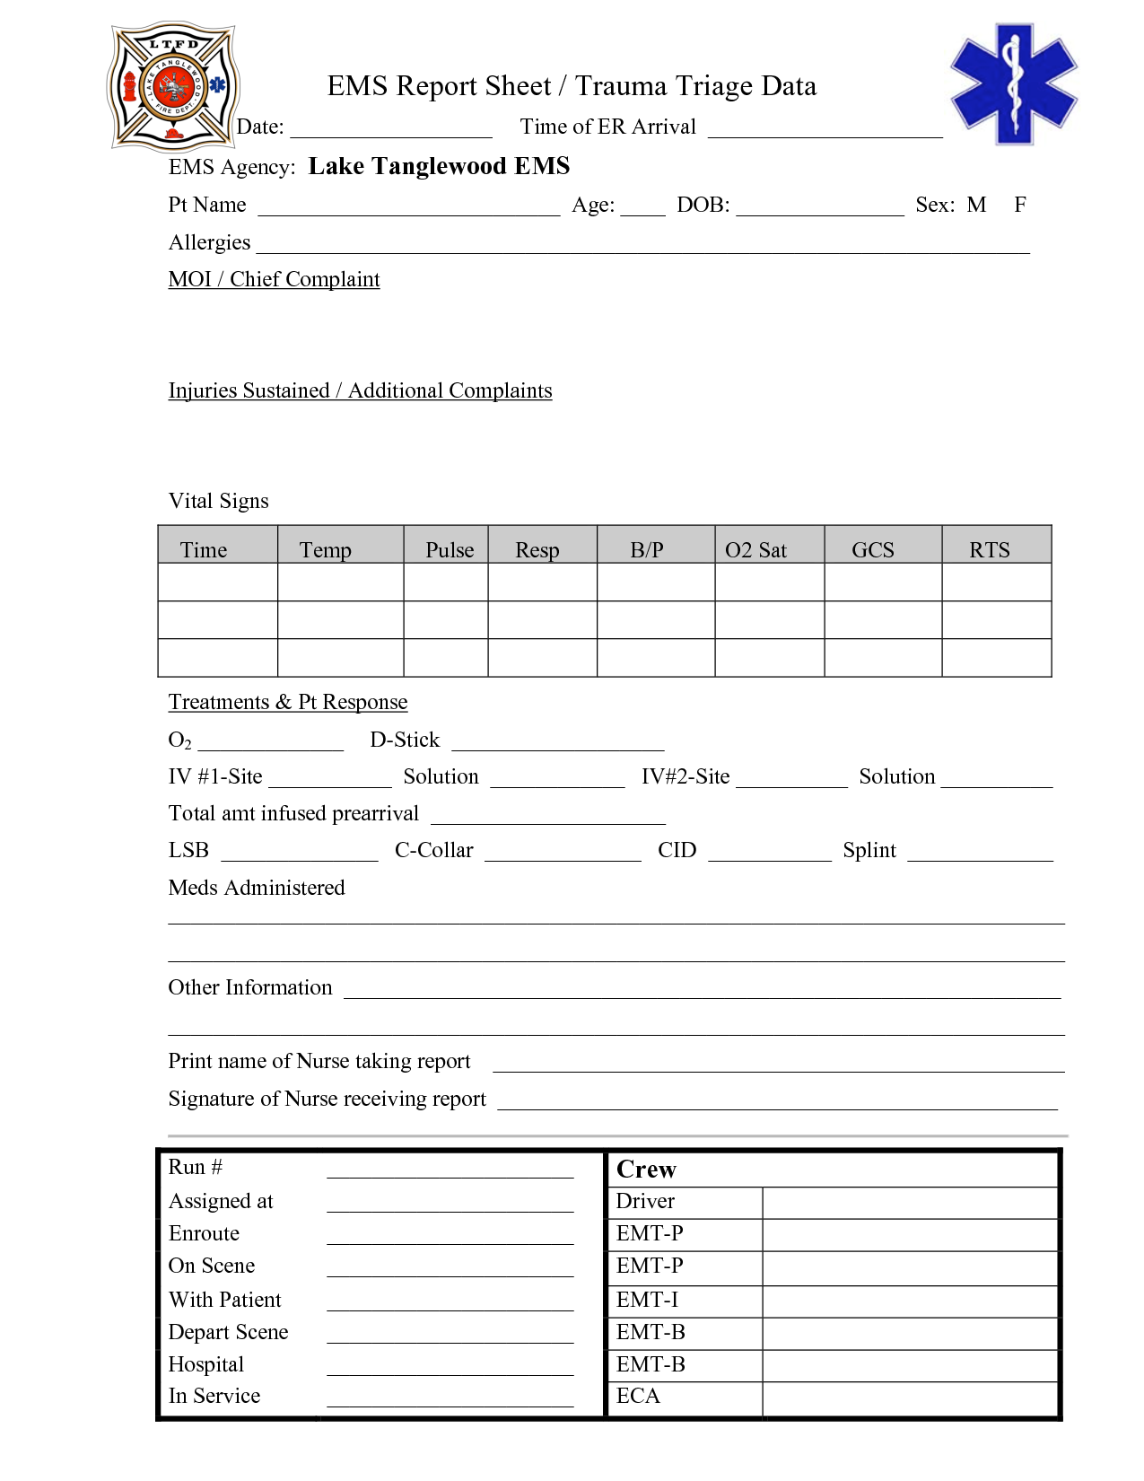
Reporting Requirements
Senate Enrolled Act No. 406
Section 5. IC 16-31-3-23.7
“Shall report the # of times an OD
Intervention drug is dispensed to the
State department under the state
Trauma registry in compliance
With rules adopted by the state dept.”
Questions: Contact: Murray Lawry
(317-233-7695) mlawry@isdh.in.gov
Notes:
Report ANY naloxone administration in the field to Indiana State Department of Health via the EMS run sheet.
ISDH is permitted by Indiana Department of Homeland Security to access run sheet data monthly.
Any problems or questions regarding reporting requirements contact: Murray Lawry at the Trauma and Injury Prevention Division

Slide 32
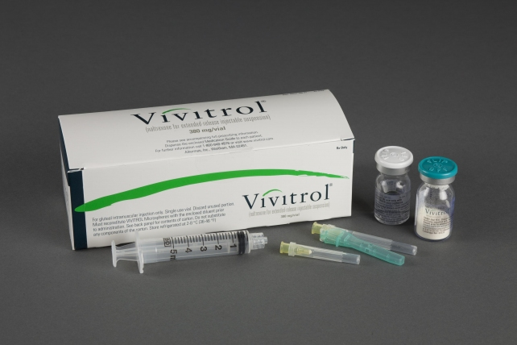
Opioid Addiction & Treatment
Methadone
Commonly prescribed in addiction treatment (liquid)
ALSO can used as a pain reliever (pill)
Suboxone & Subutex (Buprenorphine)
Commonly prescribed in addiction treatment
ALSO can be used as a pain reliever
Vivitrol (Naltrexone injectable Extended
Release)
Notes:
BOTH are long-acting
Reduces the craving for opioids for days
Can cause prolonged respiratory depression
WHAT IS VIVITROL® (naltrexone for extended-release injectable suspension)?
VIVITROL is a prescription injectable medicine used to:
Treat alcohol dependence. You should stop drinking before starting VIVITROL.
Prevent relapse to opioid dependence after opioid detox. You must stop taking opioids or other opioid-containing medications before starting VIVITROL.

Slide 33
Practical Application
Notes:
Will use the RHIC simulation mannequin and walk through a practical application
ISU football player had a football injury in Saturday’s game.
The girlfriend finds him obtunded
2 officers are called to the scene, assess the scene and the victim, and administer the drug.
The mannequin wakes up.
Can also do return demonstration with the mannequins in the room.

Slide 34
Acknowledgements
Indiana State Attorney General’s Office
BitterPill Task Force
Joan Duwve, MD, MPH, ISDH
Jack Jaeger, RN, BSN
Rural Health Innovative Simulation Center

Slide 35
References
Williams, Strang, & Marsden. ( 2013). OOKS & OOAS. Drug & Alcohol Dependence,
132, 383-386. doi:10.1016/j.dugalcdep.2013.02.007
Indiana Senate Bill 227. (2014). Second Regular Session 118th General Assembly.
Retrieved from http://www.in.gov/legislative/bills/2104/SB/Sb0277.html
Indiana Senate Bill 406. (2015). First Regular Session 119th General Assembly.
Retrieved from http://www.in.gov/legislative/bills/2015/SB/SB0406.html
Duwve, J. (2015). Naloxone: Reducing opioid overdose deaths. Personal
communication.

