Slide 1
www.mcmillencenter.org 260.456.4511

Slide 2
copyright McMillen Center
for Health Education 2015

Slide 3
Pharm Crisis: Prescription Medication Abuse
Notes:
http://perspectives.3ds.com/wp-content/uploads/pills.jpg
http://www.pharmacywillcall.com/prescription_bottle-1.jpg

Slide 4
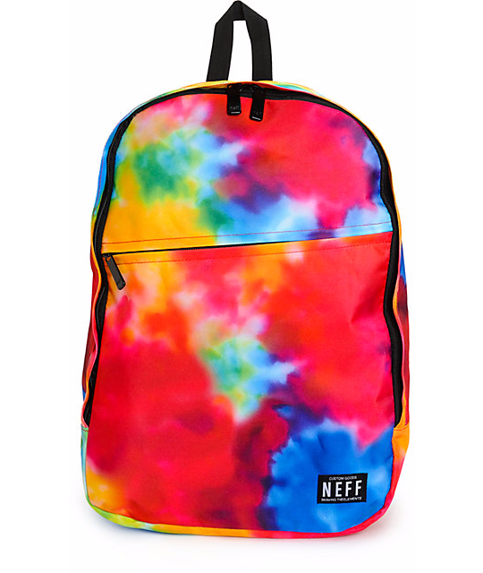
What’s in Your Back Pack?

Slide 5
Unfortunate Statistic
Every 25 minutes someone dies from an
Rx Drug Overdose
Choose a healthy alternative
Notes:
www.bitterpill.in.gov

Slide 6
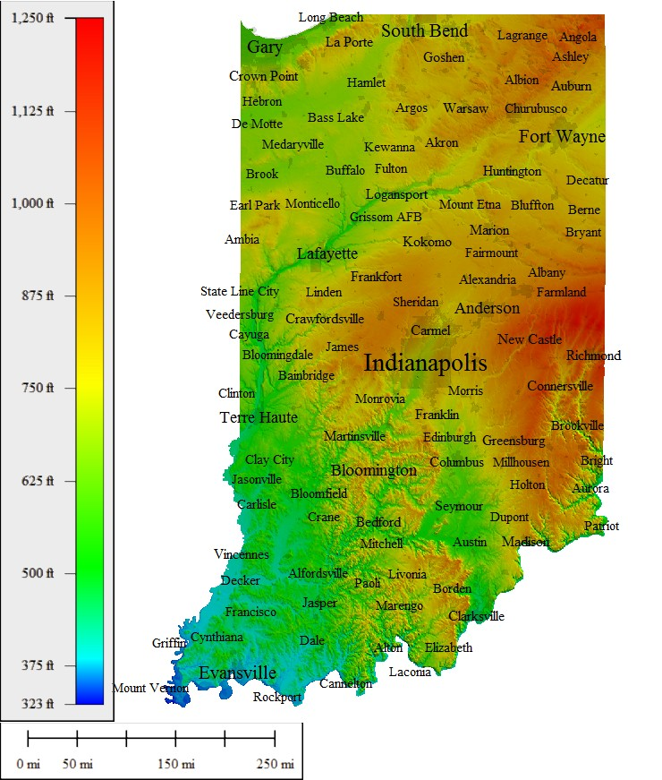
Prescription Medication
Abuse
1 in 5 Teenagers
in Indiana,
have admitted to
abusing prescription
medications.
http://www.in.gov/bitterpill/
Cautious mom
Notes:
http://3.bp.blogspot.com/_eZ6_KW9F7iM/RlETkWSO8VI/AAAAAAAAAPE/cE7i29NyWFc/s800/Pills+Spilled.jpg

Slide 7
Good Parent

Slide 8
Good Parent

Slide 9
Fort Wayne, IN
In Allen County, 287 prescription medication overdose deaths
were reported from 2008-2013.
Notes:
(A Retrospective Analysis of Overdose Deaths in Allen County 2008-2013) Confirmed deaths from the coroner’s department in Allen County.
271 confirmed manner of death This study was a retrospective descriptive study of deaths that occurred in Allen County, Indiana from 2008 to 2013 that resulted from drug overdose. It included anyone whose death was a direct result of drug overdose, regardless of whether it was intentional or accidental.
Americans make up less than 5% of world’s population but use 75% of the global supply of opiods. http://www.dmu.edu/wp-content/uploads/2014/11/american-opioid-usage-375x468.png

Slide 10
Ages 15-24 in Allen County: 100% of Prescription Medication Overdose Deaths were Accidental
Notes:
(A Retrospective Analysis of Overdose Deaths in Allen County 2008-2013) Confirmed deaths from the coroner’s department in Allen County.
287 Deaths - 271 Cases had confirmed manner of death
Accidental vs Intentional -77% Accidental
17% Intentional
6% Undetermined
79% accidental increase since 2008 (2008: n=34; 2013 n=61)
BY AGE
15-24 100% accidental & 100% with others present (in same geographic location)
25-34 years old 4% were intentional -65-74 years old 50%intentional
75-85 100% overdose were intentional
# DRUGS Toxicology (Opioids in 70% & 50% benzodiazepines – these overlapped with some deaths having evidence of both)
75% Multiple substances overdoses between 1 & 11 drugs in system. Most between 3 & 5 substances

Slide 11
Teen’s Top Three: Abused Prescription Medications
Benzodiazepines (Sedatives/Anti-Anxiety)
Opioids (Painkillers)
3. Amphetamines (ADHD/Anti-Depressants)

Slide 12
Why do teens abuse prescription medications?

Slide 13
Benzodiazepines
Prescription Medications & Medical Use:
Xanax: Anxiety & Panic Attacks
Valium: Insomnia, Muscle Spasms
Ativan: Controls Agitation from
Alcohol Withdrawal
Klonopin: Seizure Activity
Notes:
http://www.nlm.nih.gov/medlineplus/druginfo/meds/a682053.html ( All 4 medications listed can be used to relieve anxiety and panic attacks)

Slide 14
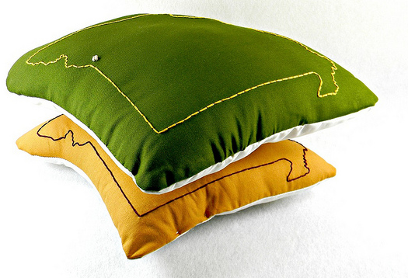
Benzodiazepines
Teen Desired Effect:
Drowsiness and Relaxation
Reduces Social Inhibitions
Come down from high after using other drugs
Street Slang:
Z-bar, blues, bricks, candy, sleeping pills, tranks

Slide 15
Benzodiazepine Abuse:
Drowsiness
Slurred Speech
Poor Concentration
Dizziness
Impaired Coordination
& Memory
Confusion
Sedation
Notes:
15

Slide 16
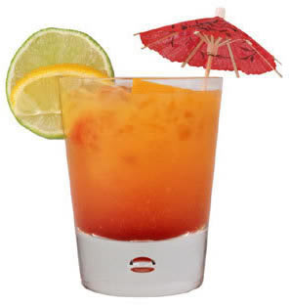
Why is this a lethal combination?
+
Notes:
16

Slide 17
Benzodiazepine Abuse
Addiction
Lowered Blood Pressure
Slowed Breathing
Respiratory Distress
Death due to overdose or in Combination with Alcohol

Slide 18
Prescription Medication
Abuse
Notes:
Bitterpill.in.gov

Slide 19
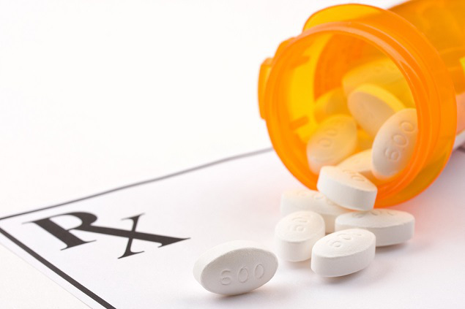
Opioids
Prescription Medication & Medical Use: Pain Relief
Vicodin
Tylenol with Codeine
Oxycontin
Percocet
Morphine

Slide 20
Opioids
Teen Desired Effect:
Get High
Self-Medication for Cramps
Dampen pain before a
“Big Game”
Street Slang:
Vics, T3’s, Ocs, Hillbilly Heroin,
Percs, White Stuff
Notes:
http://www.drugabuse.gov/drugs-abuse/commonly-abused-drugs OxyContin, widely known as “hillbilly heroin” because of its abuse in Appalachian communities, has emerged as a major crime problem in the US. In one county, it was estimated that addiction to this drug was behind 80% of the crime.

Slide 21
What illegal drug is chemically the same as opioids (painkillers)?

Slide 22
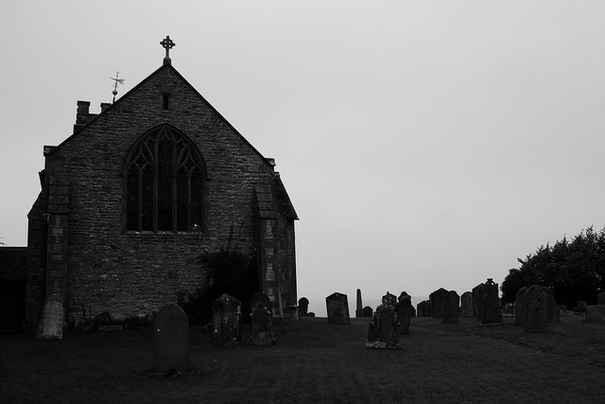
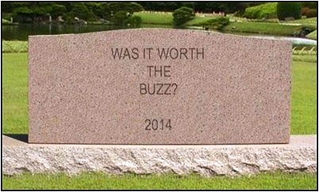
In the U.S., opioid prescription medication caused more overdose deaths than cocaine and heroin combined.
CDC Vital Signs
Notes:
CDC Vital Signs: Overdose of Prescription Opioid Pain Relievers-United States 2008
Photo from V4 BitterPill_gov. Young Adult Outreach Public Education Rx Task Force and Partnerships

Slide 23
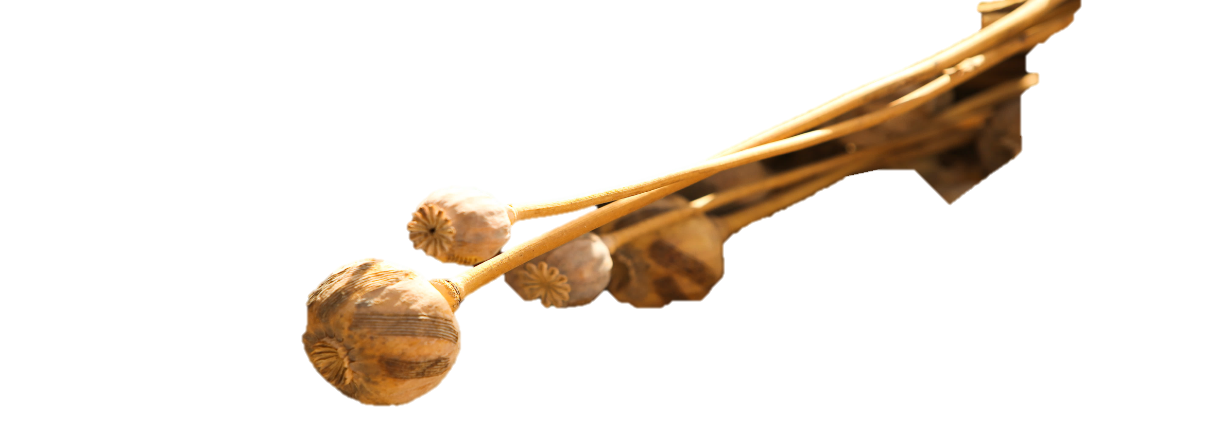
Opioids
Poppy pods contain powerful ingredients
such as codeine and morphine which are
used to make Opioids.
Morphine is used by drug dealers to make
Heroin.

Slide 24
Opioid Abuse
Euphoria, Itching, Sweating, Nausea, Drowsiness, Sedation
Lowered Blood Pressure
Slowed Breathing
Increased Risk of Respiratory Distress
Coma
Death due to overdose or in Combination with Alcohol

Slide 25
Amphetamines
Prescription Medication:
Dexedrine
Ritalin
Adderall
Medical Use:
Depression, Obesity,
Attention Deficit Hyperactivity Disorder

Slide 26
Amphetamines
Teen Desired Effect: Sense of Power, Increased Productivity, Weight Loss
Street Slang: R-ball, Vitamin R smart drugs, speed, black beauties

Slide 27
Amphetamine Abuse
Stimulant Drug
Paranoia, Wired, Loss of Appetite
Fever, Dry Mouth
Insomnia, Dilated Pupils
Increased Blood Pressure
Irregular Heart Beat
Chest Pain
Increased Respiratory Rate
Coma, Convulsions
Stroke, Heart Failure, Death

Slide 28
What were they Thinking?

Slide 29
What were they Thinking?

Slide 30
What were they Thinking?

Slide 31
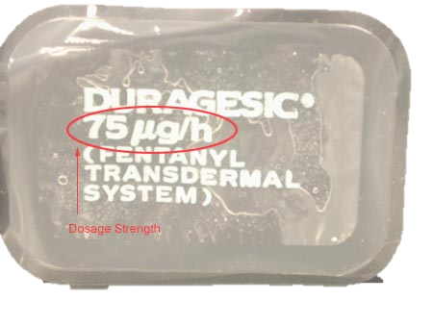
Injury by Abusing Medication Routes
Oral
Injected
Patches
Snorted
Notes:
Transdermal fentanyl comes as a patch to apply to the skin. The patch is usually applied to the skin once every 72 hours. Change your patch at about the same time of day every time you change it. Follow the directions on your prescription label carefully, and ask your doctor or pharmacist to explain any part you do not understand. Apply fentanyl patches exactly as directed. (http://www.nlm.nih.gov/medlineplus/druginfo/meds/a601202.html#why)

Slide 32
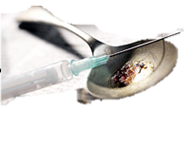
Injury by Abusing Medication Routes
Notes:
CDC Vital Signs: Overdose of Prescription Opioid Pain Relievers-United States 2008

Slide 33
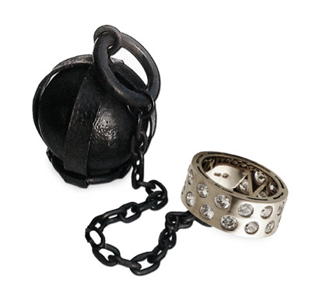
Prescription Medication Addiction: Ball and Chain

Slide 34
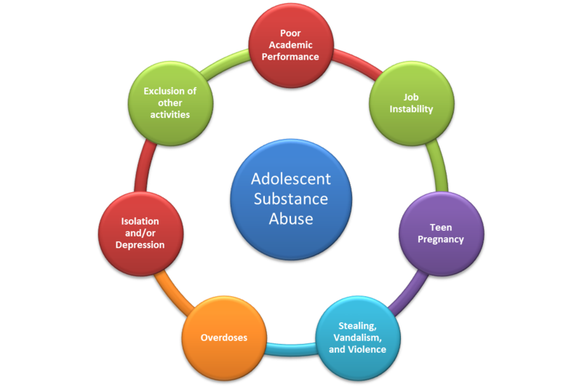
Prescription Drug Abuse =
Life Consequences

Slide 35
Addiction starts due to exposure of the brain to a chemical substance.
Addiction is not about:
Smart or not
Age Group
Popularity
Geek or Jock
Rich or poor
Notes:
Have class/group read these a loud. Include last one. Reinforce the last one.
Minor Exercise-
Ask the group to hold their breath for a moment. (Do not tell them they can stop. Let them do so on their own.)
After they stop, ask them “why they need to breath?”
When someone tells you it an involuntary reflex or that they have to, reinforce this by saying… “Despite what you might think, addicts don’t choose to be addicted. How they respond is their choice. But it is in their brain chemistry to crave things that alter their natural state.”

Slide 36
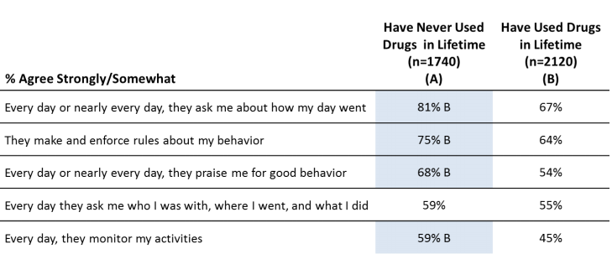
What you do or say as an adult matters
2012 Partnership Attitude Tracking Study, sponsored by MetLife Foundation
Notes:
Do they believe this is slide accurate and title is true?
“Adults are not always right. Do you find strange that we would suggest that?”
“Right now YOU are probably more knowledgeable on Rx drug abuse that most of the state of Indiana.”
Include the last one. The reason adults give their kids advice all the time is because LIFE gets harder as we age.
It is not because we think you are stupid, it is because there are times we were and want more for you.
Unnecessary addiction issues are not going to give you a better life.

Slide 37
Treatment Programs
Substance Abuse and Mental Health Services Administration (SAMHSA’s National Helpline: 1-800-622-HELP
www.samhsa.gov/find-help/national-helpline
SAMHSA's mission is to reduce the impact of substance abuse and mental illness on America's communities.
Notes:
Also known as, the Treatment Referral Routing Service, this Helpline provides 24-hour free and confidential treatment referral and information about mental and/or substance use disorders, prevention, and recovery in English and Spanish.

Slide 38
Useful Information
National Institute on Drug Abuse
www.drugabuse.gov
teens, parents, professionals
games, fact sheets, research, videos
KidsHealth
www.kidshealth.org
young kids, teens, parents, professionals
games, facts, research
Notes:
These sites provide links to other sites but in themselves are very complete and age appropriate sources of information.

Slide 39
Evaluation
Please help us improve our programs –
Complete the survey at this QR code or go to:
www.surveymonkey.com/r/mcmillenadultsurvey
Thank You!
Linda Hathaway
lhathaway@mcmillencenter.org
www.mcmillencenter.org
1-888-240-7268

Slide 40
www.mcmillencenter.org 260.456.4511

Slide 41
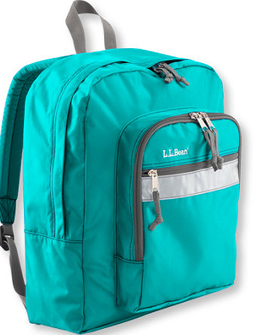
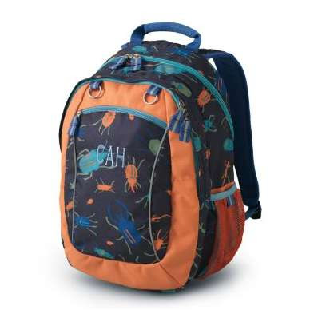
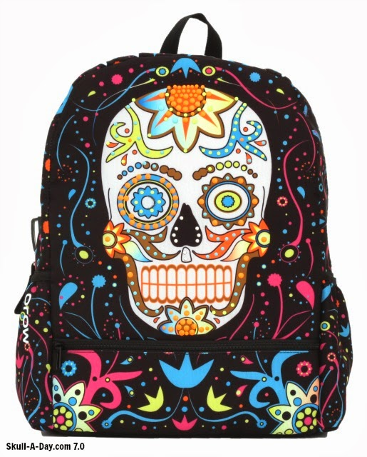
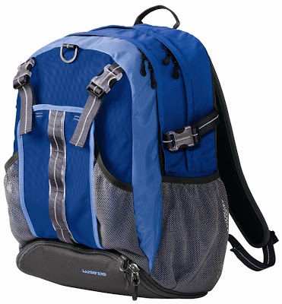
What’s in the Back Pack?
Notes:
What would you expect in a back pack? – MAYBE have 5 volunteers come up to read off back what we have in our bin

Slide 42
Life’s Complicated Enough
Notes:
Life’s Complicated Enough from NIDA.gov

Slide 44
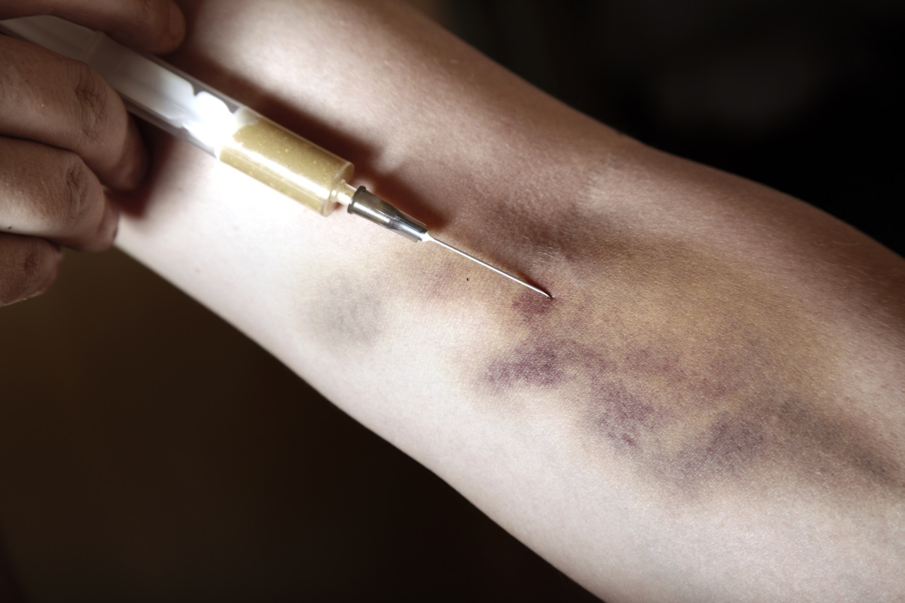
Injury by Abusing Medication Routes
Notes:
CDC Vital Signs: Overdose of Prescription Opioid Pain Relievers-United States 2008

Slide 45
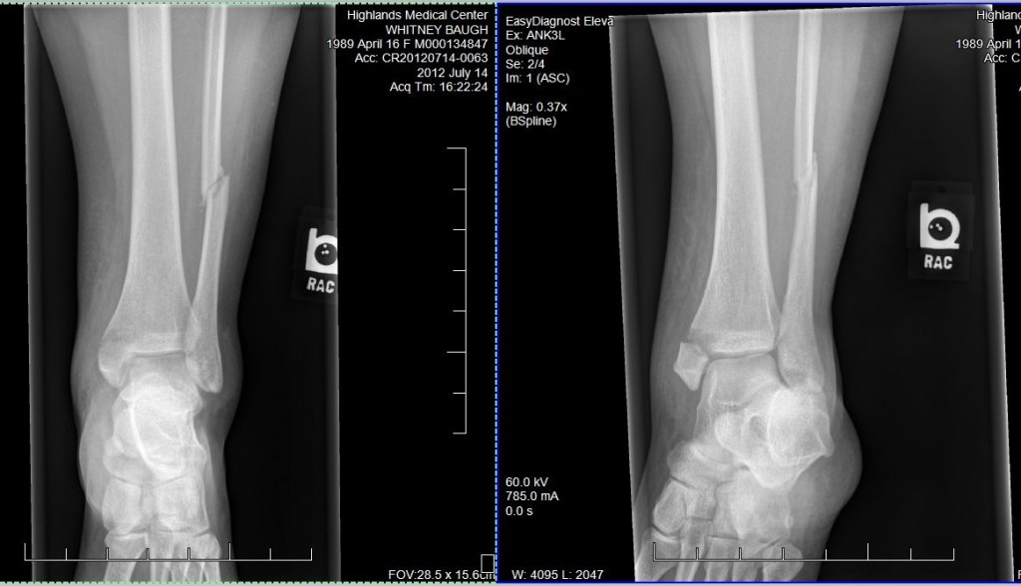
Notes:
Broken fibula in the leg

Slide 46
Drug Identification Key
White = Ritalin or Adderall
Red = Vicodin
Orange = Percocet
Yellow = Xanax
Blue = Valium

Slide 47
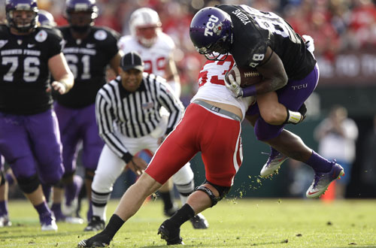

Slide 48
Drug Identification Key
White = Ritalin or Adderall
Red = Vicodin
Orange = Percocet
Yellow = Xanax
Blue = Valium

Slide 50
Drug Identification Key
White = Ritalin or Adderall
Red = Vicodin
Orange = Percocet
Yellow = Xanax
Blue = Valium

Slide 52
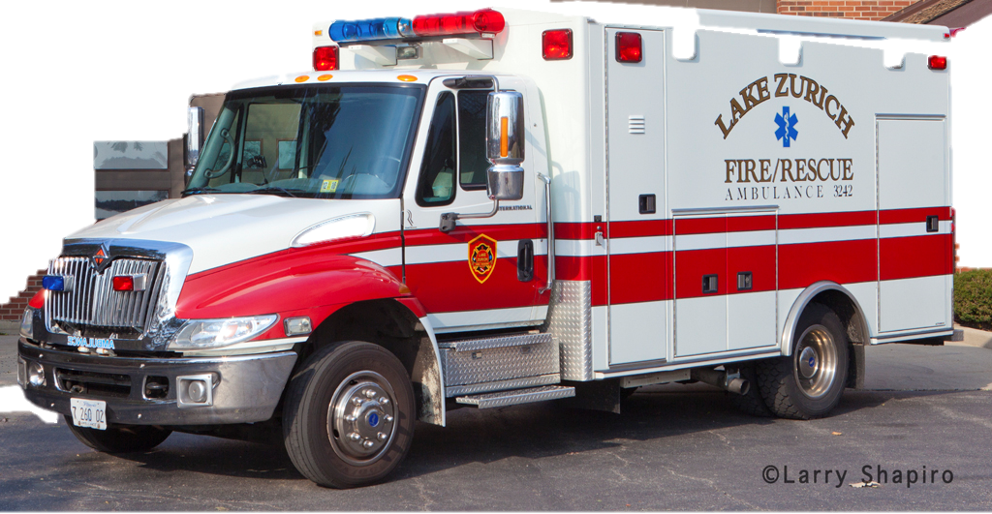
Emergency! Call 911

Slide 53
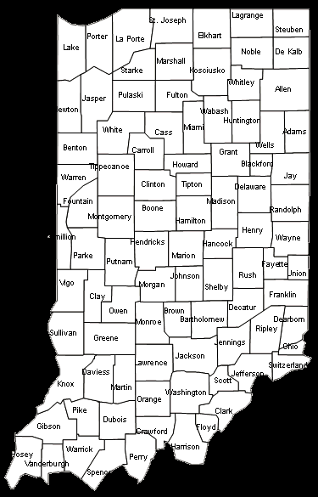
COVERING KIDS & FAMILIES LOCAL COALITIONS and CHIPRA PARTNERS
Last updated 4/30/15
Cass/ Fulton / Miami Counties
Lake County
Madison County
East Central Indiana
LaPorte County
Northeast Indiana
Central Indiana
West Central Indiana
North Central Indiana (proposed)
Covering Kids & Families of Indiana is a statewide
advocacy organization committed to
ensuring all children and adults are
enrolled in health care coverage.
CKF coordinated partnerships provide
outreach and enrollment services in 33 counties
Children’s Health Insurance Program Grant (CHIPRA) reaches eight counties: Allen, Delaware, Kosciusko, Lake, LaPorte,
St. Joseph, Parke and Vermillion

