Slide 1
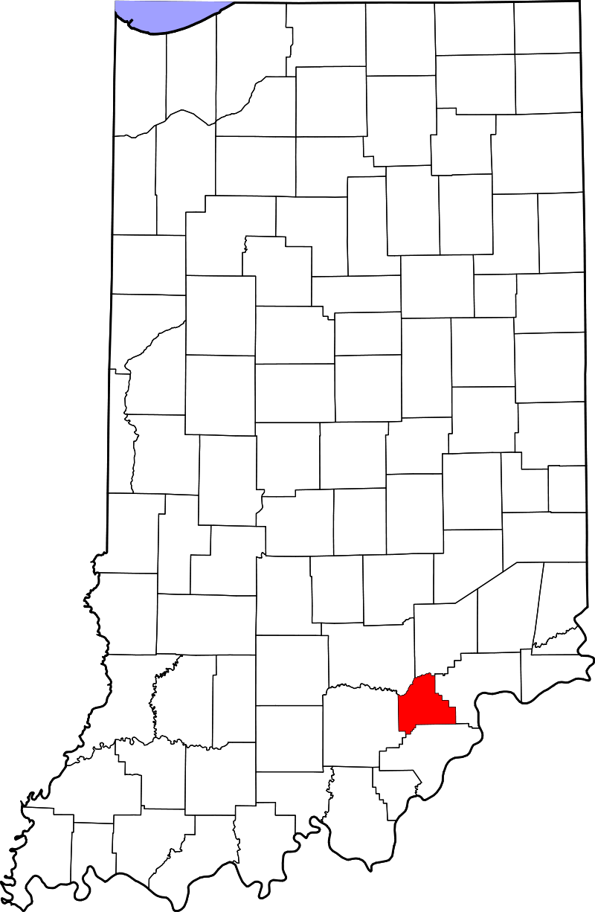
Scott County—Struggle to Strength:
Reclaiming Lives—
Rebuilding
Communities
Notes:
Lori

Slide 2
Objectives
Participants will learn of the prevention and education initiatives of Scott County during the past three years
Participants will learn of prevention and education initiatives for Scott County planned for the future
Participants will discover how coalitions have helped move the county from a place of despair and grief to a community of abundant life and dignity, where recovery is always possible.
Notes:
Lori

Slide 3
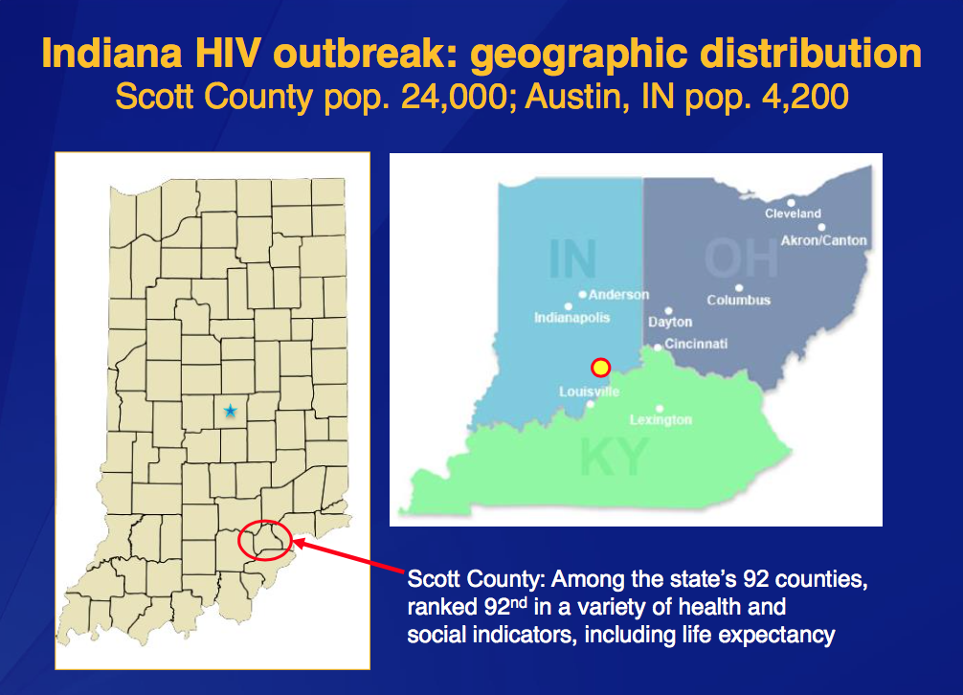
Notes:
Lori

Slide 4
Drug Overdose Deaths 2011-Present
2011: 19 Drug Overdose Deaths (majority on Opana in combination w/alcohol & other drugs)
2012: 15 Drug Overdose Deaths
2013: 7 Drug Overdose Deaths
2014: 5 Drug Overdose Deaths
2015: 6 Drug Overdose Deaths to date
Notes:
Lori

Slide 5
History and Background
10% of Austin’s 4200+ population are IDUs (Intravenous Drug Users)
Substantial unemployment, high proportion of adults with little or no high school completion, high poverty levels, limited health care access
November 2014: first 2 cases of HIV reported
End of March 2015: HIV Outbreak declared epidemic
October 2015: more than 180 HIV cases
Detox services are limited and primarily associated with serving jail time
One Stop Shop (Austin) offers HIP enrollment, vaccines, HIV prevention, treatment, resources, and substance abuse referrals, job counseling/GED/local training
Needle Exchange Program provides harm reduction benefits and serves as gateway to additional counseling and service referrals
Notes:
Lori

Slide 6
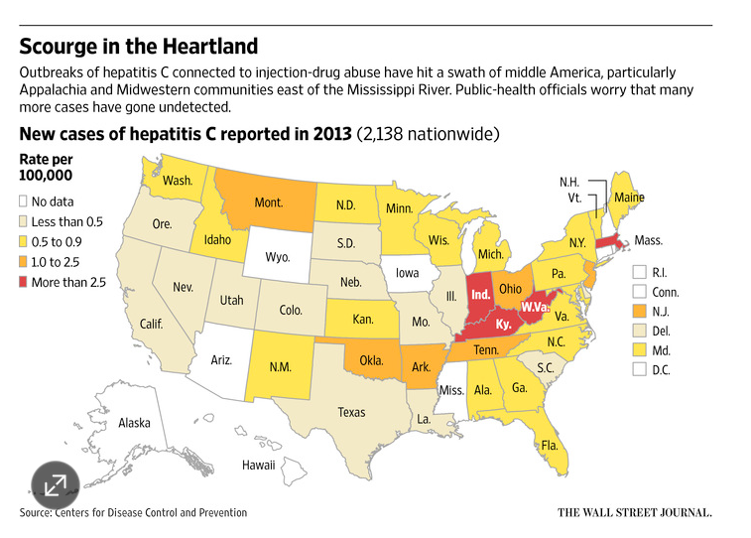
Notes:
Jene

Slide 7
Scott County Prevention Planning
Work Objectives
Identify any gaps in prevention efforts
Establish and define the potential role of prevention in short and long term response to increased IV drug use and HIV infections
Begin planning for adaptations to current work plan to address identified gaps
Plan for increased coordination with county-wide response to changes within the County
Notes:
Jene

Slide 8
Risk and Protective Factors
Low Commitment to School
Laws and Norms Favorable to Drug Use
Early Onset of Drug Use
Family Conflict
Notes:
Jene

Slide 9
Risky Behaviors: Consequences:
Youth Alcohol Use
Overdose deaths
Youth Marijuana Use
Product: Prevention of non-medical IDU
HIV/HepC
Young adult Rx non-medical use
Community Reaction
T4SC
IDU (Opana/Heroin)
Denial
Treatment Push
SUD Stigma
Needle Exchange
Notes:
Behavior = Lori Consequences = Jene

Slide 10
Prevention Strategies To Date
LifeSkills
Guiding Good Choices
Circles
Positive Social Norms Campaign: “What’s Your Side Effect?”
All Stars
Footprints
Austin 21st Century Learning Center
Scott County Family YMCA 21st Century Learning Center
4-H/Girl Scouts, Boy Scouts
PRIME For Life
Children In the Middle
Parents Who Host
QPR Suicide Prevention
Scott County YMCA Youth Programs
Just Say No Club/SADD Club
Builders Club/Key Club
Sunshine Club/Hi-Y Club
Youth Grantmaking Council
Notes:
Jene = LifeSkills, GGC, Circles Lori = WYSE

Slide 11

Notes:
Lori

Slide 12
Notes:
Lori

Slide 13
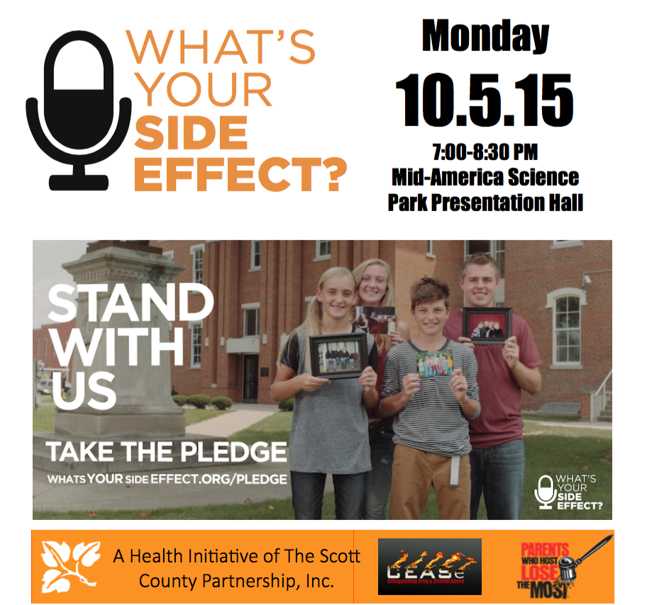
Notes:
Lori

Slide 14
Environmental Strategies To Date
Pain Clinic Ordinance
ER Pain Medication Policy
Drug Take Backs
No alcohol sold in family shopping establishments
Promotion of Physician Toolkit; changing prescribing practices
INSPECT Training for providers
Public Education: Rx Drug Abuse Signs and Proper Storage/Disposal Displays and Take-Aways
Expanding MAT (Medication Assisted Treatment)
Naloxone Training for first responders
Notes:
Lori

Slide 15
Steps for Prevention Planning
Assessment
Focus Groups
Mobilization/community development
Community education/capacity building
Partnering and Collaborating
De-Stigmatize Substance Use Disorder
Strategic Planning (Get Healthy Scott County)
Notes:
Jene

Slide 16
Future Prevention and Education Initiatives
Focus and Target Media: Positive Social Norms Campaign
Conduct and Analyze Focus Groups with IDUs and those in recovery
Mentoring/Expand Circles
Notes:
Jene

Slide 17
Future Prevention and Education Initiatives Starting ASAP:
Focus and Target Media: Positive Social Norms
  Weekly full page PSA in county newspaper
  Daily radio PSAs on county radio station
  Centerfold PSAs in Get Healthy Scott County Magazine
Conduct and Analyze Focus Groups
  Focus Groups with IDU population and people in recovery
  White Paper to be written with results
Notes:
Lori

Slide 18
Future Prevention and Education Initiatives continued:
Mentoring/Expand Circles
  Aggressive recruiting campaign to recruit Allies
  Work with Treatment Programs to identify persons coming out of treatment and needing re-entry support
Notes:
Jene

Slide 19
Coalition Partnerships
CEASe
Coalition to Eliminate the Abuse of Substances (LCC)
Scott County Partnership
Formed in 1998 to address problems in community with broad-base representation
Get Healthy Scott County
Scott County Health and Recovery Focus Area
Notes:
Lori = CEASe Jene = SCP and GHSC

Slide 20
History of Collaboration
The Coalition | The Work Accomplished
Early Childhood Coalition | Developed one-stop shop for Early Childhood Education called “Kids’ Place” Included a Children’s Health Clinic Special Needs Child Care Child Care Center/pre-school
Scott County Partnership, Inc. | Built Scott County Clearinghouse Built LifeLong Learning Center Began Drop Out Prevention Task Force
Drop Out Prevention Task Force | Increased graduation rates of county from 55% - 75% Began Credit Recovery programs for high school students Began after-school programs Began “Attendance Review Board” to address school attendance Events & Services promoting education as a value
Notes:
Jene

Slide 21
Get Healthy Scott County
2014 - Undertook Assessment to determine new focus area
February, 2015 – Determined new focus area to be Substance Abuse
March, 2015 – Declared to have an HIV epidemic
August, 2015 – Leadership Summit sponsored by DMHA continued in September. GHSC was assisted with development of the new focus area.
Notes:
Jene

Slide 22
Scott County Health & Recovery
Vision: Together Scott County will be a community of abundant life and dignity where recovery is always possible.
Mission: Will provide structure & support to individuals, families, & Scott County community as it relates to substance abuse prevention, treatment and life-long recovery by:
  Creating a recovery-oriented system of care that is easily accessible from multiple entry points without barriers
  Increasing education & awareness to decrease discrimination & stigma of substance use disorder
  Considering and treating childhood trauma as a root cause
  Mobilizing primary care providers, faith community and service providers to meet basic health & wellness needs
Notes:
Lori

Slide 23
The Work Has Begun: Subcommittees
Transportation
  Community survey to improve effectiveness of existing transportation
  Develop improved transportation routes
Treatment Services in Jail
  Expanded treatment programs
  Prep for transition
Recovery Support
  Improve access to availability of recovery groups
  Increase number of people identifying themselves in recovery
Re-Entry System
  Conduct a community assessment for re-entry
  Create clearinghouse for pathways to re-entry
Notes:
Jene = 1, 2 Lori = 3, 4

Slide 24
Components for Comprehensive Recovery-Oriented System of Care
Prevention
Judicial/Corrections/Law Enforcement
Treatment/Rehabilitation
Re-Entry into Community / Transitional Living
Long-term Recovery Support
Notes:
Jene

Slide 25
Scott County believes with our successful history of collaboration on multiple issues in the past, we will be able to pull together and successfully address the issue of substance abuse in our community. We will become a community of abundant life and dignity where recovery is always possible!
Notes:
Lori

Slide 26
Where is your community in this process?
Questions?

Slide 27
Contact Information:
Jene Bridgewater, M.Div.
Executive Director
Scott County Partnership
jene.bridgewater@scottcountypartnership
(812) 752-6365
Lori Croasdell, M.A.
Coordinator, CEASe of Scott County
Rx Drug Abuse Prevention Coordinator
Communities That Care Outreach Coordinator
lcroasdell@me.com
(812) 820-0620

