Slide 1

Vulnerable Populations,
Human Trafficking and
Drug Abuse

Slide 2
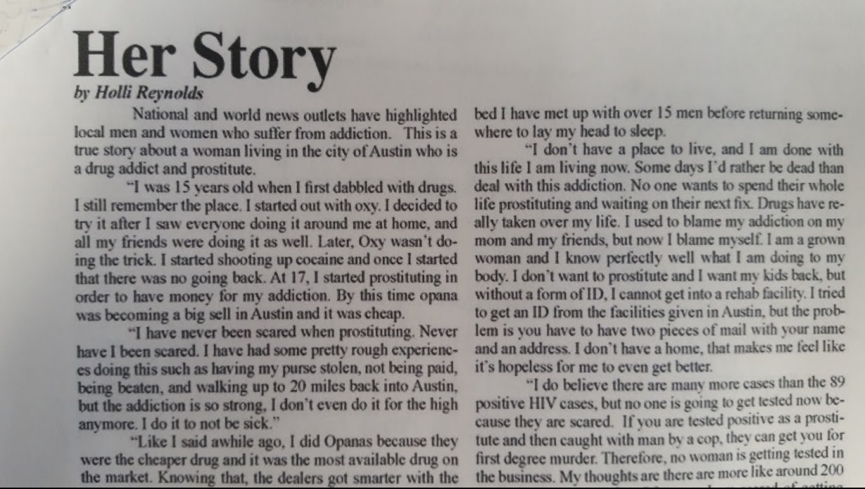
“Her Story”

Slide 3
Intersections of Human Trafficking and Substance Abuse
Recruitment through drug use: traffickers may target and recruit individuals who already have a drug addiction.
Control through drug use: traffickers may use drug addiction to keep the victim in a trafficking situation. Drugs could be used as reward or punishment.
Drug use as a coping mechanism: victims may use this as a way to respond to the trauma of their trafficking situation and self-medicate.
Drug Purchase/Sale: traffickers may ask for drugs in exchange for their victims; or, may also force their victims to sell drugs for them.

Slide 4

Intersections of Human Trafficking and Substance Abuse
Estimates reveal that between 40 and 85 percent of all persons engaged in prostitution are drug users. (1)
Physical Risks include drug and alcohol addiction (2)
“Victims may develop substance abuse problems or addictions from being coerced through drug use by their traffickers or by using substances to cope with their situation.” (3)
www.alcoholrehab.com
http://www.acf.hhs.gov/sites/default/files/orr/fact_sheet_sex_trafficking.pdf
http://www.ncbi.nlm.nih.gov/pmc/articles/PMC3651545/

Slide 5
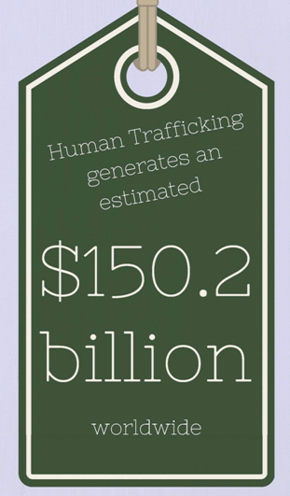
What is Human Trafficking?
State Law:
When a person uses force, threat of force, or fraud to recruit, harbor, or transport another person to engage in prostitution, or participation in sexual conduct or in which the person induced to perform such acts has not attained 18 years of age. (3)
Federal Law:
When a commercial sex act is induced by force, fraud, or coercion, or in which the person induced to perform such act has not attained 18 years of age. (1)
(2)
Victims of Trafficking and Violence Protection Act of 2000, Pub. L. No. 106-386 (2000), available at http://www.state.gov/documents/organization/10492.pdf.
International Labour Office, Profits and Poverty: The Economics of Forced Labour (2014), available at http://www.ilo.org/wcmsp5/groups/public/---ed_norm/---declaration/documents/publication/wcms_243391.pdf. See also Remarks at the Release of the 2014 Trafficking in Persons Report, U.S. Dept. of State (June 20, 2014) available at http://www.state.gov/secretary/remarks/2014/06/228083.htm. See also Civilian Security, Democracy, and Human Rights: The Economics of Forced Labor, U.S. Dept. of State (June 2014), available at http://www.state.gov/secretary/remarks/2014/06/228083.htm.
http://iga.in.gov/legislative/laws/2015/ic/titles/035/articles/042/chapters/3.5/

Slide 6

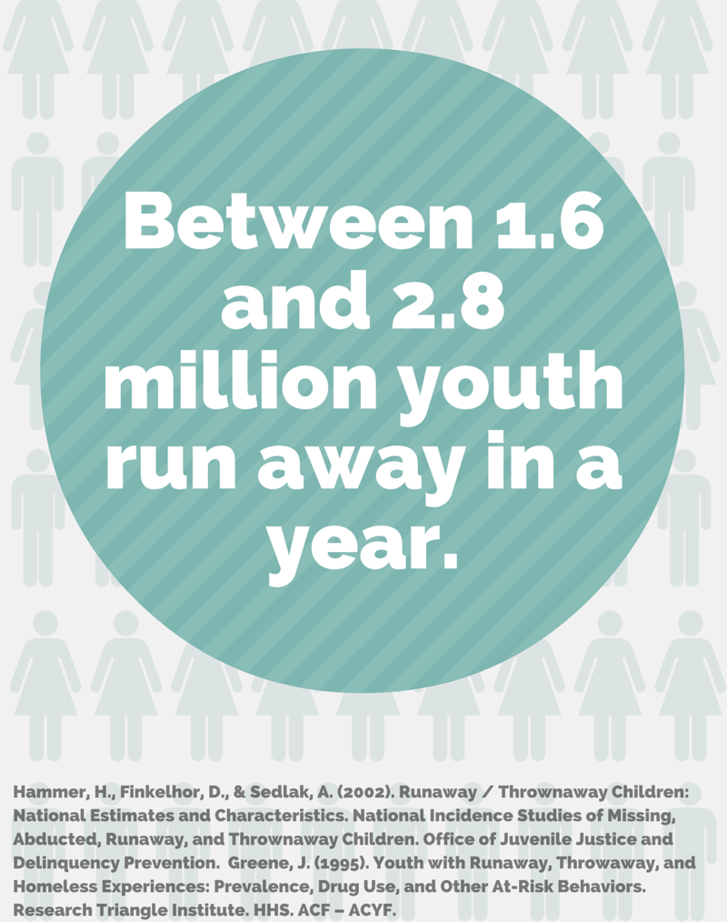
Human Trafficking in Numbers
12-14 is the average age that U.S. kids are first pulled into commercial sex. (1)
83% of sex trafficking victims found in the U.S. were U.S. citizens. (2)
Some research indicates that the average age of entry for U.S. girls is 12 to 14, while the average age for U.S. boys and transgender youth is 11 to 13. See Amanda Walker-Rodriguez and Rodney Hill, Human Sex Trafficking, FBI Law Enforcement Bulletin (March, 2011), available at http://www.fbi.gov/stats-services/publications/law-enforcement-bulletin/march_2011/human_sex_trafficking. See also Ernie Allen, President and CEO of the National Center for Missing and Exploited Children, speaking to the House Victims’ Rights Caucus Human Trafficking Caucus, Cong. Rec., 111th Cong., 2nd sess., 2010.
Human Trafficking/Trafficking in Persons, Dept. of Justice Statistics, http://bjs.ojp.usdoj.gov/index.cfm?ty=tp&tid=40 (last visited 1/14/2012).

Slide 7
Human Trafficking – Overlap with crimes and other factors
Child Abuse
Domestic Violence
Drug Use
Sexual Assault
Runaway Youth
Human Trafficking
Sexual Identity
Homelessness
Unstable Mental Health
Poverty
Labor Exploitation
Literacy
Source: Futures Without Violence

Slide 8
The Trafficked Person
Human Trafficking reaches every culture and demographics. Regardless
of their demographics, victims are vulnerable in some way, and the
traffickers will use their particular vulnerability to exploit the victim.
Some risk factors include:
  Youth
  History of childhood abuse
  Prior involvement in child welfare system
  Poverty
  Unemployment
  Desperation
  Homes in countries torn by armed conflict, civil unrest, political upheaval, corruption, or natural disasters
  Family backgrounds strife with violence, abuse, conflict
  Homelessness
  A need to be loved
  Immigration Status
  Drug use

Slide 9
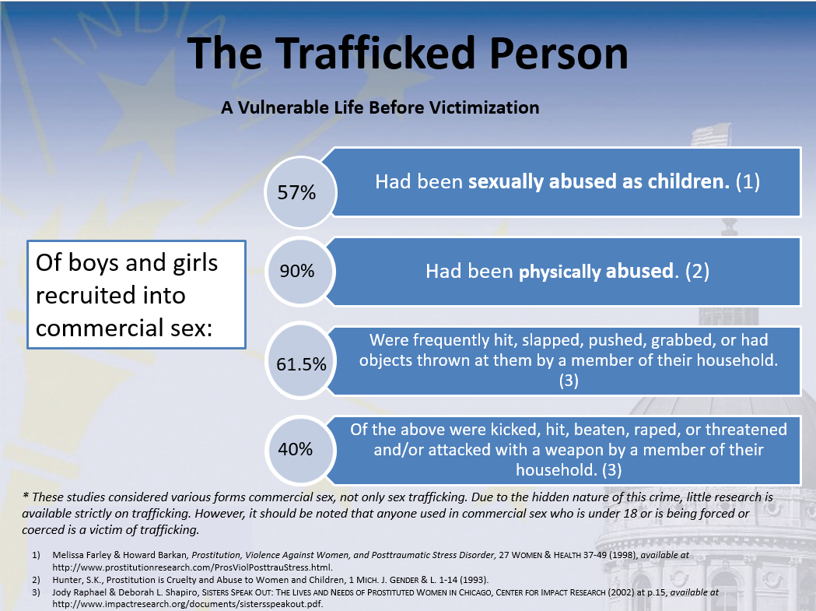
Notes:
9

Slide 10
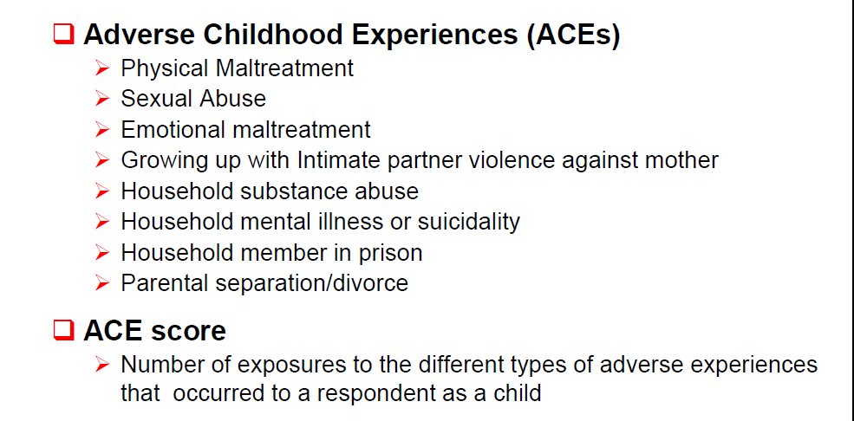
The Adverse Childhood Experience Studies
Jim Mercy, Division of Violence Prevention, National Center for Injury Prevention and Control, Centers for Disease Control and Prevention, The Public Health Implications of Child Sex Trafficking (PowerPoint presentation).

Slide 11
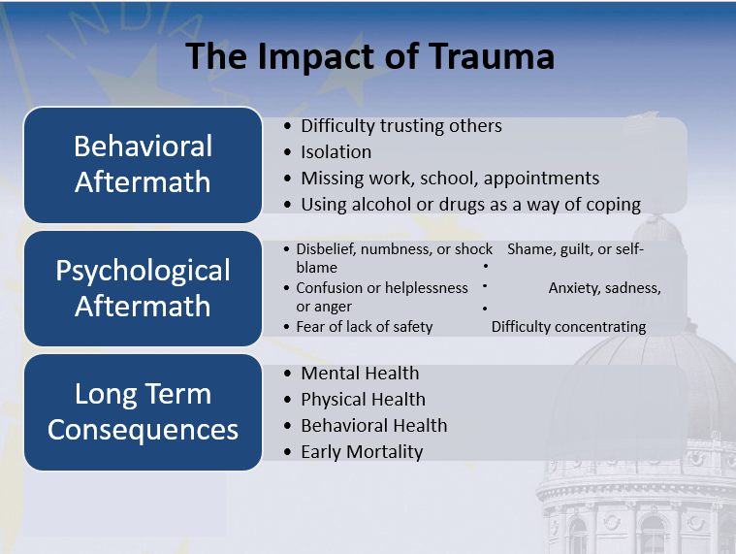

Slide 12
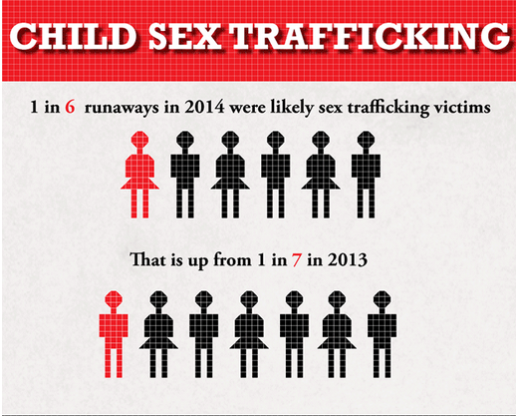
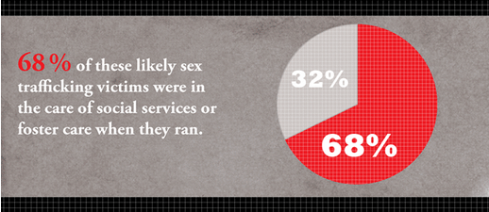
Runaways and Human Trafficking
“I’m 12. I ran away last year and a guy gave me food and shelter. Now he’s emailing and calling me. He’s the only one who understands me. He says he knows how I feel and that he’ll take care of me. I want to run away with him. Should I? Do you have advice? What if something goes wrong?”—Posting on National Runaway Safeline Forum
National Center for Missing and Exploited Children: http://www.missingkids.com/1in6

Slide 13
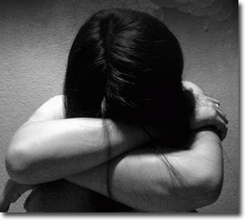
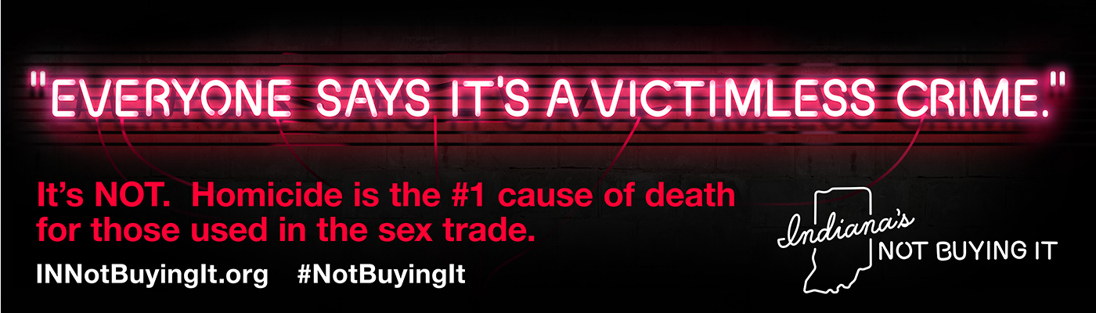
Anti-demand is critical: Further victimization at the hands of purchasers
82% had been physically assaulted, 83% had been threatened with a weapon, 68% had been raped, 84% reported current or past homelessness (1)
34 is the average age of death for those used in prostitution. (2)
One man told researchers he thought of prostitution like buying a cup of coffee: “When you’re done, you throw it out.”
1) Melissa Farley & Howard Barkan, Prostitution, Violence Against Women, and Posttraumatic Stress Disorder, 27 Women & Health 37-49 (1998), available at http://www.prostitutionresearch.com/ProsViolPosttrauStress.html
2) John J. Potterat, Devon D. Brewer2, Stephen Q. Muth, Richard B. Rothenberg, Donald E. Woodhouse, John B. Muth, Heather K. Stites & Stuart Brody, Mortality in a Long-term Open Cohort of Prostitute Women, 159 American Journal of Epidemiology 778-785 (2004), available at http://aje.oxfordjournals.org/content/159/8/778.full
3) Melissa Farley, et. al, Comparing Sex Buyers With Men Who Do Not Buy Sex: New Data on Prostitution and Trafficking, J Interpers Violence August 31, 2015 088626051560087 http://jiv.sagepub.com/content/early/2015/08/28/0886260515600874

Slide 14
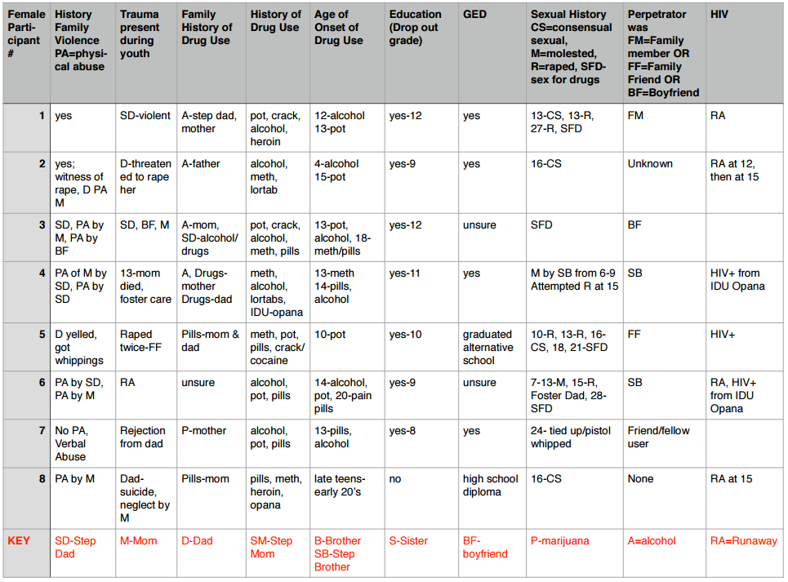
Scott County, Indiana
Conducted interviews with women in Scott County
Looking at history of abuse and drug use

Slide 15
Alternative Court Models
Columbus CATCH Court
Chicago Prostitution and Trafficking Intervention Court
New York Human Trafficking Intervention Courts

Slide 16
If you believe someone is a victim of Human Trafficking:
Call 911 if there is an emergency or crime occurring currently.
Then…
  National Human Trafficking Resource Center Hotline Number 1-888-3737-888 or send a text to BeFree (233733)
  Indiana Child Abuse and Neglect Hotline Number 1-800-800-5556
  humantraffickingtip@atg.in.gov (non-emergency)

Slide 17
Contact Information:
Abigail Kuzma, Assistant Attorney General, Victim Services and Outreach Division, OAG
Abigail.Kuzma@atg.in.gov
(317) 234-6843
Kathleen Bates, JD, Founding Director, Indiana Coalition for Prevention and Treatment (ICPT)
kbates@icptadvocacy.org
(317) 782-5669
Lori Croasdell, Coordinator, (CEASe) Coalition to Eliminate the Abuse of Substances of Scott County, Rx Drug Abuse Prevention Coordinator, Communities That Care Outreach Coordinator
lcroasdell@me.com
(812) 820-0620

