Slide 1
Prescription Drug Abuse And The Toxicology Of Medication Monitoring
Andrea Terrell, PhD, DABCC
Chief Scientific Officer
AIT Laboratories
Indianapolis, IN

Slide 2
Prescription Drug Abuse
>125 million ED visits in 2011, 2.5 million (2.0%) drug misuse or abuse related
27% illicit drugs only
34% pharmaceuticals only
35% combination (illicit, alcohol, pharmaceuticals)
2004 to 2011: 148% increase in ED visits related to pharmaceutical drug misuse or abuse (336K to 835K)
Benzodiazepines up 149%
Opioids up 183% (172K to 488K)
All drugs except Propoxyphene saw an increase
Short term rates are slowing, still increasing
Data from DAWN reports

Slide 3
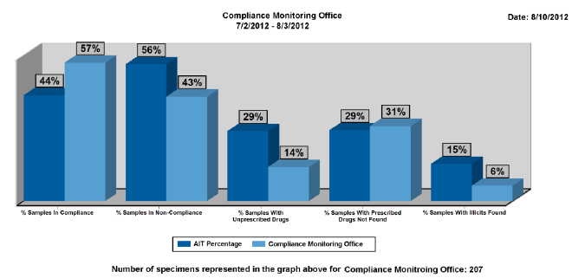
Magnitude of Non-compliance

Slide 4
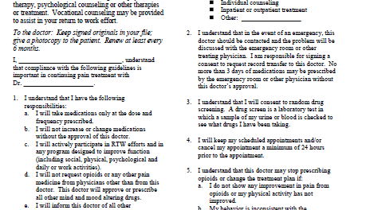
Sample Opioid agreement (WA State)

Slide 5
Overview of the testing process
Accession and order testing
Screen by Immunoassay or Mass Spectrometer
Confirm by Mass Spectrometer
Confirm all positives
Confirm prescribed meds, regardless of screen results
Certify results
Send lab report, ancillary information about results
Toxicologist interpretation

Slide 6
Lack of Standardization
What is not standardized
Panel components
Screen method
Confirmation method
Cutoffs for screen
Cutoffs for confirmation
Who and when to test
Venue for testing (in office or in laboratory)
What is standardized
Accreditation of clinical labs

Slide 7
Pain management panel components
Opioids
6-MAM (metabolite of heroin, not always included)
Hydrocodone
Hydromorphone
Morphine
Codeine
Oxycodone
Oxymorphone
Methadone
Fentanyl
Buprenorphine
Benzodiazepines
Alprazolam metabolite
Clonazepam metabolite
Lorazepam
Diazepam metabolite
Oxazepam
Temazepam
Alcohol
Drugs of abuse (cannabinoids, cocaine, methamphetamine)
Other therapeutics (Amphetamine, Barbiturates, Soma, Tramadol)
Specimen validity tests (pH, creatinine, adulterants)

Slide 8
Heroin in pain management
Heroin metabolizes into 6-MAM and Morphine
Codeine usually present as well
Not all Opiates analytical methods measure 6-MAM
SAMHSA process is to run 6-MAM if Morphine is detected
Separate method
Of 152,000 pain management samples received, approximately 1300 (0.9%) were positive for 6-MAM
MORPHINE
HEROIN
6-MAM

Slide 9
Analytical Methodology
Screen
Immunoassay
Lateral flow device – dipstick, cup
Automated analyzer
Mass spectrometry
Confirmation
Mass spectrometry – provides 100% unequivocal identification
Liquid or gas chromatography paired to the mass spec
Immunoassay is not an acceptable confirmatory method
Even if sold as “quantitative” or “semi-quantitative”
Cannot detect the presence of a specific drug

Slide 10
Cutoffs
Screen
Manufacturer set cutoffs
Opiates – 300 or 2000ng/mL
Benzodiazepines – 200 or 300ng/mL
Can validate to lower cutoffs
Opiates – 50ng/mL
Benzos – 75ng/mL
Confirmations
Completely lab dependent

Slide 11
Who and When to test
Assess
Comprehensive testing
Characterize
Risk assessment
Monitor
Low: directed analyses for drugs prescribed
Low
High
Moderate
Moderate: limited panels
High: comprehensive testing, every time
Risk based approach

Slide 12
Instant and “screen only” testing
Reimbursement driving more physicians to implement some POC drug screening
Generally a cup, dipstick or automated analyzer used at the point of care/collection
Potentially valuable “truth serum”
Limitations exist:
1. Sensitivity – cutoffs too high to detect the drug of interest
2. Selectivity – not definitive, can’t distinguish between the drug of interest and other compounds in the sample

Slide 13
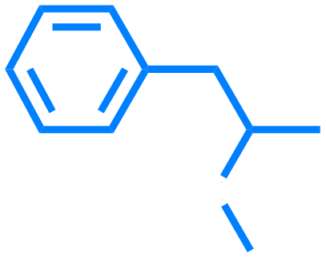
True or False Positive?
Phentermine
Methamphetamine
Both give a positive on the amphetamine immunoassay screen

Slide 14
Blood Testing
Typical specimen in compliance monitoring is urine
Blood analysis provides complementary, and unique information
Blood and urine cannot be compared directly as they provide different information:
Urine is a more suitable matrix for identifying illicit, or non-prescribed drug use, has longer window of detection
Blood is a more suitable matrix for evaluating the prescribed drug (eg. blood concentration relative to dose)
Blood testing of pain management patients can play a crucial role in accident and death investigations

Slide 15
Blood Study of Functional Pts. (Tennant et al, Practical Pain Management, March 2006)
Age/Sex | Drug | Blood Conc. | Normal | Toxic
42/F | Fentanyl Transdermal | 8.2 ng/mL | 1 – 3 | > 3
55/F | Codeine | 480 ng/mL | 30 – 120 | > 1000
48/F | Hydrocodone | 396 ng/mL | 10 - 40 | > 100
44/F | Methadone | 2580 ng/mL | 50 - 1000 | > 200
56/F | Morphine | 828 ng/mL | 10 - 80 | > 200
53/F | Oxycodone | 458 ng/mL | 10 – 100 | > 200
Study patients on therapy for 1-50 years
Blood collected 1-2 hours after regular dose
Normal & toxic ranges often don’t apply in chronic opioid therapy
Blood concentrations overlap those seen in death investigations
Routine blood testing for pain medications could be useful in the event of patient death or DUI charge
Tolerance must be considered when interpreting blood concentrations of an opioid

Slide 17
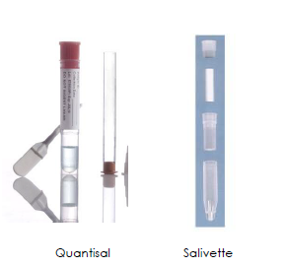
Oral Fluid/Saliva
Ease of collection
Non-invasive
Procedural and analytical hurdles
Some drugs cause dry mouth
Difficult to obtain consistent volume
Creates problem when using “buffered” device and quantitation is desired
Often multiple drugs present, so volume could be insufficient
On average 2.5 confirmations per urine sample (AIT data)
Urine more appropriate for qualitative compliance monitoring
Blood more appropriate for dosage compliance
OF may be useful alternative, challenges remain

Slide 18
Opiate Metabolism
CODEINE
MORPHINE
HEROIN
HYDROCODONE
6-MAM

Slide 19
Opiate Metabolism (cont.)
HYDROCODONE
MORPHINE
OXYCODONE
OXYMORPHONE
HYDROMORPHONE

Slide 20
Anomalies in Medication Monitoring
The presence of morphine when morphine is not prescribed (dietary)
The presence of codeine when prescribing morphine (pharmaceutical grade impurity)
The presence of hydrocodone when prescribing oxycodone (pharmaceutical grade impurity)
The presence of 6-MAM when prescribing morphine (pharmaceutical grade impurity)
The presence of Hydromorphone when prescribing morphine (minor metabolic pathway)
The presence of Hydrocodone when prescribing Codeine
(minor metabolic pathway)

Slide 21
Pill scraping – another possible trick when screening alone is used

Slide 22
Thank you!
Andrea Terrell, PhD
aterrell@aitlabs.com
toxicologist@aitlabs.com

Slide 23
FAQs
Can immunoassay be confirmatory?
Is it cost prohibitive to require UDM for every patient on an opioid?
Can the labs handle the volume of increased testing?
What are the limitations of sensitivity for low-dose semi-synthetic opioids?
Do most labs routinely do their own screening (IA) before proceeding to a confirmatory test? Or can Confirmatory be directly ordered. Do you only run confirmatory tests on positive screening?
What is the cost of screening vs. confirmatory tests?
Do you have any data validating typical urine levels for different doses of opioids?
What are the different pain panels typically?
What is the turn-around time for confirmatory testing?
Is there any clinical utility to knowing the actual level of a drug in the urine?
Are there false positives with GC/MS testing ?
If this becomes law...can most physicians assume that a certified lab that advertises confirmatory testing is using low-thresholds? Is there a lab standard for thresholds for confirmatory testing? IS there a lab standard for thresholds for screening testing?
How much urine is needed?

