Slide 1
Teen Abuse of Prescription Medication: Program and Policy Solutions
October 28, 2015

Slide 2
An “epidemic of consequences” - Drug overdose death rates continue to increase
NCHS Data Brief, December, 2011,
Updated with 2009 and 2010 mortality data
2
Notes:
And for the first time the national drug od rate surpassed car crash deaths.

Slide 3
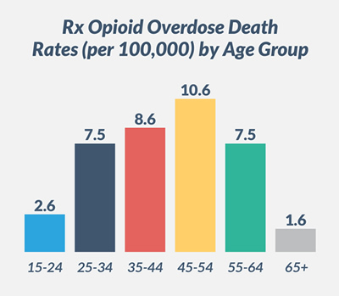
Who is overdosing?
Every day in the United States, 44 people die as a result of a prescription opioid overdose.
Centers for Disease Control and Prevention. National Vital Statistics System mortality data. (2015) Available from URL: http://www.cdc.gov/nchs/deaths.htm.

Slide 4
Partnership’s focus is on young people
90% of all adults with an substance use disorder started using under age 18
50% under the age of 15

Slide 5
Prevalence of prescription drug misuse and abuse by teens remains high
“Any prescription drug misuse includes use of narcotics, sedatives, tranquilizers, and/or amphetamines without medical supervision.
“Only 12th-graders report on their use of all of these drugs; they show a statistically significant decline between 2013 and 2014, from 16 percent to 14 percent, saying that they used one or more of these prescription drugs in the 12 months prior to the survey. The gradual turnaround began after 2005, when 17 percent indicated misuse of any of these drugs.”
- U. of Michigan, Monitoring the Future, 2014

Slide 6
Latest NSDUH data show mixed picture
Past year initiation of non-medical use of psychotherapeutics by teens 12-17 –
numbers in thousands
 | 2008 | 2009 | 2010 | 2011 | 2012 | 2013 | 2014
Nonmedical use of psychotherapeutics | 892 | 851 | 783 | 753 | 727 | 601 | 641
Pain relievers | 822 | 790 | 748 | 671 | 611 | 508 | 489
Oxycontin | 156 | 157 | 159 | 145 | 122 | 99 | 95
Tranquilizers | 283 | 280 | 237 | 298 | 280 | 219 | 254
Stimulants | 196 | 196 | 190 | 169 | 183 | 138 | 183
Methamphetamine | 45 | 49 | 45 | 76 | 31 | 40 | 51
Sedatives | 69 | 76 | 65 | 54 | 44 | 26 | 59
US Dept of HHS: National Survey on Drug Use and Health, 2014

Slide 7
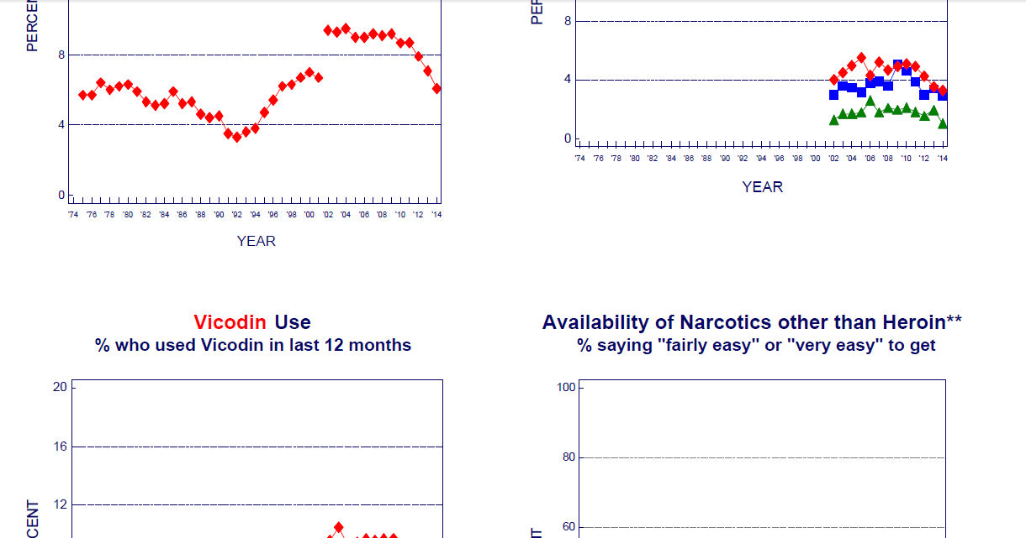
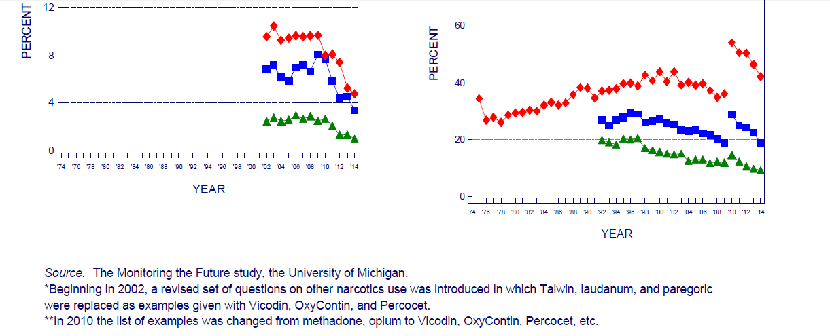

Slide 8
Challenges to Reducing Supply
CDC.gov

Slide 9
Challenges to Reducing Supply
Prescribers often not well trained in addiction medicine or pain management, and unaware of key prevention tools such as Prescription Drug Monitoring Programs (PDMP’s) or Screening, Brief Intervention and Referral to Treatment (SBIRT)
Abused medications continue to be sourced primarily “from family and friends for free” --- i.e., from medicine cabinets and via “sharing”

Slide 10
Policy Solutions
Encourage development and use of Abuse Deterrent Formulations of opiates
Partnership has consistently supported ADF’s as a key tool in keeping abusable medicine out of medicine cabinets, and out of the reach of teens
Specifically, requiring that:
Pharmacies fill prescriptions for ADF formulations only with ADF’s
Insurors cover ADF medications at same level as non-ADF medications

Slide 11
Progression to Heroin Abuse
Addiction to Rx pain relievers a precursor to heroin use: 4 out of 5 current heroin users migrated from Rx opiates
Death rates from heroin overdose are increasing rapidly as death rates from prescription opioids are leveling off
CDC Vital Statistics

Slide 12
Policy Solutions
Rebuild National Prevention Infrastructure
Safe and Drug-Free Schools Program and National Youth Anti-Drug Media Campaign eliminated
Increase Use of PDMPs/SBIRT
Prescriber Education in Rhode Island, Maryland, Delaware, Idaho, Louisiana, Maine, West Virginia and Washington State
Increased access to Medication Assisted Treatment
Naloxone for first responders and families
Good Samaritan Laws

Slide 13
Medicine Abuse Project
The Medicine Abuse Project began in 2012 in response to ONDCP’s Prescription Drug Abuse Strategy (2011), calling for education – of parents, youth, patients and prescribers
Brings together 17 corporate partners (pharmaceutical industry, chain drug stores, media), 8 federal agencies and 80+ strategic partners
Comprehensive website at www.medicineabuseproject.org, with content for parents, educators, community leaders and healthcare providers
Resources for parents, healthcare professionals, educators and community leaders – including a Medication Assisted Treatment e-book
“Mind Your Meds” public service ad campaign

