Slide 1
Police and Naloxone “The Indianapolis Experience”
Daniel O’Donnell, M.D.
Medical Director IEMS/IFD
Assistant Clinical Professor IUSOM Dept. of Emergency Medicine

Slide 2
Let me start by telling you a secret
“Now I will tell you how we got here”
Notes:
Police Officers are valuable asset in combating the growing number of opiate overdose deaths in your community.

Slide 3

What are we going to cover
Describe the Indianapolis experience
  How we started
  What were the key steps along the way
Present the science/evidence that has come out of this experience
  Training
  Patient outcomes
  Give you necessary evidence to support your own programs
Goal: Give you the information you need to development your own successful program
Notes:
You know we have an opiate problem
You know about needle exchange
Not what I am covering
I am here to discuss treatment

Slide 4
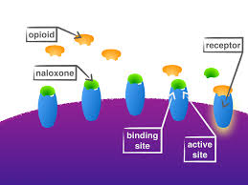
What is naloxone?
Notes:
Describe
Safety profile great

Slide 5
How did this all begin?
IMPD Southwest District Spring 2013
A “Motley Crew”
  Police (all divisions)
  EMS
  Mental health/addiction centers
  Schools
  Criminal Justice
One Mission: How can we combat the rising crime that is associated with the opiate epidemic
CRIME

Slide 6
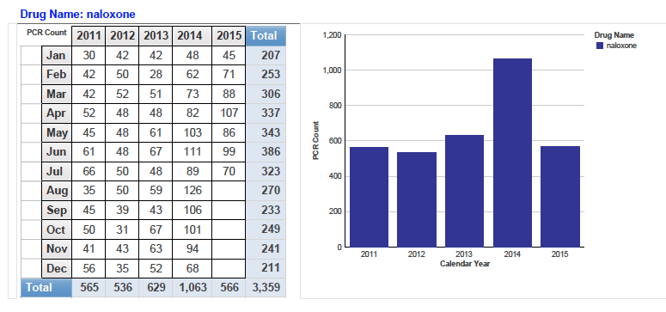
We knew this was a problem

Slide 7
Things took a turn
All parties realized that we “cannot arrest our way out of this problem”
Had to take a fundamental approach
  Education in the schools
    Programs that go beyond current drug education/awareness
    Not your average “Don’t do drugs talk”
  Look at ways to decrease the number of fatalities
    Police naloxone?

Slide 8
Brief history of police and naloxone
Not necessarily a brand new concept
A growing number of police agencies had been successfully delivering intranasal naloxone
  Quincy, MA
  Nassau County, NY
  Boston, MA
All had reported a fair amount of success
Notes:
Quincy Mass Mayors friend OD

Slide 9
Why we thought it was important
Individual OD
Bystanders recognize something is wrong
Activate 911
Public Safety Response
Notes:
Police are on scene first
MINUTES MATTER

Slide 10
The proposal was born
We had the support within the district
Had to go to the City County Building
Emphasize the growing epidemic
Stress the safety of officer delivered naloxone
Highlight the new laws regarding naloxone
  HB 227
Devise a way to make it economically “feasible”
After 20 minutes → All in for our pilot project

Slide 11
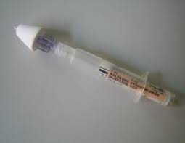
The procedure
All district officers trained:
  Recognition of opioid OD
  Administration of Naloxone intranasally
If deemed an opioid overdose → 2mg Intranasal naloxone
Brief report completed
100% patients transported
If refusal →Immediate Detention
  Concern for self harm
Notes:
Define an ID

Slide 12
The SW District pilot project
Goal: Train 150 officers how to deliver a medication they may have only heard of
Many were not “excited” about this opportunity
Potential perceived barriers
  Viewed as “enabling”
  Goes beyond the scope of what a police officer was trained to do
  Will they even be receptive to the training

Slide 13
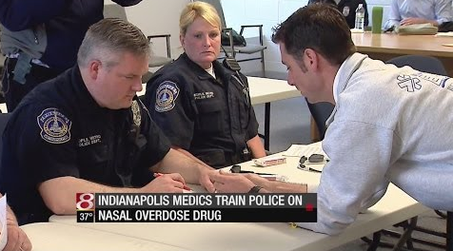
The training
Had to be quick
Stress the importance of the problem
Answer the question “Why police”
  Chain of survival
  Time is lost in an overdose
Dispel potential myths
  Combativeness (< 3% documented)
  Legal questions

Slide 14
attitudes
What would they think about the training program?
Would they reject?
Would it be effective?
Is it even seen as a problem?

Slide 15
The study
Performed a prospective investigation of officer attitudes towards naloxone training
117 subjects
Asked to complete a standardized evaluation
  Experience with opiate overdoses
  Perceived difficulty of naloxone training
  Perceived importance of naloxone training

Slide 16
What did we find
Notes:
Before training they believed that they are there for scene safety not to arrest the patients.

Slide 17
What else
They were seeing it as well
  93.2% on an overdose in 1 year
    49.6% last month
Training was not difficult
  Officers should be trained
Experience mattered
  More overdose cases = higher competency

Slide 18
conclusions
Overwhelmingly positive attitudes towards naloxone training
Consistent with literature showing that police are receptive to harm reduction interventions
Prior experience with opioid overdoses increased confidence

Slide 19
The beginning
Training was complete in 10 days
Officers began using immediately
Fire department asking about police naloxone
“Racing to the scene”
100% feedback to the officers
Time to go department wide

Slide 20
continuation
Began training each district within IMPD
Same model
  Training
  100% medical director review
  100% feedback to officers
Data collection

Slide 21
Data collected
Basic demographics
Indications for administration
  Breathing status
  Level of consciousness
Difficulty with administration
Response to administration
Need for Immediate Detention

Slide 22
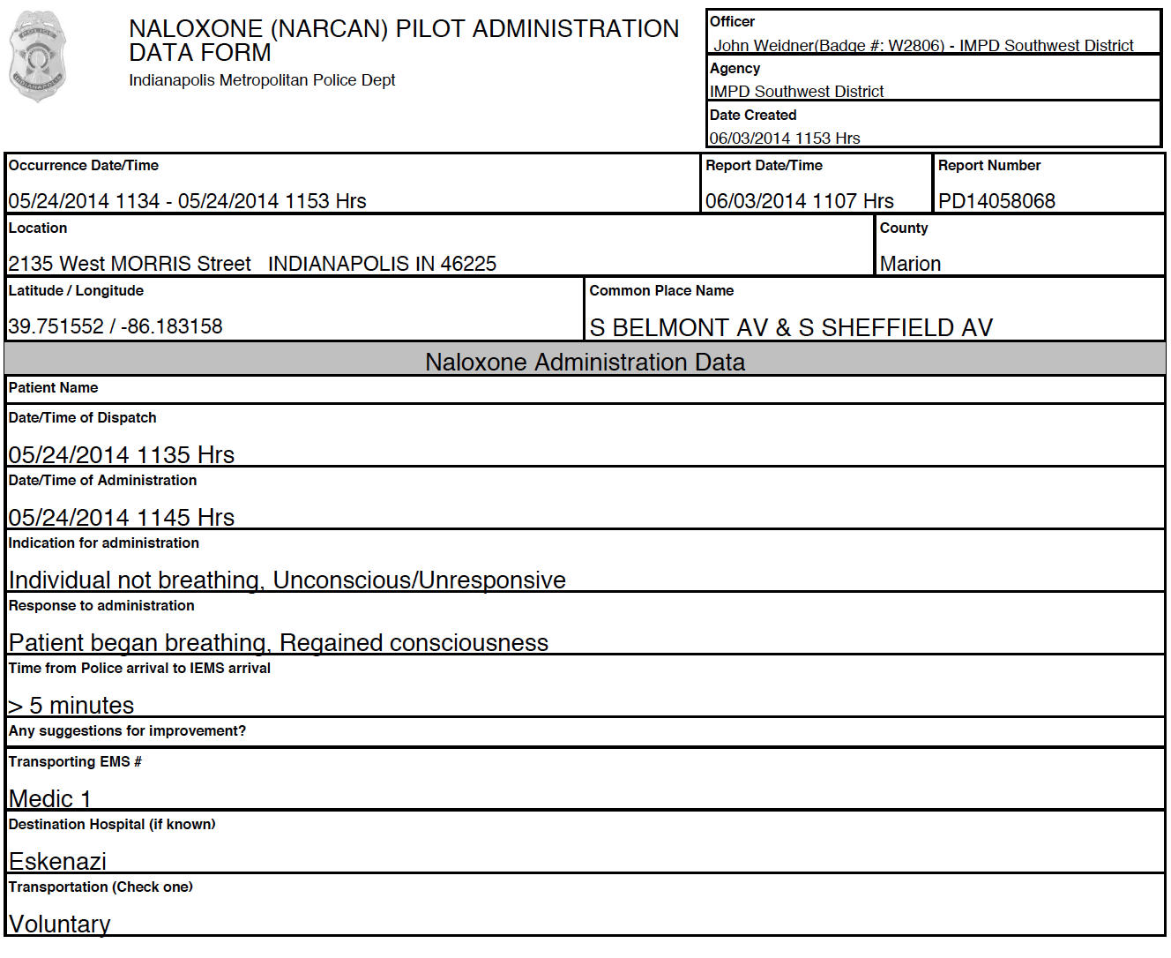

Slide 23
The evidence
Reviewed all police naloxone administrations from April 2014-August 2015
Reviewed all required officer administration forms
Examined EMS runs and hospital outcomes
N = 121 officer administrations

Slide 24
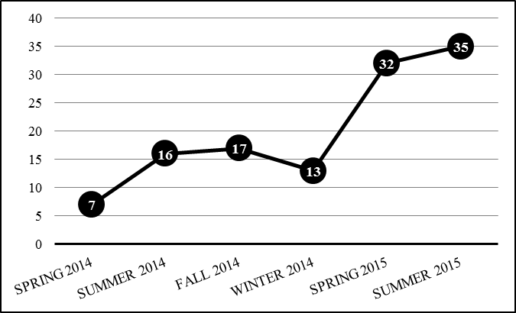
Administration by time of year

Slide 25
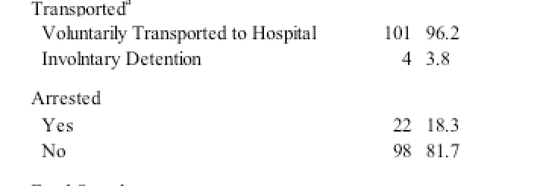
demographics

Slide 26
Indicators and response

Slide 27
EMS and hospital outcomes
Continuing to gather data
Roughly 30% receive additional naloxone by EMS
Almost 95% survive to the ED
90% ultimately discharged from the ED

Slide 28
What does this mean?
Police are appropriately recognizing opiate overdoses on the street
Once recognized, police are safely and effectively administering naloxone
Incidence of combativeness or need for scene escalation are rare
Patients who receive naloxone from police have similar outcomes when compared to those who receive from EMS

Slide 29
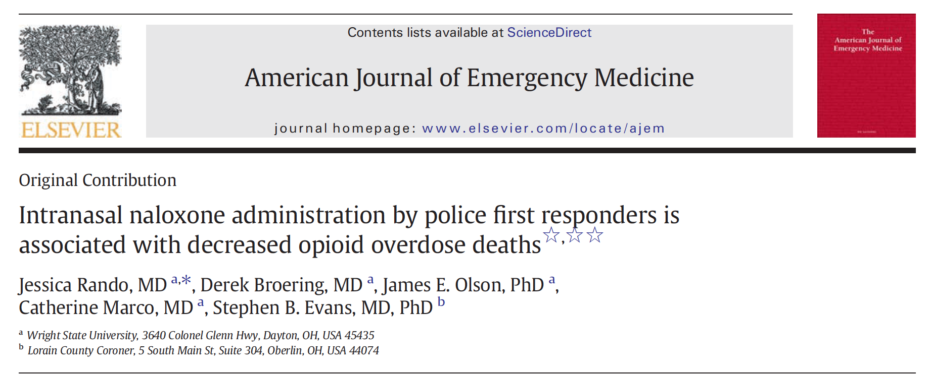
Where do we go from here?
More data is needed to analyze impact on patient care
  Improved outcomes when compared to EMS?
Examine impact on overall mortality

Slide 30
Where we need this now
Rural communities
EMS resources are spread out
Includes ALS and BLS
  Volunteer services
Often times police are first on scene for an extended period of time
As overdose time increases → increase potential for death
This issue is not just an urban problem

Slide 31
What do you do now?
Multidisciplinary approach to combatting overdose deaths seams to be working
Now that lives are being saved → Time to look into treatment
“Outside the box” treatment?
  Home naloxone prescriptions
  Naloxone Rx from Emergency Dept.
  Alternative treatment opportunities

Slide 32
conclusions
This is one step
Would not have been possible if not for support from a MULTIDISCIPLNARY team
Officers are receptive to naloxone training
Officers can be trained to correctly identify opiate overdoses and act
Officer naloxone administration appears safe and effective

Slide 33
Thank you!
Questions?

