Slide 1
Health Care System Unwanted Medication Take Back JimYoung PharmD., CPHQ Quality Assurance/Regulatory Pharmacist

Slide 2
Eskenazi Health
The mission of Eskenazi Health is to advocate, care, teach and serve, with special emphasis on the vulnerable populations of Marion County.
Nearly 70% of patients are Uninsured or have Medicaid.

Slide 3
Eskenazi Health
Emergency Department >100,000 visits per year
Outpatient >800,000 visits per year
Inpatient Adult Admission nearly 14,000 per year
Pharmacy Health Fairs 5 per year

Slide 4
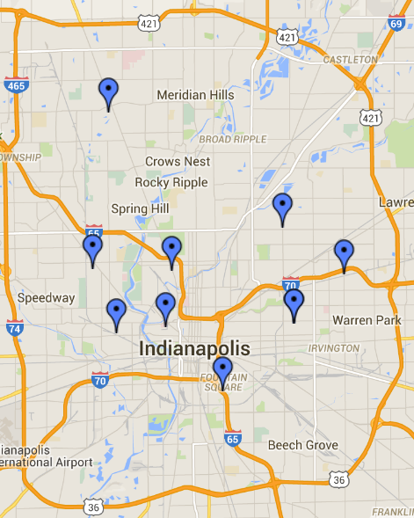
Eskenazi Health Outpatient Pharmacy

Slide 5
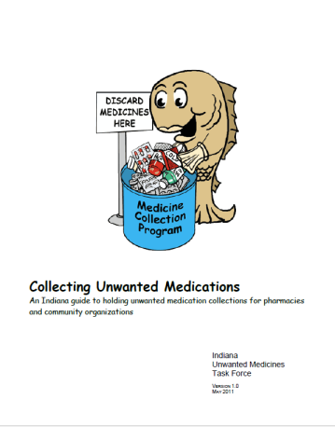
Get Involved

Slide 6
Regulations
DEA
Indiana Code
Board of Pharmacy
EPA/IDEM
DOT
Notes:
Ease to register as collector www.deadiversion.usdoj.gov/drug_disposal/index.htm

Slide 7
Medication Waste
Controlled Substances
Hazardous Waste Classification

Slide 8
Resources
Indiana Attorney General
Indiana Board of Pharmacy
DEA
IUPUI Environmental Health and Safety
Community Resources
Notes:
DEA Enrollment

Slide 9
Milestones
2010 Indiana Unwanted Medications Task Force
November 2011 856 IAC 7 Prescription Drug Take Back Program-No Controlled Substances
2014 Attorney Generals Medication Take Back Workgroup
September 2014 Disposal of Controlled Substances Final Rule

Slide 10
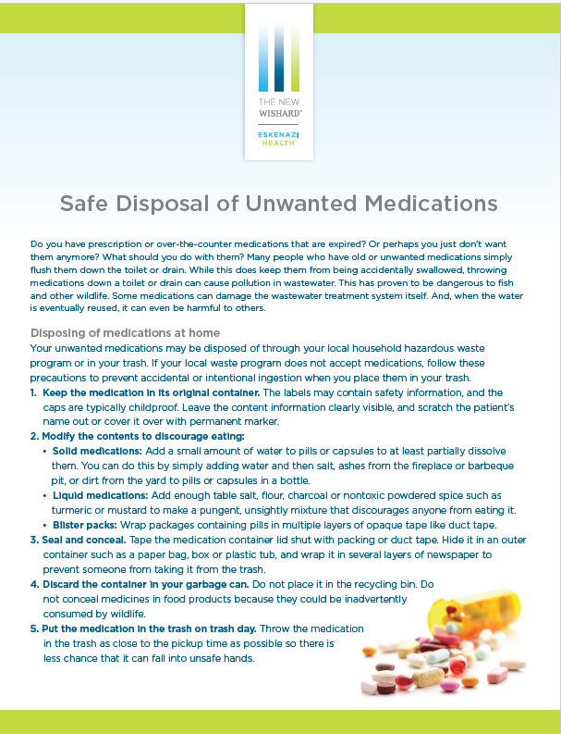
Patient Education

Slide 11
Pharmacy Involvement
Patient Education
Involvement in Health Fairs
Pharmacy Based Take Back Program
Home Health Involvement

