Slide 1
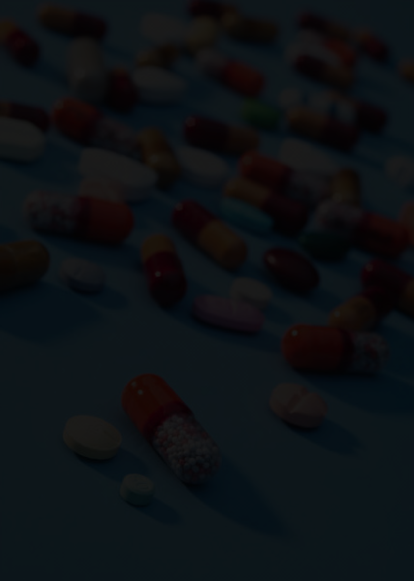


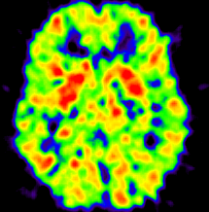

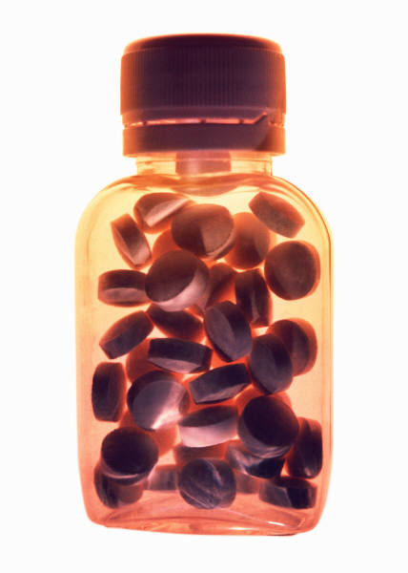
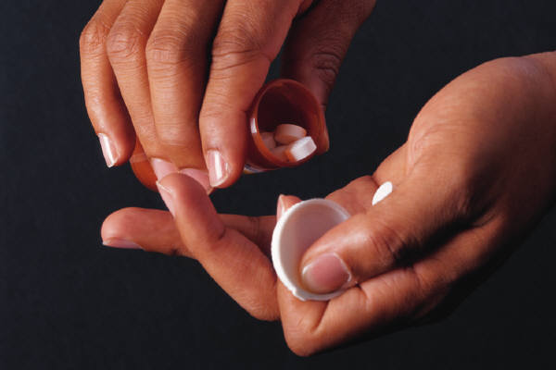


The Science of Addiction:
Prescription Opioid Abuse
Wilson M. Compton, M.D., M.P.E.
Deputy Director, National Institute on Drug Abuse

Slide 2
Key Points:
Prescription opioid abuse is a major problem in USA and is related to recent increases in heroin
  Behavioral and pharmacokinetic factors differentiate Rx use from abuse, but
  Addiction issues transcend the differences between Rx and related illicit substances
  Interventions can be effective--both primary prevention and targeting overdose or addiction

Slide 3
High Rates of Rx Opioid Abuse :
12-Month Prevalence of Rx Opioid Misuse, USA Ages 18-64, 2003-2014
%
Trend, p < .001
Data source: SAMHSA’s National Survey on Drug Use and Health (NSDUH) data, 2003-2014, adults aged 18-64 in the United States.

Slide 4
Increasing Frequent Rx Opioid Misuse:
12-Month Prevalence of 100+ days Rx Opioid, USA Ages 18-64, 2003-2014
Trend, p < .001
%
Data source: SAMHSA’s National Survey on Drug Use and Health (NSDUH) data, 2003-2014, adults aged 18-64 in the United States.

Slide 5
Increasing Rx Opioid Abuse/Depedence:
12-Month Prevalence of Rx Opioid Ab/Dep, USA Ages 18-64, 2003-2014
Trend, p < .001
%
Data source: SAMHSA’s National Survey on Drug Use and Health (NSDUH) data, 2003-2014, adults aged 18-64 in the United States.

Slide 6
Increasing Intensity of Opioid Misuse:
12-Month Prevalence of Rx Opioid Misuse without Frequent Use or Ab/Dep, Rx Opioid Ab/Dep, 100+ days Rx Opioid in USA Ages 18-64, 2003-2014
%
Trends, p < .001
Data source: SAMHSA’s National Survey on Drug Use and Health (NSDUH) data, 2003-2014, adults aged 18-64 in the United States.

Slide 7
Doubling of Treatment for Analgesic Use 2002 - 2013:
Most Recent Treatment in the Past Year for the Use of Pain Relievers among USA Persons Aged 12 or Older
Numbers in Thousands
⁺ Difference from the 2013 estimate is statistically significant at the .05 level.
Source: SAMHSA, 2013 National Survey on Drug Use and Health, released September 2014

Slide 8
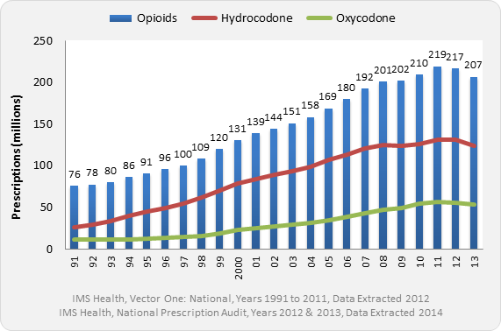
Near Tripling of Opioid Prescriptions Dispensed by U.S. Retail Pharmacies, Years 1991-2013
IMS Health, Vector One®: National, Years 1991-2011, Data Extracted 2012
IMS Health, National Prescription Audit, Years 2012-2013, Data Extracted 2014

Slide 9
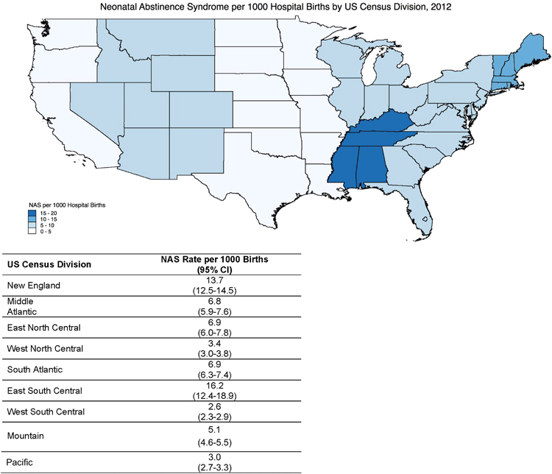
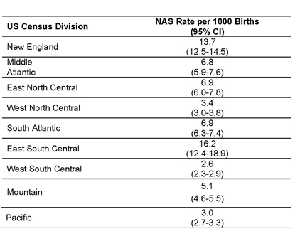
Increasing Neonatal Abstinence Syndrome Incidence & Geography, U.S. 2009-2012
Patrick SW, Davis MM, Lehman CU, Cooper WO. Increasing incidence and
geographic distribution of neonatal abstinence syndrome: United States 2009 to
2012. J Perinatol. 2015 Aug;35(8):667. doi: 10.1038/jp.2015.63. PubMed PMID:
26219703.

Slide 10
Marked Increases in Opioid-related Deaths (parallel to opioid sales and Rx opioid treatment admits), USA
2013 OD Deaths:
43,982 Any Drug
  (41,3(22,810 in 2011)
16,235 Rx opioid
  (16,917 in 2011)
8,257 Heroin
  (4,397 in 2011)bb
Sources: National Vital Statistics System, DEA Automation of Reports and Consolidated Orders System, SAMHSA TEDS

Slide 11
Overlap of Benzodiazepines and Opioids in USA
Opioid Analgesic ED Visits and OD Deaths Involving Benzodiazepines & Benzodiazepine ED Visits and OD Deaths Involving Opioids
AAPC = 1.5% (95% CI 0.8%-2.2%)
Percent
AAPC = 8.4% (95% CI 7.1%-9.7%)
AAPC = 3.0% (95% CI 1.3%-4.8%)
AAPC = 4.5% (95% CI2.4%-6.6%)
Opioid Analgesics
Benzodiazepines
Source: CM Jones, J Mcaninch analysis of CDC/NVSS and SAMHSA/DAWN Public Use Files, FDA, 2014, (In Press)

Slide 12
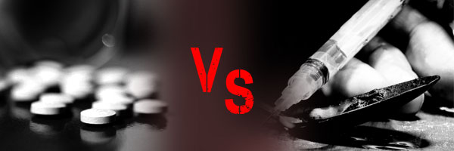
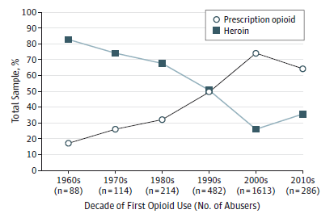
Which Drug is the First Opioid Used in Addicts?
Shifting Pattern of Heroin vs. Prescription Opioid First
Percentage of Heroin-Addicted Treatment Admissions that Used Heroin or Prescription Opioid as First Opioid
1960s: more than 80% started with heroin.
2000s: 75% started with prescription opioids.
2010-2013: Increasing initiation with heroin
Source: Cicero et al. JAMA Psychiatry. 2014;71(7):821-826

Slide 13
Past Year Heroin Use among Persons Aged 12 or Older, 2003-2014
Numbers in Thousands
Source: SAMHSA, 2014 National Survey on Drug Use and Health, 2015.

Slide 14
Trends Observed on East Coast & Midwest
These young IDUs tend to be:
    young (under 30)
    white
    equally male/female
    non-urban (suburban, rural)
    Increase in injection drug use driven by increase in prescription opioids use
Valdiserri R., et al. Am J Public Health. 2014; 104(5):816-821.

Slide 15
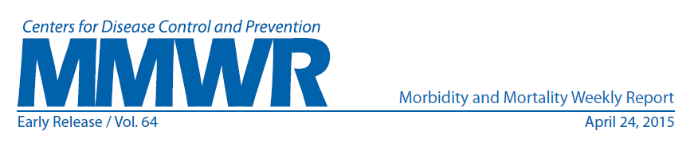
Outbreak of HIV Linked to IDU of Oxymorphone Indiana, 2015
162 HIV Infections in a Community of 4200
84.4% 114 co-infected with Hepatitis C
109
HIV+
HIV-
121
230 tested
social contacts
regarded as at
high risk for
HIV
108
4
74
54
247 located
syringe-sharing
or sex partners
112
Reported average
of 9 syringe-sharing
partners, sex partners,
or other social contacts
at risk
for HIV infection contacts
128 not located
All reported injecting tablets of oxymorphone As drug of choice
373

Slide 16
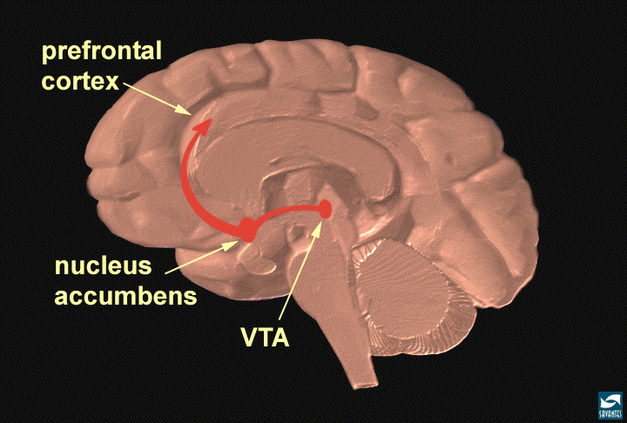
Why Do People Abuse Prescription Drugs?
Opioid prescription drugs,
like other drugs of abuse
(cocaine, heroin, marijuana)
raise brain dopamine levels
MORPHINE
250
Dose (mg/kg)
200
0.5
1.0
2.5
150
10
100
Dopamine
Neurotransmission
% of Basal Release
0
0
1
2
3
4
5hr
Time After Morphine
FOOD
200
150
100
% of Basal Release
50
Empty
Feeding
Box
0
0
60
120
180
Time (min)
Di Chiara et al.

Slide 17
Circuits Involved In
Drug Abuse and Addiction
EXECUTIVE
FUNCTION/
INHIBITORY
CONTROL
PFC
ACG
OFC
Hipp
SCC
REWARD
MOTIVATION/
DRIVE
NAcc
VP
Amyg
MEMORY/
LEARNING

Slide 18
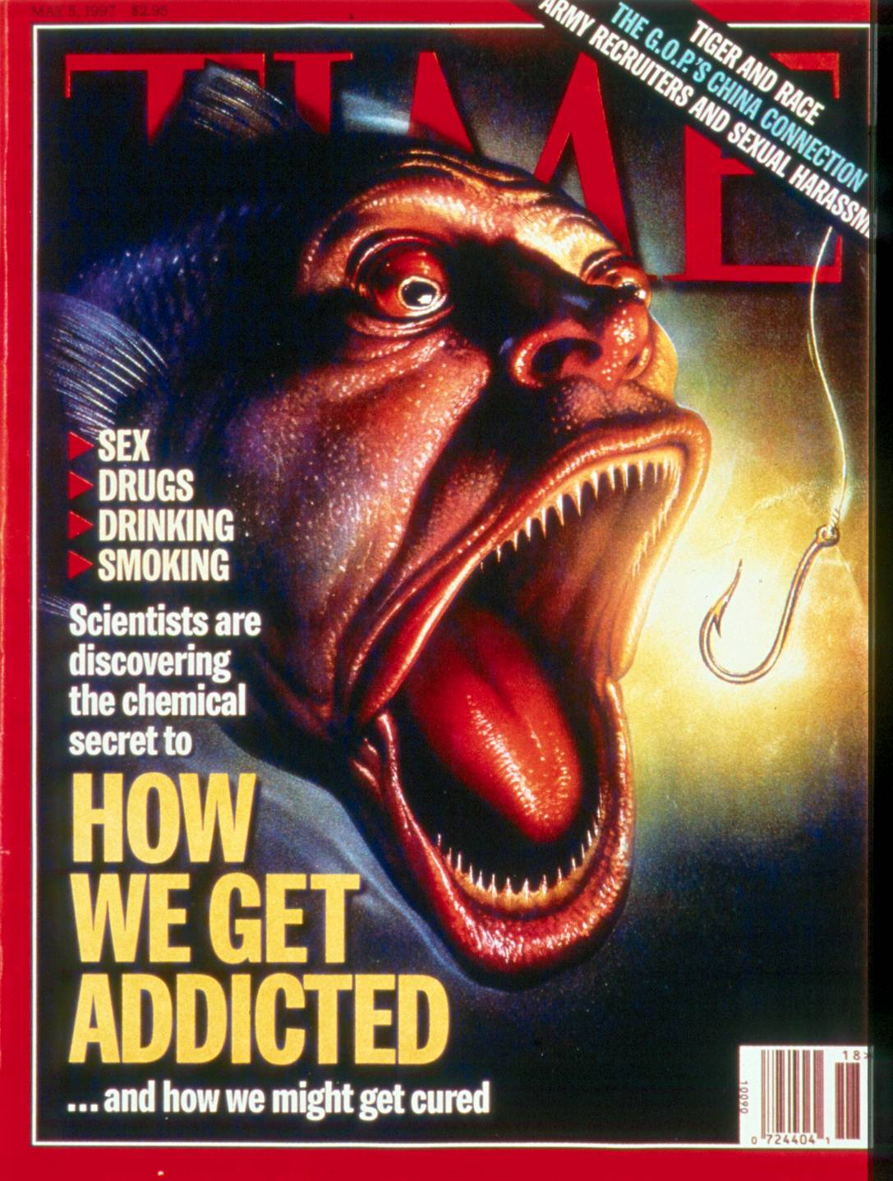
Reward Circuit
REWARD
NAcc
VP
Drugs of Abuse Engage
Systems in the
Motivation
Pathways
of the Brain

Slide 19
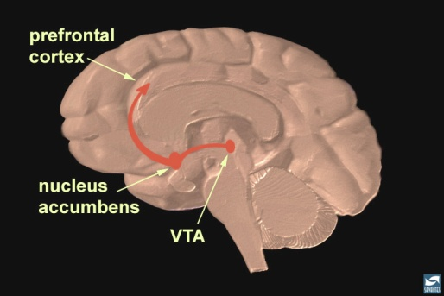

Natural Rewards Elevate
Dopamine Levels
Food
Sex
200
200
NAc shell
150
150
% of Basal DA Output
DA Concentration (% Baseline)
100
100
Empty
50
Box Feeding
Female Present
0
0
60
120
180
Sample
Number
1
2
3
4
5
6
7
8
Time (min)
Di Chiara et al., Neuroscience, 1999.,Fiorino and Phillips, J. Neuroscience, 1997.
Notes:
19
Natural rewards stimulate dopamine neurotransmission. Eating something that you enjoy or being stimulated sexually can cause dopamine levels to increase. In these graphs, dopamine is being measured inside the brains of animals. Its increase is shown in response to food or sex cues. This basic mechanism of controlled dopamine release and reuptake has been carefully shaped and calibrated by evolution to reward normal activities critical for our survival.

Slide 20
Drugs of Abuse Activate Dopamine Neurons
MARIJUANA
COCAINE
400
Accumbens
150
125
100
300
DA
DOPAC
% of Basal Release
HVA
% of Basal Release
200
100
0 20 40 60 80
Time After THC
0
Tanda, et al, Science 1997.
0
1
2
3
4
5 hr
Time After Cocaine
250
NICOTINE
MORPHINE
250
Accumbens
200
Dose (mg/kg)
Accumbens
200
0.5
Caudate
1.0
% of Basal Release
2.5
150
% of Basal Release
10
150
100
100
0
0
0
1
2
3 hr
0
1
2
3
4
5hr
Time After Nicotine
Time After Morphine
Source: Di Chiara and Imperato

Slide 21
2. Memory circuit
Hipp
MEMORY/
LEARNING
Amyg
“People, Place and Things…”

Slide 22
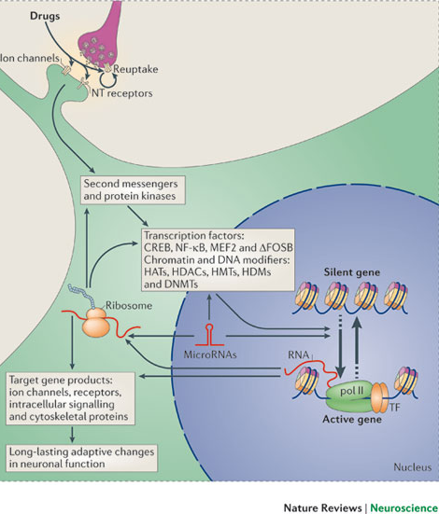
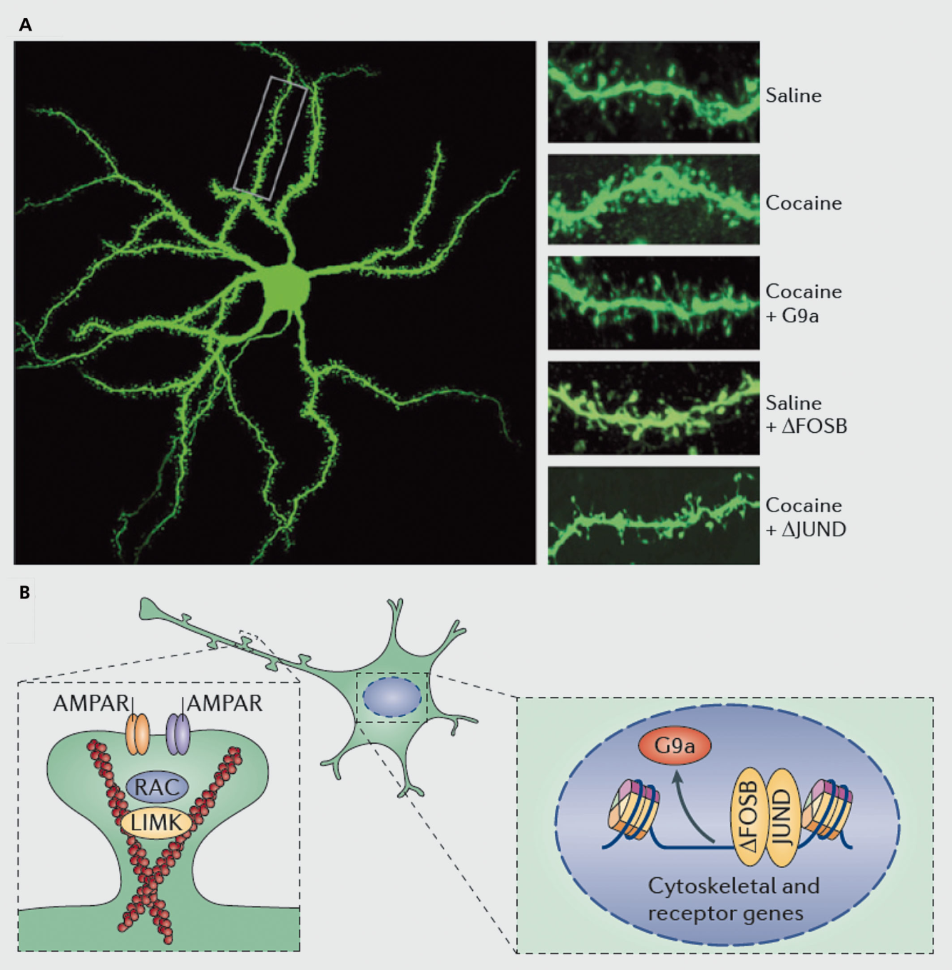
Drugs Trigger changes in Gene Expression that Either Strengthen or Weaken Synapses thus Creating a MEMORY
Robison and Nestler 2011

Slide 23
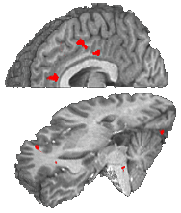

Cocaine Craving:
Population (Cocaine Users, Controls) x Film (cocaine )
Cingulate
Ant Cing
Signal Intensity (AU)
Cocaine Film
IFG
Controls Cocaine Users
Garavan et al A .J. Psych 2000

Slide 24
Cocaine Craving:
Population (Cocaine Users, Controls) x Film (cocaine, erotic)
Cingulate
Ant Cing
Signal Intensity (AU)
IFG
Controls Cocaine Users
Garavan et al A .J. Psych 2000

Slide 25
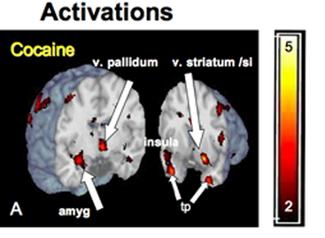
Even Unconscious Cues Can Elicit Brain Responses
Brain Regions Activated by 33 millisecond Cocaine Cues (too fast for conscious recognition)
Childress, et al., PLoS ONE 2008

Slide 26
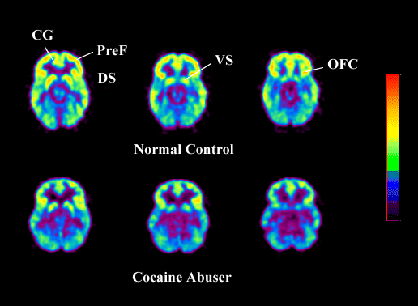
3. Motivation & Executive
Control Circuits
EXECUTIVE
FUNCTION
PFC
ACG
INHIBITORY
CONTROL
OFC
SCC
Dopamine is also associated with motivation and executive function via regulation of frontal activity.
MOTIVATION/
DRIVE

Slide 27
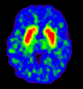
Repeated Drug Use Changes the Brain
Weakens the Brain Dopamine System
Control
Cocaine Abuser
T
Y
R
O
S
I
N
E
T
Y
R
O
S
I
N
E
T
Y
R
O
S
I
N
E
D
O
P
A
D
O
P
A
D
O
P
A
D
A
D
A
D
A
DA
D
A
DA
DA
D
A
D
A
D
A
D
A
D
A
COCAINE
D
A
D
A
D
A
D
A
D
A
D
A
D
A
D
A
D
A
D
A
D
A
D
A
D
A
PLEASURE
REPEATED USE OF COCAINE OR OTHER DRUGS REDUCES LEVELS OF DOPAMINE D2 RECEPTORS

Slide 28
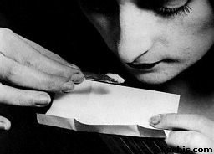

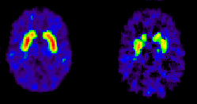
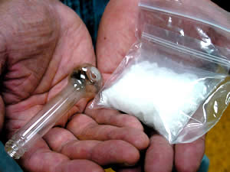
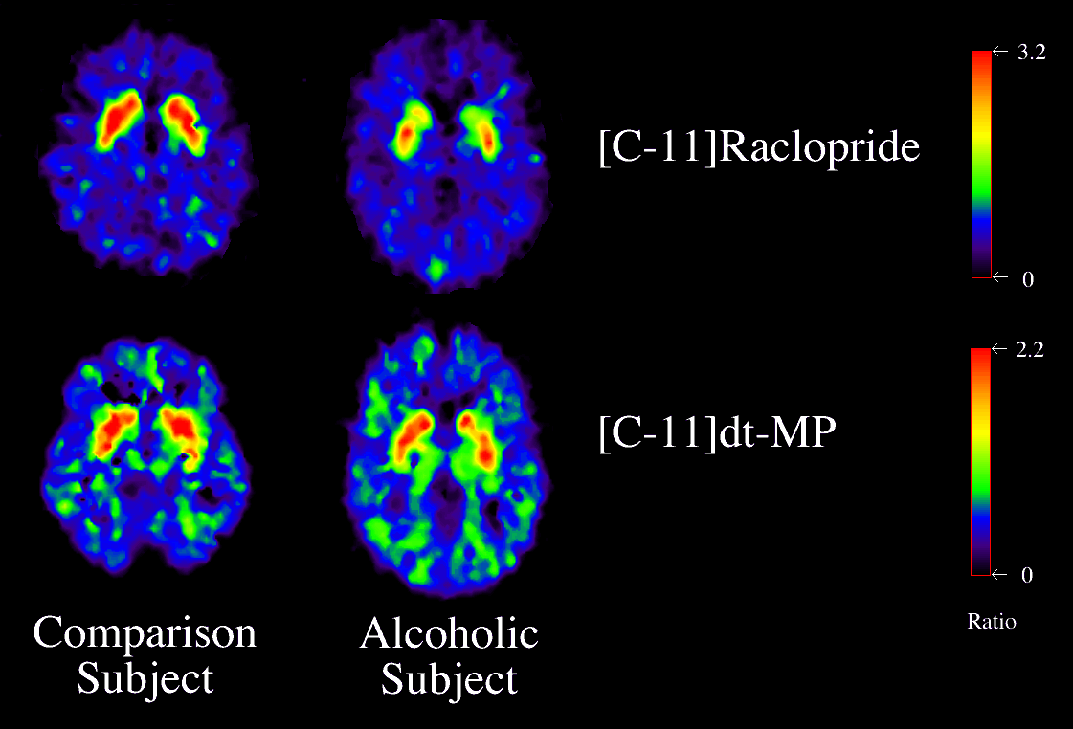
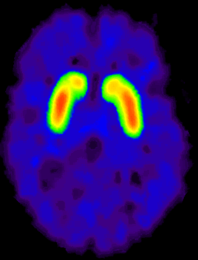
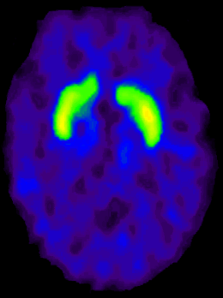
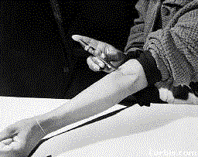
Dopamine D2 Receptors are Lower in Addiction
Cocaine
Meth
DA D2 Receptor Availability
Alcohol
Heroin
control
addicted

Slide 29
Regions of the Frontal Lobes are Less Active in Addiction
ACC
OFC
ACC
OFC
60
P < 0.01
60
P < 0.005
55
55
50
micromol/100g/min
micromol/100g/min
50
45
45
40
Controls
Abusers
40
Controls
Abusers
Volkow et al., PNAS 2011 108(37): 15037-15042.

Slide 30
Strong Relationship Of Frontal Lobe Activity and Dopamine D2 Receptors
65
ACC
OFC
60
60
P < 0.01
60
P < 0.005
55
55
55
50
50
micromol/100g/min
micromol/100g/min
50
45
45
45
40
40
Controls
Abusers
40
Controls
Abusers
35
ACC
30
1.8
2
2.2
2.4
2.6
2.8
3
3.2
3.4
90
80
umol/100gr/min
OFC
70
60
DA D2 Receptor Availability
50
40
30
2.9
3
3.1
3.2
3.3
3.4
3.5
3.6
Volkow et al., PNAS 2011 108(37): 15037-15042.
D2 Receptors (BP_{ND})
control
addicted

Slide 31
The fine balance in connections that normally exists between brain areas active in reward, motivation, learning and memory, and inhibitory control
EXECUTIVE
FUNCTION
PFC
INHIBITORY
CONTROL
ACG
Hipp
OFC
REWARD
SCC
NAcc
VP
MOTIVATION/
DRIVE
Amyg
MEMORY/
LEARNING
Becomes severely disrupted in
ADDICTION

Slide 32
ADDICTIONS as diseases of
Gene-Environment-Development
Addictions are common, developmental brain diseases expressed as compulsive behavior through continued use of a drug despite negative consequences: Onset depends on many intrinsic and extrinsic factors.
Biology
Genes/Development
Environment
DRUG/ALCOHOL
Brain Mechanisms
Addiction

Slide 33
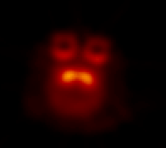
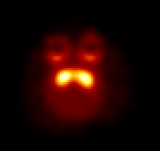
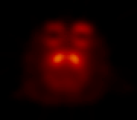
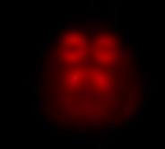
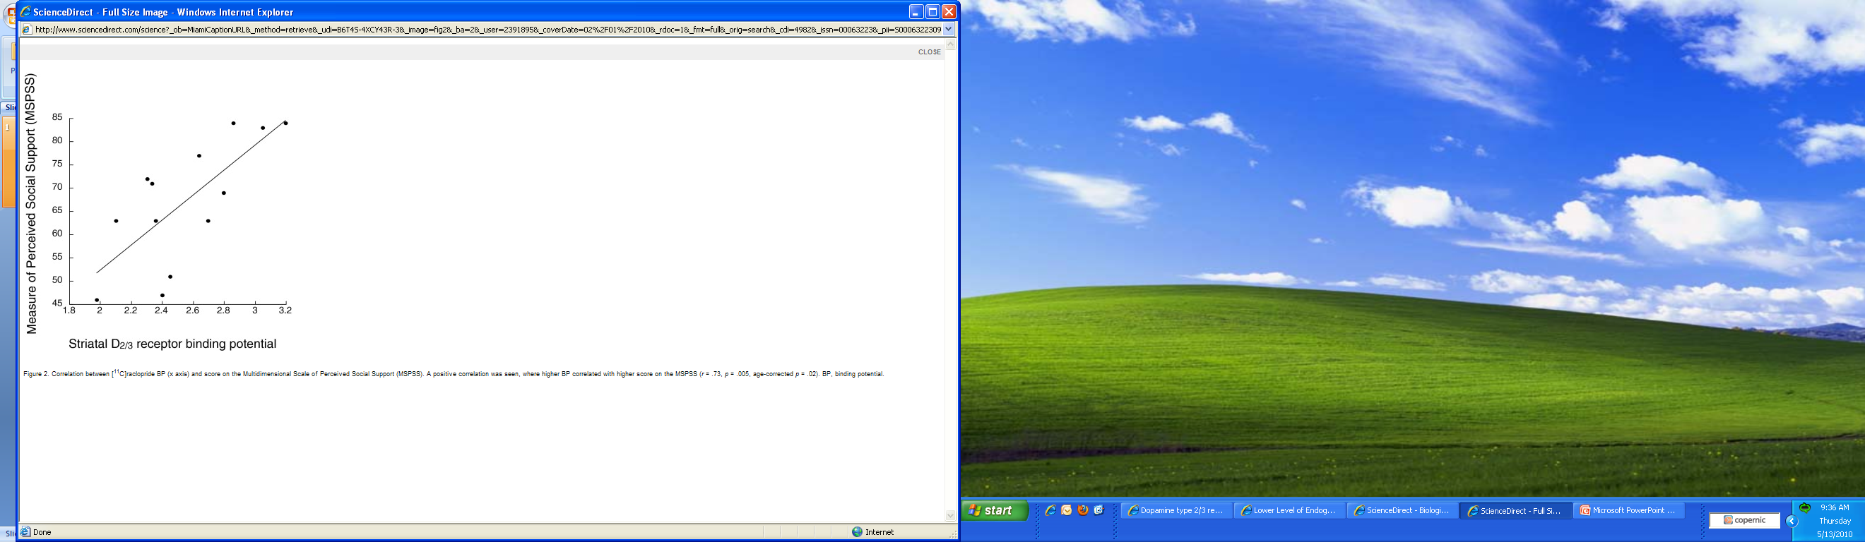
Effects of a Social Stressor on Brain Dopamine D2 Receptors and Propensity to Administer Drugs
Individually
Housed
Group
Housed
Dominant
50
Subordinate
Becomes Dominant
40
30
*
Reinforcers
(per session)
*
20
No longer stressed
10
Cocaine (mg/kg/injection)
0
S
.003
.01
.03
.1
Social Setting Can Change Neurobiology
Social Support Is Correlated
with D2/3 Receptor Binding
Becomes Subordinate
Stress remains
Morgan, D. et al. Nature Neuroscience, 2002.
Martinez D. et al., Bio Psychiatry 2010.

Slide 34
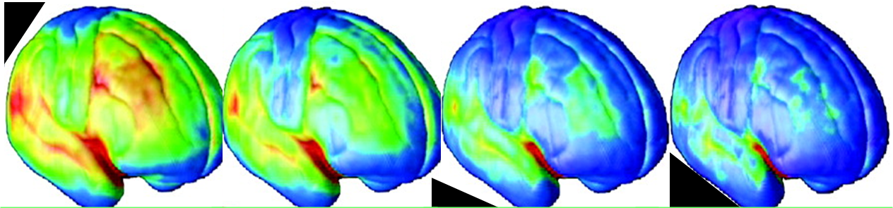
Addiction Is Developmental:
It Starts in Adolescence and Childhood
Age of Onset of Drug Abuse and Dependence
Source: Compton, et al. Archives of General Psychiatry 2007. NESARC Study.
Notes:
Addiction is also characterized as a developmental disorder characterized by increased risk for substance use disorder for tobacco MJ and alcohol
There are many factor that contribute to the increase in incidence including
-Social/ environmental factors
- Genetic and
Neurobiological factors (Sowell brain volume subtraction method between normal 12-16 year old adolescents and 23-30 year old young adults revealed parietal, temporal and occipital lobes showed little maturational change but, importantly, dorsal, medial and lateral regions of the frontal lobes (purple) those regions involved in executive function and inhibitory control were less developed.
Adolescents with risk haplotype on Chromosome 15 that start smoking before age 15 go on to become more dependent to tobacco as adults than those with other haplotypes
Universal Prevention intervention research is aimed at developing and testing programs that can reduce drug initiation and use during this vulnerable developmental period.

Slide 35
Use is NOT the Same as Addiction but Heavy Use and Early Use (i.e. early teens) increases risk
Key Question: Do All Users Become Addicted?
Estimated Prevalence of Dependence Among Users
*
*
* Nonmedical Use Source: Anthony JC et al., 1994

Slide 36
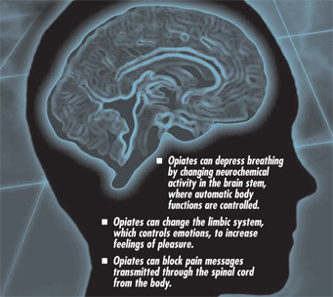
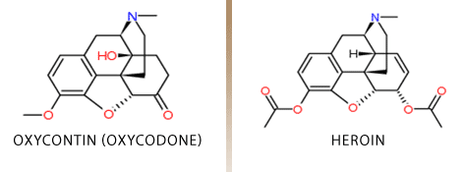
Similarities of Illicit & Prescription Drugs: Opioids

Slide 37
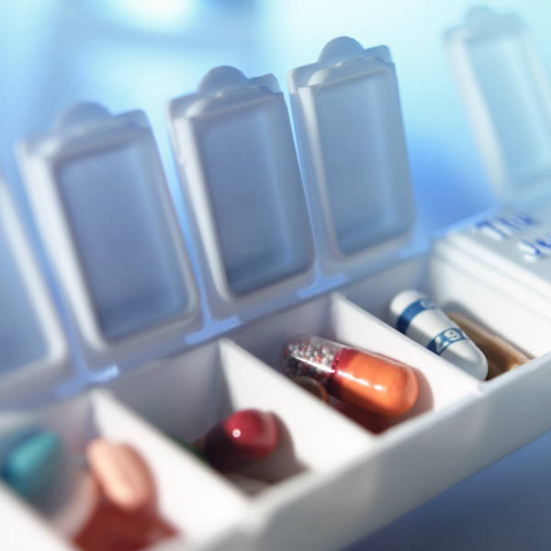
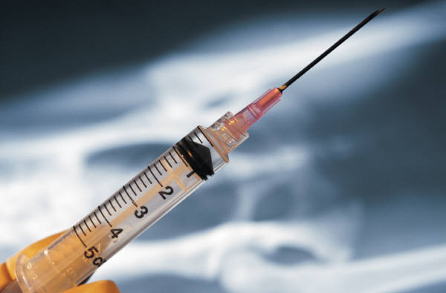


What is the Difference Between
Therapeutic Use and Abuse?
Dose and Frequency of Dosing
Lower, fixed regimes vs higher, escalating use
Route of Administration
Oral vs injection, smoking, snorting
Expectation of Drug Effects
Expectation of clinical benefits vs euphoria “high”
Context of Administration
School, clinic, home vs bar, party

Slide 38
Rewarding Effects Depend on How Fast
the Drug Gets into the Brain
iv
methylphenidate
oral
methylphenidate
iv cocaine
0.06
0.06
0.0035
0.05
0.05
0.003
0.04
0.04
0.0025
Uptake in Striatum (%/cc)
0.002
0.03
0.03
Uptake in Striatum (nCi/cc)
Uptake in Striatum (%/cc)
0.0015
0.02
0.02
0.001
0.01
0.01
0.0005
0
0
20
40
60
80
100
120
0
0
20
40
60
80
100
120
0
0
20
40
60
80
100
120
Time (minutes)
Time (minutes)
Time (minutes)
Slower uptake of oral Ritalin
permits effective treatment with less intrinsic reward (perceived “high”)

Slide 39
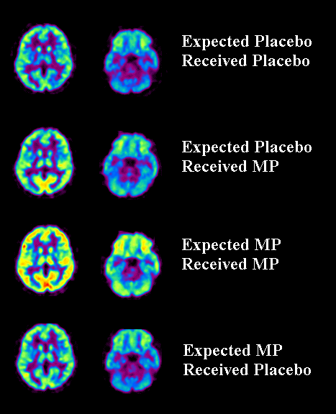
Glucose Metabolism Was Greatly Increased
By the Expectation of the Drug
30
25
20
Unexpected MP
70
15
% Changeb
10
5
Expected MP
0
Unexpected
MP
Expected
MP
Expected MP
Got Placebo
Increases in Metabolism Were About 50% Larger When MP Was Expected Than Unexpected
0
µmol/100g/min
Source: Volkow, ND et al., Journal of Neuroscience, 23, pp. 11461-11468, December 2003.

Slide 40
People Abusing Analgesics DIRECTLY & INDIRECTLY Obtain Them by Prescription: Most Recent Pill Source
Source Where Respondent Age 12+ Obtained Analgesics:
More than One Doctor
(2.6%)
One Doctor
(21.2%)
Source Where Friend/Relative Obtained
Other¹ (4.3%)
Free from
Friend/
Relative
(53.0%)
More than
One Doctor
(3.3%)
Bought on
Internet (0.1%)
Free from
Friend/Relative
(5.1%)
Drug Dealer/
Stranger (4.3%)
One Doctor
(83.8%)
Bought/Took from
Friend/Relative (4.9%)
Bought/Took from
Friend/Relative (14.6%)
Drug Dealer/
Stranger (1.4%)
Bought on Internet
(0.3%)
¹Other category includes Wrote Fake Prescription," "Stole from Doctor’s Office/Clinic/Hospital/Pharmacy," and "Some Other Way."
Other¹ (1.2%)
Source: SAMHSA, 2012 and 2013 National Survey on Drug Use and Health

Slide 41
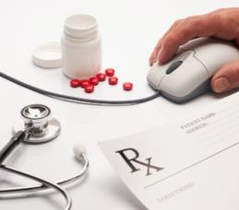

Secretary Burwell’s/HHS Opioid Priority Areas
Opioid prescribing practices to reduce opioid use disorders and overdose
The expanded use of naloxone, used to treat opioid overdoses
Expanded use of medication-assisted-treatment (MAT) for opioid use disorders
http://aspe.hhs.gov/sp/reports/2015/OpioidInitiative/es_OpioidInitiative.pdf

Slide 42
ADVANCING POLICY AND PRACTICE:
A 50 STATE WORKING MEETING TO PREVENT OPIOID-RELATED OVERDOSE AND ADDICTION, SEPT 17 – 18, 2015
Selected Themes:
Indiana HIV Outbreak
Medication Assisted Treatments: Expanding Reach of Essential Services
Naloxone for Overdose Treatment: First Responder and Other Points of Access
Prescribing Practices: Policy and Practice Interventions

Slide 43
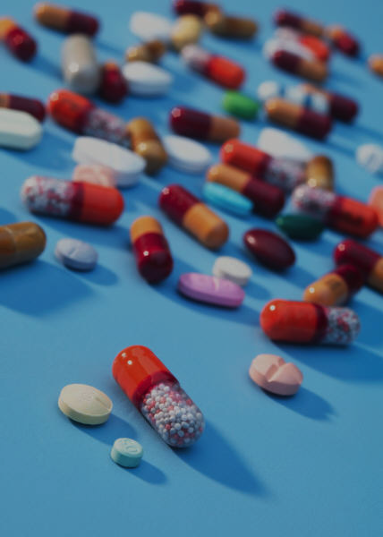
Prescription Opioid Abuse:
NIH/NIDA Priorities
Primary Prevention
Easier to Use Naloxone: Intranasal Formulations
Less abusable analgesics
New Treatments and Implementation Science for MAT: (e.g. Vaccines and Better Access to Effective Addiction Treatments)
Public and Clinician Education: (e.g. NIDAMed)
Notes:
Direct to consumer marketing

Slide 44
Universal Drug Abuse Prevention
Reduces Prescription Drug Misuse
In this study, for 100 young adults in general population starting Rx abuse, only 35 young adults from an intervention community started.
Overall, three studies now suggest the impact of universal prevention on prescription drug abuse.
**p<.01; ***p<.001; Relative Reduction Rates (RRRs)= 65-93%
Notes: General=Misuse of narcotics or CNS depressants or stimulants.
Source: R Spoth et al. American Journal of Public Health 2013

Slide 45
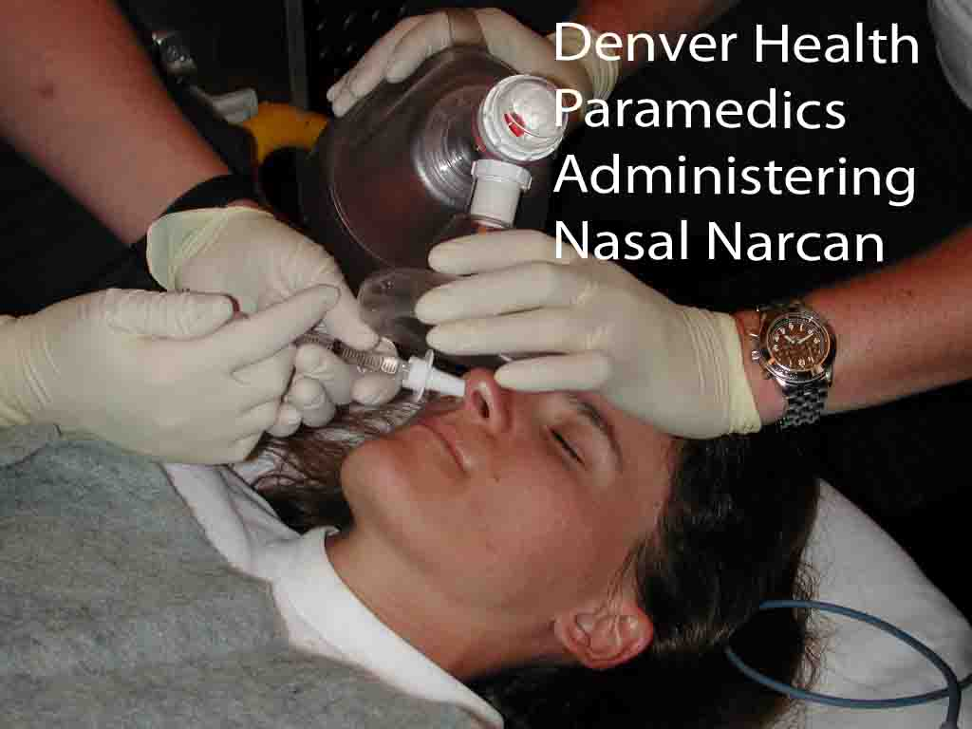
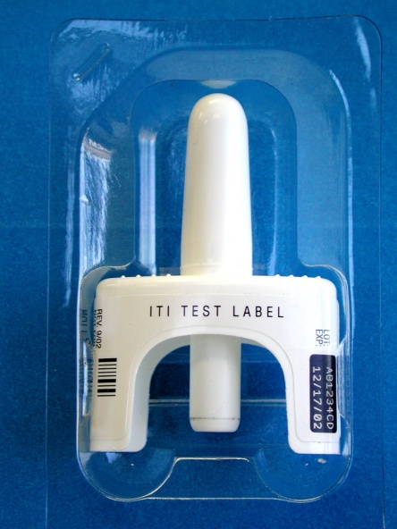
Prevention: Overdose Intervention
Naloxone Distribution for opioid
overdose victims. The potential for
direct intervention to save lives.
Note the April 3, 2014 FDA approval of the naloxone auto-injector (called “Evzio”)
Naloxone Nasal Spray Development
Needle-free, unit-dose, ready-to-use
opioid overdose antidote.
NIDA STTR Grantee – AntiOp, Inc., Daniel Wermeling, CEO
NARCAN Nasal Spray - under FDA priority review; collaboration between Adapt Pharma and NIDA
Notes:
December 16, 2014, Adapt Pharma Limited singed a license agreement for global right and IP to develop and commercialize naloxone nasal spray with Lightlake therapeutics.
July 27, 2015 – Adapt submitted an NDA to the FDA for Narcan Nasal Spray. – FDA has 60 days to determine if they will accept the application for review as filed.
September 24, 2015 – FDA accepted for filing Adapt Pharma Limited’s (Adapt Pharma) New Drug Application (NDA) for NARCAN® (naloxone hydrochloride) Nasal Spray and granted Priority Review. Priority Review is granted by the FDA to medications that, if approved, would be significant improvements in the safety or effectiveness of treatment, compared to the standard therapy. Priority Review accelerates the FDA target action date to six months from the NDA acceptance date. http://www.adaptpharma.com/media/

Slide 46
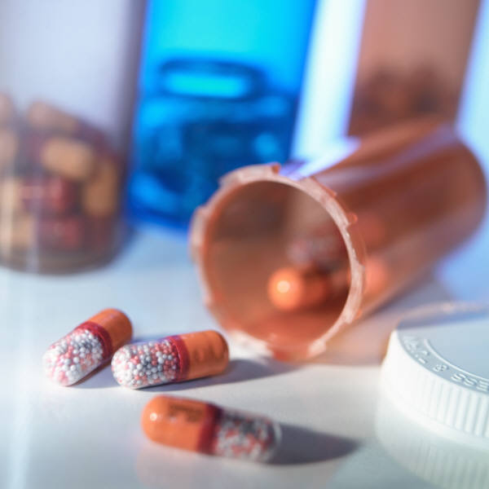
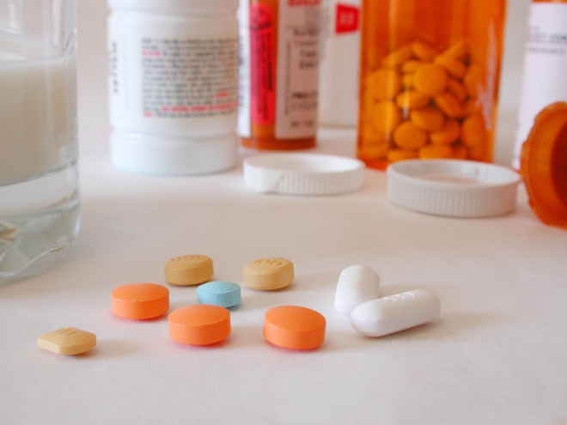
Prevention: Need for New Medications
0.0035
Develop medications with lower abuse potential including drugs that don’t cross the Blood-Brain-Barrier (i.e., CbR2 agonist)
Develop slow release formulations (low dose and long duration) and prodrug formulations (only activated with digestion)
Develop novel formulations to reduce abuse liability including mixture formulations (e.g., naloxone and buprenorphine)
0.003
0.0025
0.002
Uptake in Striatum (nCi/cc)
Slow!!
0.0015
0.001
0.0005
0
0
20
40
60
80
100
120
Time (minutes)

Slide 47
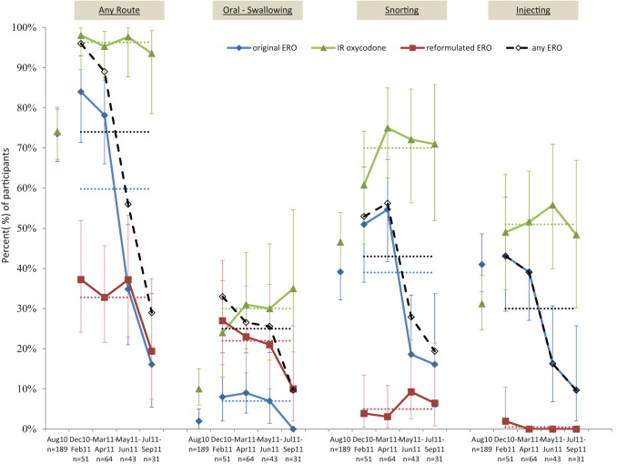
Recent Finding: Reformulation of extended-release oxycodone reduced its abuse of in a rural Kentucky prescription opioid abusers
A study conducted in Perry County, Kentucky demonstrated that the introduction of reformulated extended-release oxycodone (ERO), which was designed to be more difficult to take non-medically, caused a decrease in non-medical use of ERO, especially by snorting and injection. The reformulation was introduced between August and December 2010.
Havens, J.R., Leukefeld, C.G., DeVeaugh-Geiss, A.M., Coplan, P., Chilcoat, H.D., 2014. The impact of a reformulation of extended-release oxycodone designed to deter abuse in a sample of prescription opioid abusers. Drug and Alcohol Dependence 139, 9–17. doi:10.1016/j.drugalcdep.2014.02.018
Prevalence of abuse of original ER oxycodone (ERO), reformulated ERO, any ERO, and IR oxycodone based on current recall (December 2010 through September 2011) and retrospective recall (August 2010). Pre-reformulation (August 2010): n = 189. Post-reformulation: December 2010–February 2011: n = 51; March 2011–April 2011: n = 64; May 2011–June 2011: n = 43; July 2011–September 2011, n = 31. Error bars are 95% Confidence Intervals (CI). Dotted horizontal lines represent the mean values for each drug.

Slide 48
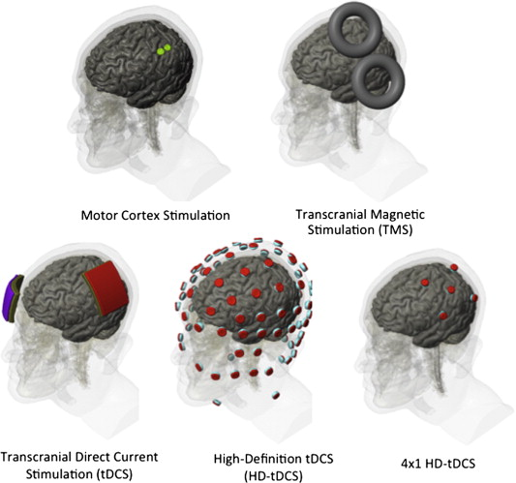
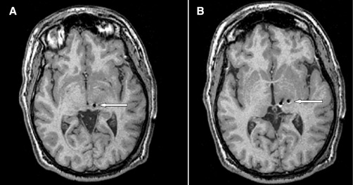
PAIN: Alternative Therapeutics
Non-Medication Treatments for PAIN and ADDICTION
Left periventricular gray
Left sensory thalamus
Transcranial Magnetic
Stimulation (TMS)
Deep Brain Stimulation (DBS)
Stereotaxtic implantation of
electrodes that emit electrical
stimulation to a targeted
neuronal region
Gray AM et al., J Pain
2014; 15(3): 283-292.
High-Definition transcranial
Direct Current Stimulation (HD-tDCS)
Transcranial Direct
Current Simulation (tDCS)
Morena-Duarte I et al., Neuroimage 2014; 85(3): 1003-1013.
Notes:
Figure 1. Prediction of Physical Pain on the Basis of Normative Data from Other Participants in Study 1. Panel A shows the signature map, consisting of voxels in which activity reliably predicted pain. The map shows weights that exceed a threshold (a false discovery rate of q<0.05) for display only; all weights were used in prediction. ACC denotes anterior cingulate cortex, CB cerebellum, FUS fusiform, HY hypothalamus, IFJ inferior frontal junction, INS insula, MTG middle temporal gyrus, OG occipital gyrus, PAG periaqueductal gray matter, PCC posterior cingulate cortex, PFC prefrontal cortex, S2 secondary somatosensory cortex, SMA supplementary motor area, SMG supramarginal gyrus, SPL superior parietal lobule, TG temporal gyrus, and THAL thalamus. Direction is indicated with preceding lowercase letters as follows: a denotes anterior, d dorsal, i inferior, l lateral, m middle, mid mid-insula, p posterior, and v ventral. Panel B shows reported pain versus cross-validated predicted pain. Each colored line or symbol represents an individual participant. Panel C shows the signature response versus the pain intensity for heat, pain-anticipation, and pain-recall conditions. Signature-response values were calculated by taking the dot product of the signature-pattern weights and parameter estimates from a standard, single-participant general linear model, with regressors for each condition. The estimates shown are derived from cross-validation, so that signature weights and test data are independent. I bars indicate standard errors. The receiver-operating-characteristic plots in Panel D show the tradeoff between specificity and sensitivity. Lines are fitted curves, assuming gaussian signal distributions. The test of pain versus no pain and the forced-choice test are shown by dashed lines and solid lines, respectively. Performance on the forced-choice test was at 100% for all conditions; thus, the lines are overlapping.

Slide 49
Medical Treatment May Reduce Deaths
Overdose Deaths
-10,000
-8,000
-6,000
-4,000
-2,000
-0
300-
200-
100-
0-
Patients Treated
Heroin OD
Buprenorphine Treatment
Methadone Treatment
R Schwartz et al. American Journal of Public Health 2013

Slide 50
Additional Challenge…
Lack of uptake of medication-assisted treatment
Addiction Specialty Programs Offering Services | As % of all programs surveyed (N=345) | Within adopting programs, % of eligible patients receiving Rx
Opioid Tx Med:
Methadone | 7.8 | 41.3
Buprenorphine | 20.9 | 37.3
Tablet naltrexone | 22.0 | 10.9
TOO FEW ARE TREATED
Knudsen et al, 2011, J Addict Med; 5:21-27.

Slide 51
Recent Finding: Treatment outcomes for prescription drug misusers--the negative effect of geographic discordance
Geographic discordance occurs when people receive treatment in an unfamiliar socio-cultural context. In Appalachia, most discordant clients live in rural counties and get therapy in non-rural counties. This study found that:
Discordant clients are more likely to report relapse, anxiety, and incarceration at follow-up.
Discordant clients are less likely to attend self-help groups at follow-up.
Negative effect of discordance on outcomes is explained by limited service access.
Oser CB, Harp KL. Treatment outcomes for prescription drug misusers: thenegative effect of geographic discordance. J Subst Abuse Treat. 2015Jan;48(1):77-84. doi: 10.1016/j.jsat.2014.08.002. Epub 2014 Aug 12. PubMed PMID: 25200740; PubMed Central PMCID: PMC4250328.

Slide 52
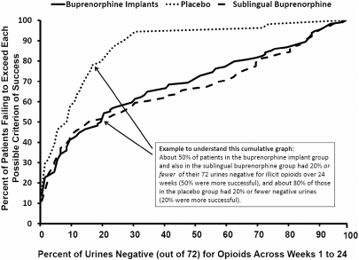
ADDICTION: New Medications
RCT Buprenorphine Implants vs Placebo & Sublingual Buprenorphine/Naloxone
Challenge: Compliance with daily intake
Solution: develop long acting medications
% of Patients Failing to Exceed
Each Possible Criterion of Success
Placebo
Sublingual
Buprenorphine
Buprenorphine Implants
% of Urines Negative (out of 72) for Opioids Across Weeks 1 to 24`
Rosenthal RN et al., Addiction 2013;105: 2141-2149.

Slide 53

ED-initiated Buprenorphine Increased Engagement In
Addiction Treatment, Reduced Self-reported Illicit Opioid Use,
& Decreased Use Of Inpatient Addiction Treatment Services
D’Onofrio JAMA. 2015.
% engaged in treatment on the
30th day after randomization
5.4
0.9
5.4
2.3
5.6
2.4
Number of days of illicit opiate use per week

Slide 54
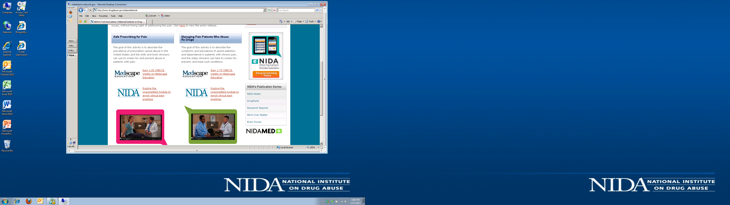
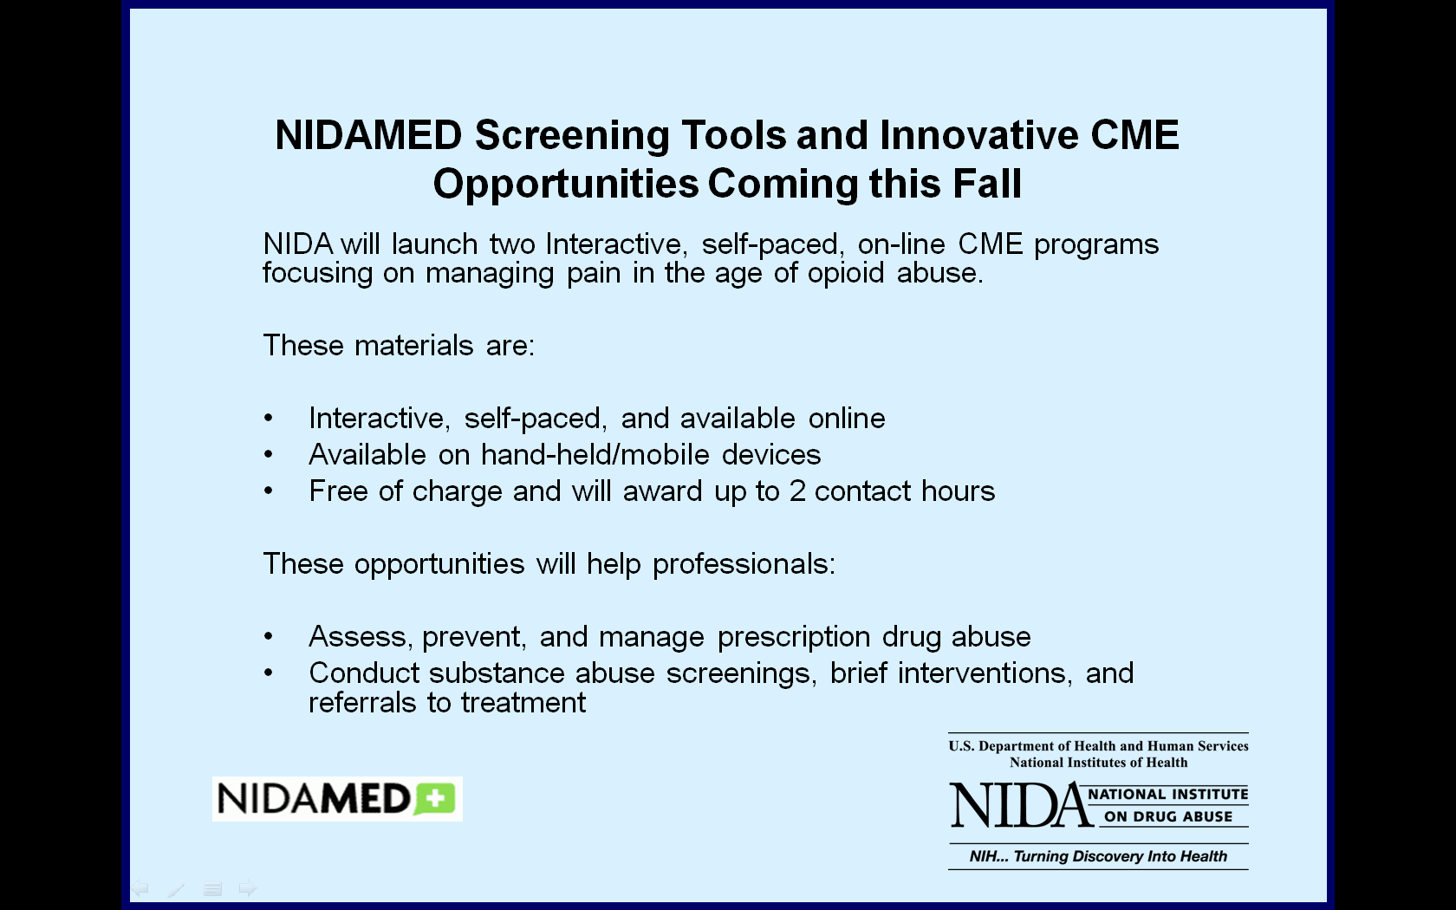
Education for Healthcare Providers
CME Courses developed by NIDA & Medscape Education, funded by ONDCP
Safe Prescribing for Pain
Managing Pain Patients
Who Abuse Rx Drugs
Skills and tools clinicians can use to screen for and prevent opioid medication abuse in patients with pain.
Learn opioid addiction symptoms in patients with chronic pain,
and how to screen for, prevent, and treat such conditions.

Slide 55


Three Pillars of CDC’s
Prescription Drug Overdose Prevention Work
Improve data quality and track trends
Supply healthcare providers with resources to improve patient safety
Strengthen state efforts by scaling up effective public health interventions
http://www.cdc.gov/washington/testimony/2015/t20150501.htm

Slide 56
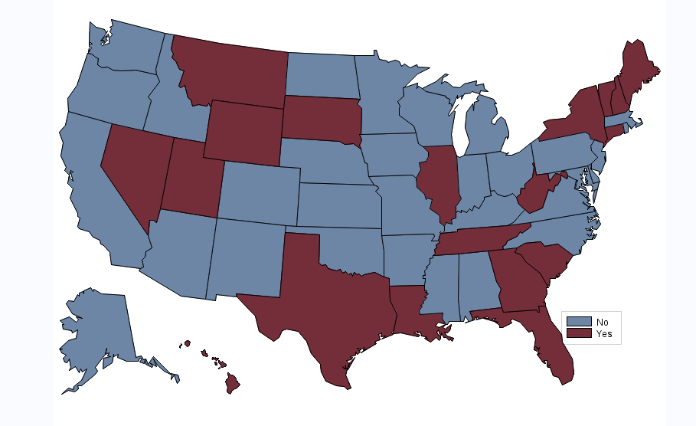
Specific Doctor Shopping Laws: 20 States
CDC PHLP 2013 CI, FL, GE, HI, IL, LA, ME, MT, NV, NH,NY, NC, SC, SD, TN, TX, UT, VT, WV, WY

Slide 57

Patient ID Requirements: 24 States
CDC PHLP 2013, Connecticut, Delaware, Florida, Georgia, Hawaii, Idaho, Illinois, Indiana, Louisiana, Maine, Massachusetts, Michigan, Minnesota, Nevada, New Mexico, New York, North Carolina, North Dakota, Oklahoma, Oregon, South Carolina, Texas, Vermont, Virginia, and West Virginia

Slide 58

Pill Mill Laws: 8 States
CDC PHLP 2013, Florida, Kentucky, Louisiana, Mississippi, Ohio, Tennessee, Texas, and West Virginia.

Slide 59
Controlled Substance/Paraphernalia Possession Protections (23‡ )
Lay Administration Criminal Liability Protections (24)
Lay Administration Civil Liability Protections (21)
Prescriber Criminal Liability Protections (14)
Prescriber Civil Liability Protections (13)
Allows Third Party Prescriptions (23)

Slide 60


Current Landscape for Guidelines:
  Small Number
  Outdated
  Not Conflict Free
  Solution….
Opioid Prescribing
Guidelines
Intended for primary care providers
Will apply to patients >18 years old in chronic pain outside of end-of-life care
Builds on joint CDC, NIDA, ONC, SAMHSA summary on “Common Elements in Guidelines for Prescribing Opioids for Chronic Pain” and the NIH Pathways to Prevention for Opioids in Treating Chronic Pain

Slide 61

Doctors (and other clinicians) Need to Know…
What Prescriptions Have Been Given to
Their Patients By Other Practitioners
This information should be:
included in the patients’
electronic health care records
accessible through a
Prescription Drug Monitoring
Program (PDMP) that provides
immediate information

Slide 62
Additional Problem:
Fragmented Approaches to Drugs and Crime
Public Health Approach
- disease
- treatment
Public Safety Approach
- illegal behavior
- punish
High Attrition
High Recidivism

Slide 63
Successful Programs Use an Integrated Public Health-Public Safety Strategy
Community-based treatment
Close supervision
Blends functions of criminal justice and treatment systems to optimize outcomes
Opportunity to avoid incarceration or criminal record
Consequences for noncompliance are certain and immediate

Slide 64
Methadone Experiment: 6 Mo Post Release (N=201)
Medications May Improve Both Health and Criminal Justice Outcomes
-- signif. diff from referral
-- signif. diff from treatment only on release
Source: Gordon, M.S., Kinlock, T.W., Schwartz, R.P., O’Grady, K.E. (2008). Addiction. A Randomized Clinical Trial of Methadone Maintenance for Prisoners: Findings at 6-Months Post-Release.
Notes:
Stat sig: Tx days: A vs. B. vs. C sig; Crime days A vs C.
heroin days, opiod UA: A vs. C. Cocaine; UA ns (days: A vs B): cell ns=63, 68, 70; N=201.

Slide 65

Multi-pronged approaches can save lives: Staten Island Case Study
data brief
opioid Rx guidelines
PSAs
PDMP law
ED opioid Rx guidelines
town halls and detailing campaign to promote guidelines
PDMP mandated use
PSAs
1
2
3 4
5
6 7
8
Source: MMWR, May 15, 2015 64(18):491-494

Slide 66
Decline in Drug Overdose Deaths After State Policy Changes in Florida, 2010–2012
Semi-Annual Drug Overdose Death Rates* for Selected Drugs, & Selected
Prescription Drug Diversion & Misuse Actions Taken, Florida, 2006 – 2012⁺
4.5
4.0
3.5
3.0
2.5
2.0
1.5
1.0
0.5
0.0
A
B
C
D
E
F
G
1/4/2010—Pain clinics must register
2/2010—Operation Pill Nation
10/1/2010—Pain clinic regulation
2/23/2011—Operation Pill Nation—raids
7/1/2011—Physician dispensing prohibited & statewide regional strike forces
F. 9/1/2011—Mandatory PDMP reporting
G. 7/1/2012—Wholesale regulations
Deaths per 100,000 population
Oxycodone
Alprazolam
Methadone
Morphine
Hydrocodone
Heroin
Jan-Jun
Jul-Dec
Jan-Jun
Jul-Dec
Jan-Jun
Jul-Dec
Jan-Jun
Jul-Dec
Jan-Jun
Jul-Dec
Jan-Jun
Jul-Dec
Jan-Jun
Jul-Dec
2006
2007
2008
2009
2010
2011
2012
PERIOD
*Per 100,000 population. Based on Florida Department of Health resident population estimates.
+ The source of overdose death data is the Florida Medical Examiners Commission.
Source: CDC, MMWR Vol 63, July 1, 2014.

Slide 67
Reduced Numbers of Analgesic Misuse Initiators:
Past Year Drug Initiates, Ages 12+, 2002-2013
Numbers in Thousands
Marijuana
Pain Relievers
Tranquilizers
⁺ Difference between this estimate and the 2012 estimate is statistically significant at the .05 level.
Source: SAMHSA, 2013 National Survey on Drug Use and Health, released September 2014

Slide 68
Recent Slight Reductions in Rx Opioid-Related Deaths but Marked Increases in Heroin
2013 OD Deaths:
16,235 Rx opioid
  (16,917 in
  )
8,257 Heroin
  (4,397 in 2011)bb
  (16,007 in 2012 and 16,917 in 2011)
  (5,927 in 2012 and 4,397 in 2011)
Sources: National Vital Statistics System, CDC

Slide 69
How Can Research Help?
PAIN: Develop Less Abusable Analgesics and Alternative Therapeutics
OVERDOSES: User Friendly Naloxone
ADDICTION: New Medications and Immunotherapies
Pharmacogenomics (Precision Medicine)
Implementation Science
Notes:
Direct to consumer marketing

Slide 70
Summary
Opioid misuse can be prevented and addiction treated.
Complex biological, developmental and social aspects of substance abuse and addiction suggest multipronged responses.
Science provides clues and is essential in planning responses.

Slide 71





www.drugabuse.gov

