Slide 1
2024-2025 STOP (Services, Training, Officers, and Prosecutor’s) Violence Against Women Formula Grant RFP Webinar
March 20, 2024

Slide 2
Thanks for joining us today: Please keep your lines muted during the presentation. This webinar is being recorded and will be posted on the ICJI website along with all Questions and Answers. Questions and Answers at the end. Feel Free to utilize the chat box during the webinar.

Slide 3
2024-2025 STOP Grant Application
Application opened: Friday, March 15th at 8 AM
Application closes: Thursday, April 25th at 11:59 PM
Applicants are strongly encouraged to submit applications 48 hours prior to the deadline.
Award Period for STOP: October 1, 2024 – September 30, 2025 (12-month award period)
Projects should begin on October 1, 2024, and must be in operation no later than 60 days after this date. Failure to have the funded project operational within 60 days from October 1, 2024, will result in the cancellation of the grant and the de-obligation of all awarded funds.

Slide 4
Accessing the RFP
Located on ICJI Website:
CJI.IN.gov → Victim Services → S.T.O.P Violence Against Women grant → STOP RFP 2024
https://www.in.gov/cji/victim-services/vawa-stop/

Slide 5
Overview
The Services * Training * Officers * Prosecutors (STOP) Violence Against Women Formula Grant Program (STOP Formula Grant Program) supports communities, including American Indian Tribes and Alaska Native villages, in their efforts to develop and strengthen effective responses to victims of domestic violence, dating violence, sexual assault (including adult survivors of child sexual abuse) or stalking. This also includes victims of domestic violence, dating violence, sexual assault or stalking who are also victims of trafficking and female genital mutilation or cutting, or forced marriage.

Slide 6
Funding Allocation
There must be 20% allocated between two categories for programs or projects that meaningfully address sexual assault, including stranger rape, acquaintance rape, alcohol or drug-facilitated rape, and rape within the context of an intimate partner relationship
**10% of the 30% allocation for Victim Services must go to culturally specific community-based organizations.

Slide 7
Program Requirements

Slide 8
Grant Eligibility Regarding Compelling Victim Testimony
For a Prosecutor’s Office to be eligible to receive grant funds under this subchapter, the head of the office shall certify, to the State, that the office will, during the 3-year period beginning on the date on which the grant is awarded, engage in planning, developing, and implementing the following:
Training developed by experts in the field regarding victim-centered approaches in domestic violence, sexual assault, dating violence, and stalking cases;
Policies that support a victim-centered approach, informed by such training; and
Protocol outlining alternative practices and procedures for material witness petitions and bench warrants, consistent with best practices, that shall be exhausted before employing material witness petitions and bench warrants to obtain victim-witness testimony in the investigation, prosecution, and trial of a crime related to domestic violence, sexual assault, dating violence, and stalking of the victim to prevent further victimization and trauma to the victim.
A completed certification form must be attached to your application in IntelliGrants under the miscellaneous section of attachments. The certification form can be found here: CJI: Victim Services: Resources (in.gov)

Slide 9
Grant Eligibility Regarding Compelling Victim Testimony, Cont.
Prosecutor Office Certification for Continuing Programs - Continuing programs awarded STOP-2023 funding, have three (3) years from October 1, 2023, to implement the items on slide 8 and will be required to complete the Prosecutor Office Certification for Continuing Programs.
Prosecutor Office Certification for New Programs - New Prosecutor Office applicants will need to complete the Prosecutor Office Certification for New Programs and will have three (3) years from October 1, 2024, to implement the items on slide 8.
Completed certification forms must be uploaded to your application in IntelliGrants
under miscellaneous section on the attachment form.

Slide 10
STOP Requirement Certification
Nondisclosure of confidential or private information
Approved activities
Non-supplantation
Nonexclusivity
Prohibition on tort litigation
Prohibition on lobbying
Delivery of legal assistance
Civil rights

Slide 11
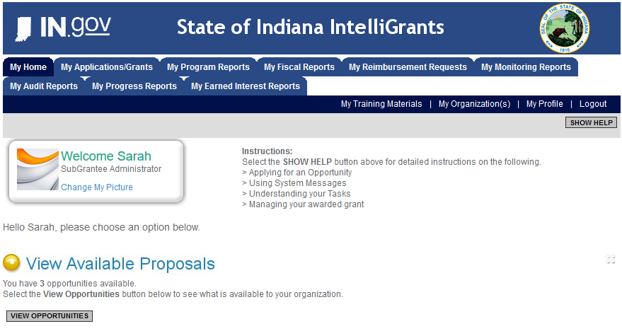
Initiating an Application
Log into IntelliGrants
If you do not have an account, register by clicking “NEW USER”
On the “MY HOME” page, access “VIEW AVAILABLE PROPOSALS”
Click on “VIEW OPPORTUNITIES”
IntelliGrants will take you to “MY OPPORTUNITIES”
Access the “2024 STOP GRANT” Application
Select “APPLY NOW”
https://intelligrants.in.gov

Slide 12
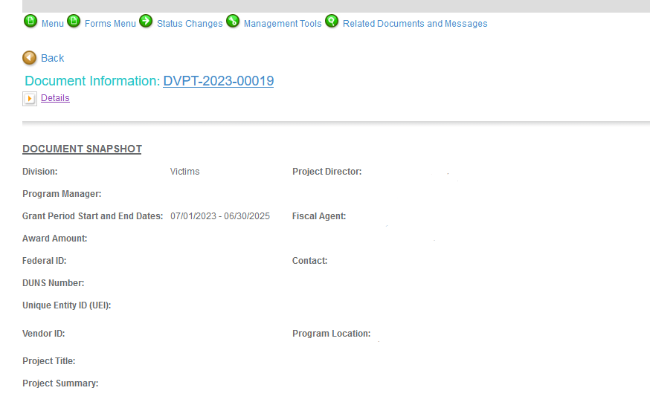
Navigating Forms Menu

Slide 13
Application Forms That Must Be Completed
Contact Information
Project Information
Programmatic Information
Goals, Objectives, and Outcomes
Problem Statement & Analysis
Program Description
Evidence Based/Best Practices
Use of Volunteers

Slide 14
Programmatic Information Form
Example: A Prosecutor’s office is requesting funds for a Prosecutor who will spend 50% of their time prosecuting domestic violence and sexual assault cases. They are also requesting 100% for a Victim Assistant position who will provide victim services.
Prosecutor Salary: $100,000 @ 50% = $50,000 Funding Requested
Victim Assistant Salary: $50,000 @ 100% = $50,000 Funding Requested
Prosecutor = $50,000/$100,000 = 50%
Victim Services = $50,000/$100,000 = 50%

Slide 15
Important Notes
Grants cannot be processed until ICJI receives its Federal Award Letter, which more than likely will be delayed pending the passage of the federal budget. Please be aware of this as you are writing your proposal.
All grants from ICJI Victim Services are reimbursement grants, which means that agency must first incur the expense prior to CJI reimbursing for the expense.
Verification of expenses along with verification of payment of expenses must be provided to ICJI on a monthly or quarterly basis prior to reimbursement of expenses by ICJI.

Slide 16
MATCH REQUIREMENT
Matching funds must
Be verifiable from the subgrantee’s records
Not be included as contributions for any other federal award
Be necessary and reasonable for the accomplishment of the project or program objectives
Be allowable under 2 C.F.R. 200.400
Not be paid by federal government under another federal award, except where authorized by federal statue
Be included in the subgrantee’s approved budget
Conform to all other provisions of 2 C.F.R Part 200
There is a 25% match requirement imposed on grant funds under this program for Government agencies.

Slide 17
MATCH EXAMPLE
Determining Match:
STEP 1: Award amount / % of Federal Share = Total Project Cost
STEP 2: Total Project Cost – Award Amount = Required Match
Example Match Requirement:
A grant recipient is awarded $150,000 in federal funding and there is a 25% match requirement.
STEP 1: $150,000 / .75 = $200,000 Total Project Cost
STEP 2: $200,000 - $150,000 = $50,000 Required Match

Slide 18
Budget Narrative
Be sure all items in the Budget are included in the Budget Narrative.
Ex: Office Supplies (copy paper, pencils, pens)
Grant reviewers are not required to contact you for clarification.
Any missing information in this section may disqualify that budget item for funding.

Slide 19
REQUIRED ATTACHMENTS
Total Agency Budget
Subgrantee Basic Budget (Nonprofit Applicant Budget Form)
Found on ICJI’s website (https://www.in.gov/cji/victim-services/resources/)
Does not apply to units of government
Indirect Cost Rate
If applicable
Sustainability Plan
Plan to maintain program once grant funds expire
Timeline
Outline completion of the project/spending expenditures for reimbursement of grant funds
Letter(s) of Endorsement
Must mention the letter is for your specific program

Slide 20
Miscellaneous
Determination of Suitability to Interact with Participating Minors Certification Form (all applicants)
https://www.in.gov/cji/victim-services/files/Advanced-Determination-of-Suitability-to-Interact-with-Minors-Certification.pdf
STOP Requirements Form (all applicants)
https://www.in.gov/cji/victim-services/files/STOP-Requirements.pdf
Consultation Form (all governmental agencies)
Prosecutor Office Certification Form (all Prosecutor Offices)
https://www.in.gov/cji/victim-services/files/STOP-Prosecution-Office-Certification-for-Continuing-Programs.pdf
https://www.in.gov/cji/victim-services/files/STOP-Prosecution-Office-Certification-for-New-Programs.pdf
Legal Assistance Certification Letter (if applicable)
Completed and signed EEOP certification (all applicants)
https://www.ojp.gov/sites/g/files/xyckuh241/files/media/document/cert.pdf
Job Descriptions, if applying for personnel costs
Any other requested information
REQUIRED
MISCELLANOUS ATTACHMENTS

Slide 21
NEW: Agency Basic Budget

Slide 22
NEW: Agency Basic Budget Continued

Slide 23
NEW: Agency Basic Budget Continued

Slide 24
Assistance
For technical assistance, contact the ICJI Helpdesk at CJIHelpDesk@cji.in.gov.
Help Desk hours are Monday – Friday, 8:00 am to 4:30 pm ET, except state holidays.
ICJI is not responsible for technical issues with grant submission within 48 hours of grant deadline.
We strongly encourage you to submit your application before the 48-hour window prior to the deadline.
For assistance with any other requirements of this solicitation, please contact the Victim Services Division at victimservices@cji.in.gov

Slide 25
QUESTIONS?

Slide 26
Thanks for attending!
Presented by
Dalayna Anderson, Victim Services, Program Specialist
DaAnderson1@cji.in.gov
317-232-3482
Becky Venus, Victim Services, Senior Grant Manager
Rvenus@cji.in.gov
317-233-5681

