Slide 1
Worker Safety
For DCS Contracted Service Providers

Slide 2
Course Competencies
At the end of this course, participants will be able to:
Explain the Four A’s of Safety and relate them to self, environment, clients, and agency policy.
Take precautions to keep one’s self safe by preparing yourself and your vehicle for unexpected circumstances.
Safely approach, enter, and exit a home or other environment.
Recognize signs of illegal substance use that can lead to worker safety concerns.

Slide 3
Four A’s of Safety Awareness, Assessment, Anticipation, Action
Worker Safety
For New Workers

Slide 4
Four A’s of Safety
Safety starts with an awareness of self, environment, clients, and policy. Click on the safety cone and print the PDF document.

Slide 5
Four A’s of Safety
Self is the only tool individuals always have with them. It is the only constant and reliable tool for intervention and defense. Self as a tool includes not only skills, but also awareness and assessment of one’s own values, beliefs, attitudes, stereotypes , and judgments.
Environment is the “where” of potentially dangerous situations. Environment also includes what to look for, as well as observations made.

Slide 6
Four A’s of Safety
Client is the “whom” with which the worker interacts. Safety is most often a concern when dealing with particular types of client emotional states.
Policy is the overarching framework that serves to protect the worker.

Slide 7
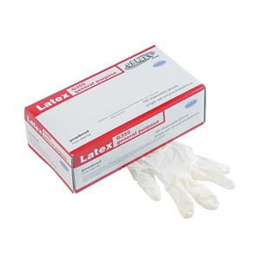
Safety Kit
The following items should be kept in your car in the case of an emergency:
Disposable blanket
Latex Gloves
Instant hand sanitizer
Bottle of water
Soap and a wash cloth
Extra sweatshirt
Lice spray
Extra pair of shoes in a sack
A change of clothes

Slide 8
Worker Safety
By wearing close-toed shoes, you can protect your feet from fluids and sharp objects on a floor.
Keep disposable gloves and bandages with you to protect yourself from hazards.

Slide 9
Taking Safety Into Your Hands
Worker Safety
For New Workers

Slide 10
Taking Safety Into Your Hands
What would you do prior to initiating the visit?
Review the Intake Form and all information provided by DCS.
Mentally rehearse what you intend to accomplish.
Update your calendar! Notify office staff when leaving, note address of your intended location.
Familiarize yourself with the neighborhood you are traveling to.
Take your identification and a cell phone with you.

Slide 11
Approaching and Exiting a Home

Slide 12
Taking Safety Into Your Hands
How would you park and exit your vehicle?
Park in the direction you wish to leave
Park in the street rather than the driveway when possible
Familiarize yourself with the neighborhood
Take only items needed to complete the visit-keys, phone, papers
-Do NOT take personal belongings into a home (jewelry, purse, etc.)
Keep vehicle doors locked

Slide 13
Taking Safety Into Your Hands
How would you approach the home?
Observe the outside of the home and surrounding area
Look/listen for signs of disturbances in and around the home
Take note of smells and objects associated with substance abuse

Slide 14
Taking Safety Into Your Hands
What would you do when entering the home?
Do not enter unless an adult invites you inside
Enter in a door within plain sight of the street
Immediately complete a visual scan for exits, barriers, weapons, etc.

Slide 15
Taking Safety Into Your Hands
What would you do once inside the home?
Stay between the client and an exit
Remain alert and observant
Keep your cellular phone accessible
Remain calm and polite; respect the client’s home and emotions
Be aware of everyone in the residence at all times
Leave immediately if you perceive a safety risk

Slide 16
Taking Safety Into Your Hands
What would you do when leaving the home?
Thank people for their time
Have your car keys out and ready upon approaching the vehicle
Observe the backseat of your vehicle before entering
Observe people and activity in the area

Slide 17
Animals
Ask for animals to be put up if you are not comfortable.
Explain any animal allergies you have, and take precautions to keep yourself healthy (medication, inhalers, etc.)
Do not approach animals that appear to be friendly without the owners permission and oversight.

Slide 18
Illegal Substances
Remanence of the use of illegal substances can cause a safety issue for workers in the home or community. You may not recognize a client’s response to recent substance use. Always be watchful of environmental signs of substance use. The following slides show images of things you might see when a person has recently used or manufactured illegal drugs.

Slide 19
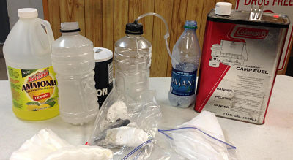
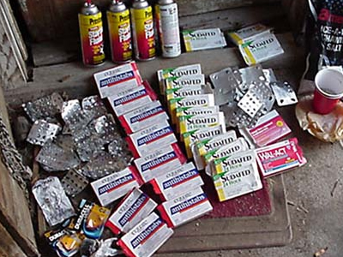
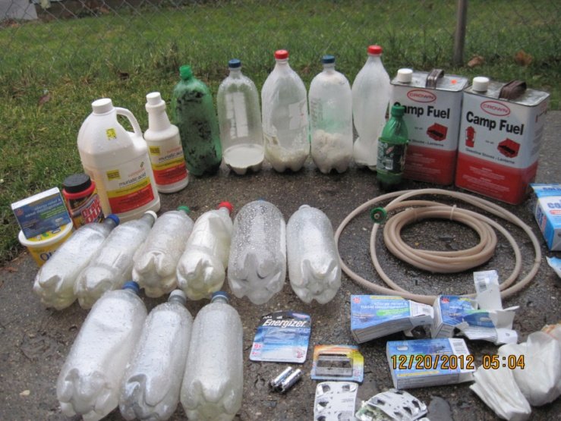
Meth Labs
Signs of manufacturing methamphetamine includes empty packages or foil packs from pseudoephedrine, hoses, plastic bottles, ammonia, and bottles with residue in them. This can cause an explosion, burning, or irritation and is very dangerous.

Slide 20
Exposure to Needles
Used needles pose a risk to others because they contain blood which can be contaminated. Workers should always be mindful of this and watching for needles on furniture, on the floor, and in open areas.

Slide 21
Course Competencies
Have we successfully completed the course competencies?
Explain the Four A’s of Safety and relate them to self, environment, clients, and agency policy.
Take precautions to keep one’s self safe by preparing yourself and your vehicle for unexpected circumstances.
Safely approach, enter, and exit a home or other environment.
Recognize signs of illegal substance use that can lead to worker safety concerns.

Slide 22
Thank you for attending Worker Safety Essentials

