Slide 1
2013 IERC Conference
Local Emergency
Planning Committees
REVIEW/UPDATES
Ian Ewusi
IERC Field Representative

Slide 2
How did LEPCs come about?
Emergency Planning and Community Right-to-know Act (EPCRA)
Methylisocyanate Releases
Union Carbide Chemical Plants (1980s)
Bhopal, India—2,500 people killed and over 10,000 known injuries
West Virginia, USA—Some fatalities and thousands of known injuries

Slide 3
What are the intentions of EPCRA?
A community’s right to know
Improve community preparedness
Promote cooperation
Increase public awareness
Build information database

Slide 4
Why should you have an LEPC?
County-specific information on chemicals present in communities
Community Right-to-Know about these chemicals
Emergency preparedness / community response plans
Local governments in charge of their own counties

Slide 5
Statutes Federal Laws Adopted by Indiana & State Laws
42 USC 11001-11050
IC 13-25-1 →→ IERC and LEPC establishment and duties
IC 13-25-2 →→ Facility emergency planning & notification
IC 6-6-10 →→ Funding IERC & LEPCs
49 CFR 110.40 →→ Funding LEPCs (HMEP/Hazardous Materials Transportation Safety and Security Reauthorization Act of 2005)

Slide 6
Composition of IERC and LEPCs Representatives from…
IERC
state government―4 reps
local government―3 reps
business & industry―3 reps
general public―3 reps
LEPCs
local/state government
law enforcement
emergency management
fire fighting
emergency medical services
health profession
environmental organizations
transportation
broadcast/print media
industry
community groups
hospitals

Slide 7
Duties & Responsibilities Statutory Requirements
IERC
Maintain SARA Title III records
Manage LEPCs
Allocate funding to compliant LEPCs
LEPCs
Meet funding requirements
Develop, manage and execute emergency response plans dealing with accidental chemical release from facilities
Distribute information to the general public

Slide 8
Goals of the IERC To Meet Statutory Requirements
Maintain SARA Title III records in Indiana (chemical storage and spill information)
Provide consistent statewide leadership to LEPCs as they develop emergency response plans to deal with accidental chemical releases from Title III facilities in their counties and as they make available to the general public chemical information submitted by those facilities
Encourage statewide LEPC compliance with statutes

Slide 9
Goals of the IERC Not Required by Statute
Facilitate/provide adequate and appropriate hazardous materials response training for emergency response community (CAMEO, Hazmat response, plan exercising)
Provide training in EPCRA reporting for LEPCs and facilities with SARA Title III chemicals
Provide technical assistance/training to LEPCs in development of emergency response plans

Slide 10
How are LEPC members appointed? Guidance on LEPC Composition & Appointments 2013
LEPC selects members
List is presented to IERC for approval
LEPC chooses chair and vice-chair without involvement of IERC
No limits on terms for members, but terms are usually 1 year
LEPC must outline membership terms in its bylaws

Slide 11
Goals of an LEPC To Meet Statutory Requirements
Have an emergency plan in place to address chemical accidents
Coordinate both local and state emergency personnel during emergencies
Keep citizens informed about the chemicals in their areas, and protect them from such chemicals
Be a resource of information and expertise for inter-agency activities and emergency response action
Sustain itself by keeping members of its community involved

Slide 12
Annual LEPC Requirements & Due Dates Online Reporting—2013
Legal Notices ⎯ January 31 (online upload)
Meeting Dates/Locations/Times ― January 31 (online entry)
Roster ⎯ March 1 (online entry)
Fiscal Report ⎯ March 1 (online entry & upload)
Plan Review ⎯ December 31 (online upload)
Bylaws (signed) ⎯ December 31 (online upload)
Meeting Minutes ⎯ December 31 (online upload)
Meeting sign-in sheets (IERC approved) ― Dec 31 (online upload)
Exercise Reports ⎯ December 31 (online entry)

Slide 13
Online LEPC Reporting DEMO
Go to http://www.in.gov/dhs/3793.htm
Enter userID/password
Log in and create contact information
Begin online reporting in/for 2013 funding year

Slide 14
Landing Page
Select “Begin” if you have your log-in info
Select “Request” if you don’t have your log-in info

Slide 15
Log-In Page
Enter user ID and password
Use recovery password to retrieve log-in info

Slide 16
Your County Page
Select “View LEPC” for compliance submission list

Slide 17
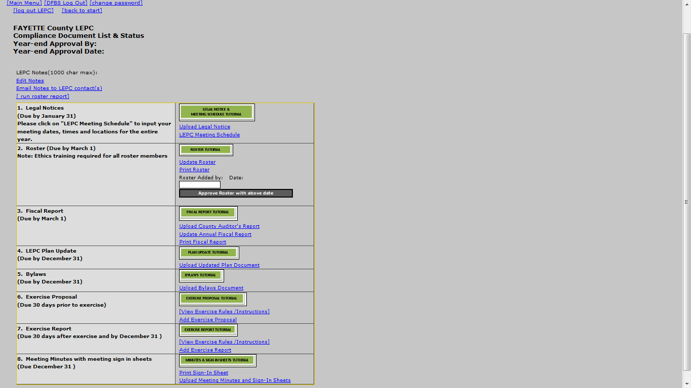
SUBMISSION
LIST

Slide 18
COMPLIANCE STEP 1: Legal Notice
ENTER MEETING SCHEDULE (dates, times & locations for the entire year)
UPLOAD LEGAL NOTICES (newspaper clippings or legal affidavit only)

Slide 19
Legal Notices − Due January 31 Online Upload
Do...
Provide a copy of the publisher’s affidavit
Submit newspaper clipping of the notice
Don’t…
Submit a letter sent to media stating meeting dates, times and location(s)

Slide 20
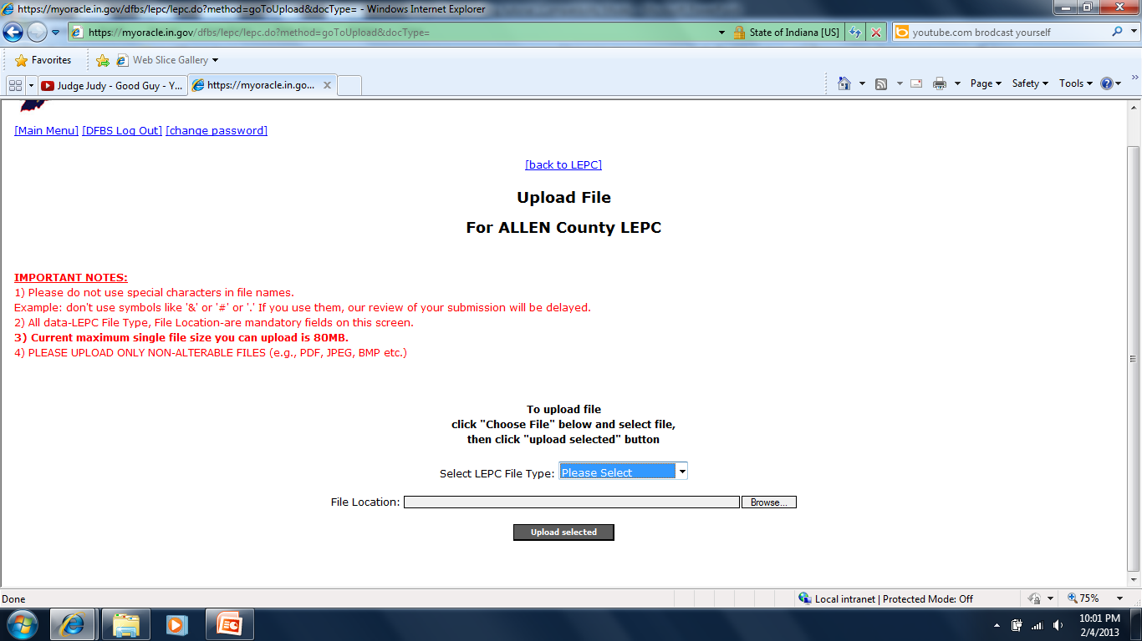
Upload Document

Slide 21
Upload Document
Selection 2
Selection 3
Selection 1

Slide 22
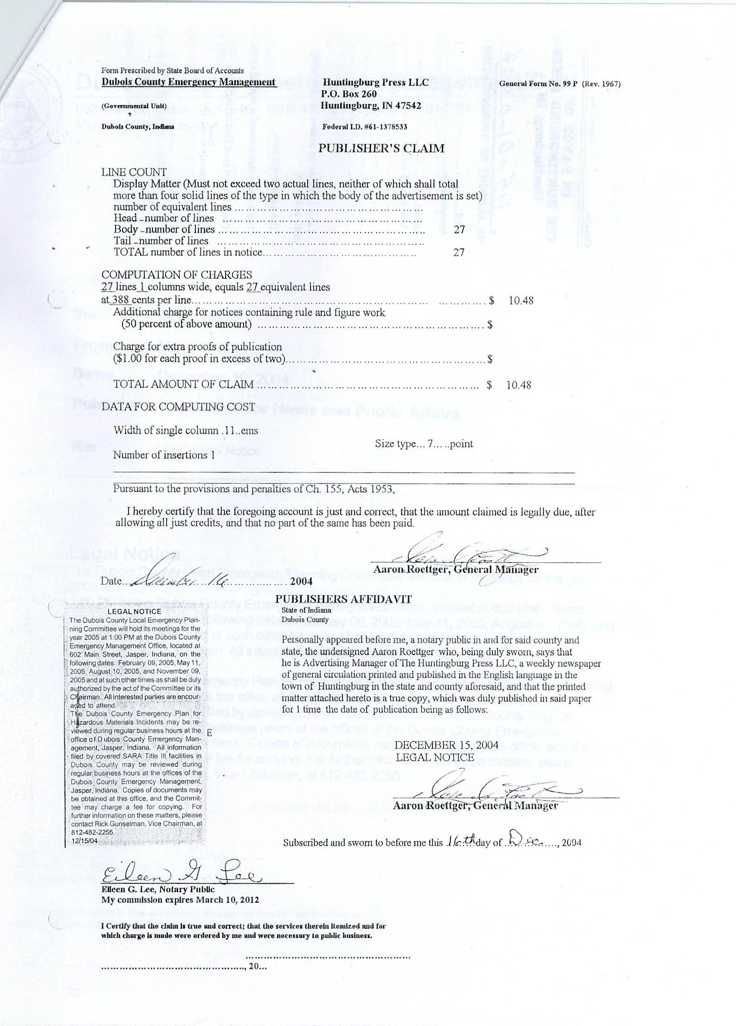
Sample Legal Notice Affidavit Online Upload

Slide 23
Annual Meeting Schedule

Slide 24
Sample Meeting Schedule
Add new meetings
Update meetings
View meetings
Send schedule to roster members
Print meeting schedule

Slide 25
COMPLIANCE STEP 2: Roster
Update Roster with current LEPC and member information.
A minimum of 12 members are required.
Enter ethics training date.
Enter proxies for qualified members only.
ONLY FEDERAL/STATE/LOCAL GOVERNMENT EMPLOYEES CAN HAVE PROXIES
Change representative designation from “Emergency Management” to appropriate designation.
All representative categories must be assigned to at least 1 but not more than 9 members.
Roster will not be approved if all representative categories are not assigned.
Update roster anytime during the year.

Slide 26
Roster Entry

Slide 27
Roster Representative Entry

Slide 28
Roster Representative Entry Member Type

Slide 29
COMPLIANCE STEP 3: Fiscal Report
UPLOAD COUNTY AUDITOR’S REPORT
ENTER ANNUAL FISCAL DISBURSEMENTS TO UPDATE REPORT

Slide 30
8 LEPC Expense Categories
Establishing LEPC plan
Dealing with public information requests
Training for emergency and HAZMAT response
Equipping a HAZMAT response team
Purchasing communication gear
Paying member stipends
$20 per member per LEGAL meeting
Paying for special projects
Must be PRE-APPROVED by IERC
Maintaining, repairing, calibrating LEPC equipment
Notes:
The IERC has established 7 expense categories to aid LEPCs with their fiscally plan.

Slide 31
Fiscal Report − Due March 1
Previous year’s expenditures (Online entry)
County treasurer’s report (Online upload)
All conditions below apply to the fiscal report:
Must be approved at a legal meeting
Must be approved at meeting with quorum of members
Must be approved by an LEPC majority vote

Slide 32
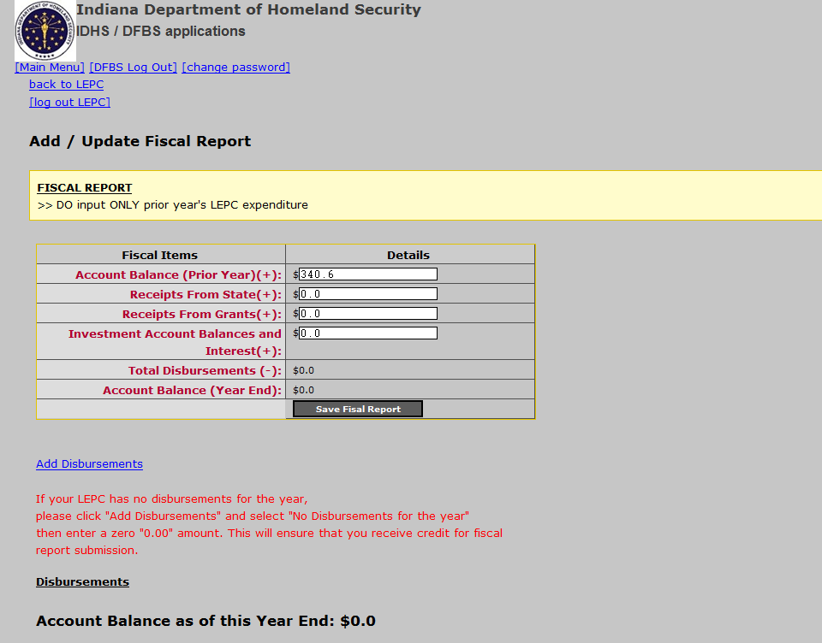
Fiscal Report Entry
State entry only
State entry only

Slide 33
Fiscal Report―Disbursement Type
Select Disbursement Type

Slide 34
Fiscal Report — Sample
State entry only
State entry only
Select “Save Fiscal Report” after disbursement entry to update account balance

Slide 35
COMPLIANCE STEP 4: Plan Updates
UPLOAD
UPDATED
PLAN
DOCUMENT

Slide 36
LEPC Plan Updates − Due December 31 Online Upload
Do...
Use the 9 planning elements in the plan evaluation/review
Submit either plan updates or entire updated plan
Provide actual text/maps as they appear in the plan
Submit all items requiring annual updates (denoted by * in your plan evaluation/review document)
Don’t...
Submit notice indicating “no changes to the plan”
Submit notice stating changes without uploading electronic files
Submit plans not addressing hazardous materials and/or the 9 planning elements
Submit the plan review with your changes/comments on it

Slide 37
COMPLIANCE STEP 5: Bylaws
UPLOAD
SIGNED UPDATED
BYLAWS
DOCUMENT

Slide 38
Bylaws − Due December 31 Online Upload
Do...
Provide copies to all members
Review bylaws at a committee meeting
Address quorum and proxy issues
Address absenteeism
Evaluate membership stipend payments
Don’t…
Adopt the IERC template or another LEPC’s bylaws without review

Slide 39
COMPLIANCE STEP 6: Exercise Proposal
INPUT EXERCISE PROPOSAL
SEND NOTICE 30 DAYS PRIOR TO EXERCISE

Slide 40
Exercise Proposal Entry
PLEASE READ INPUT INSTRUCTIONS
Select Exercise Type: Full Scale, Functional or Table Top
Enter HSEEP-NEXS Number
Enter Start Date
Enter Start Time
Enter End Date
Enter End Time
Enter Location Information
Select County
Enter Exercise Scenario
Select Fixed Facility or Transportation Incident

Slide 41
AGENCY SELECTION
Key Agencies: A minimum of four (4) of the key response agencies must be ON THE EXERCISE SCENE.
Support Agencies: A minimum of four (4) of the support agencies must be ON THE EXERCISE SCENE.

Slide 42
CHEMICAL SELECTION
SELECT CHEMICAL(S)

Slide 43
ENTER AMOUNT HERE
Fields will be populated after chemical selection.
Amount of chemical released must be more than reportable quantity (RQ). You cannot proceed if amount released is less than RQ.

Slide 44
Compliance Step 7: Exercise Report
PLEASE READ INPUT INSTRUCTIONS
Select Exercise Type: Actual, Full Scale, Functional or Table Top
Enter HSEEP-NEXS Number
Enter Start Date
Enter Start Time
Enter End Date
Enter End Time
Enter Location Information
Select County
Enter Exercise Scenario
Select Fixed Facility or Transportation Incident

Slide 45
Exercise Report − Due December 31 Online Entry
Do…
Submit proposal 30 days before exercise
Conduct tabletop, functional, full-scale or actual event
Use EHS/HS in the prescribed reportable quantities in the exercise
Partner with other county response agencies for the exercise
Submit exercise report within 30 days after exercise completion
Don’t…
Submit EMA/CEM exercise reports in lieu of LEPC exercise reports

Slide 46
COMPLIANCE STEP 8: Meeting Minutes with Sign-In Sheets
UPLOAD
MEETING MINUTES
& ACCOMPANYING SIGN-IN SHEETS
PRINT AND USE
PROVIDED
SIGN-IN SHEET
SIGN-IN SHEETS MUST BE SUBMITTED TO VALIDATE ALL MEETINGS

Slide 47
Meeting Minutes − Due December 31 Online Upload
Do...
Publish/post meeting announcement, agenda and minutes in accordance with “open door law”
Have a quorum present
Hold 2 meetings every 6 months
Submit minutes with date and time
Submit attendee sign-in sheets as provided
Don’t…
Submit county executive/council meeting minutes
Submit EMA/LEPC joint meeting minutes

Slide 48
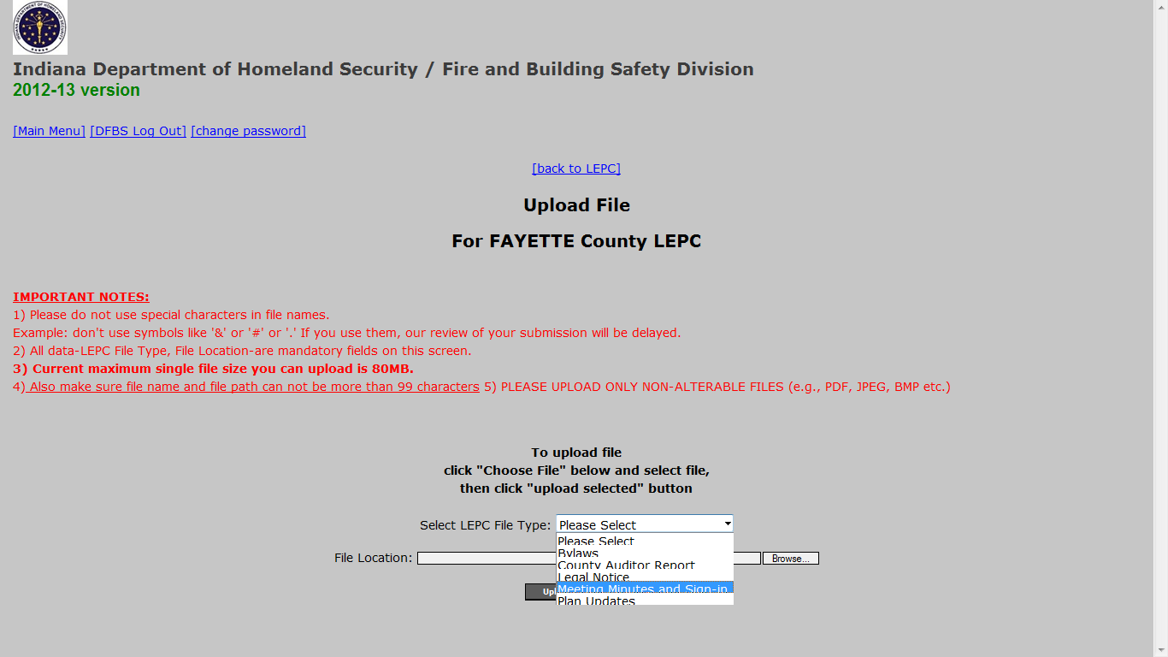
Upload Documents

Slide 49
Contact Information
Ashley Holcomb, LEPC Coordinator
Indiana Department of Homeland Security
302 West Washington Street, Room E208
Indianapolis, IN 46204
Mobile: (317) 431-4864
aholcomb@dhs.in.gov
Ian Ewusi, IERC Representative
Indiana Department of Homeland Security
302 West Washington Street, Room E208
Indianapolis, IN 46204
Mobile: (317) 695-2119
iewusi@dhs.in.gov

