Slide 1


The right skills, at the right time, in the right way. Indiana’s Demand Driven Workforce
Adult Education and Workforce Development Statewide Webinar
March 13, 2019
Marilyn Pitzulo | Adult Education Staff
Department of Workforce Development | Indiana ADULT EDUCATION
10 N. Senate Avenue, IGCS SE 203 | Indianapolis, IN 46204
AdultEd@dwd.in.gov

Slide 2


Indiana ADULT EDUCATION
Basic Skills. High School Equivalency. Short-term Training. Certifications and More.
The Right Time
If they (Muncie adult education) didn’t offer those (night) hours – with my work schedule – there’s no way I could have done it,” he said. “Brandon was one of those students who came in with a clear goal, and kept his head down until it was achieved,” says his teacher, Katey O’Connor.
After rearing five children with his wife and getting ready to see some of his oldest near their own graduation dates, Brandon Lam decided it was time for him to get his high school diploma.
“I wanted to graduate before my kids to show them the right way to do it,” he explained. After having kids young and working a steady job at Honeywell in Muncie, he had little time to study. “I am very thankful for the opportunity.
Brandon Lam
Brandon hopes to become a HVAC business owner. He is enrolled at Ivy Tech, and within the next year is on track to earn a technical certificate.

Slide 3
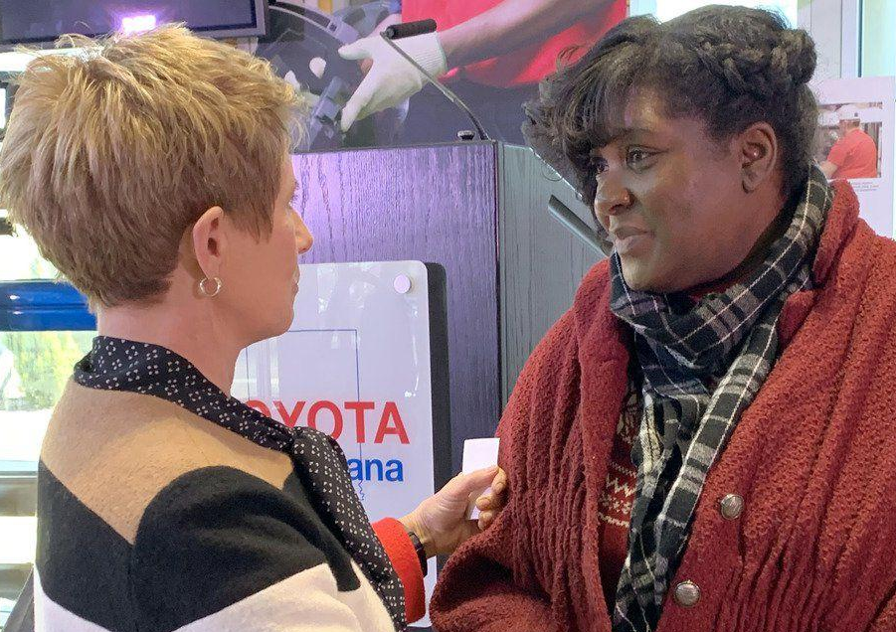
Indiana ADULT EDUCATION
Basic Skills. High School Equivalency. Short-term Training. Certifications and More.
It Wasn’t Planned
PRINCETON — It wasn't planned. Flushed faces and gasps demonstrated as much.
But the testimony of a woman who achieved her high school equivalency certificate and is moving on to pursue a degree from Oakland City University prompted Toyota Motor North America Chief Administrative Officer Chris Reynolds to mix things up a little bit (last Wednesday).
BY ANDREA HOWE Editor, The Daily Clarion 3.6.19

Slide 4
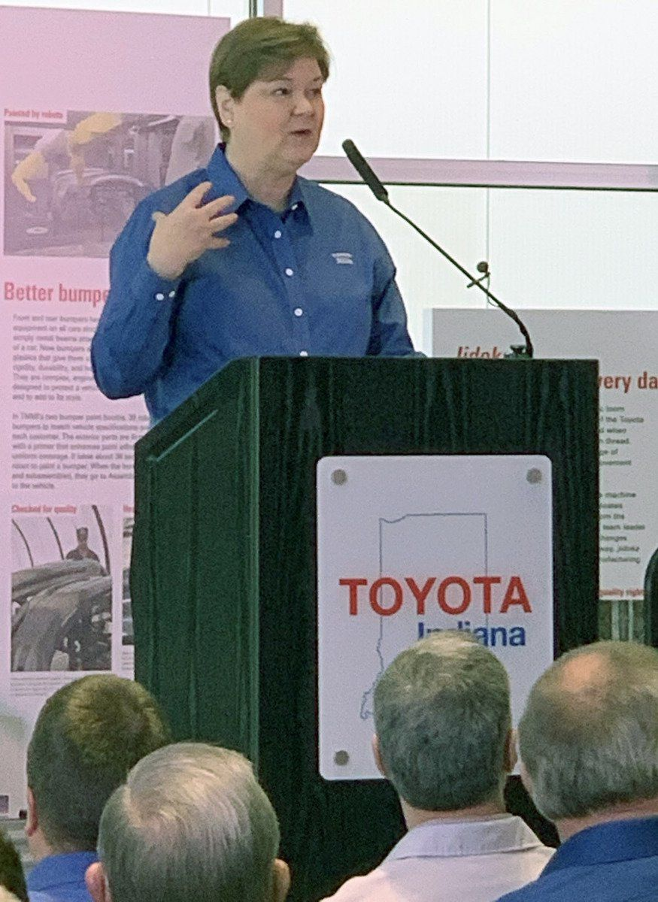
Indiana ADULT EDUCATION
Basic Skills. High School Equivalency. Short-term Training. Certifications and More.
After hearing Latasha Barnett's story, shared at the Toyota Visitors Center as part of Toyota Indiana's announcement of a $40,000 grant for adult education programs provided by Vincennes University and Indiana WorkOne Southwest, Reynolds made an impromptu change in the event, increasing Toyota's commitment by $20,000 to the effort, making $60,000 available to help remove barriers for Hoosiers who want to gain their high school equivalency certificate.
Barnett, of Evansville, earned her high school equivalency and a certified nursing assistant certificate from VU. She has been accepted at OCU, where she will seek a degree in business management and social work.
Millie Marshall | Toyota Motor Manufacturing Indiana President
BY ANDREA HOWE Editor, The Daily Clarion 3.6.19

Slide 5

Indiana ADULT EDUCATION
Basic Skills. High School Equivalency. Short-term Training. Certifications and More.
She told the crowd Wednesday that she felt at times that she wasn't strong enough or smart enough, but "when I kept God close to me," the vision for changes in her life remained clear. She encouraged others seeking a second chance at education to "keep on walking" through the process and take advantage of the opportunity, noting "the grant does make a difference in people's lives.”
Vincennes University Adult Basic Education Director Lauren Bell said the donation is "an invaluable gift" to the program.
"At Toyota, we want our communities to go places," Marshall said, noting that everyone has overcome something that may at first have seemed impossible. She said the key is turning the impossible into the "I'm possible" for people.
BY ANDREA HOWE Editor, The Daily Clarion 3.6.19
Millie Marshall | Toyota Motor Manufacturing Indiana President

Slide 6
Region | Non Grads in Follow Up | Non Grads Back in High School | Non Grads-HSE | Non Grads Plcmnt | Non Grads Positive Outcome: | Non Grads Total in Full Time Plcment | Non Grads Total in Full Time Jobs | Non Grads AU
1 | 7 | 1 | 0 | 1 | 2 | 1 | 0 | 1
2 | 32 | 0 | 0 | 15 | 17 | 13 | 12 | 7
3 | 25 | 3 | 1 | 4 | 7 | 3 | 3 | 4
4 | 9 | 1 | 0 | 5 | 6 | 5 | 4 | 2
5 | 6 | 0 | 0 | 4 | 4 | 3 | 3 | 1
6 | 15 | 1 | 0 | 8 | 9 | 6 | 6 | 6
7 | 9 | 0 | 0 | 6 | 6 | 3 | 3 | 2
8 | 5 | 0 | 0 | 1 | 1 | 0 | 0 | 3
9 | 9 | 3 | 0 | 2 | 5 | 0 | 0 | 3
10 | 2 | 0 | 0 | 1 | 1 | 1 | 1 | 1
11 | 12 | 2 | 0 | 2 | 4 | 0 | 0 | 3
12 | 10 | 0 | 0 | 2 | 2 | 2 | 2 | 6
State | 141 | 11 | 1 | 51 | 64 | 37 | 34 | 39
Youth Initiatives Updates
►JAG update
►JAG College ►Success Program update
►Summer Intern
cmfitzgerald@dwd.in.gov

Slide 7

Indiana ADULT EDUCATION
Basic Skills. High School Equivalency. Short-term Training. Certifications and More.
New and Improved Website
https://www.in.gov/dwd/2884.htm

Slide 8
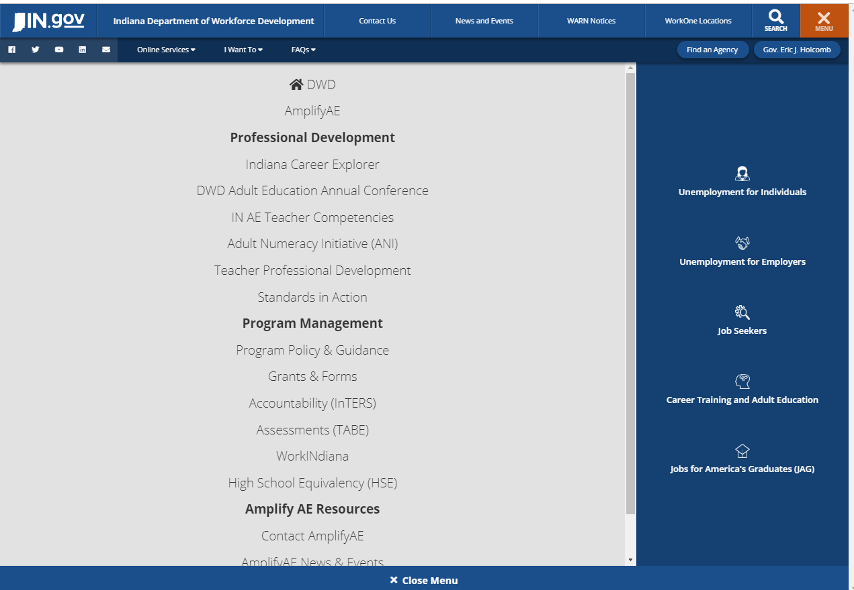
Indiana ADULT EDUCATION
Basic Skills. High School Equivalency. Short-term Training. Certifications and More.
New and Improved Website
https://www.in.gov/dwd/2884.htm

Slide 9
Indiana ADULT EDUCATION
Basic Skills. High School Equivalency. Short-term Training. Certifications and More.
PY19 GRANT INFORMATION
The PY19 RFA FAQ is now online at https://www.in.gov/dwd/2909.htm.
ABE and IELCE grant applications are due to the state office on MONDAY, APRIL 1, 2019, by 5:00 PM EST.
  If you have any technical issues submitting your application, contact our office BEFORE the submission deadline.
    Email: adulted@dwd.in.gov
    Phone: 317.233.9902
Award decisions will be issued in early May.
Your Grants Team is available to respond to your questions:
  Scott Mills smills1@dwd.in.gov 317.864.2248
  Donna Lovelady dlovelady@dwd.in.gov 317.233.9902

Slide 10
Indiana ADULT EDUCATION
Basic Skills. High School Equivalency. Short-term Training. Certifications and More.
FISCAL REMINDERS
Budget Modifications
  All requests for budget modifications must be submitted to our office (adulted@dwd.in.gov) by Monday, June 3, 2019. (Remember – a modification is required to move funds between Administrative and Program.)
Close Outs
  The DWD Finance Office will send close out packets out as usual. Remember to copy our office at the Adult Ed mailbox when you submit the final close out.
Reimbursements
  Follow up on any outstanding reimbursements before the end of the program year, June 30, 2019. Notify Cheryl Jones if any payment is overdue or an error has occurred.
  Notify Cheryl Jones if your final PY18 reimbursement will not be in by August 30, 2019.

Slide 11
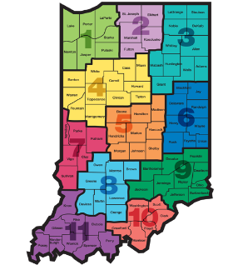
Indiana ADULT EDUCATION
Basic Skills. High School Equivalency. Short-term Training. Certifications and More.
Professional Development
Moving Forward
2018-2019
Save the Date
10 A.M.
Indianapolis Time
May 10, 2019 | Indianapolis
PDF Meeting
New Teacher Training
Train the Trainer Model
Location to be announced

Slide 12
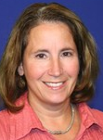
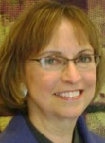

Indiana ADULT EDUCATION
Basic Skills. High School Equivalency. Short-term Training. Certifications and More.
Professional Development
Moving Forward
2018-2019
Establishing –
Workforce Education Initiatives
Integrating Education & Training (IETs)
Amplify Adult Education
Make-Up Meeting
May 14, 2019
10 a.m. – 3 p.m.
Ivy Tech Kokomo
1815 E. Morgan Street
Presenters | Denise Cox | Linda Warner

Slide 13
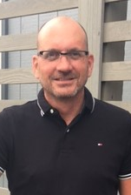

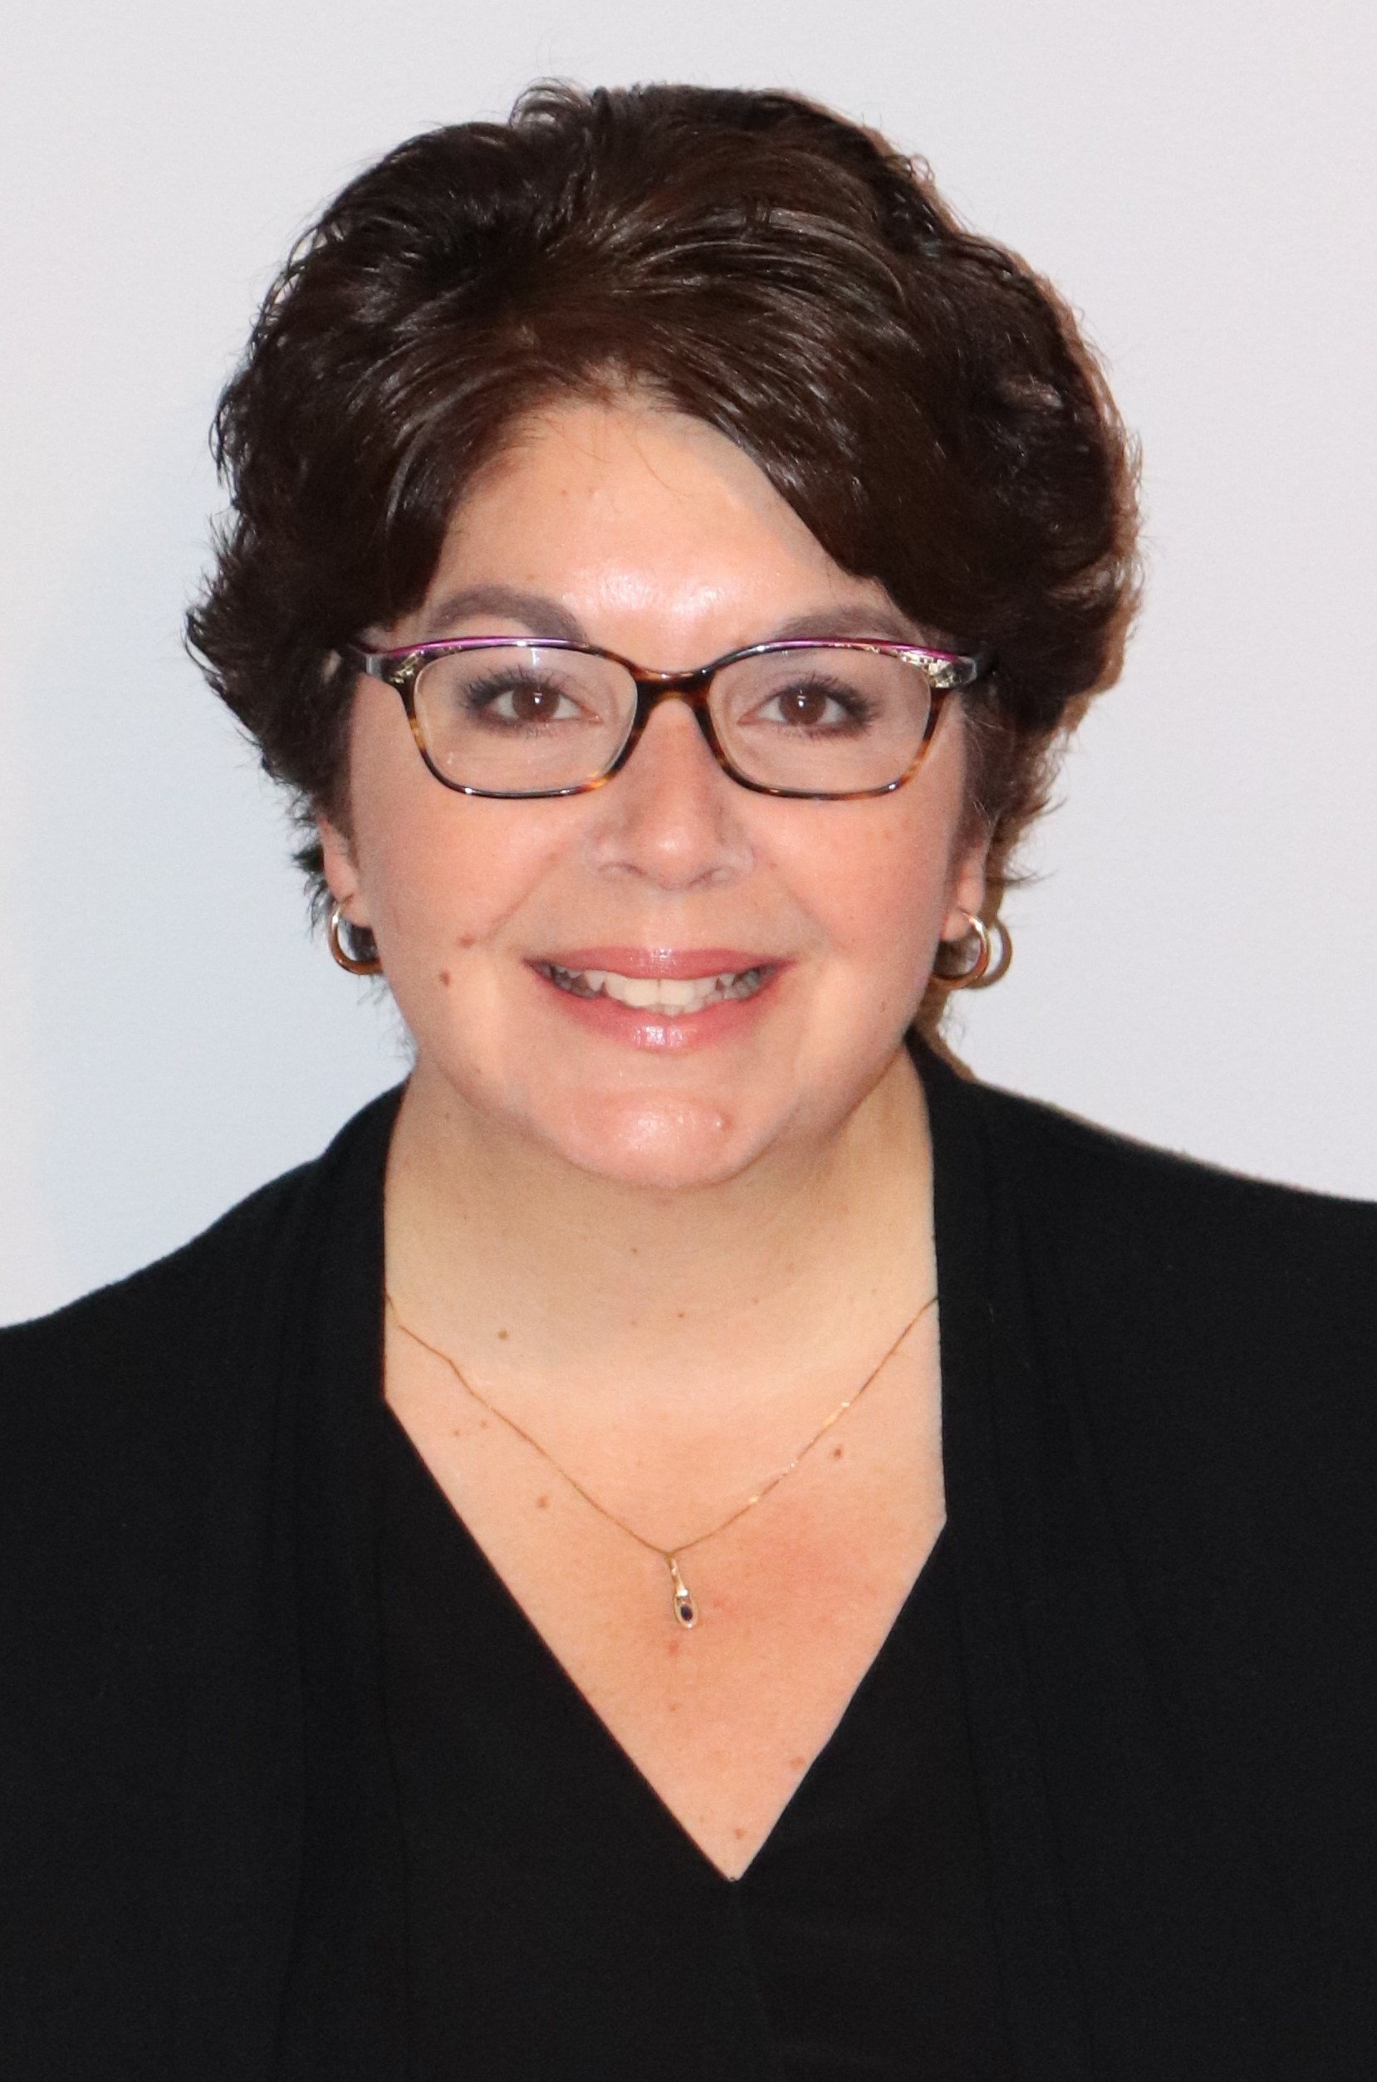
Indiana ADULT EDUCATION
Basic Skills. High School Equivalency. Short-term Training. Certifications and More.
Professional Development
Moving Forward
2018-2019
Save the Dates
9:30 A.M. -
4:30 P.M.
March 14-15 – In-Person
J. Everett Career Center, 1901 E. 86th Street Indianapolis
How to Teach Reading in the Adult Education Classroom
Jeffrey A. Fantine
This training is designed to provide instructors with strategies and resources they can use to help provide 1) evidence-based, 2) CCRS-aligned, 3) contextualized reading instruction. These strategies and resources will help maximize learner engagement to increase the reading achievement of your students so they can succeed in the workplace and in their daily lives.
1 - 2:30 P.M.
February 20 - Pre-Webinar
April 17 - Post-Webinar
Sara Z. Gutting
Presenters
Jeffrey A. Fantine, Ph.D. | Sara Z. Gutting, M.S.

Slide 14


program is open to anyone age 16 or older who is not attending a high school. It helps people prepare for the equivalency test, earn workforce
certification and even learn English as a second language.
“It’s really all about getting people into career training and employment,” said Robert Moore, director of the program.
The program serves about 500 people each year. Historically, there has been one ceremony in May to recognize their accomplishments. A second
ceremony was added in December this year.
“- 1
Indiana ADULT EDUCATION
Basic Skills. High School Equivalency. Short-term Training. Certifications and More.
New Contact for TABE
Mike Johnson
National Adult Education Director
Data Recognition Corporation
630-995-6712
mjohnson@datarecognitioncorp.com

Slide 15

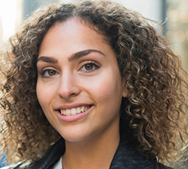

program is open to anyone age 16 or older who is not attending a high school. It helps people prepare for the equivalency test, earn workforce
certification and even learn English as a second language.
“It’s really all about getting people into career training and employment,” said Robert Moore, director of the program.
The program serves about 500 people each year. Historically, there has been one ceremony in May to recognize their accomplishments. A second
ceremony was added in December this year.
“- 1
Indiana ADULT EDUCATION
Basic Skills. High School Equivalency. Short-term Training. Certifications and More.
New HSE Testing
Center to Open
in Marion
Marion Regional Career Center | 750 West 26th Street
Director Mike Ripperger | Student Support and Community Specialist Nate McNeely
Grant County Jail | 214 East Fourth Street
TASC Test Help Desk
Toll-free telephone: 888.282.0589
Toll-free FAX: 877.800.9389
tasctesthelpdesk@datarecognitioncorp.com

Slide 16
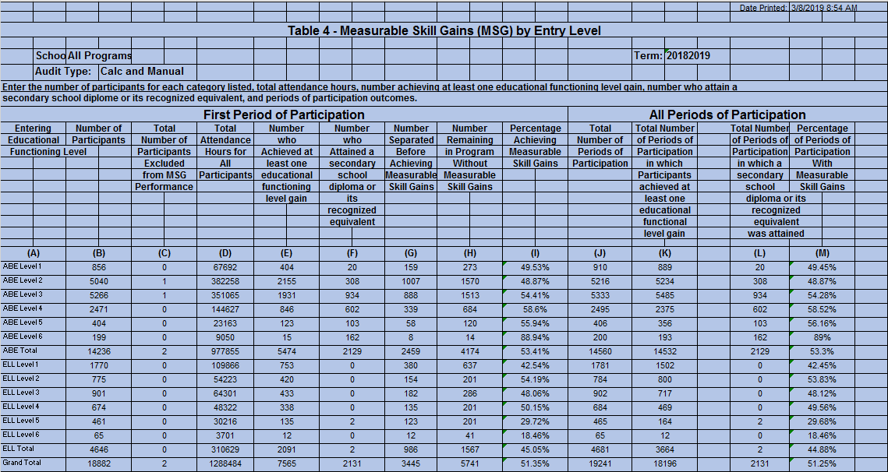
NRS State Table 4 – 2018-2019 3-8-19

Slide 17
Indiana ADULT EDUCATION
Basic Skills. High School Equivalency. Short-term Training. Certifications and More.
Total
Enrollment
2018-2019* 2017-2018**
ABE/ELL 18,882 19,865
ELL
ABE
- 1,080
+97
5.2 PERCENT DECREASE
*Data as of 3.8.19 ** Data as of 3.8.18

Slide 18
Indiana ADULT EDUCATION
Basic Skills. High School Equivalency. Short-term Training. Certifications and More.
ABE/ELL
Average Indiana
Contact Hours
2018-2019* 2017-2018**
ABE/ELL 68 hrs. 68 hrs.
No Change
*Data as of 3.8.19 ** Data as of 3.8.18

Slide 19
Indiana ADULT EDUCATION
Basic Skills. High School Equivalency. Short-term Training. Certifications and More.
MEASURABLE SKILL GAINS
Basic Skills Remediation
NRS Table 4, Column H NRS Table 4, Column I
2017-2018* 2018-2019**
64%
– Indiana Target
2018-2019
51.09%
51.35%
Instructional IMPACT
*Data as of 3.8.18 **Data as of 3.8.19
Then one day, after nearly ten years of sticking to his dream of pursuing music, and becoming an accomplished Elvis and Johnny Cash impersonator, his father had a proposition for him. “He said he knew I had this dream of recording music in Memphis and basically told me he would pay for half of everything if I got my (HSE).”
So, after years out of traditional high school, and an attempt at another high school equivalency (HSE) program out of state, Bennett enrolled at the MACC for daily adult education afternoon classes. “The teacher was great- he motivated me when I needed to be motivated.” After about four months in class, Bennett passed his HSE test and received his diploma. Bennett says, “If it wasn’t for Mr. Smith keeping me on track, I would have never gotten it done.”
“If I can make it, anyone can make it,” says Bennett.

Slide 20
Indiana ADULT EDUCATION
Basic Skills. High School Equivalency. Short-term Training. Certifications and More.
MEASURABLE SKILL GAINS
NRS Table 4, Column H NRS Table 4, Column I
2017-2018* 2018-2019**
ELL MSG INCREASE
2.5 Percentage Points
ABE 53.67%
ELL 42.43%
ABE 53.41%
ELL 45.05%
*Data as of 3.8.18 **Data as of 3.8.19
Then one day, after nearly ten years of sticking to his dream of pursuing music, and becoming an accomplished Elvis and Johnny Cash impersonator, his father had a proposition for him. “He said he knew I had this dream of recording music in Memphis and basically told me he would pay for half of everything if I got my (HSE).”
So, after years out of traditional high school, and an attempt at another high school equivalency (HSE) program out of state, Bennett enrolled at the MACC for daily adult education afternoon classes. “The teacher was great- he motivated me when I needed to be motivated.” After about four months in class, Bennett passed his HSE test and received his diploma. Bennett says, “If it wasn’t for Mr. Smith keeping me on track, I would have never gotten it done.”
“If I can make it, anyone can make it,” says Bennett.

Slide 21
Indiana ADULT EDUCATION
Basic Skills. High School Equivalency. Short-term Training. Certifications and More.
No. Separated Before Gain
3.8.19
3,445 18.24%
3.8.18
4,238
21.33%
Separations DECREASE
3.09% Percentage Points

Slide 22
Indiana ADULT EDUCATION
Basic Skills. High School Equivalency. Short-term Training. Certifications and More.
3.8.19
No. Separated Before Gain
2018-2019
– ABE/ASE Levels 1-6 17.27% Separated
– ELL Levels 1-6 21.22% Separated

Slide 23
Indiana ADULT EDUCATION
Basic Skills. High School Equivalency. Short-term Training. Certifications and More.
MEASURABLE SKILL GAIN
Basic Skills Remediation
NRS Table 4, Columns B, D, I
64%
– Indiana Target
2018-2019
Enrolled 18,882 (ABE/ELL)
Majority of ABE Students
– Level 3 (5,266)
Next Highest – Level 2 (5,040)
Then one day, after nearly ten years of sticking to his dream of pursuing music, and becoming an accomplished Elvis and Johnny Cash impersonator, his father had a proposition for him. “He said he knew I had this dream of recording music in Memphis and basically told me he would pay for half of everything if I got my (HSE).”
So, after years out of traditional high school, and an attempt at another high school equivalency (HSE) program out of state, Bennett enrolled at the MACC for daily adult education afternoon classes. “The teacher was great- he motivated me when I needed to be motivated.” After about four months in class, Bennett passed his HSE test and received his diploma. Bennett says, “If it wasn’t for Mr. Smith keeping me on track, I would have never gotten it done.”
“If I can make it, anyone can make it,” says Bennett.

Slide 24
Indiana ADULT EDUCATION
Basic Skills. High School Equivalency. Short-term Training. Certifications and More.
Number
HSE Diplomas
2018-2019* 2017-2018**
ABE/ELL 2,131 2,529
HSE Diplomas
- 398
DOWN
*Data as of 3.8.19 ** Data as of 3.8.18
Reported by InTERS

Slide 25
Indiana ADULT EDUCATION
Basic Skills. High School Equivalency. Short-term Training. Certifications and More.
High School Equivalencies
Moving Forward
2018-2019
Implications
TOTAL HSEs
2,131
3.8.19
ABE Level 3 – 934
ABE Level 4 – 602
ABE Level 2 – 308
Students may be ready at lower educational functioning levels to test
ABE Level 3 = Grade Range Equivalent 3-4
ABE Level 4 = Grade Range Equivalent 6-8
Administer TASC Readiness Assessment earlier

Slide 26
Indiana ADULT EDUCATION
Basic Skills. High School Equivalency. Short-term Training. Certifications and More.
High School Level
Moving Forward
2018-2019
ABE Levels 5-6
602 Students – 4%
3.8.19
ABE Levels 5-6
3,573 Students – 23%
3.8.18
GRADES
9-12

Slide 27
Indiana ADULT EDUCATION
Basic Skills. High School Equivalency. Short-term Training. Certifications and More.
Distance Education Measurable Skill Gains
Distance Ed
2018-2019
NRS Table 4C Column H
57.35%
ABE Enrolled 3,677
ELL Enrolled 1,148
Total 4,825
25% Participate in Distance Education
Data as of 3.8.19

Slide 28

program is open to anyone age 16 or older who is not attending a high school. It helps people prepare for the equivalency test, earn workforce
certification and even learn English as a second language.
“It’s really all about getting people into career training and employment,” said Robert Moore, director of the program.
The program serves about 500 people each year. Historically, there has been one ceremony in May to recognize their accomplishments. A second
ceremony was added in December this year.
“- 1
Indiana ADULT EDUCATION
Basic Skills. High School Equivalency. Short-term Training. Certifications and More.
Leadership in Adult Education
Managing for SUCCESS
Lauren K. Bell
Director, Adult Basic Education
Vincennes University
LKBell@vinu.edu

Slide 29

Vincennes University
Adult Basic Education
“The best thing you can give someone is a job.” Bill Cook-Founder of Cook Medical

Slide 30


Our Mission (and also how we are funded- $$)
OLD charge: Help adults earn their HSE- High School Equivalency (formerly known as GED) and send them out the door. “See ya!”
NEW charge (as of this year): Help adults earn the HSE while ALSO preparing them for training ending in certification, post-secondary education, and/or substantive employment. Must also prepare those we serve to be productive employees by incorporating the following into daily classroom routines:
a variety of soft skills
interviewing skills
resume writing

Slide 31

VU ABE PY 17-18 Successes
(Serving People BETTER!)
Became one of the top AE programs in the state, and that trend continues…
Written “in the books” as the best year in the complete history of both VU and Indiana Adult Education.
VU ABE served 1,424 adults and assisted 361 attain their HSE’s, and we are on track to meet state expectations this year.
Currently partnering with local employers to assist them in hiring quality employees (i.e.- Master Brand Cabinets in Jasper- ESL partnership- we teach prospective MB clients to speak 60% of the English language and understand MB safety material, and they then hire them/promote them). We partner with Los Bravos Restaurants, Perdue Farms, and TJ Maxx in this way as well. Toyota (Gibson County) ABE class partnership is currently getting started.

Slide 32

Integrated Education and Training
We have new IET classes in Evansville (CNA), Tell City (CNA), Paoli (CDL), Vincennes (CDL), and Princeton (CNA). Students are able to attend HSE classes while getting their certifications simultaneously.

Slide 33
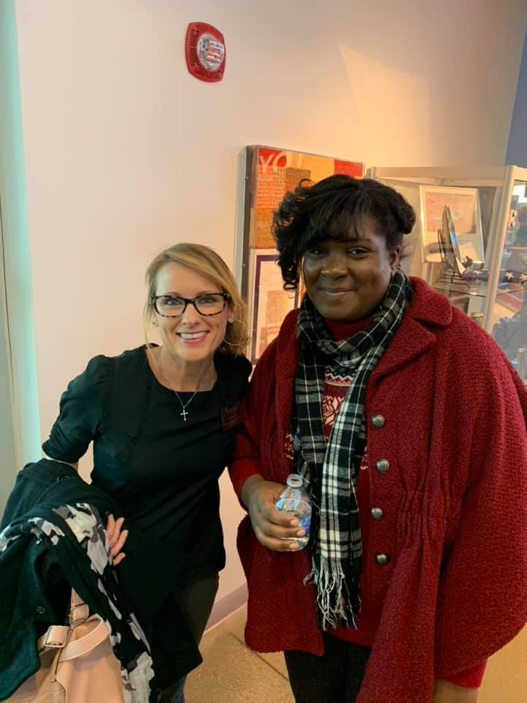
VU ABE PY 17-18 Successes
(Serving People BETTER!)
Awarded a Work INdiana grant which allows us to offer free certification trainings- Climbed to the top of Work IN programs statewide very quickly.
Very recently awarded an Indiana Online-Only distance education grant. This grant is allowing us to offer our “state-of-the-art” HSE program statewide in order to reach those not able to attend in-person HSE classes.
PICTURE AT LEFT: VU ABE CNA IET Instructor Ali Rugani with Latasha Barnett at last week’s Toyota Press Release. Latasha earned both her HSE and her CNA certification last November, and she is currently enrolled in Oakland City University where she is pursuing a degree in business management and social work.
“

Slide 34
Employer/Society Buy-In
Why Should Employers/Society Take a Chance on Successful Adult Education Students?
The majority of our students simply need encouragement and a “second chance” at success after being dealt a tough hand in life-a life most of us in this room cannot imagine.
We have very hard-working students who, after learning common sense soft skills, become great employees. They just need guidance as they have had an absence of responsible adults/authority figures in their lives.
If barriers can be met and attended to, most students are ready to dive in to a career. They just need a “hand” getting there in the beginning.

Slide 35
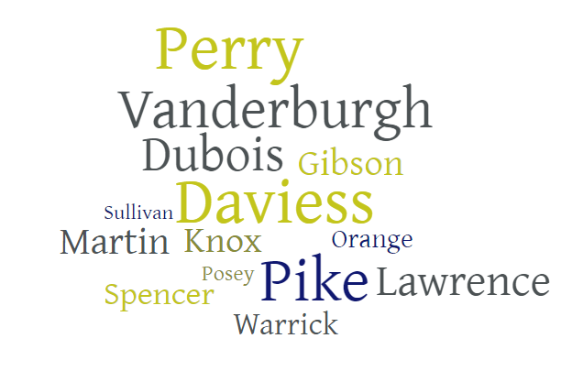
Where and how much are we?
We offer FREE adult education/ESL classes throughout 14 different counties in Southern Indiana (30-plus total classrooms):

Slide 36
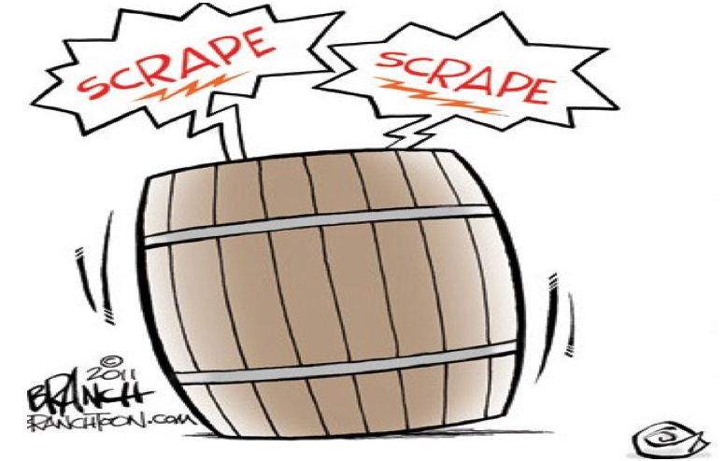
Our Rise from the “Bottom of the Barrel”
Frequent, positive, organized communication (NOT via e-mail)/Staff Support
Meaningful Trainings
Clear expectations (EXCELLENCE/COMPLETE PROFESSIONALISM and “TRIMMING THE FAT”)
Building Instructor/Staff Morale
PD Plan (Meet T4 Goals, Decrease Separations, Increase HSE’s)/PDF’s

Slide 37

My Story
Taught jr. high and high school for 15 years (Knoxville, TN, Evansville, and Mt. Vernon, IN).
Saw the “writing on the wall” in public education and decided it was time to get out.
“Fell” into adult education while trying to decide what I wanted to do next.
Taught AE for approximately 6-7 years, and my last year was promoted to Lead Instructor for the Evansville area.
Have been the VU ABE Director for over two years now.
Through all of this experience, I decided what to do by having seen what NOT to do. I really thought I saw clearly what was not working and why our program was “the worst in the state”.
Being a “Go Big or Go Home”, challenge-loving type of person, I decided if this program were not “fixed” in the first solid program year I was the director giving it every ounce of energy I had (‘17-’18), I would hang it up and let the “right” person take a stab at it. Our students deserved this program to be the best it possibly could be.
This program IS my passion and my purpose– make sure it is yours as well (take honest look).

Slide 38

The Seven Steps to Stagnation
We’ve never done it that way before.
We’re not ready for that.
We are doing all right without trying that.
We tried it once before.
We don’t have the money for that.
That’s not our job.
Something like that can’t work.

Slide 39

VU ABE LiveBinder
https://www.livebinders.com/play/play?id=2334115&backurl=/shelf/my
KEY: ABE

Slide 40

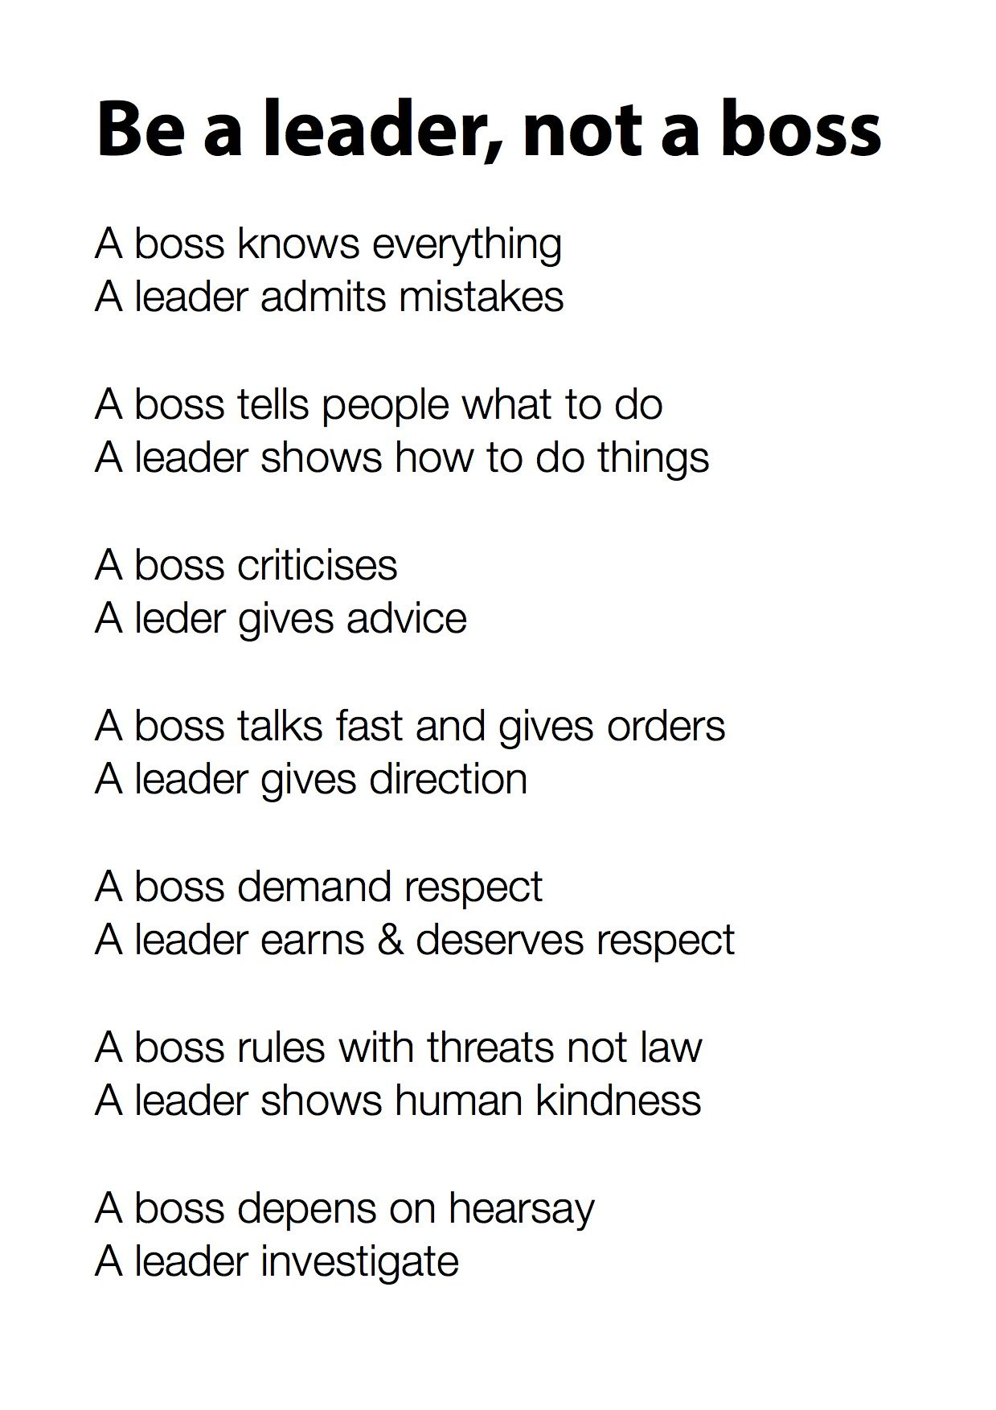
Communication/Staff Support is KEY
How?
Monthly newsletters with individual and staff Table 4 reports and a personal note from me on each individual Table 4.
MAILING the reports and newsletters to homes in order to avoid it being ignored in a sea of e-mails. Compile notes monthly.
Quarterly lead staff meetings/”Team” rather than “Boss and Employees” management style.
Quarterly site visits & teacher support through Lead Instructors/me doing “once-over” each week/bi-weekly.
PDF’s making sure PD plan is conveyed, active, and “working”.
Being available to staff 24/7 (YIKES) the first year until things were “under control”.

Slide 41
VU AE & Partner 2017-18 Kickoff MINI-Conference
June 9, 2017, 9 A.M. - 2 P.M.
*VU Staff: May claim travel & 5 hours on timesheet under June 9.
8:30- Earlybird breakfast provided
---donuts, muffins, fruit
---water, coffee (soft drinks available for purchase on first floor as well)
9:00-10:00 - “Director’s Hour”
---New expectations and updates
---Special introductions
---Policies, procedures, and processes
10:00-11:00- (Auditorium)
SPECIAL GUEST/MOTIVATIONAL SPEAKER PRESENTATION: “The Lighter Side of Education…One Flew Over the Teacher’s Lounge (Oops! I mean the Staff Preparation Room)” and PRIZE GIVEAWAYS
11:00-12:00- Lunch
---sandwiches
---chips
---fruit/veggies/sweets
12:00-2:00- Training/Refresher Courses (4 group rotations)
*inTERS/Registration- Nancy Heavrin- upstairs computer lab
*Career Readiness/Soft Skills- Missy Meredith- room 217
*TABE Basics/Classroom Procedures- Lauren Bell- room 220
*Follow-Up Process/Laptop “Organization” (bring your laptops)- Jamie Gribbins- room TBA

Slide 42
VU AE & Partner Celebration & MINI-Conference
April 5, 2019, 9 A.M. – 2:30 P.M.
VU Gibson Campus
*VU Staff: May claim travel & hours on timesheet LABELED PROFESSIONAL DEVELOPMENT under April 5.
-------------------------------------------------------------------------------------------------------------------------------------------------------------------------------------------------8:30- Earlybird breakfast & Check-In (FOYER)
---donuts, muffins
---fruit
---water, coffee (soft drinks available for purchase on first floor as well)
9:00-9:15- Director’s Welcome & Success Stories (AUDITORIUM)
9:15-9:45- Motivational Guest Speaker & Special Student Speaker (AUDITORIUM)
9:45-10:00- Quick Break & Travel to 1st Session (TBA)
10:00-11:30- Training/Refresher Breakout Sessions (TBA) (Will include: Housekeeping, Successes, T4 & Data, IET/WEI, TABE/TASC, Distance Learning, Online Program, Soft Skills, Work IN Update, Process to move students quickly (steps), Toyota Partnership Update with sneak preview of our enhanced VU ABE website sponsored by Toyota, etc.)
11:30-12:30-Celebration Luncheon (LARGE 1st FLOOR GLASS AREA)
---Taco bar catered by QDoba Mexican Restaurant
---Awards (must be present to win)
---Prize Drawings (must be present to win)
---Great conversation with colleagues
12:45-2:00- Training/Refresher Breakout Sessions (TBA)
2:00-2:30- Q&A/Discussion time with Lauren & Lead Instructors (if needed).

Slide 43
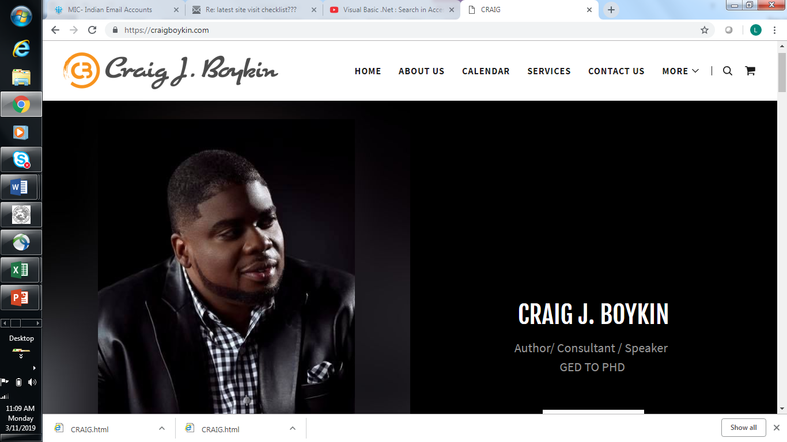

Slide 44
Vincennes University Site Visit Checklist
Student Folder/Classroom Check:
___ 1. Registration with release signed in appropriate places
___ 2. Adult Learning Plan filled out and signed by teacher and student
___ 3. UNDER-18 PAPERWORK/”checked” in inTERS (if applicable)
___ 4. All TABE scores/scoresheets (pre and post)
___ 5. Readiness test scores/scoresheets
___ 6. Documentation/proof of incorporation of daily soft skills
___ 7. Distance learning documentation (if applicable)
___ 8. Sign-in sheets/proof of attendance (with actual student signatures)
___ 9. ICE documentation in folders
___ 10. Positive classroom climate, instructor interacting in professional manner
___ 11. Evidence of instructor actively engaged with students (small groups, group lessons, focused learning, computer usage, less “packets”)
inTERS Check:
___1. Attendance updated with actual sheets labeled and filed in one location in classroom
___2. Testing data is accurate and errors are/are in process of being “fixed
___3. Registration accurately and thoroughly filled out
___4. Demographics accurately and thoroughly filled out
___5. Focus subject selected on all students (must be lowest EFL subject)

Slide 45
____**UNDER-18 records box checked if student is under 18. If you are not able to check the box stating you have exit forms on file and proper paperwork, the student may not be in your class. No exceptions.
Instructor Check:
___ 1. Has plan for meeting 10 hour professional development requirement
___ 2. Is/has been cooperating/assisting with follow-up and WorkIN efforts
___ 3. Meeting 60% goal on NRS Table 4
___ 4. Is/has been responding/submitting items in timely manner to VU staff/administration
___ 5. Is/has been sending timesheets to Jacquie on Tuesdays
_______________________________________________ ___________________
Instructor Date
_______________________________________________ ___________________
Site Monitor Date

Slide 46

Meaningful, FUN Trainings with Initial “Kickoff”
People don’t know what they don’t know. Our instructors DID NOT KNOW what a Table 4 was or what it meant; therefore, they could not meet any goals set. THAT WAS OUR PROBLEM! Things immediately improved as we TAUGHT Table 4!
“Drove home” WHY Table 4 was important (job security, students being served better).
Repeat, repeat, repeat policy and main items to always know in newsletters and trainings (T4, housekeeping, updates, etc.) People will act like they understand when really they do not. ;)
Training agendas (Include FOOD/SPEAKERS, and break meetings up). How do I fund?

Slide 47

CLEAR EXPECTATIONS OF EXCELLENCE
I desperately wanted VU ABE to “show up”. I knew clear expectations across the board must be conveyed as there had been no expectations or accountability.
No clear expectations? Staff will stop caring, take advantage, and remain in states of confusion. This will lead to one thing- chaos in the program.
All VU ABE processes are listed for instructors in easy-to-follow “steps”.
Ultimately, if a staff member has been presented with expectations, is provided assistance and support (with an improvement plan if needed), and still does not meet set expectations, that staff member is let go/given less hours. As seen on the expectations sheet, that fact is made clear upfront so there are no surprises.
PD Plan/Plans of Improvement

Slide 48
PD Plan/Awesome PDF’s
At October 2018 Small Group PD Trainings, PDF’s Covered:
Summary of how we performed last year
Goals for PY 18-19
Changes re: level gains are counted
New Adult Learner Plans
Following up on student Absences (with steps listed)

Slide 49
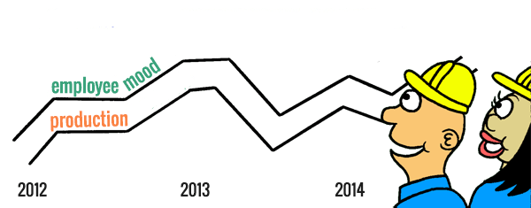
Boosting Staff Morale Means MORE!
Proven Fact: “The better you treat people, the harder they will work for you!”
Birthday cards
Awards (adds a bit of good ol’ competition and excitement)
Christmas party
Luncheons & prize drawings at trainings
“Personal touch”- Handwritten praise to each in each monthly mailing

Slide 50
Student
Success
Stories

Slide 51

Alex Roy
Alex says he “didn’t have his head on straight” in high school,
getting expelled from multiple schools. He eventually found God and decided to devote his
life to Him.
Now, after graduating from VU’s Adult Basic Education program with his HSE, Roy is headed to seminary school.
He currently holds a job at Cracker Barrel in Evansville.
He says he would never be able to move forward without earning his HSE with the help of VU ABE, and he states that it is the best thing that has ever happened to him in his life.

Slide 52

"Unless someone like you cares a whole awful lot, nothing is going to get better. It's not." The Lorax.

Slide 53
program is open to anyone age 16 or older who is not attending a high school. It helps people prepare for the equivalency test, earn workforce
certification and even learn English as a second language.
“It’s really all about getting people into career training and employment,” said Robert Moore, director of the program.
The program serves about 500 people each year. Historically, there has been one ceremony in May to recognize their accomplishments. A second
ceremony was added in December this year.
“- 1
Indiana ADULT EDUCATION
Basic Skills. High School Equivalency. Short-term Training. Certifications and More.
2019-2020
Adult Education
Grant Continuation
Timelines
Submission Deadline
April 1, 2019 – 5 p.m. EST
Award Decisions
Early May 2019
ABE and IELCE PY19 RFA FAQ
https://www.in.gov/dwd/2909.htm
Scott Mills | Donna Lovelady

Slide 54
program is open to anyone age 16 or older who is not attending a high school. It helps people prepare for the equivalency test, earn workforce
certification and even learn English as a second language.
“It’s really all about getting people into career training and employment,” said Robert Moore, director of the program.
The program serves about 500 people each year. Historically, there has been one ceremony in May to recognize their accomplishments. A second
ceremony was added in December this year.
“- 1
Indiana ADULT EDUCATION
Basic Skills. High School Equivalency. Short-term Training. Certifications and More.
2019-2020
Adult Education
Grant Continuation
https://www.in.gov/dwd/2909.htm
RFA Questions
and Answers
What is the maximum Administrative percentage for all budgets?
No more than fifteen percent (15%) of your entire budget (not including MOE) can be used for Administrative purposes.
Scott Mills | Donna Lovelady

Slide 55
program is open to anyone age 16 or older who is not attending a high school. It helps people prepare for the equivalency test, earn workforce
certification and even learn English as a second language.
“It’s really all about getting people into career training and employment,” said Robert Moore, director of the program.
The program serves about 500 people each year. Historically, there has been one ceremony in May to recognize their accomplishments. A second
ceremony was added in December this year.
“- 1
Indiana ADULT EDUCATION
Basic Skills. High School Equivalency. Short-term Training. Certifications and More.
2019-2020
Adult Education
Consideration XIV – Is the goal “20 or 15%" of enrolled individuals participating in IET?
RFA Questions
and Answers
DWD's goal is to have fifteen percent (15%) of enrolled individuals participating in IETs. This typo has been corrected in the latest version of the RFA documentation posted here – https://www.in.gov/dwd/2909.htm
Scott Mills | Donna Lovelady

Slide 56

program is open to anyone age 16 or older who is not attending a high school. It helps people prepare for the equivalency test, earn workforce
certification and even learn English as a second language.
“It’s really all about getting people into career training and employment,” said Robert Moore, director of the program.
The program serves about 500 people each year. Historically, there has been one ceremony in May to recognize their accomplishments. A second
ceremony was added in December this year.
“- 1
Indiana ADULT EDUCATION
Basic Skills. High School Equivalency. Short-term Training. Certifications and More.
Can a provider request additional funding in literacy for adult students who need individualized assistance starting with learning the alphabet and basic math facts?
“Stay strong and remember, your teacher only wants the best for you.” – Christopher Washington, CWI adult learner
No. Because of the nature of this continuation grant, the only 'extra' funds that can be requested are those linked to the Workforce Education Initiative (WEI) or the Indiana Online Only Distance Education (IOODE) program. Please see the RFA documentation for more information on these two funding streams.

Slide 57
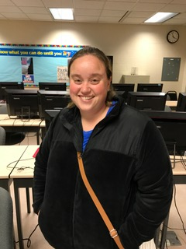
program is open to anyone age 16 or older who is not attending a high school. It helps people prepare for the equivalency test, earn workforce
certification and even learn English as a second language.
“It’s really all about getting people into career training and employment,” said Robert Moore, director of the program.
The program serves about 500 people each year. Historically, there has been one ceremony in May to recognize their accomplishments. A second
ceremony was added in December this year.
“- 1
Indiana ADULT EDUCATION
Basic Skills. High School Equivalency. Short-term Training. Certifications and More.
Can a provider request additional funding in literacy for adult students who need individualized assistance starting with learning the alphabet and basic math facts?
Is the administrative cap calculated on the budget WITH the MOE or WITHOUT the MOE?
.
Student Neoma Wyant Kokomo Adult Education
The Administrative cap (no more than 15% of the total allocation, less PDF funds) is figured on the budget WITHOUT the MOE. The Itemized Budget (PROVIDER NAME_ABE ITEMIZED BUDGET_PY19_RFA_B) document will auto calculate the percentages of Program, Administrative, and MOE totals.
No. Because of the nature of this continuation grant, the only 'extra' funds that can be requested are those linked to the Workforce Education Initiative (WEI) or the Indiana Online Only Distance Education (IOODE) program.

Slide 58
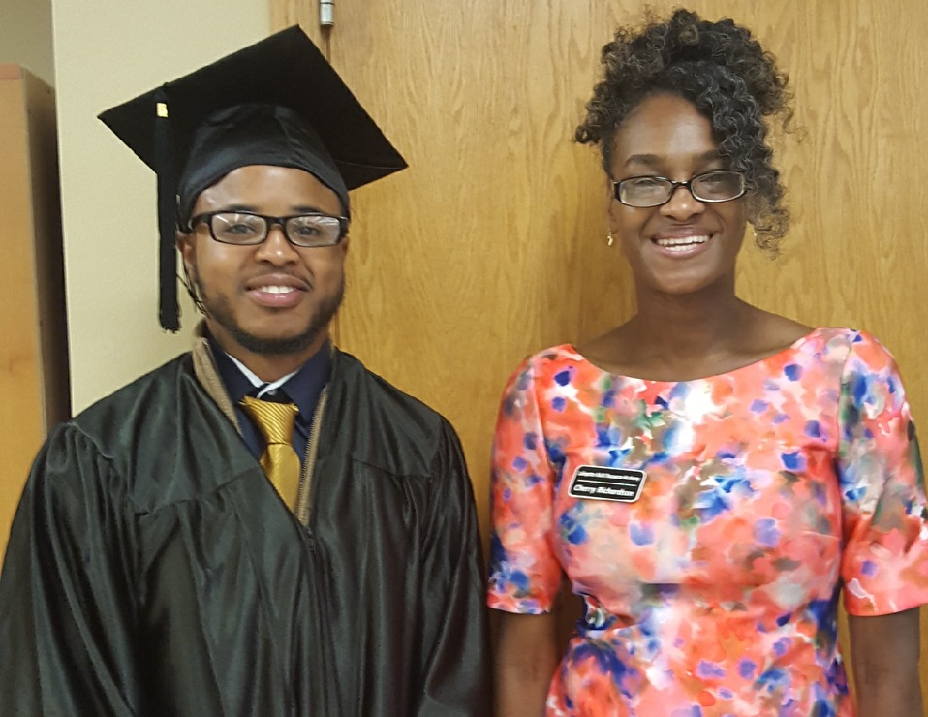
program is open to anyone age 16 or older who is not attending a high school. It helps people prepare for the equivalency test, earn workforce
certification and even learn English as a second language.
“It’s really all about getting people into career training and employment,” said Robert Moore, director of the program.
The program serves about 500 people each year. Historically, there has been one ceremony in May to recognize their accomplishments. A second
ceremony was added in December this year.
“- 1
Indiana ADULT EDUCATION
Basic Skills. High School Equivalency. Short-term Training. Certifications and More.
Will the funds for the PDF stipend and professional development be included when calculating the Administrative cap (15%)?
Can HSE Online Test Fees (DRC/CTB) be reimbursed by IELCE or ABE PY19 grants?
.
The PDF stipend and PDF professional development dollars can appear to affect the Administrative cap. Although these dollars are listed in the Federal Administrative portion of the budget, the source of those funds is different from the rest of the grant and is not subject to the 15% cap. When you are preparing your PY19 itemized budget, be sure that the Admin portion does not exceed 15% BEFORE you add the PDF line items. If it goes over 15% after you add the PDF that will not count against your program.
No AEFLA dollars (ABE/IELCE/IET/WEI/IOODE) can be used to pay for HSE testing.
HSE Graduate LeWayne Patterson | LARA teacher Cherry Richardson

Slide 59
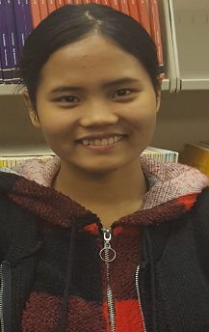

program is open to anyone age 16 or older who is not attending a high school. It helps people prepare for the equivalency test, earn workforce
certification and even learn English as a second language.
“It’s really all about getting people into career training and employment,” said Robert Moore, director of the program.
The program serves about 500 people each year. Historically, there has been one ceremony in May to recognize their accomplishments. A second
ceremony was added in December this year.
“- 1
Indiana ADULT EDUCATION
Basic Skills. High School Equivalency. Short-term Training. Certifications and More.
If a provider did not apply for or receive IELCE funds in PY18 (2018-19), can they submit an IELCE grant application for PY19 (2019-20)?
Is the IET goal established at 20% or 15%?
.
DWD's goal is to have fifteen percent (15%) of enrolled individuals participating in IETs. This typo has been corrected in the latest version of the RFA documentation posted here –
https://www.in.gov/dwd/2909.htm
Any provider that applied for and received IELCE funds during the current PY2017 competitive grant cycle (program years 2017, 2018, and 2019) is eligible to apply for IELCE funds for PY19.
Indy Reads
Student Bethny Mawi

Slide 60
program is open to anyone age 16 or older who is not attending a high school. It helps people prepare for the equivalency test, earn workforce
certification and even learn English as a second language.
“It’s really all about getting people into career training and employment,” said Robert Moore, director of the program.
The program serves about 500 people each year. Historically, there has been one ceremony in May to recognize their accomplishments. A second
ceremony was added in December this year.
“- 1
Indiana ADULT EDUCATION
Basic Skills. High School Equivalency. Short-term Training. Certifications and More.
Can funds from the potential IET and WEI allocations be used by the fiscal agent for administrative expenses?
Can a provider use any of their IET allocation under "Corrections" if they have IETs in a corrections class?
IET and WEI allocations are split between program and administrative. No more than fifteen percent (15%) of the total allocation can be used for administrative costs. Administrative expenses for activities performed in support of IET and WEI are reimbursable. (ABE funds may be used to pay for IET and WEI costs, if necessary. HOWEVER, IET and WEI funds CANNOT be used for ABE.)
Yes. Corrections/jail programs
Is MOE determined by percent of funds received/requested or same as previous grant year?
The MOE--Maintenance of Effort--should be similar to the previous year's amount.

Slide 61
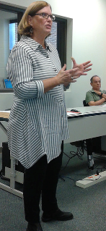
program is open to anyone age 16 or older who is not attending a high school. It helps people prepare for the equivalency test, earn workforce
certification and even learn English as a second language.
“It’s really all about getting people into career training and employment,” said Robert Moore, director of the program.
The program serves about 500 people each year. Historically, there has been one ceremony in May to recognize their accomplishments. A second
ceremony was added in December this year.
“- 1
Indiana ADULT EDUCATION
Basic Skills. High School Equivalency. Short-term Training. Certifications and More.
If a provider does not currently have a Professional Development Facilitator (PDF), can they request funds, in anticipation of getting a PDF in the upcoming program year?
Providers may apply for a PDF allocation during the grant application process. If, and only if, the provider has an approved PDF will those funds be released for reimbursement.
Will providers with a PDF receive an additional allocation to cover stipends and professional development for the PDF?
The PDF stipend and professional development funds will be included in the allocation for those providers who apply and are approved.

Slide 62
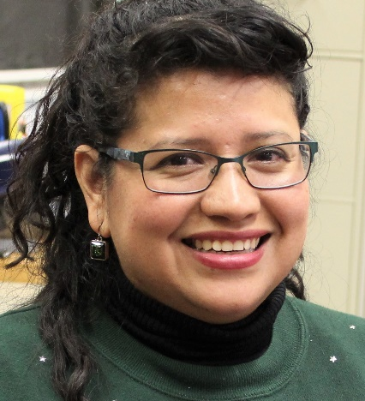
program is open to anyone age 16 or older who is not attending a high school. It helps people prepare for the equivalency test, earn workforce
certification and even learn English as a second language.
“It’s really all about getting people into career training and employment,” said Robert Moore, director of the program.
The program serves about 500 people each year. Historically, there has been one ceremony in May to recognize their accomplishments. A second
ceremony was added in December this year.
“- 1
Indiana ADULT EDUCATION
Basic Skills. High School Equivalency. Short-term Training. Certifications and More.
Can WEI funding be used to transition students from IET to paid work experiences?
Can a program not already receiving corrections funding apply for it as part of the PY2019-20 Continuation Grant?
Can a current sub-grantee apply for funding during the PY2019-20 Grant Continuation process?
WEI cannot be used to fund paid work experiences. This is not an allowable AEFLA cost.
No. Even though parts of the available funding for the ABE grant will be awarded on a competitive basis, the PY2019-20 grant is a continuation.
Any program awarded adult basic education (ABE) funds as a result of the grant process is allowed to use funds to provide adult education and literacy activities in the "corrections" environment.
Student Sandra Crump
Learn More Center

Slide 63
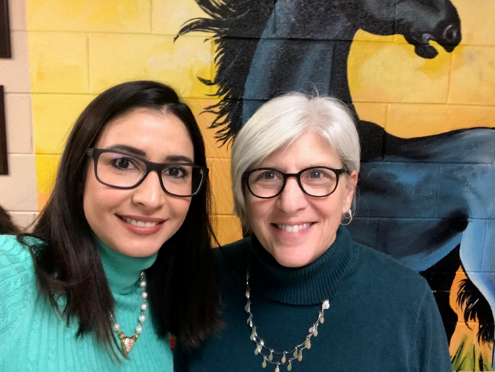
program is open to anyone age 16 or older who is not attending a high school. It helps people prepare for the equivalency test, earn workforce
certification and even learn English as a second language.
“It’s really all about getting people into career training and employment,” said Robert Moore, director of the program.
The program serves about 500 people each year. Historically, there has been one ceremony in May to recognize their accomplishments. A second
ceremony was added in December this year.
“- 1
Indiana ADULT EDUCATION
Basic Skills. High School Equivalency. Short-term Training. Certifications and More.
Do all the students in an IET course need to take the credentialing exam for the workforce training component?
If a program applies for WEI funding, must all the students in the WEI course be employed by the partner employer?
.
DWD understands a student may refuse to take or not pass the credential exam, but it must be offered to all.
There are a number of situations where WEI program could be open to non-employer partner employees
ELL Student Thalissa Painaõ
Teacher Julie Williams
Broadview Learning Center

Slide 64

Indiana ADULT EDUCATION
Basic Skills. High School Equivalency. Short-term Training. Certifications and More.
New
Workforce Initiative Coordinator
for Adult Education
Roy Melton
rmelton@dwd.in.gov
765.413.2216

Slide 65
Indiana ADULT EDUCATION
Basic Skills. High School Equivalency. Short-term Training. Certifications and More.
Professional Development
NEXT
STEPS
Moving Forward
2018-2019
Evidenced-based Reading
March 14-15, 2019 – J. Everett Career Center, Indianapolis, 9:30 - 4:30
February 20 - Pre-Webinar | April 17 - Post-Webinar | 1 - 2:30 P.M.
New Teacher Training
May 10, 2019 – PDF Meeting, 10 - 3
Contracted PD Trainings

Slide 66

STATEWIDE | Goal | To-Date
Enrollment | 1,800 | 1376
Enrollment Rate | --- | 76%
Still Enrolled | --- | 399
Completers | 1,440 | 874
Completion Rate | 80% | 89%
Dropped | --- | 103
Dropped Rate | Below 10% | 12%
Certifications issued | 1,065 | 694
Certification Rate | 74% | 79%
Employment | 640 | 344
Employment Rate | 60% | 39%
  Jessica Gray
  WorkINdiana Program Manager
  jgray1@dwd.in.gov
  WorkINdiana@dwd.in.gov
  (317) 503-1006
WorkINdiana
Updates
Statewide
.6% JAG enrollment
6.4% ERG utilization
8% TANF utilization

Slide 67
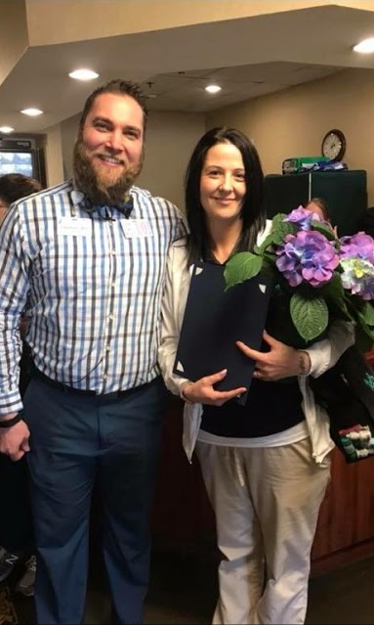
program is open to anyone age 16 or older who is not attending a high school. It helps people prepare for the equivalency test, earn workforce
certification and even learn English as a second language.
“It’s really all about getting people into career training and employment,” said Robert Moore, director of the program.
The program serves about 500 people each year. Historically, there has been one ceremony in May to recognize their accomplishments. A second
ceremony was added in December this year.
“- 1
Indiana ADULT EDUCATION
Basic Skills. High School Equivalency. Short-term Training. Certifications and More.
►Integrated Education & Training
IELCE | Short-term Training | Certifications
Good Jobs.
Better Jobs.
CAREERS.
10 IELCE certifications and 204 IET certifications.
10 pending applications
IET Enrollment 2,026 43.00% goal
IELCE Enrollment 74 12.80% goal
Still Enrolled 960
Dropped 176 16.51%
Completions 890 83.49%
Certifications 668 75.06%
3.11.19
HEA Student
Elizabeth Rodriguez
CRCA Preceptor
Waterford Crossing

Slide 68
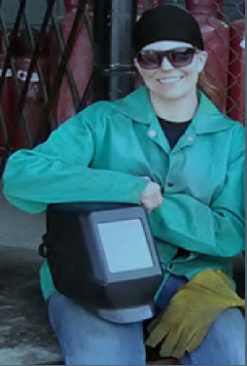
Indiana ADULT EDUCATION
Basic Skills. High School Equivalency. Short-term Training. Certifications and More.
Workforce Education Initiative
69 WEI certifications
1 pending applications (waiting for InTERS spreadsheet)
WEI monthly data report statewide enrollments –
WEI Enrollments 560 12.9 % of the goal
Still enrolled 516
Dropped 5 11.36%
Completed 39 88.64%
Certification 39 100%
Warren Student JeAnna Jones

Slide 69
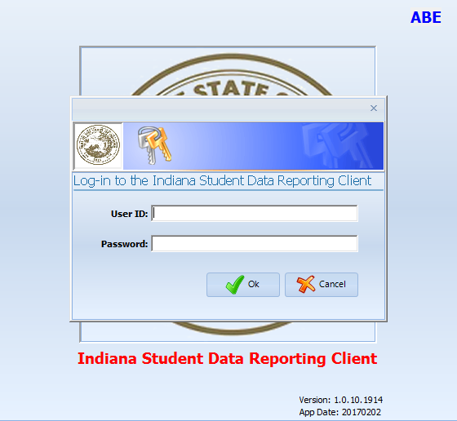
program is open to anyone age 16 or older who is not attending a high school. It helps people prepare for the equivalency test, earn workforce
certification and even learn English as a second language.
“It’s really all about getting people into career training and employment,” said Robert Moore, director of the program.
The program serves about 500 people each year. Historically, there has been one ceremony in May to recognize their accomplishments. A second
ceremony was added in December this year.
“- 1
InTERS
ADULT EDUCATION UPDATES, TRAININGS
Matt Crites
mcrites@dwd.in.gov
Brin Sisco
bsisco@dwd.in.gov

Slide 70
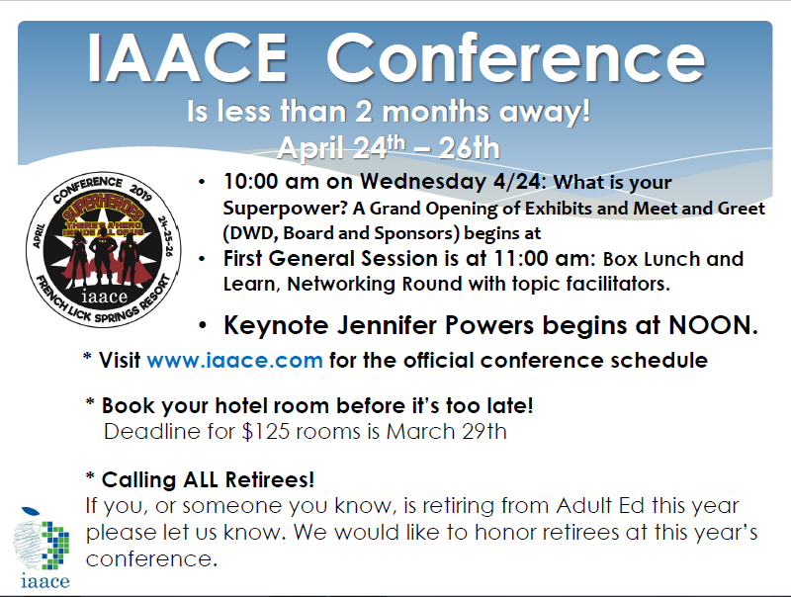
program is open to anyone age 16 or older who is not attending a high school. It helps people prepare for the equivalency test, earn workforce
certification and even learn English as a second language.
“It’s really all about getting people into career training and employment,” said Robert Moore, director of the program.
The program serves about 500 people each year. Historically, there has been one ceremony in May to recognize their accomplishments. A second
ceremony was added in December this year.
“- 1

Slide 71
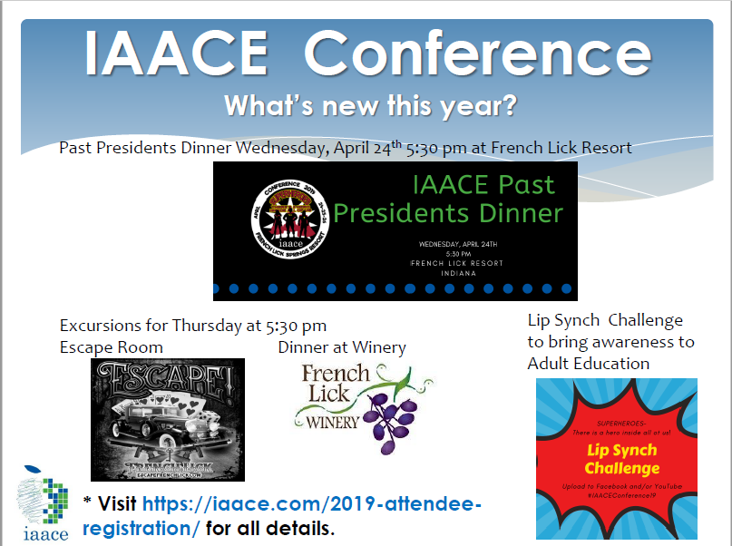
program is open to anyone age 16 or older who is not attending a high school. It helps people prepare for the equivalency test, earn workforce
certification and even learn English as a second language.
“It’s really all about getting people into career training and employment,” said Robert Moore, director of the program.
The program serves about 500 people each year. Historically, there has been one ceremony in May to recognize their accomplishments. A second
ceremony was added in December this year.
“- 1

Slide 72
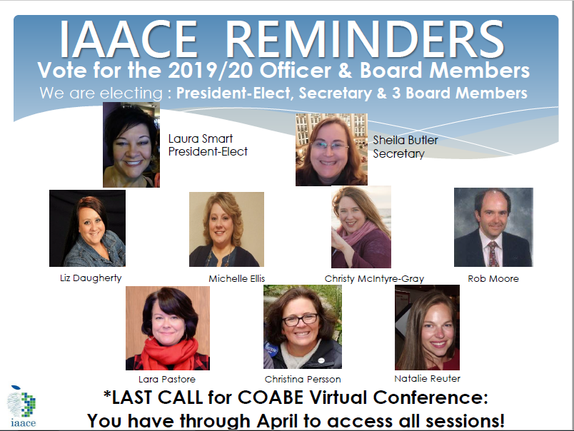
program is open to anyone age 16 or older who is not attending a high school. It helps people prepare for the equivalency test, earn workforce
certification and even learn English as a second language.
“It’s really all about getting people into career training and employment,” said Robert Moore, director of the program.
The program serves about 500 people each year. Historically, there has been one ceremony in May to recognize their accomplishments. A second
ceremony was added in December this year.
“- 1

Slide 73
program is open to anyone age 16 or older who is not attending a high school. It helps people prepare for the equivalency test, earn workforce
certification and even learn English as a second language.
“It’s really all about getting people into career training and employment,” said Robert Moore, director of the program.
The program serves about 500 people each year. Historically, there has been one ceremony in May to recognize their accomplishments. A second
ceremony was added in December this year.
“- 1
Next Adult Education & Workforce Development Statewide Webinar
4.10.19
10 to 11:30 a.m. ET
The right skills, at the right time, in the right way. Indiana’s Demand Driven Workforce

