Slide 1


The right skills, at the right time, in the right way. Indiana’s Demand Driven Workforce
Adult Education and Workforce Development Statewide Webinar
October 3, 2018
Marilyn Pitzulo | Adult Education Staff
Department of Workforce Development | Indiana ADULT EDUCATION
10 N. Senate Avenue, IGCS SE 203 | Indianapolis, IN 46204
AdultEd@dwd.in.gov

Slide 2



program is open to anyone age 16 or older who is not attending a high school. It helps people prepare for the equivalency test, earn workforce
certification and even learn English as a second language.
“It’s really all about getting people into career training and employment,” said Robert Moore, director of the program.
The program serves about 500 people each year. Historically, there has been one ceremony in May to recognize their accomplishments. A second
ceremony was added in December this year.
“- 1
Indiana ADULT EDUCATION
Basic Skills. High School Equivalency. Short-term Training. Certifications and More.
Dion Brown is passionate about food.
He started cooking with his mother when he was six. As a young adult, he landed a job working as a dishwasher for the Holiday Inn in downtown South Bend. He stayed there for 16 years, slowly working his way up to food preparation, breakfast cook, lunch cook and, finally, chef.
Six months later, the company closed its doors and he had to find another job. The new job didn’t last long.
“My brother passed away, so I went through a little depression,” Dion explained. “He lived with me for a time, so every morning I got up he was there and every night when I came home, he was there.”
Dion Brown
South Bend
SOUTH BEND
Community
School Corporation

Slide 3

program is open to anyone age 16 or older who is not attending a high school. It helps people prepare for the equivalency test, earn workforce
certification and even learn English as a second language.
“It’s really all about getting people into career training and employment,” said Robert Moore, director of the program.
The program serves about 500 people each year. Historically, there has been one ceremony in May to recognize their accomplishments. A second
ceremony was added in December this year.
“- 1
Indiana ADULT EDUCATION
Basic Skills. High School Equivalency. Short-term Training. Certifications and More.
Dion Brown
South Bend
“And then all of a sudden, he wasn’t there. I basically shut down
and did some stupid stuff at my job and got fired.”
“He lacked self-confidence. He wasn’t sure how long he would participate.” Teacher Brandon Murphy
During this time, Dion’s mother also became
sick and began to forget things. She was
diagnosed with a form of Alzheimer’s. It was
a lot to handle and Dion says he didn’t handle
it well. He mostly spent his days smoking
marijuana to deal with the pain.
√ HSE Classes
√ Certification
√ CHEF
√ Employed
His sister encouraged him to get back on his feet and, in 2016, she registered him for Brandon Murphy’s high school equivalency class. “When I first met him,” Murphy said, “he was a little undecided about what he wanted to do.”

Slide 4

program is open to anyone age 16 or older who is not attending a high school. It helps people prepare for the equivalency test, earn workforce
certification and even learn English as a second language.
“It’s really all about getting people into career training and employment,” said Robert Moore, director of the program.
The program serves about 500 people each year. Historically, there has been one ceremony in May to recognize their accomplishments. A second
ceremony was added in December this year.
“- 1
Indiana ADULT EDUCATION
Basic Skills. High School Equivalency. Short-term Training. Certifications and More.
Meet Chef Dion Brown
But Murphy says Dion’s confidence began slowly to grow. He passed three of the five sections of the readiness test on the first try, something he did not expect to do. Dion decided to stick with the class. His plan was to try and get his HSE and then figure out the rest.
But earlier this year, adult education’s career coach Deb Lane approached him about participating in a culinary class being offered through Cultivate Culinary, a new South Bend community partner. It would help him to refresh his skills, she told him. Dion signed up. The class lasted two months and provided hands-on training in food safety, food preparation, and knife skills.
Cultivate Culinary School & Catering “is devoted to ending the cycle of joblessness, poverty, and hunger in the local communities of northern Indiana by providing a food rescue service and job training in the culinary arts.”
701 N Niles Ave
South Bend, IN 46617
Phone: (574) 209-2711​

Slide 5

program is open to anyone age 16 or older who is not attending a high school. It helps people prepare for the equivalency test, earn workforce
certification and even learn English as a second language.
“It’s really all about getting people into career training and employment,” said Robert Moore, director of the program.
The program serves about 500 people each year. Historically, there has been one ceremony in May to recognize their accomplishments. A second
ceremony was added in December this year.
“- 1
Indiana ADULT EDUCATION
Basic Skills. High School Equivalency. Short-term Training. Certifications and More.
More than 100,000 people in Michiana are food-insecure
Meet Chef Brown
16% of the people in St. Joseph County are food insecure
Americans waste $165 billion of food each year
Source Cultivate Culinary
“I asked him while I was in the class if there were any open positions,” Dion said. “They help people. They rescue food and they repackage it to give to people who could use the help.”
The organization liked him, too. A week after the culinary class ended, he started cooking for employees at the Goodwill center where Cultivate Culinary is based, helping the chef to plan and prepare meals and clean up.
Source Cultivate Culinary

Slide 6
program is open to anyone age 16 or older who is not attending a high school. It helps people prepare for the equivalency test, earn workforce
certification and even learn English as a second language.
“It’s really all about getting people into career training and employment,” said Robert Moore, director of the program.
The program serves about 500 people each year. Historically, there has been one ceremony in May to recognize their accomplishments. A second
ceremony was added in December this year.
“- 1
Indiana ADULT EDUCATION
Basic Skills. High School Equivalency. Short-term Training. Certifications and More.
Dion
Brown
“I Really Love the Company”
“When I get into the kitchen I usually see what I need to do and I go,” Dion said. This initiative and drive has translated to the classroom as well, where he is finishing his HSE. He hopes to earn his diploma by December.
“His mindset completed changed this year,” Murphy said. “He‘s learned to trust his judgement. Now he’s a leader in Cultivate and he’s a leader in the classroom.
As for Dion, he’s thrilled to be working with food again, and to get the chance to watch people savor his cooking.
“I was at a low point and now I think I’m back.”
“He’s found his voice and he only reaches for greatness.” Teacher Brandon Murphy

Slide 7


Indiana ADULT EDUCATION
Basic Skills. High School Equivalency. Short-term Training. Certifications and More.
Meet Margarita Diaz
Margarita Diaz attended ELL classes to improve her English. Struggling with depression, Margarita often wanted to stop going to class, but she noticed that attending school was good for her mental health.
She pushed herself to continue in school, and was even more motivated after speaking with her child’s teacher.
“I went to a parent-teacher conference for my daughter.
The teacher told me that my daughter said, ‘I’m very proud of my mom because she is going to school to learn English.’”
Margarita was inspired by her daughter’s words and told herself, “I CAN DO IT!”
Then one day, after nearly ten years of sticking to his dream of pursuing music, and becoming an accomplished Elvis and Johnny Cash impersonator, his father had a proposition for him. “He said he knew I had this dream of recording music in Memphis and basically told me he would pay for half of everything if I got my (HSE).”
So, after years out of traditional high school, and an attempt at another high school equivalency (HSE) program out of state, Bennett enrolled at the MACC for daily adult education afternoon classes. “The teacher was great- he motivated me when I needed to be motivated.” After about four months in class, Bennett passed his HSE test and received his diploma. Bennett says, “If it wasn’t for Mr. Smith keeping me on track, I would have never gotten it done.”
“If I can make it, anyone can make it,” says Bennett.

Slide 8

Indiana ADULT EDUCATION
Basic Skills. High School Equivalency. Short-term Training. Certifications and More.
Meet Margarita Diaz
Teacher Brenda Gaston shared that Margarita was an extremely dedicated student. “She put in numerous hours to reach her goal. She was always looking to improve herself and help her classmates.” She earned her HSE diploma and graduated in June. “Achieving the HSE means a lot to me and also to my three children. I feel really proud of myself, and I enjoy knowing that I am able to help others succeed. Best of all, I am able to help my children with their homework,” Margarita said.
Walker Career Center
Adult Education Graduates
Then one day, after nearly ten years of sticking to his dream of pursuing music, and becoming an accomplished Elvis and Johnny Cash impersonator, his father had a proposition for him. “He said he knew I had this dream of recording music in Memphis and basically told me he would pay for half of everything if I got my (HSE).”
So, after years out of traditional high school, and an attempt at another high school equivalency (HSE) program out of state, Bennett enrolled at the MACC for daily adult education afternoon classes. “The teacher was great- he motivated me when I needed to be motivated.” After about four months in class, Bennett passed his HSE test and received his diploma. Bennett says, “If it wasn’t for Mr. Smith keeping me on track, I would have never gotten it done.”
“If I can make it, anyone can make it,” says Bennett.

Slide 9
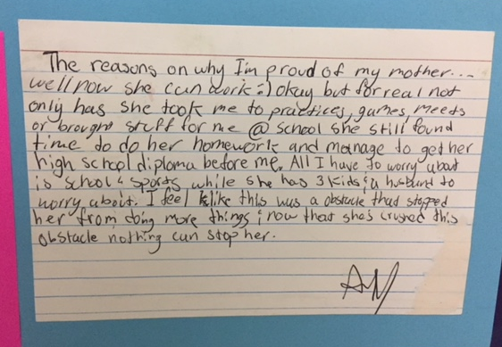
Indiana ADULT EDUCATION
Basic Skills. High School Equivalency. Short-term Training. Certifications and More.
Meet Margarita Diaz
Nothing Can
Stop Her NOW!
“Not only has she taken me to practices, games, meets . . . she still found time to do her homework and manage to get her high school diploma before me. All I have to worry about is school and sports while she has three kids and a husband to worry about. I feel like this was an obstacle that stopped her from doing more things and now that she has crushed this obstacle, nothing can stop her.”
Note from Margarita Diaz’s Son
Then one day, after nearly ten years of sticking to his dream of pursuing music, and becoming an accomplished Elvis and Johnny Cash impersonator, his father had a proposition for him. “He said he knew I had this dream of recording music in Memphis and basically told me he would pay for half of everything if I got my (HSE).”
So, after years out of traditional high school, and an attempt at another high school equivalency (HSE) program out of state, Bennett enrolled at the MACC for daily adult education afternoon classes. “The teacher was great- he motivated me when I needed to be motivated.” After about four months in class, Bennett passed his HSE test and received his diploma. Bennett says, “If it wasn’t for Mr. Smith keeping me on track, I would have never gotten it done.”
“If I can make it, anyone can make it,” says Bennett.
Notes:
JH
Margarita was inspired by her daughter’s words and told herself, “I CAN DO IT!”
Her son wrote, “Not only has she taken me to practices, games, meets . . . she still found time to do her homework and manage to get her high school diploma before me. All I have to worry about is school and sports while she has three kids and a husband to worry about. I feel like this was an obstacle that stopped her from doing more things and now that she has crushed this obstacle, nothing can stop her.”

Slide 10


Indiana ADULT EDUCATION
Basic Skills. High School Equivalency. Short-term Training. Certifications and More.
“I am thankful for the TASC.”
“The first day I went to school was a joyful day for me. I had been waiting many years to further my education. Studying subjects (like social studies and science in addition to language, reading and mathematics) became harder for me due to my lack of comprehension in the English language.
“I recalled a few times wanting to quit. With the encouragement of my teachers and the determination of studying four to five hours every day made it possible for me to accomplish the TASC. I remember the day I want to school, and got the great news from my teacher that I had passed the TASC test. That day I felt tremendous joy in my heart for this huge accomplishment in my life. I would like to thank (my teachers) and tutors for all their help and support. I want to encourage the teachers to continue to teach the way they are teaching. You are doing a great job . . . .”
Sergio A. Villanueva
Oakland City University
WVCF
Then one day, after nearly ten years of sticking to his dream of pursuing music, and becoming an accomplished Elvis and Johnny Cash impersonator, his father had a proposition for him. “He said he knew I had this dream of recording music in Memphis and basically told me he would pay for half of everything if I got my (HSE).”
So, after years out of traditional high school, and an attempt at another high school equivalency (HSE) program out of state, Bennett enrolled at the MACC for daily adult education afternoon classes. “The teacher was great- he motivated me when I needed to be motivated.” After about four months in class, Bennett passed his HSE test and received his diploma. Bennett says, “If it wasn’t for Mr. Smith keeping me on track, I would have never gotten it done.”
“If I can make it, anyone can make it,” says Bennett.

Slide 11



program is open to anyone age 16 or older who is not attending a high school. It helps people prepare for the equivalency test, earn workforce
certification and even learn English as a second language.
“It’s really all about getting people into career training and employment,” said Robert Moore, director of the program.
The program serves about 500 people each year. Historically, there has been one ceremony in May to recognize their accomplishments. A second
ceremony was added in December this year.
“- 1
Indiana ADULT EDUCATION
Basic Skills. High School Equivalency. Short-term Training. Certifications and More.
TABE 11/12 Updates
Mike Johnson | National Adult Education Director
Data Recognition Corporation - CTB
630-995-6712 | mjohnson@datarecognitioncorp.com
Tests of Adult Basic Education
Visit TABETest.com to Learn More

Slide 12


A New TABE for a New Era

Slide 13
TABE Current Status
  TABE 9&10 is approved until February 2019 (extended to June 30)
  TABE 9&10 released on new DRC INSIGHT platform
  TABE 11&12 Online released January 8, 2018 on DRC INSIGHT
  TABE 11&12 Paper/Pencil to be released April 1st
  Date that states will allow use of TABE 11&12 to be announced
    TABE 9&10 cut off date to be announced later
  TABE CLAS-E approved in 20 states
    New College and Career-Readiness (CCR) Standards pending for Adult ESL
13

Slide 14
NRS Changes
  Public comment period for WIOA draft regulations is closed
  Final NRS Descriptors released March 2016
  Final NRS Regulations released August 2016
    Rules for all parts of NRS testing/reporting and AEFLA funding
  October 1, 2016, was the first application date for publishers
    TABE 11&12 application submitted for NRS approval
  September 7, 2017 TABE 11&12 received 7 year NRS approval
14

Slide 15
TABE 11&12 Overview
  New standards
    National College- and Career-Readiness (CCR) Standards
  New test length
    Only one test length; no Survey and Complete Battery
  Changes to Math sections
    Only one Math test; standards focus on Applied Math
  Improved Locator design
    Longer Locator test provides a stronger prediction to TABE
  Reading, Math, and Language tests only
  Alignment to TASC Test and other HSE exams that align to CCRS
15
Notes:
TABE 11/12 is 100% aligned to the new College- and Career-Readiness Standards.
TABE 11/12 will be only one length; no longer will there be a long and short form. The new tests will be approximately 40 questions per section.
Math will also only be one test, not a separated Math Comp and Applied Math as TABE 9/10 has.
We are also lengthening (4 questions longer) the Locator test slightly to make it more predictive in placing students into the new TABE 11/12
TABE 11/12 will only have the 3 sections, Reading, Math and Language. There will not be the Spelling, Vocab and Language Mechanics that TABE 9/10 had.
TABE and TASC were developed by the same teams and share the same computer testing platform and are based on the same standards.

Slide 16
New NRS Educational Functioning Levels
Key Changes:
• Alignment to CCR Standards & Employability Skills Framework
Same 6 levels but new domains / strands for each
Increase in specificity & rigor (cognitive demand)
Language of exit descriptors shifting away from limiting statements to elaborate detail
Employability skills embedded throughout (often look like academic skills)
Employability Skills Framework website for reference http://cte.ed.gov/employabilityskills/
From: http://www.in.gov/dwd/abe/files/Statewide_Webinar_2_11_15.pdf

Slide 17
NRS Changes Example: NRS Level 1 Math
Old:
Individual has little or no recognition of numbers or simple counting skills or may have only minimal skills, such as the ability to add or subtract single digit numbers.
Students prepared to exit this level are able to decipher a simple problem presented in a context and reason about and apply correct units to the results. They can visualize a situation using manipulatives or drawings and explain their processes and results using mathematical terms and symbols appropriate for the level. They recognize errors in the work and reasoning of others. They are able to strategically select and use appropriate tools to aid in their work, such as pencil/paper, measuring devices, and/or manipulatives. They can see patterns and structure in sets of numbers and geometric shapes and use those insights to work more efficiently.
Number Sense and Operations: Students prepared to exit this level have an understanding of whole number place value for tens and ones and are able to use their understanding of place value to compare two-digit numbers. They are able to add whole numbers within 100 and explain their reasoning, e.g., using concrete models or drawings and strategies based on place value and/or properties of operations. They are able to apply their knowledge of whole number addition and subtraction to represent and solve word problems that call for addition of three whole numbers whose sum is less than 20 by using such problem-solving tools as objects, drawings, and/or simple equations.
Algebraic Thinking: Students prepared to exit this level understand and apply the properties of operations to addition and subtraction problems. They understand the relationship between the two operations and can determine the unknown number in addition or subtraction equations.
Geometry and Measurement: Students prepared to exit this level can analyze and compare 2-dimensional and 3-dimensional shapes based on their attributes, such as their shape, size, orientation, the number of sides and/or vertices (angles), or the lengths of their sides. They can reason with two-dimensional shapes (e.g., quadrilaterals and half- and quarter-circles) and with three-dimensional shapes (e.g., right prisms, cones, and cylinders) to create composite shapes. They are able to measure the length of an object as a whole number of units, which are not necessarily standard units, for example measuring the length of a pencil using a paper clip as the length unit.
Data Analysis: Students prepared to exit this level are able to organize, represent, and interpret simple data sets (e.g., lists of numbers, shapes, or items) using up to three categories. They can answer basic questions related to the total number of data points in a set and the number of data points in each category, and can compare the number of data points in the different categories.
New:
17
Notes:
This slide is to bring awareness to the increase in rigor required by the new NRS functional level.
This slide is the current Level 1 Math Descriptor (the lowest level of Adult Ed) compared to the new Level 1, which is more descriptive and much more rigorous.
You are bringing awareness to teachers and programs that the big shift they saw for high-level students when the new HSE tests were released is now going to happen to all levels of Adult Ed.
The blue box is what programs are following for entry level math programs (read this box) the Orange box is the new Level 1 descriptor, much more descriptive much more rigorous. But similar if you read paragraph #3.

Slide 18
How to Use TABE
How to Use TABE
Enter
Locator Test
Pre-test
Instruct
HSE
Post-test
No
HSE
Yes
Eligibility
Career
Ready to Exit
Ready to exit?
Post-sec
Placement
Notes:
This is a typical flow chart showing the steps in the TABE test administration process. It represents the assessment and learning process many Adult Education sites follow. This is not the only way to use TABE, as some sites use it for placement in a new education program, or to qualify job applicants for a new position.

Slide 19
TABE 11&12: Item Types
Level | EBSR | TE | Total | Passages
 | Math (Calculator & Non-Calculator Parts)
L | 0 | 0 | 35 | 0
E | 0 | 0 | 40 | 0
M | 0 | 4 | 40 | 0
D | 0 | 2 | 40 | 0
A | 0 | 4 | 40 | 0
 | Reading (Part 1 & Part 2)
L | 0 | 0 | 40 | 4
E | 3 | 2 | 47 | 7
M | 7 | 0 | 47 | 8
D | 9 | 1 | 47 | 9
A | 15 | 1 | 47 | 9
 | Language
L | 0 | 0 | 35 | 0
E | 0 | 7 | 40 | 2
M | 0 | 4 | 40 | 3
D | 0 | 5 | 40 | 6
A | 0 | 8 | 40 | 4
19
Notes:
Start with the left column.
Note that TABE 11/12 still has Level L, which is the orange book. Maybe ask how many people use Level L today. Other programs might find a need for level L in the future if they find that Level E is to challenging for some entry level students.
Next is the type of items, EBSR is the Evidence Based Selected Response or 2 part Reading questions. Reading has more reading involved. The EBSR are introduced on Level E with 3 and increased on Level A with 15.
Next is the Technology Enabled which is Matching, Drag and Drop and multiple select. These are only on TABE Online. TABE Paper will have Twin items that measure the same objective but with standard questions.
The Total column is the total number of questions but it is important to point out that the EBSR questions are really 2 questions, but are one question worth 2 points. So level E has 3 more questions and Level A has 15 more questions.

Slide 20
TABE 11&12 Maximum Allowable Time Revised
Level | Reading Part 1 | Reading Part 2 | Language | Math Part 1 | Math Part 2
L | 35 minutes | 60 minutes | 60 minutes | 75 minutes | N/A
E | 60 minutes | 60 minutes | 60 minutes | 75 minutes | N/A
M | 60 minutes | 60 minutes | 60 minutes | 60 minutes | 15 minutes
D | 60 minutes | 60 minutes | 60 minutes | 40 minutes | 35 minutes
A | 60 minutes | 60 minutes | 60 minutes | 30 minutes | 45 minutes
Locator | 45 minutes | N/A | 25 minutes | 15 minutes | 15 minutes
Notes:
TIMES BEEN UPDATED AS OF 3/16/18
TABE 11/12 switched to “Allowable Time” versus “Time Required” that TABE 9/10 used. We were conservative in the initial release of times based on the results of the Field Testing and the big changes in the Standards.
We have been monitoring the testing times form early users of TABE 11/12 Online since January and have not reduced the allowable time based on the new data.
We will continue to monitor the testing time data and also work with selected customers to capture testing times from paper and pencil users through out 2018 to see if any additional changes are warranted.
Math is 70 minutes.
Level E Math does NOT use a calculator
Level M Math uses a standard 4 function calculator and a protractor
Level D and A uses the same Scientific calculator that TASC and other HSE test use.
Part 2 in Math is always the calculator section
Reading: due to the increase in the number of passages needed to cover the standards the test is broken into 2 sections Part 1 and Part 2. Both need to be delivered to get a score.
Language is 60 Minutes.

Slide 21
TABE 11&12: Objectives by Level
21
Notes:
Open up a sample of the TABE 11/12 Blue Print from TABETEST.com after showing this slide. On the Blueprint point out the color coding from the pie chart to the detail under the pie chart. Also point out the Low, Med, High Emphasis column that relates to the number of questions on the test.
TABE 11/12 Level L includes foundational reading and reading texts to assess beginning readers. TABE 11/12 also includes Mathematics and Language subtests. Together, these subtests are designed to assess the skills of adults with the lowest level of math, reading, and language skills – those who function at a grade range equivalent to K-1.
TABE 11/12 Level L presents students the opportunity to show any independent reading skills they have
TABE 11/12 Levels E/M/D/A are examinee-read.

Slide 22
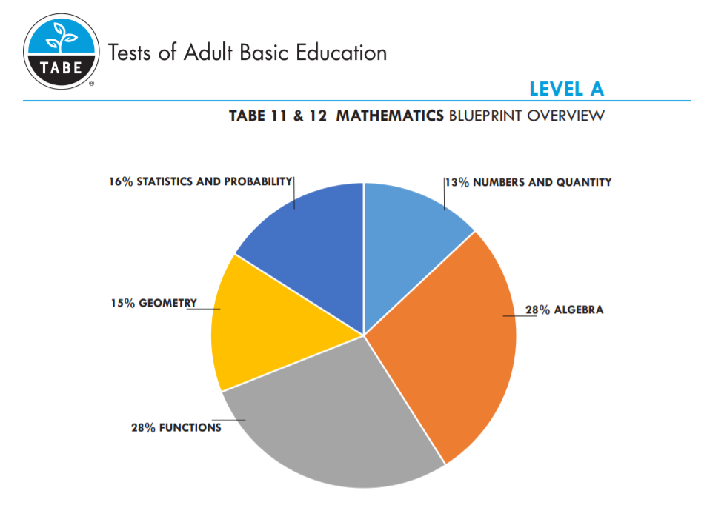
TABE 11&12 Blueprints

Slide 23
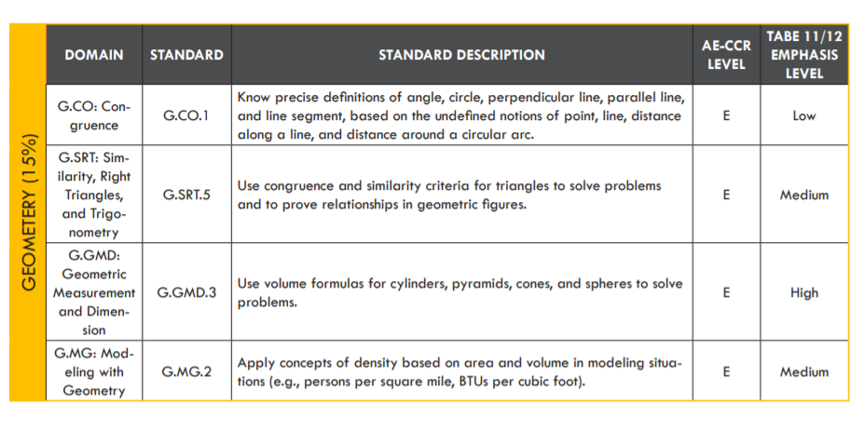
TABE 11&12 Blueprints

Slide 24
TABE 11&12: Level L
  Level L can be used to screen adult examinees entering literacy programs. Level L accomplishes this by screening for:
  Visual/reversal problems
  Auditory skills/sound discrimination
  Beginning comprehension skills
  Beginning mathematics application skills
  Beginning grammar, capitalization, punctuation, and spelling skills
  Vocabulary and word meaning
  Beginning reading skills
24
Notes:
TABE 11/12 Level L is similar to that of TABE 9/10, in that some of the test is read aloud and other sections of the test present students with the opportunity to read themselves.
Level L screens for issues such as:
Visual reversal problems: which is writing the letters and/or numbers the reversed way
Auditory skills such as sound discrimination
Beginning comprehension skills
Beginning mathematics application skills
Beginning grammar, capitalization, punctuation, and spelling skills
Vocabulary and word meaning
Beginning reading skills

Slide 25
TABE 11&12: Levels E/M/D/A Reading
  TABE 11&12 Reading content reflects mature, life- and work-related situations and highlights overlapping objectives, from word-meaning skills to critical-thinking skills
  These are measured using texts and forms familiar to everyday adult lives, as well as through excerpts that reflect our cultural diversity
  Based on OCTAE CCR standards focused largely on informational texts (e.g. research, scientific, historical information)
  The previous focus on literary text (e.g. fiction, memoir, poetry) is significantly decreased
25
Notes:
This slide you are mainly pointing out the last bullet which says the new Reading standards focus on more Reading for Information and not as much Literary reading. The last Bullet is the key message

Slide 26
TABE 11&12: Levels E/M/D/A Mathematics
  TABE 11&12 Mathematics reflects math application, particularly routine tasks such as estimating quantities and making computations involving time, distance, weight, etc.
  Standards have more emphasis on applied versus computation skills
  Item sets are integrated by mathematical contexts appropriate for adults
  The objective distribution at Level A is very closely aligned with the content distribution of the TASC/HSE Mathematics test
26
Notes:
This slide main point is that math standards have changed and what was previously a Level D skill might now be a Level M skill.
Also there are more Applied skills at the higher levels due to the standards.
You can point out as an example that Level M will use a Protractor and Level D and A will use a scientific calculator while Level M uses a four function calculator and no calculator for Level E. All Calculators and Protractors are built in utilities in Insight

Slide 27
TABE 11&12: Levels E/M/D/A Language
  The goal of adult language instruction is to build communication skills necessary for functioning effectively on the job and in daily life
  TABE Language assesses skills in grammar, usage, mechanics, sentence formation, and paragraph development. Understanding of word meaning and relationships, context, spelling, capitalization and punctuation in sentences, phrases, and clauses is included
  Items are presented in meaningful contexts that reflect the writing process as it is applied in life
27
Notes:
Key point here is to point out in bullet 1 that there are spelling and language mechanic skills included that were not part of TABE 9/10 Language.

Slide 28
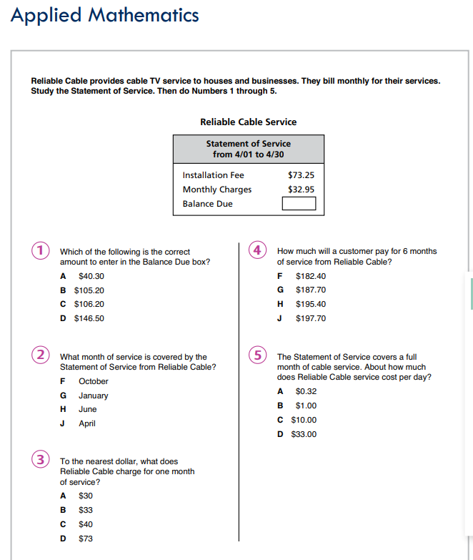
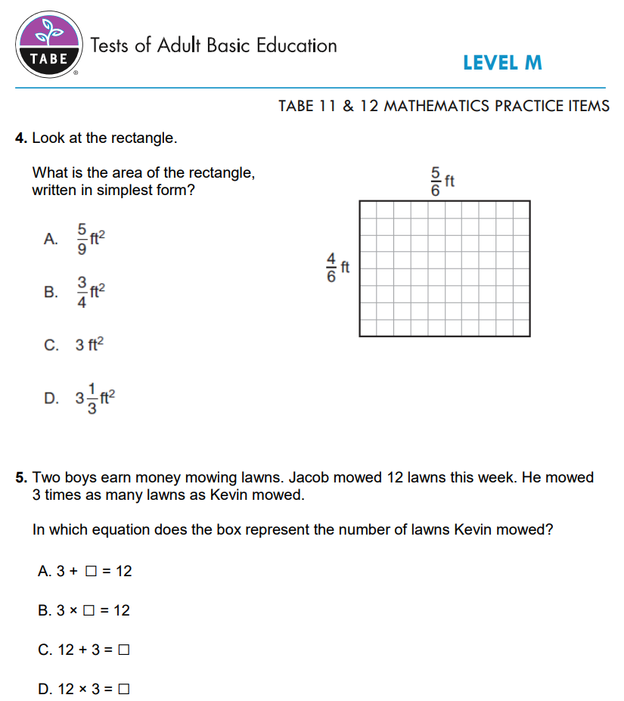
Example of how CCRS changes test items

Slide 29
DRC INSIGHT Test Engine

Slide 30
DRC INSIGHT Test Engine
  Intuitive, universally designed testing interface that is accessible for all students
  Consistent and reliable performance on a range of testing devices
  INSIGHT Runs on Windows, Mac, iOS, Chrome, Linux
  More than 32 million tests delivered in 2016–2017
  Same platform for TABE, TASC Test, TASC Readiness and TABE CLAS-E (pending).
  Since Sept 2017, 3.15 million TABE Sub-tests have been scheduled and 2.1 million of those completed
30

Slide 31
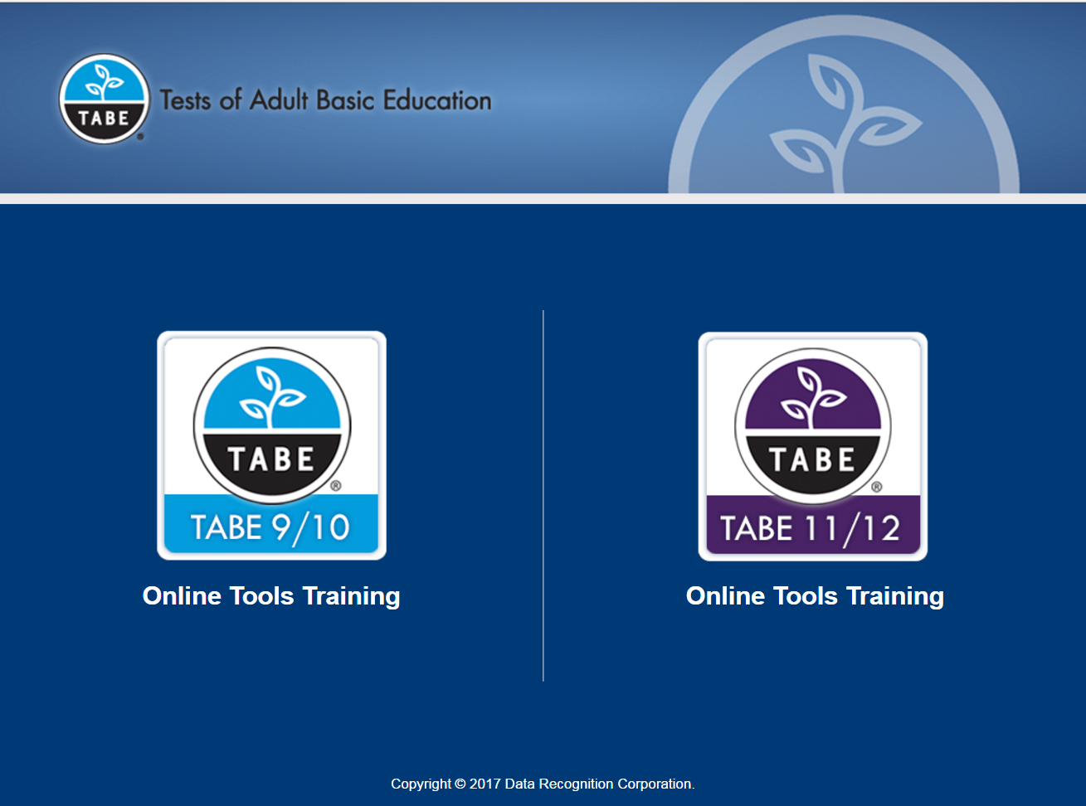


Examinee Access
31
Notes:
Better to go to live OTT on TABEtest.com to demo this if possible
New desktop icon and new opening screen that includes the Online Tools Training. Students will always have the option to take the OTT tutorial before testing but there is a link to the tutorial now at TABEtest.com under the Resources link at the top of the page.
(The graphic is hyperlinked to open the OTT)

Slide 32
TABE Scanning and Scoring
Web-based; no TestMate software required
Scanning can be done on plain-paper scanners (examples)
  Epson WorkForce ES-200
  Epson WorkForce ES-300
  Epson WorkForce ES-400
  Epson WorkForce ES-500
  FUJITSU Document Scanner fi-7160
  Brother ImageCente ADS-2800W
Dual read, Continuous feed, TWAIN compliant
  Future enhancement: Office Copy Machines
  Future enhancement: Cell phone captured pictures
All Data stored in the TABE Database also used by TABE Online
Notes:
Demo Scanning Process if Time allows
TABE 11/12 switched from Scantron OMR scanners that usually cost $4,000-$5,000 to Image based scanners that generally cost $150-$850
No TestMate Software is required ($3,500 in the past). Customer that want to scan answer sheets will request access to the TABE Portal from Customer Service at no charge.
This is a list of some sample scanners
Dual Read (Duplex) and Continuous feed (auto feed) are key words. Your flatbed home office scanner will not work.
All TABE data will now be in one single database. This allows us to export to CSV files and also to start communicating to state databases to transfer data and eliminate data entry for NRS tracking.

Slide 33
TABE Reports
TABE 11&12 Individual Profile
TABE 11&12 Individual Portfolio
TABE 11&12 Locator Report
TABE 11&12 Bulk Export
TABE 11&12 Roster Group Report
TABE 11&12 Local Exporting
TABE 11&12 Individual Diagnostic Report (planned)
TABE 11&12 Workforce Report (planned)

Slide 34
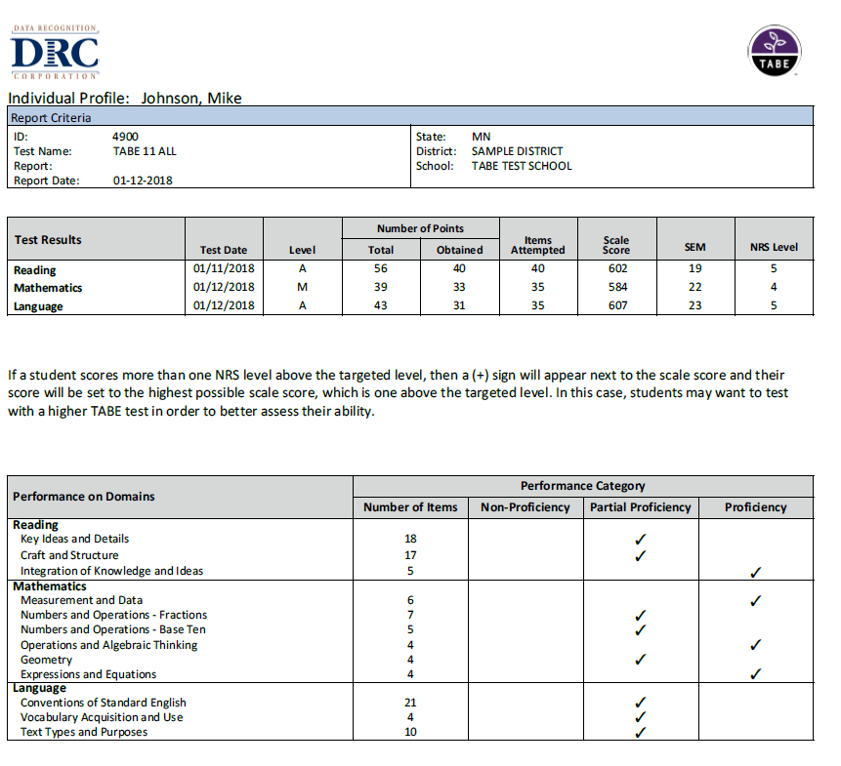

Slide 35
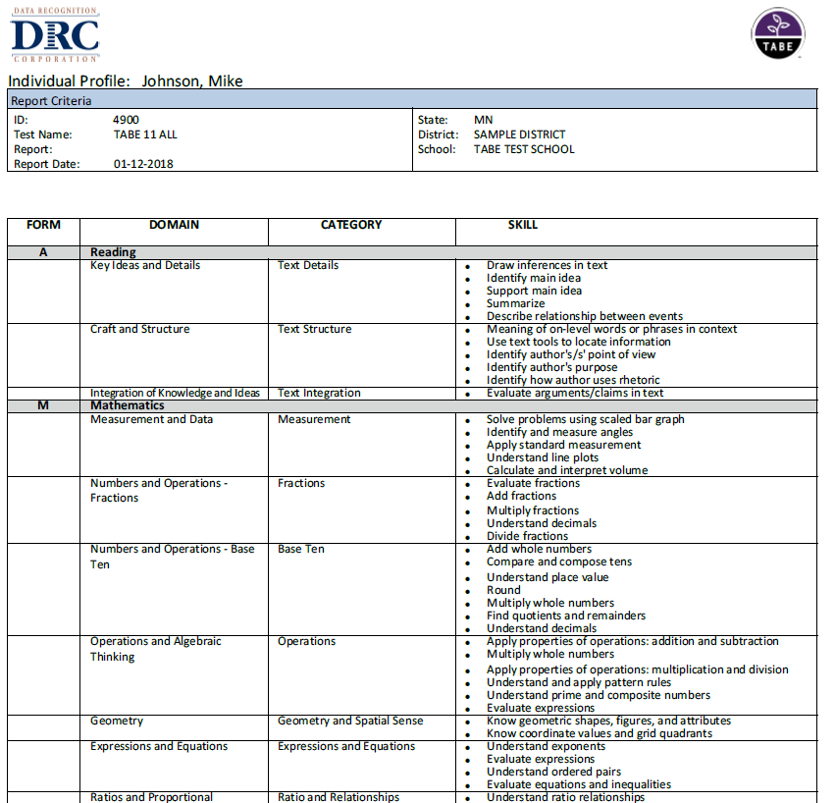

Slide 36
TABE 11&12 Resources
  Now available on tabetest.com:
  TABE 11&12 Blueprints
  www.tabetest.com/resources-2/testing-information/blue-prints/
  TABE 11&12 Sample Practice Items
    www.tabetest.com/resources-2/testing-information/tabe-1112-practice/
  TABE 11&12 Online Tools Training
    www.tabetest.com/resources-2/testing-information/online-tools-training/
36
Notes:
Really stress www.tabetest.com then go to the 11/12 section

Slide 37
Thank You!
Mike Johnson
National Director
630-995-6712
mjohnson@datarecognitioncorp.com
TABETest.com
37

Slide 38
program is open to anyone age 16 or older who is not attending a high school. It helps people prepare for the equivalency test, earn workforce
certification and even learn English as a second language.
“It’s really all about getting people into career training and employment,” said Robert Moore, director of the program.
The program serves about 500 people each year. Historically, there has been one ceremony in May to recognize their accomplishments. A second
ceremony was added in December this year.
“- 1
Indiana ADULT EDUCATION
Basic Skills. High School Equivalency. Short-term Training. Certifications and More.
TABE 11 & 12 Data Comparisons
Indiana Adult Education utilized statewide data in the InTERS database to compare –
TABE 9 & 10 grade equivalencies to TABE 11 & 12 grade equivalencies*
– Comparing students who had tested on both versions of the TABE
Student NRS Levels (as measured by TABE 11 & 12) to TASC scale scores
– Looking at students who tested using TABE 11 & 12 and passed all 5 TASC subtests

Slide 39

TABE to TABe Grade equivalencies
Total Math
Language
Reading
The average change in grade equivalencies from TABE 9 & 10 to TABE 11 & 12 was three grade levels.
This means students, on average, scored three grade levels lower on TABE 11 & 12.
The average change in grade equivalencies from TABE 9 & 10 to TABE 11 & 12 was over three grade levels.
This means students, on average, scored over three grade levels lower on TABE 11 & 12.
The average change in grade equivalencies from TABE 9 & 10 to TABE 11 & 12 was over three grade levels.
This means students, on average, scored over three grade levels lower on TABE 11 & 12.

Slide 40
TABE 11 & 12 to TASC Scale Scores

Slide 41
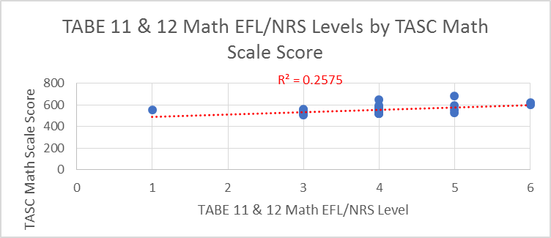
MATH
TABE 11 & 12 to TASC Scale Scores
Notes:
SM

Slide 42
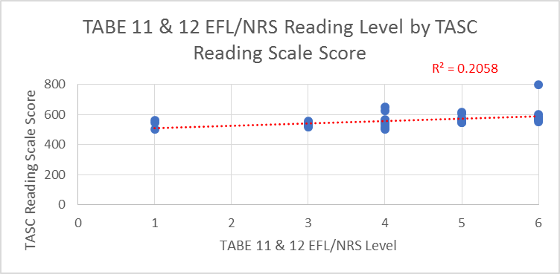
READING
TABE 11 & 12 to TASC Scale Scores

Slide 43
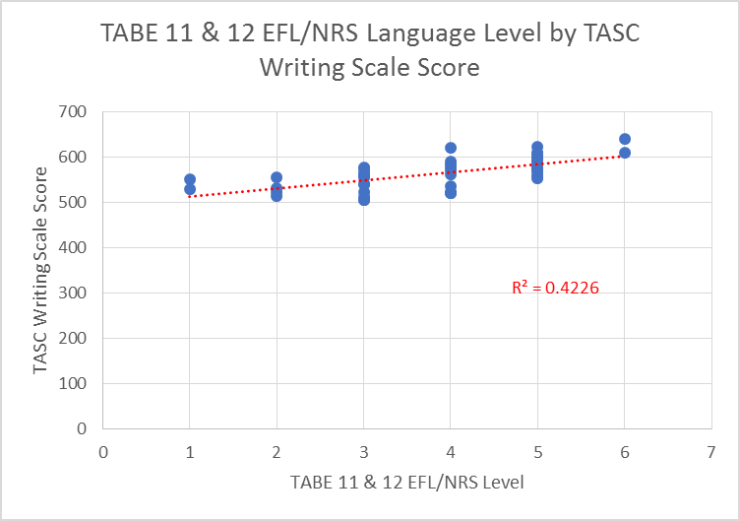
WRITING
TABE 11 & 12 to TASC Scale Scores
Notes:
SM

Slide 44
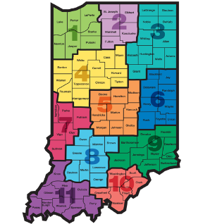
Indiana ADULT EDUCATION
Basic Skills. High School Equivalency. Short-term Training. Certifications and More.
STATE Performance Metrics
Measurable Skill Gains
High School Equivalency
√
√
INDIANA
Performance
Metrics
Then one day, after nearly ten years of sticking to his dream of pursuing music, and becoming an accomplished Elvis and Johnny Cash impersonator, his father had a proposition for him. “He said he knew I had this dream of recording music in Memphis and basically told me he would pay for half of everything if I got my (HSE).”
So, after years out of traditional high school, and an attempt at another high school equivalency (HSE) program out of state, Bennett enrolled at the MACC for daily adult education afternoon classes. “The teacher was great- he motivated me when I needed to be motivated.” After about four months in class, Bennett passed his HSE test and received his diploma. Bennett says, “If it wasn’t for Mr. Smith keeping me on track, I would have never gotten it done.”
“If I can make it, anyone can make it,” says Bennett.

Slide 45
New NRS State Table 4 – 2018-2019
9-28-18

Slide 46
Indiana ADULT EDUCATION
Basic Skills. High School Equivalency. Short-term Training. Certifications and More.
Total
Enrollment
2018-2019* 2017-2018**
ABE/ELL 8,546 8,085
ABE/ELL
+ 461
UP
*Data as of 9.28.18 ** Data as of 9.12.17

Slide 47
Indiana ADULT EDUCATION
Basic Skills. High School Equivalency. Short-term Training. Certifications and More.
Average
Contact Hours
2018-2019* 2017-2018**
ABE/ELL 40.80 hrs. 34.94 hrs.
ABE/ELL
+5.86 hrs.
UP
*Data as of 9.28.18 ** Data as of 9.12.17

Slide 48
Indiana ADULT EDUCATION
Basic Skills. High School Equivalency. Short-term Training. Certifications and More.
MEASURABLE SKILL GAINS
Basic Skills Remediation
NRS Table 4, Column H NRS Table 4, Column I
2017-2018* 2018-2019**
64%
– Indiana Target
2018-2019
22.09%
21.28%
Instructional IMPACT
*Data as of 9.12.17 **Data as of 9.28.18
Then one day, after nearly ten years of sticking to his dream of pursuing music, and becoming an accomplished Elvis and Johnny Cash impersonator, his father had a proposition for him. “He said he knew I had this dream of recording music in Memphis and basically told me he would pay for half of everything if I got my (HSE).”
So, after years out of traditional high school, and an attempt at another high school equivalency (HSE) program out of state, Bennett enrolled at the MACC for daily adult education afternoon classes. “The teacher was great- he motivated me when I needed to be motivated.” After about four months in class, Bennett passed his HSE test and received his diploma. Bennett says, “If it wasn’t for Mr. Smith keeping me on track, I would have never gotten it done.”
“If I can make it, anyone can make it,” says Bennett.

Slide 49
Indiana ADULT EDUCATION
Basic Skills. High School Equivalency. Short-term Training. Certifications and More.
Number
HSE Diplomas
2018-2019* 2017-2018**
ABE/ELL 384 367
HSE Diplomas
+ 17
UP
*Data as of 9.28.18 ** Data as of 9.12.17
Reported by InTERS
Notes:
NK
Compared to this time last year, we are on target for the number of HSEs.

Slide 50
Indiana ADULT EDUCATION
Basic Skills. High School Equivalency. Short-term Training. Certifications and More.
MEASURABLE SKILL GAIN
Basic Skills Remediation
NRS Table 4, Columns B, D, I
64%
– Indiana Target
2018-2019
Enrolled 6,206 (ABE/ELL)
Majority of ABE Students – Level 3
Next Highest – Level 2
21.82%
Data as of 9.28.18
Then one day, after nearly ten years of sticking to his dream of pursuing music, and becoming an accomplished Elvis and Johnny Cash impersonator, his father had a proposition for him. “He said he knew I had this dream of recording music in Memphis and basically told me he would pay for half of everything if I got my (HSE).”
So, after years out of traditional high school, and an attempt at another high school equivalency (HSE) program out of state, Bennett enrolled at the MACC for daily adult education afternoon classes. “The teacher was great- he motivated me when I needed to be motivated.” After about four months in class, Bennett passed his HSE test and received his diploma. Bennett says, “If it wasn’t for Mr. Smith keeping me on track, I would have never gotten it done.”
“If I can make it, anyone can make it,” says Bennett.

Slide 51
Indiana ADULT EDUCATION
Basic Skills. High School Equivalency. Short-term Training. Certifications and More.
Enrolled 6,206
2018-2019 – ABE
9.28.18 ABE Enrollment
ABE Level 1 – 444
ABE Level 5 – 270
ABE Level 6 – 140
14%
69%
Levels
2-3
ABE Level 3
2,157
35%
Data as of 9.28.18
Then one day, after nearly ten years of sticking to his dream of pursuing music, and becoming an accomplished Elvis and Johnny Cash impersonator, his father had a proposition for him. “He said he knew I had this dream of recording music in Memphis and basically told me he would pay for half of everything if I got my (HSE).”
So, after years out of traditional high school, and an attempt at another high school equivalency (HSE) program out of state, Bennett enrolled at the MACC for daily adult education afternoon classes. “The teacher was great- he motivated me when I needed to be motivated.” After about four months in class, Bennett passed his HSE test and received his diploma. Bennett says, “If it wasn’t for Mr. Smith keeping me on track, I would have never gotten it done.”
“If I can make it, anyone can make it,” says Bennett.

Slide 52
Indiana ADULT EDUCATION
Basic Skills. High School Equivalency. Short-term Training. Certifications and More.
Then one day, after nearly ten years of sticking to his dream of pursuing music, and becoming an accomplished Elvis and Johnny Cash impersonator, his father had a proposition for him. “He said he knew I had this dream of recording music in Memphis and basically told me he would pay for half of everything if I got my (HSE).”
So, after years out of traditional high school, and an attempt at another high school equivalency (HSE) program out of state, Bennett enrolled at the MACC for daily adult education afternoon classes. “The teacher was great- he motivated me when I needed to be motivated.” After about four months in class, Bennett passed his HSE test and received his diploma. Bennett says, “If it wasn’t for Mr. Smith keeping me on track, I would have never gotten it done.”
“If I can make it, anyone can make it,” says Bennett.

Slide 53
Indiana ADULT EDUCATION
Basic Skills. High School Equivalency. Short-term Training. Certifications and More.
The Snapshot
Program Year Final
RESULTS 2017-2018
Program Year
2016-2017
Enrollment 26,946
Enrollment 26,370 Down 576
Then one day, after nearly ten years of sticking to his dream of pursuing music, and becoming an accomplished Elvis and Johnny Cash impersonator, his father had a proposition for him. “He said he knew I had this dream of recording music in Memphis and basically told me he would pay for half of everything if I got my (HSE).”
So, after years out of traditional high school, and an attempt at another high school equivalency (HSE) program out of state, Bennett enrolled at the MACC for daily adult education afternoon classes. “The teacher was great- he motivated me when I needed to be motivated.” After about four months in class, Bennett passed his HSE test and received his diploma. Bennett says, “If it wasn’t for Mr. Smith keeping me on track, I would have never gotten it done.”
“If I can make it, anyone can make it,” says Bennett.

Slide 54
Indiana ADULT EDUCATION
Basic Skills. High School Equivalency. Short-term Training. Certifications and More.
The Snapshot
Program Year Final
RESULTS 2017-2018
Program Year
2016-2017
InTERS
HSEs 4,870
InTERS
HSEs 4,989 Up 119

Slide 55
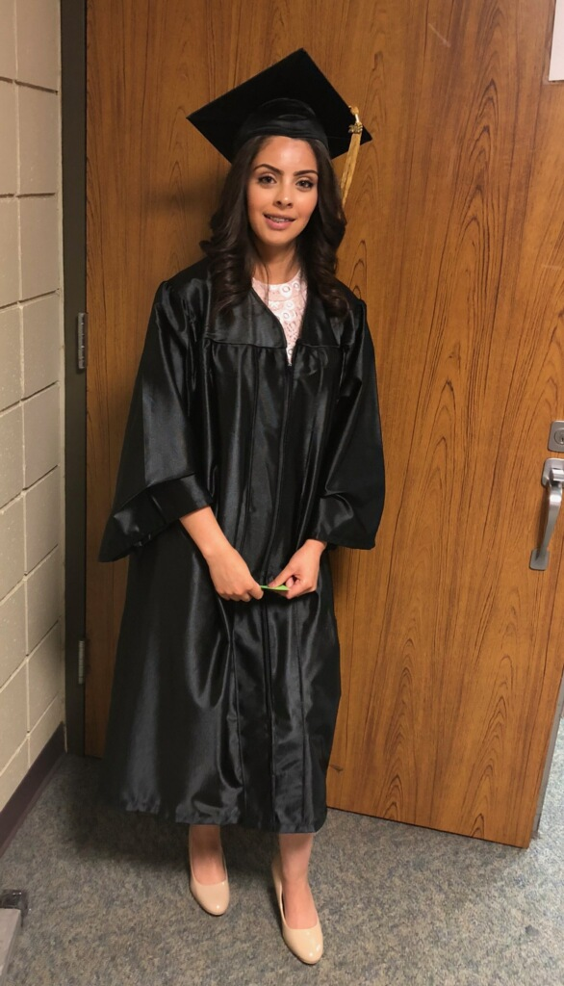
Indiana ADULT EDUCATION
Basic Skills. High School Equivalency. Short-term Training. Certifications and More.
The Snapshot
Program Year Final
RESULTS 2017-2018
APPLAUSE
Ana Angulo 2018 HSE Graduate, Warren Township Adult Education
InTERS
HSEs 4,989
Then one day, after nearly ten years of sticking to his dream of pursuing music, and becoming an accomplished Elvis and Johnny Cash impersonator, his father had a proposition for him. “He said he knew I had this dream of recording music in Memphis and basically told me he would pay for half of everything if I got my (HSE).”
So, after years out of traditional high school, and an attempt at another high school equivalency (HSE) program out of state, Bennett enrolled at the MACC for daily adult education afternoon classes. “The teacher was great- he motivated me when I needed to be motivated.” After about four months in class, Bennett passed his HSE test and received his diploma. Bennett says, “If it wasn’t for Mr. Smith keeping me on track, I would have never gotten it done.”
“If I can make it, anyone can make it,” says Bennett.

Slide 56
Indiana ADULT EDUCATION
Basic Skills. High School Equivalency. Short-term Training. Certifications and More.
The 2017-2018 Snapshot
MEASURABLE SKILL GAINS
Basic Skills Remediation
NRS Table 4, Column H
2017-2018 2016-2017
ABE 65.45% +5.79% 59.66%
ELL 57.28% + 6.47% 50.81%
TOTAL 63.78%* +6.18% 57.60%
60%
– Indiana Target
2017-2018
Instructional IMPACT
Then one day, after nearly ten years of sticking to his dream of pursuing music, and becoming an accomplished Elvis and Johnny Cash impersonator, his father had a proposition for him. “He said he knew I had this dream of recording music in Memphis and basically told me he would pay for half of everything if I got my (HSE).”
So, after years out of traditional high school, and an attempt at another high school equivalency (HSE) program out of state, Bennett enrolled at the MACC for daily adult education afternoon classes. “The teacher was great- he motivated me when I needed to be motivated.” After about four months in class, Bennett passed his HSE test and received his diploma. Bennett says, “If it wasn’t for Mr. Smith keeping me on track, I would have never gotten it done.”
“If I can make it, anyone can make it,” says Bennett.

Slide 57
Indiana ADULT EDUCATION
Basic Skills. High School Equivalency. Short-term Training. Certifications and More.
The 2017-2018 Snapshot
Distance Education Measurable Skill Gains
7.31.17
2016-2017
NRS Table 4C Column H
64.96%
8.30.18
2017-2018
NRS Table 4C
Column H
70.99%
Distance Ed
2016-2017
2017-2018*
71%
*Data as of 8.30.18

Slide 58
Indiana ADULT EDUCATION
Basic Skills. High School Equivalency. Short-term Training. Certifications and More.
The 2017-2018 Snapshot
No. Separated Before Gain
2016-2017
9,817
36.36%
2017-2018
8,537
32.37%

Slide 59
Indiana ADULT EDUCATION
Basic Skills. High School Equivalency. Short-term Training. Certifications and More.
The 2017-2018 Snapshot
No. Separated Before Gain
2017-2018
– ABE/ASE Levels 1-6 30.91% Separated
– ELL Levels 1-6 38.02% Separated
_______________________________
32.37% Separated
Notes:
NK
ABE levels 1-6 were under 31 percent; ELL levels 1-6 were at 38 percent.

Slide 60
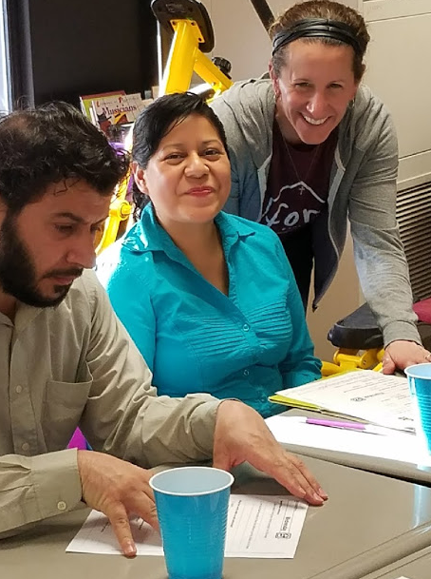
Indiana ADULT EDUCATION
Basic Skills. High School Equivalency. Short-term Training. Certifications and More.
The 2017-2018 Snapshot
Integrated Education
and Training Program
IELCE
1,433 Enrolled | 5.43% of Enrollment
MSD Wayne Township Adult Education

Slide 61

Indiana ADULT EDUCATION
Basic Skills. High School Equivalency. Short-term Training. Certifications and More.
The 2017-2018 Snapshot
Participant Status on Entry
Employed 35%
Unemployed 41%
Not in the Labor Force 24%
MSD Wayne Township
Adult Education

Slide 62
Indiana ADULT EDUCATION
Basic Skills. High School Equivalency. Short-term Training. Certifications and More.
The 2017-2018 Snapshot
Highest Degree or Level of School Completed
29.31% High School Degree/Higher
U.S. based – Non-U.S. based Schooling

Slide 63

Indiana ADULT EDUCATION
Basic Skills. High School Equivalency. Short-term Training. Certifications and More.
The 2017-2018 Snapshot
In Correctional Facility
Other Institutional Setting (Medical)
23.25%
6,132
Institutional
Measurable Skill Gains 69.44%
Notes:
NK
Nearly 25 percent of our students in 2017-2018 were in correctional or institutional settings. The actual total was 6,132. These students perform well when it comes to measurable skill gains. The percentage was nearly 70.

Slide 64

Indiana ADULT EDUCATION
Basic Skills. High School Equivalency. Short-term Training. Certifications and More.
President Trump signed last week the FY 19 Labor-HHS bill which includes funding for adult education. It is first time this bill has been enacted before the end of the fiscal year on September 30th. As previously announced, this bill includes a $25 million increase for adult education.
$25 million Increase for
Adult Education
Patricia H. Tyler
Executive Director
National Association of State Directors of Adult Education

Slide 65
Indiana ADULT EDUCATION
Basic Skills. High School Equivalency. Short-term Training. Certifications and More.
Infographic
Statistics
3.36 million Hoosiers in the labor force
476,000 adult Hoosiers without a high school credential
Average high school dropout costs taxpayers more than $500,000
Challenge
Skill up approximately half million Hoosiers without a high school credential
Solution
Adult Education Path | HSE Diploma | Integrated Education & Training
WorkINdiana
Industry Certifications
Notes:
MP

Slide 66
Indiana ADULT EDUCATION
Basic Skills. High School Equivalency. Short-term Training. Certifications and More.
2018-2019 Adult Education Online (Request for Application)
Adult Education Online
Award Updates
Scott Mills
DWD Adult Education Grants Manager | smills1@dwd.in.gov
Anticipated Start Date October 2018

Slide 67

Indiana ADULT EDUCATION
Basic Skills. High School Equivalency. Short-term Training. Certifications and More.
Statute WIOA
U.S. Department of Education
OCTAE
Office of Career, Technical, and Adult Education
MONITORING PROTOCOL
- Program Regulations
- Uniform Guidance
- EDGAR (Education Department General Administrative
Regulations)
Program Regulations 34 CFR 462 34 CFR 463
Uniform Guidance 2 CFR 200 .327 .328 .331 .338 .339
EDGAR 34 CFR 76.770, 76.720, 76.722
Notes:
JH
Last month we discussed the release of the federal monitoring protocol. This protocol will be used to monitor states.

Slide 68
Indiana ADULT EDUCATION
Basic Skills. High School Equivalency. Short-term Training. Certifications and More.
MONITORING INSTRUMENT for Indiana Adult Education Programs
NEXT
STEPS
Moving Forward
2018-2019
Indiana Adult Education
Program Quality Review
Section 1 – Performance Accountability
Section 2 – Fiscal
Section 3 – Local Leadership (professional
development)
Section 4 – Monitoring
Section 5 – State Targets

Slide 69
Indiana ADULT EDUCATION
Basic Skills. High School Equivalency. Short-term Training. Certifications and More.
2018-2019 INDIANA Grant
Program Quality Review Examples
Indiana Adult Education Program Quality Review
Section 1 – Performance Accountability
Does the grantee require that all sites and subaward recipients (if applicable) use a standardized intake form (electronic or paper) to collect all participant information required for the Adult Education and Family Literacy Act (AEFLA)? Does the intake form include the correct definitions for all data elements?
Does the grantee and subaward recipients (if applicable) require a confidentiality release form at intake for data exchange?
Do the grantee and subaward recipients (if applicable) follow the state’s assessment policy to meet Measurable Skill Gains requirements?

Slide 70
Indiana ADULT EDUCATION
Basic Skills. High School Equivalency. Short-term Training. Certifications and More.
2018-2019 INDIANA Grant
Program Quality Review Examples
Indiana Adult Education Program Quality Review
Section 1 – Performance Accountability
Do the grantee and subaward recipients (if applicable) follow the instructional hours to administer pre- and post-tests to students? Is the time for administering the post-test long enough after the pre-test to allow the test to measure educational functioning level gains according to test publisher's guidelines?
Do the grantee and subaward recipients (if applicable) accurately identify and record the skill areas in InTERS to measure educational gain?
Do the grantee and subaward recipients (if applicable) identify the appropriate alternate form or forms of each test to use for posttesting?

Slide 71
Indiana ADULT EDUCATION
Basic Skills. High School Equivalency. Short-term Training. Certifications and More.
2018-2019 INDIANA Grant
Program Quality Review Examples
Indiana Adult Education Program Quality Review
Section 1 – Performance Accountability
Do the grantee and subaward recipients enter data into InTERS at least by the 10th of each month to ensure accurate reviews by the state?
Do the grantee and subaward recipients review InTERS data by the 10th of each month for errors, missing data, out-of-range values, and is there a process in place to resolve problems?
Do the grantee and subaward recipients have procedures to verify that local reports accurately reflect data collected (e.g., through review of local program documentation, onsite auditing)?

Slide 72
Indiana ADULT EDUCATION
Basic Skills. High School Equivalency. Short-term Training. Certifications and More.
2018-2019 INDIANA Grant
Program Quality Review Examples
Indiana Adult Education Program Quality Review
Section II – Fiscal
Have all required federal/state financial reports (FFR) been submitted? Were the submissions timely?
Were the percentage caps met in each report for administration?
Are all the costs allocated for Maintenance of Effort (MOE) verifiable from the grantee’s records? Necessary and reasonable for the accomplishment of the program’s objectives?
How much program income is being reported and how is it being spent?
Are all administrative costs necessary, reasonable, and allocable?

Slide 73
Indiana ADULT EDUCATION
Basic Skills. High School Equivalency. Short-term Training. Certifications and More.
2018-2019 INDIANA Grant
Program Quality Review Examples
Indiana Adult Education Program Quality Review
Section II – Fiscal
Is the grantee reporting One Stop infrastructure costs? Has the grantee used administrative funds to support infrastructure?
Does the grantee demonstrate that it documents section 243 Integrated English Literacy and Civic Education (IELCE) activities and funds as separate from the basic grant award?
Is the staffing adequate for the grantee’s current adult education responsibilities?
Can the grantee provide evidence that staff keep time and effort charts to document allowable adult education activities?

Slide 74
Indiana ADULT EDUCATION
Basic Skills. High School Equivalency. Short-term Training. Certifications and More.
2018-2019 INDIANA Grant
Program Quality Review Examples
Indiana Adult Education Program Quality Review
Section III – Local Leadership (Professional Development)
How does the grantee deliver professional development activities to staff? What process does the grantee use to ensure that professional development activities are widely accessed by instructors and program managers? Does the grantee track participation in professional development activities?
How is the grantee expending funds to monitor and evaluate activities and disseminate information about promising practices?
Does the grantee have a process in place for using the professional development evaluation data for continuous improvement? If no, why not?
Notes:
LH
Section III – Local Leadership (Professional Development)
How does the grantee deliver professional development activities to staff? What process does the grantee use to ensure that professional development activities are widely accessed by instructors and program managers? Does the grantee track participation in professional development activities?
How is the grantee expending funds to monitor and evaluate activities and disseminate information about promising practices?
Does the grantee have a process in place for using the professional development evaluation data for continuous improvement? If no, why not?

Slide 75
Indiana ADULT EDUCATION
Basic Skills. High School Equivalency. Short-term Training. Certifications and More.
2018-2019 INDIANA Grant
Program Quality Review Examples
Indiana Adult Education Program Quality Review
Section IV – Monitoring
Does the grantee have a process in place to monitor internally? Does the grantee have a process in place to monitor subaward recipients?
Does the grantee conduct onsite monitoring? Does the grantee have a standard monitoring protocol? Does the grantee conduct desktop monitoring? Who conducts the monitoring?
Does the grantee provide internal staff, including subaward recipients, with training and technical assistance on programmatic issues?

Slide 76
Indiana ADULT EDUCATION
Basic Skills. High School Equivalency. Short-term Training. Certifications and More.
2018-2019 INDIANA Grant
Program Quality Review Examples
Indiana Adult Education Program Quality Review
Section IV – Monitoring
Are there cooperative arrangements that the grantee has with other agencies, institutions, or organizations for the delivery of adult education and literacy activities?
Are services in alignment with the local workforce development plan, including how it will promote concurrent enrollment in programs and activities under Title I of WIOA, as appropriate?
Does the grantee meet performance targets set by the state?
Does the grantee fulfill, as appropriate, required one-stop partner responsibilities?

Slide 77
Indiana ADULT EDUCATION
Basic Skills. High School Equivalency. Short-term Training. Certifications and More.
2018-2019 INDIANA Grant
Program Quality Review Examples
Indiana Adult Education Program Quality Review
Section V – State
Do the grantee and subaward recipients (if applicable) maintain an inventory of equipment purchased?
Do the grantee and subaward recipients (if applicable) follow retention schedules for program records and student files for a minimum of three years?
Do the grantee and subaward recipients (if applicable) collect required signed high school exit forms for students (16-18 years of age)?
Do the grantee and subaward recipients (if applicable) use Indiana Career Explorer with each student?

Slide 78
Indiana ADULT EDUCATION
Basic Skills. High School Equivalency. Short-term Training. Certifications and More.
2018-2019 INDIANA Grant
Program Quality Review Examples
Indiana Adult Education Program Quality Review
Section V – State
What processes are in place to monitor subaward recipients (if applicable)?
Are the provider’s staff credentials in compliance with the adult education qualifications and development policy?
Do the grantee and subaward recipients (if applicable) monitor data quality? How often and how is this being done? Are InTERS reports run routinely? Is attendance tracked daily?
At what frequency does the grantee review planned vs. actual expenditures?

Slide 79
Indiana ADULT EDUCATION
Basic Skills. High School Equivalency. Short-term Training. Certifications and More.
Monitoring TEAM
NEXT
STEPS
Moving Forward
2018-2019
Indiana Adult Education
Program Quality Review
MONITORING Team*
Lance Halsey
Roy Melton
Jennifer Montgomery
*Continue as Adult Education Coordinators (AECs)

Slide 80
Indiana ADULT EDUCATION
Basic Skills. High School Equivalency. Short-term Training. Certifications and More.
Will the Monitoring Tool be Posted to AmplifyAE? Yes
When Will Formal On-site Monitoring Begin Using the New Protocol? Draft schedule
How Will I Know if My Program is Selected? Email
How Long Will the On-Site Review Take? Probably Two Days/Less
MONITORING PROTOCOL
Indiana Adult Education
Program Quality Review

Slide 81


Indiana ADULT EDUCATION
Basic Skills. High School Equivalency. Short-term Training. Certifications and More.
WorkINdiana Updates
WorkINdiana enrolled its first student in August of 2011 and reached a total enrollment of over 7,000 students by end of June 2018. To date, over 5,800 students have completed a program, and 4,700 students have earned a certification in an industry recognized, in-demand occupation.
The WorkINdiana program offers short-term occupational training to adult education students, resulting in industry-recognized certifications.

Slide 82
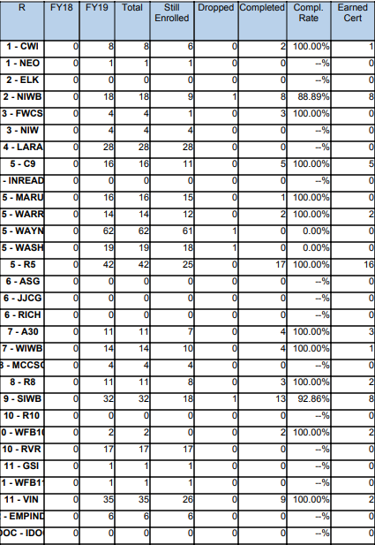
STATEWIDE | Goal | To-Date
Enrollment | 1,800 | 366
Enrollment Rate | --- | 20%
Still Enrolled | --- | 289
Completers | 1,440 | 73
Completion Rate | 80% | 94.81%
Dropped | --- | 4
Dropped Rate | Below 10% | 5%
Certifications issued | 1,065 | 50
Certification Rate | 74% | 68.49%
Employment | 640 | 26
Employment Rate | 60% | 52%

Slide 83


Slide 84

WorkINdiana
Updates
  Jessica Gray
  WorkINdiana Program Manager
  jgray1@dwd.in.gov
  WorkINdiana@dwd.in.gov
  (317) 503-1006
Final policy has been posted to the WorkINdiana website
ERG reports due 10.15.18
Get to know us!

Slide 85
Employer Reimbursement Grant
Employer Reimbursement Form
*Employer must submit reimbursement form to WorkINdiana grantee
Any allocation utilizing WorkINdiana 2018 monies are required to have an ERG appropriation
  All 1819py grantees were allocated ERG funds
  All second round 1718py grantees will be allocated ERG funds upon an approved additional funds request
Grantees must partner with at least one employer
An employer is eligible for an employer reimbursement grant for each eligible employee who obtains a HSD/HSE through a program organized or funded by the employer.
https://www.in.gov/dwd/3323.htm

Slide 86
What are eligible ERG expenses?
Example 1: Partnership is established with Employer agreeing to send eligible employees to AE for HSE training. Employer will pay AE for teacher expenses, utilities, rent/lease, TASC, and/or TABE testing per eligible employee. Employer then requests reimbursement from WorkINdiana grantee for these charges for every eligible employee completion.
Example 2: Partnership is established with Employer requesting that AE classes be held at employer site. Employer pays AE for teacher expense, TASC, and/or TABE per eligible employee. Employer then requests reimbursement from WorkINdiana grantee for these charges for every eligible employee completion.
Instructor salaries (teacher, aide, tutor, counselor)
Materials (text books, instructional software, orientation materials, workbooks)
Assessment (TABE or TASC pre-test and test)
Equipment (computers, projectors, tablets)
Supportive Services (childcare, transportation)
Other (postage, printing, property, rent/lease, utilities)

Slide 87
Indiana ADULT EDUCATION
Basic Skills. High School Equivalency. Short-term Training. Certifications and More.
Professional Development
NEXT
STEPS
Moving Forward
2018-2019
► Regionally Delivered Professional Development
► Locally Delivered Professional Development
► State Initiatives
Professional Development Team*
South – Nancy Karazsia
Central – Dan DeVers
North – Jose Torres
*Continue as Adult Education Coordinators (AECs)

Slide 88
Indiana ADULT EDUCATION
Basic Skills. High School Equivalency. Short-term Training. Certifications and More.
Professional Development
NEXT
STEPS
Moving Forward
2018-2019
New Teacher Training
Evidenced-based Reading
Addressing Racism in the Classroom
Integrated Education and Training (IET) | Workforce Education Initiative
Contracted PD Trainings

Slide 89
Indiana ADULT EDUCATION
Basic Skills. High School Equivalency. Short-term Training. Certifications and More.
Professional Development
NEXT
STEPS
Moving Forward
2018-2019
Save the Date
December 14, 2018 | Indianapolis
Adult Education Director Meeting
PDF Meeting
Future Adult Ed Meetings
Notes:
DD/NK/JT

Slide 90

Indiana ADULT EDUCATION
Basic Skills. High School Equivalency. Short-term Training. Certifications and More.
Professional Development
NEXT
STEPS
Moving Forward
2018-2019
NRS Courses
https://nrsweb.org/training-ta/online-courses
You will learn about NRS and WIOA requirements and how to improve the quality of NRS data collection and usage. You also will become familiar with the development and purpose of the NRS.
Free NRS Trainings

Slide 91

Course | Description | Time
NRS Data Flow | After completing this course, you should have a comprehensive understanding of each level of the NRS. | 10 to 15 minutes
NRS Data Dashboards | This course reviews how to use data dashboards to summarize and present NRS data and other information that you need to make decisions, understand challenges, and highlight progress toward your organization’s goals. | 2 to 3 hours
NRS Data Systems | This course presents the key steps for planning and implementing a data system that can be used for years to come. | 1 hour
Developing Report Cards for Adult Education | Learn to develop your own state or local report card in this four-part self-directed course based on the NRS Guide Demonstrating Results: Developing State and Local Report Cards for Adult Education. | 80 to 105 minutes
Using NRS Data | Gain an understanding of how to use NRS data and learn basic techniques for using NRS data to assist in the analysis of educational program data. | 10 to 15 minutes
Learning to Be an NRS Data Detective | This seven-part course includes a variety of readings and tools that illustrate the art of being a data detective and using data to monitor performance, understand programs, and plan and evaluate program improvement efforts. | 3 to 5 hours
NRS Myth Busters | Offers a detailed model and approach to assist state and local adult education programs in using their NRS data to “bust” common myths and conduct research related to adult education students, teachers, or programs. | 140 to 180 minutes
https://nrsweb.org/training-ta/online-courses
Notes:
DD/NK/JT

Slide 92
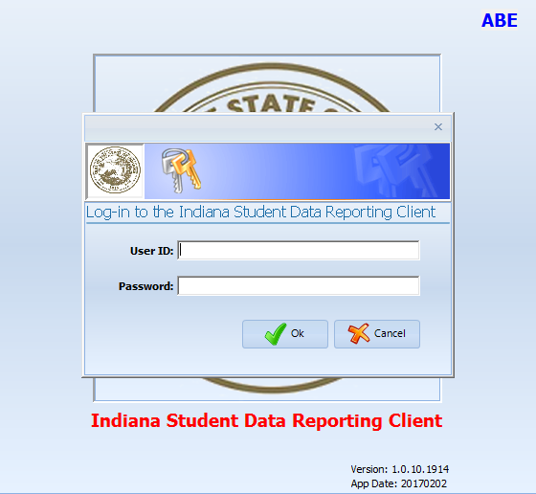
program is open to anyone age 16 or older who is not attending a high school. It helps people prepare for the equivalency test, earn workforce
certification and even learn English as a second language.
“It’s really all about getting people into career training and employment,” said Robert Moore, director of the program.
The program serves about 500 people each year. Historically, there has been one ceremony in May to recognize their accomplishments. A second
ceremony was added in December this year.
“- 1
InTERS
ADULT EDUCATION UPDATES, TRAININGS
Matt Crites
mcrites@dwd.in.gov
Brin Sisco
bsisco@dwd.in.gov

Slide 93
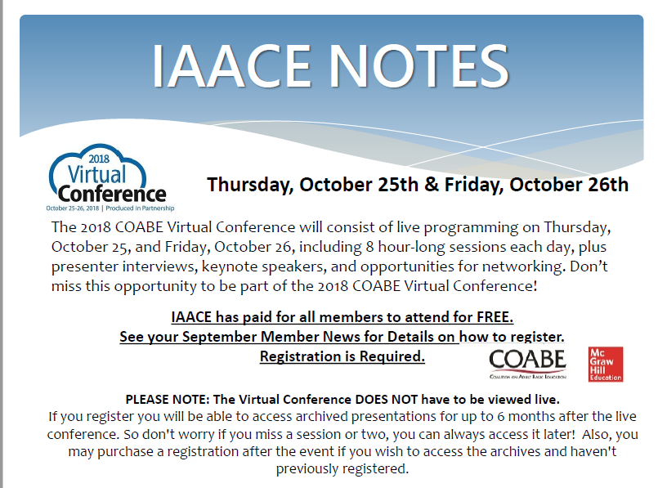
Notes:
RM

Slide 94
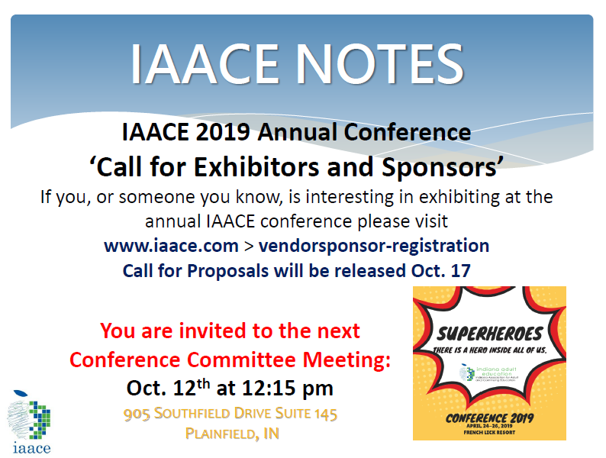

Slide 95
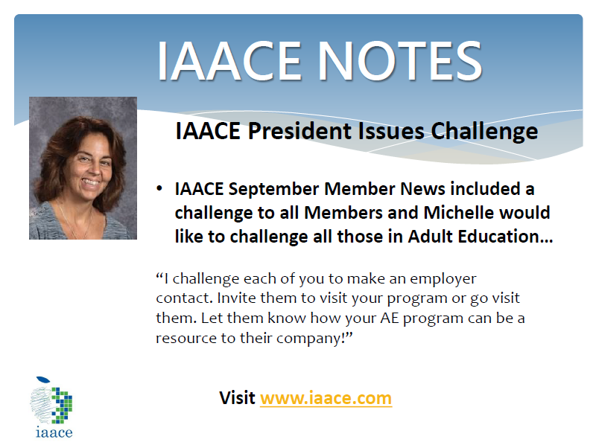
Notes:
RM

Slide 96
program is open to anyone age 16 or older who is not attending a high school. It helps people prepare for the equivalency test, earn workforce
certification and even learn English as a second language.
“It’s really all about getting people into career training and employment,” said Robert Moore, director of the program.
The program serves about 500 people each year. Historically, there has been one ceremony in May to recognize their accomplishments. A second
ceremony was added in December this year.
“- 1
Next Adult Education & Workforce Development Statewide Webinar
11.7.18
10 to 11:30 a.m. ET
The right skills, at the right time, in the right way. Indiana’s Demand Driven Workforce

