Slide 1
HIP Enrollment by Race – All HIP
*information developed based on 2013 ACS data, based upon 2012 income **Actual HIP enrollment as of June 2015

Slide 2
HIP Newly Eligible by Race
*information developed based on 2013 ACS data, based upon 2012 income **Actual HIP enrollment as of June 2015

Slide 3
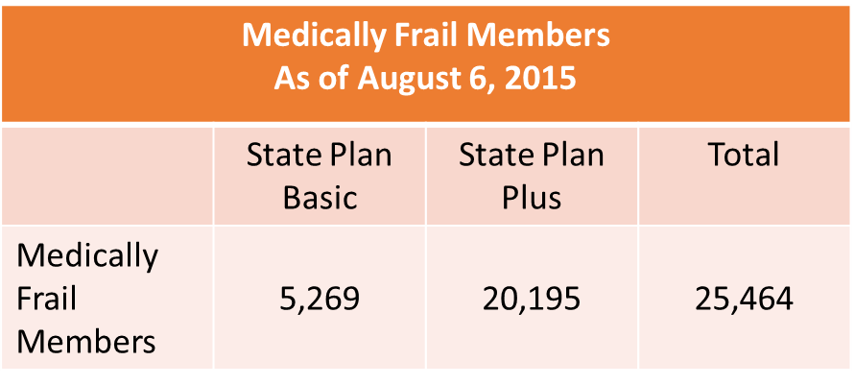
Medically Frail in HIP
Approximately 8% of HIP members are confirmed medically frail. (25,464 medically frail members out of 300,574 total members)

Slide 4
Presumptive Eligibility Qualified Providers
QPs July 2015
Provider Type | Number of Qualified Provider | Total Potential Provider by Type*
Acute Care Hospital | 114 | 219
Community Mental Health Center | 23 | 25
Federally Qualified Health Center | 27 | 68
Psychiatric Hospital | 17 | 30
Rural Health Clinic | 20 | 66
County Health Department | 9 | 57
Total | 210 | 465

Slide 5
Presumptive Eligibility July 2015
14,016 PE Applications
10,993 PE Applications Approved
PE Category | Number PE Approved
HIP | 9,313
Child 1-18 | 979
Pregnant Woman | 296
Family Planning | 194
Child less than 1 year old | 146
Former Foster Care | 24
Parent/Caretaker | 41
Total | 10,993

Slide 6
PE Experience in 1st Quarter of HIP
Presumptive Eligibility Applications and Performance Feb 1, 2015-April 30, 2015
Provider Type | PE Applications Submitted | PE applications Approved | IHCP Applications Submitted | IHCP Applications Approved*
Acute Care Hospital | 26,788 | 20,455 | 18,492 | 11,413
Community Mental Health Center | 299 | 231 | 221 | 124
Federally Qualified Health Center | 1,100 | 899 | 854 | 430
Psychiatric Hospital | 176 | 136 | 132 | 90
Rural Health Clinic | 6 | 3 | 3 | 2
County Health Department | 0 | 0 | 0 | 0
Grand Total | 28,369 | 21,724 | 19,702 | 12,059*
*Additional applications could have been approved after the date of this data pull.

