Slide 1
Indiana Health Coverage Programs Member Access
August 6, 2015 MAC Meeting

Slide 2
Where We Are Today
June 2014
June 2015
Provider Classification | Billing, Group, Dual | Rendering Providers
 | 15,049 | 35,466
Total Providers |  | 50,495
Provider Classification | Billing, Group, Dual | Rendering Providers
 | 15,166 | 37,555
Total Providers 52,721

Slide 3
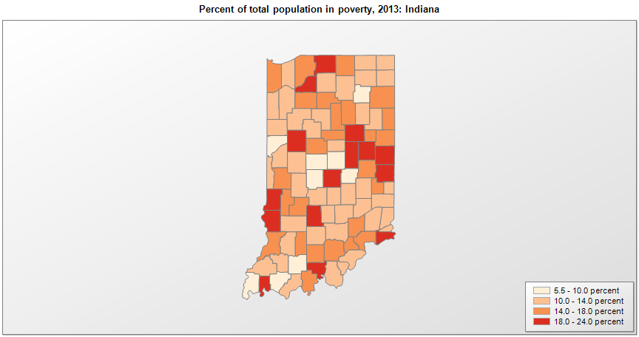
Hoosiers Living in Poverty

Slide 4
Notes:
2,372 transportation providers total

Slide 5
Air Ambulance
County | Number of Providers
ALLEN | 4
BARTHOLOMEW | 1
CLAY | 1
HARRISON | 1
IFSSA | 9
JACKSON | 1
LAKE | 1
MARION | 2
NEWTON | 1
ORANGE | 1
OUT OF STATE | 72
RANDOLPH | 1
RUSH | 1
ST. JOSEPH | 3
TIPPECANOE | 1
VANDERBURGH | 3
WABASH | 1
Total | 104
* Those counties not listed do not have a registered Air Ambulance provider

Slide 6
Ambulance Providers
Notes:
727 ambulance providers

Slide 7
Ambulatory(CAS) Providers
Notes:
655 CAS providers total

Slide 8
Non-Ambulatory(NAS) Providers
Notes:
629 NAS providers total

Slide 9
Family Member Providers
Notes:
648 family member providers total

Slide 10
Taxi Providers
Notes:
864 Taxi providers total

Slide 11
40
15
10
5
0
Ambulance
Notes:
727

Slide 12
CAS
150
15
10
5
0
NAS
Notes:
655 CAS, 629 NAS

Slide 13
60
15
10
5
0
Family Member
Notes:
648

Slide 14
Transportation Providers, by Type
Notes:
2,372 transportation providers total

Slide 15
Behavioral Health Providers
Provider Type | Total Number Enrolled
Outpatient Mental Health Clinic | 877
Community Mental Health Center (CMHC) | 231
Health Service Provider in Psychology (HSPP) | 1,547
Psychiatrist | 1,578

Slide 16
Community Mental Health Centers
Notes:
231

Slide 17
Outpatient Mental Health Clinics
Notes:
877 total

Slide 18
HSPP’s
Psychiatrists
250
15
10
5
0
Notes:
1547, 1578

Slide 19
Primary Care Panels
Programs | June 2014 | January 2015 | June 2015
Hoosier Healthwise | 5,270 | 5727 | 5,699
Care Select | 3,139 | 3,353 | 3,098
HIP | 4,278 | 4,896 | 5,833
Hoosier Care Connect | N/A | 8 | 4,999
Total | 12,687 | 13,984 | 19,629

Slide 20
Initiatives Moving Forward
Continued education throughout Indiana
Increase community involvement
More visits to smaller communities
Using hospitals as central point of contact
Examine the role of mid-level providers
Enrolling all APNs and PAs to increase provider pool
Bring Indiana current with Medicare policies
Review of mental health mid-levels to explore the possibility of expanding their roles
Examination of oversight and current billing rules and policies

Slide 21
Initiatives Cont.
Increased involvement with provider associations and organizations
Increase Indiana state employee presence at meetings
Seek feedback on publications, policies, and program updates
Explore partnerships with Colleges/Universities
Keep Indiana-trained resources in state
Educate future professionals on Indiana Health Coverage Programs

Slide 22
Contact Information
Questions?
Contact Information
Scott Gartenman, FSSA Provider Relations Director Scott.Gartenman@fssa.IN.gov

