Slide 1
IHCDA HOME Homebuyer Program Selling the Unit – Part II: Putting the Numbers Together Session 5
Samantha Spergel
Director of Real Estate Strategic Initiatives and Engagement
Indiana Housing & Community Development Authority

Slide 2
IHCDA’s Mission and Vision
Our Mission
To provide housing opportunities, promote self-sufficiency, and strengthen communities.
Our Vision
An Indiana with a sustainable quality of life for all Hoosiers in the community of their choice.

Slide 3
Agenda
Updating the Development Budget
Calculating Development Sources
Understanding Proceeds
Program Income and Repayment
CHDO Proceeds
CHDO Reuse Requirement

Slide 4
Updating the Development Budget

Slide 5
Development Budget
The Pro-Forma Closing Tab will include the Development Budget.
All costs should be included.
Remember to include Seller’s Closing Costs, Marketing costs, Realty fees as part of the TDC.
Cost of Volunteer Labor, Donated materials, Donated Property should also be included.
If there has been a change in TDC or in the sales price from what was projected, the Development Subsidy/Appraisal gap will change.

Slide 6
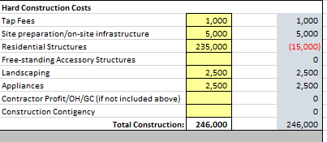
Development Budget
Column E will show any changes from the original commitment tab. If there have been changes in cost, please provide documentation of those changes.
Change order
Updated invoices
IHCDA must document to ensure an evaluation of cost reasonableness.

Slide 7
Development Budget – Developer Fee
IHCDA strongly recommends taking a developer fee.
Use of HOME for developer fee is capped at 15% of the allotted HOME per unit.
Developer Fee does not have to come from HOME – it can also paid at closing and would be seen on final closing disclosure.

Slide 8
Calculating Development Sources

Slide 9
Development Sources
The Development Sources columns will integrate the Budget, the Buyer Analysis and Sources all together.
Pro-Forma will put total TDC, any costs (i.e., Seller’s Closing Costs, or Developer Fee to be paid from proceeds) and will calculate the Development Period costs.

Slide 10
Final Development Subsidy
Gross Development Subsidy/Appraisal Gap will pull from final Development Budget.
TDC (–) Final Sales price
NOTE: if final sales price exceeds TDC, non-buyer subsidy use of HOME will convert to Interim Construction Financing and will be considered proceeds.
The total of other grants should be added. This is calculated as additional Development Subsidy. Examples can include:
Donations/discounts (including volunteer labor)
Waived Fees
Philanthropic Support
Public Funding

Slide 11
Equity, Loans and HOME
Equity that is expected to be paid from proceeds should be included.
This generally is equity from the Seller themselves.
This could also include CHDO proceeds (more later).
Any construction loans subject to repayment upon sale would be included.
The HOME drawn (total HOME award from IHCDA) would be included.
Include retainage.

Slide 12
Ensuring Sources = Uses
Subtotal of Development Period Sources will calculate.
TDC (-) Costs paid from Sales Proceeds
Pro-forma will then ensure there is not source gap – this should always show $0.
If there are changes in sources, updated documentation must be provided.

Slide 13
Where did the HOME go?
Summary of HOME Investment will provide final underwriting looking at the use of HOME for Development Subsidy, for Buyer Assistance, and any Interim Construction Financing.
HOME for Development Subsidy is based on TDC, Sales Price, Cost paid from Proceeds, and any Grants used toward the Development Subsidy.
Buyer Subsidy is calculated under the buyer analysis section and is based on Sales Price, Closing Costs, Buyer’s Cash Investment, Buyer’s Mortgage, and any other assistance toward the purchase.
HOME Construction Loan (interim financing) is based on the total HOME award (-) HOME development subsidy (-) HOME buyer subsidy.

Slide 14
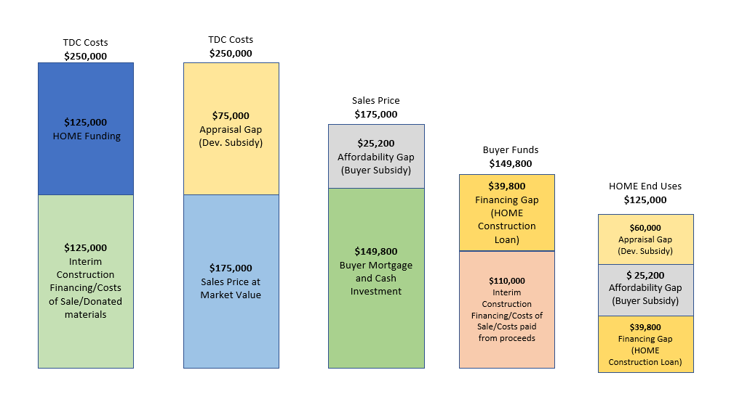
Remember me?

Slide 15
Return of Funds to Seller
Return of any developer equity and balance of the developer fee would be returned to the seller/developer.

Slide 16
Understanding Proceeds

Slide 17
What are proceeds?
Proceeds are generated when the amount of HOME funds receives by the developer is more than the HOME Developer Subsidy and HOME Buyer Subsidy.
We consider this “Interim Construction Financing” and not permanent financing.
Under the HOME regulations, Proceeds are defined as “Program Income” and are required to be repaid to IHCDA if a non-CHDO.
If a CHDO, Proceeds can be considered “CHDO Proceeds” and are not required to be repaid, but subject to the CHDO reuse agreement and IHCDA tracking.

Slide 18
What are proceeds?
As part of the final underwriting, IHCDA will certify the amount of proceeds.
Not every deal will have proceeds.
If there are proceeds to be generated by the sale of the property to the homebuyer, the Developer will be required to pay the proceeds to IHCDA within 30 days of closing on the unit. There is no interest on the repayment of proceeds.
Proceeds may be returned to IHCDA via IHCDA Online or as a mailed check.

Slide 19
CHDO Proceeds
If a developer certifies as a CHDO upon application, then the developer’s proceeds are not considered Program Income, but instead CHDO Proceeds.
No repayment is required – the CHDO may keep those proceeds.
IHCDA will determine the appropriate amount of CHDO Proceeds through the final underwriting.
IHCDA may choose to implement a cap on those proceeds to be retained by the CHDO.

Slide 20
CHDO Proceeds Reuse Requirements
CHDO Proceeds must be utilized for housing activities that benefit low-income families at or below 80% AMI but does not have to be HOME eligible.
Eligible examples include:
Emergency Repairs
Housing Production (including other homebuyer projects)
Project operating cost and reserves
Housing Refinancing Costs
Operating Expenses
Housing Counseling
CHDO Proceeds cannot be use as match on another HOME award.

Slide 21
CHDO Proceeds Reuse Requirements
Up to 5% of the CHDO Proceeds may be used for Administrative Uses/Operational purposes.
Up to 15% of the CHDO Proceeds may be used as a Developer Fee.

Slide 22
CHDO Proceeds Reuse Requirements
CHDO Proceeds are NOT subject to cross-section regulations, including:
Davis Bacon
Environmental Review/Section 106
Uniform Relocation Act
Funds generated from the use of CHDO Proceeds are not considered proceeds. Thus, only the first use of CHDO Proceeds must be tracked and used for an eligible activity.
CHDO Proceeds are still considered Proceeds through the first use even if the HOME Development Agreement with IHCDA has expired.

Slide 23
CHDO Proceeds Approval
CHDO must submit a formal request, signed by CHDO’s Executive Director/Board Chair to IHCDA identifying the use of the CHDO proceeds.
This may be submitted either with other pre-closing documentation or within 30 days of closing and approval of the final pro-forma.
If the request is not submitted within 30 days after closing, the funds will be considered Program Income and will be required to be repaid to IHCDA.
CHDOs may submit modification requests on the use of the proceeds.

Slide 24
CHDO Restrictions and Decertification
IHCDA will not allow CHDO to retain any Proceeds on units that place a third-lien on the property with a payable note that takes the place for needed additional subsidy that could have been negated with HOME Homebuyer Subsidy Funding.
Failure to use existing CHDO Proceeds on eligible activities may result in caps on retention of CHDO Proceeds for future specific projects.
If during the POA, the CHDO becomes decertified, or no longer has a mission of providing affordable housing, then all CHDO proceeds are required to be paid back to IHCDA.

Slide 25
CHDO Reporting Requirements
All CHDOs with CHDO Proceeds will be required to submit quarterly reports to IHCDA that document the use of the CHDO Proceeds and the net balance remaining.
Reporting should include when those Proceeds are used, the amount used, date received, and identification of the use (and address if property-based).
Reporting is only required for the first use of CHDO Proceeds.

Slide 26
Upcoming Training (the last one!) –
Monday, September 25th
9:30am

Slide 27
Post Closing Requirements
Resale and Recapture Requirements
Closeout documents:
Liens
HOME Agreement
Completion Reporting
Final Draw Request
Notice of Project Completion
On-Going Compliance
Annual Certification of Completion
Refinancing and Subordination policies

Slide 28
Any Questions?
Samantha Spergel, Director of Real Estate Strategic Initiatives and Engagement
sspergel@ihcda.in.gov

