Slide 1
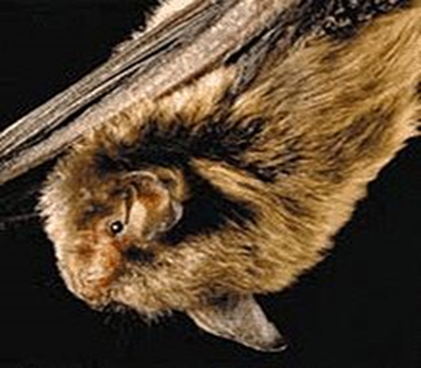
Terrestrial Habitat & Endangered Species
Project Area Land Use
Riparian Habitat
Agricultural
Residential
Small Forests
IDNR Natural Heritage Database
State Endangered:
Round (Obovaria Fasciola)
State Species of Special Concern:
Wavyrayed lampmussel (Lampsilis Fasciola)
American badger (Taxidea taxus)
No impacts expected to State Endangered or State Species of Special Concern
USFWS
2013 Interim Policy
Potential for impacts assumed to be minimal
Range-Wide Programmatic Informal Consultation for the Indiana Bat and Northern Long Eared Bat
“Not Likely to Adversely Affect”
Avoidance, Minimization, & Mitigation Measures to be implemented

Slide 2
Cultural Resources
Archaeological
Records Check and Phase Ia Field Reconnaissance
Three archeological sites that should be avoided
Historic Properties
Two resources eligible for the NRHP within the Area of Potential Effects (APE)
Trinity Reformed Church
Mulberry Commercial Historic District
Effect Finding:
“No Adverse Effect” published October 3, 2020 in The Times
State Historic Preservation Officer concurred with Finding on October 26, 2020

Slide 3
Section 4(f)
Historic Properties:
Trinity Reformed Church
Will not convert property to transportation use
Section 106 finding of “No Adverse Effect”
No Section 4(f) analysis required
Mulberry Commercial Historic District
Will not convert property to a transportation use
Section 106 finding of “No Adverse Effect”
No Section 4(f) analysis required

Slide 4
Purpose & Need
Need:
Poor structural, physical, and operational condition of the existing pavement
Moderate to severe transverse and longitudinal cracking
Moderate rutting and raveling at random locations throughout the travel lanes
Inadequate shoulder widths
Sections of the existing sidewalk and curb ramps within the do not meet American with Disabilities Act (ADA) standards.
Purpose:
Enhance the long-term integrity of the roadway pavement
Improve lateral structural support of travel lanes
Improve pedestrian access within the Town of Mulberry,
Address rutting of the pavement on the SR 38 corridor

Slide 5
Alternatives
Alternative for Section 1
Alternative for Section 2
Alternative for Section 3
Alternative for Section 4, Part 1
Alternative for Section 5
Alternative for Section 6
Full Depth Reclamation Alternative

Slide 6
Alternatives Cont…
Do Nothing
No expenditure of capital funds – utilize existing facility
Result in bridge closure
Does not meet purpose of project
Not prudent
Preferred Alternative
Full Depth Reclamation for long-term integrity of the roadway pavement and structures
Meets Purpose and Need
Feasible and prudent

Slide 7
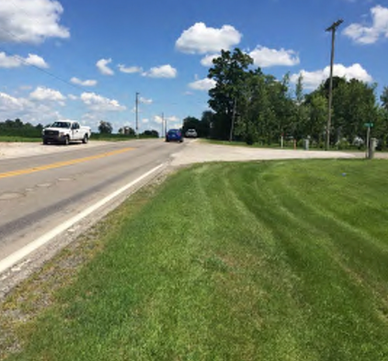
Preferred Alternative
Section 1 (Adams Road to 0.1 miles east of the Dayton Cemetery)
Section 2 (0.1 miles east of the Dayton Cemetery to 50 feet east of E. 350 S.)
Section 3 (50 feet east of E. 350 S. to 200 feet west of West Street in Mulberry)
Full depth reclamation of the travel lanes
Construction of 2 foot paved and 1 foot aggregate shoulders
Some areas will include4 foot shoulders and the installation of guardrail
Section 4 (200 feet west of West Street to 750 feet east of Park Street in Mulberry)
Section 4 Part 1 is located in a residential area and Part 2 is located in a commercial area
Mill and overlay the travel lanes and both shoulders
Section 5 (750 feet east of Park Street in Mulberry to 800 feet east of N. 500 W.)
Full depth reclamation of the travel lanes
Construction of 2 foot paved and 1 foot aggregate shoulders
Section 6 (800 feet east of N. 500 W. to north Junction of SR 38/US 421)
Full depth reclamation of the travel lanes
Construction of 2 foot paved and 1 foot aggregate shoulders
Two sections there will include full depth reclamation of the travel lanes with 4 foot paved shoulders and guardrail will be installed

Slide 8
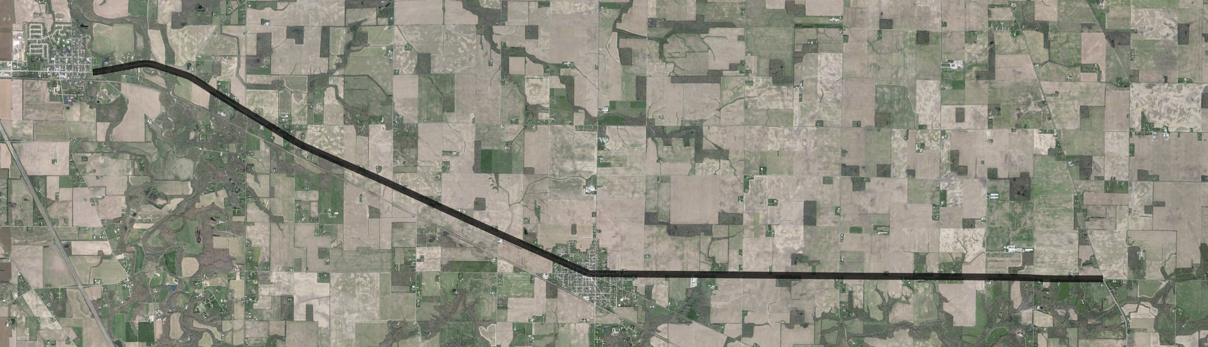
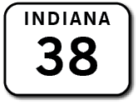
Section 1
Section 1 (Adams Road to the east edge of Dayton Cemetery)
Full depth reclamation of the travel lanes
Construction of 2 foot paved and 1 foot aggregate shoulders
SECTION 1

