Slide 1
S.R. 26 Road Rehabilitation in Clinton County
Thursday, June 6, 2019
6 p.m.

Slide 2
Welcome
Purpose of public hearing
Format
Visit our sign-in table
Informational handouts
Participate during public comment session
Submit written public comments
Project display area

Slide 3
S.R. 26 Road Rehabilitation in Clinton County
INDOT Project Team
INDOT Crawfordsville District
Project Management
Public Involvement
Communications
Design/Engineering
Environmental Analysis
Real Estate
Recognition of elected and local public officials
Sign-in at attendance table to be added to project mailing list
Public hearing notice mailed to known property owners within project area
Announcement of this meeting was posted to INDOT website. A media release was also issued
A copy of presentation and project documentation are available for review online via INDOT website

Slide 4
Project Stakeholders
Indiana Department of Transportation
Federal Highway Administration
Clinton County
Elected & local officials
Residents and citizens
Commuters
Businesses
Emergency services
Schools
Churches
Community organizations

Slide 5
Project Development
Project Selection
Early Coordination
Purpose & Need
Develop alternatives
Preliminary design phase
Environmental Analysis
PUBLIC INVOLVEMENT
Design
Environmental
Additional public involvement
Project Decision
Real Estate
Project Letting
Construction
June public information meeting 2018
Public hearing during environmental analysis phase 2019
Communicate project decisions and information 2019 - 2020
Public Involvement:

Slide 6
Environmental Consideration
National Environmental Policy Act (NEPA)
Requires INDOT to analyze and evaluate the impacts of a proposed project to the natural and socio-economic environments
NEPA is a decision-making process
Purpose and Need
Develop & Screen Alternatives
Preferred Alternative – determine a course of action
Impacts are analyzed, evaluated and described in an environmental document
What are the impacts this project might have on the community?
How can impacts be avoided?
Can impacts be minimized?
Mitigation for impacts?
Draft environmental document(s) released for public involvement May 2019
Available for review via public repositories and online

Slide 7
Types of items evaluated
Right-of-way
Streams, Wetlands, and Other Waters
Floodplains
Endangered Species
Farmland
Cultural Resources (Historic/Archaeological)
Parks and Recreational Lands (Trails)
Air Quality
Community Impacts
Public Involvement

Slide 8
Environmental Analysis & Public Involvement
Notice of Entry for Survey – 2015 thru 2017
Letters mailed to properties within general area
Describes early project proposal
Project personnel in area, access to properties
Gather data for environmental analysis
Public information meeting – June 2018
Project webpage – June 2018
Section 106 of National Historic Preservation Act – 2018 thru 2019
Take into account proposal’s impact to historic & archaeological properties
Public invited to participate
Public notices issued with 30-day comment period
Frankfort Times
“No historic properties affected” finding issued
Draft environmental documents released for public involvement – May 2019
Available for review via public repositories and online

Slide 9
Project Resources
INDOT Crawfordsville District Office
41 West 300 North, Crawfordsville, IN 47933
http://www.in.gov/indot/2701.htm
Planning, Project Development/Delivery, Construction, Maintenance for West Central Indiana
Rossville Community Library
400 West Main Street, Rossville, IN 46065
Phone: (765) 379-2246
INDOT Office of Public Involvement
100 North Senate Avenue, Room N642, Indianapolis, IN 46204
Phone: (317) 232-6601
rclark@indot.in.gov
Transportation Services Call Center
Provides citizen and business customers with a single point-of-contact to request transportation services, obtain information, or provide feedback through multiple channels of communications.
855-463-6848 • INDOT4U.com • INDOT@indot.in.gov

Slide 10
S.R. 26 Road Rehabilitation – Project Limits
Approximately from Rossville to Russiaville
One-half mile east of U.S. 421 to two miles west of Russiaville
Project generally divided into 3 segments
US 421 to SR 75
SR 75 to SR 29
SR 29 to Clinton/Howard County Line

Slide 11
Purpose and Need
Purpose
Enhance safety within the corridor
Preserve and extend the usable service life of the existing roadway
Need
Evidence of pavement deterioration
Roadway flooding due to undersized and debris-filled culverts under S.R. 26
Narrow travel lanes
Lack of shoulders
Substandard vertical sight distance

Slide 12
Alternatives Considered
Do Nothing/No Build
Perform routine maintenance only
Does not meet purpose and need
Widen roadway and install rumble striping only
Includes installing a 4-way stop at SR 26 & SR 75 intersection
Does not meet purpose and need as it does not address drainage or address pavement , does not address SR 26 & SR 75 intersection
Rehabilitation
Addresses pavement condition but would not widen roadway lanes
Does not meet purpose and need
Full-Depth Replacement
Does not widen lanes, add shoulders or address drainage
Wetland Avoidance Alternative
Avoids wetlands while proposing roadway improvements; would impact road alignment and result in the displacement of several residential properties, therefore was not considered further

Slide 13
Preferred Alternative - Proposed Improvements
Increase lane widths
Provide roadside shoulders
Improve drainage
Modify and/or replace culverts
Install rumble striping
Increase sight distance with vertical improvements
Improve sidewalk (areas with existing sidewalk)
Add a turning lane
S.R. 26 at S.R. 75
Other improvements

Slide 14
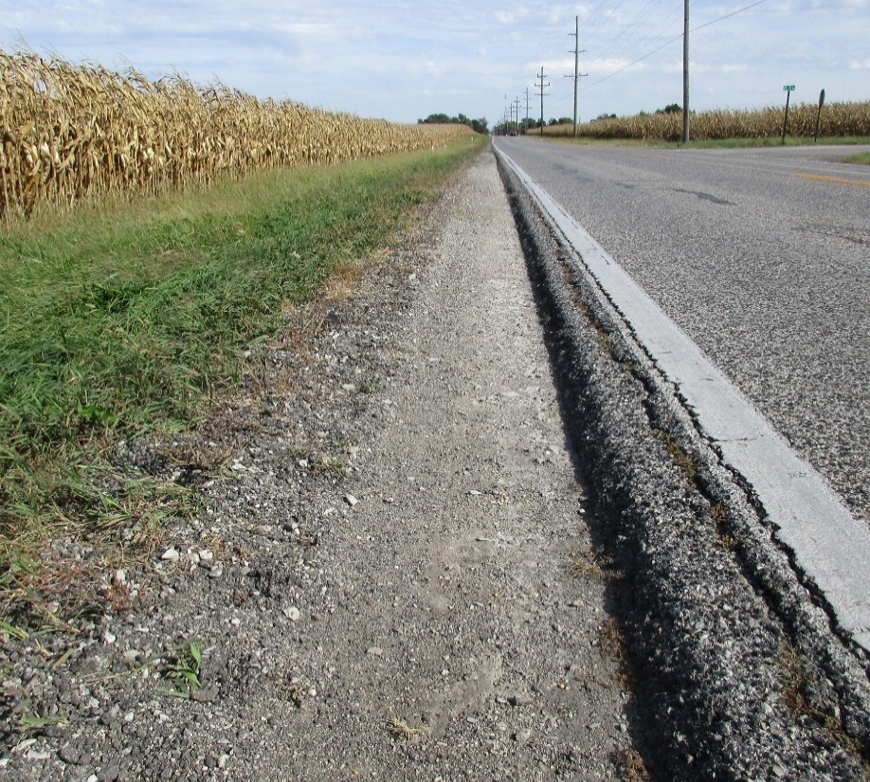
Existing Roadway
11-foot travel lanes
No shoulder
Utility poles close to roadway
Pavement failing at edge due to lack of lateral support

Slide 15
Vehicular Accident Data
Years 2013 through 2015
SEVERITY | 2013 | 2014 | 2015 | Total
No Injury | 42 | 39 | 34 | 115
Non-Incapacitating Injury | 9 | 8 | 4 | 21
Incapacitating Injury | 2 | 4 | 6 | 12
Fatal | 0 | 1 | 1 | 2
TOTALS | 53 | 52 | 45 | 150

Slide 16
Proposed Improvements - Continued
Increase lane widths
Provide roadside shoulders
Improve drainage
Modify and/or replace culverts
Install rumble striping
Increase sight distance with vertical improvements
Improve sidewalk (areas with existing sidewalk)
Add a turning lane
S.R. 26 at S.R. 75
Other improvements

Slide 17
Rumble Striping

Slide 18
Typical Section
12-foot-wide travel lanes
West of S.R. 29: 2-foot-wide paved with 6-foot stone shoulders
East of S.R. 29: 2-foot paved with 4-foot stone shoulders
Improved ditch drainage
Widen and rehabilitate existing pavement
Full pavement replacement in some areas

Slide 19
Maintenance of Traffic
Maintain local access to all residences, farm fields and businesses during construction using county roads, temporary entrances or other appropriate means
Close S.R. 26 to through-traffic during construction
Detour through-traffic to state-maintained routes using portions of U.S. 421, S.R. 18, S.R. 75, S.R. 29, S.R. 28, U.S. 31 and S.R. 931
Local access maintained via local roads during culvert construction

Slide 20
Maintenance of Traffic – Detour 1

Slide 21
Maintenance of Traffic – Detour 2

Slide 22
Maintenance of Traffic – Detour 3

Slide 23
Real Estate

Slide 24
Real Estate Acquisition Process
Uniform Act of 1970
All federal, state and local governments must comply
Requires an offer for just compensation
Acquisition Process
Appraisals
Review Appraisals
Negotiations
Moving Ahead for Progress in the 21st Century (MAP-21)
Federal law intended to streamline project development; allows real estate to be purchased during design and environmental analysis phases
Right-of-way (ROW)
Permanent
Permanent ROW is land, once purchased by INDOT from the legal land owner, becomes ROW owned by INDOT
Approximately 150 acres required
Temporary
Temporary ROW is land required during the construction of a project and is used for the purposes of construction-related activity
INDOT pays legal land owner a fee for land use during construction
Approximately 2 acres required
ROW acquisition activities are ongoing

Slide 25
Project Schedule
Preliminary design, evaluate community and environmental impact – 2018/2019
Public Hearing – 2019
Environmental Analysis Phase – 2019
Real estate acquisition activities – Continue thru 2020
Appraising
Negotiations/buying
Utilities coordination/relocation – 2019/2020
Construction – 2020 through 2021

Slide 26
Submit Public Comments
Submit public comments using the options described in first page of information packet:
Public Comment Form
Via e-mail
Participate during public comment session following formal presentation
INDOT respectfully requests that comments be submitted by Friday, June 28, 2019
All comments submitted will become included in an official public hearings transcript and made part of the public record
Comments will be reviewed, evaluated and given full consideration during decision-making process

Slide 27
Next Steps
Public and project stakeholder input
Submit comments via options described on page 1 of information packet
INDOT review and evaluation
All comments given full consideration during decision-making process
Finalize/approve environmental document, complete project design
Communicate a decision
INDOT will notify project stakeholders of decision
Work through local media, social media outlets, paid legal notice
Make project documents accessible via repositories
Questions? Contact Public Involvement Team

Slide 28
Thank You
Please visit with INDOT project team following the presentation and public comment session
Project Open House
Project maps, displays, INDOT project team and informal Q & A
INDOT Crawfordsville District page http://www.in.gov/indot/2701.htm

