Slide 1
BOB CUMMINGS LINCOLN TRAIL BRIDGE SR237 OVER THE OHIO RIVER Structure No. 237-62-6512C Des. No. 0710259 Bridge Rehabilitation Des. No. 0710260 Bridge Painting Perry County, Indiana
February 2015

Slide 2
Welcome
Rickie Clark, INDOT Office of Public Involvement
Purpose/explanation of public meeting
Public meeting format
Visit our sign-in table
Informational handouts
Submitting public comments
Project display area

Slide 3
Welcome
Introduction of INDOT project officials
Project Management
Design
Public Involvement
Michael Baker JR., Inc.
Design & Environmental Team
Recognition of elected and local public officials

Slide 4
Public Meeting
Sign-in at attendance table to be added to project mailing list.
Announcement of this meeting was posted to INDOT website. A media release was also issued.

Slide 5
Project Stakeholders
Indiana Department of Transportation
Federal Highway Administration In. and Ky.
Perry County Indiana
Hendricks County Kentucky
Local communities
Elected public officials
Community residents and citizens
Commuters

Slide 6
Project Development Process
Engineering Assessment
Environmental phase begins
Purpose & need
Develop alternatives
Preliminary design phase
Release environmental document
Construction
Public Meeting
Notes:
6

Slide 7
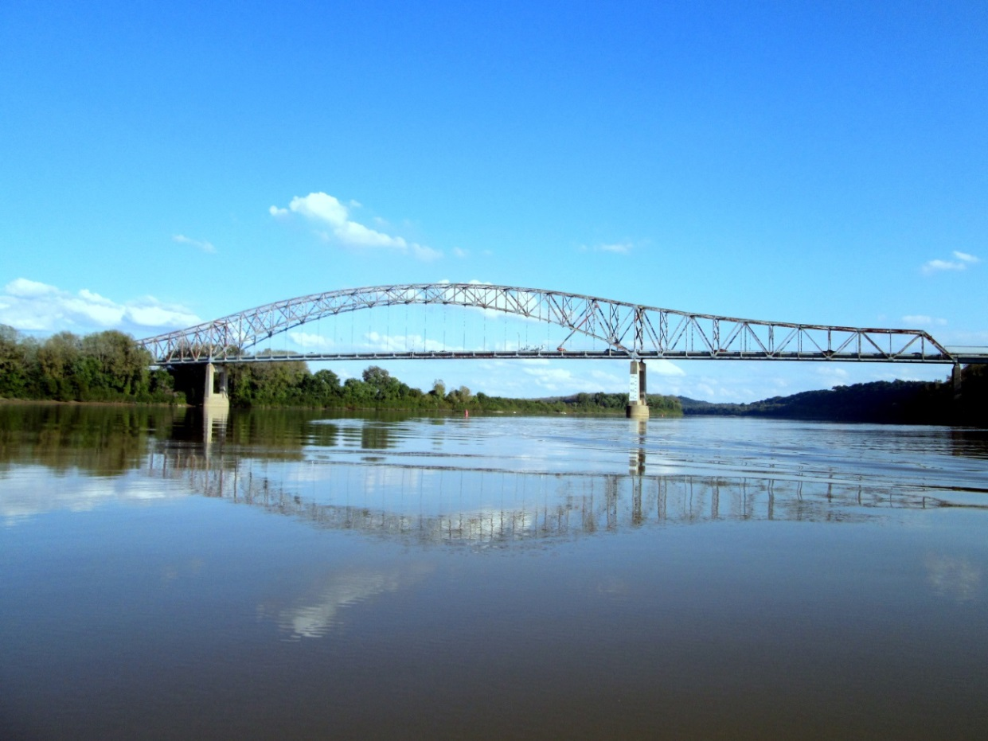
PUBLIC INFORMATION MEETING

Slide 8
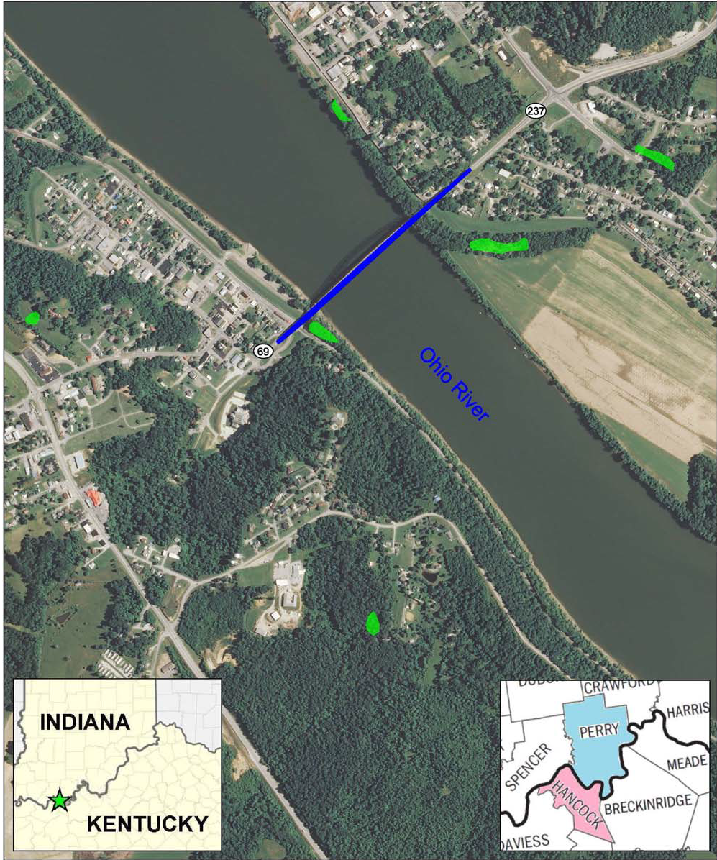
Project location
SR 237 Bridge over the Ohio River between Cannelton, Indiana, and Hawesville, Kentucky.
Located 0.38 miles south of SR 66, in Section 16, T-7-S, R-3-W, Troy Township, Perry County, Indiana and Hancock County, Kentucky.
Referred to as KY-69 in Kentucky.

Slide 9
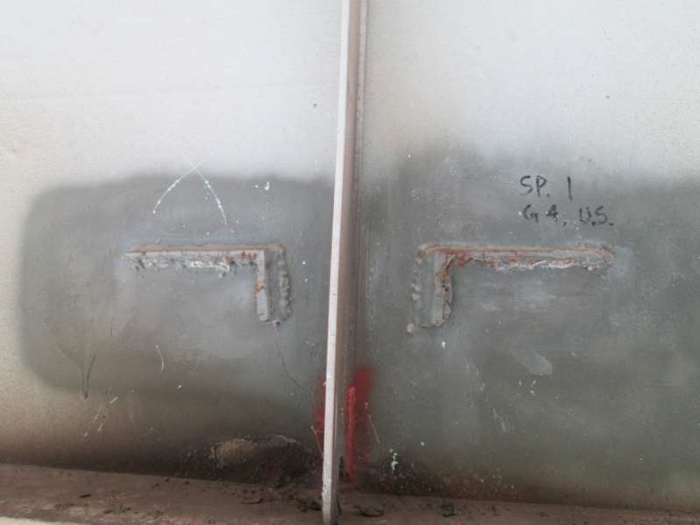
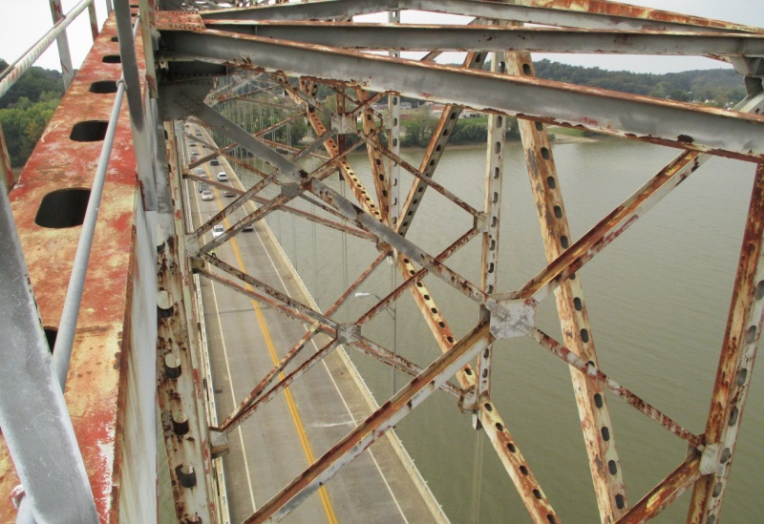
Project description
Rehabilitation Contract
Retrofit locations of various structural details
Address other high-priority repair items
Painting Contract
A separate contract
Follows Rehab
Clean and paint the steel superstructure

Slide 10
Project Funding
INDOT
KYTC
Incorporated into the STIP on October 28, in STIP Amendment #14-31.
Pending incorporation

Slide 11
Purpose
The purpose of this project is to address the retrofits and deteriorated protective coating of the Bob Cummings Lincoln Trail Bridge.

Slide 12
Maintenance of Traffic
Bridge will remain open to traffic during both projects
Provide the greatest benefit to the motoring public during construction
Most cost effective method possible

Slide 13
Cost benefit analysis
Used cost benefit analysis to compare construction alternatives based on the following:
Duration of Construction Season
Network Delay
Length of Queues
Cost of Lost Time to the Motorist
Cost of Extra Travel Distance
Cost of Maintenance of Traffic
Construction Cost

Slide 14
Rehabilitation alternative: Staged 1000 Feet Single Lane Closure with Temporary Traffic Signals
Description:
Single lane closures for staged 1000’ construction zones in three phases per side.
Duration of Construction:
4 months
March to June of the 2016 season
Location of Temporary Signals:
To regulate the two-way traffic, two temporary signals will be installed at the northeast Indiana approach and the existing Hawesville School Drive/Clay Street/KY-69 intersection at the Kentucky approach. (Based on the location of the work zones, the temporary signal at the existing intersection will also be moved to the Kentucky approach during construction.)

Slide 15
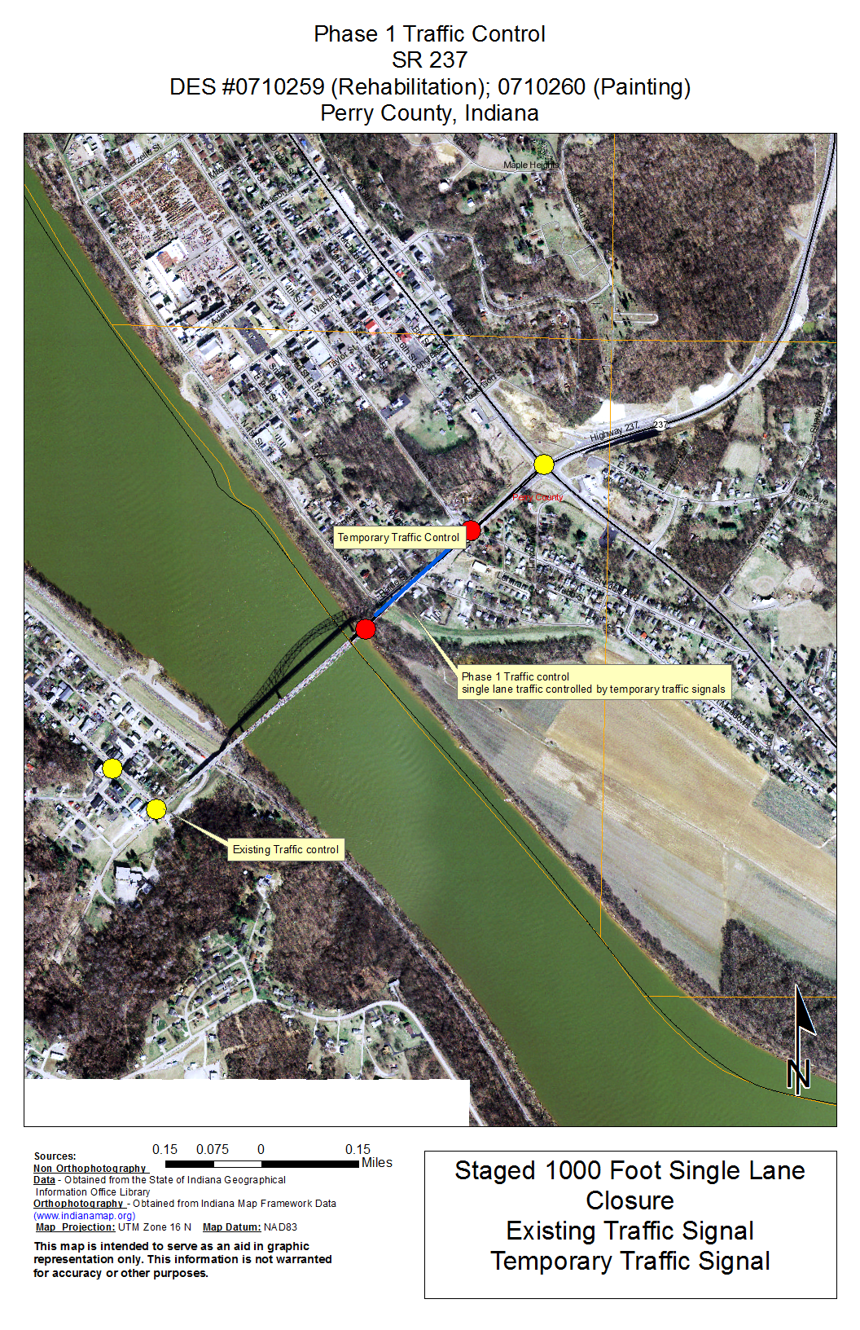
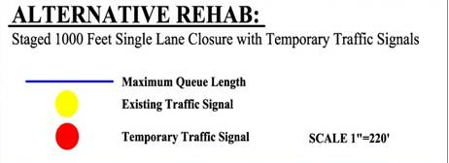
Alternative Rehab

Slide 16
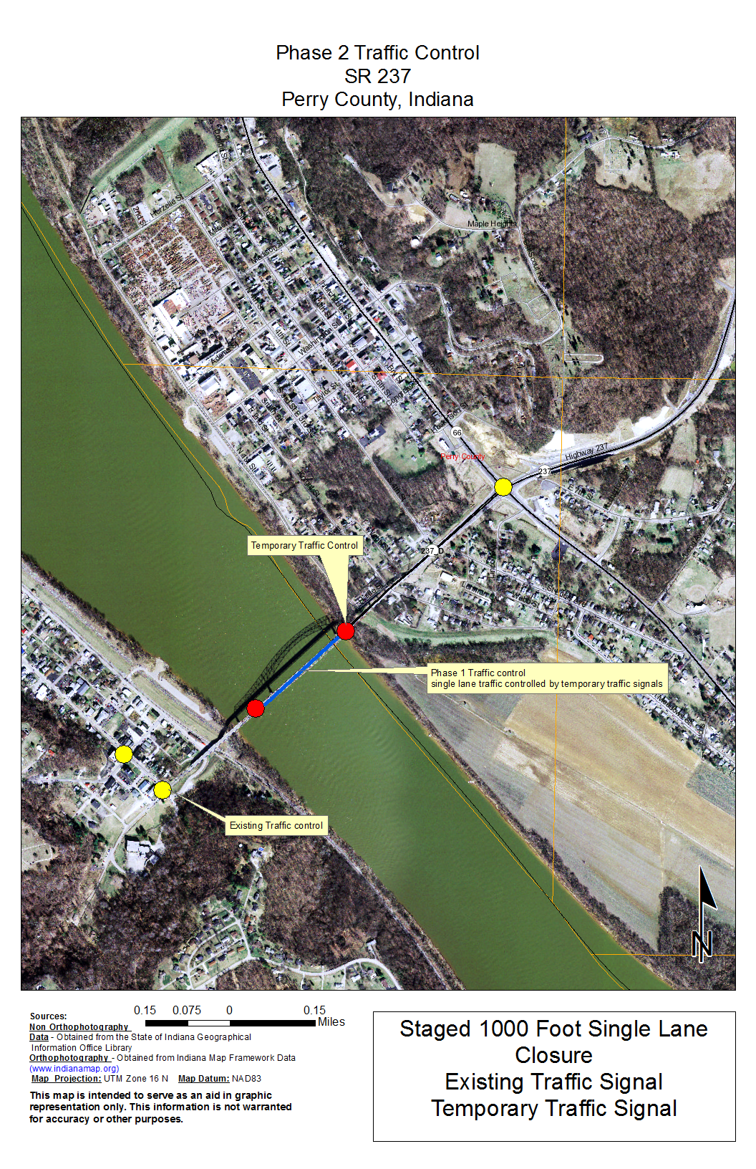
Alternative Rehab

Slide 17
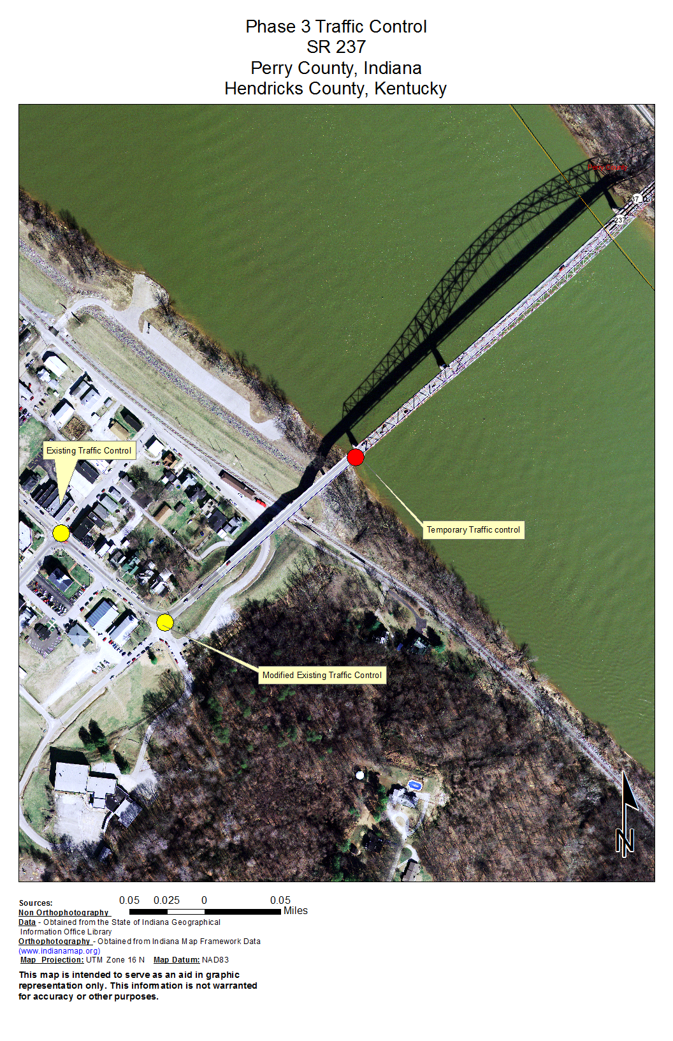
Alternative Rehab

Slide 18
Alternative Painting 2000 foot single lane closure with temporary traffic signals
Description:
A single lane closure for a 2000’ construction zone from Bent 6 to Bent 11, Spans 6 thru 10.
Duration of Construction:
11 ½ months over the course of two seasons
July to October of the 2016 season and Mid-March to October of the 2017 season
Location of Temporary Signals:
To regulate the two-way traffic, two temporary signals will be installed at approximately Bent 6 and Bent 11 on the bridge.

Slide 19
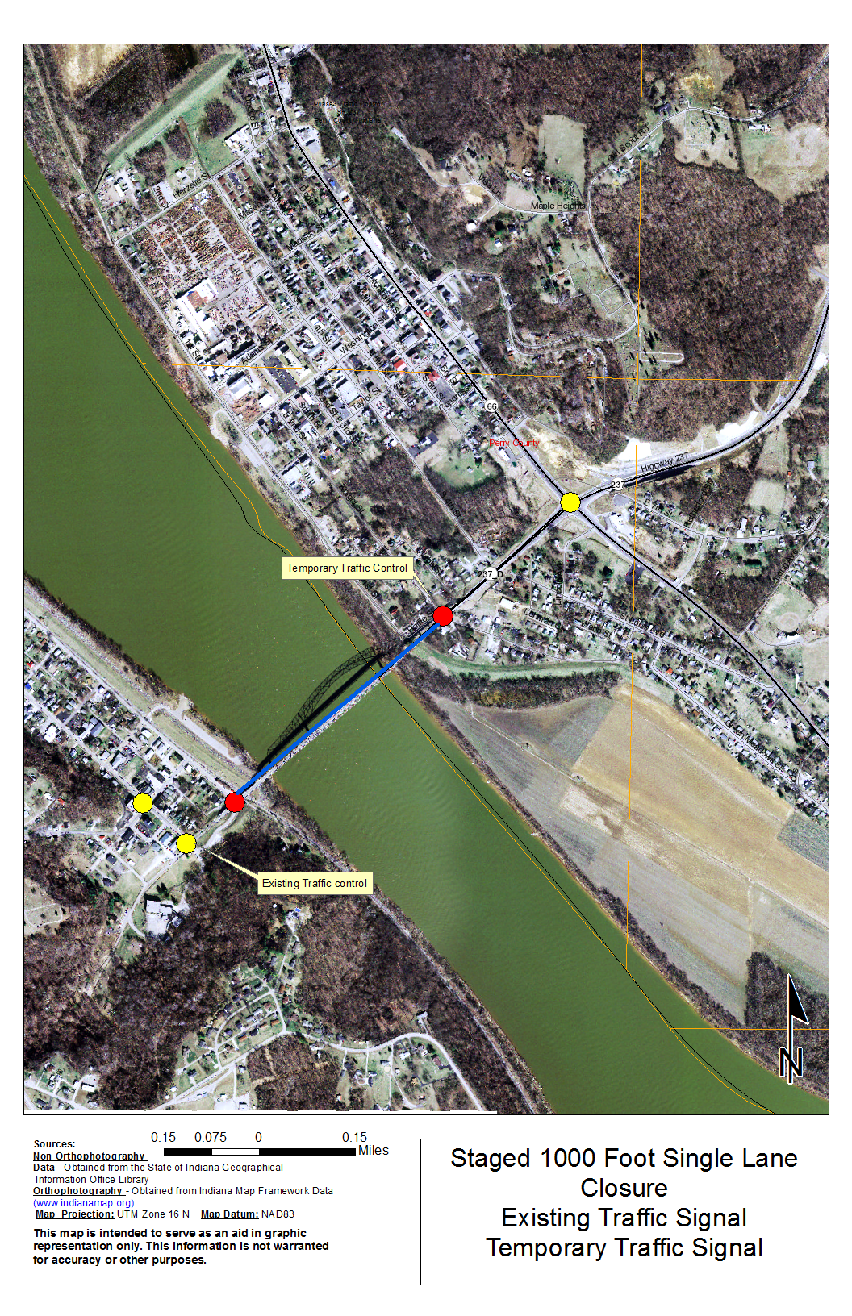
Alternative Painting

Slide 20
CONSTRUCTION DURATION
ALTERNATIVE EVALUATION
Alternative | Description | Estimated Construction Duration | Construction Seasons
 |  | (months)
REHAB | Staged 1000 Feet Single Lane Closure with Temporary Traffic Signals | 4 | March 2016 to June 2016
2A | 2000 Foot Single Lane Closure with Temporary Traffic Signals | 11.5 | July 2016 to October 2016 Mid-March 2017 to October 2017

Slide 21
Environmental Considerations
Migratory Bird Act Considerations
US Coast Guard Section 9 of the Rivers and Harbors Act of 1899 and the General Bridge Act of 1946

Slide 22
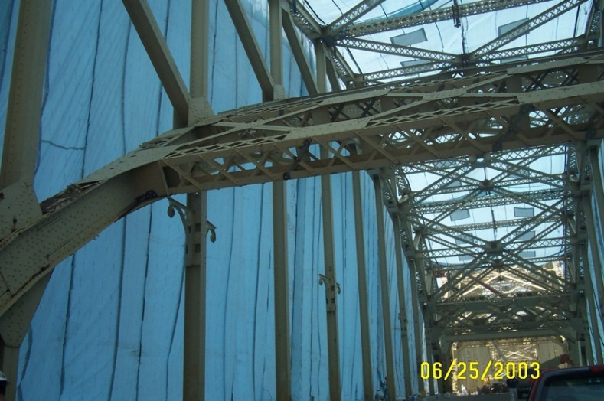
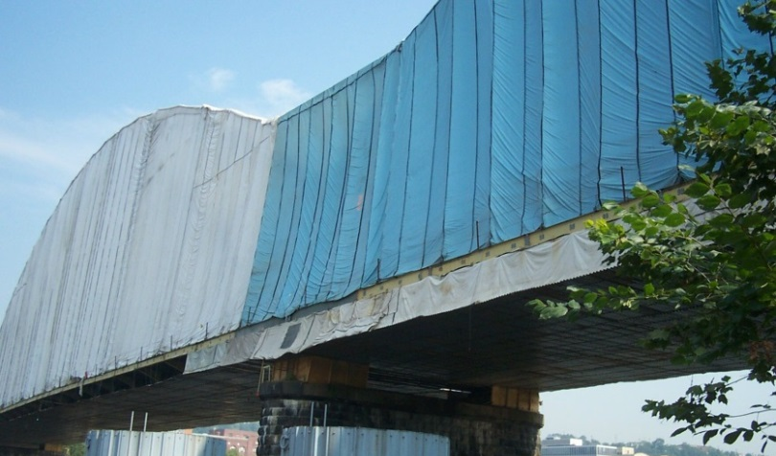
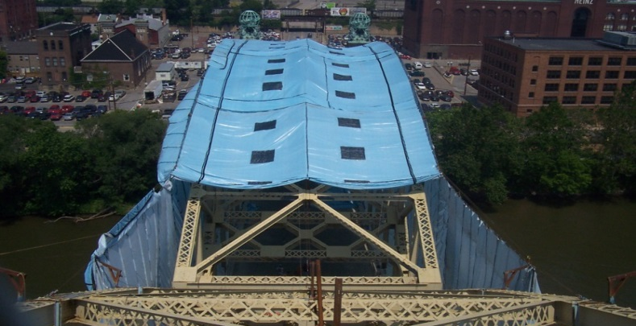
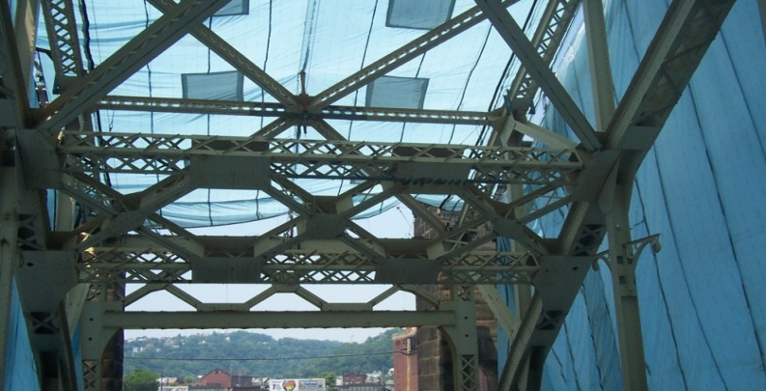
Environmental Considerations Continued
Containment Operations

Slide 23
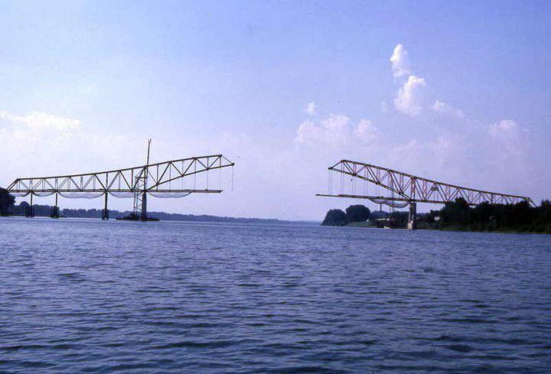
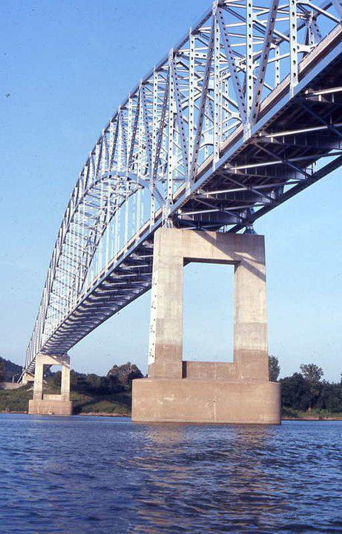
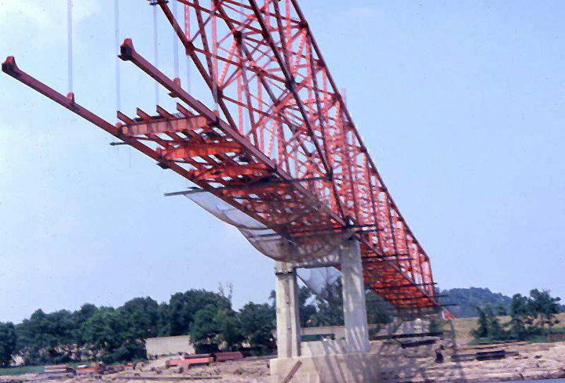
Environmental Considerations Continued
Historic Resource

Slide 24
Federal Color Standard Options for Consideration
Match the original paint color as closely as possible
Provide Comment from community
Final decision to be made based on SHPO recommendation

Slide 25
17865 Misc

Slide 26
16515 Gray

Slide 27
15526 Blue

Slide 28
Comments
Written Comment Sheets available
Concludes Formal portion of Meeting
Comments should be sent to
Ken McMullen
3925 River Crossing Pkwy, Suite 150
Indianapolis, In 46240
Email: Ken.McMullen@mbakerintl.com
Submit comments within two weeks of meeting date
http://www.in.gov/indot/3277.htm
Project Team will be available for Questions
THANK YOU!

