Slide 1
Intersection Improvement U.S. 24 at C.R. 300 East in Wabash County
Indiana Department of Transportation
Wednesday, March 20, 2019
6 p.m.

Slide 2
Welcome
Purpose/explanation of public hearing
Public hearing format
Visit our sign-in table
Informational handouts
Participate during public comment session
Submit written public comments
Project display area

Slide 3
U.S. 24 at C.R. 300 East Intersection Improvement
Introduction of INDOT Project Team
Fort Wayne District – INDOT Regional Office
Project Management
Communications
Environmental Services
Public Involvement Team
Strand Associates, Metric Environmental
Engineering, Design & Environmental Analysis
Recognition of elected and local public officials
Sign-in at attendance table to be added to project mailing list
Legal notice of public hearing was published in the Wabash Plain Dealer 3/5/19 & 3/12/19
A notice of the public hearing was mailed to known property owners within project area
Announcement of this hearing was posted to INDOT website; media release issued
A copy of presentation and project documentation are available for review on-line via INDOT website https://www.in.gov/indot/3896.htm

Slide 4
Project Stakeholders
Indiana Department of Transportation
Indiana Division Federal Highway Administration
Wabash County
Elected & local officials
Residents and citizens
Commuters
Businesses
Emergency services
Schools
Churches
Community Organizations

Slide 5
Project Development
Project Selection
Early Coordination
Environmental phase begins
Purpose & Need
Develop alternatives
Preliminary design phase
Release environmental document for public review and comment
HOLD PUBLIC HEARING
Additional work to finalize environmental document and project design
Communicate Project Decision
Project Letting
Construction

Slide 6
Environmental Analysis Phase
National Environmental Policy Act (NEPA)
Requires INDOT to analyze and evaluate the impacts of a proposed project to the natural and socio-economic environments
NEPA is a decision-making process
Purpose and Need
Alternatives Screening
Preferred Alternative
Impacts are analyzed, evaluated and described in an environmental document
What are the impacts this project might have on the community?
How can impacts be avoided?
Can impacts be minimized?
Mitigation for impacts?
Draft environmental document released for public involvement – February 2019
Available for review at project resource locations

Slide 7
Examples of Items Evaluated during Analysis
Right-of-Way
Streams, Wetlands, and Other Waters
Floodplains
Endangered Species
Farmland
Cultural Resources (Historic/Archaeological)
Parks and Recreational Lands (Trails)
Air Quality
Noise
Impact to residential and commercial properties
Environmental Justice
Hazardous Materials
Permits
Mitigation

Slide 8
Project Resource Locations
INDOT Fort Wayne District Office
5333 Hatfield Road, Fort Wayne, Indiana 46808
Planning, Project Development/Delivery, Construction, Maintenance for Northeast Indiana
http://www.in.gov/indot/2703.htm
Wabash Carnegie Public Library
188 West Hill Street, Wabash, IN 46992
Phone: (260) 563-2972
INDOT Office of Public Involvement
100 North Senate Avenue, Room N642, Indianapolis, IN 46204
Phone: (317) 232-6601
rclark@indot.in.gov
Transportation Services Call Center
Provides citizen and business customers with a single point-of-contact to request transportation services, obtain information, or provide feedback through multiple channels of communications.
855-463-6848 • INDOT4U.com • INDOT@indot.in.gov

Slide 9
Intersection Improvement – Purpose & Need
Purpose: Enhance safety at intersection
Analysis indicates high number of vehicular collisions at intersection
Severity of collisions due to type of accidents at this location
Need: Decrease number and severity of high-speed collisions at this location
Right-angle collisions occurring at this location
Resulting in higher severity and increased injury

Slide 10
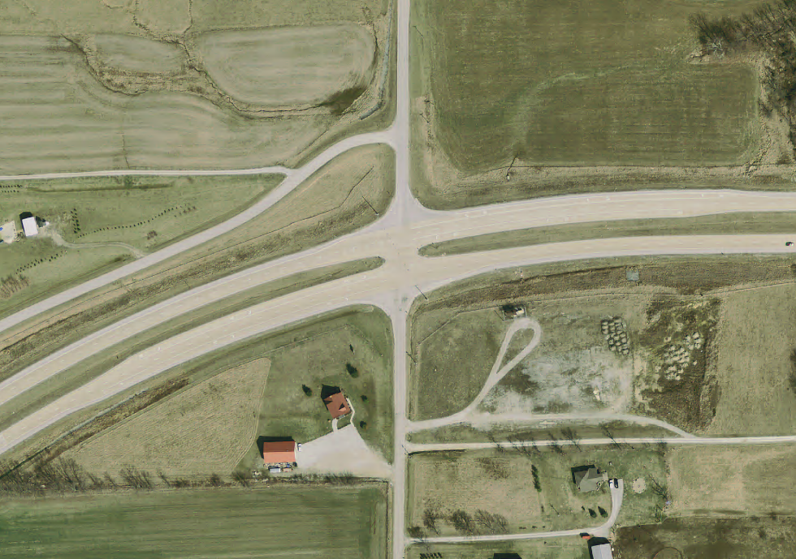
Intersection Data
Year | Fatal | Injury | Property Damage | Total
2014 | 0 | 2 | 1 | 3
2015 | 0 | 1 | 4 | 5
2016 | 0 | 0 | 1 | 1
2017 | 0 | 1 | 4 | 5
2018 | 0 | 0 | 1 | 1
Totals | 0 | 4 | 11 | 15
All crashes were right-angle
80% of crashes involved northbound and westbound vehicles
Most recent fatality in 2009
Identified as a high-crash location by frequency and severity
Lagro Road: 560 vehicles per day
US 24: 9,000 vehicles per day

Slide 11
Previous Countermeasures
Overhead Flashing Beacons – Advanced Signage

Slide 12
Alternatives Analysis
NOTE: Each alternative analyzed for 20 years after construction
No Build
Involves regular maintenance activities
Cost: $0
Does not enhance safety; does not meet purpose and need of project
Traffic Signal
Cost: $300,000-$500,000 (includes operating cost)
Lagro Road does not meet signal warrants
Signals on high-speed roadways:
Are less efficient, causing vehicles traveling 60+ mph to slow down or stop
Are susceptible to red-light running
Can cause an increase in crashes where not warranted, per a Purdue University study
No signals between SR 13 in Wabash and SR 9 in Huntington

Slide 13
Alternatives Analysis
Median U-Turn
Cost: $650,000-$900,000
Enhances safety by prohibiting county road through traffic from crossing U.S. 24 at the intersection
Meets purpose and need of project
High-Speed Roundabout
Cost: $2-3.5 million
Would require traffic on US 24 to slow to approx. 25 mph

Slide 14
Alternatives Analysis
Grade Separation
Cost: $3-5 million
Affects intersection mobility
Interchange
Cost: $12-15 million
Does not fit scale of project because of low-volume road
Requires significant time for planning and construction

Slide 15
Preferred Alternative: Median U-Turn
US 24
Lagro Rd.
Additional Pavement
Removed Pavement

Slide 16
Median U-Turn Operations
US 24
Lagro Rd.

Slide 17
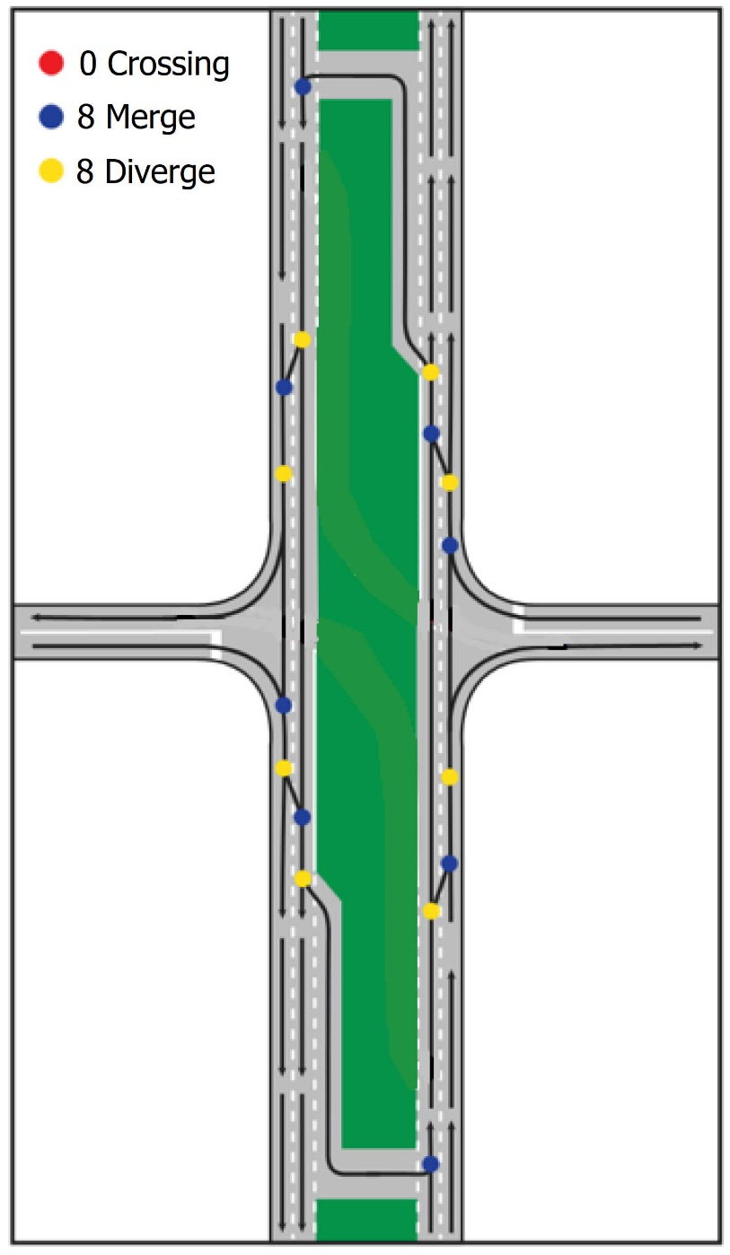
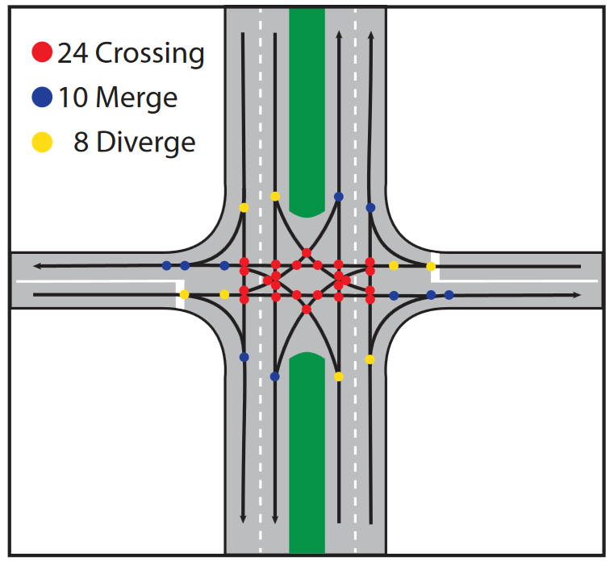
Median U-Turns Enhance Intersection Safety
Conflict points are dramatically reduced
Crossing points eliminated, reducing crash severity
Conventional
Intersection
Median U-Turn
Intersection

Slide 18
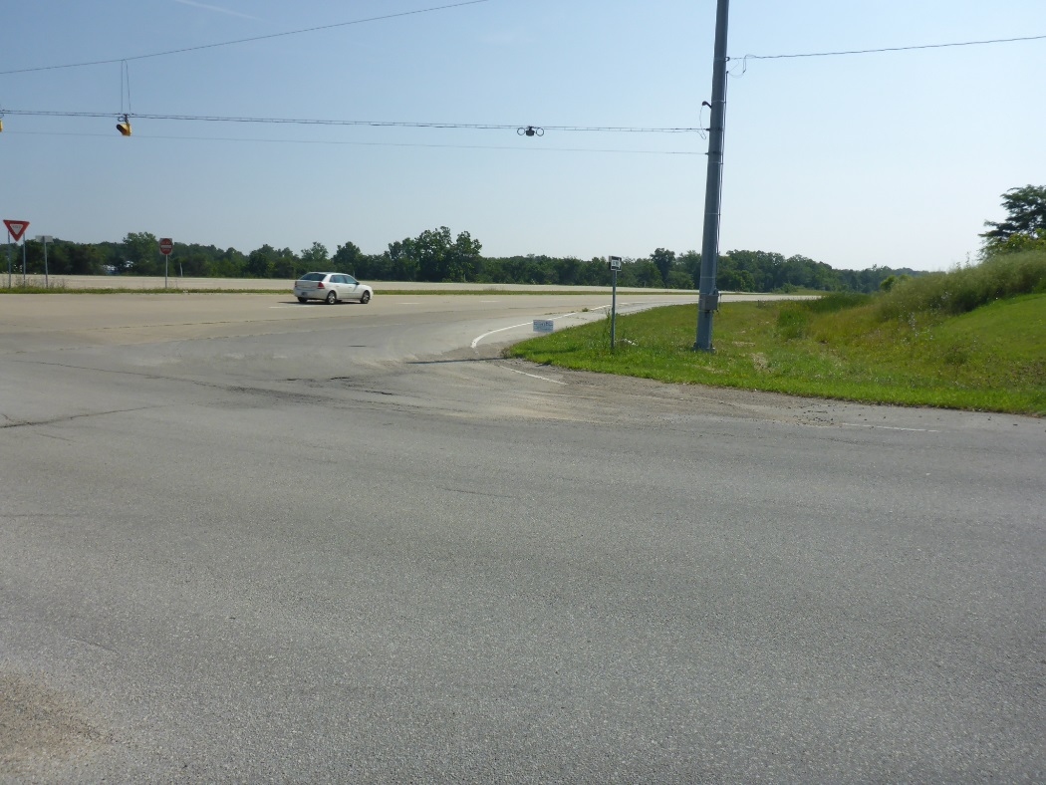
Design Features
Wider median shoulder (8’) to accommodate farm equipment
Diagrammatic signs on each approach
Improving drainage issue on northbound approach
Delineators emphasize no through movement on Lagro Road
Raised Pavement Markers delineate U-Turn lanes

Slide 19
Recap of Alternatives Considered
No Build
No additional work; crashes continue
Signalized Intersection
Traffic on minor leg (Lagro Road) does not warrant a signalized intersection when compared to traffic on major leg (US 24)
Not best fit on high-speed roadway with no other signals
Roundabout
Higher cost; slows traffic on US 24
Grade Separation: Lagro Road over US 24
Limits mobility, significant increase in project cost
Interchange
Implementation would require years of planning and design
Highest project cost
Median U-Turn Intersection
Enhances safety at intersection by eliminating or significantly reducing injury crashes
Cost-effective
Can be implemented in one construction season and be delivered next year

Slide 20
Schedule and Maintenance of Traffic
Spring 2020
3 to 6 month duration
Maintenance of Traffic
Closed intersection to provide highest contractor and driver safety as well as shortest construction duration
Traffic to/from school could use SR 524 to US 24 to SR 13

Slide 21
Submit Public Comments
Submit public comments using the options described in first page of information packet:
Public Comment Form
Via e-mail at rclark@indot.in.gov
Participate during public comment session following formal presentation
INDOT respectfully requests comments be submitted by Friday, April 5, 2019
All comments submitted are included in public hearings transcript and made part of the public record
Comments will be reviewed, evaluated and given full consideration during decision-making process

Slide 22
Project Resource Locations
INDOT Fort Wayne District Office
5333 Hatfield Road, Fort Wayne, Indiana 46808
Planning, Project Development/Delivery, Construction, Maintenance for Northeast Indiana
http://www.in.gov/indot/2703.htm
Wabash Carnegie Public Library
188 West Hill Street, Wabash, IN 46992
Phone: (260) 563-2972
INDOT Office of Public Involvement
100 North Senate Avenue, Room N642, Indianapolis, IN 46204
Phone: (317) 232-6601
rclark@indot.in.gov
Transportation Services Call Center
Provides citizen and business customers with a single point-of-contact to request transportation services, obtain information, or provide feedback through multiple channels of communications.
855-463-6848 • INDOT4U.com • INDOT@indot.in.gov

Slide 23
Next Steps
Public and project stakeholder input
Submit comments via options described on page 1 of information packet
INDOT review and evaluation
All comments given full consideration during decision-making process
Finalize/approve environmental document, complete project design
Communicate a decision
INDOT will notify project stakeholders of decision
Work through local media, social media outlets, paid legal notice
Make project documents accessible via repositories
Questions? Contact Public Involvement Team
Project resource information on-line https://www.in.gov/indot/3896.htm

Slide 24
Thank You
Please visit with the INDOT project team following the presentation and comment session
Project Open House
Project maps, displays, INDOT project team and informal Q & A
INDOT Fort Wayne District page: http://www.in.gov/indot/2703.htm

