Slide 1
Postsecondary Transitions Recommendations
Stephanie Wilson Indiana Commission for Higher Education
December 12, 2018

Slide 2
Background

Slide 3
The Need
Students who need remediation are less likely to complete postsecondary programs.
* From 2018 Indiana’s 2018 College Readiness Report

Slide 4
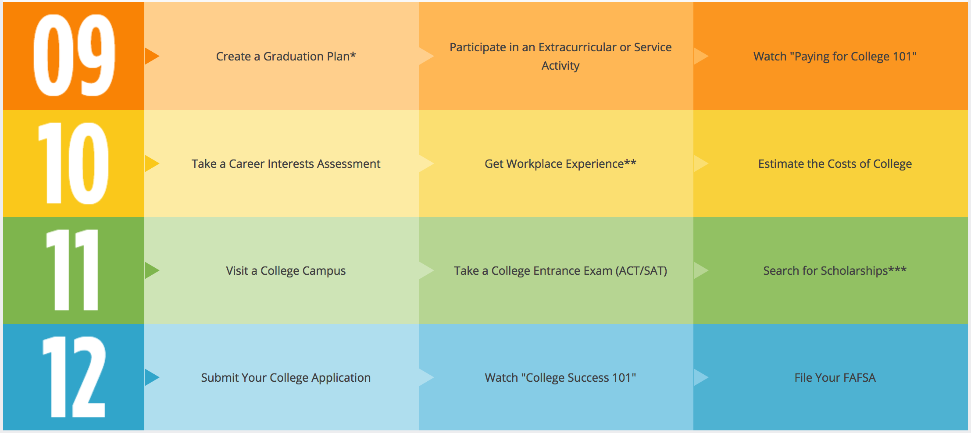
The Need
Students who have support and take key steps in high school are more likely to go to enter postsecondary programs and be successful when they get there.
Indiana’s Scholar Success Program
Notes:
In terms of persistence and completion, 21st Century Scholars outperform their other low-income peers significantly, and they are also more likely to attend an in-state institution
At 4-year campuses, 82% of scholars persistent to the second year (60% in FY 16 for 2-year)
At 2-year campuses, scholars significantly out perform minority, other low-income and all students when it comes to on-time completion (17.3% for scholars, 12.7% for all students)
29.8% of Scholars complete on-time (statewide) vs. 22.4% of their low-income peers.
48.9% of Scholars complete within 6 years (statewide) vs. 41.3% of their other low-income peers
While 12.7% of students at two-year campuses graduate on-time, Scholars are graduating at an on-time rate of 17.3% – a 14.6 percentage point increase over the last five years.

Slide 5
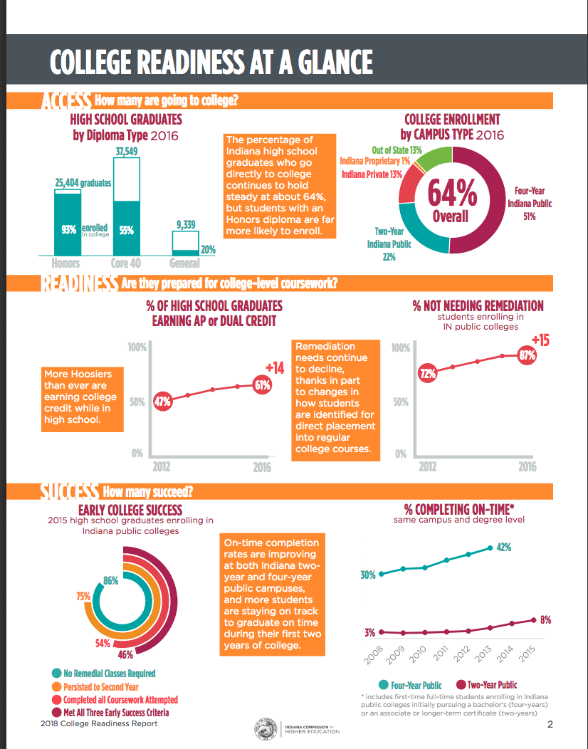
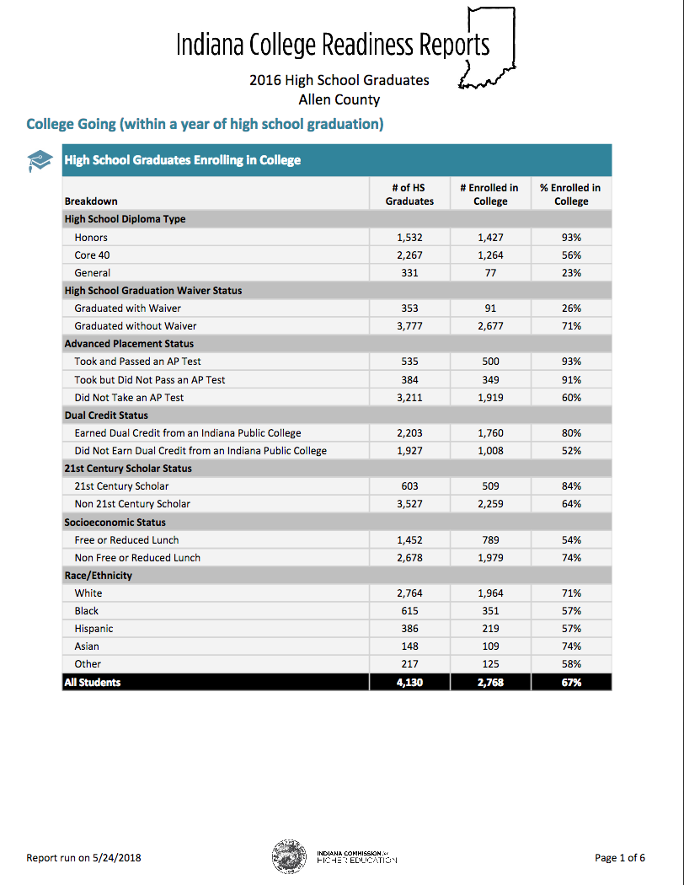
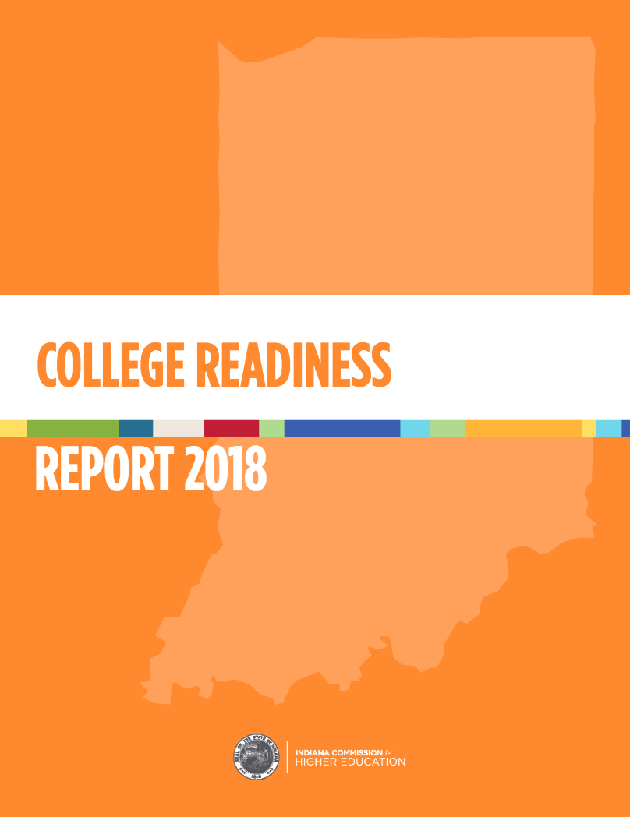
The Need
Good data on postsecondary transitions exists, but not enough students, families & communities know about it or use it.
Notes:
In terms of persistence and completion, 21st Century Scholars outperform their other low-income peers significantly, and they are also more likely to attend an in-state institution
At 4-year campuses, 82% of scholars persistent to the second year (60% in FY 16 for 2-year)
At 2-year campuses, scholars significantly out perform minority, other low-income and all students when it comes to on-time completion (17.3% for scholars, 12.7% for all students)
29.8% of Scholars complete on-time (statewide) vs. 22.4% of their low-income peers.
48.9% of Scholars complete within 6 years (statewide) vs. 41.3% of their other low-income peers
While 12.7% of students at two-year campuses graduate on-time, Scholars are graduating at an on-time rate of 17.3% – a 14.6 percentage point increase over the last five years.

Slide 6
Alignment to ICHE Strategic Plan
“Increase college readiness by improving student preparation, smoothing key transitions and boosting statewide capacity to deliver quality college-prep programming.”
- Reaching Higher, Delivering Value strategic plan; Completion section

Slide 7
The Work

Slide 8
Phase 1: Transitions Steering Committee
Co-Chairs: Commissioner Lubbers & Superintendent McCormick
Goal: Develop recommendations to 1) increase college readiness & enrollment while 2) decreasing the need for remediation.
The group met three times: April, June & September 2018

Slide 9
Phase 2: Math Work Group
Members: High school teachers, higher education faculty & math content experts.
Goals:
Agree to 12th grade math transitions course design parameters (content, sequence, alignment).
Develop or identify transition math course materials.
Recommend the course for state approval and use in postsecondary placement decisions.
Provide guidance on implementation of course pilot.
The group met three times: July, August & October 2018

Slide 10
What is the Math Transitions Course?
The Math Transitions Course is a new course for high school seniors who have passed Algebra 2 but are not ready for college-level math courses.
Pilot Phase: Students who take and pass the Math Transitions Course with a B or better will be able to enter college Quantitative Reasoning without placement testing or remediation.
Long-term: Students who pass this transitions course will be prepared for college-level math courses.

Slide 11
The Recommendations

Slide 12
Recommendation 1: Short-Term Goals
Develop and scale postsecondary transition pathways, beginning with mathematics.
Short-term goals:
Adopt the postsecondary math transition course for use beginning in the 2019-2020 school year.
Support the implementation of that course, beginning with a pilot phase.
Develop/identify Algebra 2 alternative course that aligns with a diverse set of postsecondary math courses.

Slide 13
Recommendation 1: Long-Term Goals
Develop and scale postsecondary transition pathways, beginning with mathematics.
Long-term goals:
Evaluate the impact of the postsecondary math transition course.
Scale the course statewide.

Slide 14
Recommendation 2: Short-Term Goals
Promote navigational supports that smooth student transitions from secondary to postsecondary education and training—including but not limited to study-skill development and activities required for 21st Century Scholars.
Short-term goals:
Broadly promote 21st Century Scholars activities for all students.
Leverage partnerships to expand advising supports.
Integrate study-skill development and time management training to support student success during and after their transition into postsecondary work.
Prioritize cross-agency support for FAFSA completion.

Slide 15
Recommendation 2: Long-Term Goals
Promote navigational supports that smooth student transitions from secondary to postsecondary education and training—including but not limited to study-skill development and activities required for 21st Century Scholars.
Long-term goals:
Bring guided pathways and other postsecondary advising down into high school.
Facilitate conversations among institutional leaders as well as school and district personnel about the opportunity to design and deliver advising supports during a high school senior’s second semester.

Slide 16
Recommendation 3: Short-Term Goals
Expand the use of key postsecondary transitions data to facilitate cross-sector collaboration and support student success.
Short-term goals:
Include postsecondary transitions metrics as reported metrics on online school report cards (ESSA).
Expand joint promotion activities for the College Readiness Report release.
Explore expansion of data on the College Readiness Report to include more data on postsecondary transitions. (Ex: internships, certificate programs)

Slide 17
Recommendation 3: Long-Term Goals
Expand the use of key postsecondary transitions data to facilitate cross-sector collaboration and support student success.
Long-term goals:
Facilitate regional postsecondary transitions data conversions.
Review the full range of data on postsecondary transitions currently available and identify opportunities for greater alignment and partnership in local communities.

Slide 18
Timeline & Next Steps

Slide 19
November: Commission Resolution
On Nov. 8, 2018, the Indiana Commission for Higher Education advanced a resolution supporting Indiana’s Postsecondary Transitions Recommendations.

Slide 20
Next Steps
Today: Indiana State Board of Education considers resolution in support of Postsecondary Transitions Recommendations.
2019 Session: Ensure funding for professional development for math transition course pilot.
2019-2020 School Year: Pilot the new course in 9 schools.
2020-2021 School Year: Expand the pilot to approximately 30 schools.
Beyond: Scale the math transition course statewide.

Slide 21
Questions?

