Slide 1
Assessment Update
ISTEP+ Part One Window: February 27-March 10
Approximately 15% online, 85% paper and pencil
Support materials provided for showing work on Mathematics items and interaction with Equation Editor
Preparations for IREAD-3: March 13-17

Slide 2
Outage with Amazon Web Services (AWS)
Outage experienced at 12:39 p.m. Eastern
Error 1009: Unable to download test content. Happens while a student is in a test and TestNav is unsuccessful in pulling down a test item.
Error 5035: Unable to communicate with the testing server. Please contact your administrator. Happens when a student first tries to log into TestNav
1,300 students were impacted by at least one of two notable error codes during the impacted timeframe.
1,247 students encountered the Error 1009
53 students encountered the Error 5035

Slide 3
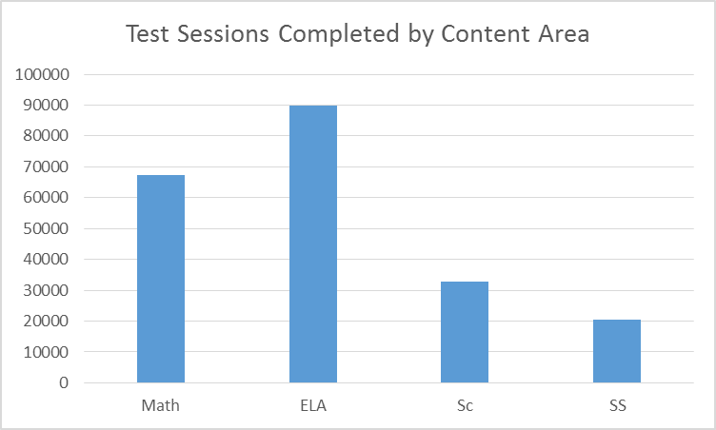
Online Student Logins by Day
Date | Total Number of Student Logins
2/27 | 33,072
2/28 | 72,776
3/1 | 68,761
3/2 | 43,945
3/3 | 31,101
3/4 | 28,670

Slide 4
Monitoring Plan
Communication with CTCs, Superintendents and Principals noted:
Purpose of monitoring to ensure fidelity of the test administration and test security requirements
Selection based on previous test irregularities and representative sample
Process includes completion of onsite monitoring checklist
Feedback provided to CTC within two weeks of test administration
Visited 17 sites during week one
No significant concerns identified

Slide 5
ISTEP+/IREAD Guidance
For students who do not achieve a passing score on IREAD-3 and are not eligible for a Good Cause Exemption, schools should design a program that meets the learning needs of individual students and make decisions regarding organization of students for instruction. Local flexibility for this includes:
retention in the traditional sense (i.e., receiving all content instruction at Grade 3 level in a Grade 3 classroom). The student would participate in Grade 3 ISTEP+ in all subject areas and the IREAD-3 retest.
providing Grade 4 instruction in some subject areas (e.g., mathematics). The school must decide if the student would participate in Grade 3 ISTEP+ in all subject areas or Grade 4 ISTEP+ in all subject areas. The student would also participate in the IREAD-3 retest.
providing instruction in all content areas (including reading/literacy) at a Grade 4 level in a Grade 4 classroom, in addition to the Grade 3 reading/literacy instruction. The school must decide if the student would participate in Grade 3 ISTEP+ in all subject areas or Grade 4 ISTEP+ in all subject areas. The student would also participate in the IREAD-3 retest.
Local decisions should be based on a student’s performance on IREAD-3 and other local assessment data collected regarding the learning needs of each student.

Slide 6
ECA Summer Retest Windows
Feedback requested from the field about test window defined
Allows for flexibility for corporations offering services during the summer
We recommend based on feedback:
June 22-28 (Thursday-Wednesday)
August 24-30 (Thursday-Wednesday)

