Slide 1
School Accountability
Indiana State Board of Education Workshop
Thursday, August 23, 2018

Slide 2
National Assessment of Education Progress (NAEP)
National Assessment of Educational Progress (NAEP) Scores
4th Grade Reading from 2003 to 2017
Since 2003, Indiana has increased by 6 points (slightly more than half a grade level) compared to the national average increase of 4 points.
Since 2009, the baseline year for A-F and K-3 reading policy, Indiana has increased by 4 points compared to the national average increase of one point.
Notes:
*The scale scores are rounded to the nearest whole number. The differences in subtracting scale scores in the chart and the text are due to rounding.

Slide 3
National Assessment of Education Progress (NAEP)
National Assessment of Educational Progress (NAEP) Scores
8th Grade Reading from 2003 to 2017
Since 2003, Indiana has improved by 7 points (more than half a grade level) compared to a national average increase of only 4 points.
Since 2009, the baseline year for A-F, Indiana has increased by 6 points compared to the national average increase of 3 points.
Notes:
*The scale scores are rounded to the nearest whole number. The differences in subtracting scale scores in the chart and the text are due to rounding.

Slide 4
National Assessment of Education Progress (NAEP)
National Assessment of Educational Progress (NAEP) Scores
4th Grade Math from 2003 to 2017
Since 2003, Indiana has far outpaced the national average improving by 9 points (nearly a full grade level) compared to half a grade level of progress nationally.
Since 2009, the baseline year for A-F, Indiana has increased by 4 points compared to the national average which remained flat.
Notes:
*The scale scores are rounded to the nearest whole number. The differences in subtracting scale scores in the chart and the text are due to rounding.

Slide 5
National Assessment of Education Progress (NAEP)
National Assessment of Educational Progress (NAEP) Scores
8th Grade Math from 2003 to 2017
Since 2003, Indiana and the Nation have improved by 6 points with Indiana slightly outpacing the nation.
Since 2009, the baseline year for A-F, Indiana has increased by one point compared to the national average which remained flat.
Notes:
*The scale scores are rounded to the nearest whole number. The differences in subtracting scale scores in the chart and the text are due to rounding.

Slide 6
Indiana A-F School Grading Results
Indiana has experienced steady improvement in school performance and raised expectations for earning A and B school grades.
Notes:
https://www.doe.in.gov/accountability/history-indiana%E2%80%99s-accountability-system
In 2013, the Indiana General Assembly added IC 20-31-8-5.4to the Indiana Code (P.L. 286-2013). This statute required the State Board to establish new A-F categories and new standards of assessing school performance. The new standards were required to be based on a measurement of individual student academic performance and growth to proficiency; and were not to be based on a measurement of student performance or growth compared with peers.
The Accountability System Review Panel, established by a Memorandum of Understanding entered into by the Speaker of the House, President Pro Tempore of the Senate, the State Board of Education, the Superintendent of Public Instruction and the Governor, conducted research and provided recommendations to the State Board of Education regarding the composition of the new A-F system. The Panel presented its final report to the State Board on November 13, 2013 and presented its recommendations for the new A-F system to the State Board on September 22, 2014.
On October 29, 2014 the State Board filed a Notice of Intent to adopt a rule to establish the new categories or designations of school performance per IC 20-31-8-5.4. At its January 7, 2015 business meeting, the Board adopted proposed language that would add 511 IAC 6.2-10 to replace the old A-F accountability system (511 IAC 6.2-6). The Board adopted the final rule that establishes the new metrics of Indiana’s student-centered accountability system on May 7, 2015. The rule was approved by the Attorney General on June 4, 2015, approved by the Governor on June 12, 2015, filed with the Legislative Services Agency on June 15, 2015 and posted on July 15, 2015. The rule is effective March 1, 2016, and is applicable beginning with the assessment of the 2015-2016 school year.

Slide 7
Florida A-F Increased in Rigor and Improved Student Achievement Dramatically Since 1999
2013
2015
2010
Writing expectation increased
“F” if less than 25% proficient readers
New grading formula
New, rigorous tests
1999
2005
High school accountability components added:
- Graduation rate
- At Risk Graduation rate
- Acceleration rate
- College readiness rate
Moved to A, B, C, D, F grades
Students with disabilities and ELL added to the calculation
Writing standard raised
2007
2016
Science and math for lowest 25% gains added to the calculation
New learning gains
2002
2012
2014
Student learning gains added to calculation
Proficiency expectation increased
HS A-F scale increased
Harder grad requirements
Notes:
Updated: August 2018
In 1999, we had more D&F schools than A&B schools. Now we have almost four times as many AB vs. DF.
The 8 dotted lines indicate times when we raised the bar on what it means to be an A or B school.
1999 – moved to A, B, C, D, and F grades
2002 – added in student learning gains to the calculation
2005 – added in students with disabilities and English language learners to the calculation and raised the writing standard
2007 – added in science and math lowest 25% gains into the calculation
2010 – added high school accountability:
Graduation rates for all students
Graduation rates for at-risk students
Acceleration rates (both performance & participation)
College readiness rates
2012 – increased cut scores on new FCAT 2.0 test, inclusion of students with disabilities and English language learning students into the proficiency components of the grade calculation
2013 – increased cut score of FCAT writing from 3.0 to 3.5, if fewer than 25% of students are reading on grade level school is automatic F.
2014 – increased grading scale for high schools, more rigorous graduation requirements
2015 – implement Senate Bill 1642 back to basics (without learning gains) and a new statewide assessment
2016 – learning gains to proficient and advanced included in new calculation for the first time

Slide 8
What signals are you sending to educators?
The three main signals educators should get from a school accountability system.
Help every child get to grade level proficiency or higher
Help every child make annual progress from where they entered my classroom
Help the most struggling students make great progress

Slide 9
School Grades: Fundamental Principles
A-F school grades provide transparent, objective and easily understood data to parents, educators and the public to spur improvement among all schools.
5
Focus on the progress of the lowest performing students in each school
6
1
Report results as close to the end of the school year as possible
Use clear and transparent descriptors of A, B, C, D, and F
7
2
Include objective, concise student learning outcome measures
Communicate clearly to parents
3
8
Establish rigorous criteria, with automatic increases, in order to earn A, B, C, D or F grades
Balance measures of student performance and progress
4
Calculate student progress toward grade level and advanced achievement
9
Use grades to identify schools for recognition, intervention, and support
9

Slide 10
Indiana A-F grading system under 511 IAC 6.2
Indiana uses a 0-100 point scale to grade each domain and school using A-F.
Weight | Elementary and Middle School Indicators
50% | Proficiency - ELA/Math using percent proficient time the participation rate
50% | Growth – ELA/Math using the SGP average of the top 75% and bottom 25% scores
Weight | High School Indicators
20% | Proficiency - ELA/Math using percent proficient time the participation rate
20% | Growth – ELA/Math using the SGP average of the top 75% and bottom 25% scores plus improvement of proficiency from 10th to 12th grade
60% | Multiple Measures Graduation Rate – 4-year cohort plus improvement of 5-year cohort College and Career Readiness – Passed AP or IB and earned college credit or industry certificate
Notes:
Testing in grades 3-10 and 12.
Growth is calculated through complicated process. It’s incentivizing the right thing for teachers – get most points for moving the lowest performing students far. However, there is no benchmark for ever getting a student to proficiency or higher.
Three performance levels on the test:
Passing plus 1, 2
Passing 1, 2, 3
Does not pass 1, 2, 3
An index setting bars for: exceeding, meeting and below expectations.
Normative and complicated
Always winners and losers
Complicated
Not necessarily pushing every child to reach proficiency

Slide 11
Indiana A-F grading system under ESSA
Indiana uses a 0-100 point scale to grade each domain and school using A-F.
Weight | Elementary and Middle School Indicators*
42.5% | Proficiency - ELA/Math using percent proficient
42.5% | Growth – ELA/Math using SGP awarding points based on a value table that differentiates on prior achievement score
10% | Proficiency and Growth of English Learners on English Proficiency
5% | Chronic absenteeism
*The long-term goal for SQ/SS is for K-8 to utilize a school climate and culture assessment
Weight | High School Indicators
15% | Proficiency - ELA/Math using percent proficient
15% | Growth/Improvement – ELA/Math using SGP awarding points based on a value table that differentiates on prior achievement score
10% | Proficiency and Growth of English Learners on English Proficiency
30% | Graduation Rate – 4-year cohort plus improvement of 5-year cohort
30% | College and Career Readiness – Passed AP or IB and earned college credit or industry certification
N = 20 students
Notes:
This school accountability system fully complies with ESSA.
Main differences between the state and federal systems
Inclusion of EL indicator in federal system
Inclusion of chronic absenteeism in federal system. Chronic absenteeism is an input, but limited to five percent of the calculation.
Change in weights of indicators as a result of including EL and chronic absenteeism indicators
Growth in the state system is for the top 75% and the lowest performing 25% but the federal system just measures growth for all students.
Students included in the graduation rate numerator in the federal system is more rigorous than the state system as required by ESSA.
Belief among some that this calculation will be harder (at least for one year) than the state calculation – because of the limitation on the graduation rate to only standard high school diplomas. And due to potentially high bar for the ELP indicator

Slide 12
What Grade Did My Child’s School Earn?
Releasing two different school grades can create a communications challenge.
Release both the State and ESSA school grades at the same time
Explain the differences
Give the timeline for a consolidated grade

Slide 13
Advice for Future School Accountability Discussions

Slide 14
Indicators to Avoid
Normative growth
Normative growth models are a zero-sum game – always winners and losers
Results don’t really tell you about the school’s ability to improve student outcomes toward meeting standards
Scores rely on factors outside the school’s control (i.e., performance of other schools)
Student Attendance Rates, Teacher Attendance
Schools and parents/schools and teachers become adversaries
Forcing a school to focus on an area that may different than the local priority for improvement
Can improvements in these indicators occur with a different policy lever?
Participation Rates in Certain Courses
Can be gamed
No relationship to quality or outcomes
Forcing participation negatively impacts course rigor and student motivation
Measuring actual student outcomes makes actual student outcomes matter

Slide 15
Accountability vs. Transparency
Many pieces of information should first be reported transparently first and evaluated before considering for inclusion as an accountability indicator.
Climate Surveys
Character Skills
School Safety & Discipline
Postsecondary Transitions
Notes:
Climate Surveys
Significant costs of survey administration outweigh the value-added to accountability
Response bias leads to unrepresentative and invalid survey results
Leading indicators like climate surveys tend to provide redundant information about schools
Character Skills
There is no standardized definition for which non-academic skills students need to achieve success
“Character skills” are highly subjective and unreliable as a school-measure
School Safety & Discipline
Educators may feel compelled to sacrifice safety and discipline to retain higher ratings
Safety and other discipline data in a school accountability system requires significant context and consistency in statewide reporting

Slide 16
Specific Recommendations

Slide 17
Recommendations: A-F school grading calculation
Indiana has a good/two good calculations that can be even better.
Create a single, federally compliant system.
Use criterion-based growth to measure progress/growth to proficient and advanced achievement
Consider including growth of the lowest performing students in each school in addition to all student growth.
Create automatic increases in requirements for earning an A, B, C, and D grades.
Improve reporting tool and report results over the summer so parents and educators have time to make decisions before the start of the next school year.

Slide 18
Advice for How to Make Changes to School Grades
Finalize changes to school grading rules before the start of the school year so educators understand the ground rules
Provide sufficient time for schools to adjust to major changes
For new indicators, collect, report and analyze data before including in the accountability calculation
Don’t make major changes too frequently
Model the data
Remember that the accountability system is just one tool. Don’t forget other policy levers (financial incentives, autonomy, reporting).

Slide 19
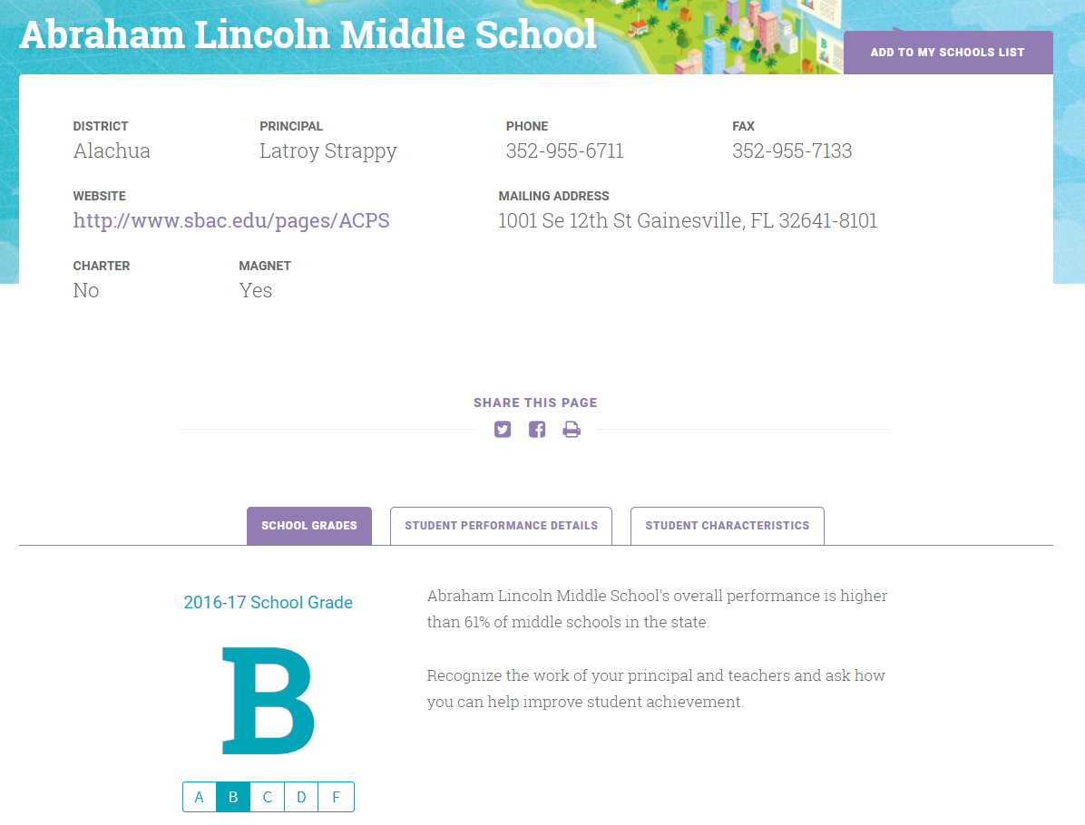
Reinventing school report cards empower families
Indiana should reimagine their public reporting tool to reflect state priorities, highlight the breadth of school data and most importantly, be parent-friendly.
Notes:
PL Questions: Indiana have a good, clear school accountability website?
No, the site should be improved
https://www.doe.in.gov/accountability/annual-school-performance-reports
https://www.doe.in.gov/accountability/find-school-and-corporation-data-reports

Slide 20
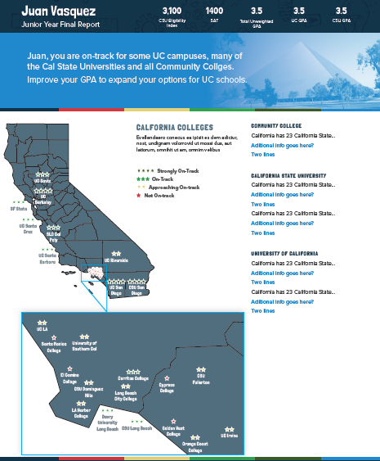
Reinventing student test reports empower families
Use technology to turn student data into personalized stories for parents.
Notes:
Spotlight Education
Mike Fee, Co-Founder, Spotlight Education
Proprietary technology that turns education data into a relevant story for “everyday users”
Narrative Text (printed, webpages) – Data Verbalization℠
Personalized Mobile Videos – Data Animation℠
Highly experienced team: education, entrepreneurship, software development
Strong partnerships with leading organizations (New Mexico PED, Oakland & Long Beach Unified; ETS, NWEA, College Board)

Slide 21
Testing recommendations
Improve state assessment systems by moving to fewer, better tests.
Move the state test later in the year to give teachers more time to teach​
Indiana accomplished later testing and reduced the number of hours spent on testing
Ensure incoming and current teachers get access to student score reports​
Provide parent-friendly score reports with real action items for parents to take to assist their child​
Provide parent friendly score reports that show the child’s progress over time, strengths, and areas for improvement​
For local, diagnostic tests, ensure one week turnaround of data to teachers so they an use the information for instruction​
Be transparent with parents at the start of the year, about what tests are given, what grades, who requires, and the purpose of the test

Slide 22
Questions

Slide 23
Resources
Documents and other resources developed by ExcelinEd.
A-F School Grading Fundamental Principles
ExcelinEd Accountability Website
https://www.excelined.org/quality/school-accountability/
ESSA A-F Playbook
https://www.excelined.org/wp-content/uploads/A-F.ESSA_.PlayBook.Nov2016-FINAL.pdf
Know Your School Website
https://www.excelined.org/quality/school-report-cards/
A-F Communications Toolkit
https://www.excelined.org/wp-content/uploads/2018/03/A-F-School-Grading-Communications-Toolkit-March-2018.pdf

Slide 24
Patricia Levesque
Chief Executive Officer
Patricia@ExcelinEd.org

