Slide 1
Introduction to Simplex Concepts
Notes:
Kirsten
8:50
At Ivy Tech, we use a lot of different tools and models to help us tackle the challenges we encounter. Among them are:
Simplex
Project Management
Process Improvement
In particular, today we’ll spend time with Simplex. Not only is Simplex being integrated into our college culture, but it is what prompted many of your ALPs.

Slide 2
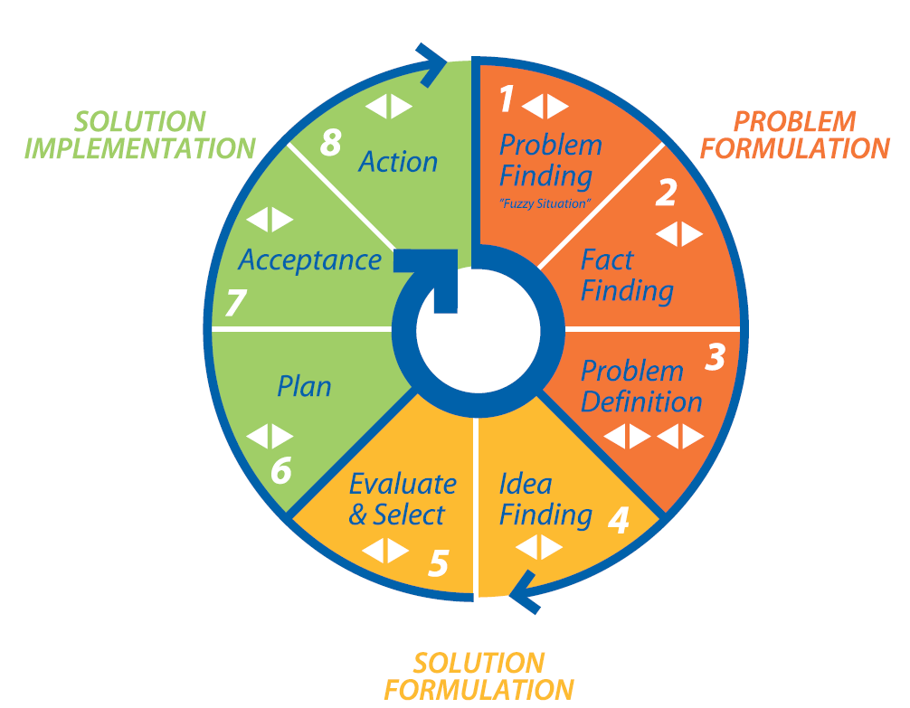
…as solving one problem also leads to new challenges and opportunities
Notes:
Kirsten
8:54
Because the College is faced with so many complex problems/“fuzzy” situations:
Begun to use Simplex to provide a process for problem solving
Used in strategic planning
“Fuzzy” situations across the state
Goal – create a culture of creative problem solving
Simplex Training and Certification program
Simplex encourages creativity and innovation in problem solving
Circular process – solving one problem also leads to new challenges and opportunities

Slide 3
Process Roles
Content Roles
Notes:
Kirsten
8:55-8:57
There are 4 styles of problem solving that correspond with the 8 step process:
Generating – getting things started: finding new problems and opportunities
Conceptualizing – defining problems and putting ideas together
Optimizing – turning abstract ideas into practical solutions
Implementing – getting things done
Each person has natural tendencies toward one of these problem solving styles:
Can be a mix – for instance, I’m a generator, conceptualizer, implementer
Just like with strengths, there’s no “right” style of problem solving
All styles are necessary for problem solving success
Can learn to use/master other styles
Everyone is creative and everyone contributes to the creative process in different ways

Slide 4
No Judgment
No Logic
Relax
Quantity
Stream of options
Radical options
Think in pictures
Build onto fragments
Yes Judgment
Yes Logic
Clarify meanings
Use relevant criteria
Focus on a few
Consider risky options
Modify and refine
Move toward action
Deferral of
Judgment
Separate divergent
and convergent thinking
Notes:
Kirsten
8:57-8:59
One of the basic skills in Simplex is demonstrated through this diagram. In each stage of the Simplex process you’ll:
Diverge: No judgment or logic
Goal is quantity
Every statement/idea is a good one
Everything gets written down
Converge: Using judgment and logic
Goal is to narrow and refine
Evaluate statements/ideas
Deferral of Judgment
Wait to make any judgment calls or evaluations until we converge

Slide 5
Divergent and Convergent Skills are used in each Step
This speeds up “Good Thinking”
Notes:
Kirsten
8:59-9:01
Simplex is an 8 step process – this process overlaps with the styles
Divergent and convergent skills are used in each step of the process (indicated by triangles)
Problem Finding – identification of “fuzzy” situation
Fact Finding – uncovering all the facts about the “fuzzy” situation
Problem Definition – clearly defining and coming to agreement on exactly what the problem is
Idea Finding – generating as many innovative ideas/solutions as possible
Evaluate and Select – evaluating the possible solutions against a determined set of criteria
Plan – creating an action plan for initial steps
Acceptance – identifying and planning for necessary buy-in around solution and action plan
Action – implementing the solution and action plan

Slide 6
Killer Phrases
Good idea, but…
Not in the budget
Be practical
Leadership wont support it
We’ve already tried it
Let’s form a committee
It’s too hard to track
Has anyone else tried it?
It’s too hard to administer
We don’t have time
It needs more study
Against policy
We’ve always done it this way
Notes:
Kirsten, Rachel, & Trent
9:06-9:10
Killer phrases stop innovative thinking
One of the primary guidelines of diverging is to avoid killer phrases
Killer phrases can be verbal (voiced to the group) or internal (blocks to your own thinking)
Let’s hear a few more ideas:
Ideas from LI
Idea from Trent – Kirsten uses Killer Phrase
Idea from Rachel – Kirsten uses Killer Phrase
Debrief:
What happened in the room?
How did you feel?
I’m sure you’ve all been in a meeting when a killer phrase was used:
How was the rest of the meeting?
What happened to innovation?

Slide 7
Divergent Thinking Guidelines
No evaluation or logic
Relax your brain
Don’t worry about being right, have fun
Quantity is King
Don’t interrupt yourself - stream your thoughts
Reach for radical, wild ideas
Think in pictures - use your five senses
Build, Build, Build
Notes:
Kirsten
9:24
You’re going to have an opportunity to practice diverging with your ALP team
Before we do, here are some reminders

Slide 8
Converging Skills
View differences in perception as constructive
Explain exactly what the words mean to you
Listen carefully to what others say about an option
Build on points of agreement
Give unusual options a good hearing
Work towards full group participation
Don’t let higher status/more vocal people swing the group
Notes:
Kirsten
10:06-10:08
Point to FC with tape:
Up until now, we’ve deferred judgment
Now we’re going to step into converging, where we’re supposed to evaluate
Discuss the bullet points

Slide 9
Questions?
Notes:
Kirsten
8:50
At Ivy Tech, we use a lot of different tools and models to help us tackle the challenges we encounter. Among them are:
Simplex
Project Management
Process Improvement
In particular, today we’ll spend time with Simplex. Not only is Simplex being integrated into our college culture, but it is what prompted many of your ALPs.

