Slide 1
State Board of Education
August 2nd, 2017

Slide 2
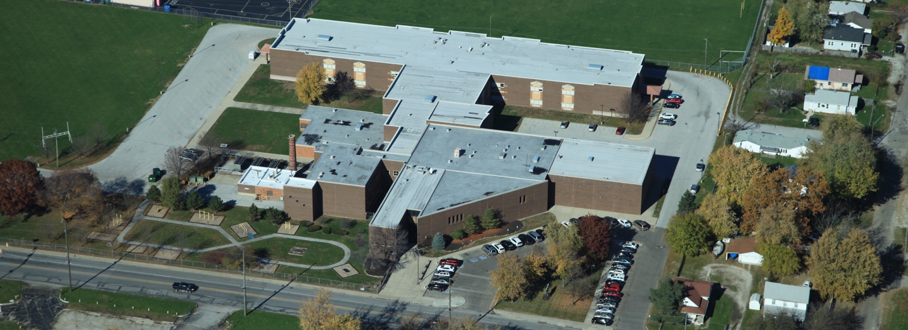
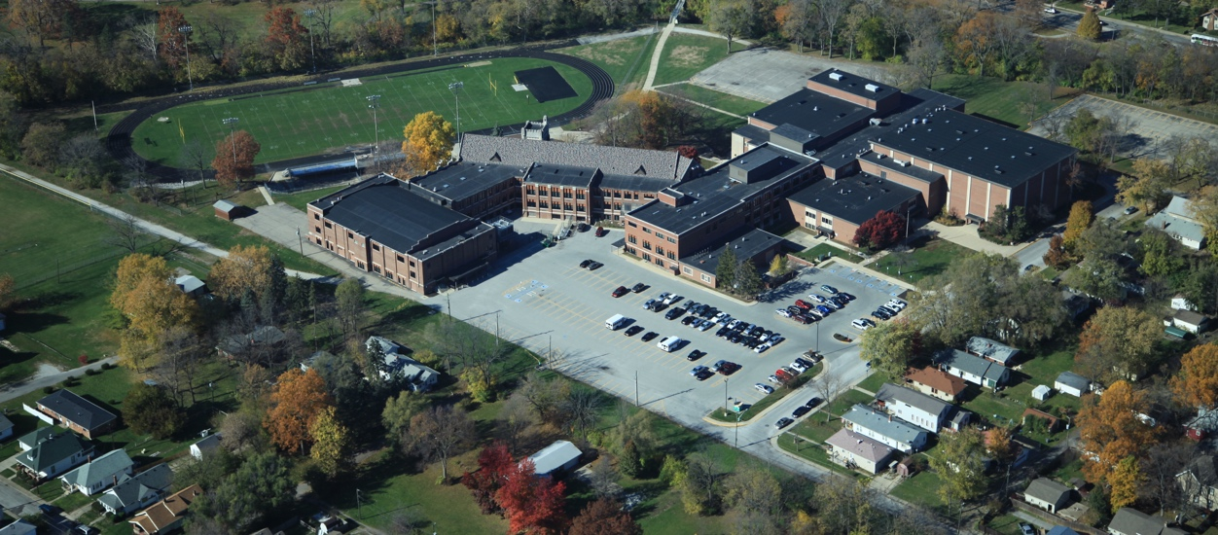
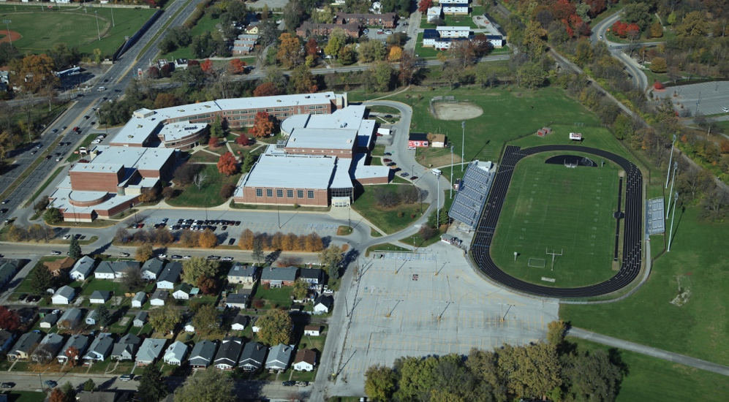
The Path Forward: Charter Schools USA (CSUSA), Noble Education Initiative (NEI), Indianapolis Public Schools (IPS) & State Board of Education (SBOE)

Slide 3
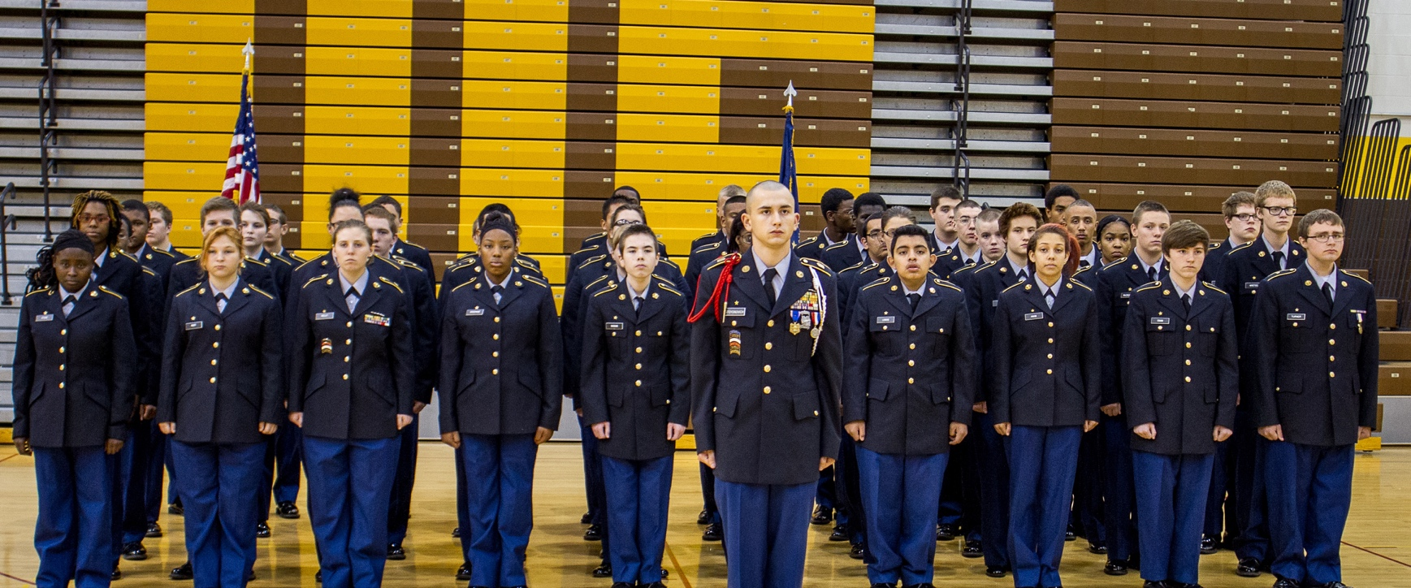
What is the future of these students?

Slide 4
Challenges in 2012
Documented Academic Probation (F) for six consecutive years
Lack of safe and secure environment
Graduation rates significantly below the state average or acceptable average
On probation with AdvancED (SACS Accreditation)
Non-compliant in special education in several areas including, but not limited to: LRE and timely evaluations
Hostile conditions in the turnover of the schools

Slide 5
Changes
Consistently hired qualified leadership and staff
Extensive environment & safety investments
Rigorous Instructional Culture
New school-wide schedule
In School Academic remediation
HYPE (Helping Young People Excel) and T9 (Transitional 9th) – for significantly under credited and/or needed an alternative learning environment
Restorative justice & responsive classroom
Academic and behavioral expectations for student athletes.
Focused each school on building a culture that was focused on education.
Quality control site visits with follow-up professional development

Slide 6
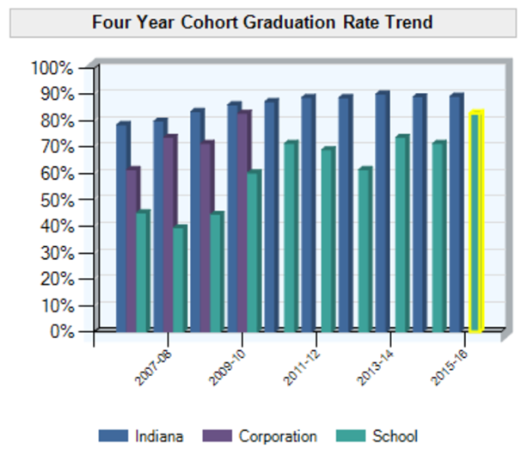
Successes
Moved a Turnaround Academy off the failing list & increased graduation rate
Moved all schools off of probation with AdvancED within one or two years and just successfully obtained a five year renewal last fall
Special education compliance achieved by end of year one
Increased school safety & decreased the number of violent incidents on campus
Created “Baby” Donnan per recommendation

Slide 7
Improvements
EMMA (K-6) IREAD3 Results 2016 vs. 2017
 | 2016 | 2017* | Change
State | 89.8% | 83.3% | -6.5%
IPS | 75.0% | 63.2% | -11.8%
Emma | 57.1% | 66.7% | +9.6%
Emma (“Baby”) Donnan had the HIGHEST percentage rate increase in IREAD3 passing rates in all of IPS for this past school year (2016-17)
The state average actually decreased this past year
This was achieved with a significantly higher 3rd grade enrollment at Emma than the prior year!
21 students in 2016
36 students in 2017
*This does not include summer retakes. Assume a comparable rate increase for each entity.
Source: IDOE Compass

Slide 8
Improvements: Blue = Good!
Every school exceeded normative growth in BOTH math and ELA
Every school made improvements from 2016 (except for EMMA MS)
Students on average achieve more growth as their tenure with us increases
Reading scores for our students with us for 3+ years is almost twice the growth of their peers nationally!

Slide 9
Improvements: “Baby” Emma
EMMA (K-6) ISTEP+ Results 2016 vs. 2017
 | 2016* | 2017^ | Change
ELA | 33.6% | ^
Math | 26.0% | ^
Nearly all schools in Indiana have struggled to effectively implement the new, more rigorous state standards in concert with preparation for the new assessments
The important measure is the annual improvement of student success on those more rigorous standards
^Preliminary Results Embargoed.
*Source: IDOE Compass

Slide 10
Improvements: Emma MS
EMMA (7-8) ISTEP+ Results 2016 vs. 2017
 | 2016* | 2017^ | Change
ELA | 18.0% | ^
Math | 10.6% | ^
Nearly all schools in Indiana have struggled to effectively implement the new, more rigorous state standards in concert with preparation for the new assessments
The important measure is the annual improvement of student success on those more rigorous standards
^Preliminary Results Embargoed.
*Source: IDOE Compass

Slide 11
Improvements: Howe MS
HOWE (7-8) ISTEP+ Results 2016 vs. 2017
 | 2016* | 2017^ | Change
ELA | 23.1% | ^
Math | 15.1% | ^
Nearly all schools in Indiana have struggled to effectively implement the new, more rigorous state standards in concert with preparation for the new assessments
The important measure is the annual improvement of student success on those more rigorous standards
^Preliminary Results Embargoed.
*Source: IDOE Compass

Slide 12
Improvements & Challenges: Howe HS
HOWE (9-12) Results 2016 vs. 2017
 | 2016* | 2017^ | Change
ELA | 17.7% | ^
Math | 6.2% | ^
Grad Rate | 70.0% | ^
CCR | 10.7% | ^
Nearly all schools in Indiana have struggled to effectively implement the new, more rigorous state standards in concert with preparation for the new assessments
The important measure is the annual improvement of student success on those more rigorous standards
^Preliminary Results Embargoed.
*Source: IDOE Compass

Slide 13
Improvements: Manual HS
MANUAL (9-12) Results 2016 vs. 2017
 | 2016* | 2017^ | Change
ELA | 14.4% | ^
Math | 3.9% | ^
Grad Rate | 71.3% | ^
CCR | 17.5% | ^
Nearly all schools in Indiana have struggled to effectively implement the new, more rigorous state standards in concert with preparation for the new assessments
The important measure is the annual improvement of student success on those more rigorous standards
^Preliminary Results Embargoed.
*Source: IDOE Compass

Slide 14
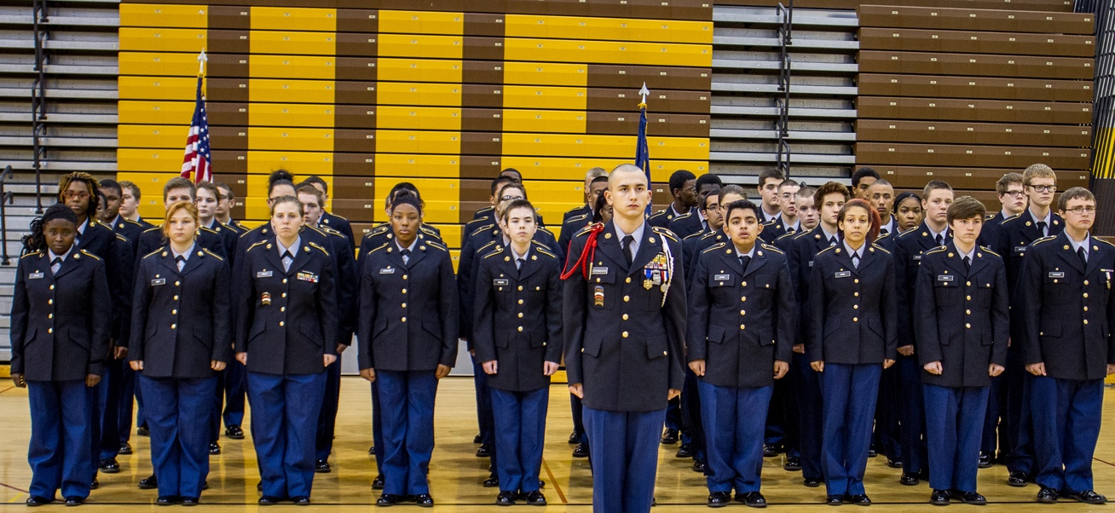
Our Mission
To provide Indy-centric academic and operational support for Howe, Manual, and Emma Donnan that will not only push them to higher levels of achievement in the short-term but will also set them up for long-term, sustainable success

Slide 15
Our Objectives
Successfully move schools off Turnaround status by 2020 demonstrating consistent performance over time
Immediately transfer the educational management of Howe, Manual, and Emma Donnan from CSUSA to NEI while maintaining operational and fiscal support by CSUSA
Reintegrate schools with their state & local communities by intentionally planting & reinforcing Indiana roots and decision-making
Continue to collaborate with IPS and SBOE throughout the process to identify best steps for schools after (or before) 2020

Slide 16
Our Methods
Non-profit organization developed to focus on Indy schools, unaffiliated with prior management
Strategic and operational decision-making made locally
Pivot from universal turnaround strategies to tailored success acceleration strategies (The 8-Step Process for school turnaround)
Set strong, yet achievable goals
Build on the progress made in the turnaround process and incorporate lessons learned and improvement opportunities
Utilize best-in-breed strategies, programs, and services for student achievement
Address the fundamentals of academics and school culture
Engage community, state, and nationwide resources

Slide 17
New Educational Support Programming
8-Step Process for Continuous Improvement
Extended School Day with extra Success period
Aligned instructional content & differentiated
Curriculum maps aligned to state standards
Monthly assessments aligned to state standards
Internationally Certified Character/Leadership Development Integration Partnership
Expanded CTE & Dual Credit courses
Health Professions, Welding, Ag (Food Science), Ag (Animal Science), Business, Marketing, Culinary Arts, Criminal Justice, Education Professions & Early Childhood Education

Slide 18
New Faculty, Student and Community Support
Early Childhood Centers
Pre-K at Emma and Howe starting fall 2017
Serving the community, faculty and students

Slide 19
New & Renewed Community Partners for Howe
Jane Pauley Community Health Center
Irvington – Library
Irvington - YMCA
Irvington – Community Development
Irvington – Prime Smile
IUPUI – Indy Learning Center
IUPUI – Upward Bound
Urban League
Indianapolis East Redevelopment Committee
Transamerica Life Insurance
Eskenazi

Slide 20
New & Renewed Community Partners for Howe
Big Brothers & Little Sisters of Central Indiana
Center for Leadership Development
Marion County Commission on Youth
Covering Kids & Families
Excel Centers
Stop Over, Inc.
John H. Boner Center
Teachers Credit Union
Ivy Tech Community College
The Martin Center
Voice of the Victim

Slide 21
New & Renewed Community Partners for Emma & Manual
Garfield Park – Neighborhood Association
Garfield Park – Recreation Center
Garfield Park – Library
Garfield Park – Conservatory
Mayor’s Office of Latino Affairs
Kid’s Inc.
Big Car
Boy’s and Girl’s Club
Southeast Community Services
Center for Leadership Development
Fountain Square Library
Anthem

Slide 22
New & Renewed Community Partners for Emma & Manual
Southeast Neighborhood Association
Password Community Mentoring
Indianapolis Black Alumni Council
ABC Construction
Shepherd Community Center
Community Health Network
CELL at UINDY
United Way
Urban League
Girls, Inc.

Slide 23
Outcomes

Slide 24
Academic Goals
 | 2017-18 (Baseline) | Year 1 Goals | Year 2 Goals | Year 3 Goals | Year 4 Goals
ISTEP+ / ILEARN |  | Increase the percentage of students passing ISTEP by 5-10% over prior year rate*
ECA (HS only) |  | Increase percentage of ECA pass rate by 5-10% over prior year rate*
High School Graduation Rate (excluding Transfer Students) |  | 80% | 80% | 85% | 90%
Number of HS Graduates Receiving Honors Diploma/HS Acceleration |  | Increase by 5% over prior year
Post-Secondary |  | 100% of graduating seniors will be accepted to a post-secondary institution (college, university, military, etc.) or entrance into credentialed career path (workforce).
 |  | Scholarships of $1m | Scholarships of $1.1m | Scholarships of $1.3m | Scholarships of $1.5m
*Based on recent state assessment history, these goals – starting in year 2 - may be contingent upon a normalization of results transitioning from ISTEP to ILEARN

Slide 25
Culture Goals
 | 2017-18 (Baseline) | Year 1 Goals | Year 2 Goals | Year 3 Goals | Year 4 Goals
Student Attendance Rate |  | D: 85% H: 80% M: 80% | D: 85% H: 80% M: 80% | D: 90% H: 85% M: 85% | D: 90% H: 85% M: 85%
Student Truancy (# of students with more than 10 unexcused days absent) |  | Reduce prior year by 5%
Staff Attendance |  | 90% attendance rate
Behavior Interventions |  | Reduce out of school suspensions and referrals by 10% Increase restorative justice practices
Co-curricular Activities |  | 50% of student body involved in at least one activity | 60% of student body involved in at least one activity | 70% of student body involved in at least one activity | 75% of student body involved in at least one activity
Parent Involvement |  | 10 hosted school-wide events/year HS: 3 college/career events MS: 2 college/career events, 1 HS matriculation meeting

Slide 26
Requests
Align the scope of work at Emma Donnan with Manual and Howe by extending their contracts to 2020
Support the Implementation of the 8-Step Process Turnaround work by maintaining the FY17 SIG funding levels for FY18

Slide 27
What is the future of these students?
Success!

Slide 28
State Board of Education
Thank you!

