Slide 1
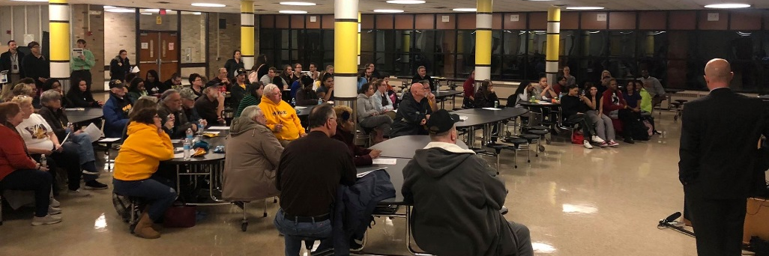
School Transition Task Force
Per its authorization from the SBOE, the School Transition Task Force will develop recommendations, informed by local input, as to the appropriate option through which Emma Donnan, TC Howe, and Emmerich Manual High School will exit turnaround status in June 2020.
Facilitated by Dr. Charles Schlegel & Joe Mount

Slide 2
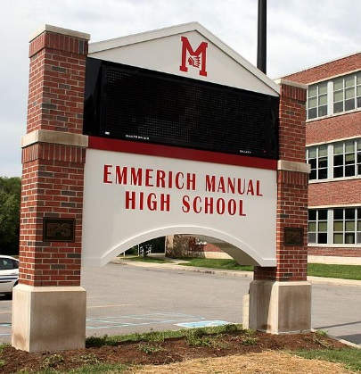
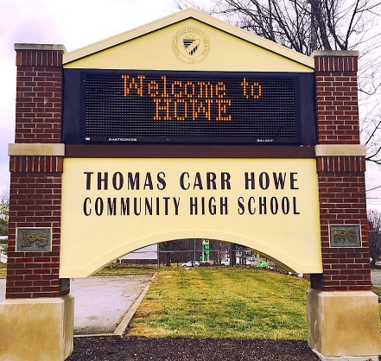
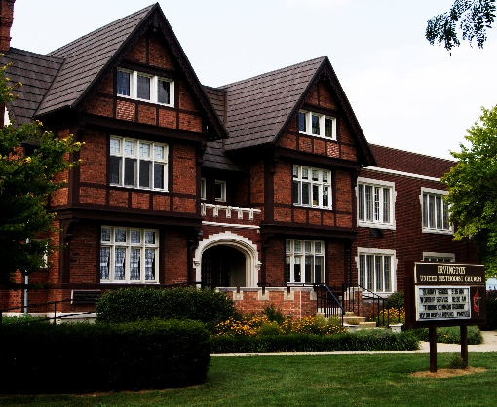
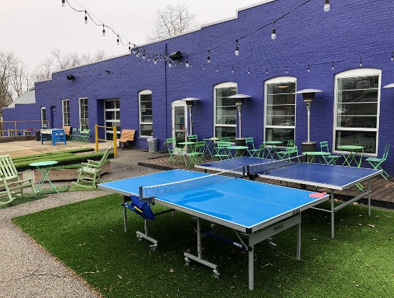
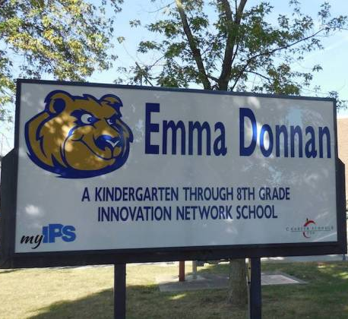
Community Outreach
Oct. 29
Manual HS
Nov. 13
TC Howe HS
Jan. 29
Irvington United
Feb. 6
Tube Factory
Feb. 12
Emma Donnan MS
A series of five community meetings, located on the south and east sides in locations central to the schools, attracted over 500 attendees. Our social media presence reached out to additional stakeholders, appearing on over 70,000 pages and engaging with community members over 4,000 times.

Slide 3
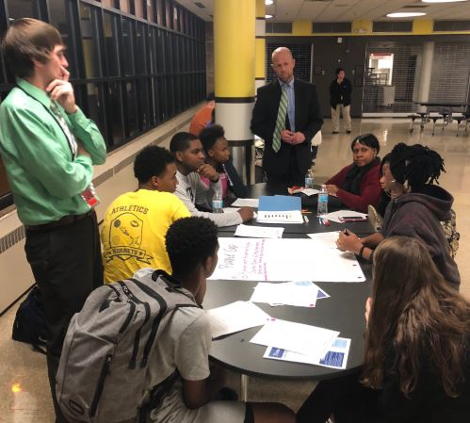
Community Engagement
Stakeholder Identity
Data was gathered through surveys completed at the community meetings and online. In the end, over 800 surveys were completed.

Slide 4
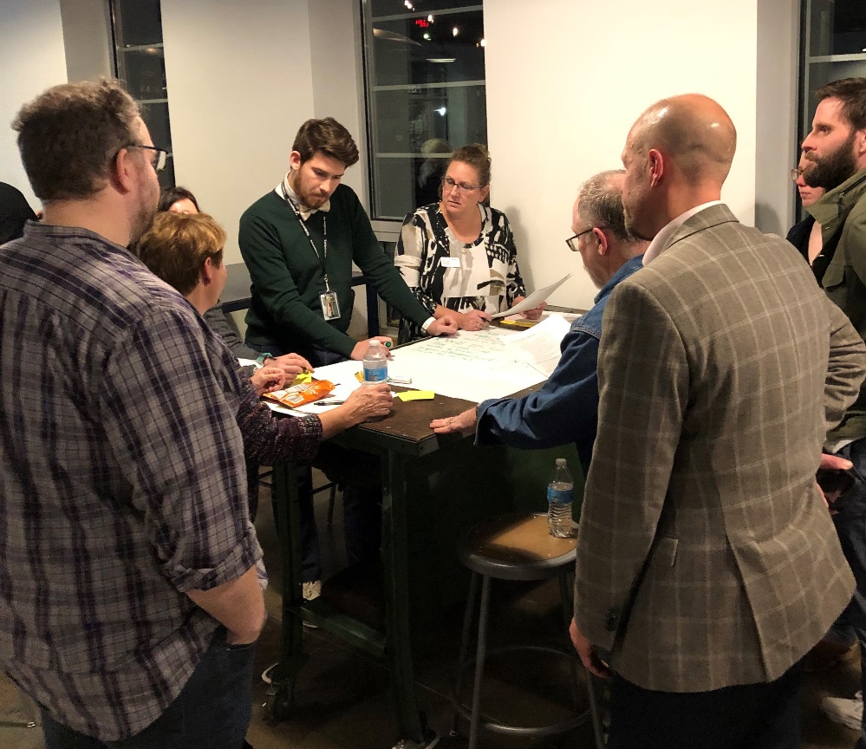
Community Engagement
Stakeholder Zip Code
49%
of Respondents Live in or Adjacent to the Schools’ Neighborhoods
Data was gathered through surveys completed at the community meetings and online. In the end, over 800 surveys were completed.

Slide 5
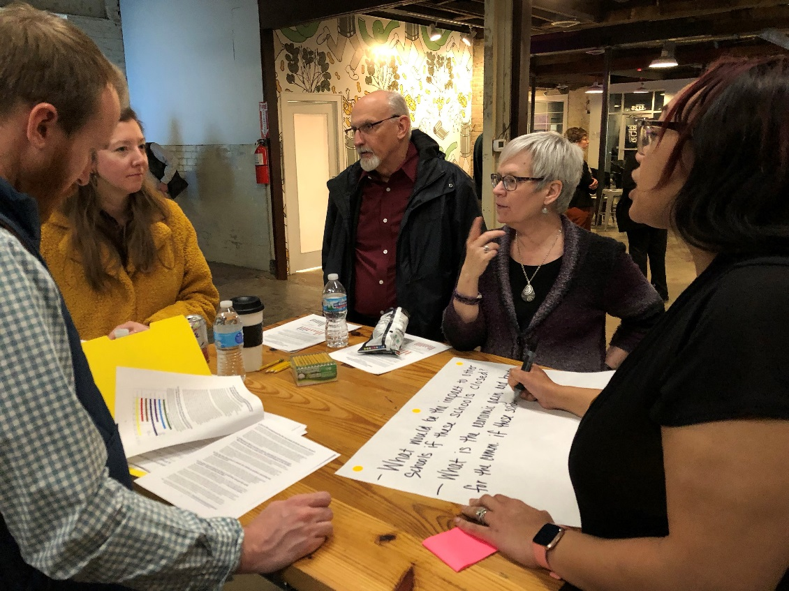
Community Engagement
School Affiliation
Data was gathered through surveys completed at the community meetings and online. In the end, over 800 surveys were completed.

Slide 6
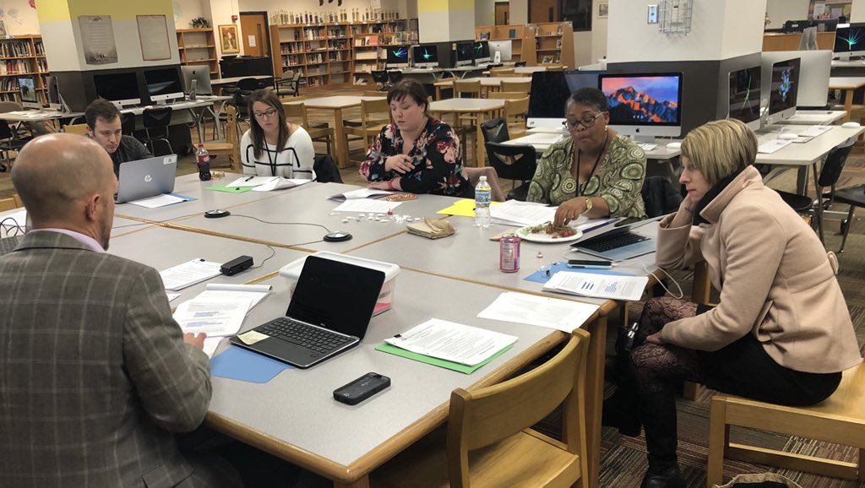
Incorporating Input
Task Force members met monthly to review the input received during community meetings, ask questions and discuss the turnaround options at a deeper level, and construct the recommendation for each school.
Facilitated by Dr. Charles Schlegel & Joe Mount

Slide 7
Key Findings
Donnan is Different
based upon the school’s 2015 innovation agreement with IPS.
IPS sticks to its plan,
and will not operate Howe or Manual as high schools if returned to them.
Chartering is an option.
Upon SBOE’s direction, the Special Management Team intends to seek charters for each school.

Slide 8
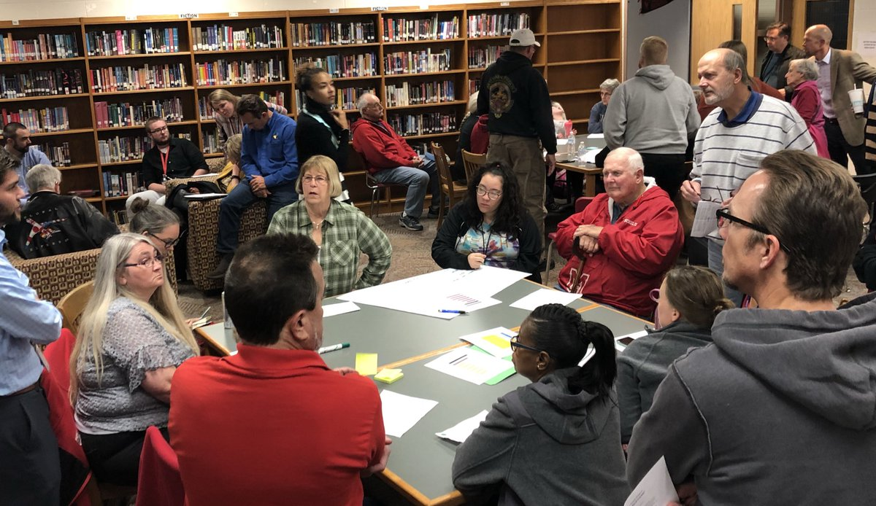
Community’s Choice for
MANUAL
Support for the MANUAL Charter Option
Strongly Oppose
Strongly Support

Slide 9
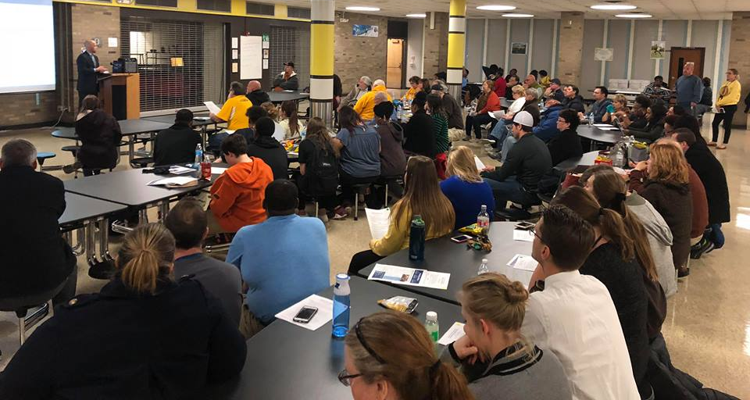
Community’s Choice for
TC HOWE
Support for the TC HOWE Charter Option
Strongly Oppose
Strongly Support

Slide 10
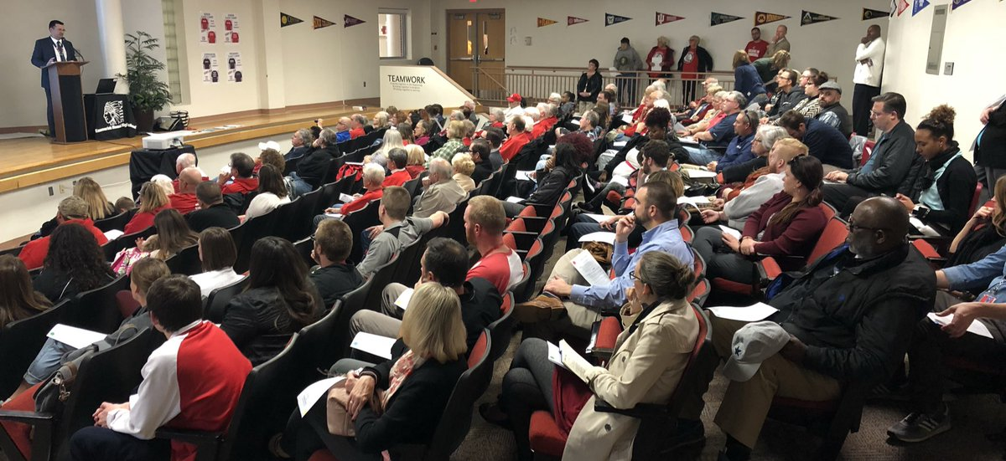
Community’s Priorities
For the Future

Slide 11
Task Force Recommendations

