Slide 1
Indiana State Board of Education Meeting
Turnaround Academy Update
Proposed Performance Management System
August 2, 2017

Slide 2
Agenda
Summary of Statewide Achievement
Turnaround Academy Performance Management System
Questions & Comments

Slide 3
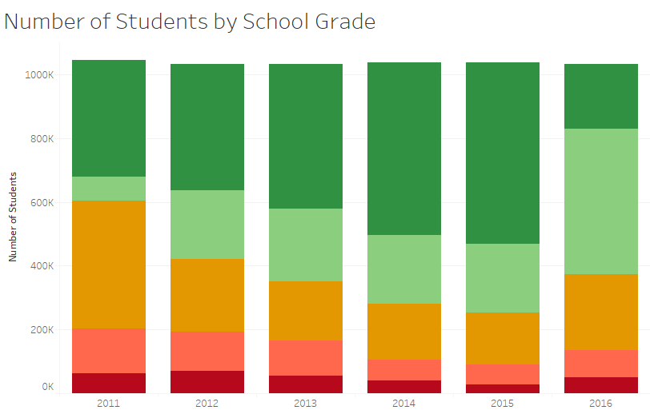
Statewide Enrollment Trends
Notes:
There are 134,329 students in D/F schools
Of which: 47,365 or approximately one-third are in a school that has received three consecutive D/F grades
(52,252 if you include the TA’s)

Slide 4
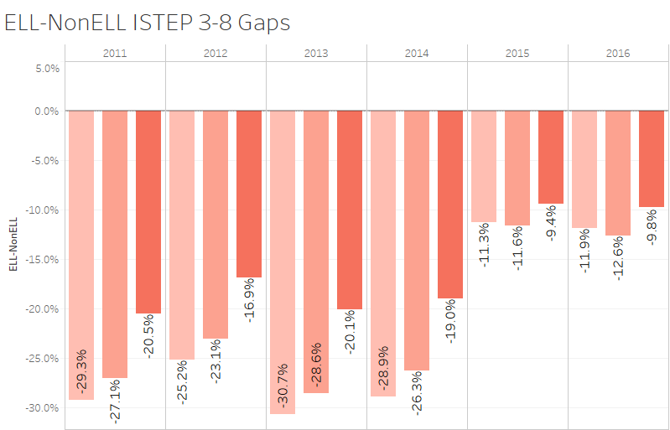
ELL Subgroup Has Improved
Notes:
Targeted investments for small populations may yield results
ELL population has observed gap closures across the board

Slide 5
2016 Disaggregated School Enrollment
Notes:
Targeted investments may not also show results on a large scale
After millions of federal and state funds invested to support poor and minority students in Indiana:
One in five minority students are still in a D/F school
One in seven students with F/R meals are still in a D/F school
These gaps exist not only in access, but also in achievement and college and career readiness

Slide 6
Enrollment in Turnaround Academies
Notes:
These gaps are manifested in our TA’s, which represent Indiana’s most underserved students
Less than 1/3 of IN students are minority, more than 80% of students in TA’s are minority
½ of students receive F/R meals in IN, more than 80% of students in TA receive F/R meals

Slide 7
If the 12 Turnaround Academies receive a C or higher…
The number of minority students in D/F schools would decrease by
The number of students with F/R meals in D/F schools would decrease by
The number of students in D/F schools would decrease by
4,887 students
4,191
students
3,952
students
Notes:
TA’s reflect a disproportionate number of poor and minority students in chronically failing schools

Slide 8
Turnaround Academy
Performance Management System
Clarify expectations for all turnaround academies to inform transition decisions
Reset benchmarks & targets for all SBOE turnaround academies
Tailor monitoring & support to specific intervention at each school
SBOE Turnaround Committee
Stakeholder Feedback
Public Impact

Slide 9
Turnaround Academy
Performance Management System
2- and 5-Year Student Achievement Benchmarks
Aligned to Indiana’s A-F Accountability Model
Earn a ’D’ or higher rating by the end of year 2
Exit comprehensive status by the end of year 5
Annual Leading Indicators of Student Success
Developed annually in collaboration with IDOE
Tailored to unique school needs/priorities
Inform ongoing decision-making & evaluation
1003 School Improvement Grant (SIG) Application
Activities and expenditures aligned to school improvement plan
Informs ongoing monitoring and support for federal programs

Slide 10
Timeline & Next Steps
July/August
Finalize performance management framework for SBOE turnaround academies
Communicate expectations to school and district leaders
September
Each turnaround academy finalizes their 2- and 5-year benchmarks
IDOE partners with schools to develop annual leading indicators
October
Performance agreements adopted by the SBOE

Slide 11
Turnaround Academy
Performance Management System
Questions or Comments

