Slide 1
Voter Assignments and Data Cleanup
2023 Election Conference
Anola Gallion & Jason Jacobs, Proficiency Management Leads

Slide 2
Step-By-Steps to Review
Voter Cleanup, Reprecincting, and Redistricting
HAVA Administrator Update and Voter Exception - District Mismatch
Signature History Functionality
Submitting a County Authorization Request in SVRS
If you choose to clean up address points through GeoConvergence’s GIS software, you will also need:
GIS Geocode Data Maintenance
GeoConvergence-Mapping Support Tools for Reprecincting
GeoConvergence-Voter Assignment-Tips and Tricks for Validating Voter Assignments and Precincts

Slide 3
How to Review and Correct Voter Assignments and Missing Data in SVRS
Review your County Precinct Key to ensure that all districts are correctly assigned to each precinct.
If the districts on your Precinct Key need updated, mark the changes, and attach the file to a County Authorization Request.
Perform Batch Redistricting in SVRS after the changes are completed by the HAVA.
Review your Voter Exceptions to find voters with mismatched or missing data.
Use the Reports Library AND Voter > Voter Exceptions to be thorough!
Relevant reports are listed in the Voter Cleanup, Reprecincting, and Redistricting SBS
If you work with GeoConvergence to clean up address points, be sure to upload the file produced by GeoConvergence into SVRS when your GIS project is complete!

Slide 4
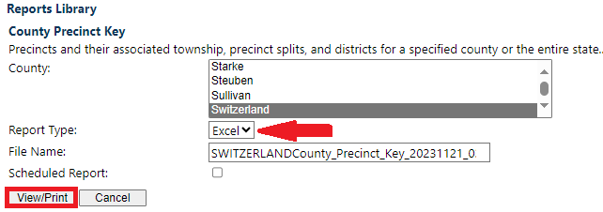
Precinct Key Updates
The Precinct Key may be generated in a PDF or Excel file. The PDF file will give more space for marking changes by hand. The Excel file will allow you to edit the columns and rows electronically. Please use a different font color or highlight the cells where you are making changes if using the Excel file.
Once edits have been made, attach the file to a County Authorization Request to get the changes approved by the IED so the HAVA administrator can make the updates.

Slide 5
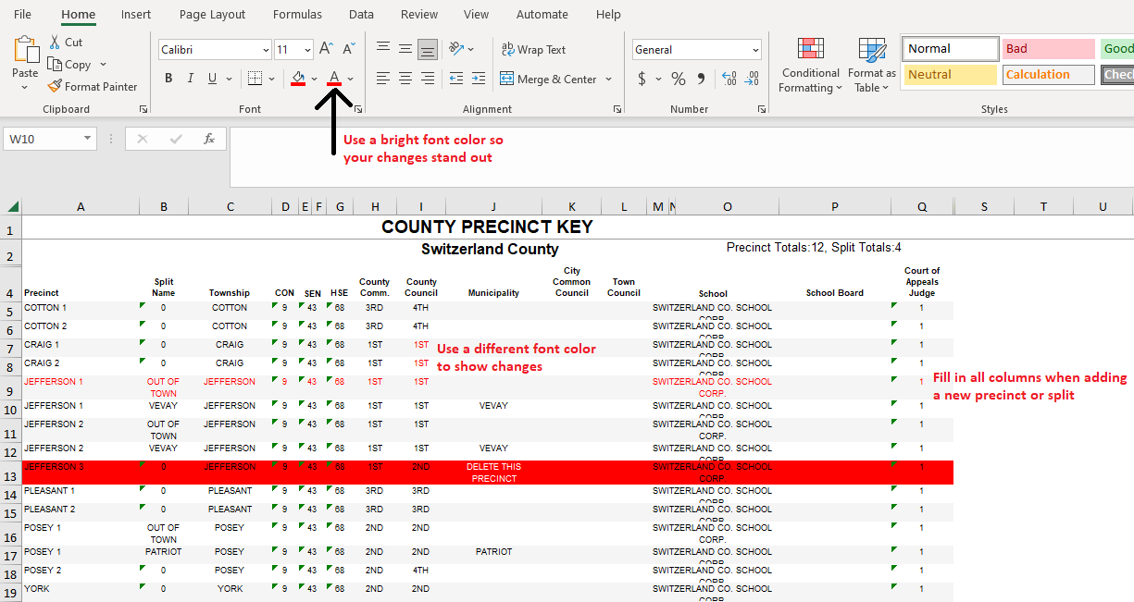
Make Precinct Key Changes Stand Out
Help the HAVA understand your request
Use bright font colors
Fill out new lines COMPLETELY

Slide 6
Updating Precincts and Districts
Changes made to the Precinct (column A) can only occur after reprecincting with IED or renaming precincts. If precinct boundaries are changing, reprecincting must be completed in SVRS in order to move voter data to the correct precinct. If only the name of the Precinct is changing, no further action is needed in SVRS after the HAVA makes the updates. Please contact the IED for more information on the process for making changes to precinct names and boundaries. The Civix Help Desk can assist you with moving voters in SVRS once boundary changes have been approved by the IED.
Changes to districts (columns B-Q) are more common and require batch redistricting to be completed in SVRS once the HAVA has completed the updates. Precinct Key updates will be active the day after they are entered by the HAVA, so please generate a new Precinct Key and check for accuracy before beginning batch redistricting.

Slide 7
Redistricting Voters After Changes to Precinct Key Districts
Any changes to districts on a Precinct Key require the county to complete Batch Redistricting once the changes are in effect in SVRS.
Registrations that are updated after the Precinct Key changes are made in SVRS will automatically have the new districts applied.
Existing registrations need the districts associated to them to be “refreshed,” so batch redistricting is done to update the data on existing registrations.

Slide 8
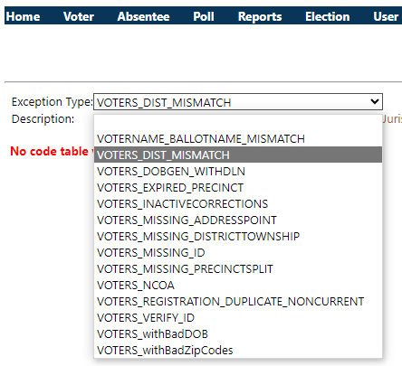
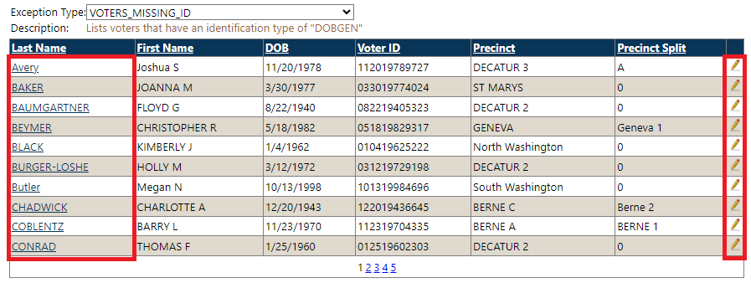
Voter Cleanup – Exceptions & Reports
*ACTION NEEDED* Make sure all your voter information is correct before the next election!
Using Voter Exceptions:
From the SVRS homepage, navigate to Voter > Voter Exceptions and select an Exception Type from the dropdown menu, as shown on the right.
Click the hyperlink on the Last Name to view the voter’s profile.
Click the pencil to perform a Correction to the registration.
Using Reports from the Reports Library:
From the SVRS homepage, navigate to Reports > Reports Library and review the reports in the Voter section.
Address Point Assignment Exception
DOB Cleanup
Precinct Assignment Exceptions
Voters Missing DLN & SSN
Voters Missing Signatures
These screenshots are showing
the Voter Exceptions process

Slide 9
You Can Do It!
Cleaning up voter data takes time and patience…and leg work!
Tips for Success:
Check the most recent registration form on file for the voter to look for information that is missing in SVRS and perform a Correction if it can be added based on the information provided on the VRG form.
If a voter is missing a signature in SVRS, you may need to scan in the registration document you have on file for them, or you may just need to activate a signature that has already been saved to SVRS.
Review your precinct maps to determine where voters with misassigned address points belong. Manual address point corrections can be made in SVRS, or you can move the address points by using the GeoConvergence software and then uploading a file into SVRS.
The Election Division can provide you with a current precinct map.

Slide 10
Resources for Counties
Web Training using Microsoft Teams
GIS Geocode sessions – July 9, July 11, September 5 (Tentative)
Step by Step and SOP documents on the County Portal
3. HelpDesk Contact:
1-888-467-8771
INSVRSHelpDesk@gocivix.com

Slide 11
Questions

