Slide 1
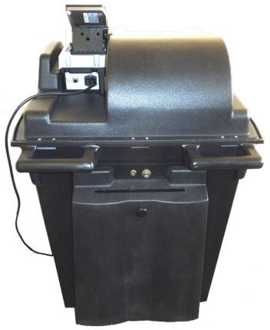
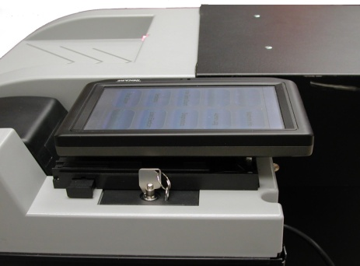
Instructions for Opening Training- OVO
STEP # 1
STEP # 2
Locate the touch screen interface on the right hand side of the Precinct Scanner.
Gently lift the screen from the top/back edge and move the stand back until it stops.
Set the touch screen back.
Plug the power cord into the power socket on the back of the scanner
Insert ballot style header card and zero tape will print. If you need additional copies press the “Print Copy” button.
Press done when completed and now you’re ready for voting.
STEP # 3
STEP # 4
STEP #5
Power on the scanner by flipping the power switch (on the back of the unit) so the “I” is toggled downward
Wait for the scanner to power on. This process may take about 2 mins.
A machine info report will print out.
Power Switch

