Slide 1

What Pharmacists and Technicians need to know to fight the opioid battle
Tracy Brooks, PharmD, BCPS, BCNSP
Assistant Professor of Pharmacy Practice
Member of PRMC’s Palliative Care Team
Member of Indiana RX Task Force

Slide 2
Objectives:
Pharmacists:
Review the terms “legitimate medical purpose” and “corresponding responsibility” as they apply to the use of opioid analgesics in the treatment of chronic pain.
Examine the Medical Licensing Board’s final version of the opioid prescribing rule for Chronic Pain Management, focusing on the steps that must be taken by a prescriber prior to writing a prescription for pain medications.
Describe a systematic approach that can be taken by pharmacists when screening controlled substance prescriptions for the treatment of chronic pain.
Formulate a counseling checklist for educating patients on long-acting opioids.

Slide 3
Objectives:
Pharmacy Technicians:
Explain to a patient the three options they have to dispose of a scheduled medication.
Describe a systematic approach that can be taken by pharmacy technicians when screening controlled substance prescriptions for the treatment of chronic pain.
Recognize which controlled substances are in what schedule (Schedule I – V), focusing on the recent changes.

Slide 4
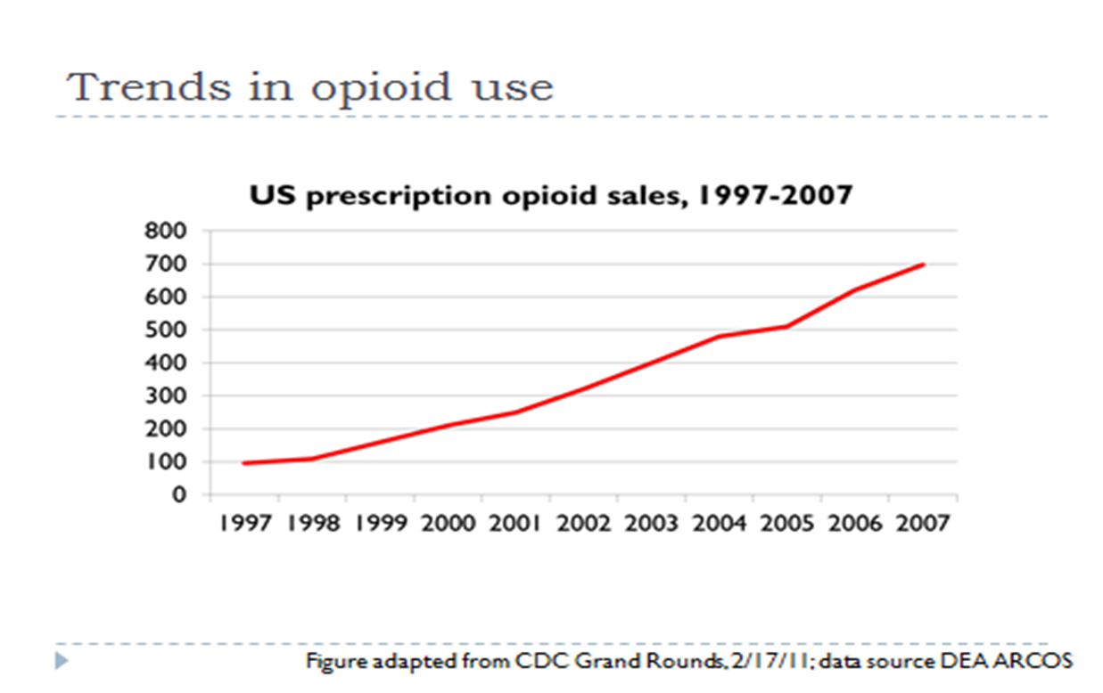
Notes:
In 1997, 97 mg Oral Morphine Equivalents were sold/distributed per person in the US
In 2007, the equivalent to 710 mg Oral Morphine Equivalents were sold/distributed per person in the US
This was equivalent to supply every adult American with 5 mg hydrococodone (vicodin) every 6 hours ATC for 45 days.

Slide 6
July 2014
Each day, 46 people die from an overdose of prescription painkillers* in the US.
Health care providers wrote 259 million prescriptions for painkillers in 2012, enough for every American adult to have a bottle of pills.
10 of highest prescribing states for painkillers are in the South.
Notes:
Pain killers - - opioid (vicodin, oxycontin, opana, methadone)

Slide 7
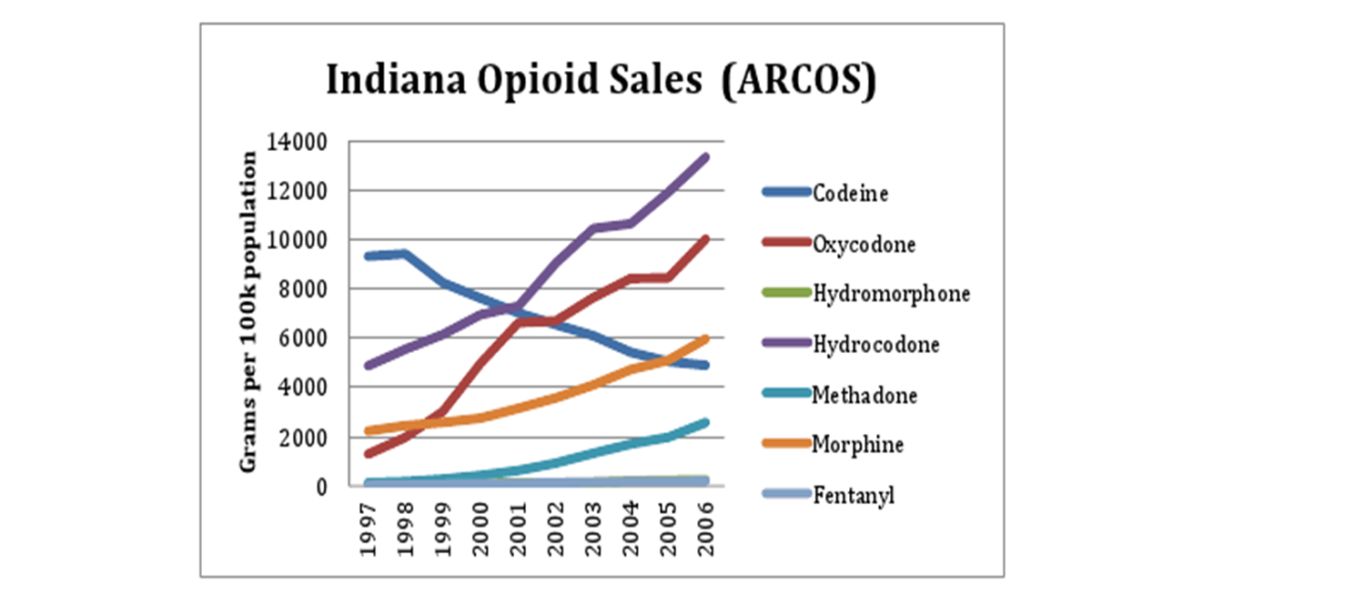
Notes:
The sales of most opioids have rapidly increased over the past decade with hydrocodone sales having more than doubled between 1997 and 2006 while oxycodone increased by nearly 10 fold. The DEA stopped making sales data available publically after 2006 claiming that it is data for internal and law enforcement use.
The only narcotic with decreasing sales was codeine – we now know it has poor analgesic properties, it’s a prodrug that requires enzyme metabolism that due to genetics, can substantially influence its effectiveness (and can be deadly in children).

Slide 8
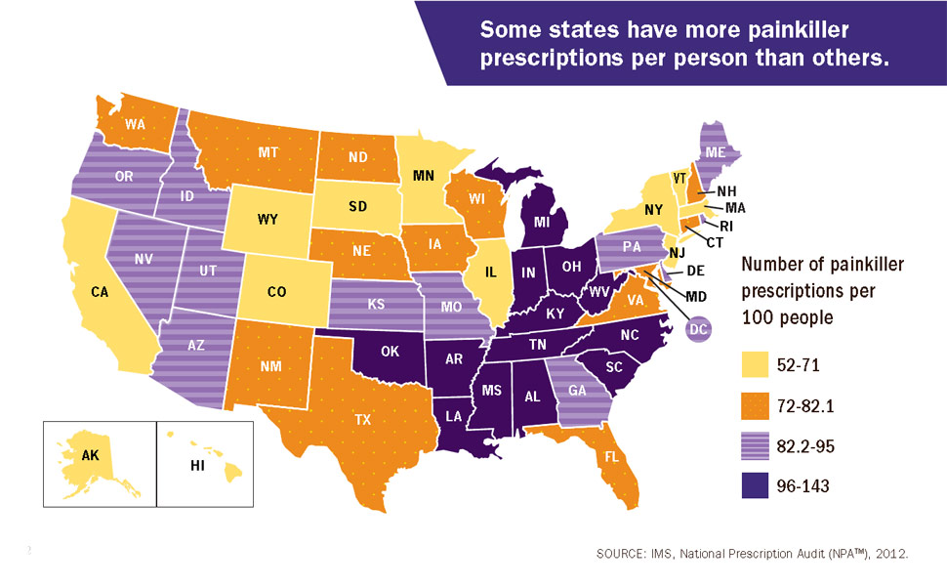

Slide 9
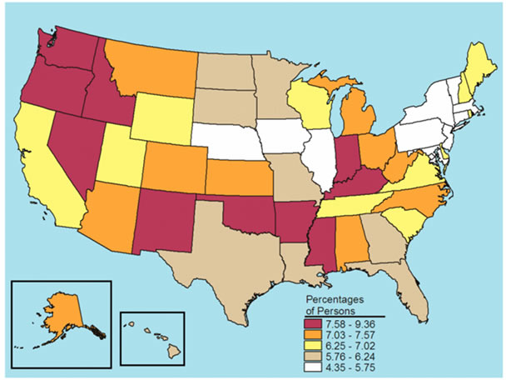
Non Medical Use of Pain Relievers, age 12-17
Notes:
Now, let’s focus on Indiana. Indiana is one of 10 states in the highest percentage of adolescents aged 12-17 that have admitted to the non-medical use of pain relievers in their lifetimes.

Slide 10
Indiana Data
Notes:
Focusing on a more narrow age group - - and a more concerning “consistent” pattern of use - - - almost 4% of 8th graders admit to monthly misuse of prescription pain killers.

Slide 11
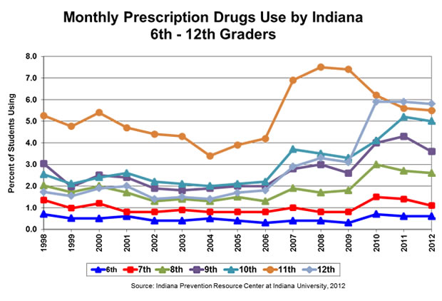
Notes:
Data gathered by a survey completed anonymously by the students. Again - - this is Indiana data through 2012. ALARMING. Especially when you look at the 9th, 10th, and 11th grade increases.
Clearly illustrates that Indiana has a prescription drug misuse problem.

Slide 12
Notes:
So, in summary:
IN has a lot of drug in the state (sales rate high)
IN has a high accidental overdose rate (exceeds the national average) involving opioids
Based on 2009 death data - - when analyzed for codes X40-44 - - we rank 16th in the US in deaths due to drugs - - our death rate surpasses the National Average.

Slide 13
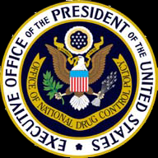
2011 Prescription Drug Abuse Prevention Plan
Public Health approaches to reducing drug use in American
Notes:
Includes action in four major areas to reduced prescription drug abuse

Slide 14
Plan to address the opioid epidemic:
Education
Amend Federal law to require practitioners who request DEA registration to be trained
Drug manufacturers to develop Opioid REMS (Risk Evaluation and Mitigation Strategy)
Work with medical and healthcare boards to require education in health professional schools
Work with ER physicians to develop evidence-based clinical guidelines for best practices
Media campaign targeted to parents on risks of prescription medications
Notes:
New legislation in New York would require healthcare professionals who prescribe pain medication to complete three hours of Continuing Medical Education (CME) on addiction and pain management every two years. 6-2015
The American Academy of Family Physicians is against mandatory
American College of Emergency Physicians Opioid Guideline Writing Panel published their recommendations in Ann Emerg Med October 2012 (2012;60:499-525) and the American Academy of Emergency Medicine published theirs in 2-10-13.
Education is both raising awareness through the education of youth, patients, and healthcare providers - - that misuse and abuse of prescription drugs can be as dangerous or more dangerous than the use of illegal drugs, leading to addiction and even death.
They are not safer just because they are FDA approved.
Educate patients how to store their opioid medications, etc.
Also health care professionals get little training in the importance of appropriate prescribing and dispensing of opioids to prevent adverse effects, diversion, and addiction. Nor do we get training on recognizing substance abuse.
A Survey in 2000 to medical residency programs found only 56% required substance use disorder training and the number of curricular hours was 3-12. Upon resurvey, improvements are being made, but not uniformly applied in all residency programs or medical schools.

Slide 15
Tracking and Monitoring
Prescription Drug Monitoring Programs (PDMP) are a data base where controlled substances prescribed by authorized prescribers and dispensed by pharmacies are uploaded: Patient name, controlled substance (number of tablets), fill date, pharmacy it was filled at, prescriber

Slide 16
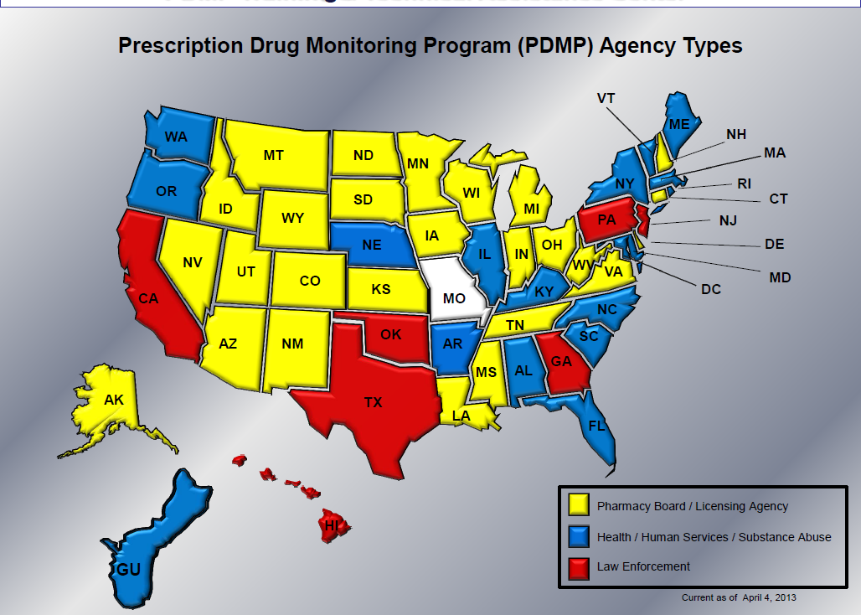
Notes:
Who has a PDMP?
Currently, 49 states, the District of Columbia, and one US territory (Guam( have legislation authorizing the creation and operation of a PDMP.
As of April 2015 - - the House of Representatives approves a prescription drug monitoring database - - so now all eyes are focused on the senate.
What is the holdup - - worries about privacy

Slide 17
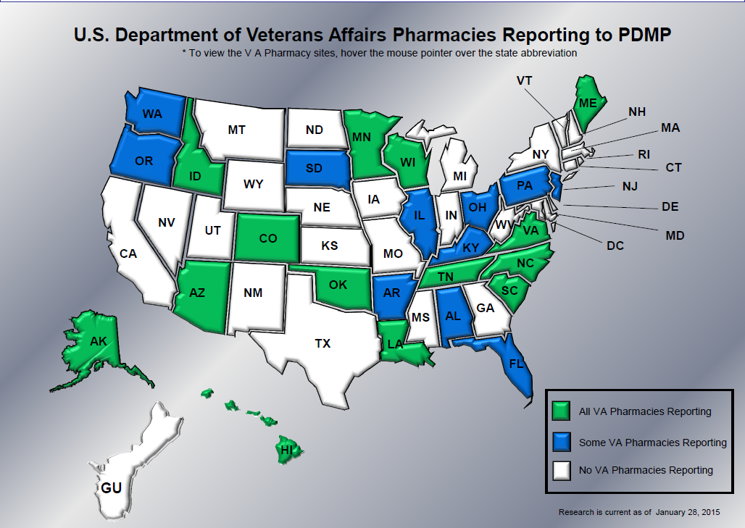
Notes:
Obama report - - further goal was to work with Congress to pass legislation to authorize the Secretary of Veterans Affairs (VA) and the Secretary of Defense (SOD) to share patient information on CS prescriptions with PDMPs. Has not happened yet.

Slide 18
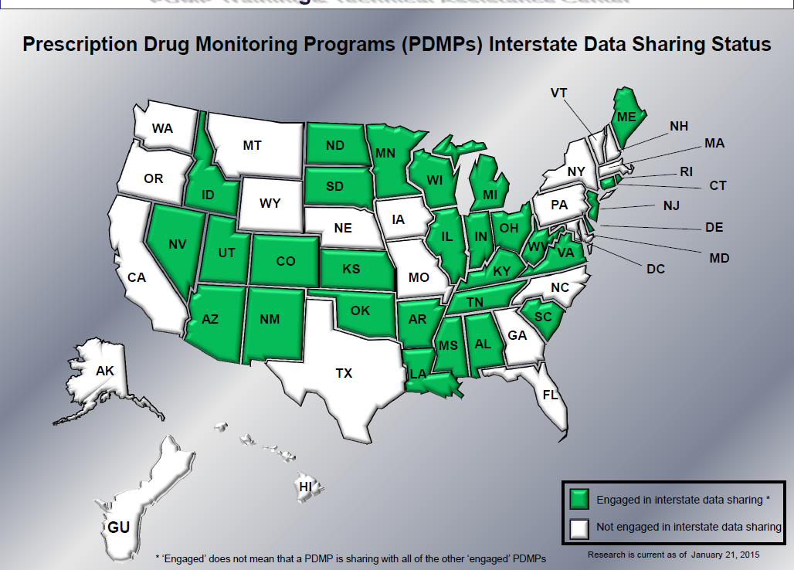

Slide 19
  Proper Medication Disposal
Development of a proper disposal of unused, unneeded, or expired medications which would provide individuals with a secure and convenient way to dispose of medications
Notes:
A large source of the drug epidemic is a direct result of what is in Americans’ medicine cabinets.

Slide 20
Secure and Responsible Drug Disposal Act of 2010
DEA published disposal of Controlled Substances Final Rule - - went into effect 10-9-14
Expands who can register with the DEA and become an “ultimate user” - - now retail pharmacies can apply and have an authorized collection receptacle, mail-back packages, and take-back events.
This is a voluntary program

Slide 21
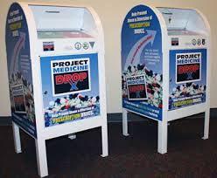
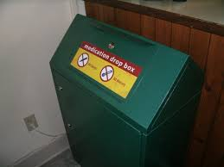
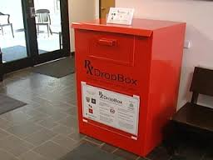
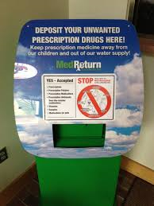
Collection Receptacles
Securely fastened to a permanent structure
Securely locked, substantially constructed container with permanent outer container and removable inner liner
Outer container with small opening where contents can be added, but not removed
Inside registered location
Inner liner – waterproof, removable and sealable without touching contents, not transparent, with unique ID
Notes:
DEA recognizes that collection and disposal of controlled substances is voluntary and costly. DEA notes that costs to collectors may be offset by potential benefits of providing these services, including “increased consumer presence” at the registered locations.

Slide 22

How many retail pharmacies in Fort Wayne have jumped on this opportunity??
Notes:
I called Nash Drug Store - - that has 3 stores in Hillsdale, Michigan area - - they have had a program called the little yellow jug - - to dispose of non-Controlled substances. They have registered to become an Ultimate User with the DEA, but their non-profit disposal service is still waiting (since October) to hear if the DEA will approve of their receptacle before they go live.

Slide 23
How are you supposed to dispose of opioid medications?
Permanent “Unwanted Medication” Drop-off sites ***only take pills
Huntertown Town Hall
Rousseau Centre Building
Indiana State Police Post
New Haven Police Department
Notes:
Can you take back prescription medications to the pharmacy? No.
The only medications that pharmacies can take back are OTC medications in unopened, sealed packaging.
If a loved one has hospice nursing and passes away - - can the hospice RN take the medications out of the home with her? No

Slide 24

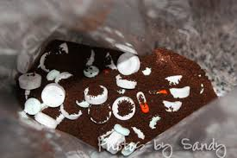
FDA:
Most medications – mix medicines with unpalatable substance (kitty litter, used coffee grounds), place mixture in a sealed container, and dispose in your outside trash.

Slide 25
Disposal of medications
Controlled substances – The FDA has stated that since these medications are especially harmful, they should not be thrown in the trash.
Dispose of these medications by flushing them down the sink or toilet.
EVEN fentanyl patches!
Notes:
When drugs are prescribed prophylactically or in response to an acute or chronic illness, only a portion of the active ingredient of the drug is metabolized (Ternes 1998). The nonmetabolized parent compound, as well as the metabolites, enter the natural aquatic environment through waste discharges into receiving streams, which may reach downstream recreational lakes or even the intakes of drinking water treatment plants. The ubiquitous worldwide use of pharmaceuticals has led to the presence of low but measurable part-per-trillion levels of these biochemically active compounds in surface and groundwater. In the United States, the most comprehensive monitoring of these chemicals in water was performed between 1999 and 2000 by the U.S. Geological Survey in many of the nation’s streams (Kolpin et al. 2002). This study and others identified many products, including analgesics, antiinflammatories, antibiotics, antiepileptics, beta-blockers, blood lipid regulators, antidepressants, contrast media, oral contraceptives, and cytostatic and bronchodilator drugs in sewage, surface water, groundwater, and drinking water. Therefore, at the low part-per-trillion levels found in aquatic environments, which are far below human therapeutic doses, and even compared with the much higher levels of routinely measured water quality chemicals, there is concern that some of these compounds could have an ecological and human health effect.
Despite the various complex variables that combine to cause pollution of the aquatic environment by pharmaceuticals, actions can be taken to reduce their presence in the environment, such as responsible disposal of leftover drugs from the consumer sector. Some activities have already been sponsored by the U.S. federal government regarding drug disposal (Daughton 2003). As an example, the White House Office of National Drug Control Policy, in collaboration with the U.S. EPA and FDA, implemented the nation’s first public guidance on consumer drug disposal (Office of National Drug Control Policy 2009), but guideline standardization is still needed.

Slide 26
AAPCC 2007 summaries of some of these cases to illustrate how some medicines can result in fatality if they are accidentally taken by children.
A 4-year old female was found not breathing by her grandparents in their home. Resuscitation was attempted, but was ineffective and the child died. During the autopsy, a transdermal fentanyl patch, a strong opioid pain medicine, was found in the child’s gastrointestinal tract. Apparently, the child found a discarded patch in the trash and ingested it, resulting in a massive overdose of fentanyl.¹
Notes:
According to Kellie Taylor, PharmD., MPH, in FDA’s Division of Medication Error Prevention and Analysis, FDA is aware of 32 cases of accidental exposure to fentanyl since 1997, most of them involving children younger than 2 years old. There have been 12 deaths and an additional 12 cases requiring hospitalization.
American Association of Poison Control Centers’ 2007 Annual report

Slide 27
Flushing medications down the toilet – pose a risk to human health?
FDA is aware of recent reports that have noted trace amounts of medicines in the water system. Disposal of these select few medicines by flushing contributes only a small fraction of the total amount of medicine found in the water. The majority of medicines found in the water system are a result of the body’s natural routes of drug elimination (in urine or feces).
Scientists to date have found no evidence of harmful effects to human health from medicines in the environment. Based on the available data, FDA believes that the known risk of harm to humans from accidental exposure to these medicines far outweighs any potential risk to humans or the environment from flushing them.

Slide 28
Most people in today’s society would not consider obtaining a prescription medication from a family member or friend is illegal.
Notes:
67% get them from friends/family (either free or they buy them)
5% Take from friend or relative without asking
72% people got the prescription opioids for non-medically approved use from family and friends.
4% from drug dealer
17% from physicians
...No controlled substance in schedule II, which is a prescription drug as determined under the Federal Food, Drug, and Cosmetic Act (21 U.S.C. 301 et seq.), may be dispensed without the written prescription of a practitioner.

Slide 29
  Law Enforcement
Assist states to address doctor shopping and pill mills.
Law enforcement training initiative that targets states with highest need
Identify and seek to remove administrative and regulatory barriers to “pill mill” and prescriber investigations
Expand the use of PMDPs to identify criminal prescribers and clinics by the volume of selected drugs prescribed and doctor shoppers

Slide 30
State Laws and Regulations regarding opioid prescribing as of 2013
Notes:
As of 2013, Indiana remains as one of only two states without any regulations/laws/or medical board rules on how physicians prescribe opioids according to the Wisconsin Pain Policies Group (see states in “white”)

Slide 31
Indiana State Medical Licensing Board
In September 2012, the Indiana Attorney General’s Prescription Drug Abuse Task Force was established and tasked with reducing the number of deaths associated with opioid medications
An “Emergency Rule” was adopted 10-24-13 that regulates physicians engaged in the practice of prescribing pain medications for chronic pain (enforced 12-15-13).
On 9-25-14, the MLB adopted the final version of the opioid prescribing rule for chronic pain management (effective 11-1-14).

Slide 32
Evidence of Effectiveness of Opioids in Chronic
Non-Cancer Pain (CNCP)
The Manchester University College of Pharmacy Drug Information Center
conducted a Medline Search using the terms “analgesic, opioid”, and “pain,
chronic” with or without the term “NOT cancer” with results limited to studies
conducted in humans and published in English. Observational and interventional
studies inherently related to use of opioids for CNCP were included.
Results:
Four controlled clinical trials
Six non-controlled clinical trials
Six observational studies

Slide 33
Summary of evidence:
Data regarding the efficacy of opioids in CNCP is lacking
Overall, duration of exposure was low (average 329 days), the most popular opioids (combinations with acetaminophen) were not assessed, discontinuations were high, and high proportions of patients experienced adverse effects.
Serious adverse events and those relating to overdose were rare
Primary efficacy endpoint was commonly a visual pain analog scale, rather than looking at functional improvement (ie Brief Pain Inventory – Short Form)

Slide 34
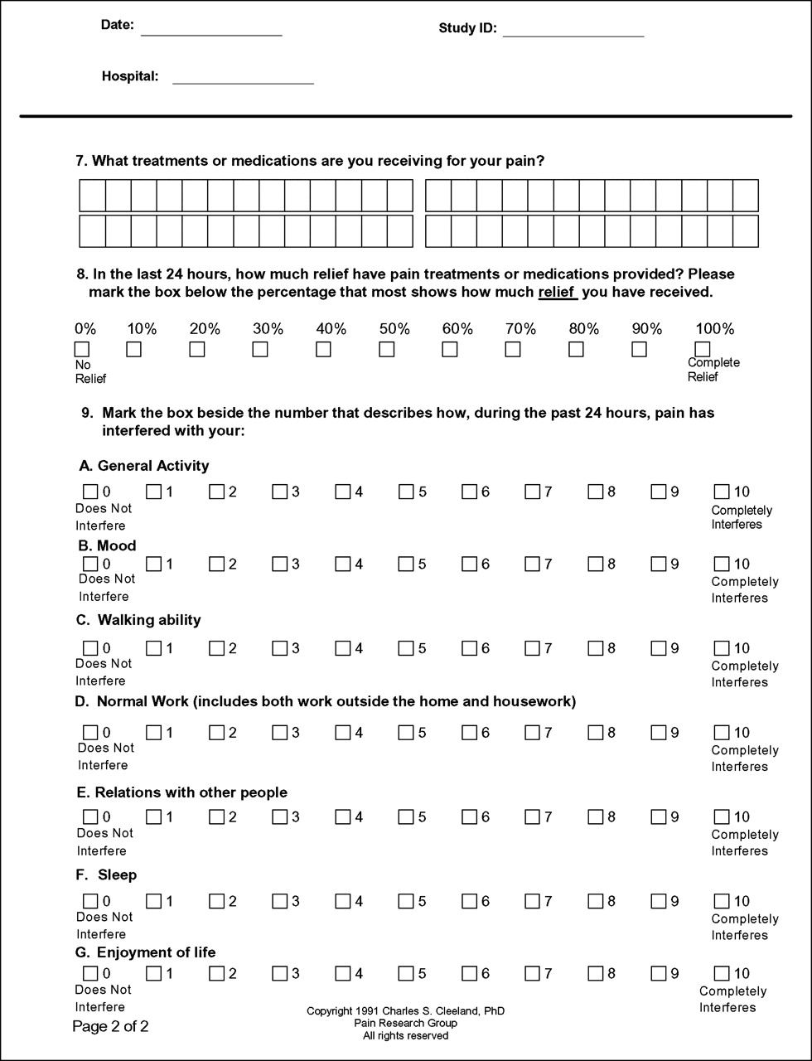

Slide 35
The Prescribing Rule
Applies only to prescribing of opioid-containing controlled substances for chronic pain (> 3 consecutive months) > 60 pills or 15 mg OME/day
A. Patient assessment – H&P, exam, get previous records, use pain assessment tool, assess mental health status, risk for substance abuse, establish working diagnosis and goals
B. Where medically appropriate, utilize non-opioids
Notes:
Excludes: Patients with a terminal medical condition, someone in a IN Licensed health facility, enrolled in IN hospice or palliative care program
If you prescribe Hydrocodone ER (Zohydro ER) - - Day #1 – also necessitates a written warning that it is not abuse deterrent
Basically > 60 pills/month or > 15mg OME / day

Slide 36
The Prescribing rule, continued
C. Patient informed consent
Risks and benefits
Explain treatment plan
Counseling of women of child-bearing age about risk to fetus
Safe storage
Disclosure of EtOH intake
D. Patient visits
No prescribing without periodic visits (quarterly)
During visits – evaluation of progress

Slide 37
The Prescribing rule, continued
Inspect reports
Outset and at least annually
Daily high dose threshold
Face to Face review of treatment plan when OME > 60 mg/day; consider referral to pain specialist
Treatment agreements – medication use agreement
Drug Monitoring testing***
Notes:
Treatment Agreements - - must include at minimum: Goals, consent to drug testing if determined necessary, prescribing policies (no sharing, take as prescribed), patient inform physician of any controlled substances, etoh, illicit substances taken by patient, permission to random pill counts, and listing reasons why opioid therapy may be changed by MD.
DMT - - was going to be required starting 1-1-2015 - - - now only when MD determines medically necessary

Slide 38
Pharmacist’s responsibility
“A prescription for a controlled substance to be effective must be issued for a legitimate medical purpose by an individual acting in the usual course of his professional practice. The responsibility for the proper prescribing and dispensing of controlled substances is upon the prescribing practitioner, but a corresponding responsibility rests with the pharmacist who fills the prescription.”
Notes:
Legitimate medical purpose - - doesn’t mean you need to know the exact diagnosis - - can find out talking with the patient….does not say you must document that you verified this with the prescriber. Simply that filling it ASSUMING its legitimate, without undertaking any inquiry whatsoever, would be difficult to defend if concerns regarding this prescription arise.
Usual course of his professional practice - - NOT THE SAME as scope of practice, which relates to qualifications and licensure limitiation of the practitioner. The COURSE of practice has to do with the ACTIVITIES undertaken by the practitioner when the prescription was issued. Did the practitioner take a history, conduct a physical exam, develop a plan of care, document treatment goals, and schedule a follow-up visit? If a pharmacist fills a prescription KNOWING this has not been done, then the DEA regulation has been violated. Just the language KNOWINGLY suggests that a pharmacist need not be perfect

Slide 39
Pharmacist-Pharmacy Technician Collaboration to Reduce Diversion and Abuse of Opioid Analgesics
Establish a set of standardized rules to assess patients for misuse, abuse, and diversion
Eliminate biases or stigmas such as physical appearance, behaviors, “all people who regularly have opioid Rx’s are selling them,” certain geographical locations, perceived social status, etc.
Notes:
Assumptions about the appropriateness of opioid prescriptions should not be made based on quantity of drug prescribed or frequency of filling alone!
Patients in pain certainly may not look or act their best
All patients who fill prescriptions for opioids should equally receive counseling about proper use of their medications and have their questions answered

Slide 40
VIGIL process
Receiving the Prescription (primarily Pharmacy Technician)
Evaluating the Prescription (primarily Pharmacist)
Medication deliver to the patient (Pharmacist or Pharmacy Technician)
By applying the VIGIL process for every individual to whom these identified conditions apply, you do not stigmatize any one individual patronizing the pharmacy
Notes:
Your pharmacy should determine what conditions warrant the use of the VIGIL process, then apply it to every individual to whom these specific criteria apply. Many pharmacies may decide that the VIGIL process is not necessary for a patient that presents a single prescription for a small amount of an opioid that is to be used in an acute situation. Some pharmacies may begin to apply VIGIL when a patient presents a second Rx for a 30-day supply of an opioid;

Slide 41
Receiving the Prescription
Focus on the prescription
Full name and address of patient (check ID)
Drug name, strength, dosage form, quantity, directions for use
Name and address and DEA# prescriber
Evaluate the validity of the prescription
Notes:
Forged prescription - - take to a private area and verify with the prescriber.
Follow company policy when deciding whether to call police.
Document your efforts in your records

Slide 42
DEA Number
9 characters: First two are letters, last seven are numbers
The first letter is always A, B, F, G, M, or X
Prescribers with a Drug Addiction Treatment Act (DATA) waiver will have DEA numbers that start with X
Mid-level practitioners start with M
The second letter of the DEA number is the first letter of the prescriber’s last name (unless a prescriber has married and changed last names)
Final verification
  add the first, third, and fifth digits together
  Add the second, fourth, and sixth digits together. Multiply this number by 2
  Add these two results together. The last digit on the right must match the last digit of the DEA number.
Notes:
There are no numbers left that start with A or B - - - as all possible numbers have been assigned, so F has been added as a possible first letter and G is now being used for prescribers who are contractors with the Department of Defense.

Slide 43
2. Focus on the patient
Simply ask the patient about their pain (document)
Check INSPECT
RED FLAGS | Pts | GREEN FLAGS | Pts
Male 18-45 yo | +2 | Nonproblematic INSPECT | -2
Immediate family uses opioids | +2 | Written “pain contract” shared with Pharmacy | -2
Patient not legal resident of county | +2 | Family member willing to accept responsibility for patient | -2
Opioid Rx from ER in last 6 mo | +2 | Prescriber is Board Certified Pain management, known to RPh | -2
Opioid, BZD, Soma at same time | +4 | Uses insurance, never cash | -2
>2 prescribers in last 6 mo | +2 | Willing to accept generics | -2
Refill requested > 20% too early, more than once in past 6 mo | +2 | Drug prescribed is abuse-deterrent formulation | -2
Lost or stolen medication > once in last year | +2 | Receives regular Rx from mental health professional | -2
Resides in group home w > 3 other residents | +2 | At least 1 uncontrolled Rx in past 6 mo | -2
Notes:
There is no responsibility to discover factors that are not readily apparent at the pharmacy!!!

Slide 44
Evaluating the Prescription:
Level of Care reflects risk
Score | Risk | Care Level | Approach
0-4 | Low | Standard | Check ID
5-9 | Medium | Special | Check ID, Medication use Agreement w Pharmacy
10+ | High | Extra | Above plus Attestation from prescriber
 | Unacceptable | NONE | Medication Denied: Noncompliant with an element of the VIGIL process Acquire a police report that patient has previously sold a medication dispensed by the pharmacy The pharmacy discovers that the patient is an active addict who is not being treated The prescriber cancels the prescription
Notes:
Attestation from prescriber - - prescriber must sign and send to the pharmacy an attestation that appropriate procedures were followed in the issuance of the prescription.

Slide 45
Factors (measured over a 12-month period) that were associated with a risk for prescription opioid abuse or misuse
Age 18-24
Male
> 12 opioid prescriptions
Opioid prescriptions filled at > 3 difference pharmacies
Early prescription opioid refills
Escalating morphine dosages
Psychiatric outpatient visits
Hospital visits
Diagnoses of nonopioid substance abuse (including alcohol, cigarettes)
Depression
Posttraumatic stress disorder
Hepatitis

Slide 46
Multiple physicians
>3-4
Multiple Pharmacies
> 3-4
Multiple opioids
12 scripts/year;
Early refills/overlapping
High dose/High pill count
Rapidly escalating doses

Slide 47

Red Flags
A Red Flag is not a stop sign
One or two isolated Red Flag incidents is not a trend
Realize that there are behaviors that make you think twice, but are not as likely a sign of a serious abuse/misuse problem
Most of the time prescriptions for controlled substances should be dispensed, unless there is a good reason to refuse to do so.
Notes:
Aggressive complaining of pain and the need for medication, requests for a specific drug, limited duration unsanctioned dose escalations, hoarding pills, misusing a drug to treat a different symptom, drinking more alcohol when in pain.
Also realize that the quantity of drug prescribed and the frequency of new prescriptions is not always a good indicator of fraud or inappropriate prescribing. Patients being treated with opioids for legitimate chronic pain can develop tolerance and physical dependence.

Slide 48
Efforts to reduce illegal, nonmedical use of prescribed controlled drugs must be balanced so as not to interfere with appropriate medical use of these medications.
Notes:
Goal - - deny medications to people who would abuse the medications and those who would divert them to nonmedical uses.
Just about every pharmacy has a story to tell about being duped into dispensing an opioid to an abuser. It’s human nature to resent being conned, and most pharmacists try hard to avoid dispensing opioids to con artists and abusers. In fact, the problem of diversion and abuse is so prevalent that pharmacists often look askance at any patient with an opioid prescription. The desire to avoid being conned sometimes becomes a larger focus than the call to provide relief from pain and suffering.
We need to be diligent, but in a manner that doesn’t unnecessarily restrict access for patients who need pain relief.

Slide 49
Where did all of this start?
Florida 2010 - people poured in from across the country. Florida had 93 of the top 100 oxycodone dispensing physicians in the country.
Manufactures shipped > 650 million oxycodone pills to Florida (> 24 pills for every resident in the state) and people were dying.
2010 - - 1516 deaths due to oxycodone (4/day)
Notes:
August 2010 = pharma reformulated oxycontin
2/2011 law enforcement prosecuted physicians and pain clinics

Slide 50
Walgreen’s
$80 million paid in civil penalties to settle allegations of violating the Controlled Substances Act by negligently allowing opioids to make their way to the black market.
Failure to report larger than usual orders of opioids
Filling fraudulent Rxs (expired DEAs, lacking DEA or address)
Dispensing without a Rx
Inaccurate/incomplete recording keeping

Slide 51
Drug Distributors
The DEA has tightened control over drug distributors
3 main distributors: Cardinal Health, AmerisourceBergen, and McKesson Corp make up 90% of the drug distribution market in the U.S.
DEA requires Cardinal to review orders for the controlled drugs, visit pharmacies to look for signs of diversion and hire extra field inspectors for Florida pharmacies.

Slide 52
What should the pharmacist do?
Goals:
Decrease the amount of controlled substances in our communities
Ensure legitimate pain patients are safe on their medications
Notes:
Document that script is legitimate or document that it is not.
Request picture ID - - copy Rx, report to INSPECT and or Law Enforcement and/or Physician

Slide 53
Medication Delivery to the Patient
□ How to take opioids properly / adverse effects
□ Dangers of concomitant use of other CNS depressants, alcohol, illegal drugs
□ Discontinuation of opioids
□ Risks associated with sharing opioids with others
□ Proper storage in the household
□ Avoiding unsafe exposure by preventing theft and proper disposal
□ Purpose and content of Patient Treatment Agreement
□ Effects on fetus with women of childbearing age

Slide 54
Scheduled Drugs
Schedule I – Heroin
Schedule II – Fentanyl, methadone, opium tincture, oxycodone products, methylphenidate, hydrocodone combination products 10-6-14
Schedule III – acetaminophen/codeine, anabolic steroids, buprenorphine
Schedule IV – benzodiazepines, butorphanol, “non-benzodiazepines”, soma, tramadol 8-8-14
Schedule V – Robitussin AC, Lomotil, Pregabalin
Notes:
Non-benzodiazepines - - lunesta, sonata, ambien, etc.
Why is lyrica a Schedule V? In addition, Lyrica is a Schedule V controlled substance. Studies of the drug in recreational users of sedative/hypnotic drugs indicated subjective psychoactive effects of a magnitude similar to the benzodiazepine diazepam. Roughly 4% of subjects reported eurphoria as an adverse event in trials, compared to 1% for placebo; some sub-populations reported euphoria rates as high as 12%. In addition, abrupt termination of treatment was associated with insomnia, nausea, headache and/or diarrhea. Patients receiving Lyrica should be monitored closely for evidence of dependence, misuse or abuse.

Slide 55
What will the effect of Hydrocodone being a Schedule II have?
New York State - made changes effective 2-23-2013:
All products containing hydrocodone were placed on Schedule II
Tramadol was placed on Schedule IV
Required physicians to consult New York’s Prescription Monitoring Program (PMP) before prescribing.
Electronic prescribing of controlled and noncontrolled substances becomes mandatory for all practitioners
3-27-2015.

Slide 56
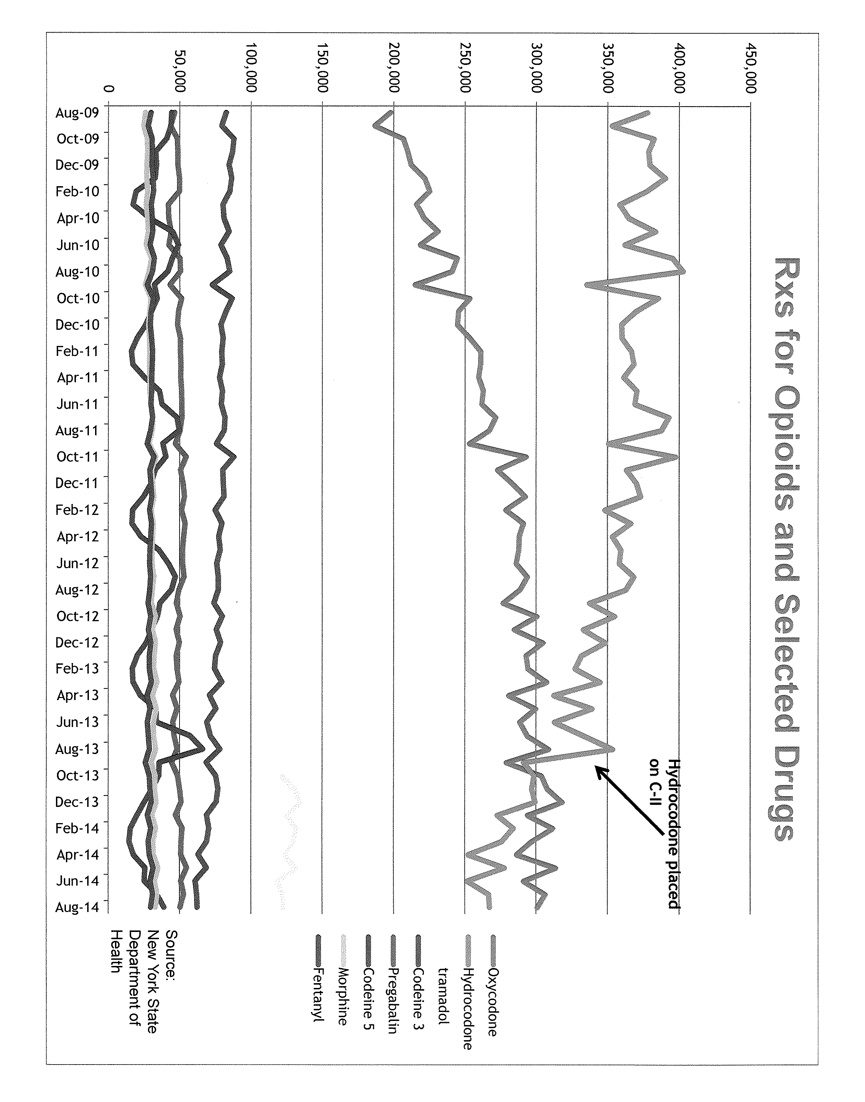
New York State
Notes:
Compared to the year previous:
9% decrease in total prescriptions
18% decrease in hydrocodone prescriptions
Slight increase in oxycodone prescriptions
11% increase in buprenorphine prescriptions (still CIII)

Slide 57
Conclusion
Objectives:
“Legitimate medical purpose” and “Corresponding responsibility”
MLB Opioid Prescribing Rules in Indiana
Disposing opioids
Recent Scheduling changes
How pharmacists-pharmacy technicians can systematically approach screening patients with controlled substances

Slide 58
References
Responding to the Prescription Drug Abuse Epidemic: Hearing Before the United States Senate Hearing on International Narcotic Control, 112th Congress 2(2012) (Statement of Joseph T Rannazzisi, Deputy Assistant Administrator, DEA.
Gasbarro R. Protecting your practice and patients from prescription drug abuse. PharmCon, Inc.
U. S. Department of Justice (USDOJ). Drug Enforcement Agenecy. Office of Diversion Control. Appendix D. Pharmacist’s Guide to Prescription Fraud; 2014. Available at: www.deadiversion.usdoj.gov/pubs/manuals/pharm2/appendix/appdx_d.htm Accessed January 8, 2015.
Institute of Medicine of the National Academies: Relieving Pain in America: A Blueprint for Transforming Prevention, Care, Education and Research. Washington DC: The National Academies Press; 2011.
Brushwood D. A Pharmacist-Pharmacy Technician Collaboration to Reduce Diversion and Abuse of Opioid Analgesics. Power-Pak CE.
McPherson L. Prescriptions for Opioids Analgesics, Verifying the Prescriber Got it Right – The Pharmacist’s Corresponding Responsibility. PharmCon, Inc.
Indiana Medical Licensing Board – Website http://www.in.gov/pla/2832.htm
PL Technician Training Tutorial, Safety Considerations with Opioids. Pharmacist’s Letter/Pharmacy Technician’s Letter. January 2014.
Stemming the Tide: Stopping Prescription Opioid Diversion. Pharmacist’s Letter. June 2014.
Managing Opioids in the Community Pharmacy Setting: Balancing Risks and Benefits. Pharmacist’s Letter. March 2014.

