Slide 1



JUVENILE JUSTICE PLANNING GRANTS

Slide 2

OVERVIEW
House Enrolled Act 1359 established the Juvenile Community Alternatives and Diversion Planning Grants program.
Community Alternatives grant requirements can be found at Indiana Code § 31-40-5.
Diversion grant requirements can be found at Indiana Code § 31-40-5.

Slide 3
ELIGIBILITY
Public entities
State and local governments
Nonprofit organizations
Nongovernmental organizations
Other eligibility requirements include good standing with the Indiana Department of Revenue (DOR), Indiana Department of Workforce Development (DWD), and the Indiana Secretary of State (SOS).

Slide 4


FUNDING AVAILABILITY
Awards are for a twelve-(12) month period of funding.
In interest of supporting rural counties with limited-service capacity, each county is eligible for $20,000 for a one-year planning grant for each of the grant programs.

Slide 5
PLANNING ACTIVITIES
Planning activities include the following:
Services or programs that develop community alternatives to detention, or that divert youth from involvement with the juvenile justice system.
Collaborative activities to plan the programs and their implementation.
Travel to observe promising practices or programs in another area of the state.

Slide 6

HOW CAN PLANNING GRANT FUNDS BE USED?
TITLE
Personnel, employee benefits, cost of supplies, and travel to perform the activities listed below are allowable costs.
Planning Activities: activities that assist with the development of a collaborative program.
Technical Assistance: training or assistance that with adherence, implementation, or applications of model programs.
Preparation and Implementation: activities that prepare for the implementation of a chosen evidence-based project.

Slide 7
COLLABORATION REQUIREMENTS
Counties must convene their local or regional Justice Reinvestment Advisory Council (JRAC) or another local collaborative body that includes juvenile justice stakeholders and a juvenile court judge to assess needs for community alternative programs. The assessment must include:
  Review of youth justice system data.
  Review of existing programs and services.
  Identification of community organizations and groups with which partnerships could be developed for program implementation.
  Review of best-practices.
  Consideration of any economies of scale in regionalization.

Slide 8
Applying for Funding
IMPORTANT DATES
INTELLIGRANTS
Applications and all required documentation must be submitted by 11:59 p.m. (ET) on Friday, November 15, 2024.
The award period is April 1, 2025-March 31, 2026.
All applications and required documentation must be submitted through IntelliGrants.
IntelliGrants is an end-to-end solution for the administration of grants. Everything from the grant application, reports, and fiscal drawdowns will occur online within IntelliGrants.

Slide 9
UNALLOWABLE COSTS
The following budget items listed below are unallowable and will not be supported by this program’s funding:
Direct financial assistance to a client such as cash.
Supplanting existing positions or offsetting existing expenses of the recipient.
Lobbying.
Fundraising (including financial campaigns, endowment drives, solicitation of gifts and bequests, and similar expenses incurred solely to raise capital or obtain contributions) and time spent procuring funding including completing federal and state funding applications.
Purchase of real estate.
Construction and physical modification to buildings, including minor renovations (such as painting or carpeting).
Purchase of vehicles.
Indirect cost rate and/or de minimis rate.

Slide 10

ADMINISTRATIVE COSTS
Administrative costs are an allowable expense. Administrative costs include time to complete program required time and attendance sheets and programmatic documentation, reports, and required statistics; administrative time to collect and maintain satisfaction surveys and needs assessments used to improve service delivery within the funded project. Administrative costs are limited to 10% of the total grant funded budget.

Slide 11
Administrative Cost examples
Personnel time for Program reporting, preparing fiscal report documentation as described in the CJI Documentation policy; collecting time sheets for any employees paid by grant funds.
Benefits for any employee who is in the personnel section due to administrative time. Can only be at the percentage the position is on the grant for or less.
Personnel time for conducting and documenting surveys or completing and documenting needs assessments.

Slide 12

TRAVEL COSTS
Expenses and reimbursements for in state and out of state travel must follow the most current Indiana Department of Administration State Travel Policy or the subrecipient’s travel policy, whichever is more restrictive. Learn More.

Slide 13

CONTRACTORS AND CONSULTANTS
When a subrecipient contracts for work or services, the following is required:
All contractual services must be obtained through a procurement method. Verification of this method must be supplied upon completion of the contract.
All consultant and contractual services shall be supported by written contracts signed by all parties stating the services to be performed, rate of compensation, and length of time over which the services will be provided.
A copy of all written contracts for contractual or consultant services shall be attached in IntelliGrants to the grant file upon their ratification.
Payments shall be supported by statements outlining the services rendered, date of service, and cost of service.
Any consultant costs exceeding the allowable rate (maximum of $81.25 per hour or $650 per day) will not be allowed.

Slide 14

PROGRAM COSTS
Program costs must meet the following criteria:
Costs must be necessary and reasonable for the stated purpose of the grant.
Costs must be in accordance with generally accepted accounting principles. Learn more.
Costs must be consistent with policies and procedures of the grant program and applied uniformly.
Costs must be adequately documented with supporting materials including receipts, invoices, timesheets, paystubs, etc. The ICJI supporting documentation policy can be found here.

Slide 15
REQUIRED ATTACHMENTS WITH APPLICATION
Timeline: Please attach a timeline for the completion of the project and/or expenditure of the grant funds.
Collaboration Plan: Any county participating in the program is required by IC § 31-40-5-5 to have its local or regional Justice Reinvestment Advisory Council, or another local collaborative body that includes stakeholders across the juvenile justice system, oversee each grant award to the county and engage in collaborative service planning for the county.
Audit Record: Include your most recent State Board of Accounts or independent audit.
Miscellaneous
  If applying for funds for personnel costs, attach the relevant job descriptions.
  If applicable, attach other requested information.

Slide 16

APPLICATION REVIEW
ICJI will review and score all grant applications as part of the competitive application process, and will assess the following criteria:
The completeness of the grant application;
Whether the grant application is within the purpose areas of the funding;
The applicant’s eligibility;
Whether the grant application, the applicant, and the project are in compliance with all applicable state laws, regulations, and rules;
Whether the proposed expenditures set forth in the project budget are allowable and allocable;
Any potential conflicts of interest;
Whether the applicant has any state debt delinquency;
The applicant’s ability to successfully pass clearance checks from the Department of Revenue (DOR), Department of Workforce Development (DWD), and Secretary of State (SOS);
Any and all risk associated with granting funds to the applicant;
Whether the applicant is debarred or suspended by any state department or agency; and
Responses to the questions on the application.

Slide 17
MONITORING
All grant awards will be monitored by an ICJI Grant Manager and/or ICJI Compliance Monitoring team member using a combination of desk reviews and site visits. Additionally, the Grant Manager will review all submitted reports for timeliness and accuracy. Delinquencies and report contents will be addressed as needed by ICJI staff. Late and repeated incorrect reports could disqualify recipients from future funding.

Slide 18
INITIATING AN APPLICATION IN INTELLIGRANTS

Slide 19
STEPS TO INITIATE APPLICATION IN INTELLIGRANTS
Log into your IntelliGrants account.
  If you do not have an account, then you can obtain one on the home screen of IntelliGrants.
On the “MY HOME” page access the “VIEW AVAILABLE PROPOSALS” section.
Click on VIEW OPPORTUNITIES.
  IntelliGrants will take you to the My Opportunities page.
Access the 2025 Juvenile Diversion and Community Alternatives Planning Grant Program Application.
Select “Apply Now”.

Slide 20
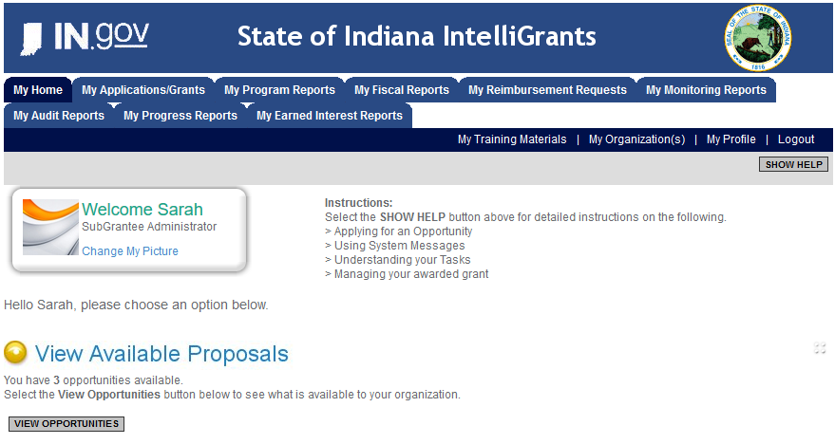

Slide 21
INTELLIGRANTS JUVENILE DIVERSION AND COMMUNITY ALTERNATIVES PLANNING GRANT APPLICATIONS

Slide 22
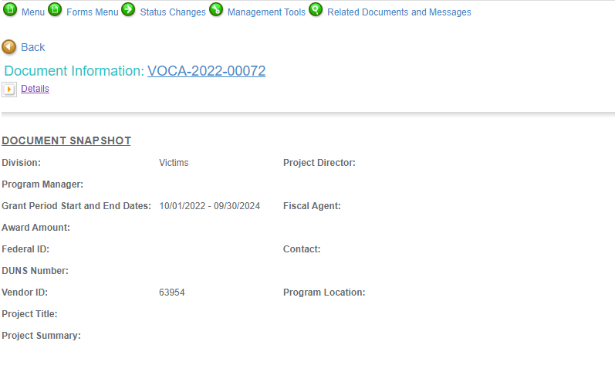

Slide 23
FORMS THAT NEED TO BE COMPLETED
Contact
Project Information
Programmatic Information
Problem Statement and Analysis
Method, Timeline, and Outcomes
Budget
Budget Narrative
Attachments

Slide 24
FORMS THAT NEED TO BE COMPLETED CONT.
Contact
  Points of Contact for the grant (ICJI will notify these individuals of your award notice).
Project Information
  Project title
  Summary
  Total amount requested
  SAM registration
  Duns number
  UEI number
Programmatic information
  Select the category you are applying for.

Slide 25
FORMS THAT NEED TO BE COMPLETED CONT.
Problem Statement and Analysis
  State the problem you are attempting to address and your proposed solution.
Method, Timeline, and Outcomes
  Provide a list of entities in your community that you will partner with to create a plan of action to eliminate or reduce the identified. (Must be at least the local JRAC or community stakeholders who work with the population).
  Share a timeline about your grant. Be specific, clear, and include key milestones.
  The outcome of a planning grant is to figure out what the problem is by bringing stakeholders together and creating a plan of action to address the identified problem. The plan should be based on solid evidence that the proposed program identified at the end of the planning period is likely to succeed or improve the problem.

Slide 26
FORMS THAT NEED TO BE COMPLETED CONT.
Budget
  Please provide a basic budget outlining the proposed use of funds.
Budget Narrative
  Please answer every question with thorough detail to explain what the expenses are and how they are calculated.
  Ensure that your requested expenses are allowable by reading the Request for Proposal and any supporting documents.

Slide 27
REPORTING

Slide 28
FISCAL & PROGRAM REPORTING
At the end of each month or quarter, planning grantees will be required to report on the activities that occurred over the last month/quarter. The following are questions that will be asked each reporting period:
How many meetings with stakeholders were held
Who attended the meetings and what entity/agency/system did the attendee represent?
What happened at the meetings? Are there minutes you can share related to the meetings? If so, please upload them with this report
What are the next steps for your group?
Were there firm commitments from stakeholders to continue to participate in the process?
Were any innovative solutions brought forth by stakeholders? If so, please share details about the ideas.
What challenges did you face during this reporting period?
If grant dollars were expended, how were they used to support the planning process?
Please refer to Appendix B in the RFP for required information for your application. The RFPs can be found here and here.

Slide 29
Fiscal Reporting requirements for all 3 funding sources
Fiscal reporting is required and will be due quarterly on all 3 funding sources
If awarded grant funds, be aware that even though these grants are funding up front, we will still require that the subgrantees provide documentation to verify the grant funds were spent on allowable expenses that are on the approved budget.
Notes:
Each grantee will be required to submit documentation to support the expenses that were claimed during each
reporting period. (E.g., if members of the planning group traveled to observe and learn about an evidence-based
program in another city the receipts from that travel will be required, or if a contractor was paid to complete a
study of youth involved in the justice system, then invoices and proof of work will be required by the
contractor.)

Slide 30
POINTS OF NOTE
Please be sure to read and review the RFP that is specific to the grant you are applying for prior to completing your application.
There will be no match requirement for these grants.
ICJI is not responsible for technical issues with grant submission within 48 hours of grant deadline.
For assistance with any other requirements of this solicitation, please contact The Youth Services Division at ICJI.
Please note: ICJI personnel are unable to assist you with the creation or writing of your grant proposal.

Slide 31
Q & A

Slide 32
THANK YOU
Ellen Sheets, Youth Director
Esheets1@cji.in.gov
Dalayna Anderson, Youth Assistant Director
DaAnderson1@cji.in.gov

