Slide 1



JUVENILE JUSTICE GRANTS

Slide 2


Thanks for joining us today:
Please keep your lines muted during the presentation.
Webinar is being recorded. It will be posted on the ICJI website.
Questions and Answers at the end.
Feel Free to utilize the chat box during the webinar.

Slide 3
The purpose of this webinar is to:
  Explain the Juvenile Justice funding sources
  Provide an overview of the Requests for Proposals for all the funding sources
  Provide an overview of the application process
  We are not able to answer specific questions about your application such as what to write in your narrative or budget.
  We are not able to give any more specifics as to what is allowable or unallowable other than what is in this webinar.

Slide 4

OVERVIEW
House Enrolled Act 1359 established the Juvenile Community Alternatives, Juvenile Diversion, and Juvenile Behavioral Health Competitive Pilot Grant programs.
The Community Alternatives grant program and purposes can be found at Indiana Code § 31-40-5-6.
The Diversion grant program and purposes can be found at Indiana Code § 31-40-5-3.
The Behavioral Health Competitive Grant Pilot program and purposes can be found at Indiana Code § 31-40-6-3.
Additionally, House Enrolled Act 1359 established the Youth Justice Oversight Committee (YJOC). This committee was tasked by the legislature with a 5-fold purpose and has been meeting since July 2022. https://www.in.gov/youthjustice/

Slide 5

OVERVIEW CONTINUED
YJOC 5-fold Purpose Areas:
Develop a plan to collect and report statewide juvenile justice data.
Establish procedures and policies related to the use of certain screening tools and assessments.
Develop a statewide plan to address the provision of broader behavioral health services to children in the juvenile justice system.
Develop a plan for the provision of transitional services for a child who is a ward of the department of correction.
Develop a plan for the juvenile diversion and community alternatives grant programs.

Slide 6
JUVENILE DIVERSION OVERVIEW
The purpose of the Juvenile Diversion grant is as follows:
Prevent further involvement of the child in the formal legal system.
Provide eligible children with alternatives to adjudication that require the least amount of supervision and conditions necessary consistent with the protection of the community and the child's risk of reoffending, as determined by a risk screening tool.
Emphasize the use of restorative justice practices.
Reduce recidivism and improve positive outcomes for a child through the provision of research-based services, if warranted, that address the child's needs.

Slide 7
JUVENILE COMMUNITY ALTERNATIVES OVERVIEW
The purpose of the Juvenile Community Alternatives grant is as follows:
Provide cost effective, research-based alternatives in lieu of the use of secure detention, out-of-home placement, and department of correction facilities in the community.
Reduce the use of secure confinement and out-of-home placement.
Reduce recidivism and improve positive outcomes for children.

Slide 8
Similar Requirements for both Diversion and Alternatives
Both require that the program be overseen by the local Justice Reinvestment Advisory Council (JRAC) OR another local collaborative body that includes juvenile justice stakeholders and that engages in collaborative service planning for the County.
Both grants require recipients to report specific performance measures on a monthly or quarterly basis and provide an aggregate report at the end of the grant cycle.
Risk Assessments are required to be completed for the Diversion grant and for the Alternative Grant the risk assessments completed during the Youth’s involvement in the Juvenile Justice System must be reported.
Any non-governmental entity must have an operating agreement or memorandum of understanding (MOU) with the referring entity prior to receiving funding.

Slide 9
Diversion and Alternatives Planning Grants
One year grant, up to $20,000 planning grant per county to prepare for implementation of a Diversion or Alternatives two year grant.
Requirement: Counties must convene their local or regional Justice Reinvestment Advisory Council (JRAC) or another local collaborative body that includes juvenile justice stakeholders and a juvenile court judge to assess needs for a diversion or community alternatives program. The assessment must include:
Review of youth justice system data
Review of existing programs and services
Identification of community organizations and groups with which partnerships could be developed for program implementation
Review best practices
Consideration of any economies of scale in regionalization

Slide 10
Diversion and Alternatives Differences
Diversion
Alternatives
Prevent FUTHER involvement in the Juvenile Justice System
Services or programs for restorative justice as defined in IC § 31-37-8.5-1
Services or programs that offer alternatives to detention that offer the least restrictive means necessary to ensure safety and protection for the individual, family and community while meeting all necessary requirements of supervision
Services or programs that have as goals: recidivism reduction and the promotion of positive outcomes through research based intervention and that address the needs of the youth.
Provide cost-effective, research based alternatives in lieu of use of secure detention, out of home placement and DOC placement.

Slide 11
JUVENILE BEHAVIORAL HEALTH COMPETITIVE GRANT PILOT PROGRAM OVERVIEW
The purpose of the juvenile behavioral health competitive grant pilot program is to support jurisdictions, particularly in rural areas, to evaluate a child's behavioral health needs and divert the child from formal court involvement and out-of-home placement into community or school based mental health treatment.
Grant recipients shall use a validated mental health screening tool, and a full mental health assessment tool, if necessary, and may use the funds to conduct the following activities:
Partnering with law enforcement to implement a program to divert a child from formal court proceedings.
Creating crisis stabilization services and a mobile crisis unit.
Providing comprehensive case management for a child or family in crisis.
Identifying and strengthening community based intensive treatment and management services.
Establishing telehealth services (as defined in IC 25-1-9.5-6) and programs.
Supporting mental health evaluations, which include the use of telehealth services (as defined in IC 25-1-9.5-6).

Slide 12
ELIGIBILITY
Public entities
Units of state and local governments
Nonprofit organizations
Nongovernmental organizations
Other eligibility requirements include good standing with the Indiana Department of Revenue (DOR), Indiana Department of Workforce Development (DWD), and the Indiana Secretary of State (SOS).

Slide 13


FUNDING AVAILABILITY: JDCA/JCA
Awards are for a twenty-four-(24) month period of funding.
The formula allots a base amount of $75,000.00 per grant per county. Additional funds in the amounts of $5,000, $10,000, or $15,000 are added to the base amount based on county population, with smaller counties receiving more funding to comply with the statutory requirement to focus on rural counties. County population is determined by the 2020 United States Census. Funding availability and awarded funds can be found at the link below:
https://datavizpublic.in.gov/views/JuvenileDiversionFunding/Home?%3Aembed=y%3AisGuestRedirectFromVizportal
The formula does NOT apply to Behavioral Health grants.
County Population Category | Diversion/Alternatives Grant Program | Population-Based Funding | Total Funding
< 25,000 | $75,000 | $15,000 | $90,000
25,000-50,000 | $75,000 | $10,000 | $85,000
> 50,000 | $75,000 | $5,000 | $80,000

Slide 14

JUVENILE DIVERSION ALLOWABLE ACTIVITIES
Allowable activities and costs are those that support the operations and services delivered to youth involved in or youth to be diverted from the juvenile justice system. These activities include but may not be limited to:
Activities that support the operations of youth diversion programs.
Activities that develop youth diversion programs.
Activities that are evidence based or restorative justice projects.
ICJI strongly recommends programs that are evidence based or considered to be promising practices. The selected program may be altered to meet the requirements of the applicant, but fidelity should be maintained as closely as possible. More information regarding rated programs and practices, as well as examples of model programs may be found here or here.
This Photo by Unknown Author is licensed under CC BY-NC-ND

Slide 15

JUVENILE COMMUNITY ALTERNATIVES ALLOWABLE ACTIVITIES
Allowable activities and costs are those that support the operations and services delivered to youth involved in the juvenile justice system. These activities include but may not be limited to:
Services or programs that develop community alternatives.
Services or programs that support the operations and service delivery of community alternatives to incarceration or alternatives to placement with the Department of Correction.
Services or programs that are evidence based or restorative justice projects.
ICJI strongly recommends programs that are evidence based or considered to be promising practices. The selected program may be altered to meet the requirements of the applicant, but fidelity should be maintained as closely as possible. More information regarding rated programs and practices, as well as examples of model programs may be found here or here.
This Photo by Unknown Author is licensed under CC BY-SA

Slide 16
JUVENILE BEHAVIORAL HEALTH ALLOWABLE ACTIVITIES
Allowable activities and costs are those that support the operations and services delivered to youth involved in or youth to be diverted from the juvenile justice system. Grant recipients shall use a validated mental health screening tool, and a full mental health assessment tool, if necessary, and may use funds to conduct the following activities:
Partnering with law enforcement to implement a program to divert youth from formal court proceedings.
Creating stabilization case management for a child or family in crisis.
Providing comprehensive case management for a child or family in crisis.
Identifying and strengthening community based intensive treatment and management services, including multisystemic therapy (MST), for youth, regardless of payor source.
Establishing telehealth services (IC § 25-1-9.5-6) and programs to allow youth involved in services to take advantage of remote mental health services. Any providers used must comply with all requirements of IC § 12-23-1-6 and Indiana Administrative Code 440 IAC 4.4-2-1. All addiction treatment services rendered on a more than incidental basis must be done by a provider certified by the Indiana Family and Social Services Administration; Division of Mental Health and Addiction.
Supporting mental health evaluations, which include the use of telehealth services (IC § 25-1-9.5-6).
Planning sessions and costs to develop juvenile behavioral health pilot programs, including meetings with a local collaborative body that includes juvenile justice stakeholders.
Activities that support operations and service delivery of juvenile behavioral health pilot programs with a preference for regional models.
Evidence based juvenile behavioral health pilot projects.
ICJI strongly recommends programs that are evidence based or considered to be promising practices. The selected program may be altered to meet the requirements of the applicant, but fidelity should be maintained as closely as possible. Examples of model programs may be found here in the Grants Process Workgroup Report and the Behavioral Health Report.

Slide 17

ALLOWABLE COSTS
Personnel, employee benefits, and cost of supplies and travel to perform the activities listed below are allowable costs. Overtime for grant funded staff is an allowable cost, but to claim the increased rate, there must be a separate line item in the budget that includes the overtime rate of pay.
Costs for program materials such as pamphlets, handouts, booklets, or brochures.
Culturally and linguistically appropriate services such as interpreters and/or having documents translated into other languages.
Technical assistance with respect to adherence to or application of model programs.
Placement advocacy to assist in locating and securing safe alternatives to incarceration or out of home placement.
Medical advocacy including referrals for mental healthcare services, and funding for any mental healthcare services, including services delivered via telehealth and related out of pocket costs that would otherwise be the responsibility of the youth or family.
Counseling and support services, and childcare services for families who are engaged in a diversion, community alternatives or behavioral health care programs

Slide 18
PROGRAM COSTS
Program costs must meet the following criteria:
Costs must be necessary and reasonable for the stated purpose of the grant.
Costs must be in accordance with generally accepted accounting principles. Learn more.
Costs must be consistent with policies and procedures of the grant program and applied uniformly.
Costs must be adequately documented with supporting materials including receipts, invoices, timesheets, paystubs, etc. The ICJI supporting documentation policy can be found here.

Slide 19
UNALLOWABLE COSTS
The following budget items listed below are unallowable and will not be supported by this program’s funding:
Direct financial assistance to a client such as cash.
Supplanting existing positions or offsetting existing expenses of the recipient.
Lobbying.
Fundraising (including financial campaigns, endowment drives, solicitation of gifts and bequests, and similar expenses incurred solely to raise capital or obtain contributions) and time spent procuring funding including completing federal and state funding applications.
Purchase of real estate.
Construction and physical modification to buildings, including minor renovations (such as painting or carpeting).
Purchase of vehicles.
Indirect cost rate and/or de minimis rate.

Slide 20

2025 Group 2 Grant Applications
Applications opened: Monday, March 17th
Applications close: Thursday, April 17th at 11:59 PM.
Applicants are strongly encouraged to submit applications 48 hours prior to the deadline.
Award Period: July 1, 2025 – June 30, 2027 (2 years)
Planning Grants Award Period: July 1, 2025 – June 30, 2026 (1 year)

Slide 21

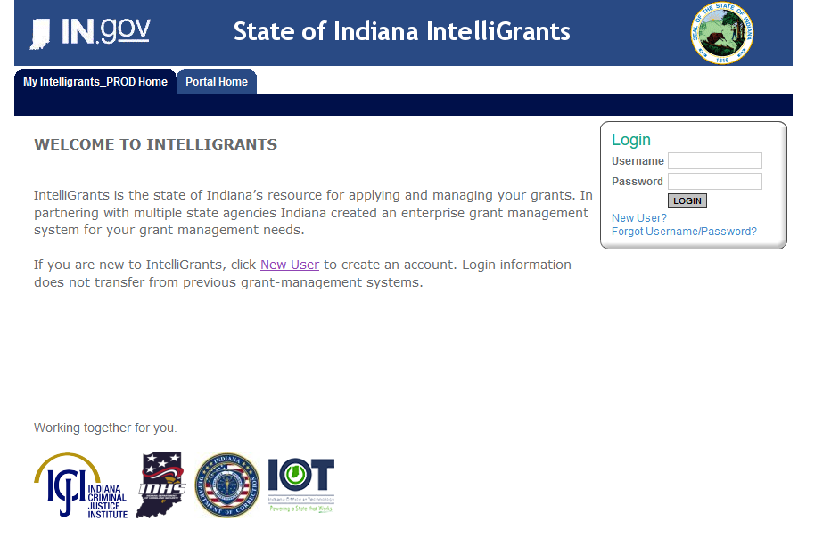
Initiating an application
https://indianaintelligrants.intelligrants.com/Login2.aspx?APPTHEME=INGRT

Slide 22
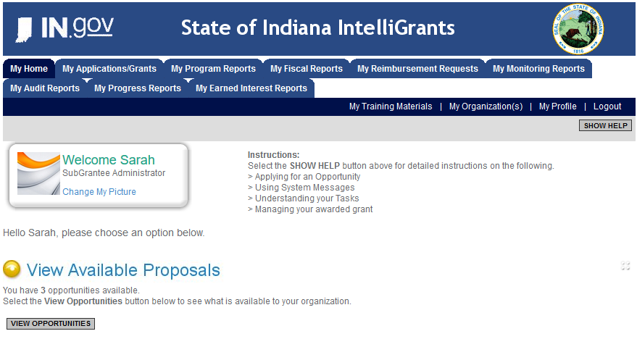
Steps to initiating an application
Log into your IntelliGrants account
  If you do not have an account, then you can obtain one on the home screen of intelligrants (New User?)
On the “MY HOME” page access the “VIEW AVAILABLE PROPOSALS” section
Click on VIEW OPPORTUNITIES
Intelligrants will take you to the My Opportunities page
Access the 2025 BHCPP/JCA/JCAP/JDCA/JDCAP Application
Select “Apply Now”

Slide 23
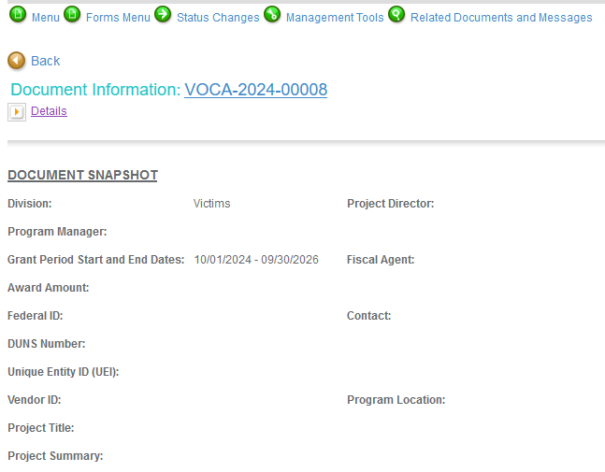
Navigating Forms Menu
Contact Information
Project Information
Programmatic Information
Problem Statement & Analysis
Goals, Objectives, and Outcomes
Program Description
Evidence Based/Best Practices
Use of Volunteers
Budget
Budget Narrative
Attachments

Slide 24
Problem Statement & Analysis
The Problem Statement should be no more than one or two sentences and should only state the problem your program is addressing.
Documenting the severity of the problem should include using local data and compare this to statewide data.
The last question should show how the proposed program is alleviating the problem that was stated in the earlier question.

Slide 25
Goals, Objectives & Outcomes
Goals – A goal is a broad, general statement that identifies the long-range purpose of the program. It is the desired result or outcome.
Objectives – These are the means for achieving the goals (activities performed to achieve the goal). Objectives should be SMART (Specific, Measurable, Achievable, Relevant, and Time framed).
Specific: Use specific rather than generalized language. Clearly state the issue, the target group, the time and place of the program.
Measurable: Be clear in the objective about what will be changed and by how much. Setting this clearly at the start makes it easier to evaluate.
Achievable: Be realistic about what the program can achieve in terms of the scale/scope of what is being done, the time and resources available.
Relevant: Needs to align with current program tasks and project and focus in one defined area.
Time Framed: Clearly defined timeframe including target or deadline date.
Outcomes – The outcomes measure the impact the activities had on those you served with your program
Notes:
This is what you will be reporting on throughout the lifecycle of the grant so ensure you are collecting this data.

Slide 26
Program Description
WHAT – WHO – WHERE – WHY – WHEN – HOW
WHAT – Explain your proposed program
WHO – Target population as well as who is implementing the proposed program
WHERE – List the location(s) where this proposed program will take place. Also include the geographical area description of where this proposed program will take place.
WHY – Explain the rationale for this proposed program
WHEN – List out your monthly timeline for this proposed program for the award period
HOW – List sources, activities and methodologies for implementation of this proposed program
Notes:
These questions are some of the most important questions when filling out your application. Whoever reads your grant will get an idea of your program through these answers.

Slide 27
Budget
PERSONNEL – BENEFITS – SUPPLIES/OPERATING – EQUIPMENT – TRAVEL – CONSULTANTS/CONTRACTORS
PERSONNEL – Ensure position is accurately listed (salaried, hourly, etc.). The full amount the personnel makes in a year needs to be listed with the percentage they plan on working on this funding stream to equal the total amount requested.
BENEFITS – Ensure you include benefits in this section and not within the personnel request. Ensure the percentage is the percentage the personnel is spending on the grant/the percentage you are requesting for this line item (NOT the benefit percentage i.e. 7.65%)
SUPPLIES/OPERATING – Supplies must be $499.99 PER UNIT or less to be considered a supply. If an item is $500.00 or more PER UNIT, it is then considered equipment and must be requested within the equipment section. The total cost of a supply line item is allowed to be more than $500. For example, a bookshelf costs $100/shelf and you are requesting 10 of them. That is allowable in the supply section because each shelf is only $100. The budget should reflect this $100 per unit, 10 unites, to equal a total of $1,000.

Slide 28
Budget Continued
PERSONNEL – BENEFITS – SUPPLIES/OPERATING – EQUIPMENT – TRAVEL – CONSULTANTS/CONTRACTORS
SUPPLIES/OPERATING CONT. – The operating section can be used for items like rent, cell phone service, utilities, etc.
EQUIPMENT – This section is for items that are $500 PER UNIT or more, and tangible personal property.
TRAVEL – Mileage must be requested at the State mileage rate (currently $0.49). This section can also be used for conference registration fee, travel expenses related to that, etc. A common mistake is lumping all costs under general travel. General travel is only used for expenses like luggage costs.
CONSULTANTS/CONTRACTOR – Consultants evaluate organizations needs and provides professional advice (limited to rate of $81.25 per hour or $650 per day) while a contractor provides goods or performs services and is not subject to the maximum rate. A signed agreement is required to be attached and the minimum requirement for the agreement must include the period affected, duties of each party, pricing of goods/services (hourly rate, cost per item, etc.) and signatures of each party.

Slide 29
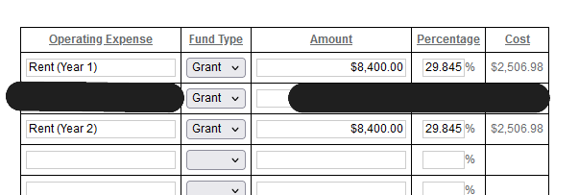
Budget Continued
PERSONNEL – BENEFITS – SUPPLIES/OPERATING – EQUIPMENT – TRAVEL – CONSULTANTS/CONTRACTORS
If the grant is a 2-year grant, please be sure to the budget includes costs for the full 2-year period and have labels.

Slide 30
Budget Narrative
Each section that is filled out within the budget forms will then open the corresponding boxes required to be filled out within the budget narrative.
Personnel – If position(s) are split funded, ensure the total salary is listed with each funding source and the amount that funding source provides not just the percentage.
Benefits – Show/explain how the amount requested was calculated. Ex: $50,000*.0765=$3,825x50% = $1,912.50
Supplies/Operating – List out the line items and explain what will be requested within each line. Ex: Office Supplies would include pens, highlighters, folders, paperclips. If requesting utilities in the operating section be sure to list out the services/providers/total amounts/allocated amounts/etc.

Slide 31
Budget Narrative Continued
Equipment – Explain the lines that are being requested in the budget
Travel – Explain each line item being requested in the budget. If the request is for a conference be sure to explain what conference and the benefit of it.
Consultants/Contractors – Answer each question in detail for each contractor/Consultant on the budget.

Slide 32

Attachments
Total Agency Budget (link for this form is located in the RFP)
Sustainability Plan
Timeline
Collaboration Plan (JDCA/JCA only)
Letters of Endorsement
Miscellaneous
  Any additional information (contracts, lease agreements, job descriptions)

Slide 33

For technical assistance contact the ICJI Helpdesk at CJIHelpDesk@cji.in.gov. Help Desk hours are Monday – Friday, 8:00 am to 4:30 pm ET, except state holidays.
ICJI is not responsible for technical issues with grant submission within 48 hours of grant deadline.
For assistance with any other requirements of this solicitation, please contact The Youth Division at ICJI.

Slide 34

Q & A

Slide 35
THANK YOU
Ellen Sheets, Youth Director
Esheets1@cji.in.gov
Dalayna Anderson, Youth Assistant Director
DaAnderson1@cji.in.gov

