Slide 1
2022 VOCA Supplemental Webinar/Q&A
October 20th ,2022

Slide 2
Thanks for joining us today: Webinar is being recorded. It will be posted on the ICJI website. Questions and Answers at the end. Feel Free to utilize the chat box during the webinar.

Slide 3
2022 VOCA Supplemental Grant Application
Application opened: Tuesday, October 18th at 9 AM
Application closes: Monday, November 7th at 11:59 PM
Applicants are strongly encouraged to submit applications 48 hours prior to the deadline.
Award Period for VOCA Supplemental: October 1, 2022 to September 30, 2023 (12-month award period)

Slide 4
Funding Eligibility and Availability
Eligible entity types include only VOCA 2022-2024 awardees
2022-2024 awardees may only request allowable VOCA expenses that were included in the original application submitted for the VOCA 2022-2024 grant cycle but were later removed due to funding reductions
The following categories are allowed:
Personnel
Benefits
Travel
Supplies
Equipment
Operating expenses
Consultants/contractors

Slide 5
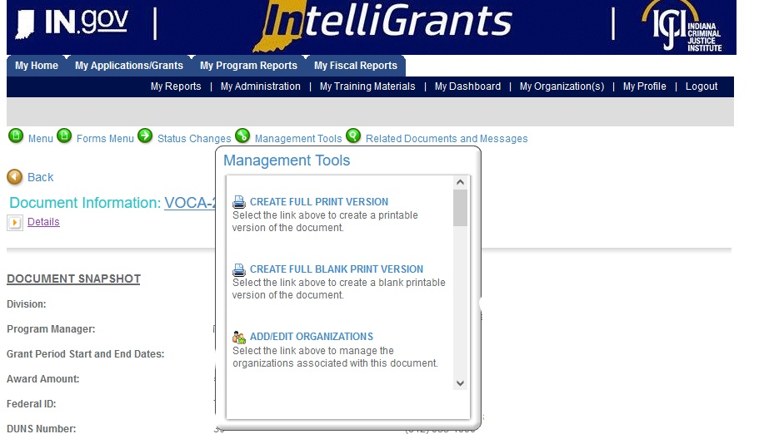

Slide 6
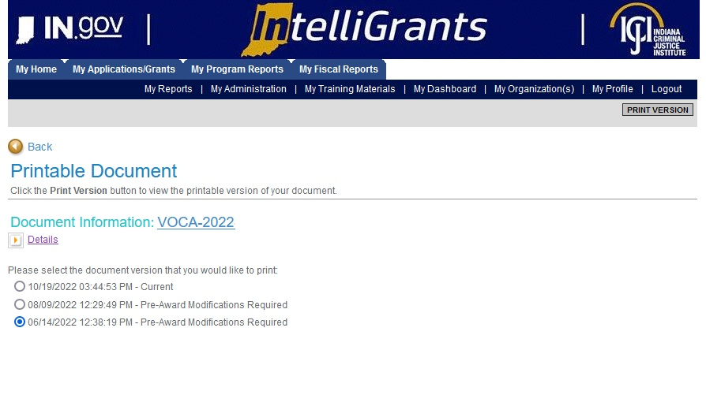

Slide 7
New allowable rates for Travel include:
Per Diem
In-State $41.00 per day
Out of State $52.00 per day
Mileage
$0.49 per mile
No match is required
Important Notes

Slide 8
Application/Forms
The application has been modified in IntelliGrants to only include the forms that are necessary
The following forms need to be completed:
Contact
Project Information
Use the same project title from your VOCA 2022-2024 application as well as the same project summary
In the project summary text box, add the comment “This application supplements <agency name> <VOCA 2022-2024 grant number >, refer to this grant application for information about this project”.
Budget
Budget Narrative
Attachments

Slide 9
Attachments Required:
Total Agency Budget
Found on ICJI’s website (https://www.in.gov/cji/victim-services/resources/) – Nonprofit Applicant Budget Form
Indirect Cost Rate if applicable
Miscellaneous
Job Descriptions for any position listed in personnel
If applicable, attach any other requested information

Slide 10
Questions?

