Slide 1
EMA Orientation Seminar Module 4 planning, WEBEoc, & lepc
{{
October 2021

Slide 2
Module 4
In this module we will go over:
Planning
Presented by:
WebEOC
Presented by:
LEPC
Presented by:

Slide 3
{{
Planning
In this portion “presenter” will go over planning initiatives.

Slide 4
PLANNING SECTION ORG CHART
Peri Rogowski State Planning Officer
Janice Lee Division Project Manager
Scott Huffman Continuity Planning Manager
Allison Curry Natural Hazards Planning Manager
Joshua Kiilu Cybersecurity & Risk Assessment
Felicia Wolfe Technological Hazards Planning Manager
Selena Rosas Critical Infrastructure & Logistics Planning Manager
Vacant Emergency Services Planning Manager
Vacant Mass Care Planning Manager

Slide 5
PLANNING SECTION RESPONSIBILITIES
Manage statewide Emergency Management and Homeland Security planning and assessment initiatives
Develop and maintain over 50 state-level emergency plans including the State Emergency Operations Plan (EOP), associated annexes, support and hazard specific plans and continuity plans using the FEMA 6-Step Planning Process, Community Lifelines and Whole Community planning methodology
Develop county planning templates, provide local EMAs guidance, review and feedback of county emergency plans and risk assessments
Oversee state compliance of the federally mandated National Incident Management System (NIMS) which includes all 6 components:
National Qualification System Incident Command System (ICS)
Resource Typing Mutual Aid
Emergency Operations Centers Inventorying
Provide leadership and staffing for the State EOC Planning Section and ESF-14 during activations
Provide leadership and staffing support for the Indiana Incident Management Assistance Team (IMAT)

Slide 6
SECTION RESPONSIBILITIES CONTINUED
Oversees the National Risk Assessment (NRA) compliance requirements for the state. Includes development, coordination, analysis, and reporting of the following national risk assessments:
State Hazard Identification and Risk Assessment (HIRA)
State Threat and Hazard Identification and Risk Assessment (THIRA)
State Stakeholder Preparedness Review (SPR)
Special Event Assessment Rating (SEAR) Report
National Incident Management System (NIMS) Compliance Report
Comprehensive Preparedness Guide (CPG) 101 Compliance Report

Slide 7
SECTION RESPONSIBILITIES CONTINUED
Collaborate and provide support to the IDHS Exercise Section during exercises which validate plans and assist in the development of the Integrated Preparedness Plan (IPP)
Collaborate and provide training data to the IDHS Training Section collected from SPR for RTIPP
Oversee compliance of the national Emergency Management Accreditation Program (EMAP)
Conduct After Action Reports (AARs) and improvement plans (IPs) for real-world incidents

Slide 8
SECTION RESPONSIBILITIES CONTINUED
Oversee the new ESF-14 (Cross-Sector Business and Infrastructure)
Creating a Business Emergency Operations Center (BEOC)
Working to build a Private-Public Partnership to support ESF-14

Slide 9
SECTION RESPONSIBILITIES CONTINUED
Work with federal, state and local partner agencies on a variety of hazard-specific and support plans, training, and exercise projects including:
Continuity of Operations and Continuity of Government Planning
Complex Coordinated Terrorist Attack Full-Scale Exercise (with Kentucky)
Cybersecurity
Natural hazards including earthquake, tornado, flood, winter and summer weather events
Logistics and Critical Infrastructure Security Planning
CBRNE (Chemical, Biological, Radiological, Nuclear and Explosive) Planning
Terrorism Consequence and Active Shooter Planning
Mass Care, Emergency and Disaster Medical and Healthcare Planning
Election Security Planning
Civil Unrest Planning
Emergency Communications and Notifications

Slide 10
HIRA / THIRA / SPR / SEAR / NIMS / CPG 101 REPORT CYCLES
HIRA Reports Due Every 3 Years by 1/30
SEAR Report Due Every Year by 8/31
THIRA Reports Due Every 3 Years by 11/15
CPG 101 Reports Due Every Year by 11/30
NIMS Report Due Every Year by 11/30
SPR Reports Due Every Year by 11/15
HIRA – Foundation for THIRA Step 1 - Conducted Every 3 Years: Due January 30th of 2021 – 2024 – 2027
THIRA – Foundation for SPR Step 1 - Conducted Every 3 Years: Due November 15th of 2022 – 2025 – 2028
SPR – Measures Progress of Core Capability Gaps - Conducted Every Year: Due November 15th
SEAR – Measures Risk of a Terrorist Attack at a Special Event - Conducted Every Year: Due August 31st
NIMS – Annual Compliance Report Required by FEMA - Conducted Every Year: Due November 15th
CPG 101 – Tracks Annual Planning Development - Conducted Every Year: Due November 15th

Slide 11
Hazard Identification and Risk Assessment (HIRA)
The HIRA is a quantitative process in which counties select all natural, man-made or technological hazards or threats that present the greatest risk to their community.
The HIRA uses a Calculated Probability Risk Index (CPRI) formula that measures the probability, magnitude/severity, warning time, and duration of the known hazard or threat.
It allows state and local government officials to better assess their risks to plan and prepare for consequences of threats and hazards.
The HIRA results generate the information needed for the THIRA, Step 1.

Slide 12
THREAT & HAZARD IDENTIFICATION RISK ASSESSMENT (THIRA)
THIRA is a 3-step risk assessment completed every 3 years.
The THIRA helps communities understand their risks and determine the level of capability they need in order to address those risks. The outputs that form this process lay the foundation for determining a community's capability gaps as part of the Stakeholder Preparedness Review.
The THIRA includes standardized language to describe threat and hazard impacts and capability targets. This allows communities to collect more specific, quantitative information while also providing important context.

Slide 13
STAKEHOLDER PREPAREDNESS REVIEW (SPR)
The SPR is a 3-step process completed annually and measures the progress of the capability targets identified in the current THIRA
Communities collect detailed and actionable data on current capabilities and identified gaps and identify priorities and timelines
Communities indicate their approaches for reducing gaps and assess the impact of relevant funding on building and sustaining capabilities
County EMAs gather feedback from county stakeholders, SMEs, businesses, non-profit organizations, and higher education partners
SPR results assist the state and federal government in prioritizing capabilities to build and sustain, plan for threats and hazards, and validate capabilities used in mitigation plans and grant justifications

Slide 14
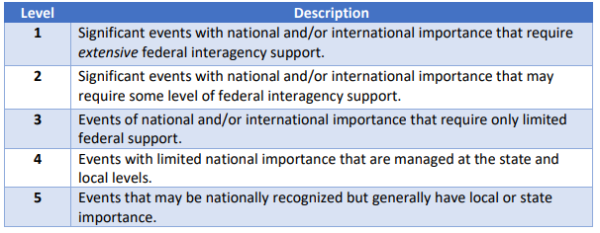
Special Event Assessment rating (SEAR)
Measures the threat, vulnerability and consequences of special events. Includes sporting and conference events, concerts, festivals, fairs, parades, and other local group gatherings. All data is input into WebEOC.
All SEAR events are submitted to the US Department of Homeland Security’s Office of Operations Coordination who applies a risk-based methodology to all submitted events and assigns them a SEAR rating as described below:

Slide 15
NIMS COMPLIANCE SURVEYS
The annual National Incident Management System (NIMS) survey is directed by the Homeland Security Presidential Directive (HSPD)-5 which requires adoption of NIMS by state, tribal, territorial and local organizations as a condition for federal preparedness assistance through grants, contracts and other activities.
IDHS has created an on-line NIMS compliance survey to create a more streamlined experience for emergency managers.
This on-line survey is due annually no later than November 15^{th.}

Slide 16
CPG 101 PLANNING COMPLIANCE SURVEY
The annual Comprehensive Preparedness Guide (CPG) 101 compliance survey supplements CPG-101 by tracking the timing for developing or revising emergency operation plans and captures planning elements contained in CPG-101
The CPG 101 survey is combined with the NIMS survey and Comprehensive Preparedness Guide (CPG) 101 planning survey to create a more streamlined experience for emergency managers.
This on-line survey is due annually no later than November 15^{th.}

Slide 17
COMPILATION OF NPS CROSSWALK VIEW-AT-A-GLANCE

Slide 18
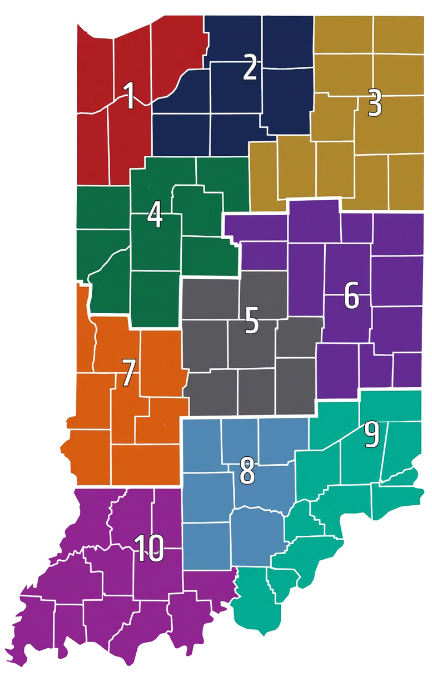
DISTRICT PLANNING MANAGER SUPPORT
District 1 – Joshua Kiilu – JKiilu1@dhs.IN.gov
District 2 – Felicia Wolfe – FWolfe@dhs.IN.gov
District 3 – Peri Rogowski – PRogowski@dhs.IN.gov
District 4 – Felicia Wolfe – FWolfe@dhs.IN.gov
District 5 – Janice Lee – JALee@dhs.IN.gov
District 6 – Janice Lee – JALee@dhs.IN.gov
District 7 – Scott Huffman – SHuffman@dhs.IN.gov
District 8 – Scott Huffman – SHuffman@dhs.IN.gov
District 9 – Selena Rosas – SRosas@dhs.IN.gov
District 10 – Allison Curry – ACurry@dhs.IN.gov

Slide 19
PLANNING AND ASSESSMENT GUIDANCE
National Planning Frameworks
National Incident Management System (NIMS)
Comprehensive Preparedness Guide (CPG) 101 (Planning) and CPG 201 (THIRA/SPR)
Securing Public Gatherings
Presidential Policy Directive / PPD-8: National Preparedness
National Preparedness Goal
Whole Community
Key Components of Presidential Policy Directive 8 and Estimating Capability Requirements
National Risk and Capability Assessment (THIRA/SPR)
Community Lifelines
Critical Infrastructure Sectors
Continuity Programs

Slide 20
{{2921
Planning@dhs.IN.gov
INDIANA DEPARTMENT OF HOMELAND SECURITY
302 West Washington Street Room E208
Indianapolis, IN 46204

Slide 21
Thank you!

Slide 22
{{
Webeoc
In this portion “presenter” will go over a WebEOC orientation tutorial.

Slide 23
Objectives
Home Page
County Home Dashboard
Events Board

Slide 24
Webeoc homepage

Slide 25
County dashboard

Slide 26
County status

Slide 27
Webeoc monthly test
Incident to use
2021 WebEOC Monthly Test Exercise
Required Action
EOC Activation Change
Suggestive Action
EOC Activation Change
Travel Advisory Change
Opportunity to remain proficient

Slide 28
Webeoc post
What - A brief synopsis, including:
Threat – The nature of the problem
Vulnerability – Why this is a problem
Consequences – The potential impact of the incident
Where - location of the report, information should be as specific as possible
When – the time and date of the report
Who - the name of the person making the report, and the agency he or she works for

Slide 29
Event types
Agriculture and Animal
Communications
Earthquake
Emergency Management
Energy
External Affairs
Fire
Flooding
Law Enforcement
Logistics
Long Term Recovery
Mass Care
Oil and Hazardous Materials
Public Health
Public Works
Search and Rescue
Test
Transportation
Weather

Slide 30
Types of incidents
All Hazards
Potential to expand beyond capability of daily operations
Crosses multiple jurisdictions
Severe weather
Incidents involving interstate closures
Working HazMat incident
Large fires involving more than one department
Unknown substance calls
Schools, Government Facilities, etc.
Bomb or EOD activity
Active shooter incidents

Slide 31
Types of incident cont.
Serious injury or death of public safety personnel
Dam or levee problems/issues
Industrial accidents
Explosions of any kind
Hazardous radiation incident
Search and rescue operations
Amber/Silver Alerts
Structural collapses
Train derailments

Slide 32
Events/incidents board
Information can be kept at the district level without involving the state
IDHS does not actively monitor district E/I boards
Will see if pushed to State board
Will see if pushed to other jurisdictions
Main source of incident information
Scrolling feed of incident information
Variety of users may contribute with posts
Posts may be updated
Incident dependent
Search Capability

Slide 33
Events/incident display

Slide 34
Events/incidents input

Slide 35
Event mapping

Slide 36
Missions and tasks
What is the mission? There may not be a specific resource you request so being specific with the mission allows logistics to come up with other resources that can meet the goal of the mission.

Slide 37
Webeoc user guide
Please take this time to fill out the WebEOC User Guide and turn it into your Liaison. They will then get your account created.

Slide 38
Thank you!

Slide 39
{{
Lepc
In this portion “presenter” will go over LEPC information.

Slide 40
Superfund Amendments and Reauthorization Act (SARA)
Title III of SARA is known as the Emergency Planning and Community Right-to-Know Act (EPCRA).
Identify the storage, use, and release of chemicals.
Foster communication between facilities that handle hazardous chemicals and their communities.
Expand emergency planning for hazardous chemical accidents and enhance emergency response capabilities for hazardous chemical incidents.
Under Section 312 of EPCRA, facilities are required to submit a Tier II form to state, local officials, and the public on potential hazards. The information includes the locations and amounts of hazardous chemicals present at a facility during the previous calendar year.

Slide 41
Indiana Emergency Response Commission (IERC)
Meets bimonthly on the second Monday at 1:30pm EST starting in January.
A virtual option for attendance will always be available.
The meeting information can be found https://www.in.gov/dhs/boards-and-commissions/indiana-emergency-response-commission/
The IERC was established to implement the Emergency Planning and Community Right-to-Know act of 1986 (EPCRA).

Slide 42
Local Emergency Planning Committee (LEPC)
LEPCs develop and maintain an emergency response plan to deal with accidental chemical releases from facilities in their respective county.
LEPCs also provide information, upon request, about chemicals in the community to the general public.
An LEPC can also direct the public records request to IDHS https://www.in.gov/dhs/public-records-request-web-form/
Compliant LEPCs receive funds from Tier II Facility fees once a year. This money can be spent on training, hazmat equipment, etc.
See IC 6-6-10-7(b) for a complete list of LEPC spending categories.

Slide 43
LEPC Compliance
The LEPC has several activities to complete throughout the year to be compliant and receive funding.
January 31st – Legal Notice
March 1st – Bylaws
March 1st – Roster
March 1st – Fiscal/Auditors Report (prior year)
May 1st – Exercise Proposal Report
The final exercise report needs uploaded 60 days after the exercise.
The exercise is not required to be HSEEP complaint unless using grant funding.
October 16th – Hazardous Materials Response Plan
Completion and upload of at least four meetings and meeting minutes
Two meeting in the first half of the year and two meetings in the second half.
Contact the LEPC/IERC program manager for Tier II Manager access, if needed.

Slide 44
Contacts
IERC/LEPC Program Manager
Amanda Horner
ahorner@dhs.in.gov
Cell: (317) 954-4388
Office: (317) 234-9696
SARA Tittle III Program Manager
Casey Kenworthy
ckenworthy@dhs.in.gov
Cell: (317) 671-0981
Office: (317) 234-9697

Slide 45
Thank you!

Slide 46
END
{{

