Slide 1
Improving Opportunities for Adult Learning
Katie Rounds
Indiana Department of Workforce Development
June 21, 2024

Slide 2
Learning Objectives
Provide an overview of how the DWD Adult Education and Next Level Jobs Workforce Ready Grant (WRG) and Employer Training Grant (ETG) programs support building a highly skilled adult workforce.

Slide 3
Slide Title
Adult Education: The Challenge
423,178
Bulleted text
Bulleted text
Bulleted text
Indiana Adults 18-64 Without a
High School Diploma
Unemployment Rate of 5.9% vs 4%
Labor Force Participation Rate of 46.0% vs 62.5%
Wage increase of more than $8,400 annually after completing an HSE
Source: American Community Survey; Current Population Survey

Slide 4
Indiana Adult Education
High School Equivalency or Diploma*
Administered by DWD
Federal funds: $12M
State funds: $17M
Offers integrated credential training
Offers workforce programming
English language learning & civics education
*Adult Secondary Credit

Slide 5
Eligible Participant
16 years of age or older;
Not enrolled or required to be enrolled in secondary school; and
Who is—
Basic skills deficient;
Does not have a high school diploma or equivalent; or is an
English language learner

Slide 6
Comprehensive Network
55 Local Providers and Subcontractors
School districts
Higher education
Community-based agencies
Workforce
Indiana Department of Correction

Slide 7
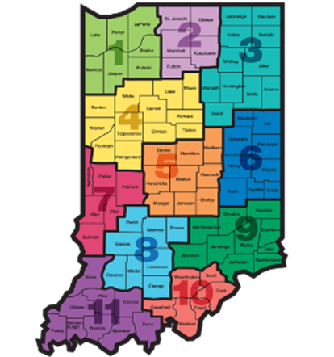
Slide Title
Across Indiana
Nearly 250 class locations with 1,000 adult educators
Administrators
Teachers
Coaches/counselors
Paraprofessionals
Volunteers
Bulleted text
Bulleted text
Bulleted text

Slide 8
Slide Title
Year-to-Date Comparisons
Bulleted text
Bulleted text
Bulleted text
 | June 2023 | June 2024 | Change
Enrollment | 21,666 | 24,550 | +2,884
Measurable Skill Gains | 65.88% | 67.29% | +1.41%
High School Equivalencies | 3,450/3,538 | 3,733/3,833 | +283
Source: Indiana Adult Education

Slide 9
Performance Outcomes: A National Leader
#3 in High School Equivalencies Issued
California:
Florida:
Indiana:
Georgia:
North Carolina:
13,854
5,427
3,808
3,441
3,393
Source: U.S. Department of Education

Slide 10
Slide Title
Integrated Education and Training (IET)
A robust certification program that combines:
Indiana ranks 2nd in the Nation in IET Enrollments
2,862 Enrollments
2,129 Certifications
171 IET Courses
Bulleted text
Bulleted text
Bulleted text
Adult education and literacy
Workforce preparation
Occupation-specific training

Slide 11
Slide Title
Workforce Education Initiative (WEI)
State | WEI
Indiana | 2,698
Alabama | 1,892
California | 805
Georgia | 710
Texas | 685
A partnership between Indiana Adult Education and Hoosier employers to:
Help employees retain jobs
Improve performance
Foster career advancement
Indiana represents 25.6% of total national enrollment
Bulleted text
Bulleted text
Bulleted text
Source: U.S. Department of Education

Slide 12
Slide Title
Next Level Jobs: Workforce Ready Grant
The Workforce Ready Grant (WRG) provides free training for Hoosiers in some of the state’s highest-demand, high-wage industries
Bulleted text
Bulleted text
Bulleted text
Program Basics
Job skills training aligned with eligible occupation
Credit-bearing and non-credit bearing programs
Short-term training: average program length less than 10 weeks
Trainee Eligibility
Indiana resident
At least a HS diploma, but less than a college degree
Enrollment in qualifying program at an eligible training provider
Training Programs
186 Active Training Programs
147 Active Training Providers
Highest number of programs available in Adv Manufacturing and Health Sciences

Slide 13
Workforce Ready Grant
Fiscal Year 2024 thru Q3
1,458 participants in training
617 credentials earned
$28 average post-training wage
$2,188 average cost per trainee

Slide 14
Slide Title
Industry Impact
Top 5 Certifications
CDL
Welding
Medical Assisting
Medical Coding
Industrial Maintenance
Bulleted text
Bulleted text
Bulleted text

Slide 15
Slide Title
Next Level Jobs: Employer Training Grant
The Employer Training Grant (ETG) reimburses employers who train, hire, and retain new or incumbent workers to fill in-demand positions within recognized job fields.
Bulleted text
Bulleted text
Bulleted text
Program Basics
Job skills training aligned with eligible occupation
40+ hours in length
For new or existing employees
Results in credential or approved specialized company training
Reimbursement Details
Up to $5K for training resulting in credential
Up to $3K for company specialized training
Up to $1K for HS student in work-based learning
Max of $50K per employer
Wage Requirements
Minimum starting wage of $17 per hour for new employees
3% wage increase for existing worker trainees

Slide 16
Employer Training Grant
Fiscal Year 2024 thru Q3
945 employers
6,457 employees estimated to receive job-relevant training in in-demand occupations​
Average investment per employer $25,558​
Average cost of training per employee $3,378

Slide 17
Thank you!
Katie Rounds
KRounds1@dwd.in.gov

Slide 18
One Stop To Start
Whitney Ertel, Executive Director
Governor’s Workforce Cabinet
June 21, 2024

Slide 19
Learning Objectives
Understand the ease of Indiana’s One Stop To Start campaign
Learn how to spread the word in your local area

Slide 20
Slide Title
Goal
Bulleted text
Bulleted text
Bulleted text
Strengthen Indiana’s economy by connecting individuals and employers to State programs and resources

Slide 21
Slide Title
One Stop To Start
Consumer-focused awareness campaign
(25 - 45-year-olds)
Utilizes existing state workforce, training and education programs
Connects people to resources, training and good job opportunities in their area
Bulleted text
Bulleted text
Bulleted text

Slide 22
Slide Title
Partners
Bulleted text
Bulleted text
Bulleted text

Slide 23
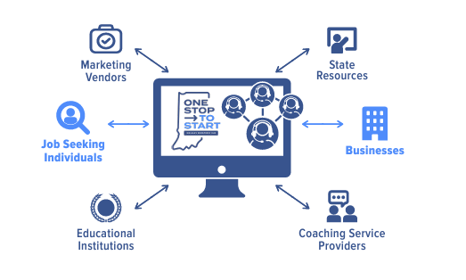
Slide Title
What’s Different
One “front door” to get started
Career navigators and one-on-one assistance
Warm handoff to partner
Showcases emerging industries alongside critical need jobs
Connect employers with resources and alternative talent pools
Bulleted text
Bulleted text
Bulleted text

Slide 24
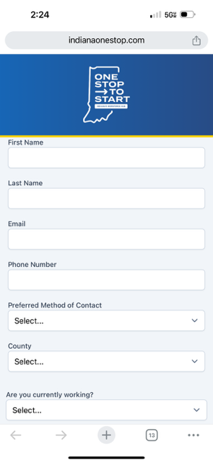
Slide Title
How it Works
Asd
Bulleted text
Bulleted text
Bulleted text
Notes:
Connect within one business day

Slide 25
Slide Title
Individuals
Tuition free certifications (NLJ Workforce Ready Grant)
Apprenticeships, Work-Based Learning
College Financial Aid
High School Degree/Equivalency
Upskilling, Reskilling
Barrier Removal
Bulleted text
Bulleted text
Bulleted text

Slide 26
Slide Title
Employers
NLJ Employer Training Grant
Manufacturing Readiness Grant
Apprenticeships, Work-Based Learning
On-Site Employer Training Opportunities
Alternative Labor Pools
Bulleted text
Bulleted text
Bulleted text

Slide 27
Slide Title
Emerging and Critical Need Industries
Additional Highlighted Industries
AI, Information Technology & Business Services
Bio / Pharma/ Life Science
Clean & Alternative Energy
Education & Early Learning
Engineering
Food & Ag Tech
Healthcare & Behavioral Health
Infrastructure & Building Trades
Smart Logistics & Transportation
Smart Manufacturing & Robotics
Bulleted text
Bulleted text
Bulleted text

Slide 28
Slide Title
Marketing Efforts
Digital
Facebook, LinkedIn, Reddit
Print/Radio/TV
Inside Indiana Business
Indianapolis Business Journal
Spotify, Pandora
Partnerships
Pacers/Fever
Indianapolis Motor Speedway
Bulleted text
Bulleted text
Bulleted text

Slide 29
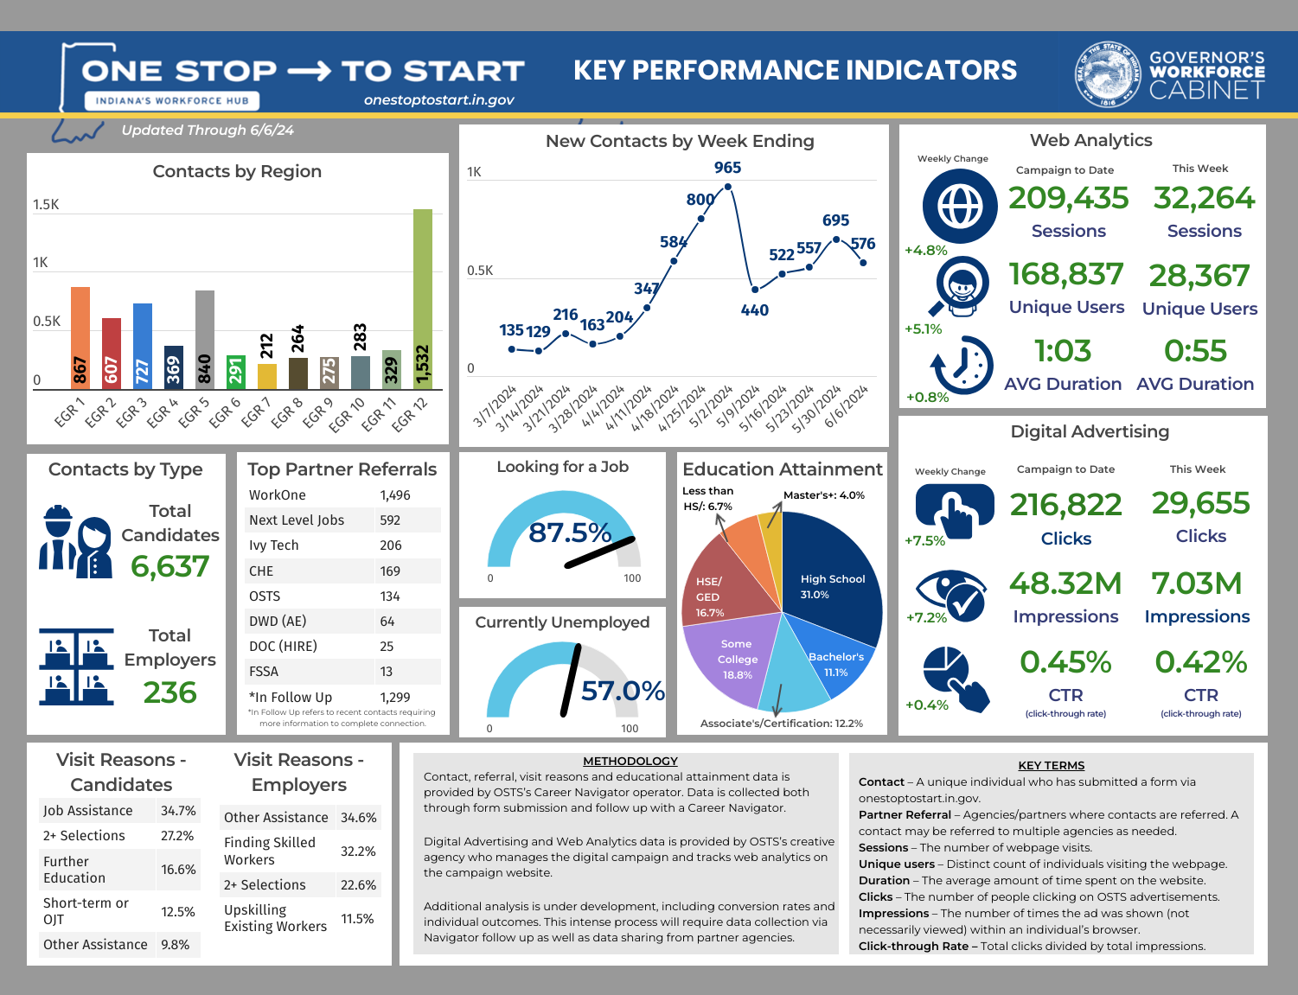
Slide Title
Bulleted text
Bulleted text
Bulleted text

Slide 30
Slide Title
Enhanced Portal Offering (May 1)
Phase 1 offerings maintained
Enhanced candidate profiles
1:1 employer engagement with a navigator
Candidate prescreening and vetting
Navigator career coaching available to individuals
Access to database granted to select employers
Bulleted text
Bulleted text
Bulleted text

Slide 31
Slide Title
Economic Development Possibilities
Talent Attraction: Out of state marketing
Partnerships: Work in collaboration with LEDOs and REDOs to target local employers in need
Microcampaigns: Targeted campaigns to help fulfill specific workforce needs of partner employers
Business Attraction: Assistance with large hiring events for new businesses to the state
Bulleted text
Bulleted text
Bulleted text
Notes:
.

Slide 32
Slide Title
OneStopToStart.IN.Gov
Bulleted text
Bulleted text
Bulleted text

Slide 33
Thank you
Whitney Ertel
Executive Director, GWC
wertel1@gov.in.gov

