Slide 1
Public Safety & Emergency Response
Jonathan Whitham
Indiana Department of Homeland Security
June 21, 2024

Slide 2
Learning Objectives
Strengthening the State Disaster Relief Fund
Supporting Firefighters
Enhancing EMS

Slide 3
Strengthening the SDRF
Increased max payout to $25,000
No need for a U.S. SBA declaration
Individual and Public Assistance
Reliant on state criteria/not federal criteria
as of July 1, 2024

Slide 4
Formula Changes for the SDRF
50% eligible costs multiplied by total damage costs
Increases award if mitigation actions taken

Slide 5
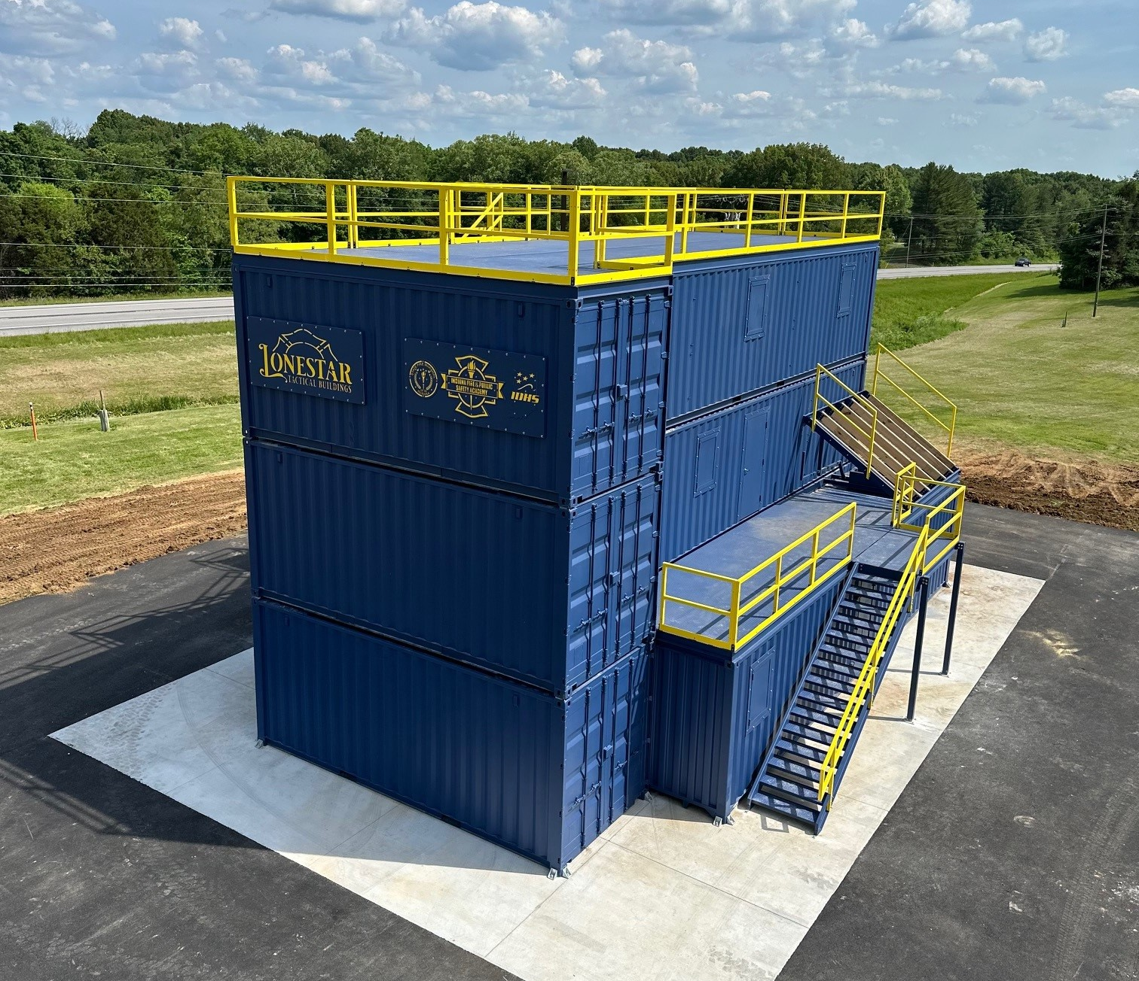
Hub-and-Spoke Firefighting Training
$17.7 million total investment in firefighter training and gear
First General Assembly funds ever allocated for firefighter training
Supports a regional approach to statewide training

Slide 6
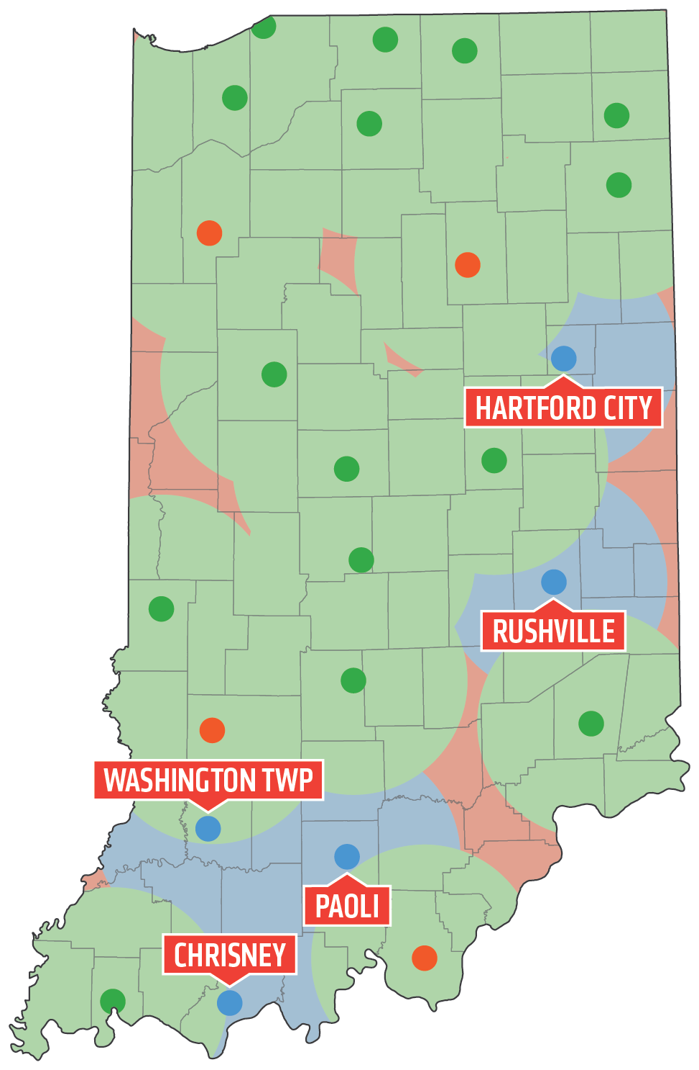
Hub-and-Spoke Training Locations
4 Phase I training locations to be complete this summer
5 Phase II training locations were announced June 18
Hartford City
Rushville
Washington Township
Paoli
Chrisney

Slide 7
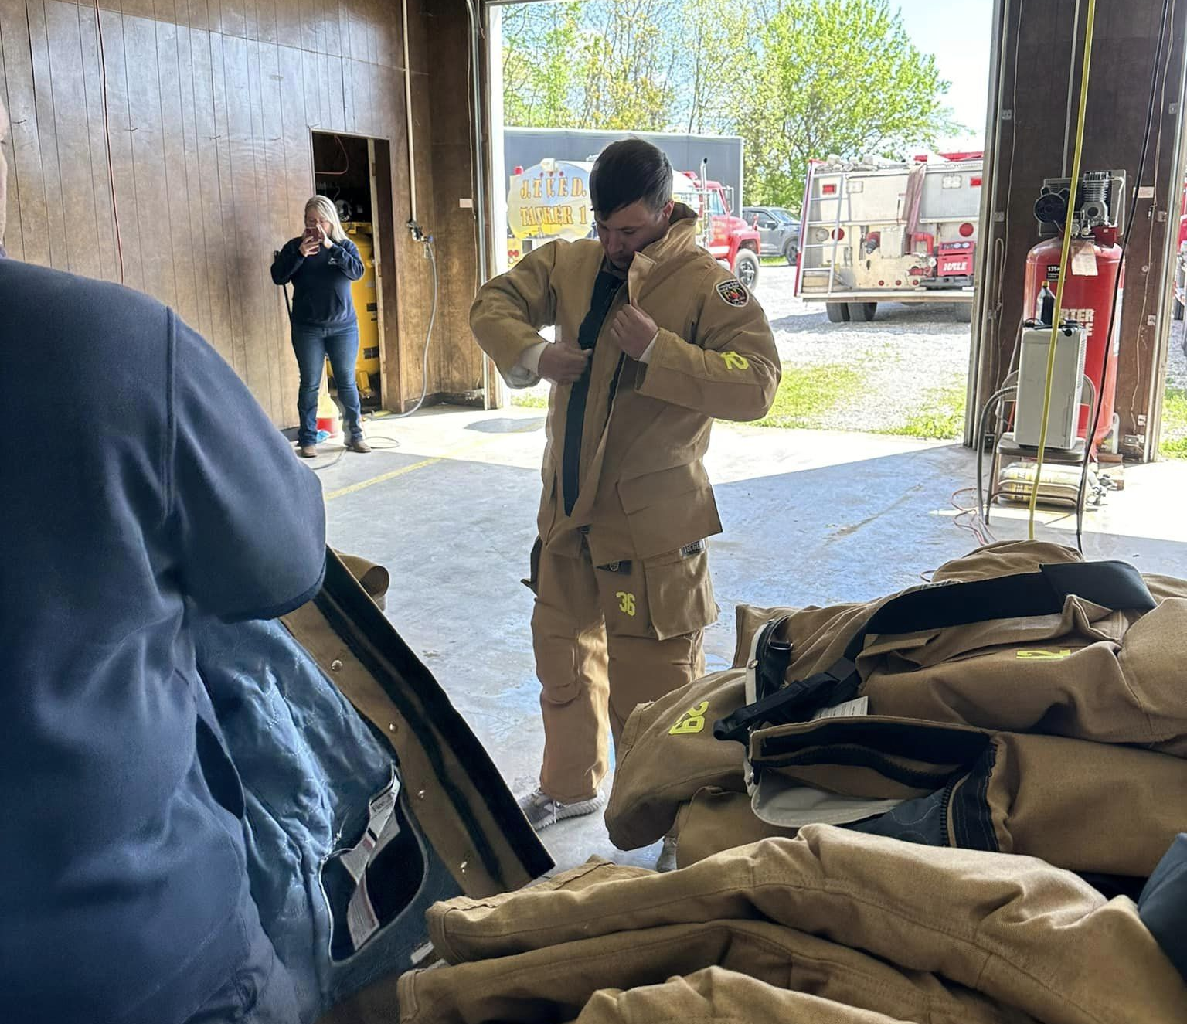
Hub-and-Spoke Volunteer PPE
$10 million investment
946 sets (turnout gear and SCBA) for 66 departments
Gear is being fitted and distributed now
Great need still exists for the more than 600 volunteer departments in Indiana

Slide 8
PFAS Testing Pilot Program
Voluntary opportunity for firefighters
$200,000 allocated
Results provided to firefighter
Anonymous data to help establish additional resources/programs
Building roster of candidates on IDHS website
July 1 law requires PFAS label on new fire gear

Slide 9
EMS Vision 2025
$14 million initiative approved by the Legislature to enhance EMS
First-ever workforce study
Training and Equipment grants distributed
Active committee examining long-term sustainability
Vision 2025 report coming

Slide 10
Thank you!
Jonathan Whitham
JWhitham@dhs.in.gov

Slide 11
Cybersecurity
Tracy Barnes & Graig Lubsen
Indiana Office of Technology
June 21, 2024

Slide 12
Learning Objectives
What free and low-cost services provided by the Indiana Office of Technology are available to local governments

Slide 13
IN.gov Domain
Why an IN.gov domain?
Security and brand recognition of valid IN.gov Program
Federal Grant money - easier to apply for with an IN.gov domain
Allows for IN.gov email addresses
Examples:
AllenCounty.IN.gov; CityofElkhart.IN.gov;
TownofSandborn.IN.gov
https://on.in.gov/localgovernment

Slide 14
Slide Title
Website
Multiple templates
Full control of content
Responsive Design, 508 Compliance, and Security
Access to 3rd party tools
Bulleted text
Bulleted text
Bulleted text
https://on.in.gov/localgovernment

Slide 15
Payment Processing
Two payment processing vendors
Security of electronic payments to your agency
More than $2 Billion processed yearly
Offered at no cost to agencies by using the convenience model
80+ local government customers
https://on.in.gov/localpayments

Slide 16
Slide Title
Procurement Offerings
Through SHI
Through Cisco
Bulleted text
Bulleted text
Bulleted text
Servers/Laptops/Desktops
Monitors
Conference Room Equipment
Various Software products (Microsoft, Oracle, etc.)
Network Firewall
Switches
VOIP Phones
Other offerings
Cloud Contact Center
Cellular phones and service
https://on.in.gov/localgovernment

Slide 17
Cybersecurity Assessment
Cybertrack
IOT has paid for 342 cybersecurity assessments – free for locals
Conducted by Purdue University and Indiana University
IOT does not see the details of your assessment
Blueprint for improving your security
https://on.in.gov/localgovernment

Slide 18
Cybersecurity Training
KnowBe4
Industry-leading cybersecurity training platform
Available at no-cost
167 locals using more than 34,500 licenses – $635,145 in value
Build your own plan or copy state’s training
https://on.in.gov/localgovernment

Slide 19
SLCGP
State and Local Cybersecurity Grant Program (SLCGP)
Formed in response to the federal Infrastructure Investment and Jobs Act
Indiana receives ≈$20M over a four year period – 80% goes to locals
Currently providing Advanced Security Training, User Training, Endpoint Monitoring
https://on.in.gov/localgovernment

Slide 20
Thank you!
Tracy Barnes
tbarnes@iot.in.gov
Graig Lubsen
glubsen@iot.in.gov

