Slide 2
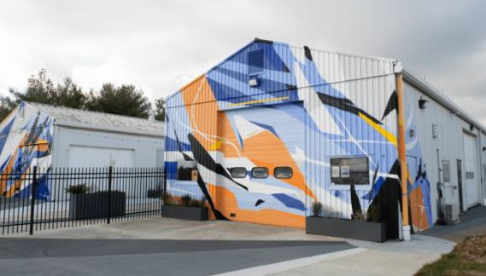

Slide 3
Shift from transactional to strategic, relationship-based organization – and have produced historic results
Growing the state economy, driving economic development and helping businesses launch, grow and locate to Indiana by executing our 5E strategy:
To create the opportunity for all Hoosiers to earn a good living and prosper in a diverse economic environment that encourages growth, creates and retains the jobs of today, and attracts and invests in the jobs of tomorrow.
Environment
Economy of the Future
Entrepreneurship
Energy Transition
External Engagement
Population Growth
Higher Wages
National Security

Slide 4
PROJECTS
208
PAYROLL
$7.6B
EXPECTED NEW JOBS
INDIANA RANKINGS
EJ2023
NEWCAPEX
$28.7B
(29% increase year over year)
#7
#7
Forbes
Business Facilities MANUFACTURING (JOBS)
BEST STATE TO START A BUSINESS
Tax Foundation 3#
PROPERTY TAX
RANK
Business Facilities #7 MANUFACTURING (OUTPUT)
AVERAGE HOURLY WAGE
Startup City Rankings 3#
BEST OF THE
MIDWEST (INDIANAPOLIS)
$36.07 27,866
Elevate Ventures MOST ACTIVE VC IN GREAT LAKES REGION
iiiitiitiiitiitiiiti
(3.9% increase year over year)

Slide 5
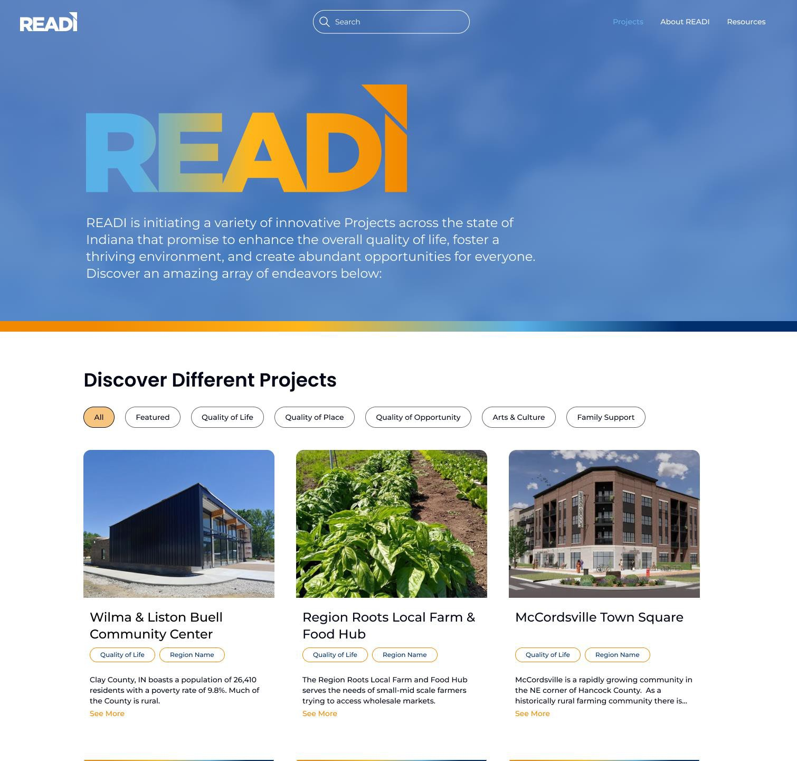
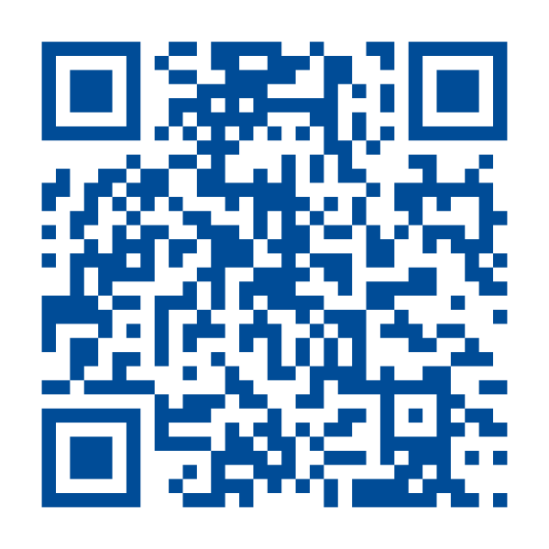
IndianaREADI.com

Slide 6
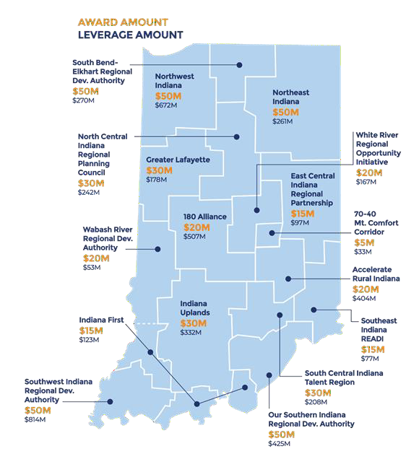
17 regional proposals represented more than $15B of investment demand in projects like trails, broadband, childcare and wellness initiatives, workforce development programs and marketing.
All 92 counties participated.
Proposals included nearly 800 projects and programs. 361 projects funded.
10:1 leverage from private and public sources to state
investment.
7:1 match from private sources to state investment, more than 66% of total investment from the private sector.
$50M max allocation for regions.

Slide 7
Tourism, Arts, Culture, Community
Family-support initiatives
Trails & Parks, Public Spaces
Housing Availability & Affordability
Growth Infrastructure
Mixed-use Developments
Infrastructure leading to jobs
Talent supply & education
Innovation & Entrepreneurship

Slide 8
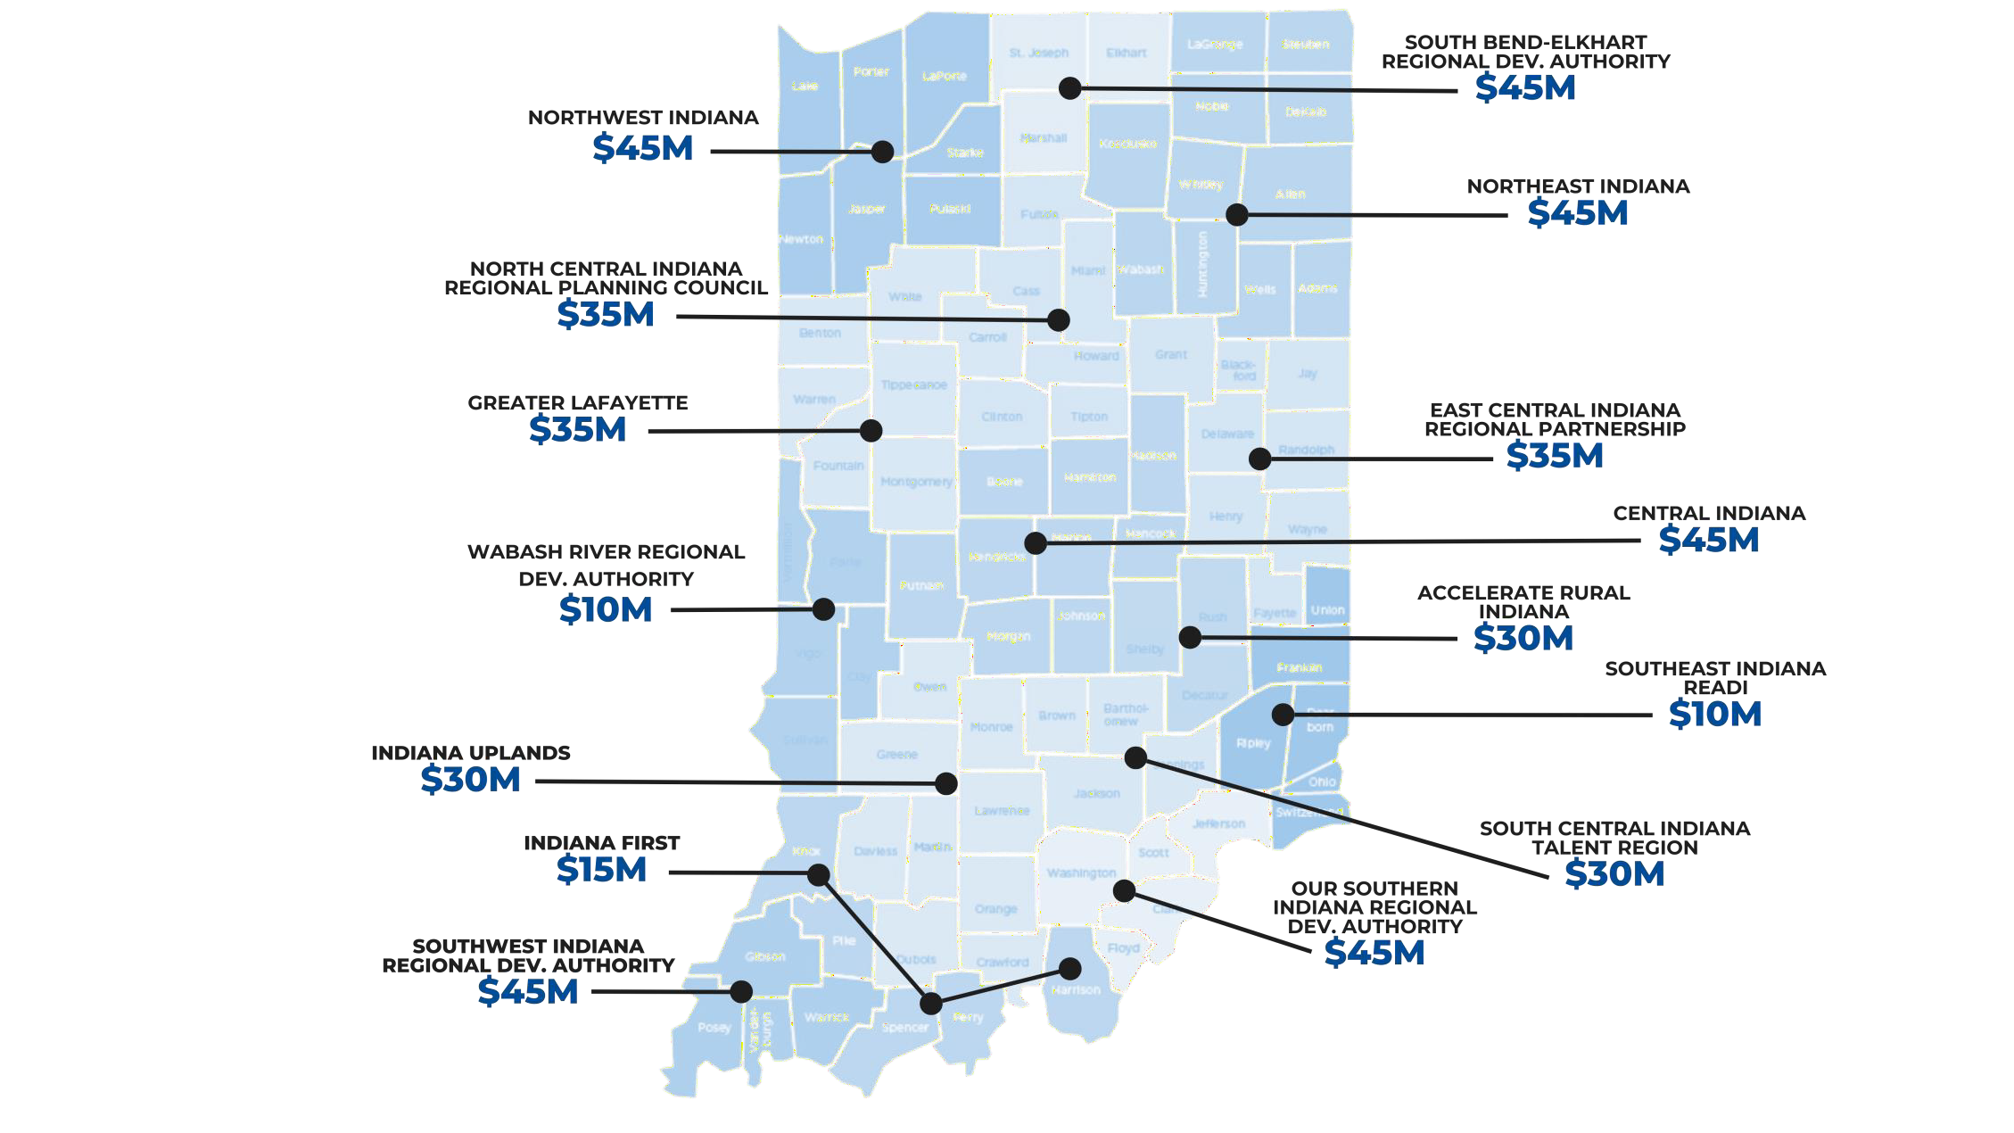

Slide 9
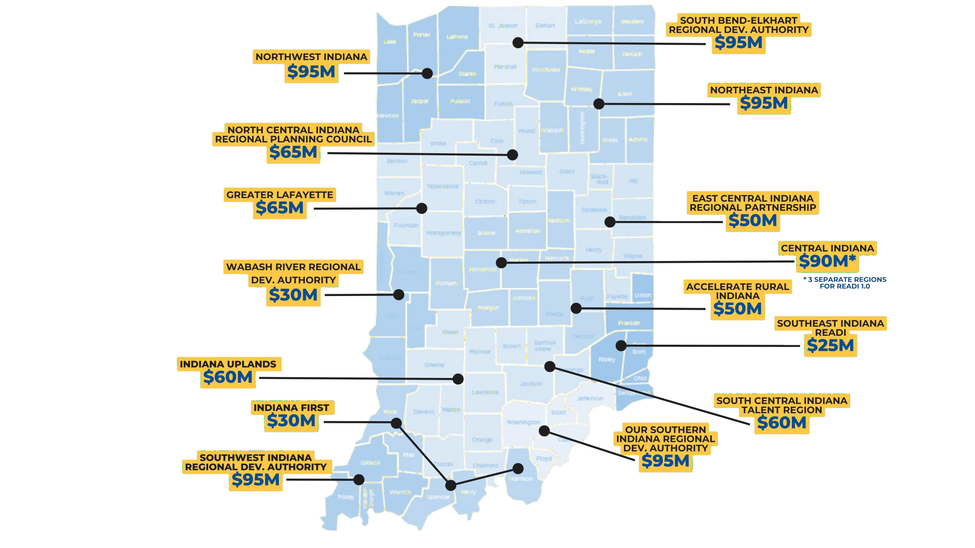

Slide 10
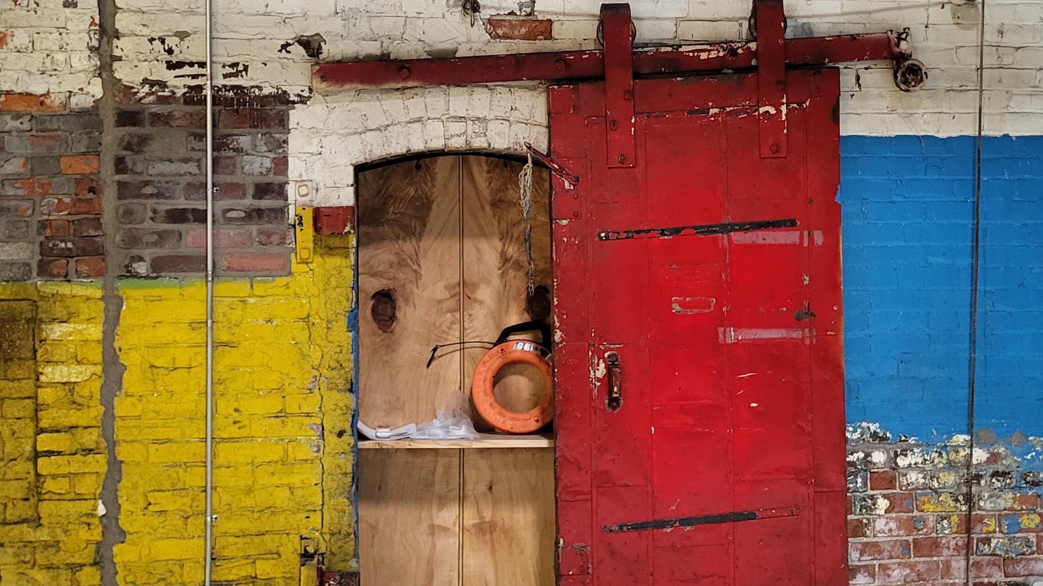
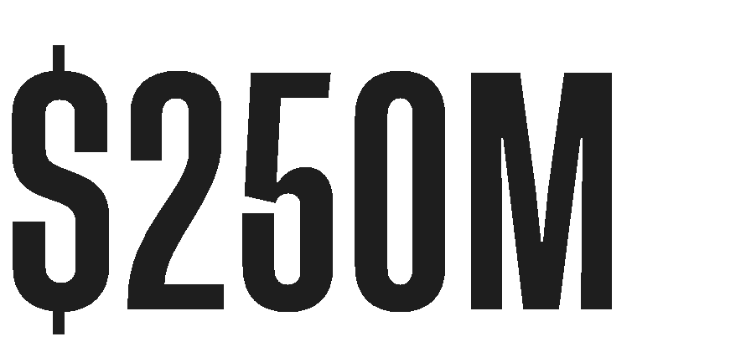
Eligible Entities
Only READI 2.0 regions that receive funding are eligible for this initiative.
Eligible Entities
Eligible proposals are restricted to READI 2.0 regional planning organizations that received a funding allocation.
Eligible Activities
Eligible Activities
Eligible projects must include properties that are either vacant, deteriorating, underutilized or blighted that have demonstrated an impact on the valuation of the subject assets and surrounding property values.
Public art including murals, sculptures, installations, programmable lighting on key assets or other artistic community improvements;
Development of museums, performing arts venues, art centers, art studio complexes or other culturally significant attractions or facilities (including improvements to existing facilities);
Eligible activities may include rehabbing historic structures, repurposing closed industrial plants to create inviting community spaces or mixed-use developments, or demolishing vacant, single-family homes to construct new affordable housing.
Art and cultural competitions or festivals, provided the applicant demonstrates long-term funding commitments to sustain any such effort;
Initiatives to attract nationally and internationally recognized arts and cultural performances to Indiana;
Total Appropriation:
Initiatives to support the further development of a region’s creatives and
creative economy; and
Development of visual architectural design elements that are unique to local communities
Total Appropriation:

