Slide 1
Extended Absences
Family-Medical Leaves
Employee Relations Division
Lavenia Haskett
Cori Villecco

Slide 2
Learning Objectives
Participants will be able to…
Understand the eligibility, application, and notification processes and responsibilities for FML.
Identify situations where FML applies to state employees.
Locate the appropriate resources for employees and managers for FML.
Identify what questions you can and cannot ask state employees about their absences.

Slide 3
How to Recognize a Need for FML
Family Medical Leave
Disability
Addition to Employee’s Family (Adoption, Birth, or Foster Care)
Family Medical Leave
New Parent Leave
Disability
Employee’s Own Medical Condition
Medical Condition of Employee’s Spouse, Parent(s), or Child(ren)
Family Medical Leave
Family Member Deployed for or Injured During Military Service
Family Medical Leave
Military Family Leave

Slide 4
Eligibility
FML
12 months’ employment
1250 hours worked in preceding 12-month period
NPL
6 months’ employment
Child born or adopted after 6-month mark
S/LTD
6-months’ active employment
Incapacity starts after 6-month mark
Military Family Leave
12 months’ employment
1500 hours worked in preceding 12-month period

Slide 5
Duration
FML
12 weeks in each Fiscal Year (FY)*
NPL
Ends 6 months after date child born or adopted
S/LTD
30-day Elimination Period
Short-term benefits begin 31st day of incapacity through 6th month
Military Family Leave
10 days during 30 days prior to deployment, 30 days after deployment, or during military member’s leave during deployment
Covers all qualifying events (not 12-wks each)
Intermittent, Continuous, or Reduced Schedule
Full-day increments only
150 hours full-time; 75 hours part-time
Long-term benefits begin after STD ends
Annual recertification

Slide 6
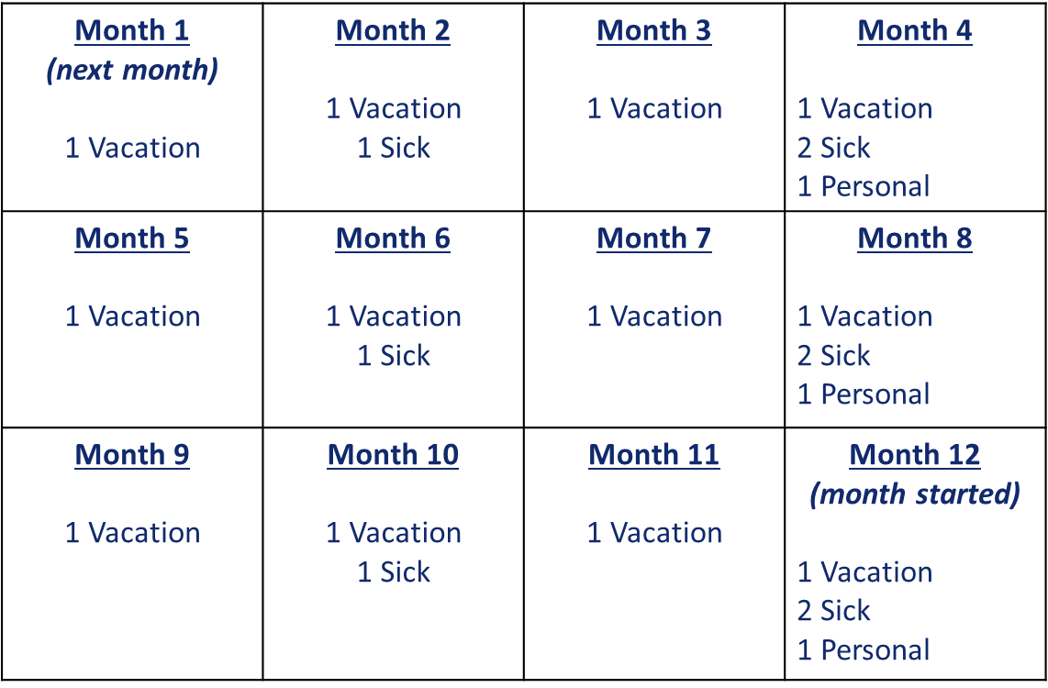
Accrual Calendar

Slide 7
Accrued Leave Balances
Accruals (Sick, Vacation, Personal) are added to view on first Sunday of each Pay Period when due but cannot be used until the actual Accrual Date.
Example
Pay Period Begins: Sunday, February 4, 2024
Employee’s Accrual Date: Tuesday, February 13, 2024
If employee had no balances of leave at end of previous pay period (Saturday February 3), then employee cannot use any leave that is calculated to accrue during this pay period until February 13.
Accrual Date can be viewed in these screens
Absence Balances
Request Absence

Slide 8
FML Balances
Review employee’s leave balances before approving absence requests.
Balances are not accurate in real time.
If not using FML Unpaid, the employee must have sufficient balance of FML and Sick, Vacation, or Personal leave for concurrent use and payment.
There is one bucket of FML hours assigned for a full fiscal year (FY).
All approved FML absences must use hours allotted to that one bucket for that FY.
If FML is approved for a time period less than the full FY, remaining annual balance will be visible, HOWEVER, it cannot be used without a new event and approval.
Read the FML approval notices (full content of email notification, not just subject line) to learn the parameters and time limits that apply.
Unused hours do not rollover into another FY; balances are zeroed out each year on June 30.

Slide 9
Cannot use FML hours just because there is a balance of FML.
If the approval has an expiration date before June 30, remaining hours are not authorized without new event, request, and approval. Example:
Surgery + Recovery: Aug 1 – Sep 30
450 FML hours approved for FY (full allocation made on first request each FY)
44 workdays @ 7.5 hours each = 330 FML hours used
450 – 330 = 120 FML hours’ balance on Oct 1
Cannot use any of those hours unless a new request is approved.
Remaining FML Balances

Slide 10
Remaining FML Balances
On June 30, all existing FML balances are zeroed out.
Employees must submit new requests and new certifications of supporting medical documentation for each FY.

Slide 11
Paid or Unpaid?
FML
Unpaid
FML
Paid if employee concurrently uses sick.
FML
Paid if employee concurrently uses vacation.
FML
Paid if employee concurrently uses personal.
FML
Paid if employee concurrently uses comp time.
FML
Paid if employee concurrently uses NPL.

Slide 12
Resources to share with employees
FML: SPD: Family & Medical Leave (in.gov)
NPL: SPD: New Parent Leave (in.gov)
S/LTD: JWF Specialty Company
Phone: 1-888-818-7795 (toll free), 317-574-7876 (local)
Fax: 1-866-893-4674
Disability application: www.jwfspecialty.com/applications-forms
Mailing Address: P.O. Box 40968, Indianapolis, IN 46240
Job Aids in SuccessFactors/JAM Home - Welcome (sapjam.com)
Q/A:
INSPD Employee Relations Division
1.855.SPD.INHR (1.855.773.4647), Option 4
Fax 317.974.2029
HR: Indiana Department of Health
Cori Villecco
E: cvillecco@spd.in.gov
P: 317.7620 (or via TEAMS)

Slide 13
Applying for FML: Employee’s Responsibilities
Notify manager of upcoming, anticipated absences.
Notice of FML is required 30 days in advance or same/next business day of learning of need for absence if less than 30 days.
Submit initial request & upload documentation in Request Extended Absence tile under Time tile in PS/ESS.*
Read all notifications and follow instructions.
*PS/ESS = PeopleSoft Employee Self Service

Slide 14
Applying for FML: Manager’s Responsibilities
Establish procedures for employees to notify you of absences.
Share resources with employees regularly, so no one is scrambling in an emergency.
Read all notifications and discuss with the employee to ensure both understand parameters of leave.
Managers do not have access to request FML on behalf of employees.

Slide 15
Taking Absences under Approved FML: Employee’s Responsibilities
Notify manager of upcoming, anticipated absences (30 days in advance).
Submit request in Request Extended Absence tile under Time tile in PS/ESS* prior to payroll deadlines for pay period.
Keep timelines in mind
Schedule foreseeable/planned absences to cause least disruption to operations whenever possible.
*PS/ESS = PeopleSoft Employee Self Service

Slide 16
Taking Absences under Approved FML: Manager’s Responsibilities
Establish procedures for employees to notify you of absences.
Enforce timely entries by employees.
If employee is incapacitated, manager must complete and fax to SPD’s Employee Relations Division information each pay period on Manager Request on Employee’s Behalf for Usage of Family & Medical Leave or New Parent Leave to Fax Number 317.274.2029:
Be sure to include all relevant information

Slide 17
Completing Timesheets & Absence Requests: Employee’s Responsibilities
Holidays must be entered on timesheet.
FML absence cannot be entered on holidays.
FML will be charged on holidays if no work is performed entire calendar week due to FML reason.
Timesheets and Absence Requests must be completed correctly and submitted no later than the end of final shift of each pay period leave is taken.

Slide 18
Completing Timesheets & Absence Requests: Employee’s Responsibilities
Leave taken intermittently may be entered into PS/ESS* upon return to work, but no later than end of final shift of the pay period.
If leave is taken on final shift of pay period, requests must be submitted by 10:00am ET on Monday immediately following end of pay period.
Changes to Absence Requests require
Cancellation of previous request(s)
Submission of new request(s)
*PS/ESS = PeopleSoft Employee Self Service

Slide 19
Completing Timesheets & Absence Requests: Manager’s Responsibilities
Require submission of timesheets & absence requests by end of final shift each pay period.
Review each employee’s timesheet for accuracy. Do not approve inaccurate timesheets.
Require use of FML unpaid or FML with paid leave. Do not allow or enter ALWP for FML absences.
Managers cannot enter FML absences.

Slide 20
Completing Timesheets & Absence Requests: Manager’s Responsibilities
Do not enter or approve any absences for time spent on S/LTD disability benefits periods.
Entry of REG-Regular Hours Worked cannot be entered for any day or hour the employee was not, in fact, working.
Entering REG for non-work hours is falsification of official documents subject to disciplinary action up to and including dismissal.

Slide 21
If planned absence (e.g., surgeries, childbirth) require an employee to
Enter hours worked and leaves daily as the date approaches, and
Complete timesheets in advance for pay period during absence.
Don’t wait until the end of the pay period to enter work hours or absence requests.
Team Calendar View!
Excellent tile on PS/MSS** homepage
Shows weekly or biweekly views of all your direct reports’ (and indirect reports’) work schedules and absences in a calendar format.
Tips for Timesheets & Absence
Requests
**PS/MSS = PeopleSoft Manager Self Service

Slide 22
When you see “Completed Successfully” in PeopleSoft, it just means “thank you for completing this step, you may take the next step”. It does NOT mean EE is eligible for the leave requested.
Eligibility is determined at time request is submitted
PS does not encumber leave for future requests
Future absences may become ineligible by that future pay period if employee requests same type of leave earlier without cancelling the future absence request.
Absence codes are not on timesheet drop down. Must use Request Absence or Extended Absence Request tiles on PS/ESS* Homepage.
Tips for Timesheets & Absence
Requests
*PS/ESS = PeopleSoft Employee Self Service

Slide 23
Notification Workflow
Managers in the “reports to” position automatically receive email notice whenever one of their direct reports submits a request for FML.
All responses (approved/denied/pushed back for clarification) issued by SPD’s Employee Relations Division.
Whenever there is a change in supervision, both the incoming and the outgoing manager are obligated to ask about existing FML or NPL approvals and to share notifications and information available.

Slide 24
Notification Workflow
Emails may be sent by gmisworkflow@iot.in.gov or an individual usually with @spd.in.gov address.
Subject Line: Agency #/Dept. #/EE’s Last Name/FML or NPL Request ID#/Description of Action
The content of each email message contains important details about the status of each request and the parameters assigned to using the leave.
READ EACH ONE

Slide 25
Notifications: FML
What can you learn by reading the important content of each email?
Whether employee’s leave is approved as Continuous, Intermittent, or a Reduced Work Schedule.
FML Request ID# (required on every absence request for that FML reason)
Start Date of the Leave
Anticipated End Date of the Leave
Estimated Frequency and Duration of Intermittent Absences

Slide 26
Notifications: FML
What can you learn by reading the important content of each email?
Recommendations and reminders about S/LTD applications
Insurance coverage
Requirement to submit Release to Return to Work
Instructions for updates if leave must be extended or is shortened
If request was denied, why it was denied
Instructions for entering Extended Absence Requests in PS/ESS*.
*PS/ESS = PeopleSoft Employee Self Service

Slide 27
How Can I Manage Intermittent Absences?
Can review notifications, place reminders on your calendar for follow-up.
Can require the employee to use comp time and sick leave concurrently for own serious health condition or that of family member.
Can review timesheets and absence requests are require accuracy in reporting.
Can ask the employee to document absence was for FML reason, date and time of appointment (and travel to/from) and sign it.

Slide 28
How Can I Manage Intermittent Absences?
Can require compliance with call-in timeframe if the employee was not experiencing episode.
Can hold the employee to performance standards for quality of work.
Can establish interim deadlines or milestones for projects and hold employee to standards.
Can ask whether a regular, reduced schedule better fit the need and reduce uncertainty of intermittent call-in usage?
If so, what schedule? Period of time schedule applies (week/pp/month/etc.). That is, how often must employee & manager update the schedule?

Slide 29
How Can I Manage Intermittent Absences?
Cannot ask what condition or specific reason the employee is taking leave for.
Cannot ask what is wrong with the employee or family member requiring care.
Cannot ask for a doctor’s statement for every absence.
Cannot require the employee to make-up FML absences.
However, if the employee works 37.5 hours over the course of week, you cannot charge FML for any absences just because they occurred during business hours.

Slide 30
How Can I Manage Intermittent Absences?
Cannot require compliance with call-in timeframe if the employee was incapacitated at that time.
Cannot transfer the employee to another job unless FML is for planned course of treatment.
Cannot require the employee to meet full-time performance standards for quantity or timeliness. E.g., if employee misses 12 weeks of the year (25%) due to FML, performance standard is met if employee performs 75% of full-time standards.

Slide 31
Can I Ask My Employee Anything About FML?
Yes, Managers can ask questions about specific absences:
Is this absence for the reason the employee has approved FML?
Which FML reason/approval Request ID# applies to this absence (if the employee has more than one open FML case)?
Is the employee requesting use of accrued leave or comp time? If not, does the employee have balance of sick leave or comp time that must be used for a serious health condition?
If the absence is for the employee’s own condition, what duties cannot be performed today?
If the absence is to care for a family member, what care will the employee be providing today?
If the absence is for a military qualifying exigency related to deployment, request contact information about the third party hosting the event or meeting the employee is attending.
How much notice did the employee have about this appointment?
Keep in mind guidelines for foreseeable events

Slide 32
What Can Managers Do about Suspected FML Misuse?
First, take a step back and give employee the benefit of the doubt.
Remember, all dates, frequencies, and durations are estimates.
No doctor can state a medical condition will flare up exactly [X] times a month nor how long each episode might last. Doctors state their estimates based on their knowledge of the condition generally and their patient specifically.
Your personal experience with a serious health condition is irrelevant, and your medical opinion cannot be considered.

Slide 33
What Can Managers Do about Suspected FML Misuse?
Next, review the notification(s) and talk to employee about parameters of the approval.
Do you and the employee understand the parameters in the same way?
If not, contact SPD’s Employee Relations Division to discuss.
If yes, the parameters are clear, but the employee needs more time than was approved because condition or treatment changed, tell the employee to contact SPD’s Employee Relations Division to discuss updating the paperwork for a revised approval.

Slide 34
What Can Managers Do about Suspected FML Misuse?
Then, if there is evidence of misuse (e.g., Employee took FML and attended a concert or other event)
Discuss facts with the employee
Listen to the explanation and ask your HR representative whether any discrepancies should be investigated or whether SPD’s Employee Relations Division should be called for advice
Take appropriate disciplinary or other action

Slide 35
How Can I Manage Continuous Absences?
Before the Employee Starts Leave
Notify HR representative of upcoming leaves. There are forms to complete and enter into PeopleSoft.
Discuss upcoming assignments to gather status reports and reassign as needed.
Discuss how the employee plans to use any accrued or other leaves appropriate for the absence.
Remind employee to apply for S/LTD if absence is anticipated to last 3 weeks or more.
Prepare Performance Progress Review if absence is anticipated to last more than 30 calendar days (performance standards for quantity and timeliness may have to be adjusted).
Place reminders on calendar for follow-up.

Slide 36
How Can I Manage Continuous Absences?
While the Employee is on Leave
Do not require regular call-in from the employee or updated medical information.
Complete Timesheet and Absence Request entries and approvals.
Check in periodically to see how the employee is feeling.
Share with the HR representative any updates employee gives or tells you.

Slide 37
How Can I Manage Continuous Absences?
When the Employee Returns from Leave
Contact the employee in advance to confirm planned return-to-work date and share with your HR representative.
Remind the employee to submit to HR Representative a Release to Return to Work before the employee performs any work.
If the employee anticipates restrictions, contact your HR representative for assistance with ADA reasonable accommodations forms and discussions.
Prepare “re-onboarding” experience: updates to policies, procedures or practices, whether employee needs to renew any licenses and/or take any training, other workplace changes employee should know.
Review performance standards and adjust based on length of absence and timing within the performance review cycle.
Notes:
Returning to work from a leave of even a few weeks can be difficult because the EE has been focused on their personal situation, not what might be happening at work. Things change very quickly these days, so you must prepare the EE for those changes.

Slide 38
www.in.gov/spd
Resources for Managers
NextLevel State Work
Employee Relations
Laws Rules and Policies
Standardized Policies
Employee Handbook
Hours of Work and Overtime
Family & Medical Leave
Americans with Disabilities Act
Drug and Alcohol Testing
Call SPD’s Employee Relations Division
1.855.SPD.INHR (1.855.773.4647), Option 4

Slide 39
Short- & Long-Term Disability
Resources for Employees
Call JWF Specialty Co.
1-888-818-7795 (toll free)
317-574-7876 (local)
Fax application to JWF Specialty Co.
1-866-893-4674
Obtain Online Application Forms
www.jwfspecialty.com/applications-forms
Mailing Address
JWF Specialty Co.
PO Box 40968
Indianapolis IN 46240

Slide 40
Questions?
Call toll free
1-855-SPD-INHR
(1-855-773-4647)
Call Employee Relations
Choose Option 4

