Slide 1
Level 1 Assessment
Notes:
In this lesson we are going to go over the Level 1 Assessment portion of the new Revised Total Coliform Rule, also known as the RTCR, that will go into effect on April 1st. 2016.

Slide 2
Abbreviations To Know
RTCR – Revised Total Coliform Rule
TCR – Total Coliform Rule
TC – Total Coliform
EC – E. Coli
PN – Public Notice
CCR – Consumer Confidence Report
PWS – Public Water Supply
TT – Treatment Technique
MCL – Maximum Contaminant Level
O&M – Operation and Maintenance
Notes:
Before we get started, I am going to go over some abbreviations that will be helpful to know throughout the presentation.
RTCR stands for Revised Total Coliform Rule
TCR means Total Coliform Rule
TC is Total Coliform
EC is E. Coli
PN is Public Notice
CCR is Consumer Confidence Report
PWS is Public Water Supply
TT is Treatment Technique
MCL is Maximum Contaminant Level
And O&M is Operation and Maintenance

Slide 3
How is the Standard Changing?
Under the proposed treatment technique for coliform, total coliform serves as an indicator of a potential pathway of contamination into the distribution system. A PWS that exceeds a specified frequency of total coliform occurrence must conduct an assessment to determine:
if any sanitary defects exist and,
if found, correct them.
Notes:
Let’s first start out by introducing how the standard is changing with the new RTCR.
Under the proposed treatment technique for coliform, total coliform serves as an indicator of a potential pathway of contamination into the distribution system. A PWS that exceeds a specified frequency of total coliform occurrences must conduct an assessment to determine:
if any sanitary defects exist and,
if any are found, correct them.

Slide 4
Treatment Technique (TT) Triggers
Level 1 Assessments
Notes:
So that means instead of having an MCL for total coliforms, the RTCR replaces it with what is called a treatment technique. In this presentation we are going focus on treatment technique (TT) triggers that lead to conducting a Level 1 assessment.

Slide 5
TT Trigger: Level 1 Assessment
Must consider all compliance samples (total number of routine & repeat samples) to determine Level 1 assessment trigger
PWS Collects
Results
40 or more samples
More than 5.0 % TC+
Level 1 Assessment
40 or less samples
2 or more are TC+
Within 1 Month
Failure to take every required
repeat sample after any TC+
Notes:
Let’s go over how you can trigger a Level 1 Assessment.
You must consider all compliance samples (the total number of routine & repeat samples) to determine a Level 1 assessment trigger.
If your PWS collects 40 or more samples in a month and more than 5% of those samples are TC+, a level 1 assessment is triggered.
If your PWS collects 40 or less samples in a month and 2 or more samples are TC+, a level 1 assessment is triggered.
Also, please note that if you fail to take every required repeat sample after any TC+, a level 1 is triggered.

Slide 6
TT Level 1 Assessments and Corrective Action
Level 1 Assessment
Conducted by the PWS or State Approved entity
A basic examination of the source water, treatment, distribution system and relevant operational practices
PWS must fix all sanitary defects found
Notes:
The key points of a Level 1 Assessment are as follows:
It can be conducted by the PWS or State Approved entity.
It is a basic examination of the source water, treatment, distribution system and relevant operational practices (you are going to examine the whole system).
It is required when PWS has a TC+ and fails to take all repeat samples;
And the PWS must fix all sanitary defects found.

Slide 7
Purpose of Assessments
RTCR requires PWSs to investigate the system when monitoring results show the system may be vulnerable to contamination and to correct any “sanitary defects” identified.
Being triggered into a Level 1 Assessment is not a violation, however failure to complete the assessment, submit the assessment to IDEM and/or correct sanitary defects are a TT violation.
Notes:
The purpose of performing assessments is to enhance public health protection by identifying the presence of "sanitary defects”. The rule defines “sanitary defects” as “defects that could provide a pathway of entry for microbial contamination into the distribution system or that are indicative of a failure or imminent failure in a barrier that is already in place.” [40 CFR 141.2]
While sanitary defects under the RTCR are not directly linked to significant deficiencies under the GWR, they may overlap.
Sanitary defects deal with pathways of microbial contamination.
Significant deficiencies deal with more than microbial contamination and include operational issues.
While some sanitary defects are also significant deficiencies, (for an example a missing well cap), some sanitary defects are not significant deficiencies (like with a torn well screen). There are overlaps between the two but sanitary defects are not just a subset of significant deficiencies.
The assessment process in the RTCR is intended to strengthen public health protection.
Also, it is important to remember that being triggered into a level 1 assessment is not a violation. However, if you fail to complete the assessment, fail to submit the assessment to IDEM, and/or fail correct all sanitary defects you will occur a TT violation.
SOURCE: Assessment Guide section 3

Slide 8
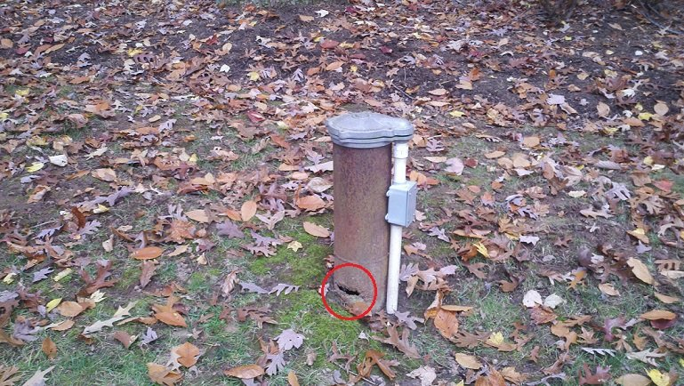
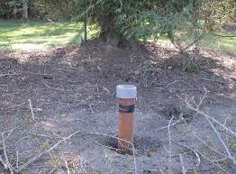
What is a Sanitary Defect?
Examples
Cracked Well Casing
Leak in the distribution line
Improper grading around
the Well Casing
Notes:
Some examples of sanitary defects would be but are not limited to a missing well cap, cracks in the well casing, improper air gap on the softener brine waste line, a small leak in a distribution line, or improper grading around the well casing.

Slide 9
Elements of Assessments
At a minimum, assessments must include review and identification of:
1. Events that happened that could create impaired water quality
2. Changes in distribution system O&M that may affect distributed water quality, including water storage
3. Source and treatment considerations that bear on distributed water quality
4. Existing water quality monitoring data
5. Inadequacies in sampling sites, sampling protocol, and sample processing
Notes:
In conducting a Level 1 the assessor must evaluate minimum elements as outlined in the Rule. These elements are as follows:
Atypical events that may affect water quality or indicate that water quality was impaired.
Changes in distribution system maintenance and operation that may affect distributed water quality, including water storage.
Source and treatment considerations that bear on distributed water quality, where appropriate.
Existing water quality monitoring data.
Inadequacies in sample sites, sampling protocol, and sample processing.
40 CFR 14.859(b)(2)

Slide 10
Assessments and Corrective Actions
Conduct Level 1 assessment of the system when certain conditions occur.
Any sanitary defect found must be corrected within required time frame.
Completed assessment form must be submitted to IDEM within 30 days of learning of the trigger.
Notes:
The PWS must conduct a Level 1 assessment of the system when one is triggered.
Any sanitary defect found during the assessment must be corrected within required time frame.
The completed assessment form must be submitted to IDEM within 30 days of learning of the trigger. If not, a violation will occur.

Slide 11
Reporting
PWSs are required to report the following within a required timeframe:
Monitoring Results
EC+ routine sample: end of day
EC MCL violation: end of day
Treatment technique violation
Completed assessment form: 30 days from trigger
Completed corrective action: 30 days or IDEM determined
Certification of compliance with PN requirements
Failure to comply with any of the RTCR requirements
Notes:
With the new RTCR, PWSs are required to report the following within a required timeframe:
The required monitoring results;
Any EC+ routine sample by the end of day;
Any EC MCL violation by the end of day;
All Treatment technique violations;
The Completed assessment form is due 30 days from the trigger date;
The Completed corrective action is due in 30 days or if IDEM determines a longer; time is needed
All Certification of compliance with PN requirements;
And any time your system fails to comply with any of the RTCR requirements.

Slide 12
Recordkeeping
PWSs are required to keep records of the following within the required timeframe:
Monitoring results
Assessment forms and documentation of corrective actions completed
Copies of PN issued
Certifications
Site Sampling Plans
Notes:
Also, PWSs are required to keep records of the following within the required timeframe:
Any Monitoring results;
All Assessment forms and documentation of corrective actions completed;
Any Copies of PN issued;
All Certifications;
And Site sampling plans/

Slide 13
Questions? Contact IDEM at (317) 234-7430
Notes:
If you would like to talk to someone about these new requirements please call the IDEM DWB at 317-234-7430.

