Slide 1
Seasonal Systems
Notes:
During this presentation we are going to cover seasonal systems in regards to the Revised Total Coliform Rule, also known as the RTCR. All components of this rule will go into effect on April 1st, 2016.

Slide 2
Are you a Seasonal System?
Non-community water system.
Starts-up and shuts-down at the beginning and ending of each operating period.
Examples – campgrounds, fairgrounds, and seasonal food service facilities.
Notes:
So what is a seasonal system – a seasonal system is defined as a non-community water system that is not operated as a public water supply (PWS) on a year-round basis and starts-up and shuts-down at the beginning and end of each operating season. Examples include campgrounds, fairgrounds, and seasonal food service facilities.
From RTCR Fact Sheet

Slide 3
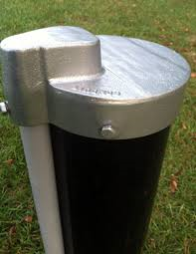
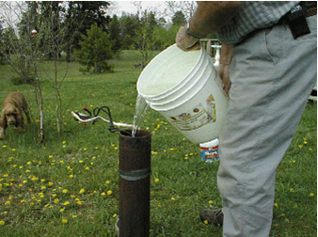
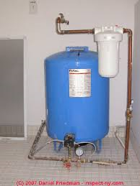
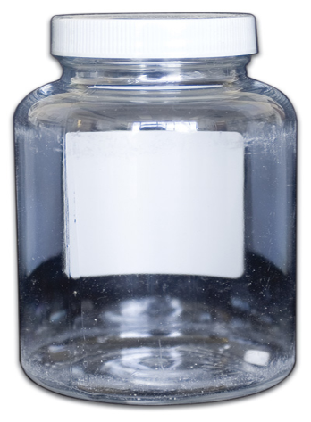
Step 1: Start-Up Procedures
Notes:
Start up procedures are a new element with the RTCR. Starting April 1, 2016, all seasonal systems must complete the state required startup procedures before serving water to the public. Your water system must complete and submit the state certification form confirming completion of these start-up procedures. In the next slide I am going to go over the key elements of the required start-up procedures.

Slide 4
Start-Up Procedures
Flush all pipes until water is clear.
Inspect and Repair.
Disinfect the system.
  Guidance on how to properly disinfect you system can be found on the following website http://www.in.gov/idem/files/welldisinfection.pdf
Collect a satisfactory special purpose sample.
Notes:
You must conduct your state start-up procedures before delivering drinking water to your customers. Start-up procedures help reduce the presence of harmful bacteria in water. The key elements are as follows
Flush all pipes until the water is clear
Flushing the pipes in all areas of your water system helps remove buildup and dirty water that has gathered during the off season.
Next Inspect and Repair
You will need to inspect the entire system to make sure everything is in good working order. This includes the well cap and casing, any treatment equipment you may have, all storage tanks and all distribution lines or system piping.
Then Disinfect
Kill harmful bacteria and inactivate viruses by adding a disinfectant or by making sure the adequate disinfectant residual is present in all areas of your water pipes. Your system should be flushed thoroughly. Be sure to keep the highly chlorinated water away from surface water bodies such as lakes, streams, and ponds, as well as septic systems..
You can find guidance on how to properly disinfect your water system at the website posted on the slide.
Collect Special Purpose Samples
Collect water samples and have them tested for the presence of bacteria at a state certified lab, after flushing, cleaning, repairing, and disinfecting your water system. These samples need to be marked special purpose. Also, if applicable, sample and test to determine if the adequate amount of disinfectant residual is present to help provide safer drinking water. You should find out your sample results before delivering water to your customers.

Slide 5
Submit Seasonal Systems Start-up Requirements Form
A link to this form (55927) can be found on our RTCR Website under “What’s new for Seasonal Systems.”
Perform all of the items on the form.
Once completed, sign the form.
Submit the form to IDEM.
Failure to complete required start-up procedures will result in a violation.
Notes:
Complete and submit the seasonal start-up requirements form (form 55927). A link to this form can be found on our RTCR website, under “What’s New for Seasonal Systems.”
Once you have completed all of the start-up procedures on the checklist, you will sign the bottom of the form and submit that form to IDEM. This form is certifying that you have completed all of the required start- up procedures and your system is ready to be opened to the public. You can submit the form by mail, fax, email, or hand delivery.
If your water system does not complete all of the start-up procedures, you must notify your customers that your water system had a drinking water violation for failure to complete start-up procedures and inform them of any possible health risks.

Slide 6
Complete Shutdown Procedures
      Inspect your entire system and look for problems and damage that needs attention or repair.
      Turn off the power to your water supply pump and all treatment systems.
      If there is potential for your pressure tank or storage tank to freeze, drain it. If there is no potential for your tanks to freeze, you may choose to leave them full.
      Drain all of the water from your internal plumbing.
      Protect your distribution system by not leaving taps open in the off season.
Notes:
Similar to start-up procedures, completing shutdown procedures at the end of your business season will help you minimize repairs to the water system when your water system opens up again next season. In general, you should:
- Inspect your entire system and look for problems and damage that needs attention or repair.
-Turn off the power to your water supply pump and all treatment systems.
-If there is potential for your pressure tank or storage tank to freeze, drain it. If there is no potential for your tanks to freeze, you may choose to leave them full.
-Drain all of the water from your internal plumbing.
-Protect your distribution system by not leaving taps open in the off season.

Slide 7
Site Sampling Plans
Must submit a site sampling plan to IDEM on or before March 31st, 2016.
Samples must be collected based on the written site sampling plan.
Samples are monthly when water system is in operation (during open season).
Notes:
The next component of the RTCR is the Site Sampling Plan.
Every system must submit a site sampling plan to IDEM on or before March 31st, 2016.
Samples must be collected based on the written site sampling plan.
All seasonal systems must sample for TC once a month for all the months that they are in operation.

Slide 8
Site Sample Plan
Example
Notes:
This is an example of an acceptable site sampling plan for a campground. As you can see from the map, they have a Routine sample site located at lot #5 which is representative of the distribution system. They have acceptable upstream and downstream sample locations at lots 8 and 3 because they are located within 5 service connections from the routine sample location. So this system will use this map to know where they need to collect their monthly routine TC sample as well as where they need to collect their repeats in the case they have a positive routine sample one month. They also have included their source water sampling tap for the Ground Water Rule sampling if it should be triggered.

Slide 9

Questions? Contact IDEM at (317) 234-7430
Notes:
If you would like to talk to someone about these new requirements please call the IDEM DWB at (317) 234-7430

