Slide 1
Project Lifecycle Insights From a District Project Manager
Jennifer Beck, PMP Taylor Darrah
Senior Project Manager Project Manager
Greenfield District

Slide 2
Agenda
Introduction
INDOT Asset Management Cycle
INDOT Project Lifecycle
Initiation
Development
Construction
Final Closeout
Parting Words
Questions

Slide 3
Introduction
Greenfield District PM Teams
Tipton/Albany Sub
Jennifer Beck, Taylor Darrah, Sacha Teague, Kim Szewczak
Greenfield/Cambridge City Sub
Nathan Riggs, Don McGhghy, Ashleigh Pattison, Jodi Riall
Indy Sub
Christine Williams, HT Pham, Sarah Doyle, Stacey Sorrell

Slide 4
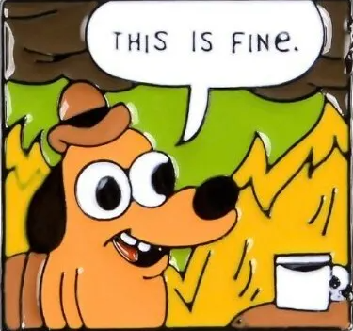
Introduction

Slide 5
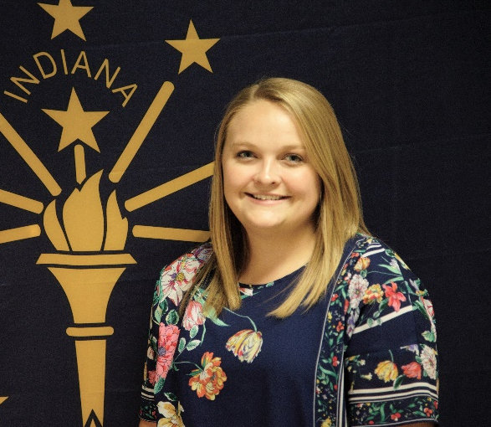
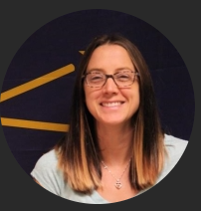
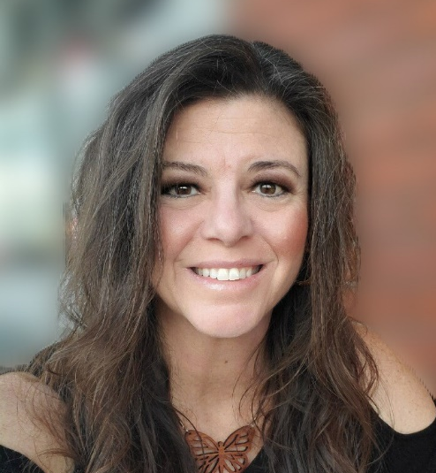
Introduction
Taylor Darrah Kim Szewczak Sacha Teague
Jay, Randolph, Delaware Hamilton & Madison Tipton, Howard

Slide 6
INDOT Asset Management Cycle
Technical Services
Capital Programs
Construction
Maintenance

Slide 7
INDOT Project Lifecycle
Initiation
Scoping
Development
Progress Reporting
Construction
Oversight
Final Closeout
Team Creation
Programming
Close PO’s
Progress Meetings
Final Review of Contracts
Managing scope, schedule and budget

Slide 8
INDOT Project Lifecycle - Initiation
New Project Assignment is Made
Technical Services Scoping
Virtual Van Trips / Call for Projects
Mini Scope / Engineering Assessment
Local Program Funding Award
Rural or MPO Project Application
Early Coordination Meeting
Technical Services
Capital Programs
Construction
Maintenance

Slide 9
INDOT Project Lifecycle - Initiation
New Project Assignment Checklist* for an INDOT Project Manager
Confirm all scoping documents have been received
Review for potential project bundling
Determine appropriate delivery method (in-house, small purchase, on-call, RFP)
Confirm/Request funding to be programmed and added to the TIP and/or STIP
Update SPMS
Project Team
Schedule
Risk Assessment
Log Notes
*Not all inclusive

Slide 10
INDOT Project Lifecycle - Initiation
Project Scoping Meeting
Includes Contracts Department
Discuss appropriate tasks, level of effort, payment schedule, etc.
Project Kickoff Meeting
Includes Project Team Stakeholders
Set Expectations
Preferred communication, Risk Evaluation, Problem Resolution Plan, Decision Making Authority, etc.
Set Schedule
INDOT Required Milestones to be programmed into SPMS within 60 days of Project Assignment

Slide 11
INDOT Project Lifecycle - Initiation
Early Coordination Meeting
For local projects only
Rural or MPO funding
Sets expectations between INDOT PM and the ERC assigned
Set general schedule

Slide 12
INDOT Project Lifecycle - Initiation
Interlocal Agreements
Local Projects
Boilerplate agreement, per phase
State/Local Partnerships
Serves as the Project Charter
Terms can vary widely project to project
Outlines roles and responsibilities between agencies
Project Manager must be intimately familiar with the details

Slide 13
INDOT Project Lifecycle - Initiation
Project Manager Insights
Jennifer
The time spent in the initiation phase can make or break a project. Don’t rush into a kickoff meeting if you’re not ready to get into the weeds.
Taylor
Schedules should be customized for each project based on specific needs. No one is entitled to the dates provided in the letting prep schedule, if a Project Manager wants to build in float and have earlier deadlines, they are entitled to request this.
Sacha
Project Mangers need to know all members of their project team with roles and responsibilities clearly defined. This includes respective INDOT oversight team members where applicable.
Kim
Identifying risks and establishing risk mitigation plans from day one is critical.

Slide 14
INDOT Project Lifecycle - Development
Carry the project through the Project Development Process
Keep all stakeholders informed and involved…
Technical Services
Capital Programs
Construction
Maintenance

Slide 15
INDOT Project Lifecycle - Development
District*
Utilities
Environmental
R/W
Program Director
ERMS Coordinator
Local Programs
Asset Owners
Scoping
Construction
Maintenance
R/W Permits
Survey
*Not all inclusive
Central Office*
Legal
Contracts
Communications
Legislative Affairs
Executive Office
Finance
Pavement Design
Hydraulics
Real Estate
Waterway Permitting
Design Review
Geotech

Slide 16
INDOT Project Lifecycle - Development
External Stakeholders
Other State Agencies
IDEM, DNR, ISP, IEDC, etc.
Local agencies
Elected officials, city/county staff
MPOs
Local Emergency Responders
Police, fire, nearby hospitals
Local Schools Districts
Local Businesses & Business Organizations

Slide 17
INDOT Project Lifecycle - Development
Monitor Project Progress
Progress reports / meetings
Maintain SPMS Data
Keep the schedule up-to-date
Update funding program and estimates
Request TIP/STIP updates as needed
Update Risk Register monthly
Add log notes as needed to reflect status updates, issues with resolutions and meetings
Upload relevant documents/e-mails
Request Change Management when necessary
Cost increase
Scope change
Schedule delay (moving out of current fiscal year)

Slide 18
INDOT Project Lifecycle - Development
Change Management Expectations
Scoping Documents
New Score completed by District Asset Engineer
Cause/Justification – must be well written, balancing detail with brevity
Safety Concerns and/or Conditions
If changing project limits – include PK’s, pavement logs, condition of pavement (slicer data), define how it contributes to overall purpose and need
Condition of asset (bridge and pavement data) and if it can support a fiscal year change
New Estimate – what changed, comparison spreadsheet with % increase/decrease
Have other options been considered?
Has Value Engineering been applied?
Change Managements related to scope should be submitted no later than Stage 2
Change Managements related to cost should be submitted no later than Stage 3

Slide 19
INDOT Project Lifecycle - Development
Constructability Reviews
Requested for all stage submittals
Requires manual upload of stage submittal documents
Critical for ensuring construction feedback throughout the development process
Document transfers / access to large documents
ERMS is great for viewing, but not sharing
Coordinate mutually agreed upon location for sharing project documents
Independent sharefile sites can be beneficial
Final Tracings Reviews
Annual Fiscal Year Lockdown reviews

Slide 20
INDOT Project Lifecycle - Development
Review and Approve Consultant Invoices
Ensure correct PO is being invoiced
Ensure tasks billing towards line up with progress report/activities witnessed
Look for typos or errors that could trigger audit issues
Evaluate Consultant Supplemental Fee Requests
Complete Consultant Performance Evaluations
Stage 1
Stage 2
Stage 3
Final Tracings

Slide 21
INDOT Project Lifecycle - Development
Local Projects
Review Quarterly Reports and Attend Quarterly Meetings
Update Schedules
Provide feedback on development progress for program administrators
Assist ERC’s Upon Request
Project Consultant Reviews at Final Tracings

Slide 22
INDOT Project Lifecycle - Development
Project Manager Insights
Jennifer
It’s unacceptable for a designer to bring a problem to our attention with no solutions or suggested next steps. This is what we are paying for.
Taylor
PM – Consultant communication is so important because of the extensive internal communication that is constantly happening. When things change, be it scope, schedule or budget, we need to know why!
Sacha
Consultant PMs need to be the ones to keep INDOT PMs informed, you don’t want the INDOT PM to find out about a project problem from someone else. Ensure PMs are included in or aware of all INDOT coordination.
Kim
Early communication of potential change managements is tremendously helpful due to the amount of work needed to get them through the process.

Slide 23
INDOT Project Lifecycle - Construction
Attend Progress Meetings
Ensure project purpose is carried on through construction
Oversee fulfillment of project commitments
Assist with determining participating vs. non-participating change orders
Track Error & Omission change orders
Recoverable vs. Non-Recoverable
Document and share lessons learned
Oversee the unofficial detour process
When applicable, manage public outreach

Slide 24
INDOT Project Lifecycle - Construction
Time to build the project!
Project Lead transfers from Project Manager to Project Engineer/Supervisor
Point of transfer occurs at the Pre-Construction Conference
Project Managers are still involved throughout construction
Technical Services
Capital Programs
Construction
Maintenance

Slide 25
INDOT Project Lifecycle - Construction
Project Manager Insights
Jennifer
Designers and Project Managers need to agree with the level of involvement in progress meetings.
Taylor
Change Orders – we are required to ensure that the change order is still in compliance with the project planning/environmental/permit documents. Especially when plan revisions are involved.
Customer Services inquiries are heavier during this phase, so we still need consultant support to address the questions as they arise.
Sacha
Lessons learned are so important to improve the quality of future projects. Whenever any are identified throughout the construction process, please ensure the PMs are in the loop.
Kim
Include PMs on all correspondence with construction, we’re still involved! And we’re the one’s approving the invoices!

Slide 26
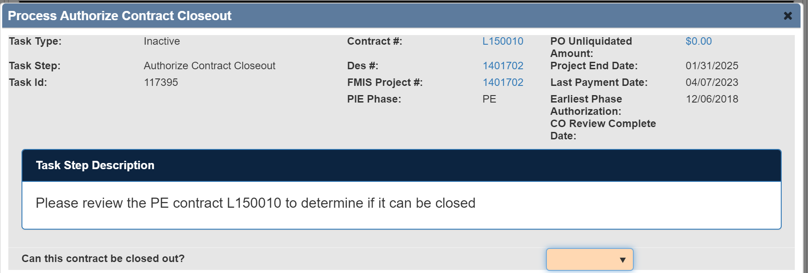
INDOT Project Lifecycle – Final Closeout
Project Managers ensure timely closeout of all INDOT projects
Make sure final invoices for all phases have been received and paid.
Ensure contract tasks were fulfilled
Consultant Contracts
INDOT/LPA Contracts
Interlocal Agreements
Maintenance Agreements

Slide 27
INDOT Project Lifecycle – Final Closeout
Project Manager Insights
Jennifer
Project close out can get really complicated if an error in invoicing is found in audit, PLEASE review invoices before your finance department sends them out to help us avoid a big mess at the end of a project!!
Taylor
If a project has been completed for a while and are we asking the consultant if they are done invoicing, there needs to be a very good reason if the answer to that question is no.
Sacha
Invoice regularly so that PO’s stay active. At least every 6 months – or explain why you can’t invoice for 6 months. Keep us informed!
Kim
Mark your last invoice appropriately so POs don’t sit open indefinitely, even if the balance is zero.

Slide 28
Parting Words

Slide 29
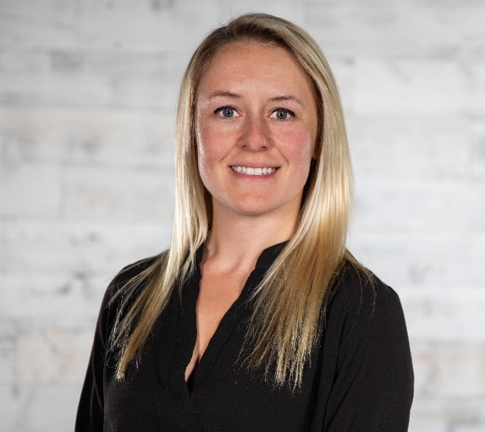
Questions?
Jennifer Beck, PMP
Senior Project Manager
Indiana Department of Transportation
Greenfield District
Cell: (765) 745-8276
Email: jbeck@indot.in.gov
Taylor Darrah Project Manager
Indiana Department of Transportation
Greenfield District
Office: (317) 467-3915
Cell: (317) 526-6080
Email: TDarrah@indot.in.gov

