Slide 2
User Manual Outline
Web-General overview
1.1 Login / Logout
1.2 Screen concepts
1.3 Tabs/Fields
1.4 Menu/buttons
Inventory
2.1 Asset Types
2.2 Asset Chapters and Attributes
2.3 Asset Elements
2.4 Asset Add/Edit
2.4 Elements Add/Edit
2.5 Asset Documents
2.6 Asset Photos
2.8 Map
Inspections
3.1 Inspection Menu
3.2 Inspection Task Info
3.3 Inspection Documents
3.4 Inspection Photos
Critical Findings
4.1 Critical Findings Menu
4.2 Critical Findings Task Info
5. UAT Test Scenarios 1/10/2023

Slide 3
General Overview
1

Slide 4
1.1 Login/Logout

Slide 5
1.2 Screen concepts
Search section
Content section
Menu section

Slide 6
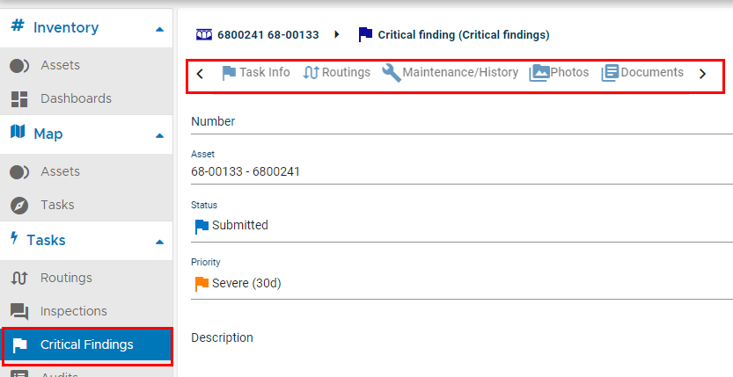
1.3 Tabs/Fields
Field types
Text
Numerical
Boolean
Date
Hour
Rich text
Field entering
Input
Dropdown list
Field accessibility
Read-only
Editable

Slide 7
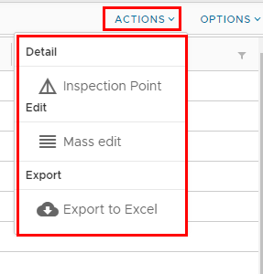
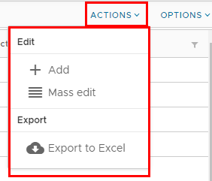
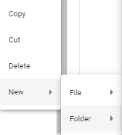
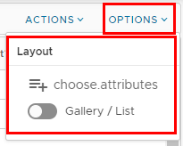
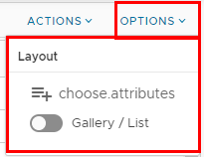
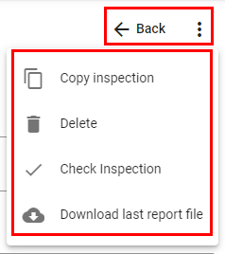
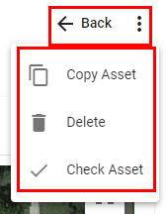
1.4 Menus/Buttons
Main Buttons
Inspections
Assets

Slide 8
Inventory
2

Slide 9
2.Inventory
2.1 Asset Types
2.2 Asset Chapters and Attributes
2.3 Asset Elements
2.4 Asset Add/Edit
2.5 Element Add/Edit
2.6 Asset Document
2.7 Asset Photos
2.8 Assets in the Map

Slide 10
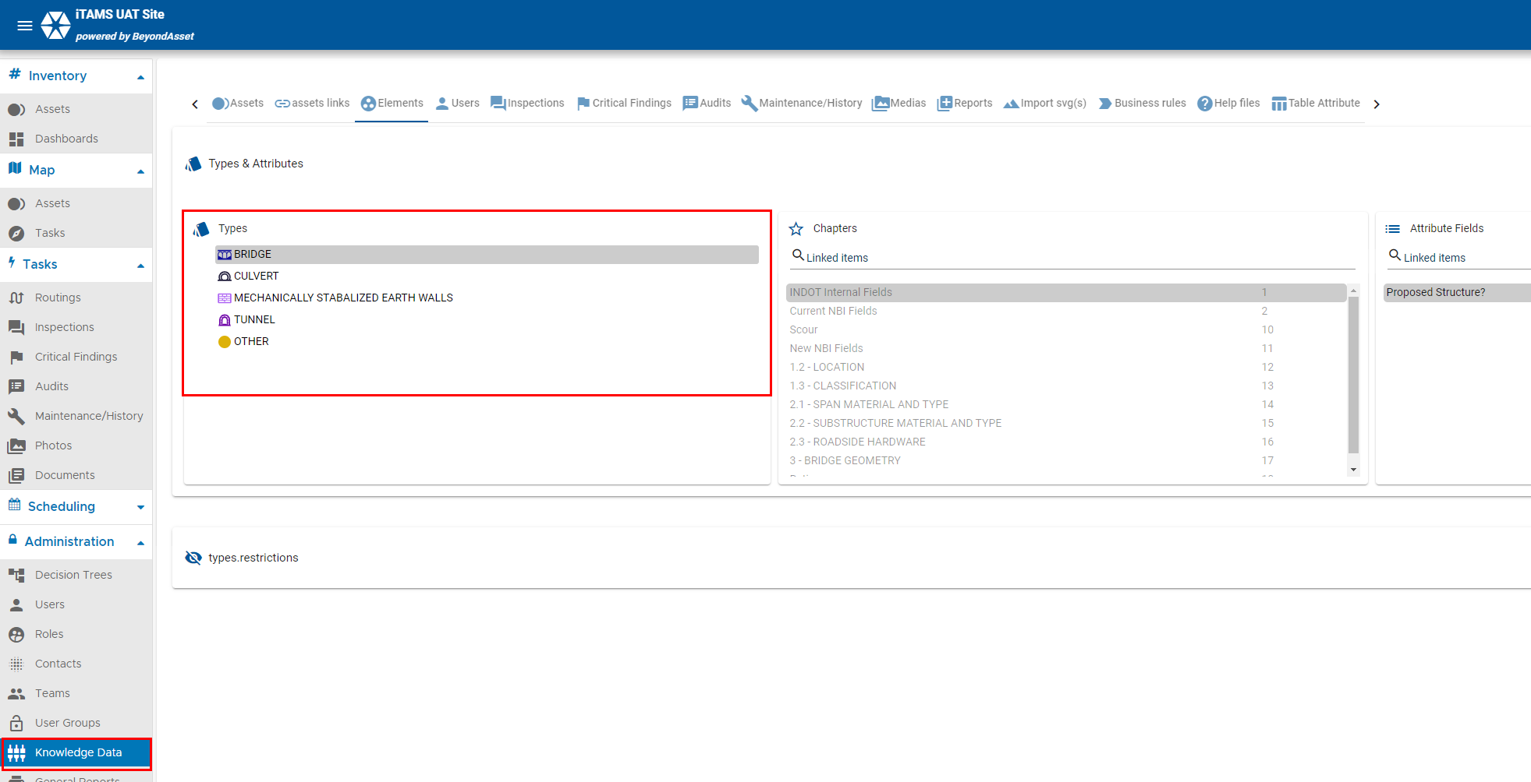
2.1 Asset Types

Slide 11
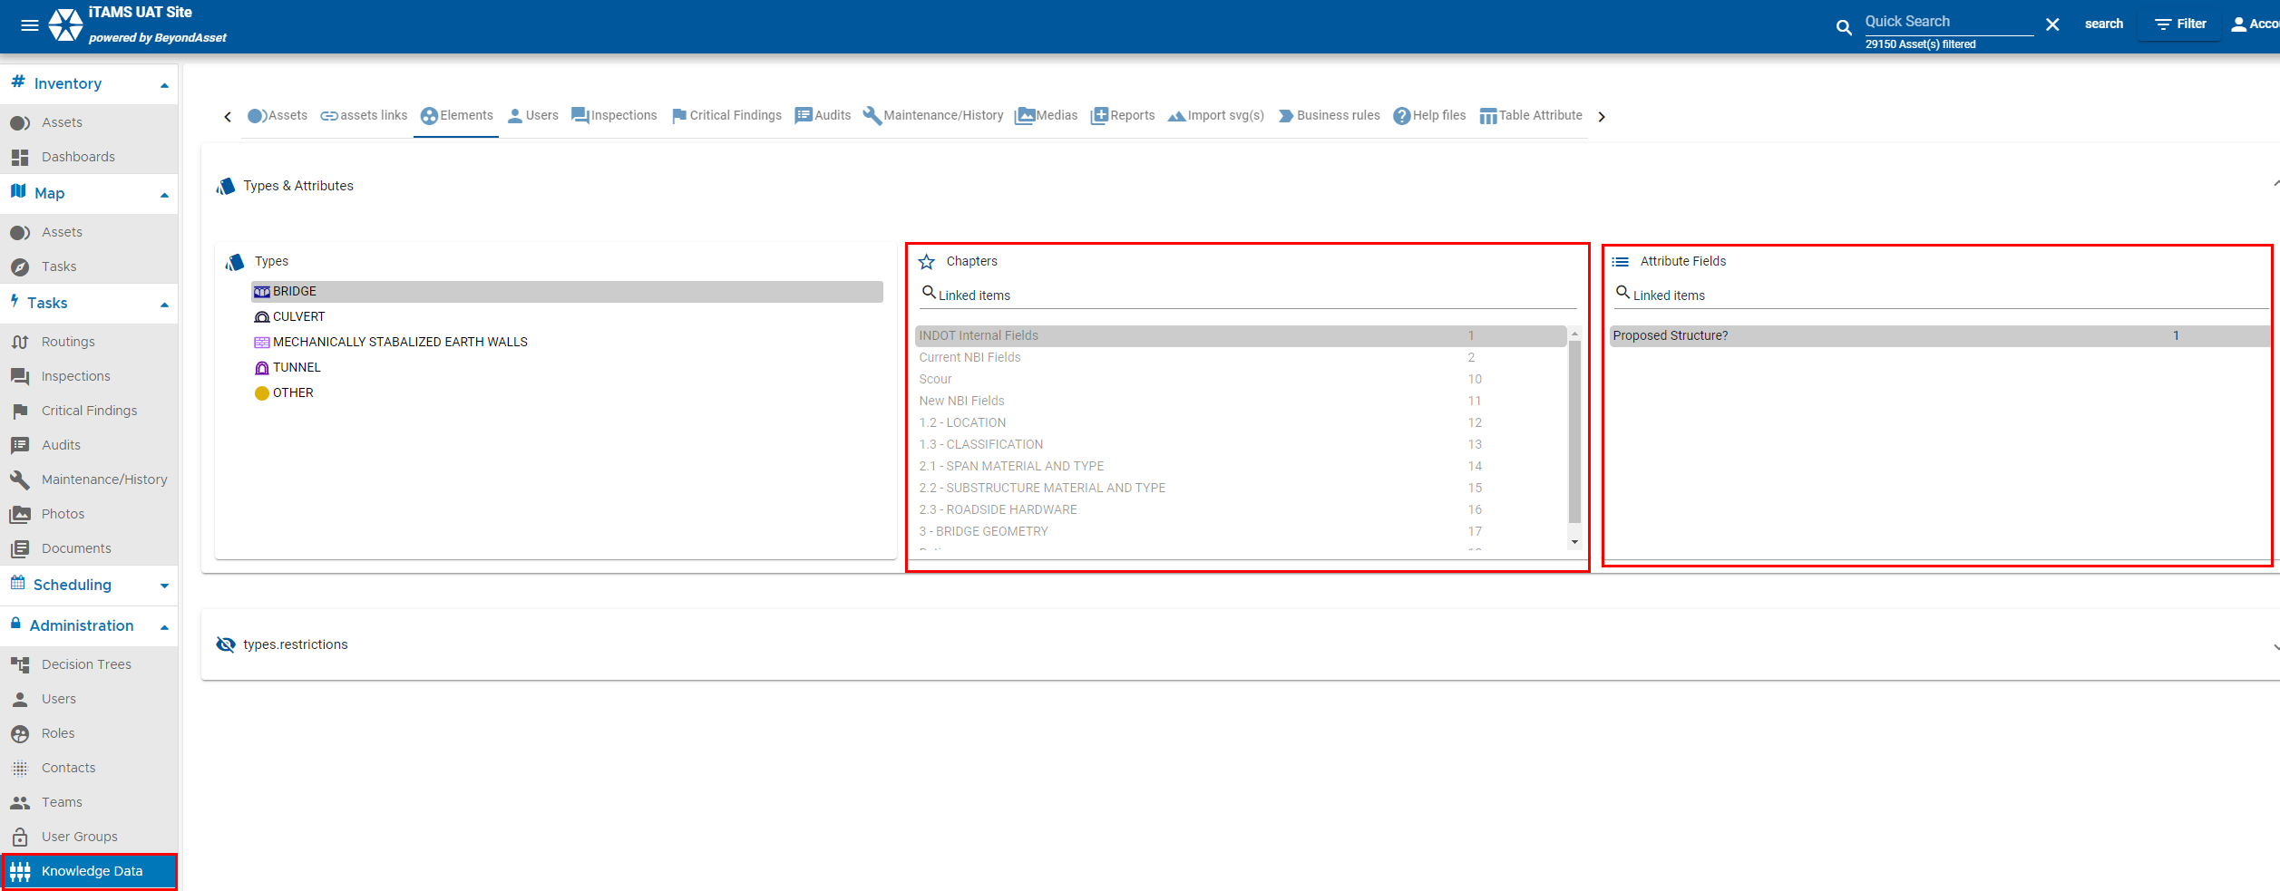
2.2 Asset Chapters and Attributes

Slide 12
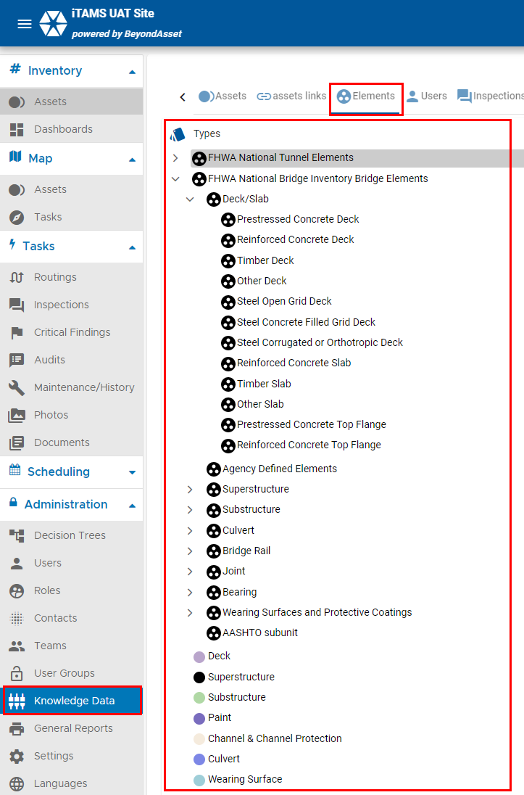
2.3 Asset Elements

Slide 13
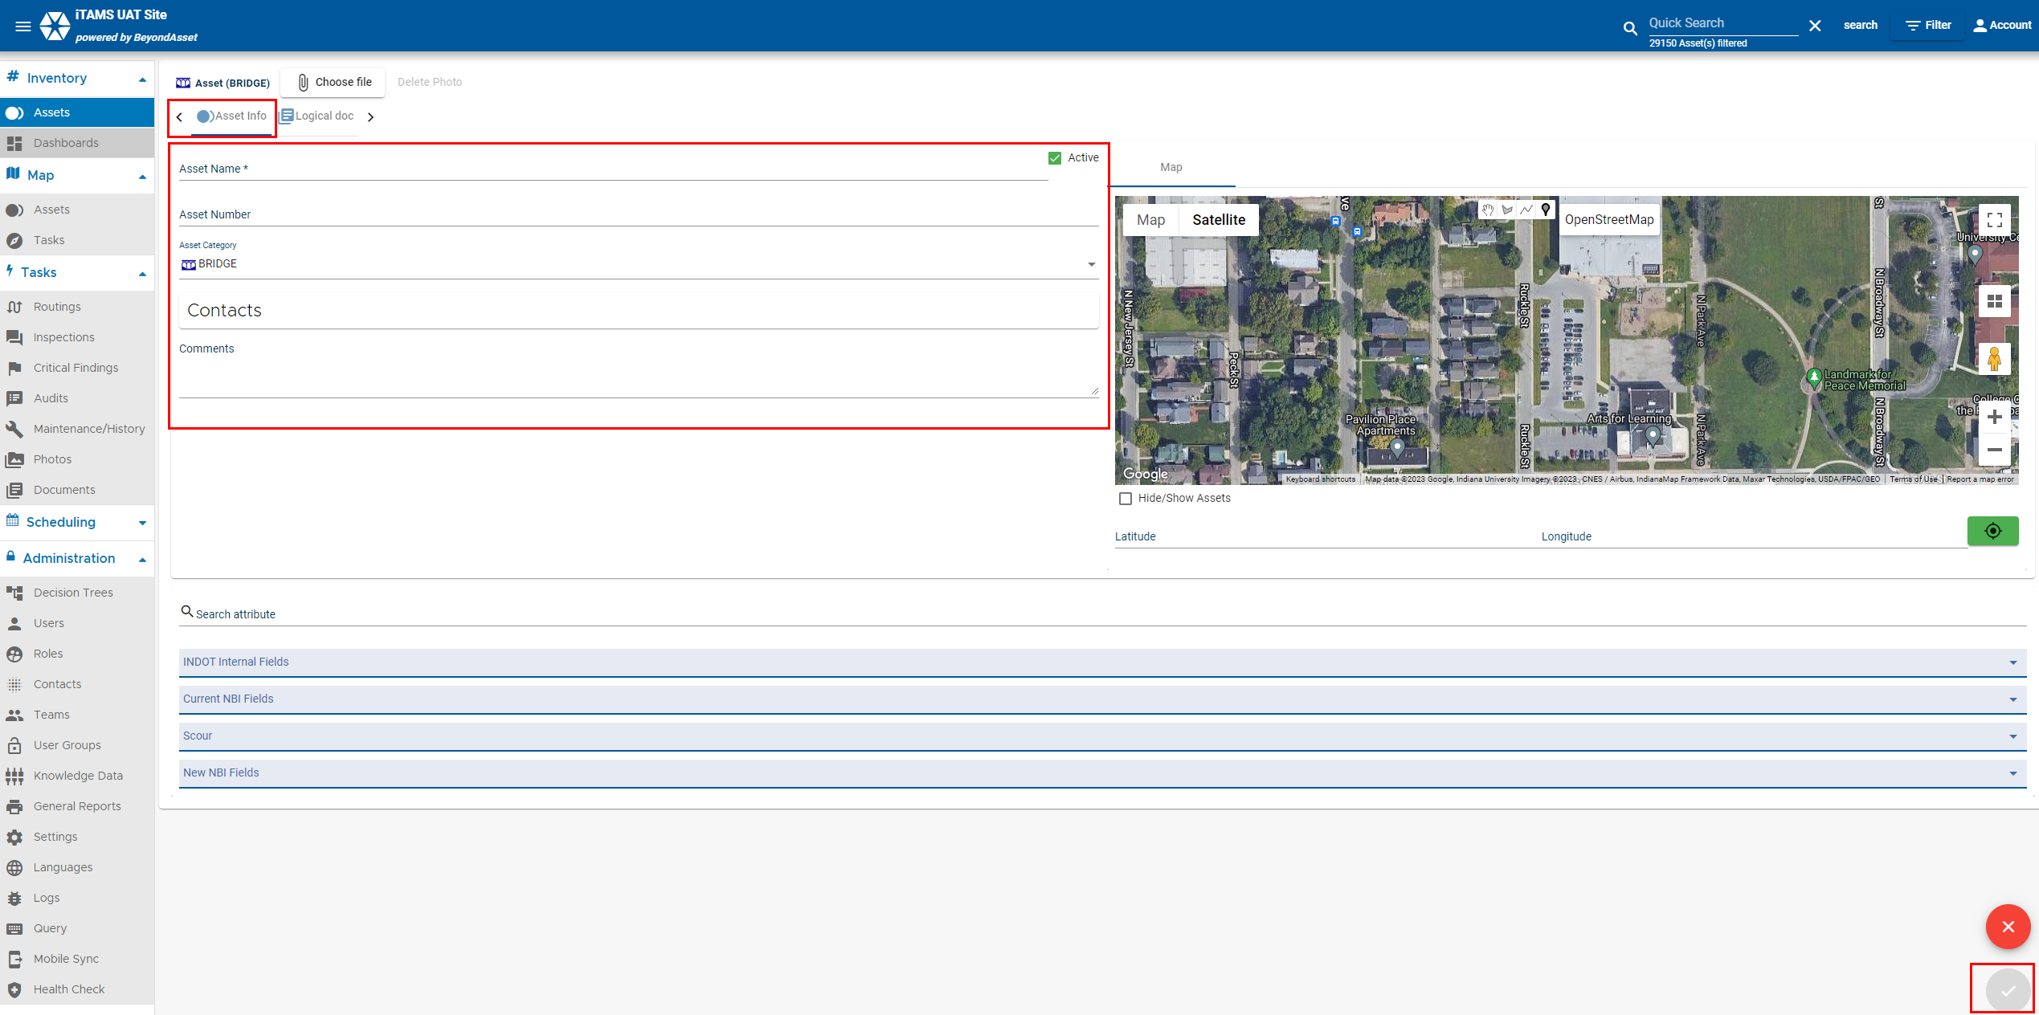
2.4 Asset Add/Edit

Slide 14
2.5 Element Add/Edit

Slide 15
2.6 Asset Documents

Slide 16
2.7 Asset Photos

Slide 17
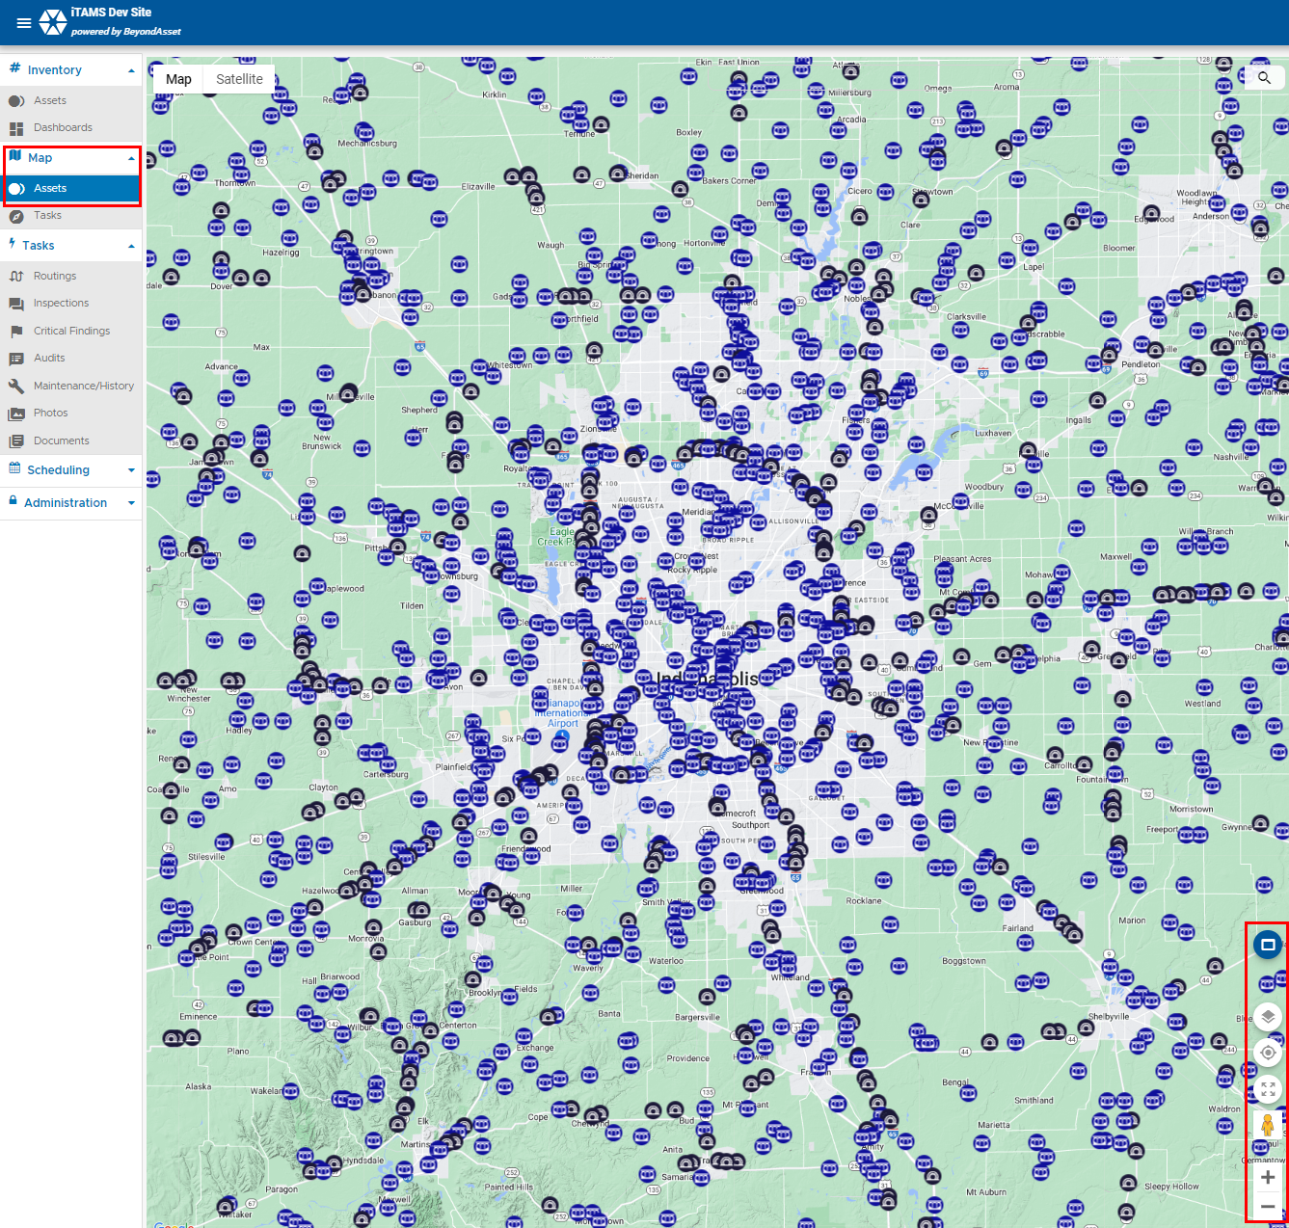
2.8 Map

Slide 18
Inspections
3

Slide 19
3.0 Inspections
3.1 Inspection Menu
3.2 Inspection Task Info
3.3 Inspection Documents
3.4 Inspection Photos

Slide 20
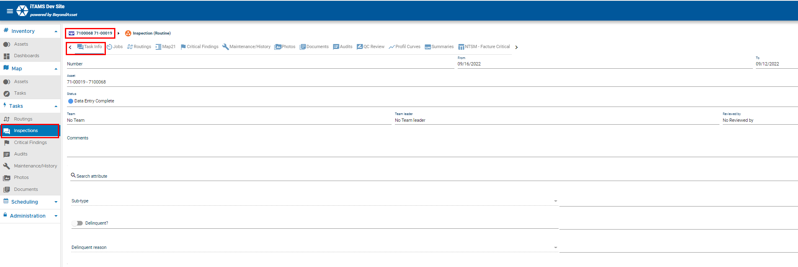
3.1 Inspections Menu

Slide 21
3.2 Inspection Task Info

Slide 22
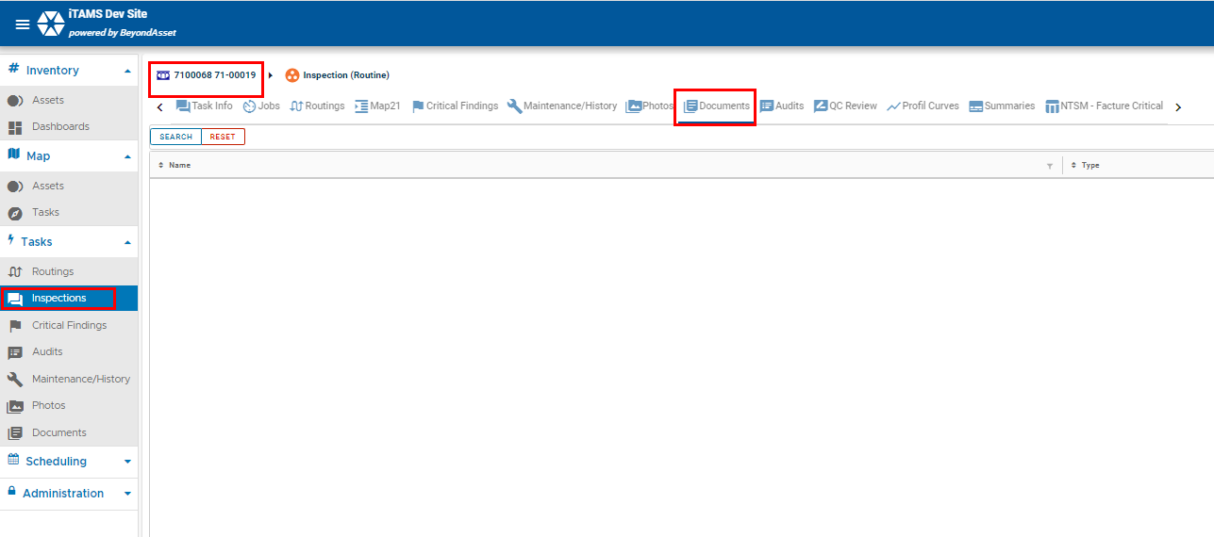
3.3 Inspection Documents

Slide 23
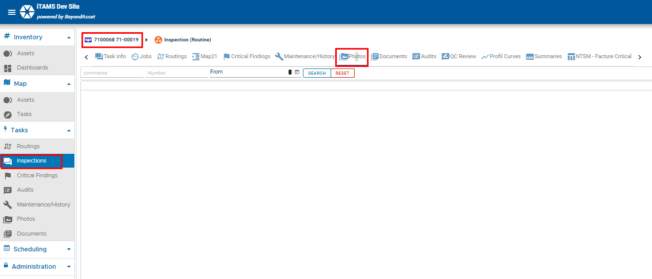
3.4 Inspection Photos

Slide 24
Critical Findings
4

Slide 25
4.0 Critical Findings
4.1 Critical Findings Menu
4.2 Critical Findings Task Info

Slide 26
4.1 Critical Findings Menu

Slide 27
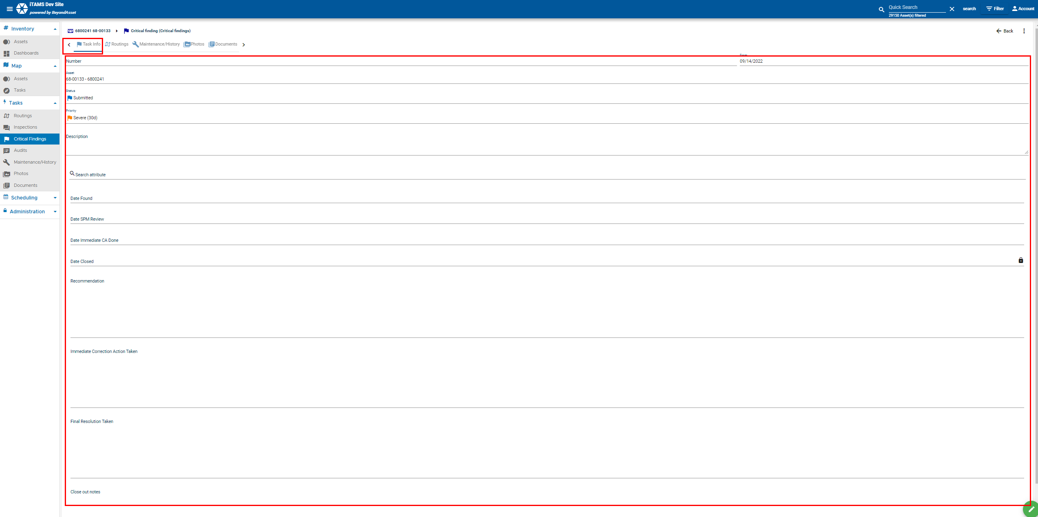
4.2 Critical Finding Task Info

Slide 28
UAT Test Scenarios 1/10/2023
5

Slide 29
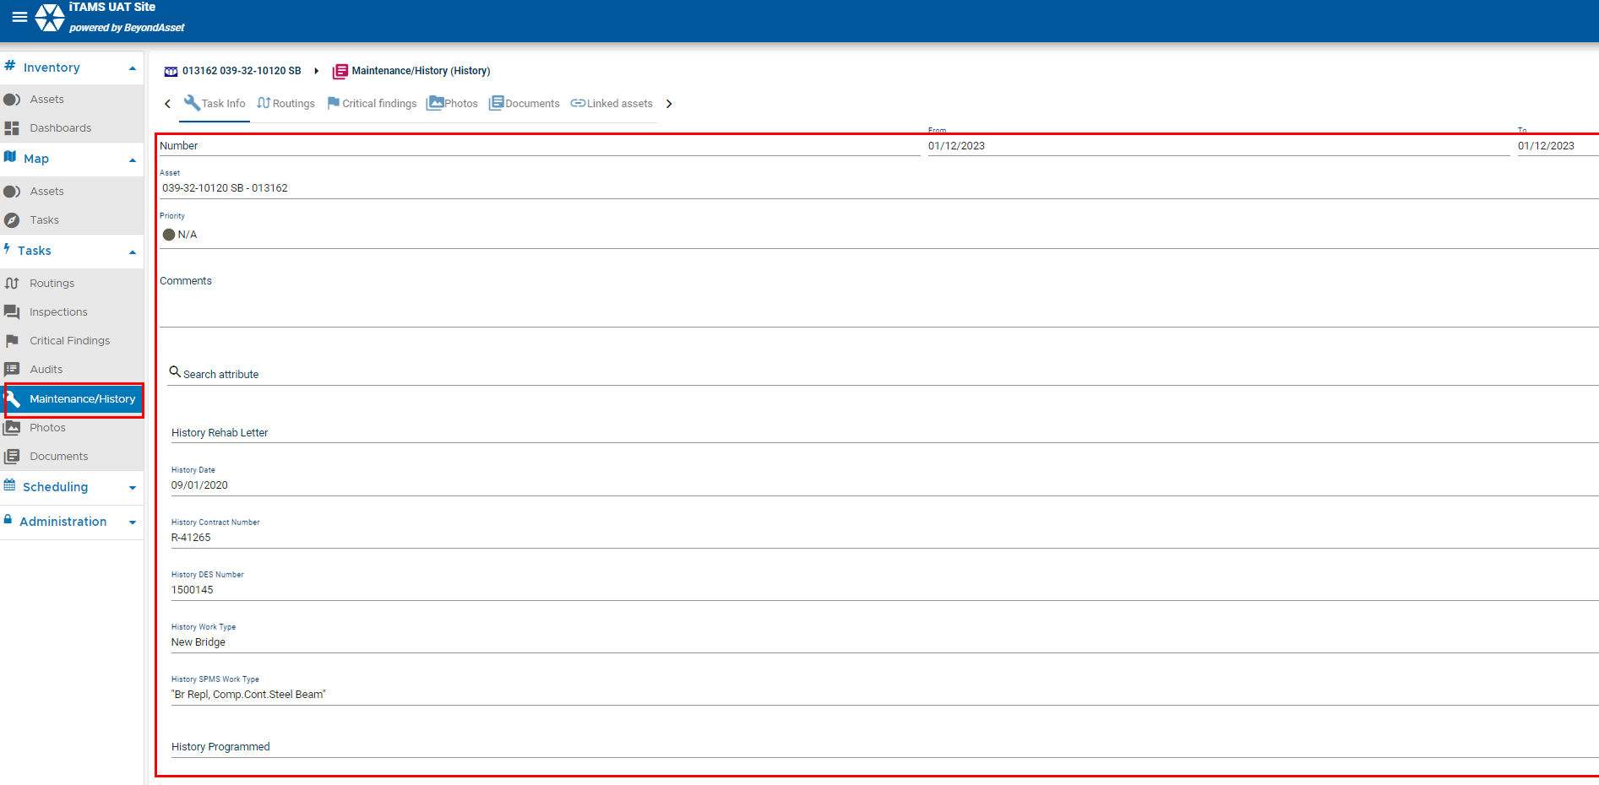
9
Reset Filter in the top right of the page. Navigate to the Maintenance/History Menu. Select record with the type = to “History”. See bridge history..

Slide 30
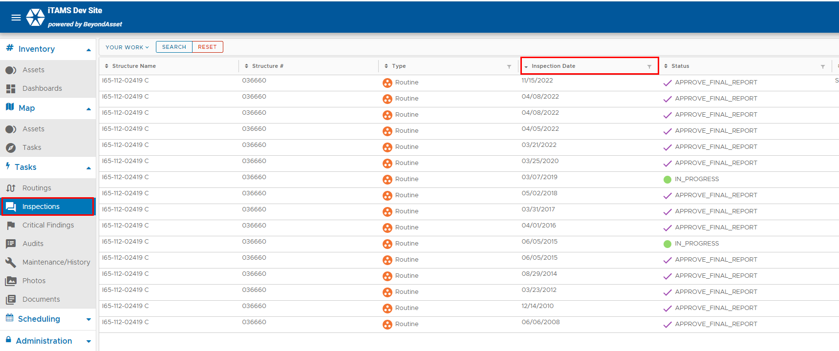
10
Rename Start Date for Inspections to be named “Inspection Date”. Navigate to the Inspection Menue. See the column "Inspection Date".

Slide 31
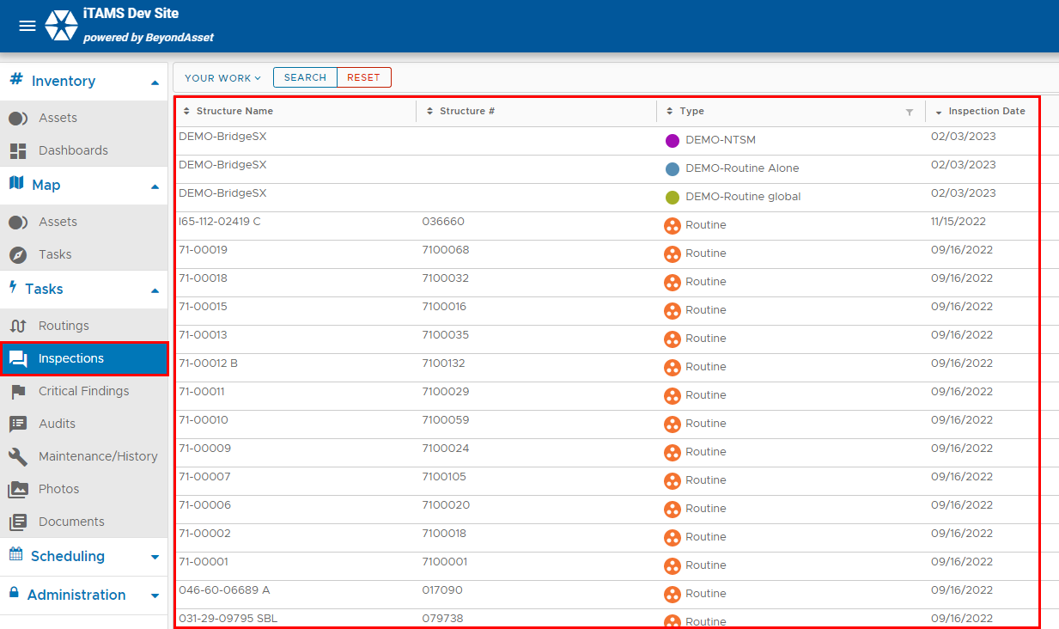
15
The Home Page should default to the Inspection Menu. Login to iTAMS and see how the Inspection Menue is highlighted and displayed.

Slide 32
16 - Manually Change in UAT
Inspection Column Defaults should be the following: Asset Name, Asset Number, Inspection Type, Inspection Date, Team Leader, Status, Team (Consultant). Navigate to the Inspection Menu. The Columns displayed should be the following: Asset Name, Asset Number, Inspection Type, Inspection Date, Status, Team Leader, Team.

Slide 33
17
Asset Column Defaults should be the following: Contact (Parent Asset), Asset Name, Asset Number, Asset Category, Feature Carried, Feature Intersected. Navigate to the Asset Menu, the following columns should be displayed: Contact (Parent Asset), Asset Name, Asset Number, Asset Category, Feature Carried, Feature Intersected.

Slide 34
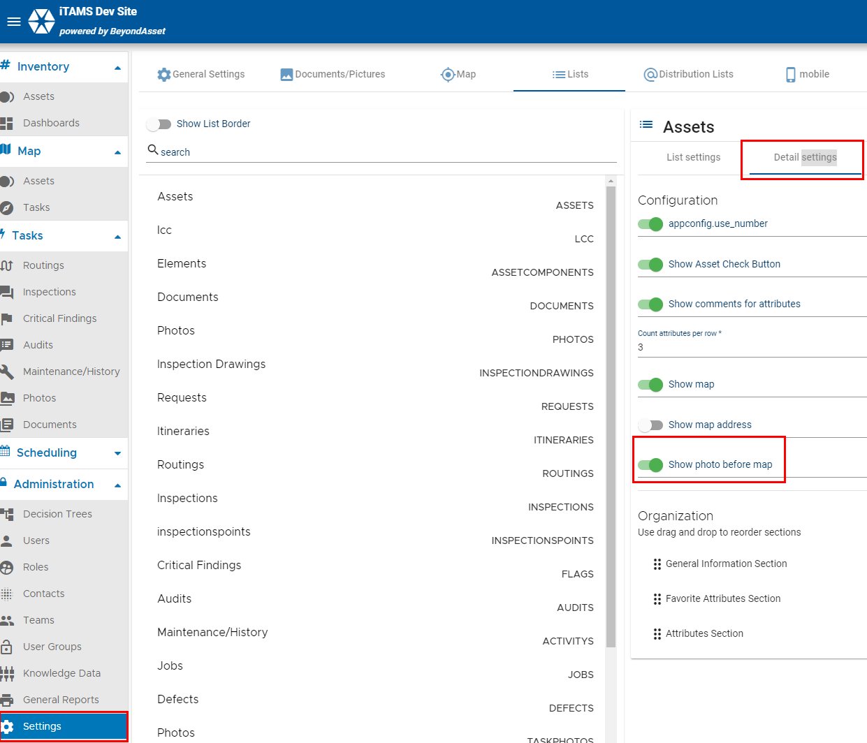
20
In the Asset Detail page, the photo should be displayed as the default instead of the map. See backend settings. Only Admins will be able to see the backend. Users can navigate to an asset, the image displayed should be "Photo".

Slide 35
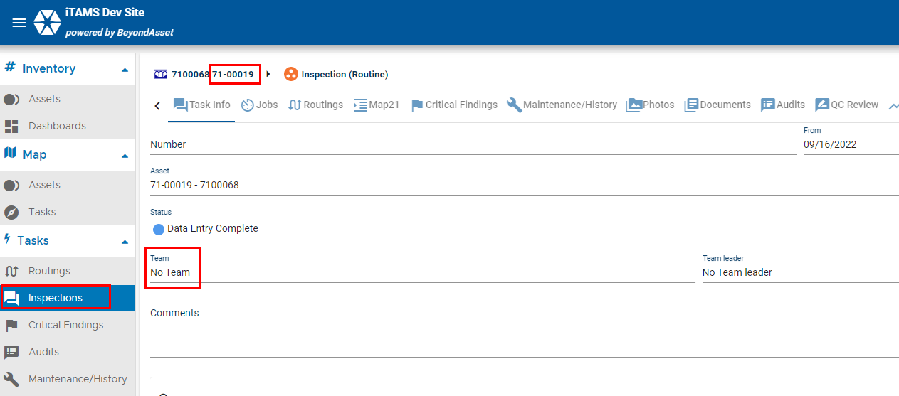
24
Display Team Member field in the Inspection screen. Navigate to the Inspection Menu, see the "Team" column. Select an inspection, see "Team" field. Note that the Teams have not yet been loaded into iTAMS so the value will appear blank.

Slide 36
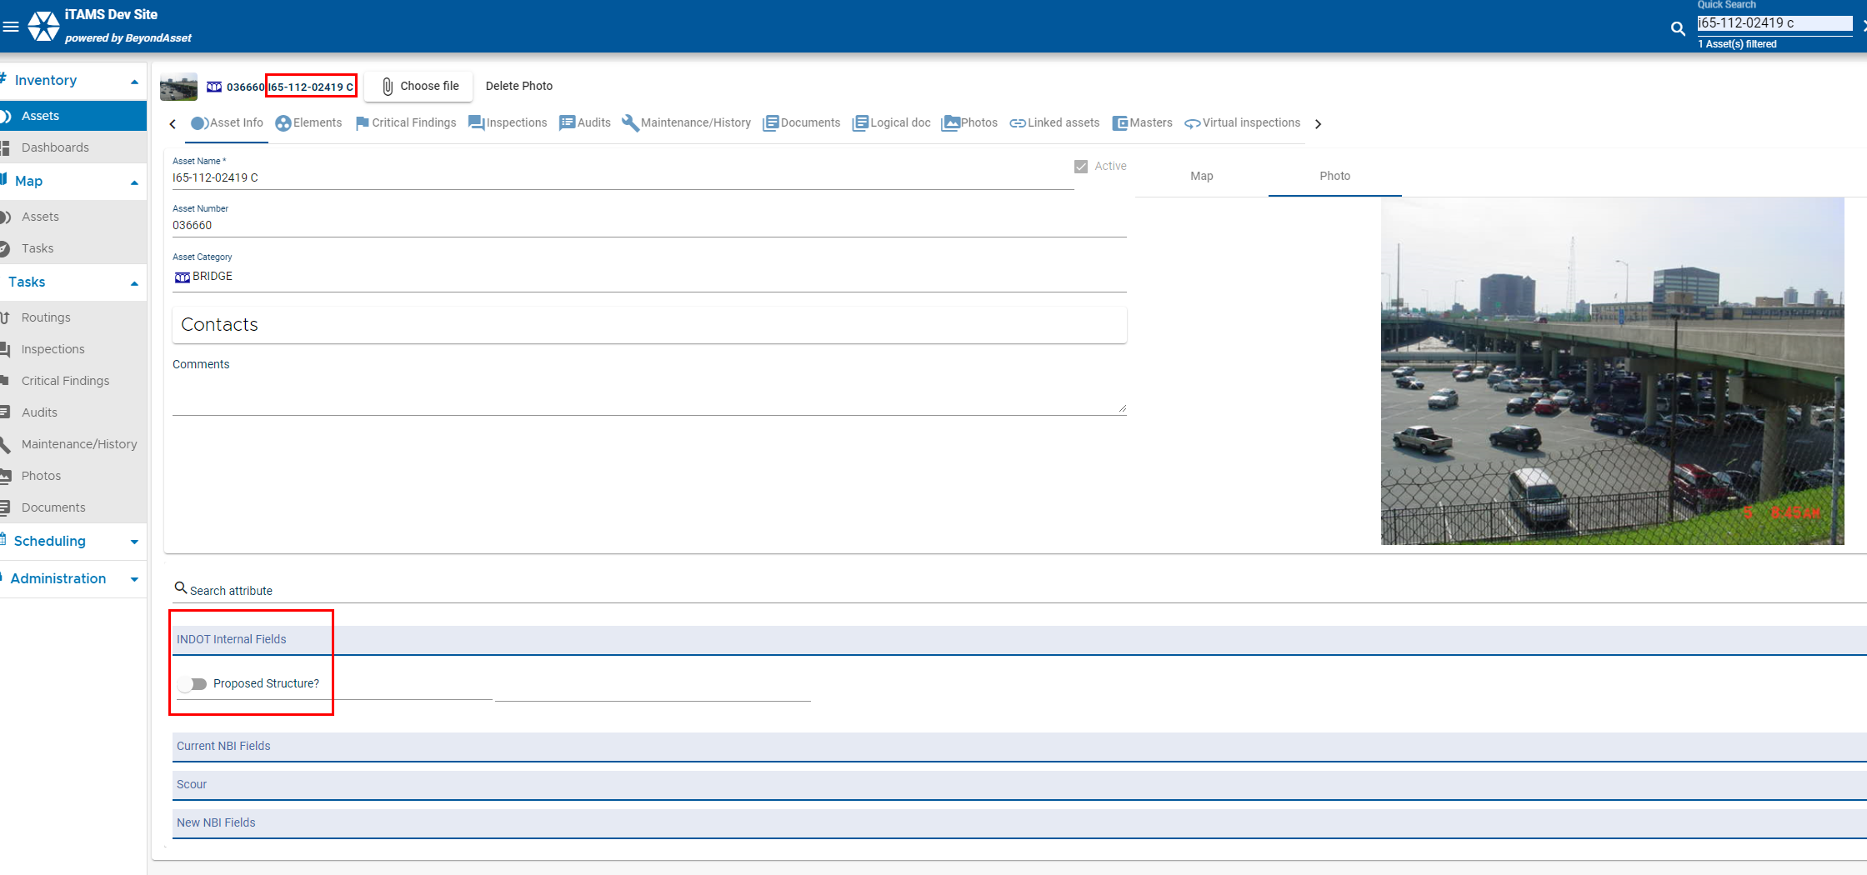
28
Create field call "Proposed" Y/N in the Asset page. Update "Proposed" field for Asset records with a status of "Proposed" from BIAS to say Y in iTAMS. Navigate to an asset. Select the Chapter "INDOT Internal Fields". You will see the field "Proposed Structure".

Slide 37
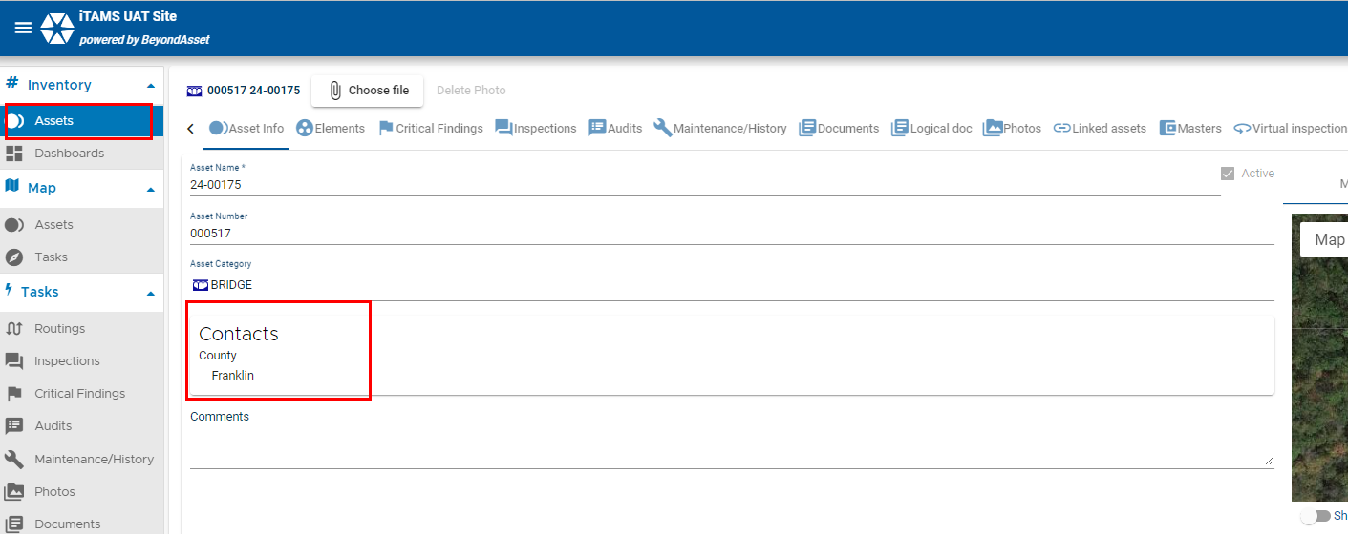
32
Navigate to the Asset Menue, Select an Asset, See Contacts assigned to that asset.

Slide 38
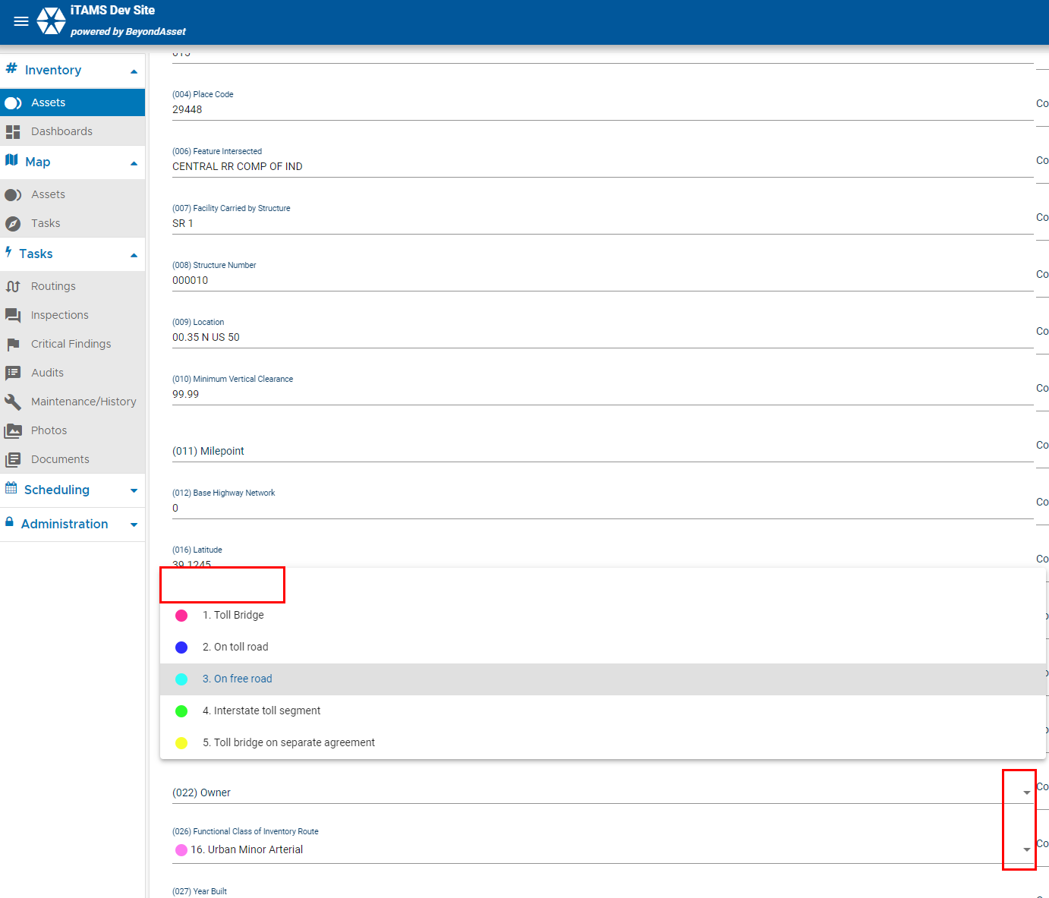
34
Provide a blank value in dropdown menus. This is standard functionality. Navigate to the “Current NBI Fields” click edit at the lower righthand corner (edit equals checkmark) and see any dropdown field and you will find a blank value in the dropdown list.

Slide 39
35
Would like the ability to restore deleted assets, reports, users, maintenance items, and attachments. Ideally deleted records would be logged as historical records and NOT deleted for a period of time and then after a specified time period the record could be permanently deleted. What is the preferred number of months a record would be storied as historical? Sixense demoed some options such as active and inactive functionality and inventory value history. Some recovery cases will require contacting Sixense.

Slide 40
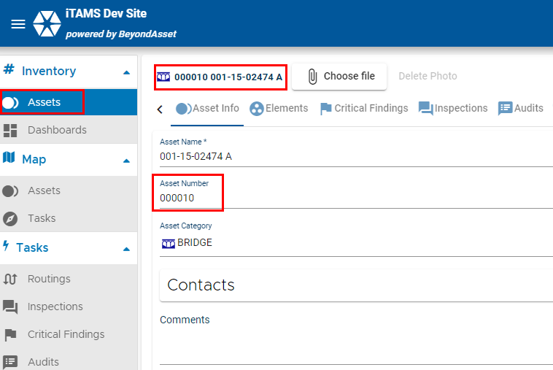
38
Add Asset Number to asset page layout. Navigate to the Asset Menu, see the column "Asset Number". Click on an Asset, see the "Asset Number" Field.

Slide 41
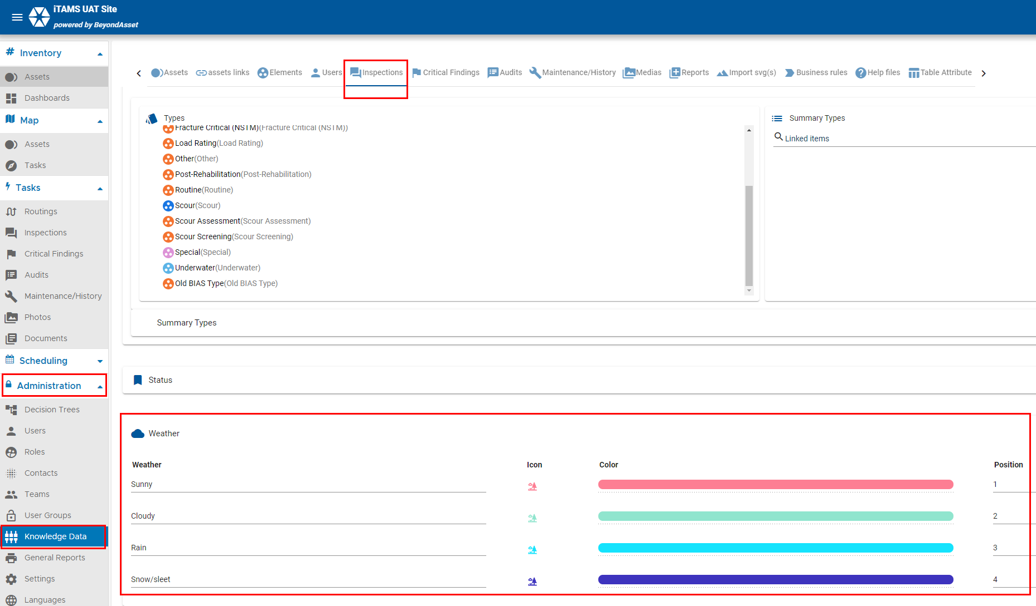
49
If you are an Admin, navigate to the Administration Menu and click the down arrow, Click Knowledge Data Menu, Select the Inspections Tab, Scroll down to the Weather box to see drop down values..

Slide 42
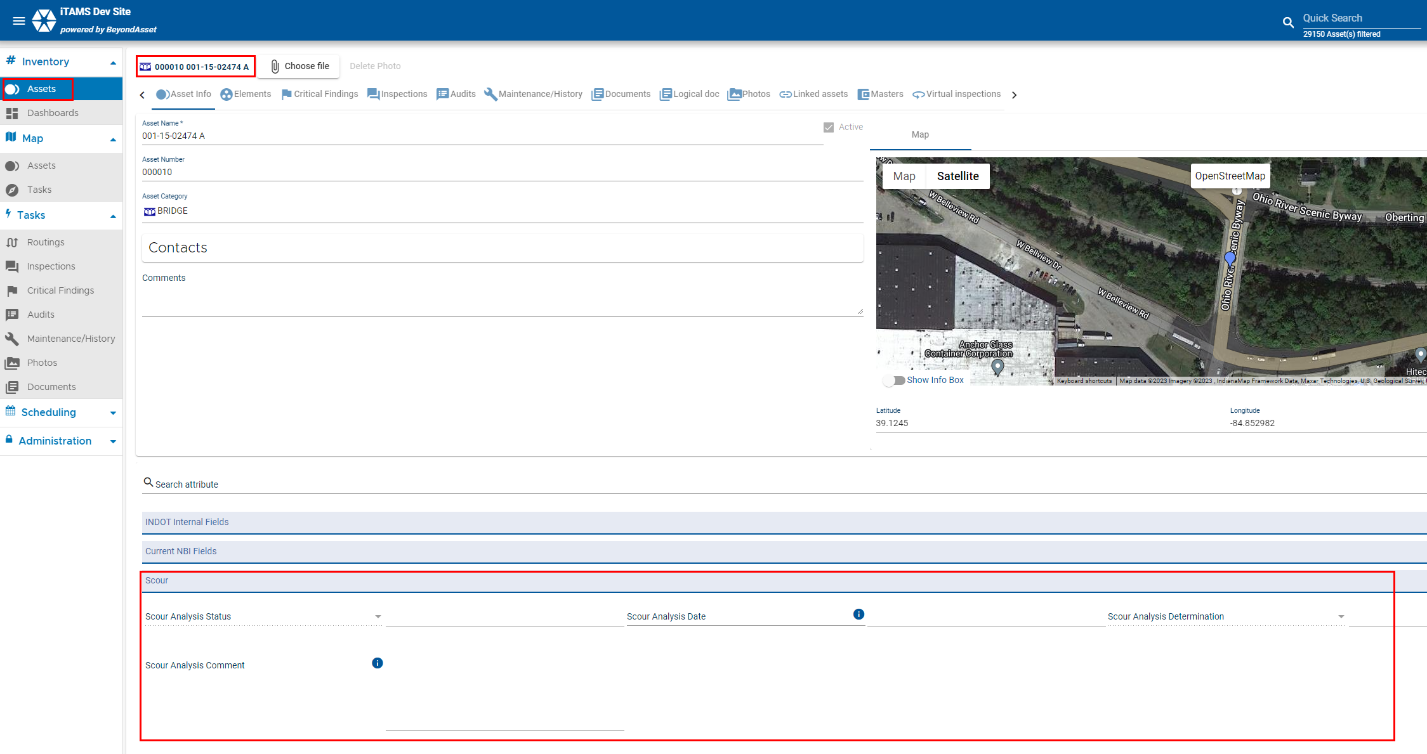
56
Create the following fields in the "Scour" Chapter: Scour Analysis Status, Scour Analysis Date, Scour Analysis Determination, Scour Analysis Comments. Navigate to the Asset Menu, select an asset. Select the "Scour" Chapter, you should see the following fields: Scour Analysis Status, Scour Analysis Date, Scour Analysis Determination, Scour Analysis Comments. Click edit to see dropdown values.

Slide 43
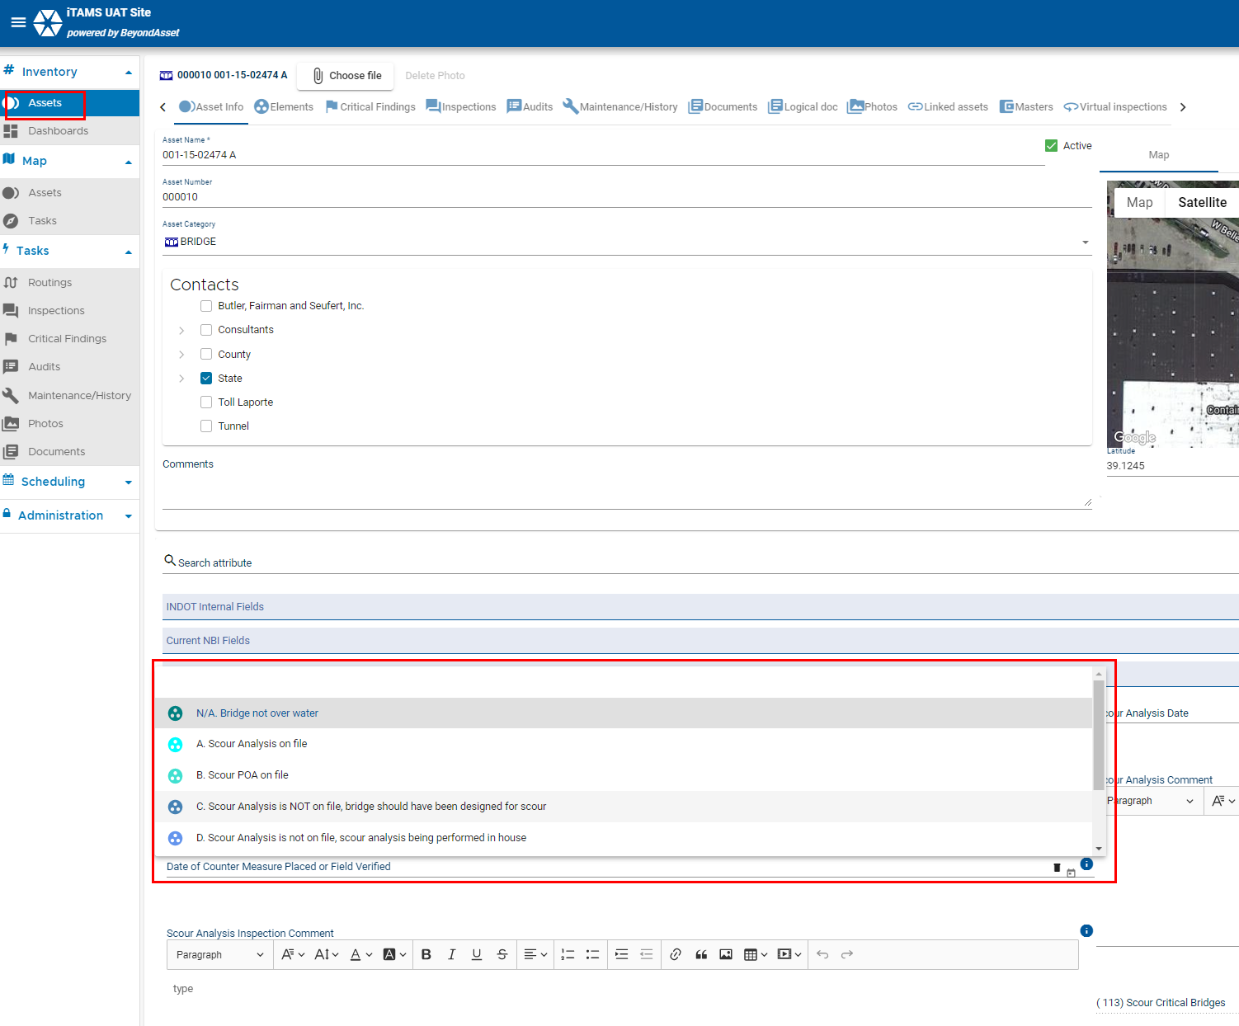
58
Navigate to the Scour chapter. Click edit to see dropdown fields are alpha characters.

Slide 44
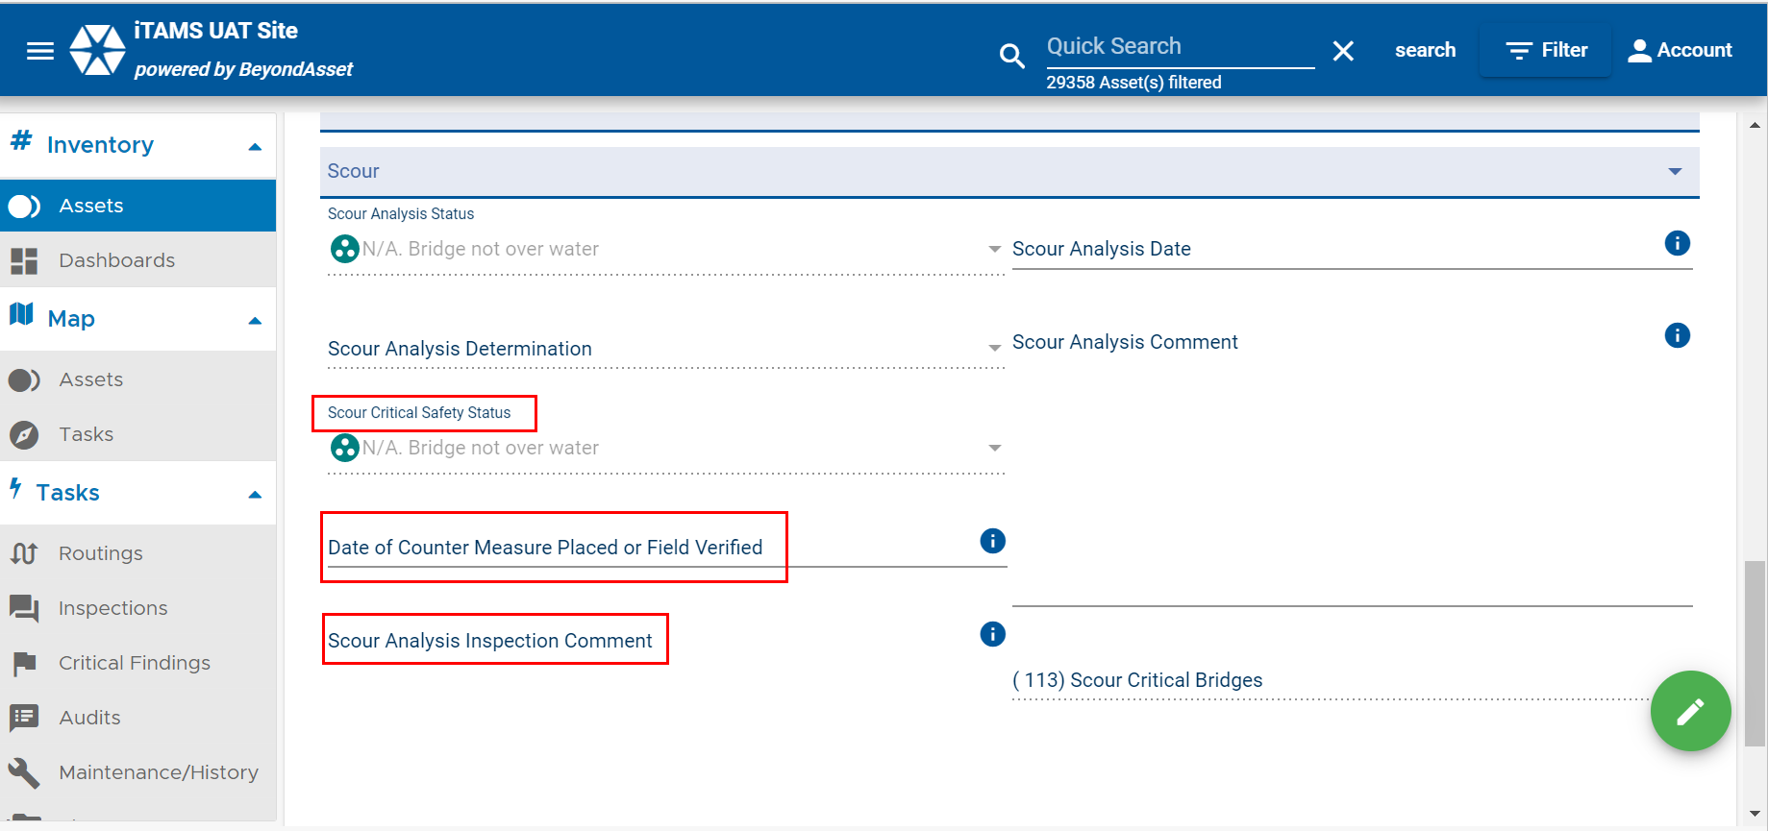
60
Navigate to an asset. Select an asset. Click on the "Scour" chapter. See the following fields: Scour Critical Safety Status, Date of Counter Measure Placed or Field Verified, Scour Analysis Inspection Comments.

Slide 45
64
Demo audit trail functionality in iTAMS. Navigate to any field with the clock symbol and click the clock symbol to see modification made to that field.

Slide 46
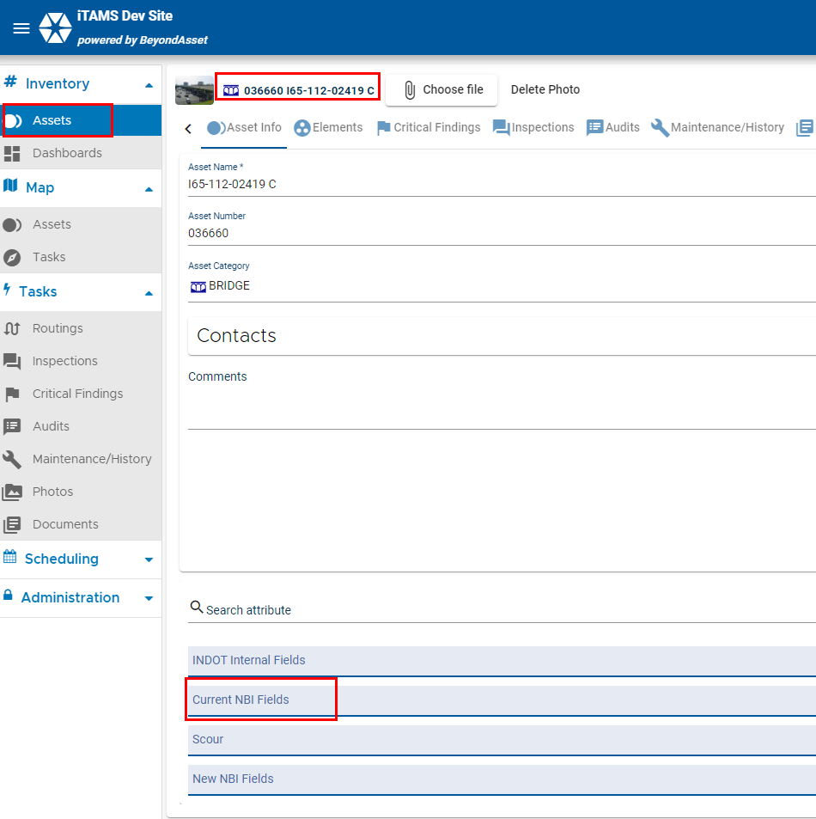
67
Rename existing chapter called “NBI Fields” to “Current NBI Fieldes”. Navigate to the Asset Menu, select an Asset, see the Chapter named "Current NBI Fields".

Slide 47
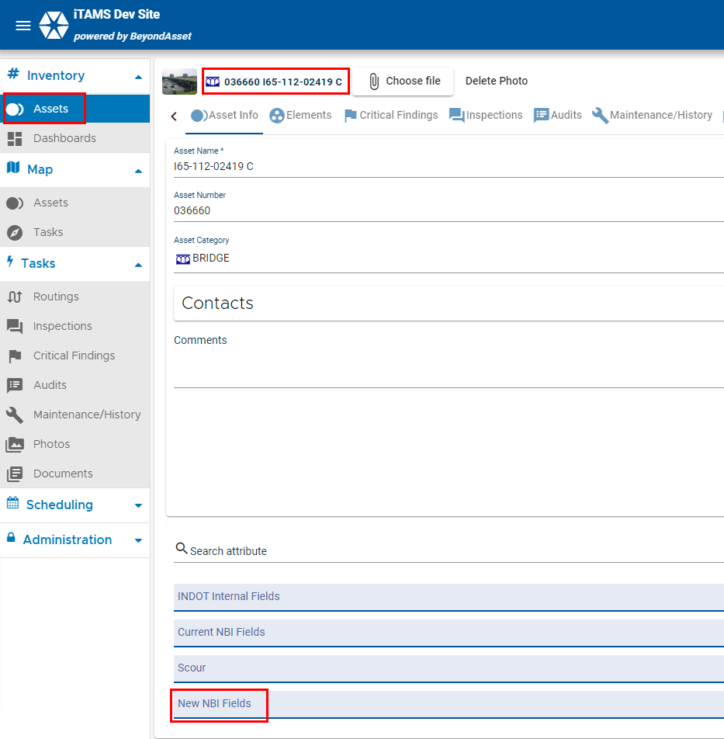
79
Rename “1.1 IDENTIFICATION” to “New NBI Fields”. Navigate to the Asset Menu, select an Asset, see the Chapter named "New NBI Fields".

Slide 48
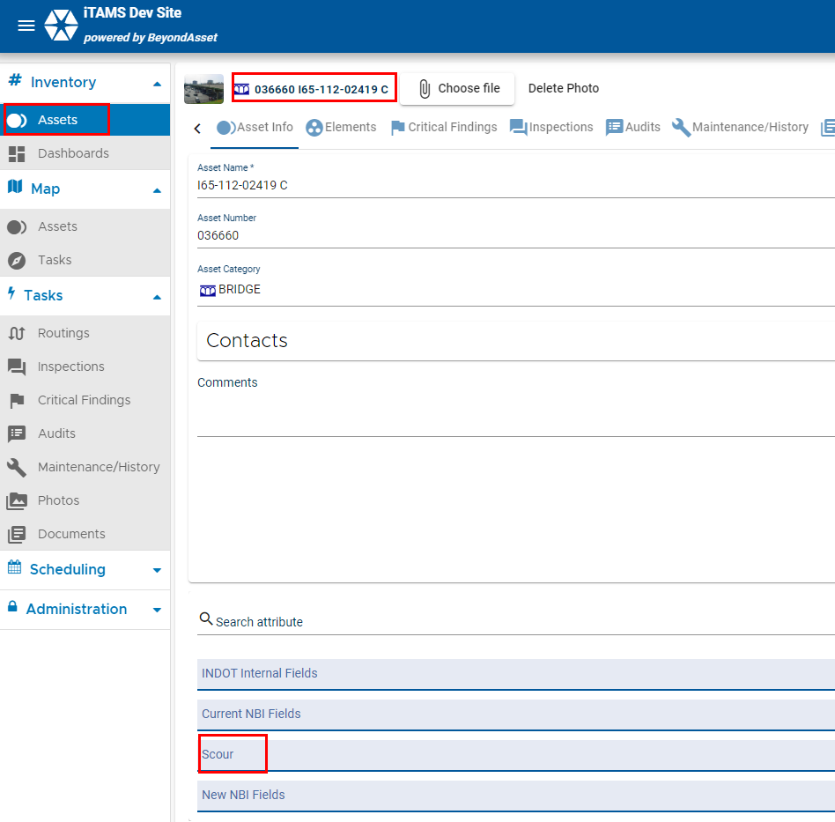
82
Rename chapter “Hydraulics – Scour Determination by Analysis” to “Scour”. Navigate to the Asset Menu, select an Asset, see the Chapter named "Scour".

Slide 49
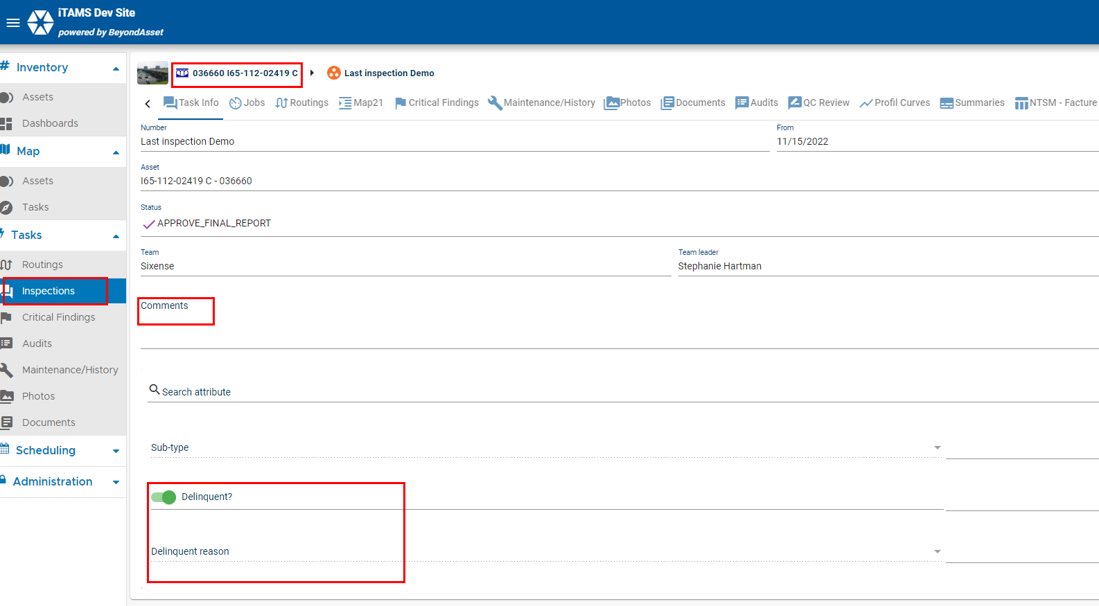
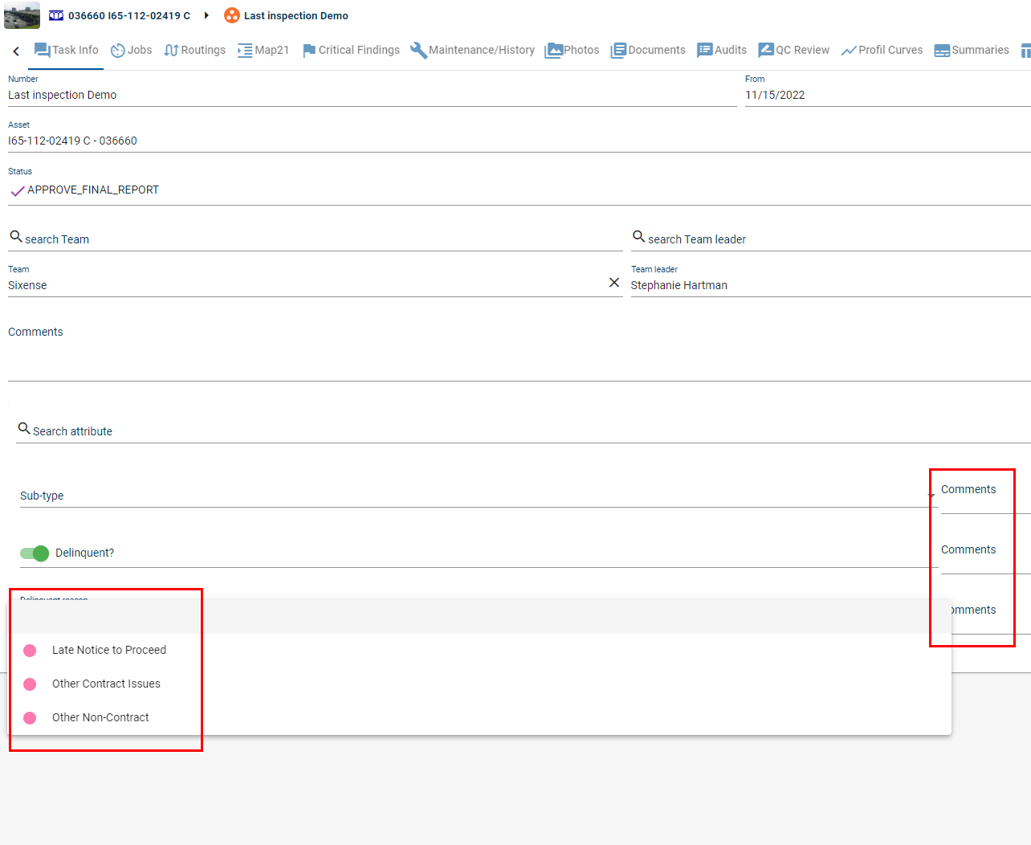
88
Create a field called “Is Delinquent” with the dropdown values: “Yes”, “No” to specify if Bridge Inspection Type Is Delinquent. Create the field called “Delinquent Reason” with the following dropdown values: Late Notice to Proceed, Other Contract Issues, Other Non-Contract. Add comment box to Delinquent Inspection Type. Navigate to the Inspection Menu, click on an inspection, you should see the following fields: “Is Delinquent” with the dropdown values: “Yes”, “No” to specify if Bridge Inspection Type Is Delinquent. “Delinquent Reason” with the following dropdown values: Late Notice to Proceed, Other Contract Issues, Other Non-Contract. A comment box.

Slide 50
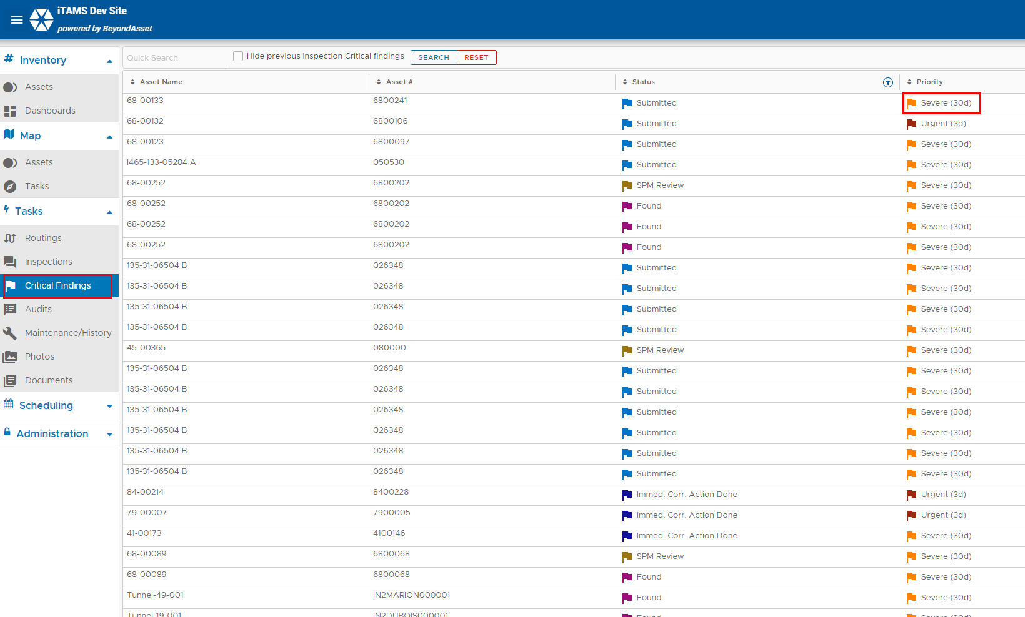
94
Make Critical Finding Priority = Sever flag orange. Navigate to the Critical Findings Menu, see the sever flag is in orange.

Slide 51
94
Make Critical Finding Priority = Sever flag orange. Navigate to the Critical Findings Menu, see the sever flag is in orange.

Slide 52
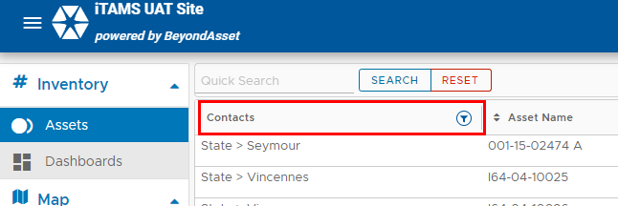
100
Navigate to the Asset Menu, Click Filter -> Advanced Filter, Click Load, Click Apply, See filtered Assets.

Slide 53
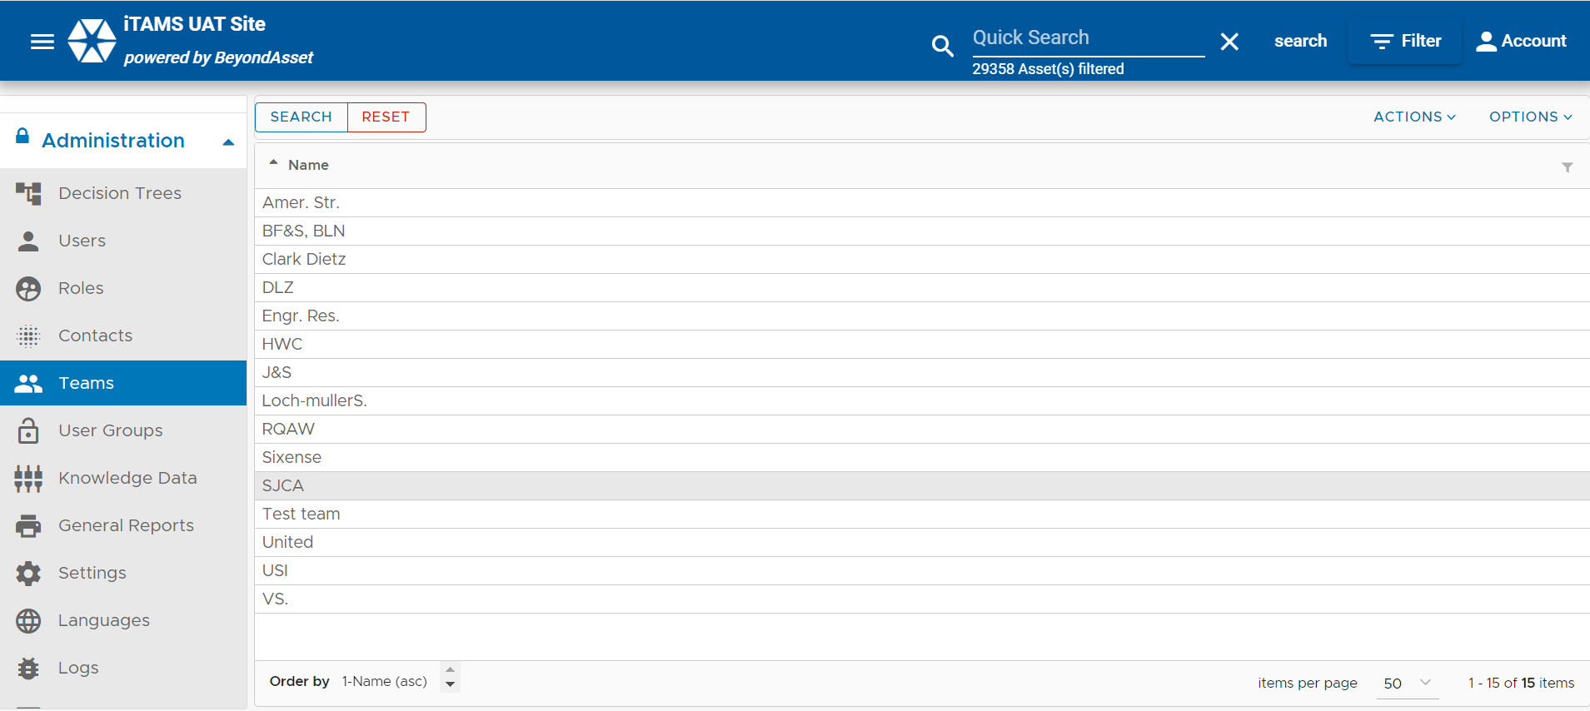
119
If you are an Admin, naviagete to the Administration Menu, select Teams, see list of consultants.

Slide 54
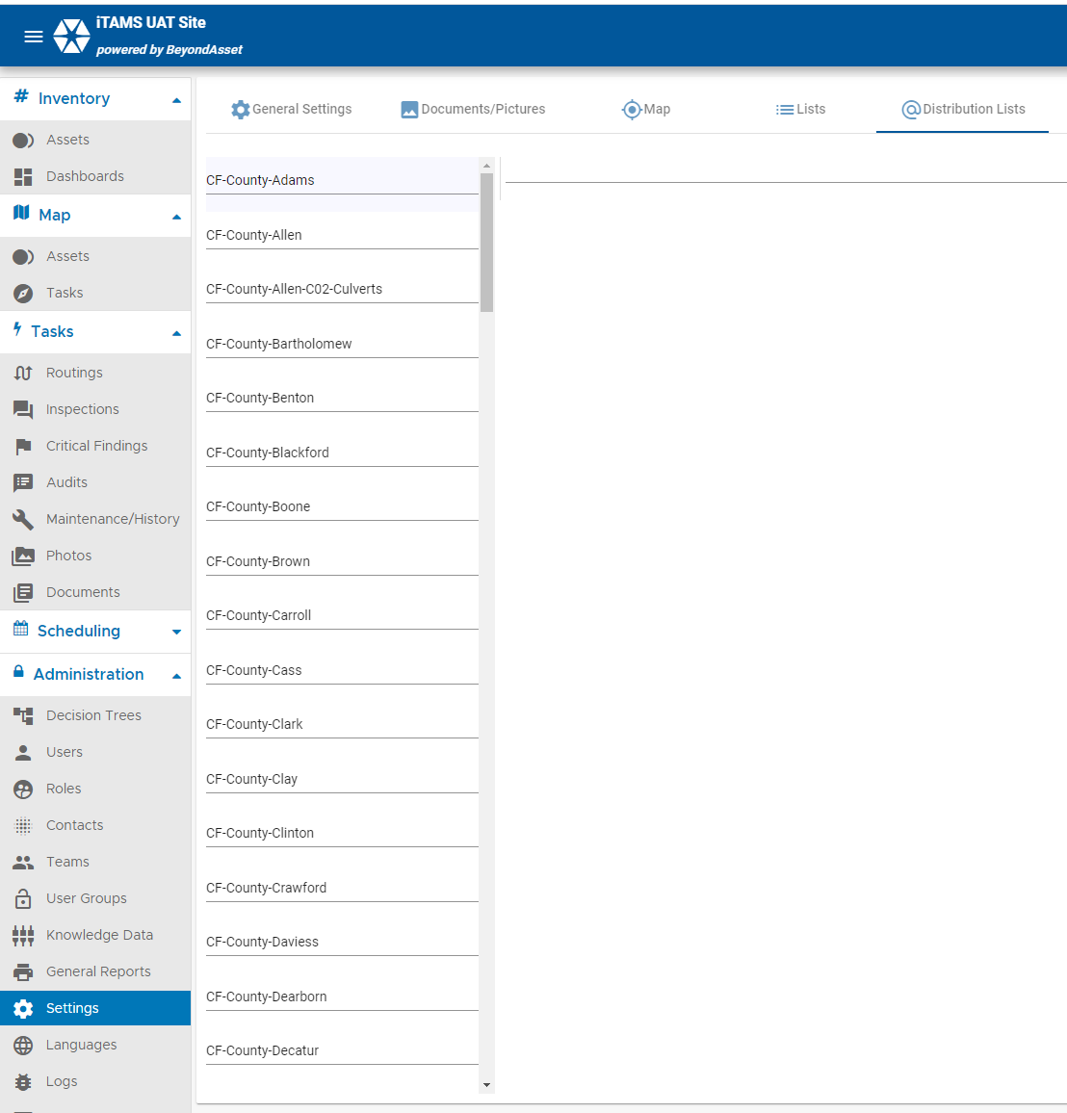
104
If you are an Admin, navigate to the Settings Menu, Select the Distribution Lists tab at the top see 98 distribution lists.

Slide 55
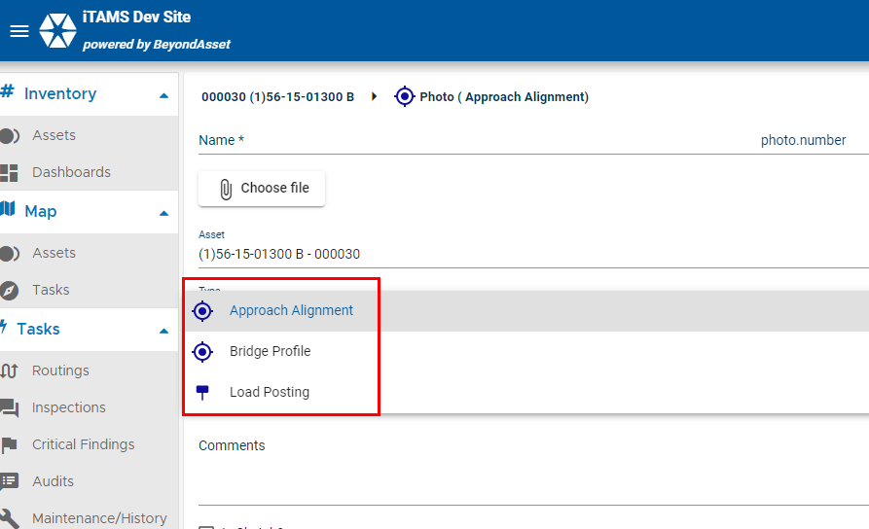
124
Create Asset Photo Types: Approach Alignment, Bridge Profile, Load Posting. Remove the type General Shot

Slide 56
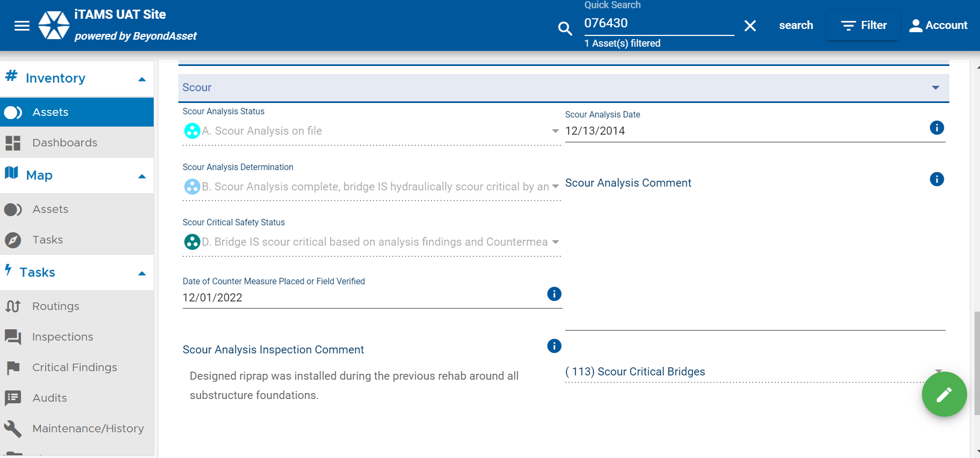
140
Navigate to the asset number 076430. Select the asset. Click on the chapter "Scour". See the fields populated with criteria.

Slide 57
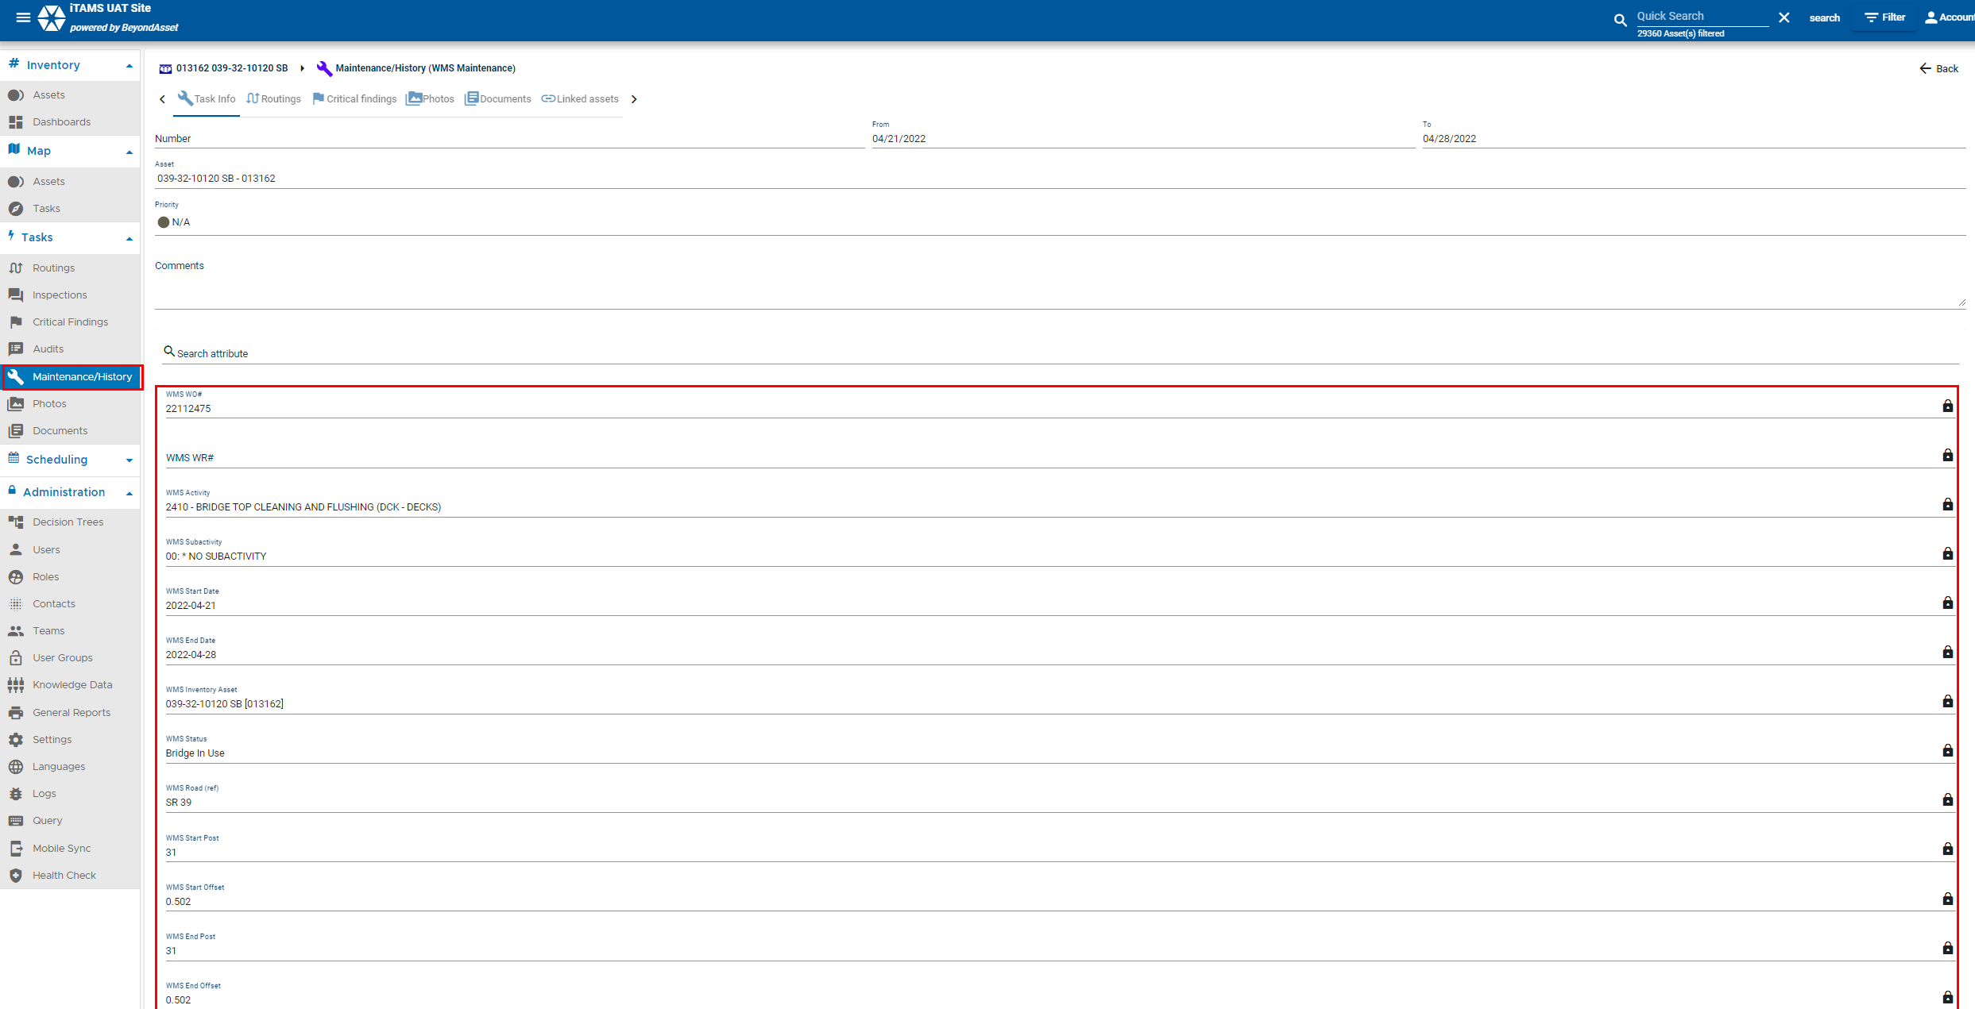
145
Be sure to reset your filter first. Navigate to the Menu Maintenance/History, Select a record with the Type WMS Maintenance, See WMS fields. These fields should be locked and not be able to be edited by users.

Slide 58
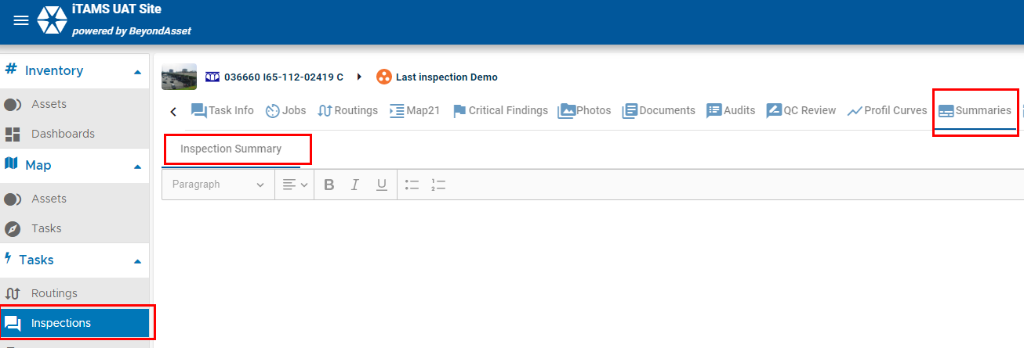
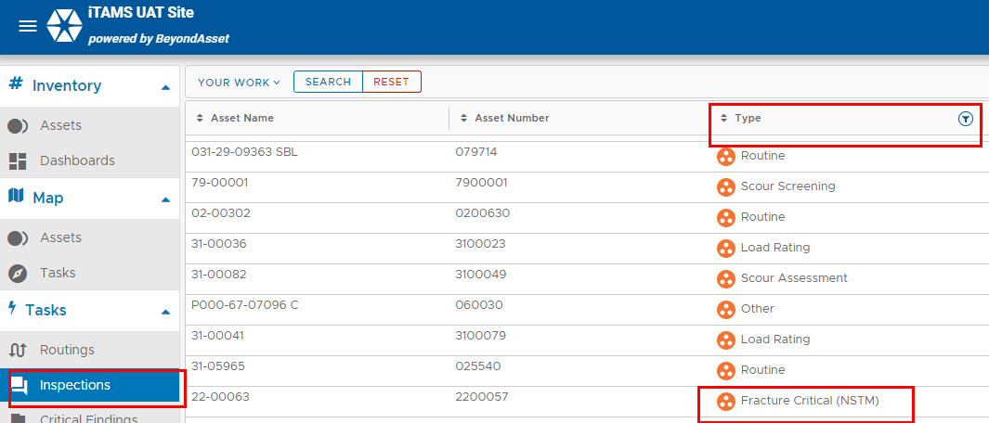
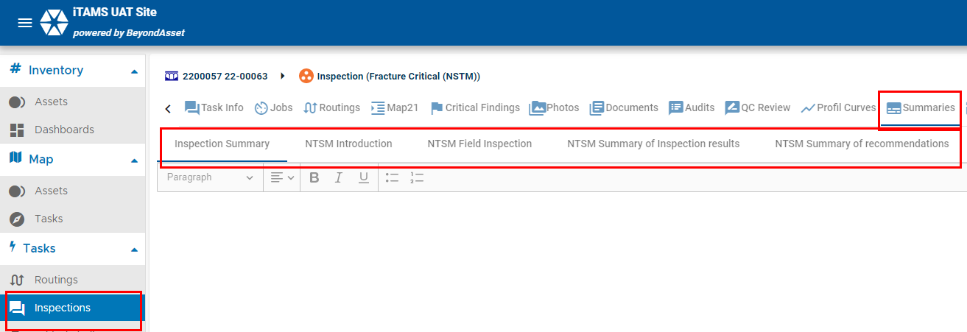
156
Navigate to the Asset Menu, Click on the Inspections Menu, Seliect and Inspections Type "Routin", Click on the Summaries Tab, See the sections "Inspections Summary". Navigate to the Asset Menu, Click on the Inspections Menu, Select the Inspection Type "Fracture Critical (NSTM) see tabs.

Slide 59
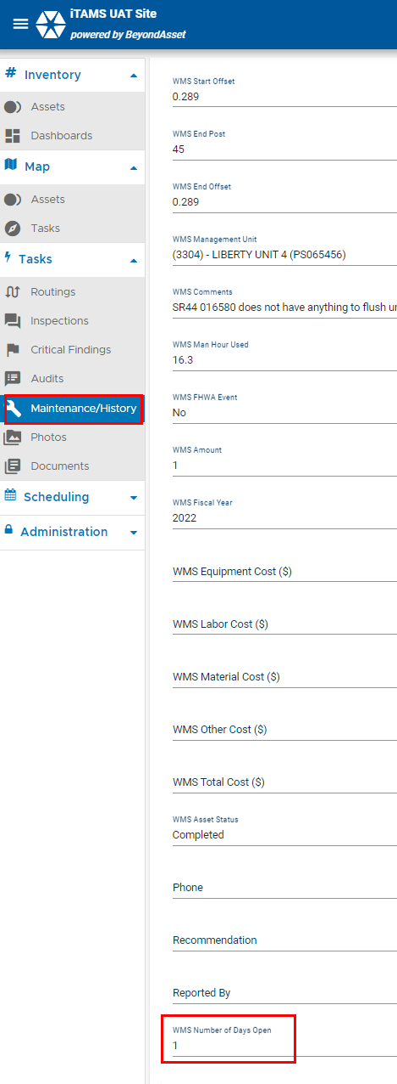
193
Reset your Filter. Navigate to the Maintenance/History Menu, Select a WMS record, scroll down to see the field "WMS Number of Days Open.

Slide 60
Q&A
6

