Slide 1
IOT Microsoft Low Code No Code
Center of Excellence
Team Charter

Slide 2
Center of Excellence
The LCNC CoE Governance Committee promotes, shares, and collaborates on the MSFT Power Platform to efficiently and effectively achieve business objectives, with the goals of maximizing return on investment (ROI), accelerating automation, standardizing around best practices, and facilitating shared knowledge
The IOT Microsoft Low Code No Code Center of Excellence is the team that provides best practices, support, governance, and leadership in the State of Indiana’s use of Microsoft’s Power Platform.
The Primary Focus
Increase enterprise wide Low-Code No-Code (LCNC) adoption, standardization, risk mitigation and project acceleration; by providing guidance on proven practices, architecture, and training.​
Be a key influencer on major development and methodology decisions.
The type of Center of Excellence (CoE) will range from consultative to directive depending on the level of capability and need of the agencies in the area of the Microsoft Power Platform and Low Code No Code (LCNC) initiatives.

Slide 3
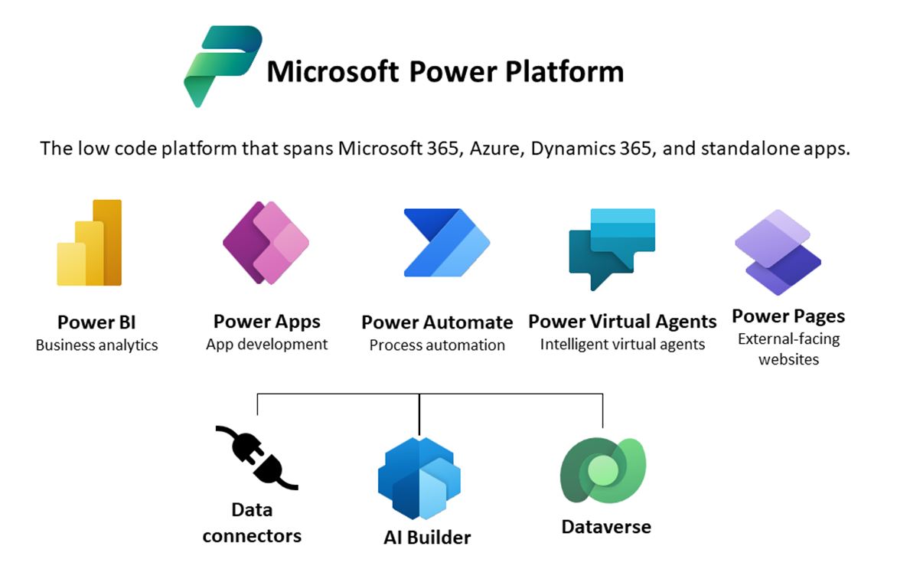
Power Platform Family
Microsoft Power Platform is a family of products that delivers innovative business solutions on one seamlessly integrated platform. Power BI, Power Apps, Power Automate, and Power Virtual Agents allow any business to analyze and visualize real-time business performance, quickly and easily build custom apps, automate workflows, and integrate AI capabilities.
Power Platform provides a low-code interface for any user to quickly create custom apps while also offering robust tools for professional developers. This enables the integration of innovative solutions across Azure, the Modern Workplace, Dynamics 365, and standalone applications. At the intersection of these products lies digital transformation - empowering customers to innovate anywhere and unlock value everywhere.

Slide 4
Guiding Principles & Objectives
Start where you are
Maximize business value from the use of Microsoft Low Code No Code
IOT co-creation of value with Agencies
Balance Governance & Innovation
Partnership
Embrace IOT Enterprise Standards (Security, Integration, Data, etc.)
Keep it Simple
PRINCIPLES
Enable efficient and effective utilization of LCNC platforms across the organization.
Promote standardized development practices, guidelines, and best practices for LCNC solutions.
Foster collaboration and knowledge sharing among LCNC developers.
Drive innovation and continuous improvement in low code/no code development processes.
Monitor and evaluate performance and impact of LCNC initiatives.
Provide guidance and support to LCNC project teams
Ensure security, compliance, and risk management considerations are addressed in low code/no code development projects.
OBJECTIVES

Slide 5
Organizational Team & Groups
The Steering Committee sets the vision and strategy for LCNC technology.
The CoE Sponsor sets the business strategy and CoE LCNC decisions based on strategic objectives.
The CoE Governance Committee is the cross functional team that aligns CoE policies and governance with agency requirements and objectives.
The Core CoE team members are:
CoE Owner is responsible to coordinate the COE operations to meet demands and ensure strategic alignment with stakeholders
Analyst is responsible for portfolio and demand management, coordination objectives and maintaining strong agency relationships.
Architect has specific MS LCNC technical expertise and will collaborate with agencies, the community of practice, and LCNC project teams.
Partnerships: IOT and Agency Planning, Technology and Delivery teams.
Major stakeholders and technology SMES will participate as Flex team members to provide specific business domain and/or technical expertise to the CoE.
Steering Committee
CoE Sponsor
Larry Jenkins
CoE Governance
Committee
CORE TEAM
CoE Analyst(s)
CoE Owner
Robert Evans
Architect(s)
IOT CoEs
IOT Tech Delivery Teams
IOT Managers
IOT Pro Dev LCNC Delivery Teams
Agency CoEs
Community of Practice
Agency Managers
Planning and Governance Groups
Partner PMs, BAs, and Devs

Slide 6
Organizational Team & Groups
Stakeholder Groups
IOT CXOs
IOT Data Exchange Team
IOT Messaging and Collaboration Team (Exchange Team)
IOT Security Team
IOT Architecture Team
IOT Project Management Team
IOT Power Platform Technical Team (Managed through MSP)
IOT Manager Software Asset Management Team
BRM Team
LCNC Champions Community
LCNC Community of Practice

Slide 7
Team Role and Responsibilities
Executive Steering Committee
CoE Analyst
Provide executive vision and steering of the MS Power Platform application across the enterprise (cross-functional representation)
Change management arbitration and approval for new projects to meet vision & business objectives
Notification of 2nd escalation with cross-agency issues
Define success criteria and key metrics for Executive tracking
The CoE Analyst manages the MSFT LCNC Portfolio, SDLC process documentation and coaching, and oversight of governance processes.
Oversees project approval and intake (LCNC suitability, delivery track and launch)
Provides best practice guidance for determining ROI on COE and/or agency led initiatives
Technical issue management
Training for Agency level initiatives
Executive Sponsor
Technical Architect
Sets the business vision for the COE
Sets priorities and steers team decisions based on strategic business objectives
Drives yearly time, resources, budget and staffing allocation decisions
Aligns Sr Stakeholders
Final Point of Escalation
Trained and certified in creating MSFT LCNC applications.
Experienced and qualified in using the Power platform and understands how to build compliant, scalable, and fit-for-purpose applications
Support the LCNC / citizen development process and teams to deliver applications that are tailored to meet the user and business needs, including design, data security, access, and proper licensing
Knowledgeable about best practices in application development, user experience, nonfunctional and architectural constraints, governance, and IT procedures
Responsible for identifying training needs within IOT and Agencies and organizes training events.
Works to replace physical governance w/ technical enforcement and guardrails that prevent or limit unwanted or unforeseen impacts.
Provides project management and business analyst support to the delivery teams.
CoE Owner
Responsible for overall implementation strategy and planning , drives program execution
Establishes cross-functional team with regularly scheduled meetings to optimize and evolve the COE across Agencies
Ensure Adoption and Service projects map to the enterprise strategy
Initial point of escalation
Own success criteria and metrics for Executive tracking

Slide 8
Governance Point of Contacts
Responsibilities
CoE Sponsor
Provides oversight and direction to the CoE Governance Committee.
Larry Jenkins
LCNC – Agency Strategy alignment.
Collaborate in LCNC governance between CoE Agencies.
Spearhead adoption of CoE Governance & Delivery Frameworks.
Drive the MS LCNC roadmap.
Determine centralized & de-centralized LCNC responsibilities
Monitor CoE KPIs, LCNC Adoption & Compliance
Identify opportunities to fully leverage LCNC capabilities
Organizational Change Management and Marketing campaign to communicate success and alignment.
CoE Governance Committee Chair / CoE Sponsor
Robert Evans
Responsible for bringing forward any issues to the committee and communicating governance decisions
INDOT- Melanee Habig
IDEM- Vanessa Williams
FSSA- Derrick Cash
IOT Messaging and Collaboration- TBD
IOT Security- TBD
Agency Representatives
Bring the perspective of the agencies to promote MS LCNC growth and ongoing refinement of the CoE governance guidelines.

Slide 9
CoE Service Levels
State Agencies have varying levels of MS LCNC knowledge and development experience. The IOT LCNC CoE will provide corresponding levels of services - Consultative, Governance and Directing - to best align with the agency's objectives and requirements.
Consultative
1
Governance
2
Directing
3
Educate agencies on MS LCNC benefits and opportunities.
Establish development best practices, standards, and training for LCNC development.
Provide secure Power Platform Environments.
Evaluate and recommend LCNC Initiatives.
Builds on Consultative services.
Assists agencies to build secure and scalable applications through standardizing on best practices.
Alerts agencies and makers to risks and areas for improvements.
Provides operation dashboards and usage reports to manage applications and growth.
License management
Extends Consultative and Governance services to engage directly in LCNC application
delivery.
Full project lifecycle support.
Provides Architecture role for large projects
Fusion teams of Pro Dev and citizen developers.

Slide 10
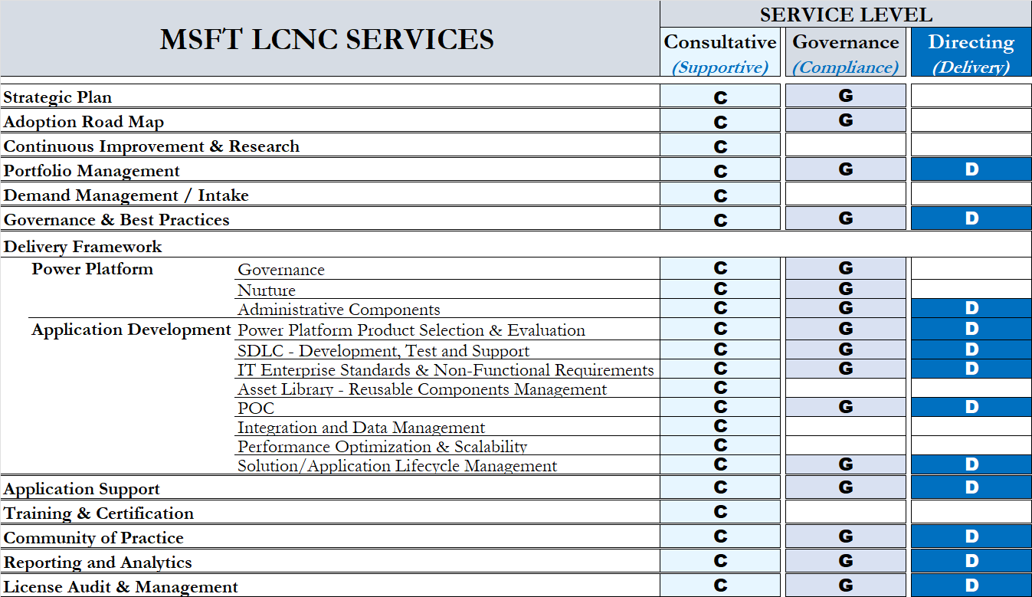
Services & Service Level

Slide 11
Service Definitions
COE MANAGEMENT
Strategic Planning
Adoption Roadmap
Continuous Improvement
& Research
Portfolio Management
Demand Management
Develop and maintain a 2-5 year plan for the enterprise management and advancement of the Microsoft Power Platform, LCNC applications and citizen development, and continued alignment with business and technology strategy
Direct and advance enterprise adoption and citizen development of the Microsoft Power Platform initiatives based on the IOT Adoption Maturity Roadmap. Track progression milestones and alignment with the Microsoft LCNC strategic plan.
Stay up to date with the latest trends, advancements, and emerging technologies in the Power Platform space. Conduct research, evaluate new features and capabilities of Power Platform.
Maintain an enterprise-wide inventory of planned, active and deployed MSFT LCNC applications and power platform initiatives. Ensures alignment with and between strategic planning, roadmap advancement and release management.
Demand management is the CoE process to collect, evaluate, prioritize and approve MSFT LCNC requests, It also includes coordinating resource as well as release and license management between IOT and agency LCNC teams.
Notes:
Robert.. Is 2-5 realistic [BAO]

Slide 12
Services Definitions
GOVERNANCE AND DELIVERY FRAMEWORK
Governance & Best Practices
Power Platform:
Governance
Power Platform:
Nurture
Power Platform:
Admin Components
GOVERNANCE: CoE Governance provides enterprise guidance, oversight and decision making for the MSFT LCNC program. Defines guidelines, standards and best practices for CoE management and LCNC application development and delivery frameworks. Encompasses regular reviews and audits to ensure compliance with enterprise standards.
DIRECTING: CoE LCNC Governance democratized business application development with guardrails, security, onboarding, technical support and operational observability. External Compliance - Ensure that IT processes and IT-supported business processes are compliant with laws, regulations, and contractual requirements.
AUDIT PROCESS: auditing process as a tool for users to check whether their app, flow, chatbot or custom connector is compliant, and to submit information to the CoE admins as business justification to stay in compliance.
MONITORING AND REPORTING: outlines the processes for monitoring and reporting on the use of the Power Platform. This includes monitoring for compliance and security risks, as well as reporting on usage and adoption.
PROVIDE TRAINING AND EDUCATION: provides resources for training and education on Power Platform topics, including video tutorials, documentation, and links to relevant Microsoft resources.
MANAGE USER GROUPS AND COMMUNITIES: offers guidance on establishing user groups and communities to promote collaboration, knowledge sharing, and feedback.
MONITOR FEEDBACK AND MAKE IMPROVEMENTS: mechanisms for collecting feedback from users, such as surveys and user groups.
OWN POWER BI DASHBOARD: overview of the Power Platform environment, including usage metrics, Power Automate flows, audit logs, and compliance status.
ENVIRONMENT MANAGEMENT: tools for managing the various environments within the Power Platform, including creating and deleting environments, setting up sandbox environments, and managing environment permissions.
MONITOR NOTIFICATIONS AND ALERTS: notifications and alerts for various events, such as the creation of new apps or the deletion of sensitive data.

Slide 13
CoE Service Definitions
APPLICATION DEVELOPMENT
Power Platform Product Selection & Evaluation
SDLC (Development, Test, & Deploy)
IT Standards & Non-Functional Requirements
Asset Library – Reusable Components Management
Assist citizens and pro developers in selecting suitable Power Platform products based on project requirements and state agency goals.
Citizen developers need a broad understanding of the end-to-end development process. The CoE will provide a LCNC Agile SDLC Methodology which can cater to projects of varying ambition, scale and complexity to include roles and skills based on execution path, development, test, version control and support processes
Identify and incorporate IT enterprise application development standards in LCNC development. (D, Security, Reliability, Integration, Design, etc.)
Establish component libraries for LCNC developers both to ensure consistency across apps and to enable makers to focus on the business logic in their applications rather than on common components.
POC
Integration Data Management
Performance Optimization , Scalability
Solution Lifecycle Management
Help agencies explore the feasibility and potential of Power Platform solutions through proof-of-concept projects. Collaborate with stakeholders to identify suitable use cases, develop prototypes, and demonstrate the value of Power Platform for specific business scenarios.
Consultative: Provide consultative services on data architecture and infrastructure. Including assessments of current data infrastructure, recommendations of improvements and upgrades, assistance in designing data architecture that supports the Center of Excellence’s data management goals.
Assist citizens and pro developers in integrating Power Platform applications with other systems and data sources within the State of Indiana's ecosystem. Design and implement data integration strategies, establish data governance frameworks, and ensure proper data quality, security, and compliance.
Optimize the performance of Power Platform applications to ensure efficient execution and responsiveness. Conduct performance assessments, identify bottlenecks, and apply optimization techniques. Help citizens and pro developers scale their Power Platform applications to handle increased workloads and user demands.
Creation of processes and frameworks for managing the application lifecycle of Power Platform solutions to include roadmap, version control, release management and change control and ensure smooth transitions and minimal disruption.

Slide 14
CoE Service Definitions
SUPPORT AND CONTROLS
Application Support
Track at minimum. Provide Tier 1 or Tier 2 support.
Education
Educate agencies on how to work with the IOT LCNC Center of Excellence. Offer information on power platform products and best practices. Directing agencies to hands-on trainings, certifications, and the many advanced features and application development techniques Microsoft offers.
Community of Practice
Foster a community of Power Platform practitioners and enthusiasts within the State of Indiana. Facilitate knowledge sharing, collaboration and networking opportunities through forums, online communities and regular meetings. Provide support channels for users to seek assistance, share ideas and troubleshoot issues.
Reporting & Analytics
Create management and stakeholder visibility and the information required by the CoE and LCNC teams for future growth and process improvement. Including monitoring of key metrics against strategic insights and overview of the LCNC applications health and compliance to IT standards.
Licenses Management
Ensure effective license management, compliance, and cost optimization to enable the agencies to leverage the platform while maintaining licensing integrity. Oversight and management of inventory, procurement, compliance, cost management, renewal, training and user support of licenses. License availability will be confirmed in the future LCNC intake process
Notes:
Application Support may be to general and not feasible. Robert your take [BAO]

Slide 15
CoE Meeting Cadence
FREQUENCY | MEETING AGENDA | ATTENDEES
BIWEEKLY | Review current progress with the adoption What’s new/ upcoming Issues/ roadblocks Review reporting and metrics What’s new/ upcoming Issues/ roadblocks | CoE Core Team + Flex
MONTHLY | Review reporting and metrics Review any new features updates/announcements from Microsoft Outstanding issues/ concerns | Governance Committee
EVERY QUARTER | Status update to Leadership on adoption progress Success stories Plan next step in the roadmap | Steering Committee

