Slide 1
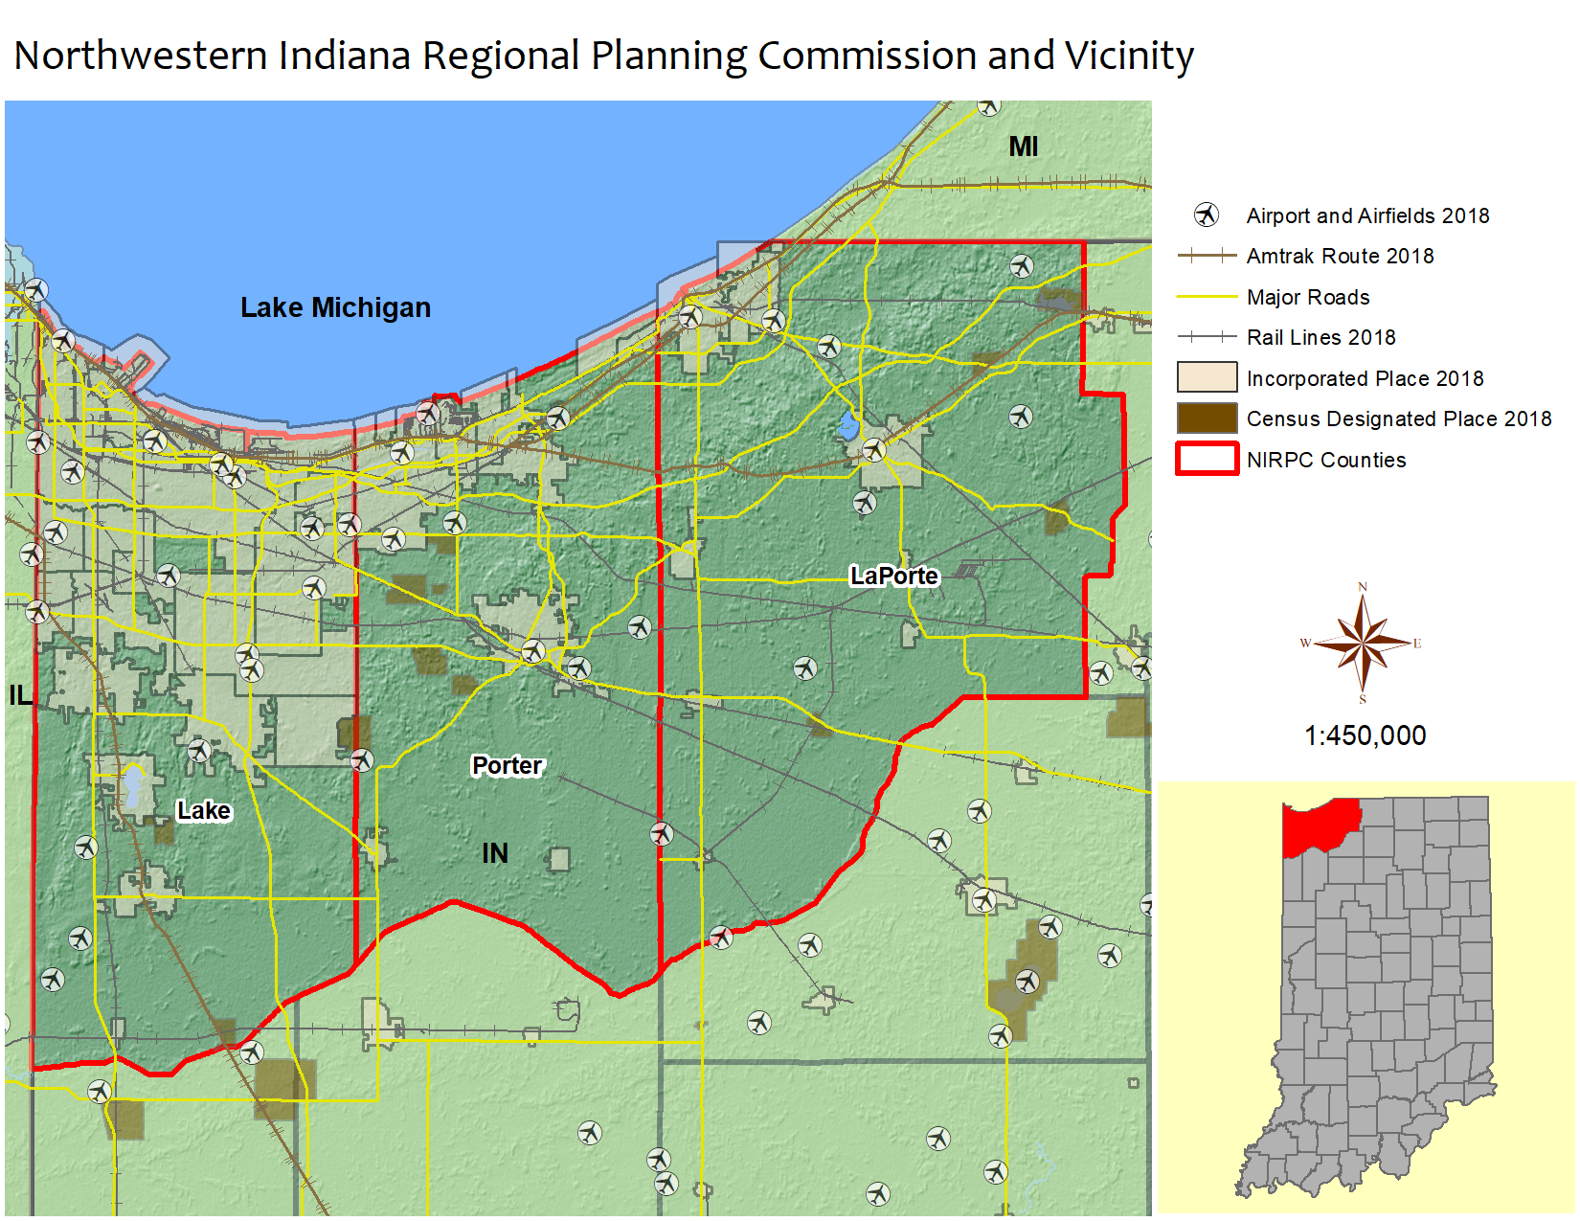


Industry Clusters
Northwestern Indiana
Regional Planning Commission
(NIRPC)
Industry Cluster Analysis Update
December 2024

Slide 2

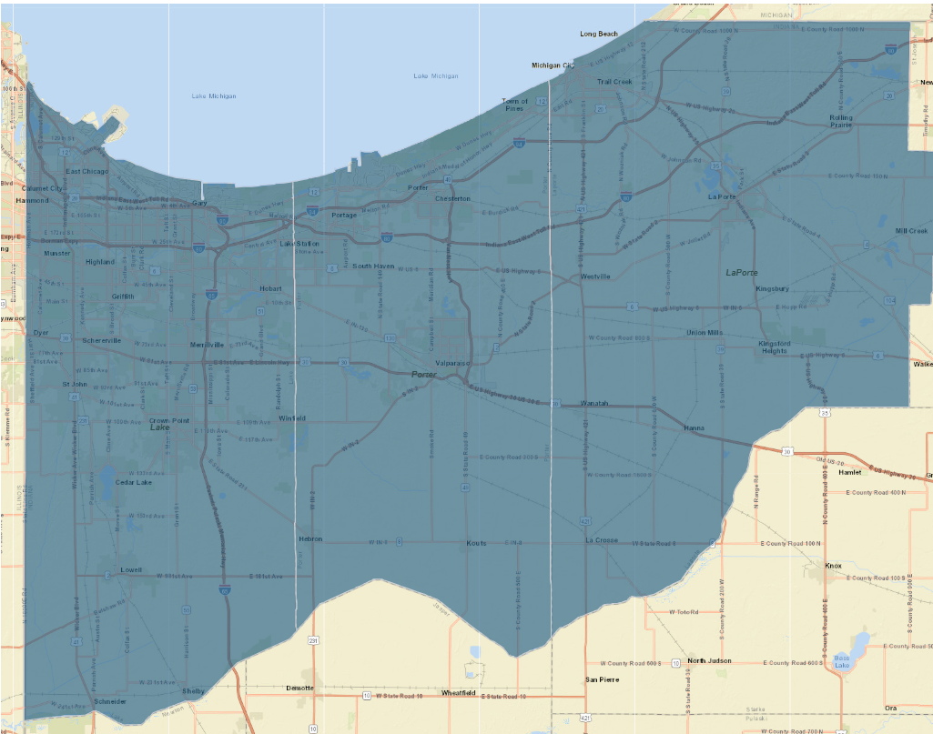
2
Introduction
Northwestern Indiana Regional Planning Commission
The Northwestern Indiana Regional Planning Commission is comprised of the following Indiana counties:
Lake County
Porter County
LaPorte County
Data Snapshot // NIRPC

Slide 3
3
Assets
Transportation assets are present
Data Snapshot // NIRPC

Slide 4

Key Economic Indicators in NIRPC, Chicago Metro Area, and Indiana
4
Economy
 | NIRPC (all jobs) (QCEW, non-QCEW, self-employed and proprietors) | Chicago-Naperville-Elgin, IL-IN Metro Area (QCEW, non-QCEW, self-employed and proprietors) | Indiana (QCEW, non-QCEW, self-employed and proprietors)
Jobs 2018 | 377,807 | 5,932,474 | 3,962,379
Jobs 2023 | 399,365 | 6,211,128 | 4,218,876
Job change 2018-2023 | 21,558 | 278,654 | 256,497
% Job change 2018-2023 | 6% | 5% | 6%
Average total earnings per job, 2023 | $60,723 | $79,536 | $63,481
Cost of Living (COL) | 93.8 | 103.0 | 95.6
COL Adjusted Average total earnings per job, 2023 | $64,737 | $77,220 | $66,403
Establishments, 2023 | 18,175 | 253,386 | 189,164
NIRPC has a COL advantage over Chicago Metro and the State of Indiana.
Data Snapshot // NIRPC
Source: Lightcast– 2024.4 (QCEW + non-QCEW + Self-employed + Proprietorships)
Notes:
Chicago-Naperville-Elgin, IL-IN contains Lake, Cook, Will, DuPage, Grundy, Kendall, Kane, DeKalb, and McHenry counties in IL; and Lake, Porter, Newton, and Jasper counties in IN.

Slide 5
Key Economic Indicators in NIRPC, Chicago Metro Area, and Indiana
5
Economy
 | NIRPC (all jobs) (QCEW, non-QCEW, self-employed and proprietors) | Chicago-Naperville-Elgin, IL-IN Metro Area (QCEW, non-QCEW, self-employed and proprietors) | Indiana (QCEW, non-QCEW, self-employed and proprietors)
Sales 2023 | $123.5 Billion | $1559.5 Billion | $973.1 Billion
GRP 2023 | $52.9 Billion | $860.8 Billion | $475.8 Billion
GRP per job 2023 | $132,508 | $138,583 | $112,787
Exports per job 2022 | $200,046 | $100,814 | $129,817
Total purchases 2023 | $ 57.2 Billion | $ 623.1 Billion | $422.1 Billion
Within region | 39.7% | 69.8% | 51%
Imported from outside of state/region | 60.3% | 30.2% | 49%
Nearly 60% of industry purchases (supply chain demand) are obtained from outside of NIRPC Region. Closing the economic leakages will be a relevant strategy.
Data Snapshot // NIRPC
Source: Lightcast– 2024.4 (QCEW + non-QCEW + Self-employed + Proprietorships)

Slide 6
What are industry clusters?
6
Cluster Analysis
Local and regional concentrations of competitive businesses and industries that
    Buy and sell from each other
    Use similar or complementary technologies
    Share a labor pool
    Share supply chains
    Share, leverage and promote innovation
    Include supporting services and specialized infrastructure
    Include high and low-value added employment
    Have career pathways available in the talent ecosystem
    Produce for exports outside the region
    Drive regional economic growth and wealth creation
Data Snapshot // NIRPC
Economic Clusters for the 21st Century | 6

Slide 7
7
Cluster Analysis
List of Clusters
There are 22 clusters developed by the PCRD that are used to determine the regional economic assets of the region.
Primary Metal Manufacturing
Transportation Equipment Manufacturing
Glass & Ceramics
Advanced Materials
Chemicals
Agri. & Food Processing
Fabricated Metal Product Manufacturing
Machinery Manufacturing
Forest & Wood Product
Trans & Log
Arts & Entertainment
Mining
Biomedical/Biotech
Energy
Apparel & Textiles
Edu.& Knowledge
Printing & Publishing
Defense & Security
Business & Financial
IT & Telecommunication
Electrical Equip, Appliance & Component Manufacturing.
Computer & Electronic Product Manufacturing
Data Snapshot // NIRPC

Slide 8
8
Cluster Analysis
How to interpret cluster data results
The graph’s four quadrants tell a different story for each cluster.
This quadrant contains clusters that are
more concentrated in the region but
are declining (negative growth).
These clusters typically fall
into the lower quadrant
as job losses cause a
decline in
concentration.
This quadrant contains clusters that are more
concentrated in the region and are also growing. These clusters are strengths
that can help a region stand out
from the competition. Small,
high-growth clusters can be
expected to become more
dominant over time.
Stars
Top right (strong and advancing)
Mature
Top left (strong but declining)
This quadrant contains
clusters that are under-
represented in the region
(low concentration) and are
also losing jobs. Clusters in this
region may indicate a gap in the
workforce pipeline if local industries
anticipate a future need. In general, clusters
in this quadrant show a lack of competitiveness.
Emerging
Bottom right
(weak but advancing)
Transforming
Bottom left
(weak and
declining)
This quadrant contains
clusters that are under
represented in the region
but are growing, often quickly.
If growth trends continue, these
clusters will eventually move into the
top right quadrant. Clusters in this quadrant
are considered emerging strengths for the region.
Data Snapshot // NIRPC
Modified from: http://www.charlestonregionaldata.com/bubble-chart-explanation/

Slide 9
Quadrant Location
Size of Location Quotient
Percentage Change in Last 5 Years
Number of Employees
9
Cluster Analysis
Cluster Analysis
Bubble chart: what to look at first
Start with clusters located in the STARS quadrant
See if the MATURING clusters might have a good chance of growing again
Determine if EMERGING clusters are likely to grow in strength
Avoid clusters that are “TRANSFORMING”
Focus on clusters with an LQ of 1.2 or higher
Clusters with high LQs represent economic activities in which the region is competitive relative to the U.S.
REMEMBER: Clusters only capture industries that have the likelihood of exporting goods and services.
The horizontal line (the x-axis) shows the percentage growth or decline of a cluster over a five-year period.
Make sure to examine the SIZE and DIRECTION of that change.
Dramatic declines in a cluster with a an LQ of 1.2 or higher could be a difficult one to resurrect.
The size of the bubble refers to the number of people employed in that cluster.
It may be worthwhile to focus on clusters that are both competitive and that employ a good number of people.
Data Snapshot // NIRPC

Slide 10
Industry Cluster Competitiveness (Bubble Chart) 2018-2023
10
Cluster Analysis
Cluster
Mature
Star
Transforming
Emerging
Note: Label includes cluster name, LQ in 2023, and Employment in 2023.
Data Snapshot // NIRPC
Source: Economic Modeling Specialists International (EMSI) – 2024.1 – QCEW Employees, Non-QCEW Employees, Self-Employed, and Extended Proprietors

Slide 11
11
Cluster Analysis
Manufacturing sub-clusters
Manufacturing Super-Cluster
Computer & Electronic Product Manufacturing
Electric Equipment, Appliances & Component Manufacturing
Fabricated Metal Product Manufacturing
Primary Metal Manufacturing
Machinery Manufacturing
Transportation Equipment Manufacturing
Data Snapshot // NIRPC

Slide 12
Mfg. Industry cluster competitiveness (Bubble Chart) 2018-2023
12
Cluster Analysis
Cluster
Mature
Star
Transforming
Emerging
Note: Label includes cluster name, LQ in 2023, and Employment in 2023.
Note: LQ values cannot be negative. The Y-axis is extended to -1 to facilitate the visualization.
Data Snapshot // NIRPC
Source: Economic Modeling Specialists International (EMSI) – 2024.1 – QCEW Employees, Non-QCEW Employees, Self-Employed, and Extended Proprietors

Slide 13
Mfg. Industry cluster competitiveness (Bubble Chart) 2018-2023
13
Cluster Analysis
Cluster
Mature
Star
Note: Label includes cluster name, LQ in 2023, and Employment in 2023.
Note: LQ values cannot be negative. The Y-axis is extended to -1 to facilitate the visualization.
Data Snapshot // NIRPC
Source: Economic Modeling Specialists International (EMSI) – 2024.1 – QCEW Employees, Non-QCEW Employees, Self-Employed, and Extended Proprietors

Slide 14
14
Cluster Analysis
NIRPC : Cluster Analysis 2018-2023
Mature Clusters
Primary Metal Mfg (22.97, 15,876)
Fab. Metal Prod. Mfg (1.65, 4,383)
Advanced Materials (2.45; 26,091)
Biomedical/Biotechnical (Life Sciences) (1.15; 35,145)
Transportation And Logistics (1.34; 25,764)
Star Clusters
Machinery Mfg (1.66, 3,568)
Chemicals (1.37; 5,991)
Glass And Ceramics (2.94; 1,535)
Mining (4.00; 3,873)
Level of Specialization
Growth of Specialization
Transforming Clusters
Computer & Electronic Prod. Mfg (0.16, 318)
Arts, Entertainment, Recreation And Visitor Industries (0.85; 12,809)
Defense And Security (0.48; 7,623)
Education And Knowledge Creation (0.62; 5,398)
Energy (Fossil And Renewable) (0.97; 19,851)
Forest And Wood Products (0.82; 4,352)
Information Technology And Telecommunications (0.41; 6,891)
Emerging Clusters
Transp. Equip. Mfg (0.60, 1,972)
Electrical Equip & Appliance Mfg (0.58, 464)
Agribusiness, Food Processing And Technology (0.71; 7,740)
Apparel And Textiles (0.94; 2,319)
Business And Financial Services (0.62; 36,490)
Printing And Publishing (0.7; 4,477)
Data Snapshot // NIRPC
Note: 2023 Location Quotient and 2023 Jobs in parentheses

Slide 15




Appendix
15
Report Contributors
Authors/Editors
Indraneel Kumar, Ph.D.
Data Analysis
Indraneel Kumar, Ph.D.
Report Design
Tyler Wright
Data Snapshot // NIRPC

Slide 16


16
Purdue Center for Regional Development
Contact Us
1341 Northwestern Avenue
Purdue Schowe House
West Lafayette, IN 47906
765-494-7273
pcrd@purdue.edu
seeks to pioneer new ideas and strategies that contribute to regional collaboration, innovation and prosperity.
www.pcrd.purdue.edu

